Slide 1
USTC_W3-19_0e14_main sensor test
Recycled main sensor from LTS study
Mounted on Santa Cruz board
Col 3 Row 2 to signal
All other pixels + guard ring to GND
- 30 C
Analysis done this morning, needs a little refining

Slide 2
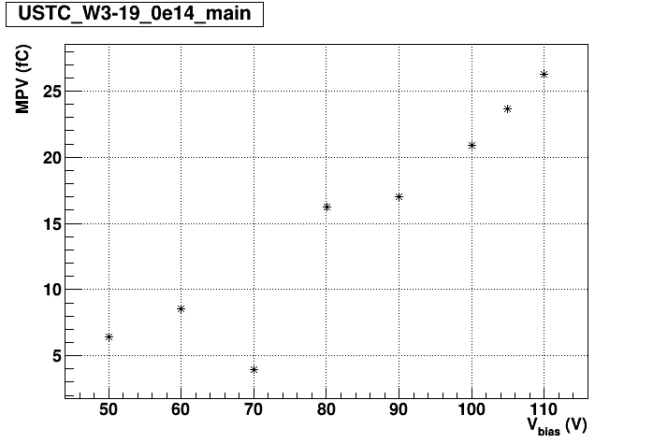
Charge MPV (not corrected for 1 fC)
Bad fit
Leakage current
Vbd criterion approx. 1 uA at -30 C

Slide 3
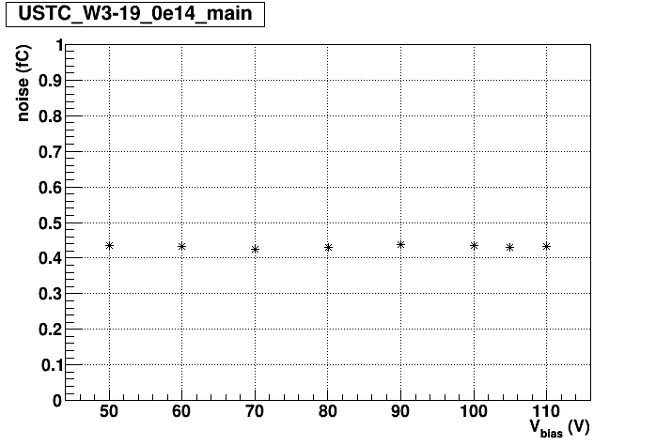
Time Resolution
Noise

