Slide 1
Production status report: Wafer irradiation tests (JSI)
HGTD Sensor meeting, 2025

Slide 2
Overview IHEP-IME
 | Previous status | Change | New status
Wafers received | 0 | 17 | 17
Wafers irradiated
Wafers tested
Wafers accepted
Wafers rejected
Received IHEP QCTS from production pilot batch !
  Batch no. 4
Example QCTS ATLAS ID (wafer 2, die 5):
  20WS2104000205
  ATLAS ID generation tool in internal database

Slide 3
Overview USTC-IME
 | Previous status | Change | New status
Wafers received
Wafers irradiated
Wafers tested
Wafers accepted
Wafers rejected

Slide 4
BACKUP

Slide 5
Wafer Acceptance/Rejection process
Acceptance Criteria
Multiple fails
Wafer rejected
3 QCTS neutron irradiated to 2.5e15
dies 10, 31, 48
TCT-IT sample 1 (die 31)
Not OK
TCT-IT + Sr90 sample 2
TCT-IT + Sr90 sample 3
Not OK
?
?
?
Sample 1 Not OK
Sample 2 OK
OK
Sr90 sample 1
(All pass)
OK
(All pass)
OK
Acceptance Criteria
V_{gl} > 16.6/16.9 V (USTC/IHEP)
Gain (100 V) > 2.7 (IHEP only)
Interpad distance < 100 um
Wafer accepted

Slide 6
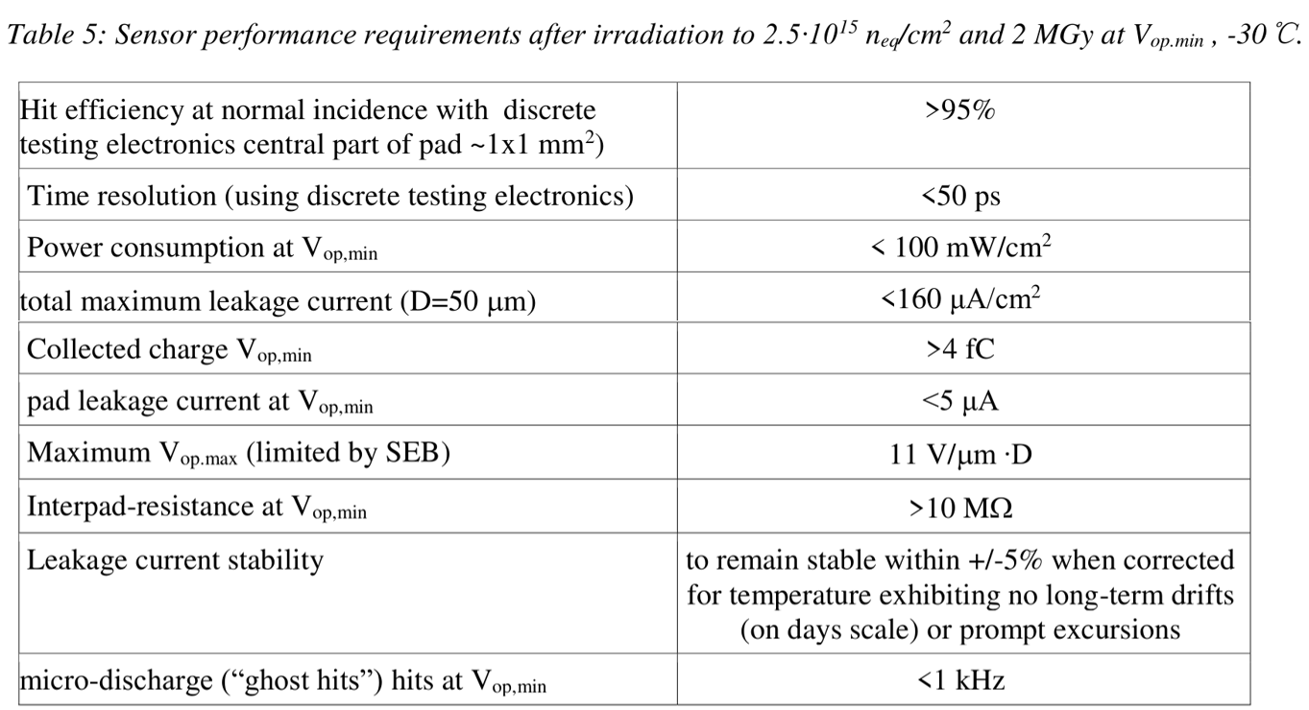
Sensor IT specifications
From HGTD Invitation to Tender – Technical Specification:
Testbeam
Wafer Irradiation Tests
for each production wafer
TCT (+ ⁹⁰Sr for additional tests)
Design Irradiation Tests
Compliance with other specifications tested on a small number of samples during preproduction
Sensor End of Life (EoL) fluence 2.5e15 n_{eq}/cm² and TID 1.3 MGy

Slide 7
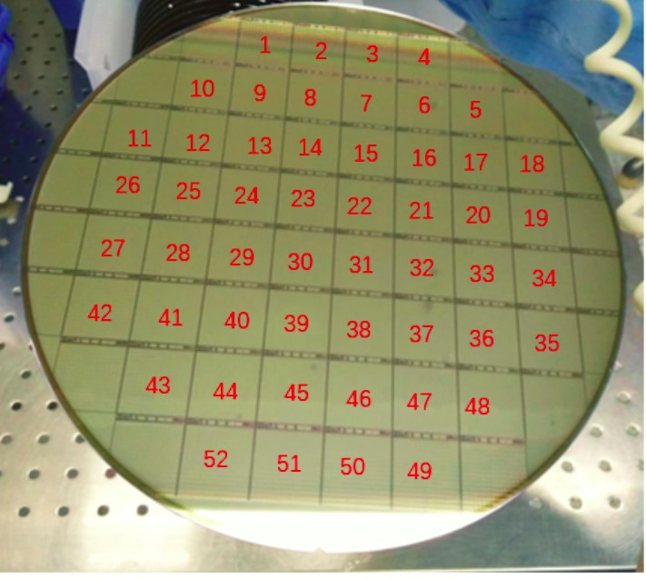
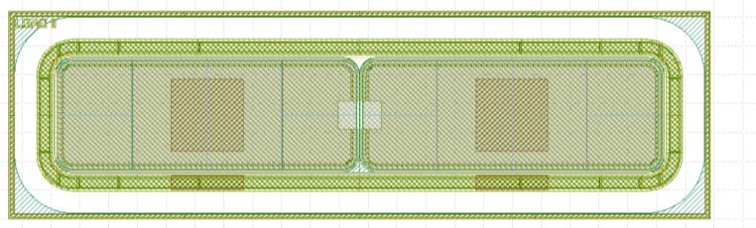
IT test structure and studied samples
  Irradiation Tests done on Quality Control Test Structure (QCTS) using 1 × 2 LGAD
    QCTS adjacent to each main sensor on wafer
    Channel size 2.1 mm × 0.8 mm (geometric capacitance same as pad on the main sensor)
    Same device measured with different methods to minimize systematics
    In production irradiate dies 10, 30 and 48 [•]
      Fluence 2.5e15 neq/cm2, annealing 80 min at 60 °C
  Electrical connections of 1 × 2 LGAD :
    CV/IV: one channel to Signal, one channel + guard ring to Guard
    Sr90: one channel to Signal, one channel + guard ring to Guard
    TCT: both channels to Signal, guard ring floating
main 15 x 15 sensor
QCTS
LGAD1
LGAD2
Optical window in the interpad region

Slide 8
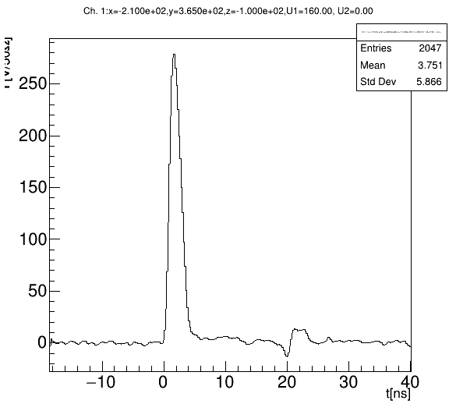
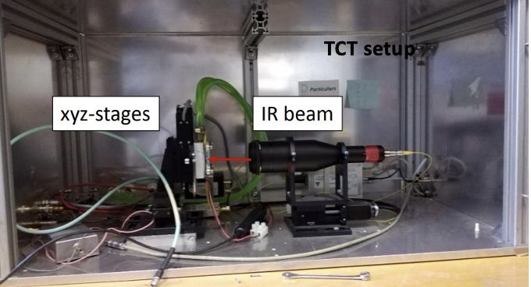
Irradiation Test – TCT setup
  Particulars TCT setup (infrared light 1064 nm – MIP-like charge distribution, pulse duration 600 ps, repetition rate 1 kHz)
  Beam spot FWHM 10 µm, positioning stages wit sub-µm resolution
  2.5 GHz Particulars amplifier and DRS4 readout
  Beam energy monitor to normalize injected charge within individual run
  Active temperature control to +20 °C
  Collected charge proportional to signal integral [0, 3 ns]
Charge ∝ integral [0, 3 ns]

Slide 9
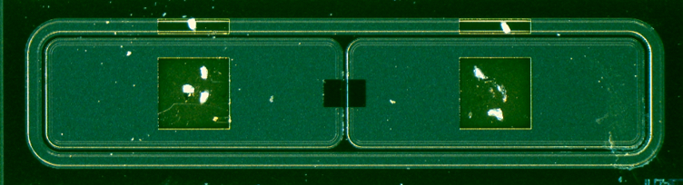
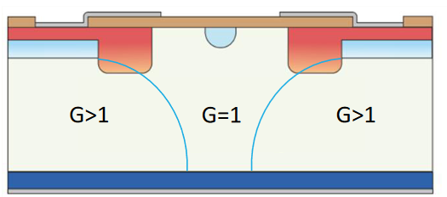
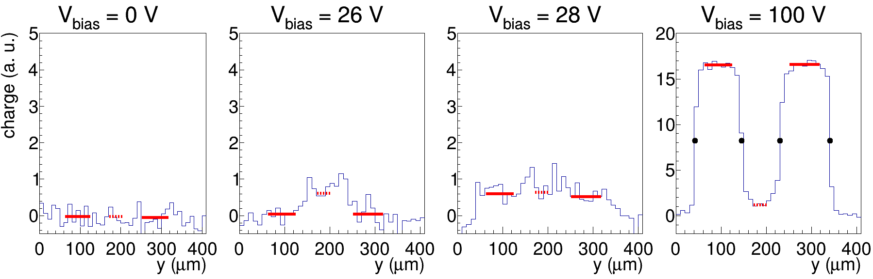
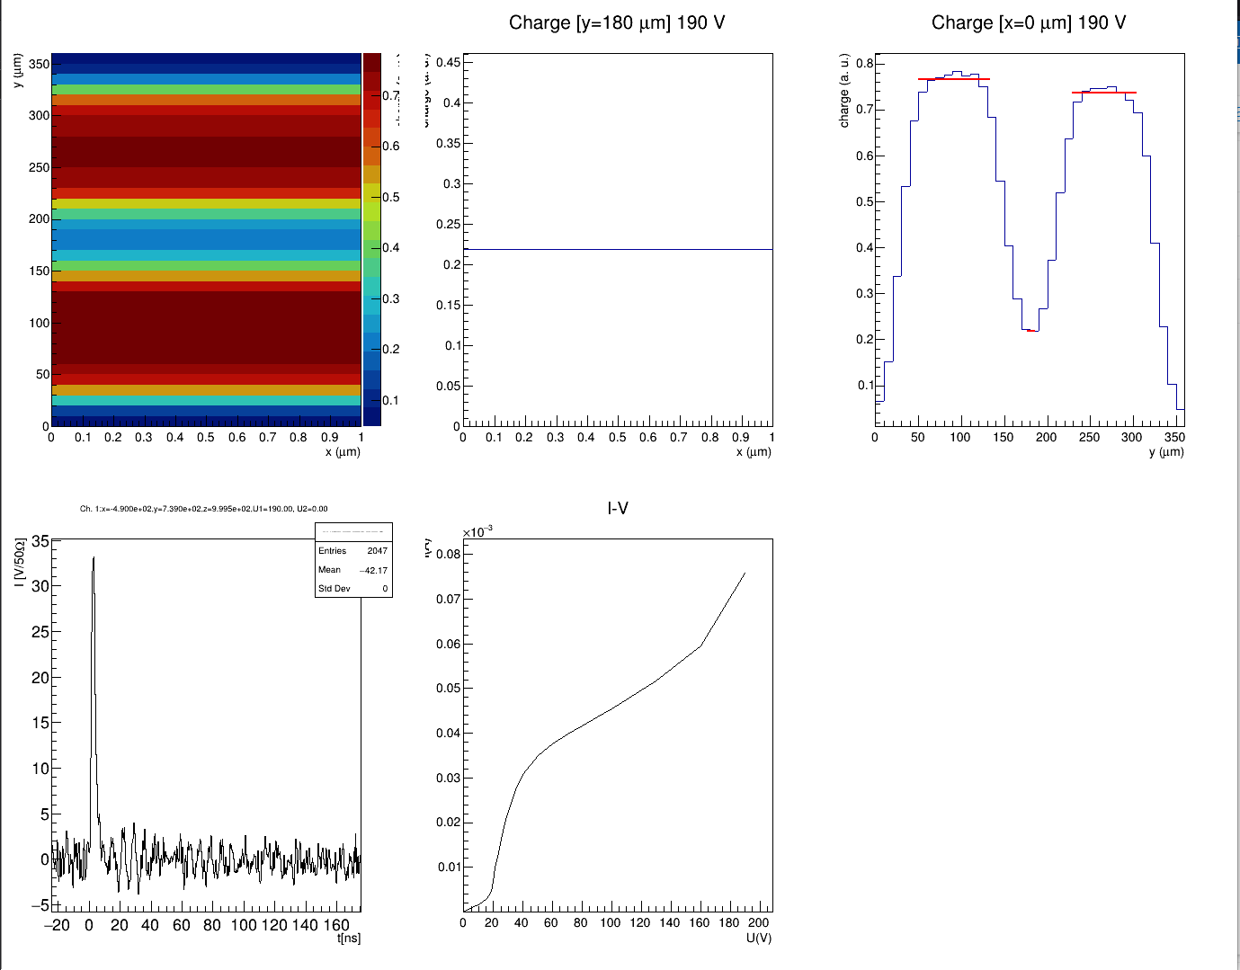
IT-QC: TCT test method
  Top-TCT in the interpad window using focused infrared laser (MIP-like charge distribution)
    Access the region with gain (LGAD) and region without gain (“PIN”)
  Collected charge as a function of voltage in LGADs and PIN
    V_{gl} is at the onset of LGAD signals
    Gain (V) = Charge (LGAD) / Charge (PIN) … Gain (100 V) as figure of merit
    Interpad distance
  Semi-automated upload of analyzed data to database (Grafana)
  Qualification Task Iskra Velkovska (JSI Ljubljana) – Report 1, Report 2
scan direction
laser direction
LGAD1
PIN
LGAD2
LGAD1
LGAD2
Collected charge (a.u.)
Interpad distance
(50 % max)
LGAD1
PIN
LGAD1
PIN
LGAD2
LGAD2
LGAD1
PIN
LGAD2
V_{bias} = 100 V
PIN

Slide 10
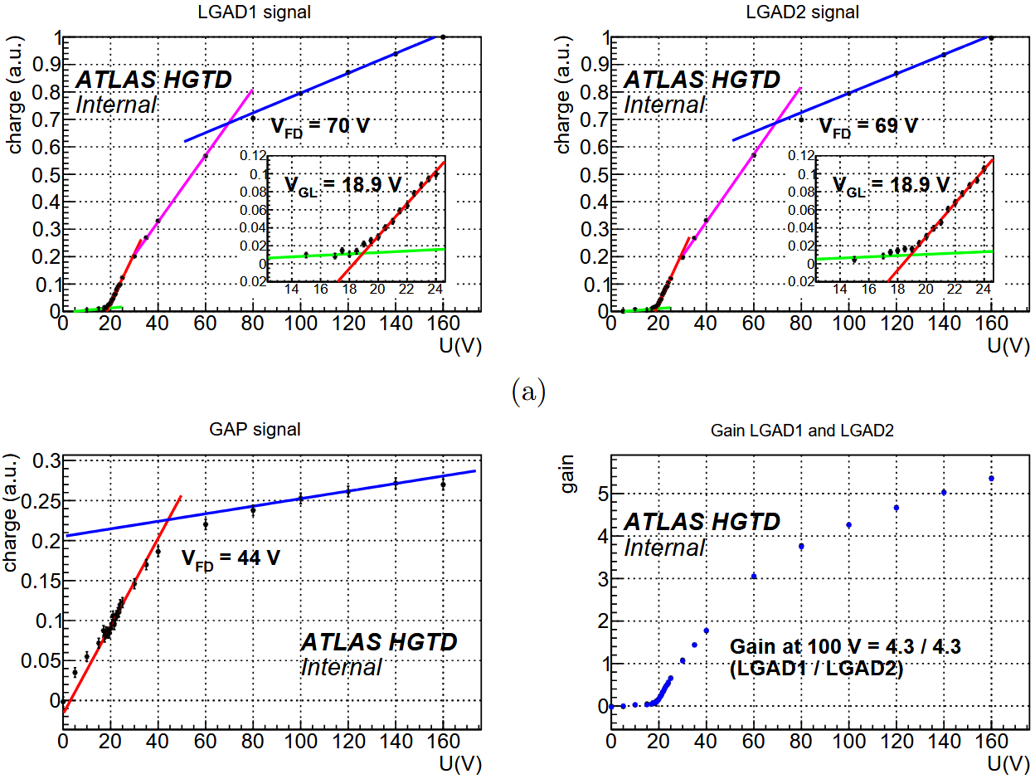
IT-QC: TCT parameter extraction

Slide 11
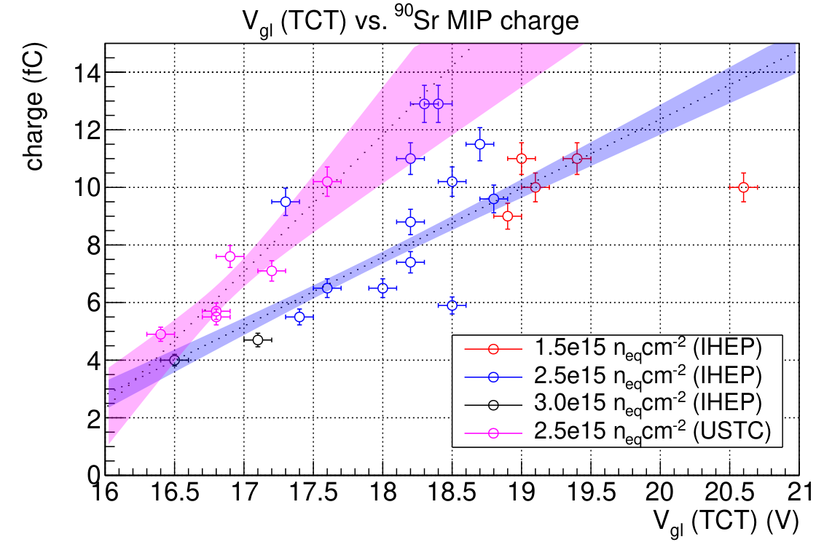
Correlation V_{gl}(TCT) vs. Sr90 charge (preproduction)
Cutoff V_{gl} (USTC-IME)
Cutoff V_{gl} (IHEP-IME)
Correlation between V_{gl} from TCT and collected charge with ⁹⁰Sr used to derive Acceptance Criteria
Cutoff V_{gl} corresponding to 5 fC (HGTD spec) is
  USTC-IME: 16.6 V
  IHEP-IME: 16.9 V

Slide 12
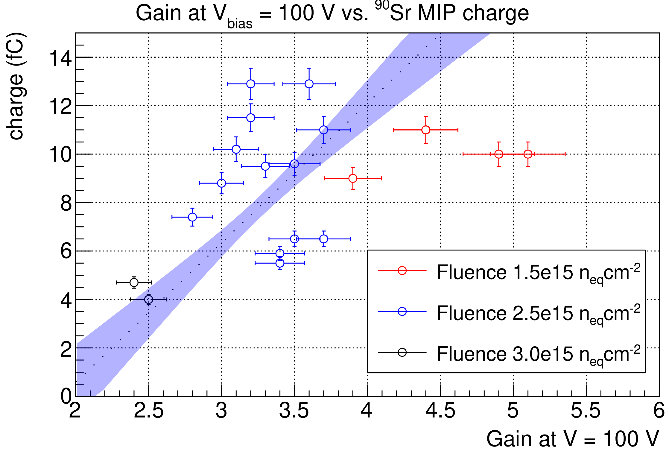
Correlation Gain(TCT) vs. Sr90 charge (IHEP-IME only)
IHEP-IME only
Cutoff Gain
Cutoff Gain(100 V) corresponding to 5 fC (HGTD spec) is 2.7 (IHEP-IME)
Not applicable for USTC-IME, since gain is smaller and uncertainty is large

Slide 13
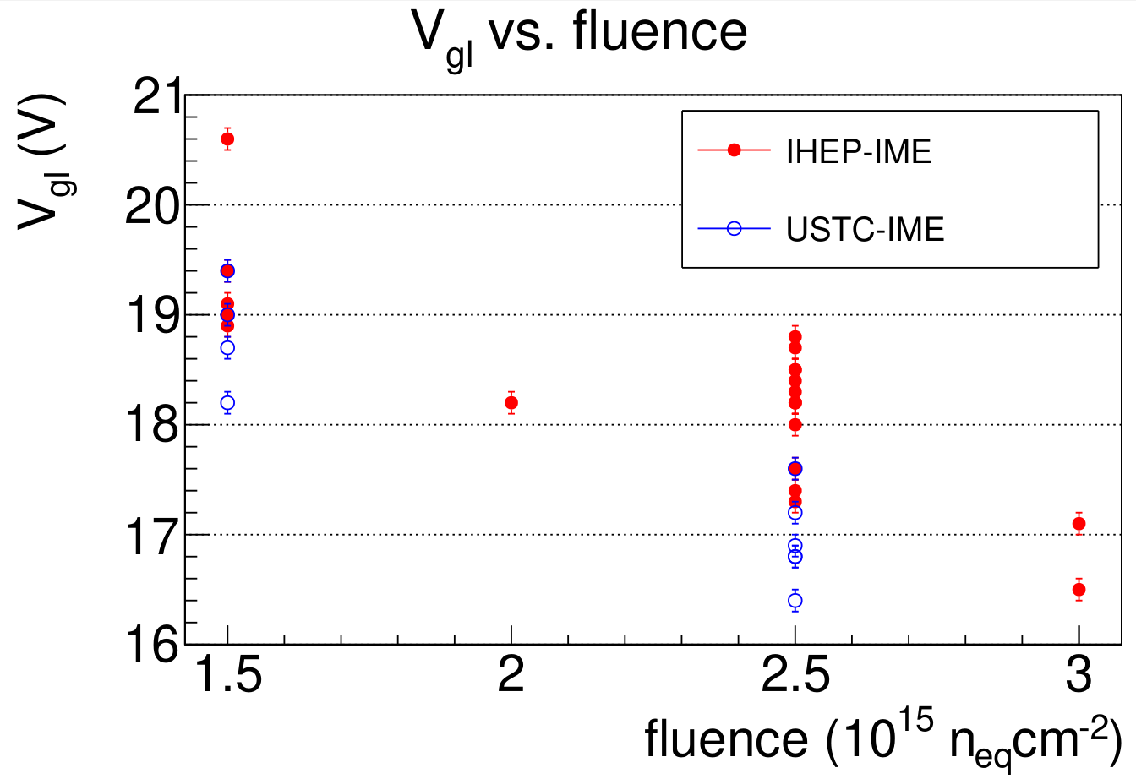
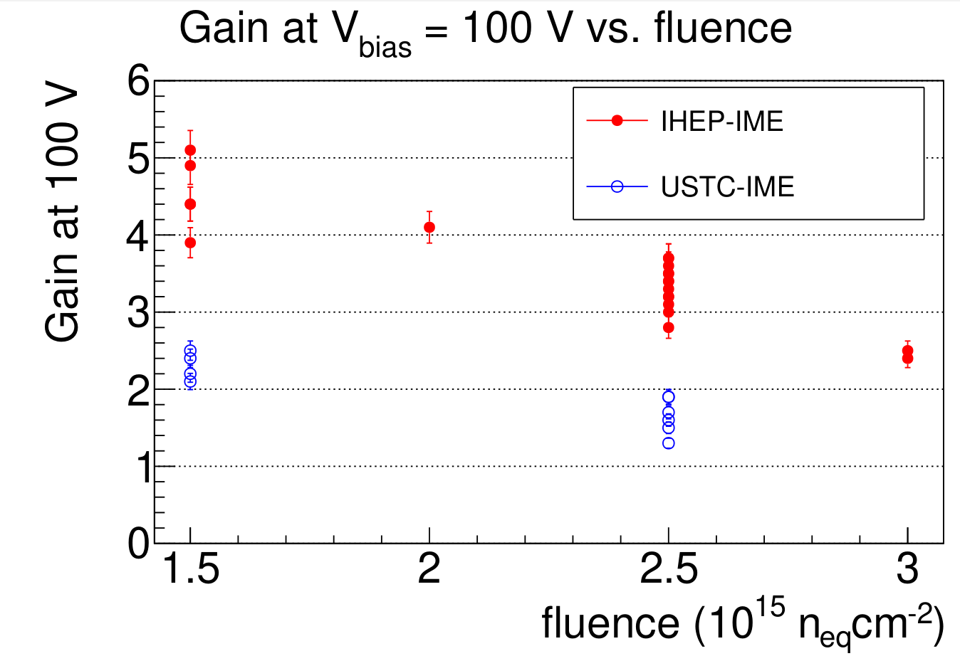
IT-QC: TCT results (preproduction)
Preproduction TCT results (V_{gl} and Gain (100 V)) as a function of fluence
  29 IHEP-IME wafers, 5 USTC-IME wafers
  Results slightly different between two designs (Gain (100 V)) not very sensitive on fluence in USTC-IME)
These results were correlated with ⁹⁰Sr measurements to derive Acceptance Criteria

Slide 14
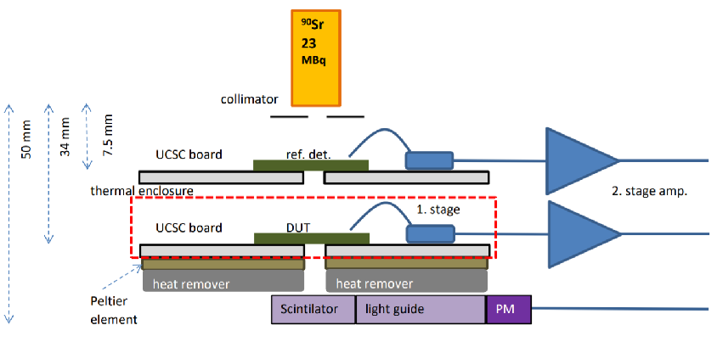
Sr90 measurements
  Sr90 Charge collection/Time resolution measurement setup
    Setup based on UCSC boards
    Trigger on reference LGAD + PMT
    DUT cooled to –30°C, not part of the trigger
    Up to 2 measurements per day, relatively time consuming
    In production will only be used for diagnostics of problematic wafers / occasional calibration
    5000 events per setting, geometric acceptance 10 %
  Deposited charge from 2 MeV beta electron is 20 % more than a MIP (conservative estimate)
    10 % more ionization
    10 % comes from more multiple scattering → wider charge cloud → less gain loss due to smaller E-field screening
    4 fC MIP specification corresponds to 5 fC charge in Sr90 measurements

Slide 15
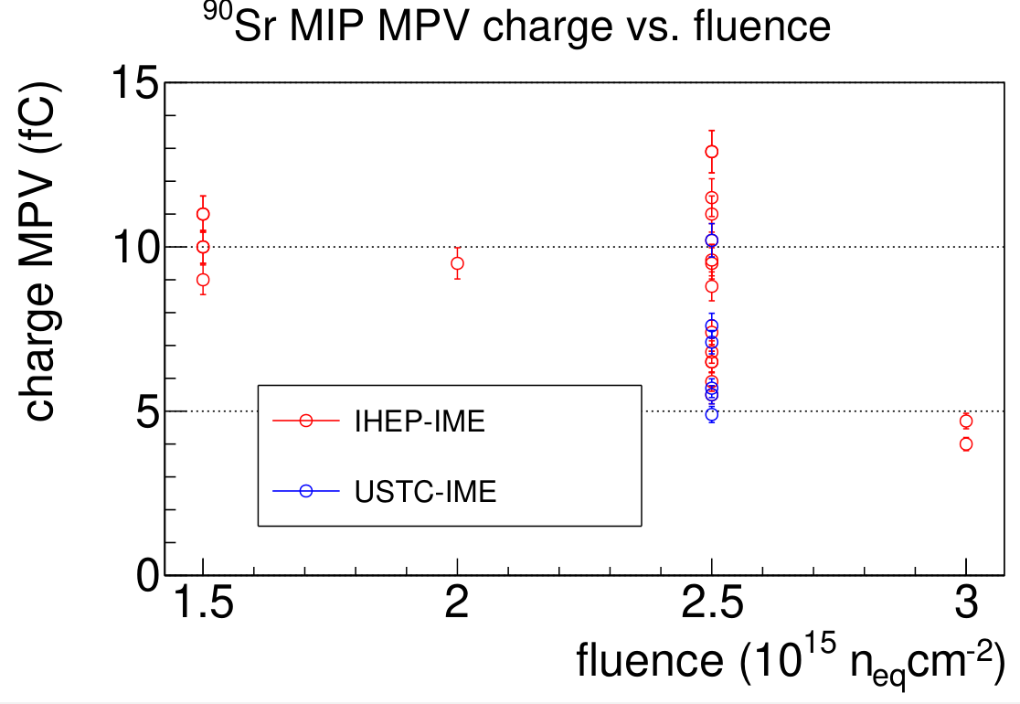
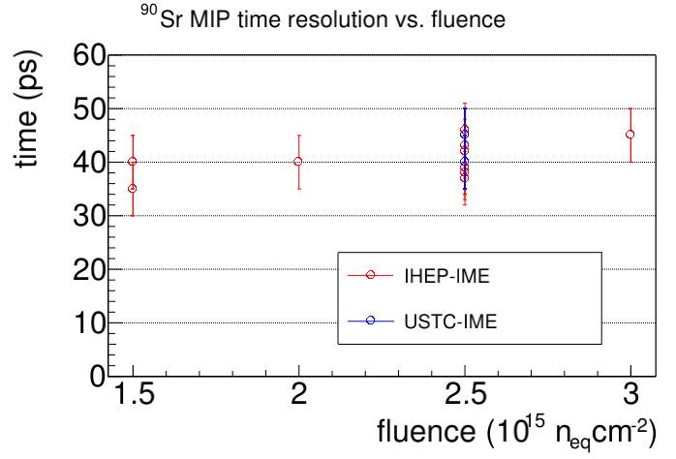
⁹⁰Sr charge collection results (preproduction)
V_{bias} = 550 V
Preproduction samples characterized also with ⁹⁰Sr (MIP charge MPV and time resolution)
  Beta electrons generate 20 % more charge than MIP, hence charge threshold 5 fC
Significant scattering of results at EoL fluence – wafer to wafer and fluence (10 %) variations
All samples after EoL fluence within the charge and time resolution specifications

Slide 16
