Slide 1
Production status report: Wafer irradiation tests (JSI)
HGTD Sensor meeting, 2025

Slide 2
Overview IHEP-IME
 | Previous status | Change | New status
Wafers received | 17 | 0 | 17
Wafers irradiated | 0 | 17 | 17
Wafers tested | 0 | 17 | 17
Wafers accepted | 0 | 16 | 16
Need more tests | 0 | 1 | 1
Wafers rejected | 0 | 0 | 0
Measured IHEP QCTS from production pilot batch (batch 4)
Irradiated + measured samples on position 30
Measured after 1st biasing
Had to repeat 1 sample (W9) + measured position 5 for that wafer

Slide 3
ATLAS ID | Wafer | Sensor # | Vgl 1 | Vgl 2 | Gain 1 | Gain 2
20WS2104000230 | 2 | 30 | 18.2 | 18.1 | 3.2 | 3.2
20WS2104000330 | 3 | 30 | 17.8 | 17.8 | 3.2 | 3.2
20WS2104000430 | 4 | 30 | 18.2 | 18.1 | 3.6 | 3.6
20WS2104000530 | 5 | 30 | 18.1 | 18.1 | 3.2 | 3.2
20WS2104000630 | 6 | 30 | 17.4 | 17.3 | 3.2 | 3.2
20WS2104000830 | 8 | 30 | 17.0 | 16.9 | 3.0 | 3.0
20WS2104000930 | 9 | 30 | 17.3 | 17.1 | 2.6 | 2.6
20WS2104001030 | 10 | 30 | 17.8 | 17.7 | 3.0 | 3.0
20WS2104001130 | 11 | 30 | 18.3 | 18.3 | 3.2 | 3.1
20WS2104001230 | 12 | 30 | 17.8 | 17.8 | 3.2 | 3.1
20WS2104001330 | 13 | 30 | 18.2 | 18.1 | 3.2 | 3.2
20WS2104001430 | 14 | 30 | 17.9 | 17.9 | 3.3 | 3.3
20WS2104001530 | 15 | 30 | 17.9 | 18.0 | 3.3 | 3.3
20WS2104001630 | 16 | 30 | 18.2 | 18.2 | 3.1 | 3.1
20WS2104001730 | 17 | 30 | 18.0 | 18.0 | 3.1 | 3.1
20WS2104001830 | 18 | 30 | 18.3 | 18.2 | 3.1 | 3.1
20WS2104001930 | 19 | 30 | 17.9 | 17.8 | 2.9 | 2.9

Slide 4
WAFER 9 – additional tests
ATLAS ID | Wafer | Sensor # | Vgl 1 | Vgl 2 | Gain 1 | Gain 2
20WS2104000905 | 9 | 5 | 17.7 | 17.7 | 2.7 | 3.0
20WS2104000905 (repeat) | 9 | 5 | 17.8 | 17.9 | 2.9 | 2.9
ATLAS ID | Wafer | Sensor # | Vgl 1 | Vgl 2 | Gain 1 | Gain 2
20WS2104000930 (repeat 1) | 9 | 30 | 17.1 | 17.2 | 2.6 | 2.6
20WS2104000930 (repeat 2) | 9 | 30 | 17.1 | 17.3 | 2.6 | 2.6
20WS2104000930 (repeat 3) | 9 | 30 | 17.3 | 17.2 | 2.8 | 2.7
20WS2104000930 (repeat 4) | 9 | 30 | 17.4 | 17.3 | 2.8 | 2.8

Slide 5
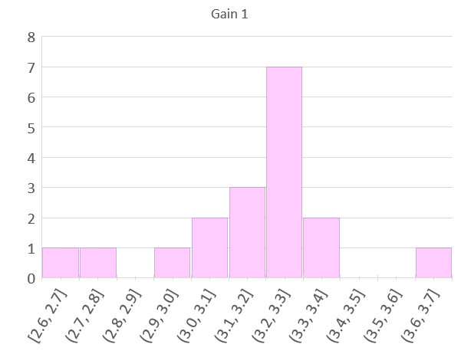
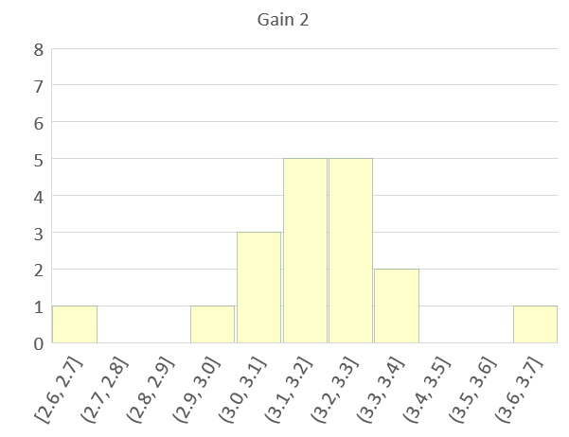
Gain distribution histograms

Slide 6
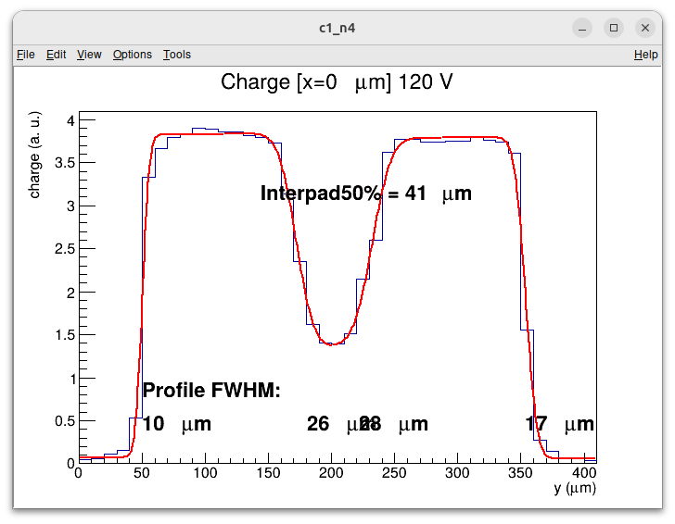
WAFER 9 POSITION 30

Slide 7
