Slide 1
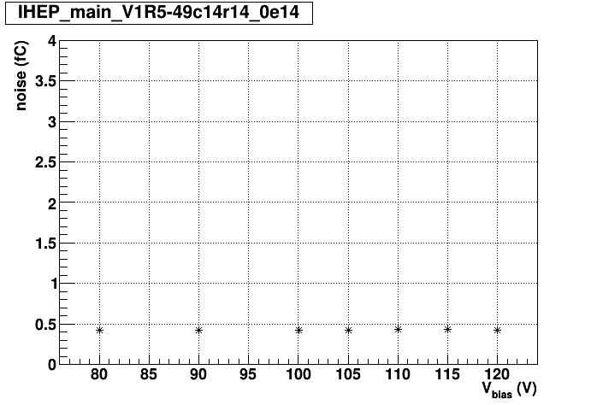
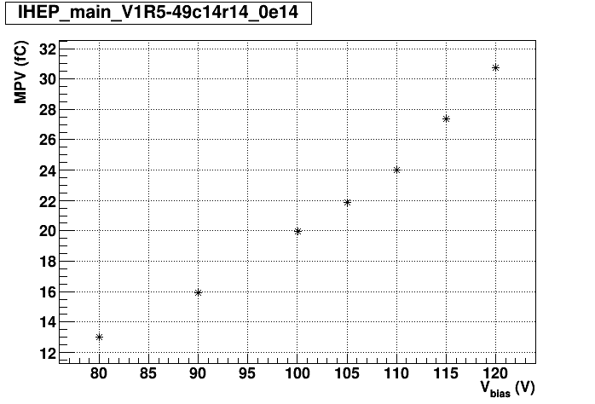
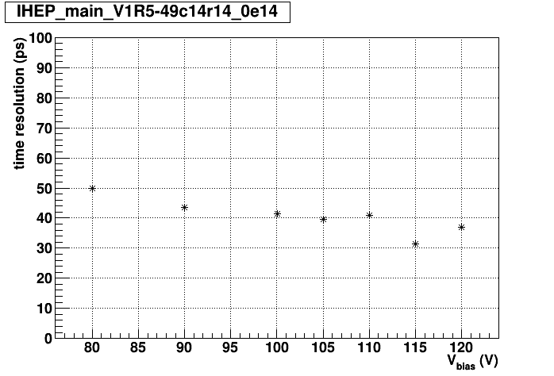
Sr90 on IHEP main sensor
One pixel (not outer) to readout, rest to guard
Time resolution around 44 ps @ 16 fC (90 V)
T = -26°C

Slide 2
HGTD production main sensors
Received 15 IHEP main sensors for tests: 5 A (ok) + 5 B1 (150 V < Vbd < 165 V) + 5 B2 (one pixel high current)
Tested with a single needle on automatic probe station pad by pad
  225 I-V measurements per sensor
  Determine Vbd, Ileak @ 0.8 Vbd (global), I-V
  room T – Vbd corrected to 20 °C
  A lot of work done by students Bor & Urban
We do not observe significant correlations between CQC (15 R x 1 C + GR) and our 1 x 1 measurements
  A1: tested & analyzed 2 sensors (W8, W10)
    ok, Vbd 7 V and 2 V above CQC
  B1: tested all 5 (W19)
    Vbd up to 20 V higher than CQC
    Some have early breakdown pixels
  B2: tested all 5 (W5):
    Vbd up to 20 V higher than CQC
    Breakdown pixels not matching
Data, scripts, plots: \\F9silab05\silab - disk storage\Measurents\Projects\ATLAS-HGTD\Production\automatic_probe_station

Slide 3
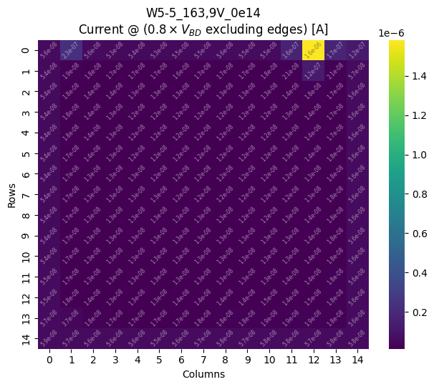
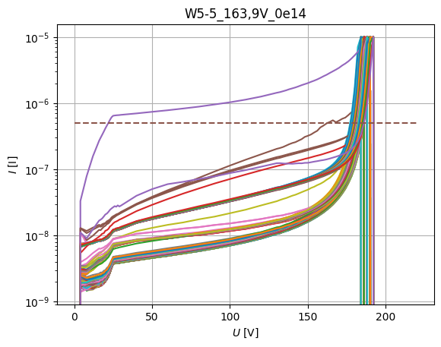
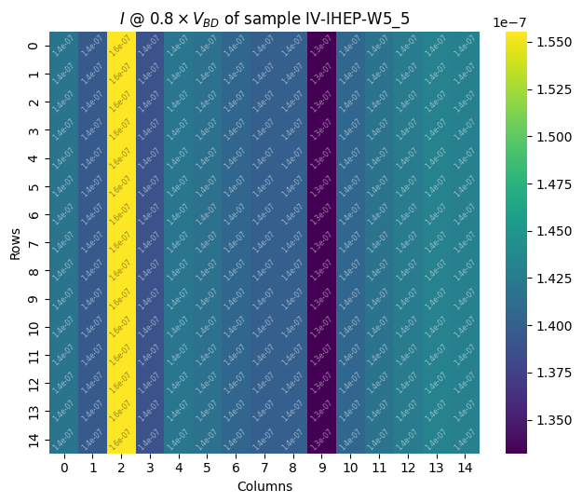
W5-5 (B1)
IJS 225 I-Vs

Slide 4
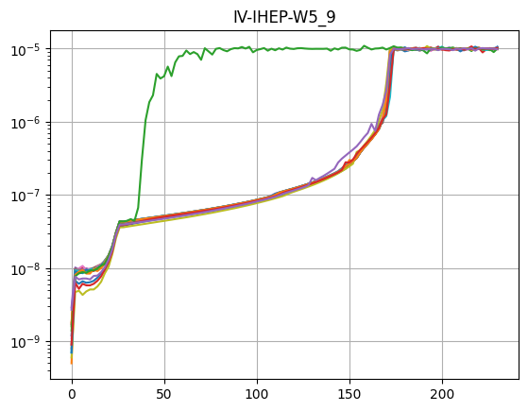
W5-5 – best matching CQC I-V candidate W5-9
IJS 225 I-Vs
CQC 15 I-Vs

Slide 5
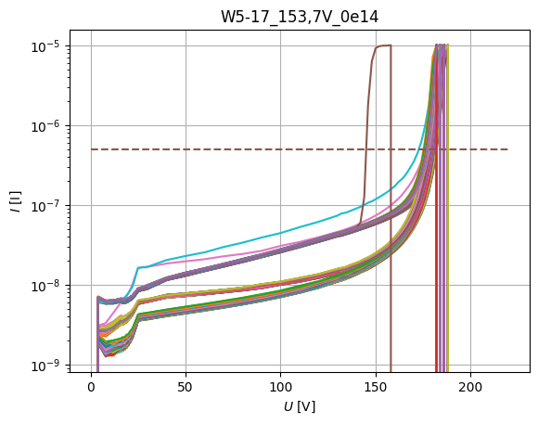
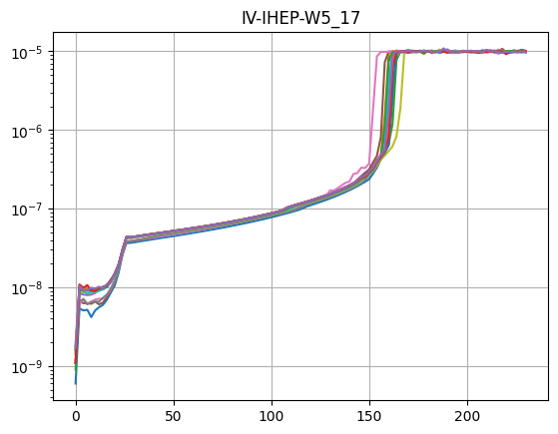
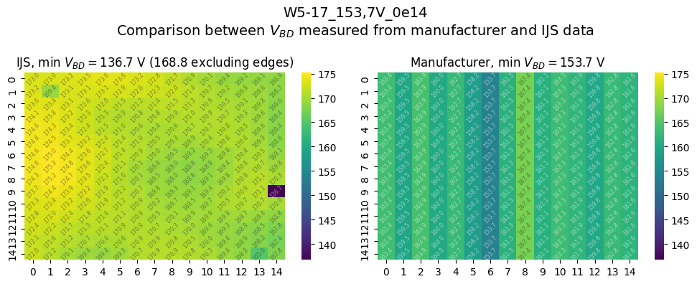
IJS 225 I-Vs
CQC 15 I-Vs

Slide 6
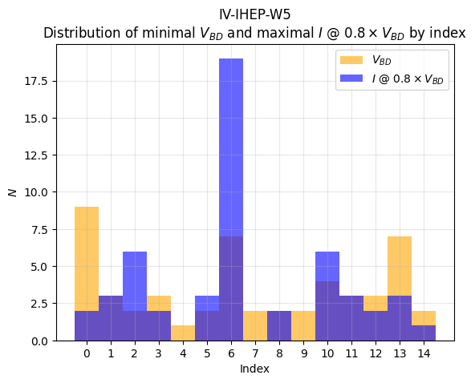
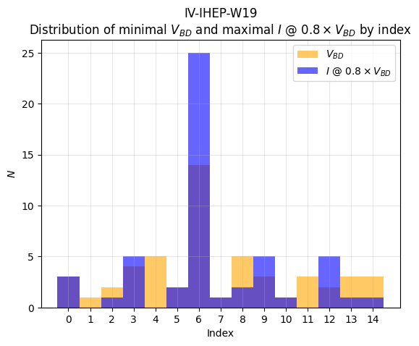
CQC data
Vbd & I leak properties for all 52 sensors on the wafer
Column 6 (starting with 0) suspicious

