Slide 1
ANNEALING STUDY

Slide 2
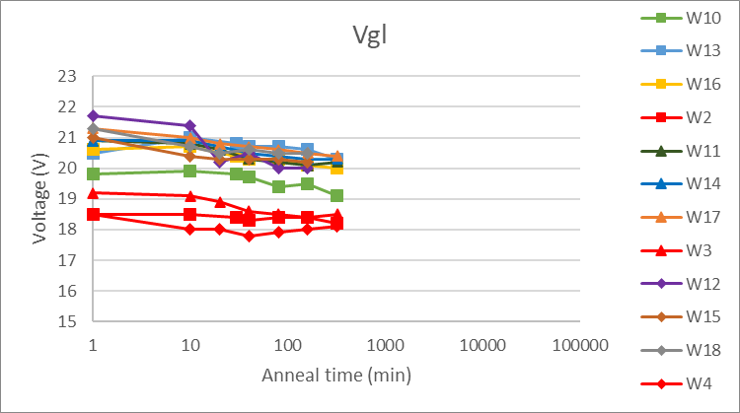
Vgl (time of annealing)

Slide 3
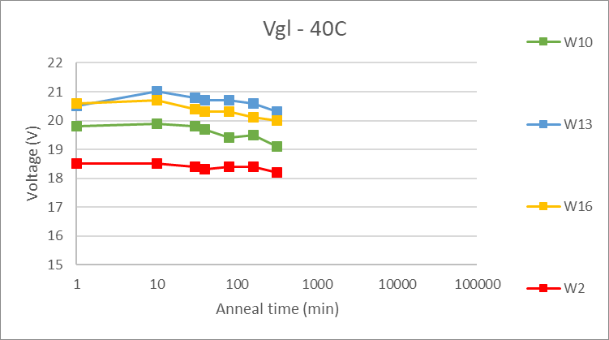
Vgl – 40C (LGAD)

Slide 4
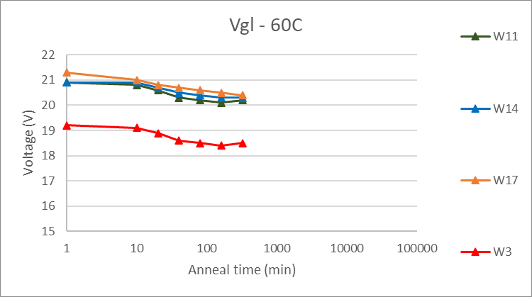
Vgl – 60C (LGAD)

Slide 5
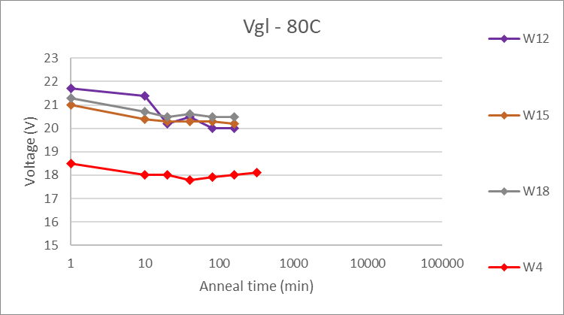
Vgl – 80C (LGAD)

Slide 6
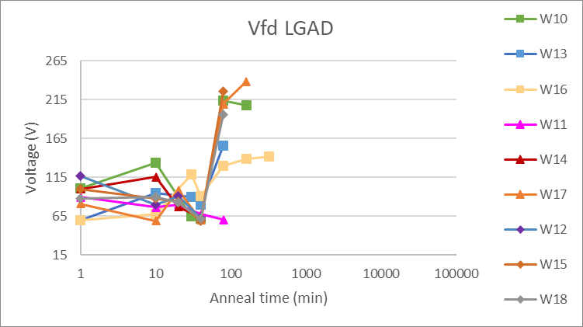
Vfd – LGAD

Slide 7
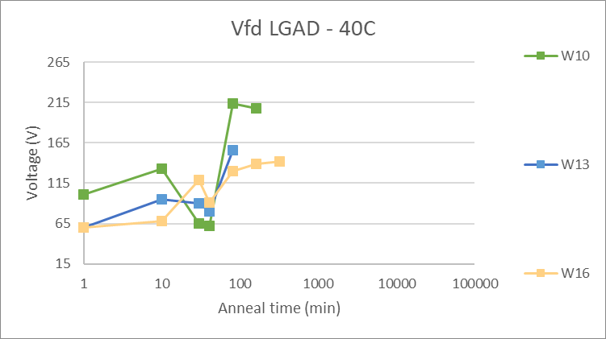
Vfd – 40C (LGAD)

Slide 8
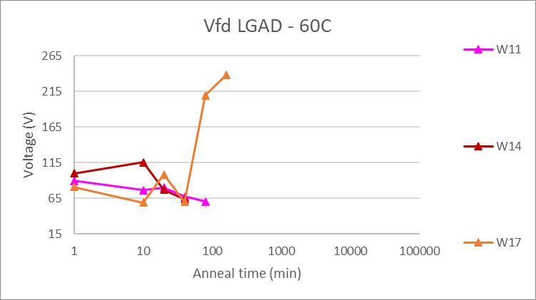
Vfd – 60C (LGAD)

Slide 9
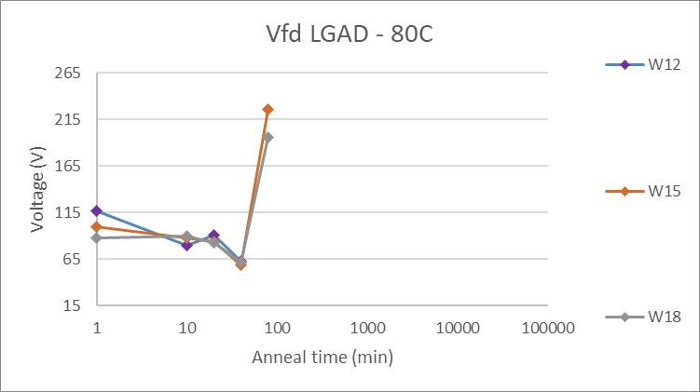
Vfd – 80C (LGAD)

Slide 10
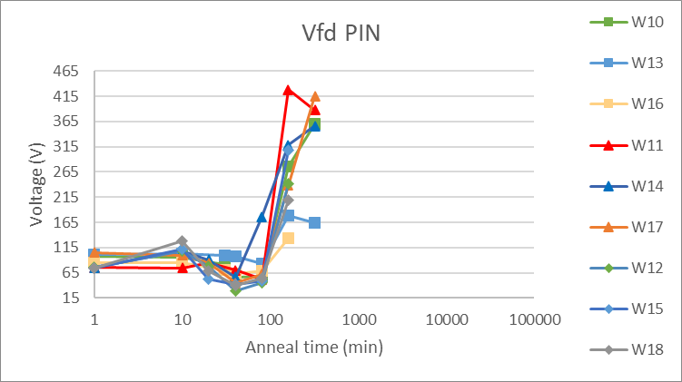
Vfd - PIN

Slide 11
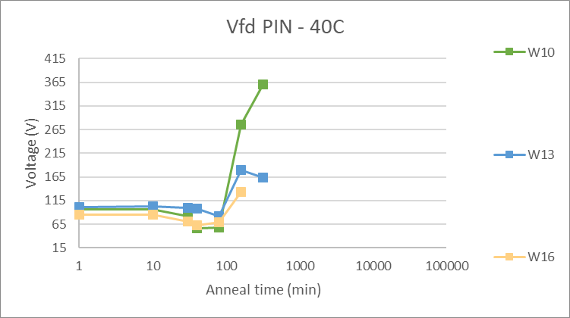
Vfd – 40C (PIN)

Slide 12
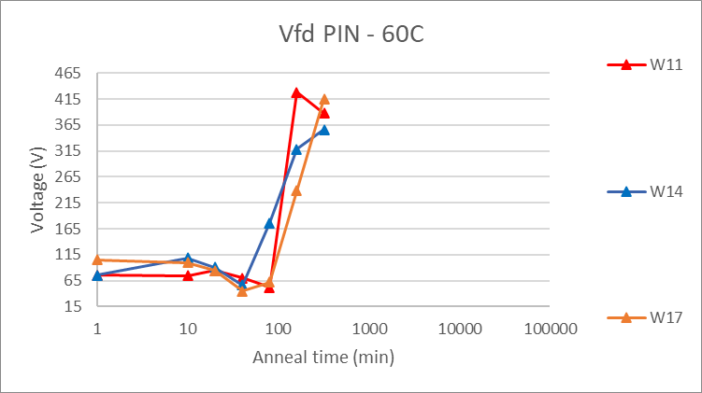
Vfd – 60C (PIN)

Slide 13
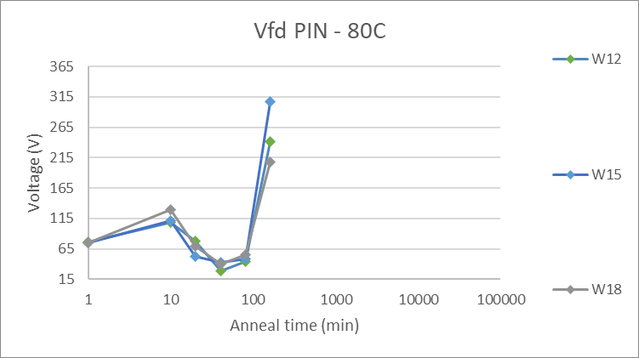
Vfd – 80C (PIN)

Slide 14
TCT RESULTS – 40C

Slide 15
TCT RESULTS – 40C

Slide 16
TCT RESULTS – 40C

Slide 17
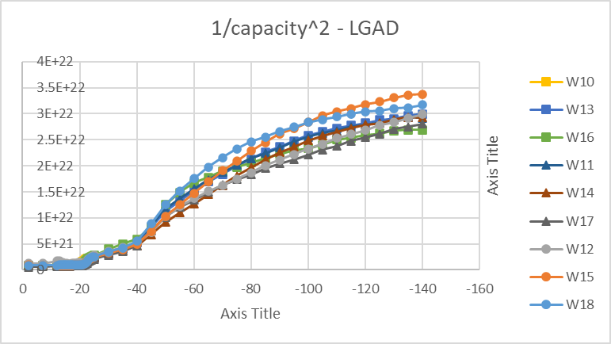
Not annealed

Slide 18
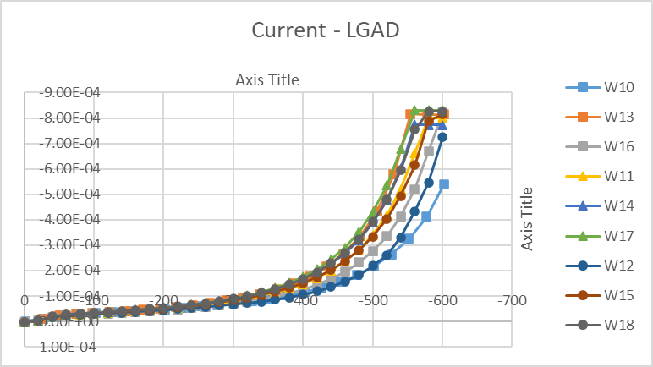
Not annealed

Slide 19
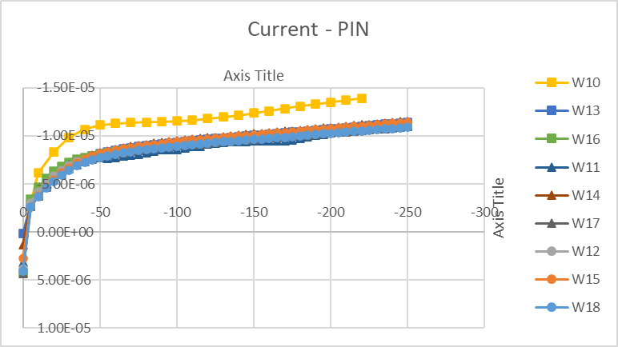
Not annealed

Slide 20
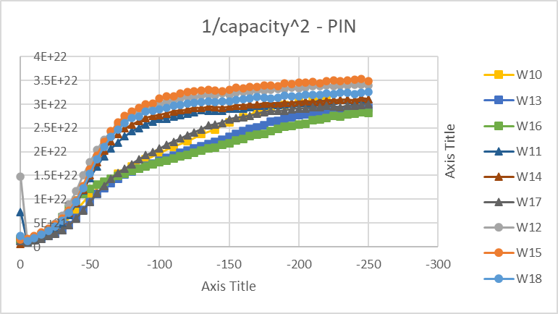
Not annealed

Slide 21
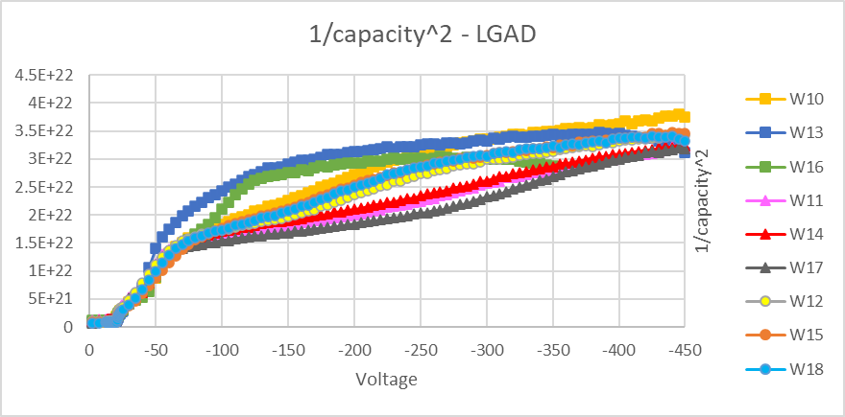
320 min

Slide 22
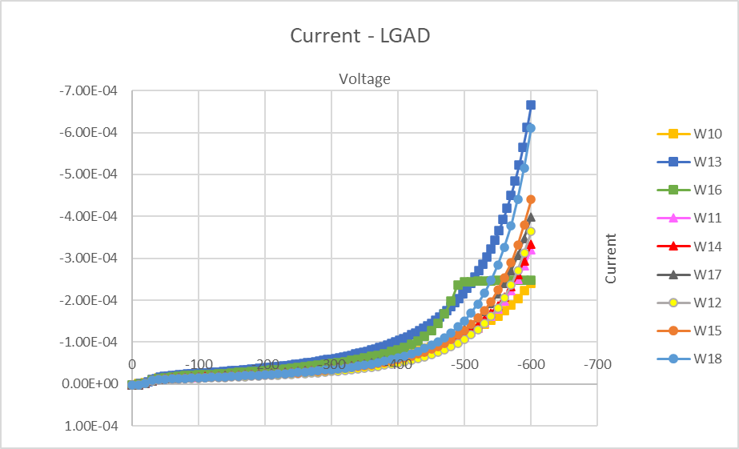
320 min

Slide 23
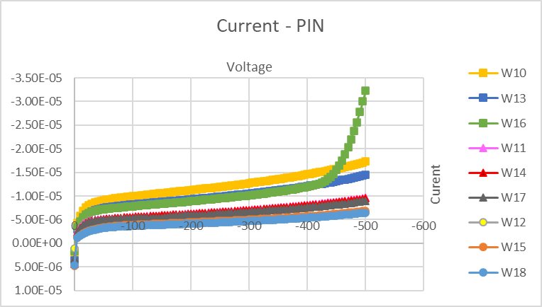
320 min

Slide 24
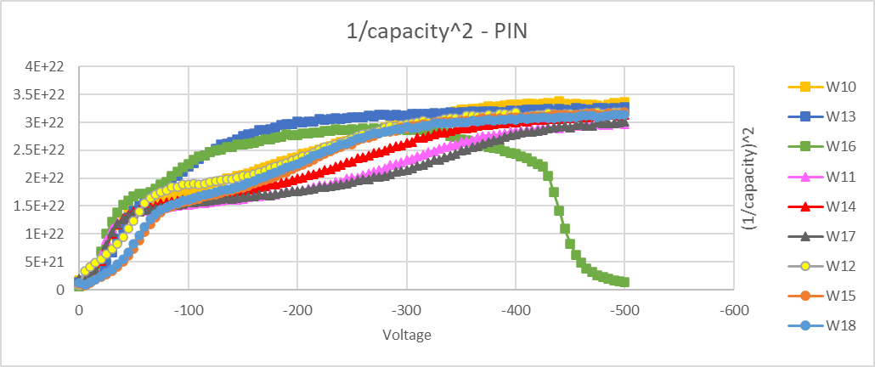
320 min

