Slide 1
First-principles screening of mineral candidates for dark matter detection with the PALEOCCENE technique
May 20, 2025
Vsevolod Ivanov
Virginia Tech NSI & Department of Physics

Slide 2
Outline
Overview of PALEOCCENE & Material Requirements
Role of Color Center Defects
Candidate Minerals & Requirements
Alkali Halide Defects & Formation Mechanisms
Vacancy clusters in LiF
Computational Considerations - Koopman’s Tuning & Electron-Phonon Coupling
Formation mechanisms
Forsterite, Scheelite, Corundum, & Zircon
Which simple defects are optically bright and visible?
Nudged Elastic Band method for energy barriers

Slide 3
Outline
Overview of PALEOCCENE & Material Requirements
Role of Color Center Defects
Candidate Minerals & Requirements
Alkali Halide Defects & Formation Mechanisms
Vacancy clusters in LiF
Computational Considerations - Koopman’s Tuning & Electron-Phonon Coupling
Formation mechanisms
Forsterite, Scheelite, Corundum, & Zircon
Which simple defects are optically bright and visible?
Nudged Elastic Band method for energy barriers

Slide 4
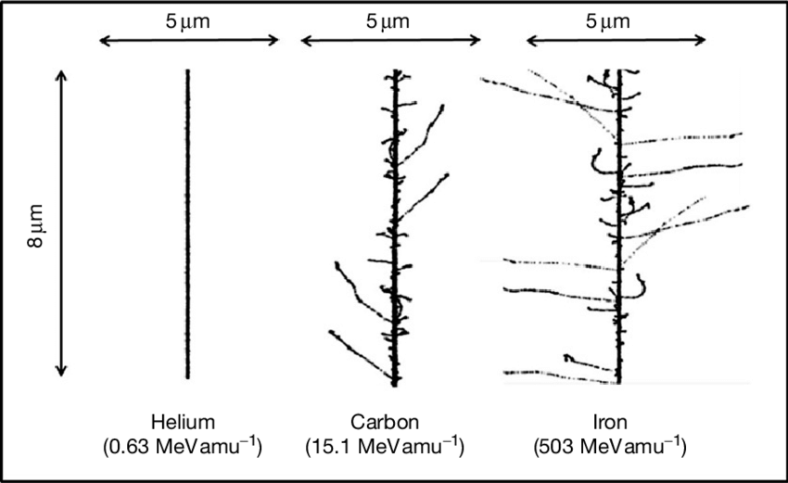
Overview
Idea: Minerals in the earth’s crust can potentially be detectors with exposures approaching 10⁹ kg-years.
The lowest energy nuclear recoils create atom-scale crystal defects, which may be detected optically as color centers.
MDvDM | Yokohama | May 2025

Slide 5
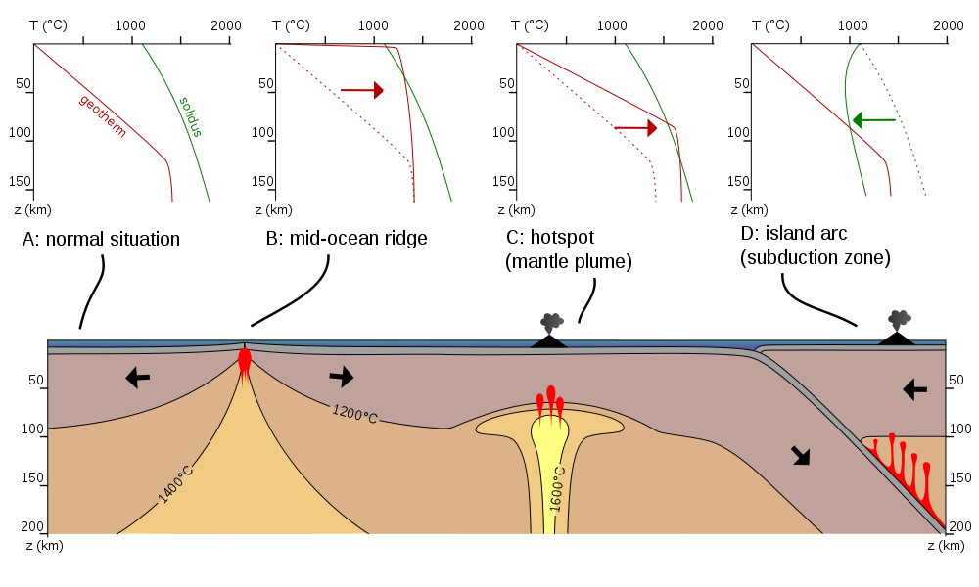
Mineral Requirements
Cosmological backgrounds become negligible with ~5km of rock shielding
High temperatures cause defect annealing! –avoid historically hot or geologically active regions
Samples must be large, high-quality single crystals (not amorphous rock)
Low concentrations of Uranium/Thorium
Synthetic version available for R&D
MDvDM | Yokohama | May 2025

Slide 6
Mineral Candidate List
Mineral Nat. Abundant Synth. Avail ≥1 km Low U/Th__
Diamond ✓ ✓ ✓ ✓
Olivine ({Mg/Fe}SiO₄) ✓ ? ✓ ✓
Zircon (ZrSiO₄) ✓ ? ? ✓
Alkali Halide (LiF, NaCl,…) ✓ ✓ ✓ ✓
Quartz (SiO₂) ✓ ✓ ✓ ✓
Corundum (Al₂O₃) ✓ ✓ ? ✓
Apatite ✓ ✓ ? ?
Monazite X ? ? ?
Zirconia (ZrO₂) X ✓ X ✓
Scheelite (CaWO₄) X ✓ ? ✓
MDvDM | Yokohama | May 2025

Slide 7
Mineral Candidate List
Mineral Nat. Abundant Synth. Avail ≥1 km Low U/Th__
Diamond ✓ ✓ ✓ ✓
Olivine ({Mg/Fe}SiO₄) ✓ ? ✓ ✓
Zircon (ZrSiO₄) ✓ ? ? ✓
Alkali Halide (LiF, NaCl,…) ✓ ✓ ✓ ✓
Quartz (SiO₂) ✓ ✓ ✓ ✓
Corundum (Al₂O₃) ✓ ✓ ? ✓
Apatite ✓ ✓ ? ?
Monazite X ? ? ?
Zirconia (ZrO₂) X ✓ X ✓
Scheelite (CaWO₄) X ✓ ? ✓
MDvDM | Yokohama | May 2025

Slide 8
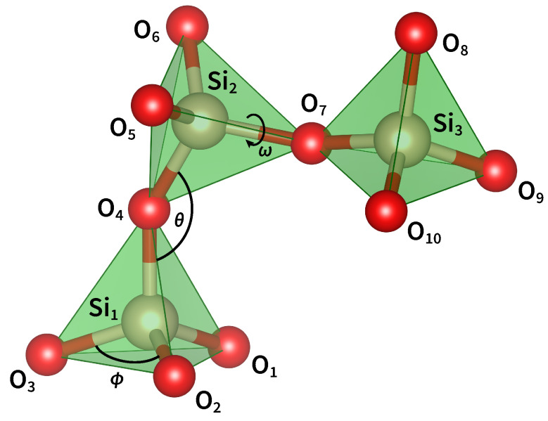
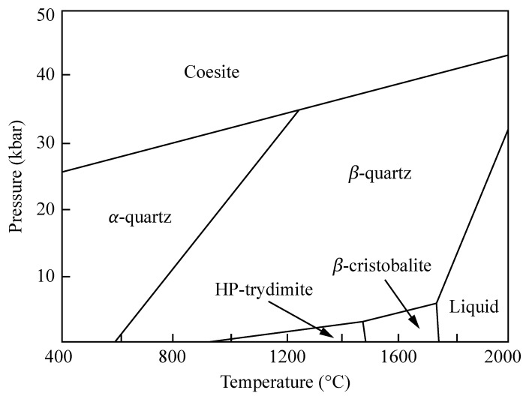
Quartz (SiO₂)
Main color center is the E’ defect
Many other optically inactive defects! MD predicts ~500 unidentified defects for each E’ center!
Reason - flexible structure & flat potential surface – also why silica has many structural polymorphs
Zirconia (ZrO₂) also has same issue
J. Chem. Phys. 14 July 2015; 143 (2): 024505 Materials (Basel). 2021 Dec 13;14(24):7682
MDvDM | Yokohama | May 2025

Slide 9
Mineral Candidate List
Mineral Nat. Abundant Synth. Avail ≥1 km Low U/Th__
Diamond ✓ ✓ ✓ ✓
Olivine ({Mg/Fe}SiO₄) ✓ ? ✓ ✓
Zircon (ZrSiO₄) ✓ ? ? ✓
Alkali Halide (LiF, NaCl,…) ✓ ✓ ✓ ✓
Quartz (SiO₂) ✓ ✓ ✓ ✓
Corundum (Al₂O₃) ✓ ✓ ? ✓
Apatite ✓ ✓ ? ?
Monazite X ? ? ?
Zirconia (ZrO₂) X ✓ X ✓
Scheelite (CaWO₄) X ✓ ? ✓
MDvDM | Yokohama | May 2025

Slide 10
Diamond
Data on 20,000+ defects in diamond is already available!
Part of current efforts to identify color center spin-qubits for QIS
Our contribution: https://www.quantumdefects.com
ADAQ database:
https://defects.anyterial.se/
MDvDM | Yokohama | May 2025

Slide 11
Mineral Candidate List
Mineral Nat. Abundant Synth. Avail ≥1 km Low U/Th__
Diamond ✓ ✓ ✓ ✓
Olivine ({Mg/Fe}SiO₄) ✓ ? ✓ ✓
Zircon (ZrSiO₄) ✓ ? ? ✓
Alkali Halide (LiF, NaCl,…) ✓ ✓ ✓ ✓
Quartz (SiO₂) ✓ ✓ ✓ ✓
Corundum (Al₂O₃) ✓ ✓ ? ✓
Apatite ✓ ✓ ? ?
Monazite X ? ? ?
Zirconia (ZrO₂) X ✓ X ✓
Scheelite (CaWO₄) X ✓ ? ✓
✓
MDvDM | Yokohama | May 2025

Slide 12
Mineral Candidate List
Mineral Nat. Abundant Synth. Avail ≥1 km Low U/Th__
Diamond ✓ ✓ ✓ ✓
Olivine ({Mg/Fe}SiO₄) ✓ ? ✓ ✓
Zircon (ZrSiO₄) ✓ ? ? ✓
Alkali Halide (LiF, NaCl,…) ✓ ✓ ✓ ✓
Quartz (SiO₂) ✓ ✓ ✓ ✓
Corundum (Al₂O₃) ✓ ✓ ? ✓
Apatite ✓ ✓ ? ?
Monazite X ? ? ?
Zirconia (ZrO₂) X ✓ X ✓
Scheelite (CaWO₄) X ✓ ? ✓
✓
→ Use ab initio calculations to determine which mineral is ideal for PALEOCCENE (many simple interstitials/vacancies that are optically bright + visible spectrum)
MDvDM | Yokohama | May 2025

Slide 13
Outline
Overview of PALEOCCENE & Material Requirements
Role of Color Center Defects
Candidate Minerals & Requirements
Alkali Halide Defects & Formation Mechanisms
Vacancy clusters in LiF
Computational Considerations - Koopman’s Tuning & Electron-Phonon Coupling
Formation mechanisms
Forsterite, Scheelite, Corundum, & Zircon
Which simple defects are optically bright and visible?
Nudged Elastic Band method for energy barriers

Slide 14
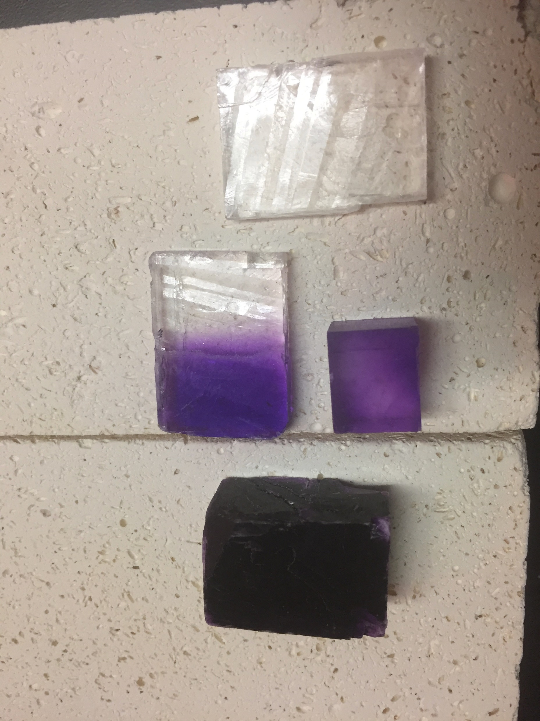
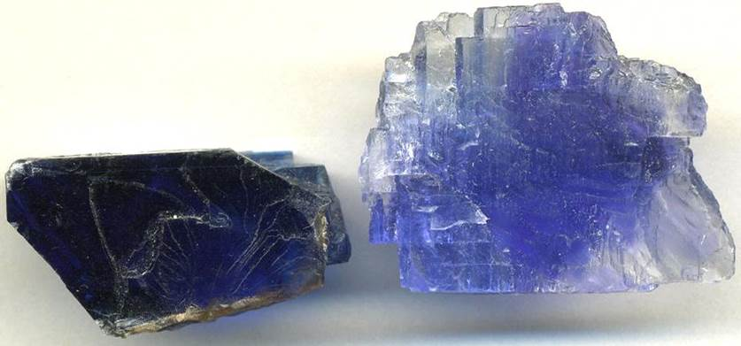
Irradiated Alkali Halides
Goldstein (1896) – alkali halides bombarded by cathode rays change color!
MDvDM | Yokohama | May 2025

Slide 15
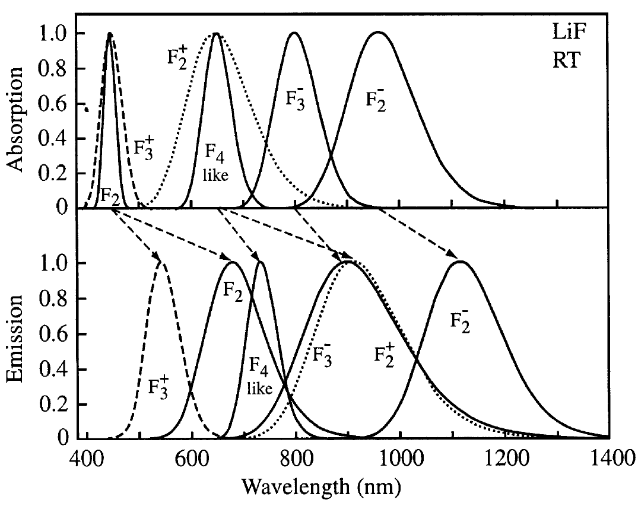
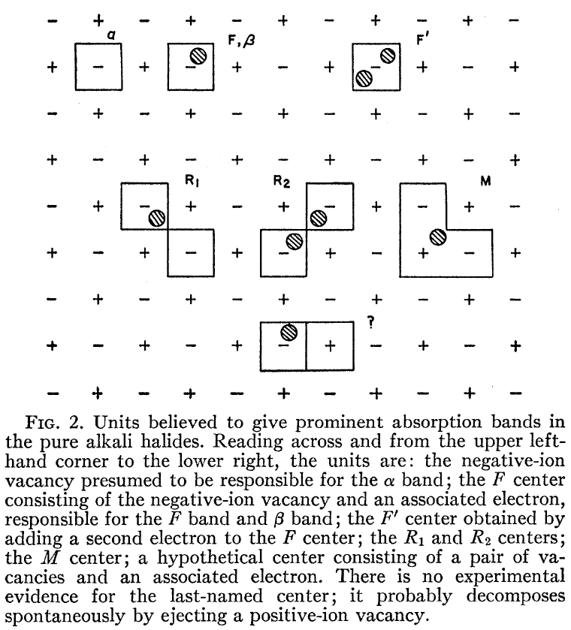
Abundance of Color Centers!
Journal of Luminescence 100 (2002) 333–343
MDvDM | Yokohama | May 2025

Slide 16
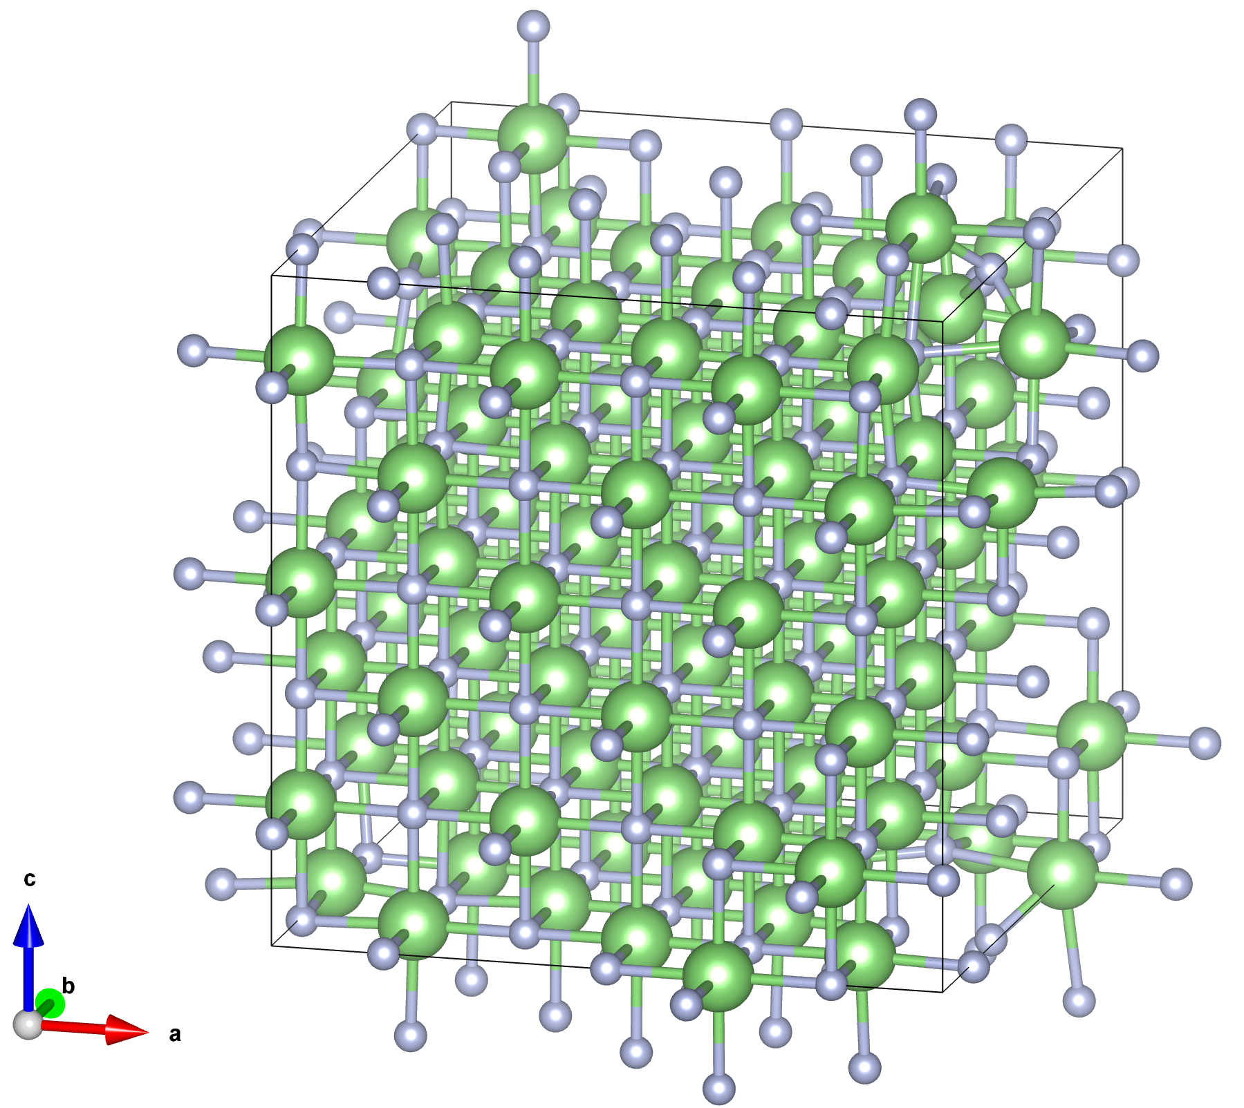
Simulation Considerations
Defect is embedded into a large supercell of 200-500 atoms (256 for LiF)
For each charge/spin state, the ground state structure is relaxed first with DFT, then hybrid functional methods
Hybrid functionals mix DFT with Hartree-Fock simulations, set by two parameters (α – mixing, μ – cutoff range)
Excited states approximated using ∆SCF method (unoccupy/occupy orbitals). Note – this ignores exciton/many-body effects!
MDvDM | Yokohama | May 2025

Slide 17
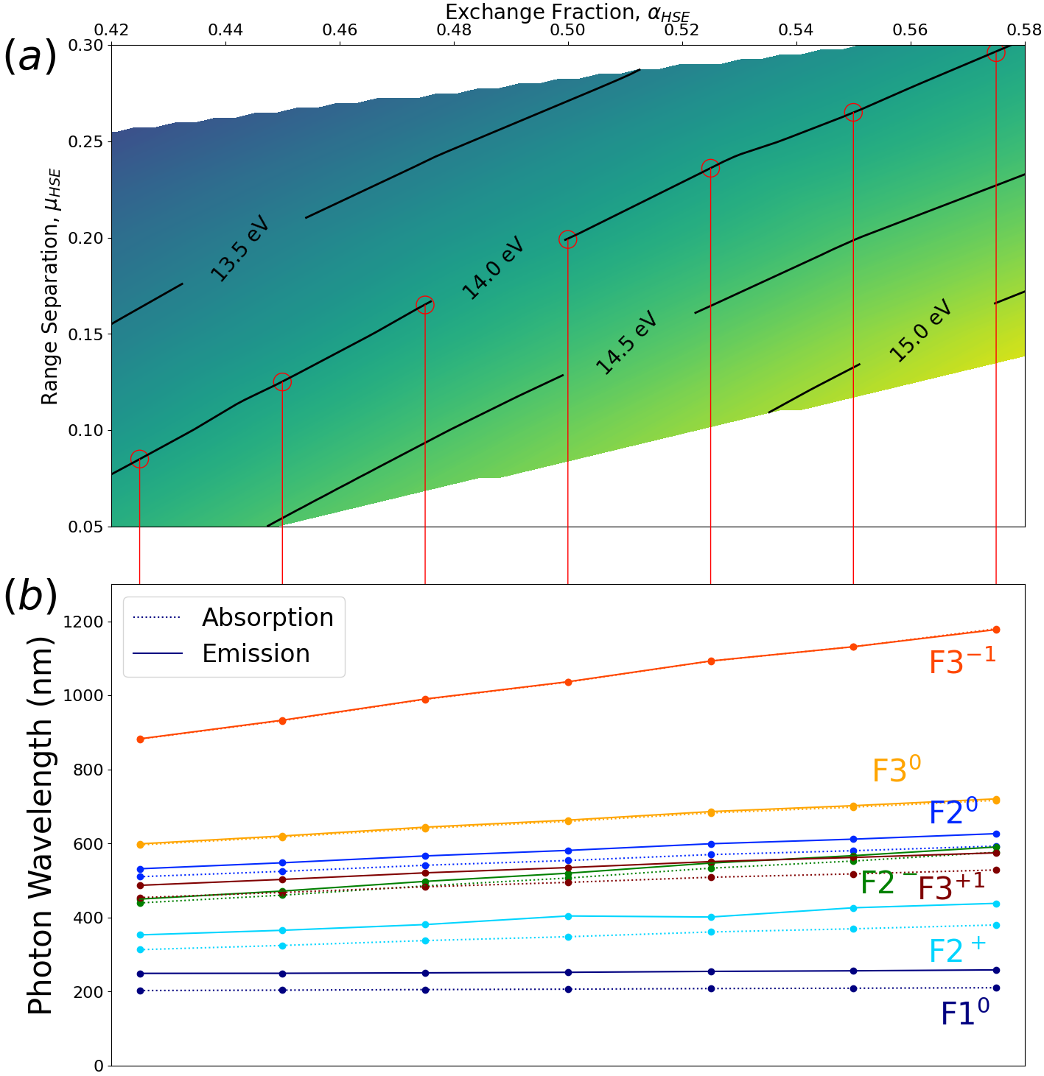
Generalized Koopmans’ Theorem
Generalized Koopmans Theorem:
∆HOMO – position of the highest occupied level relative to the conduction band
∆LUMO – position of the lowest unoccupied level relative to the conduction band
∆IE – vertical ionization energy
gKT: ∆HOMO = ∆LUMO = ∆IE
https://arxiv.org/abs/2412.21060
MDvDM | Yokohama | May 2025

Slide 18
Generalized Koopmans’ Theorem
Generalized Koopmans Theorem:
∆HOMO – position of the highest occupied level relative to the conduction band
∆LUMO – position of the lowest unoccupied level relative to the conduction band
∆IE – vertical ionization energy
gKT: ∆HOMO = ∆LUMO = ∆IE
https://arxiv.org/abs/2412.21060
MDvDM | Yokohama | May 2025

Slide 19
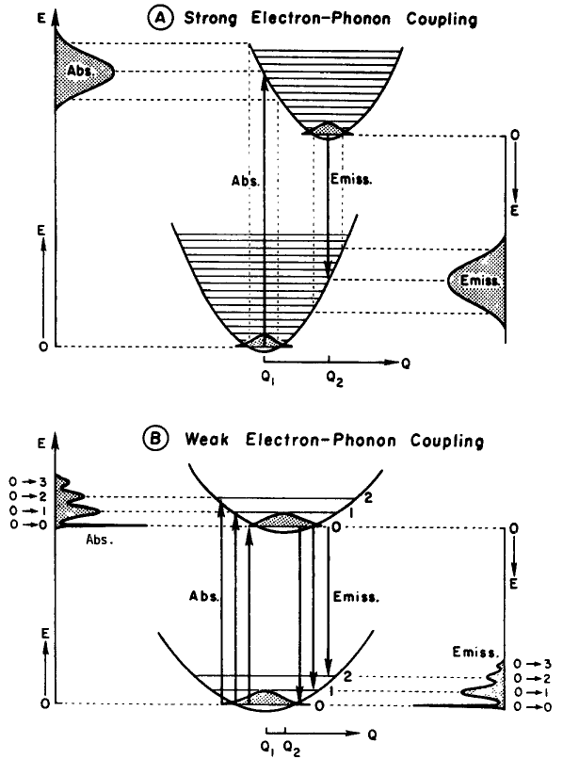
Strong el-ph Coupling!
J. Phys. Chem. Solids Vol. 52, No. I. pp. 249-297. 1991
MDvDM | Yokohama | May 2025

Slide 20
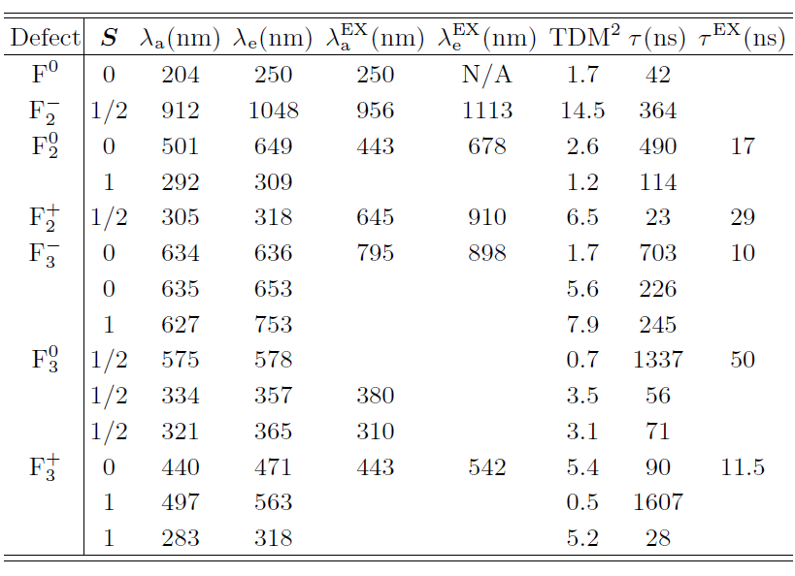
Defect Data
https://arxiv.org/abs/2412.21060
MDvDM | Yokohama | May 2025

Slide 21
Defect Data
https://arxiv.org/abs/2412.21060
MDvDM | Yokohama | May 2025

Slide 22
Defect Data
These defects are highly delocalized! → Need larger Supercell
https://arxiv.org/abs/2412.21060
MDvDM | Yokohama | May 2025

Slide 23
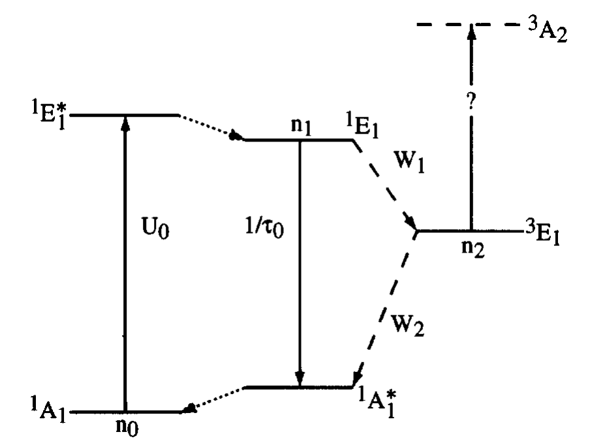
Defect Data
Phys. Rev. B 54, 17508
MDvDM | Yokohama | May 2025

Slide 24
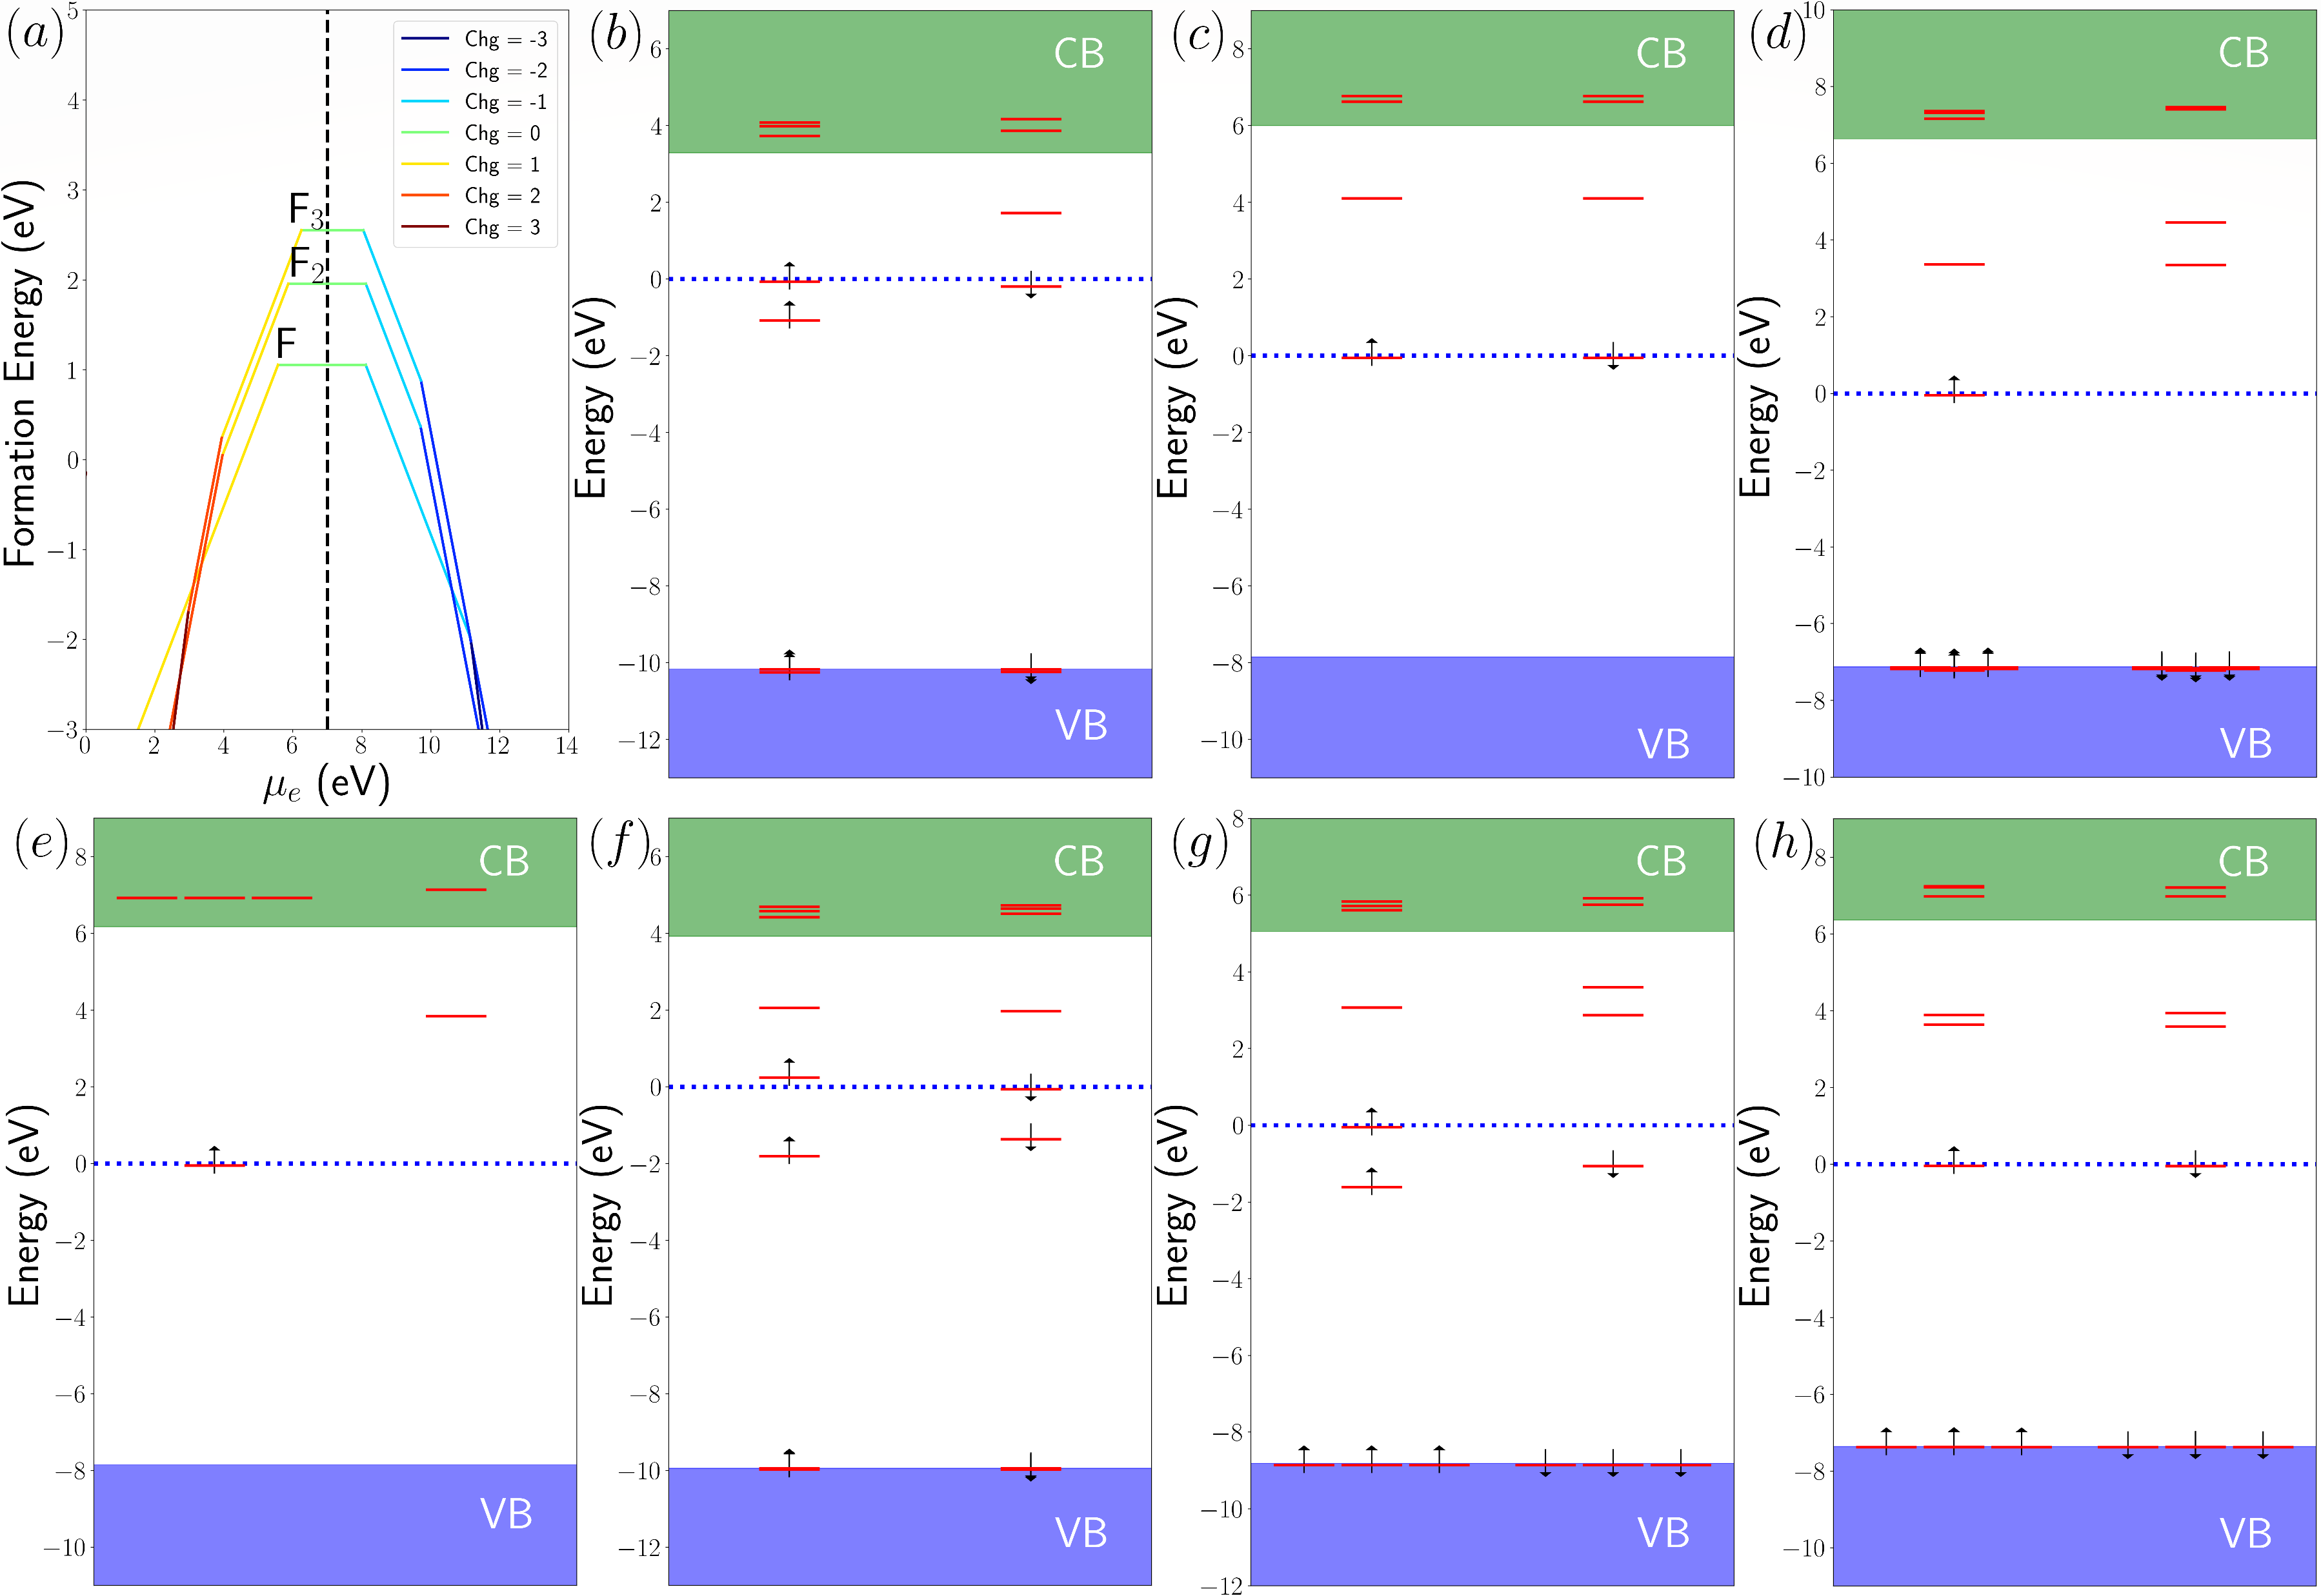
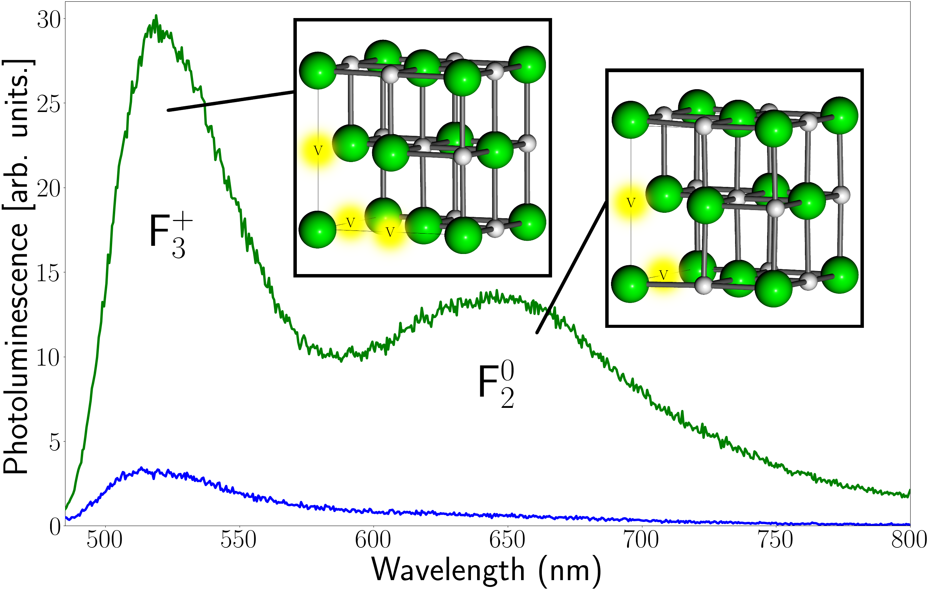
Electronic Structures
Overall decent match to experimental PL!
What about formation energy? How do we understand PL annealing changes?
F₂⁻
F₂⁰
F₂⁺
F
F₃⁻
F₃⁰
F₃⁺
https://arxiv.org/abs/2412.21060
MDvDM | Yokohama | May 2025

Slide 25
Electronic Structures
Overall decent match to experimental PL!
What about formation energy? How do we understand PL annealing changes?
F₂⁻
F₂⁰
F₂⁺
F
F₃⁻
F₃⁰
F₃⁺
https://arxiv.org/abs/2412.21060
MDvDM | Yokohama | May 2025

Slide 26
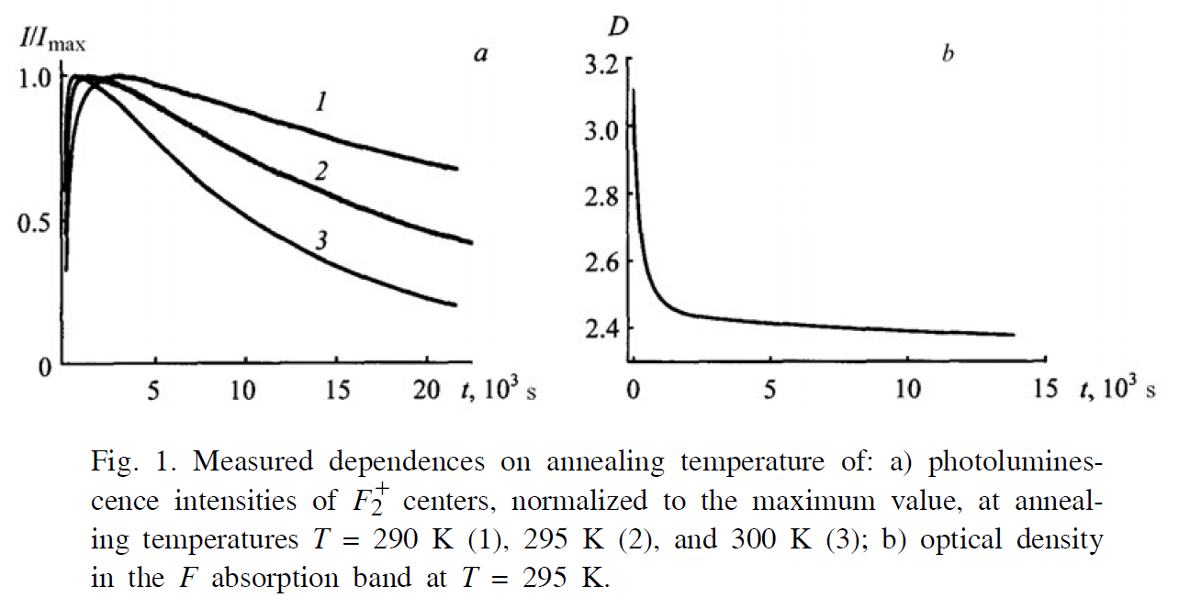
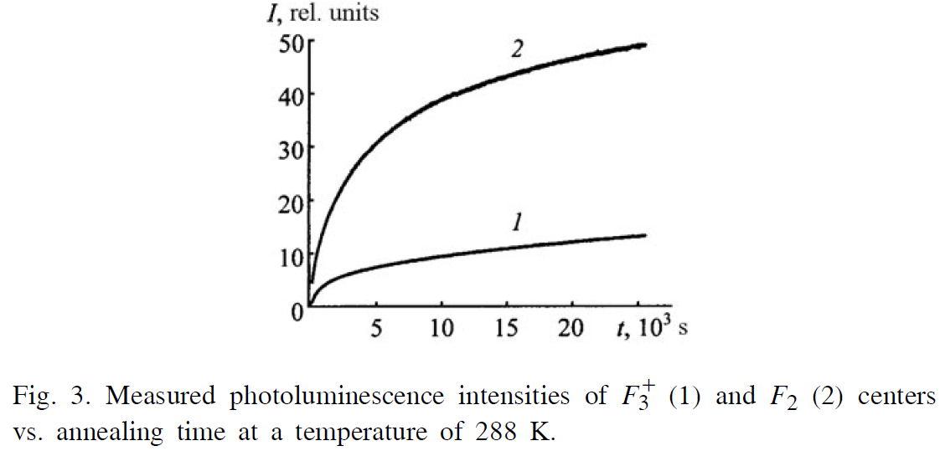
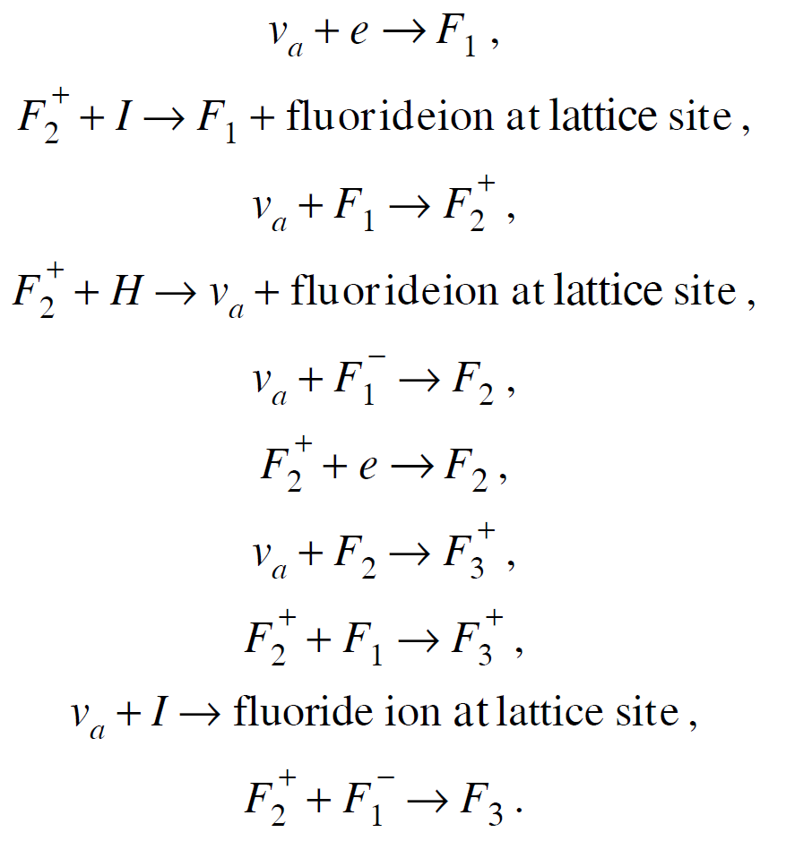
Defect formation dynamics: what happens after irradiation?
After formation, F-centers rapidly recombine into F2 and F3+ defects – rates can be determined by photoluminescence measurements as samples anneal over time.
How can we determine reaction rates from first principles?
MDvDM | Yokohama | May 2025

Slide 27
Defect formation dynamics: what happens after irradiation?
Arrhenius equation – rate given by activation energy:
$$a=e^{−E_{a}/k_{B}T}$$
Need to consider all reaction pathways! Ex: the vacancy concentration over time:
$$n_{v}(t)=n_{0v}e^{−t/τ_{v}}$$
$$τ_{v}=\frac{1}{a_{v1}n_{1}+a_{v1}^{′}n_{1}^{′}+a_{vI}n_{I}+a_{v3}n_{3}}$$
where $a_{v1}, a_{v1}^{′}, a_{v3},a_{vI}$ are the rates for vacancies combining with $F_{1}, F_{1}^{−}, F_{2},$ or an interstitial fluoride ion.
Can these be extracted from Laplace transform of PL decay?
So, we need activation energy!
Find E_{a} for this reaction using NEB method
MDvDM | Yokohama | May 2025

Slide 28
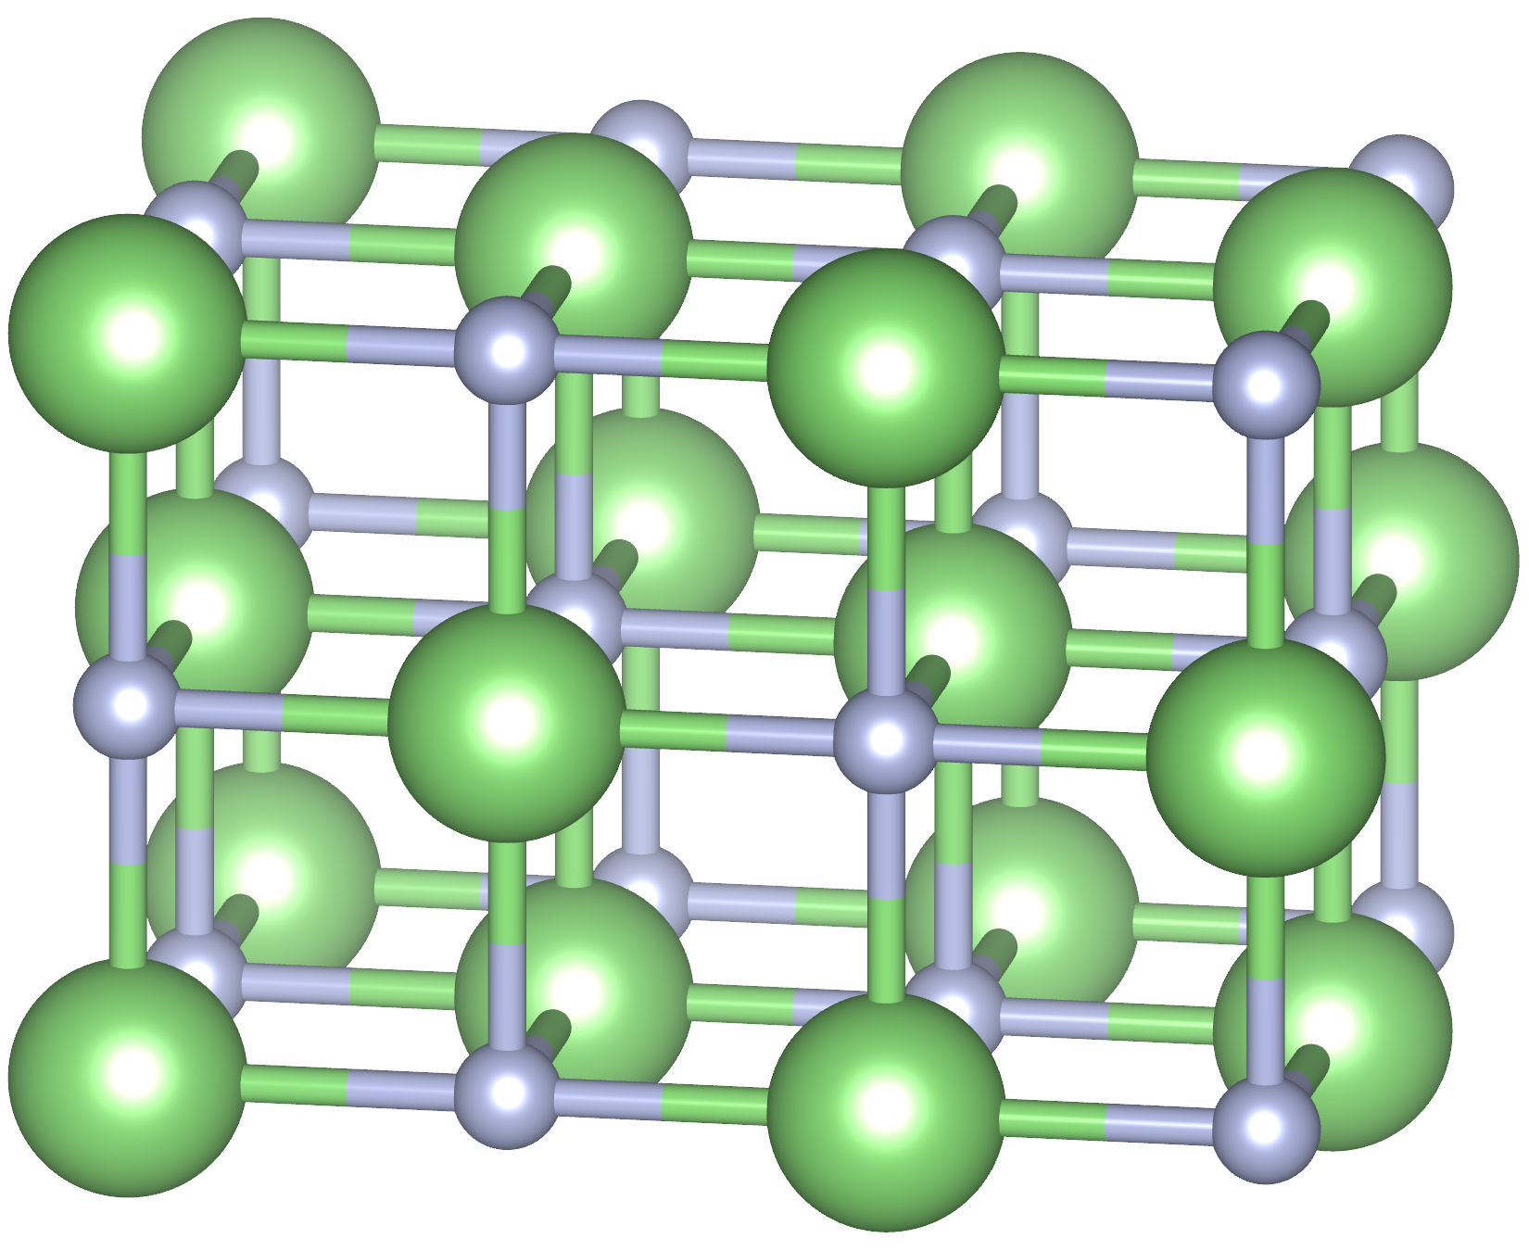
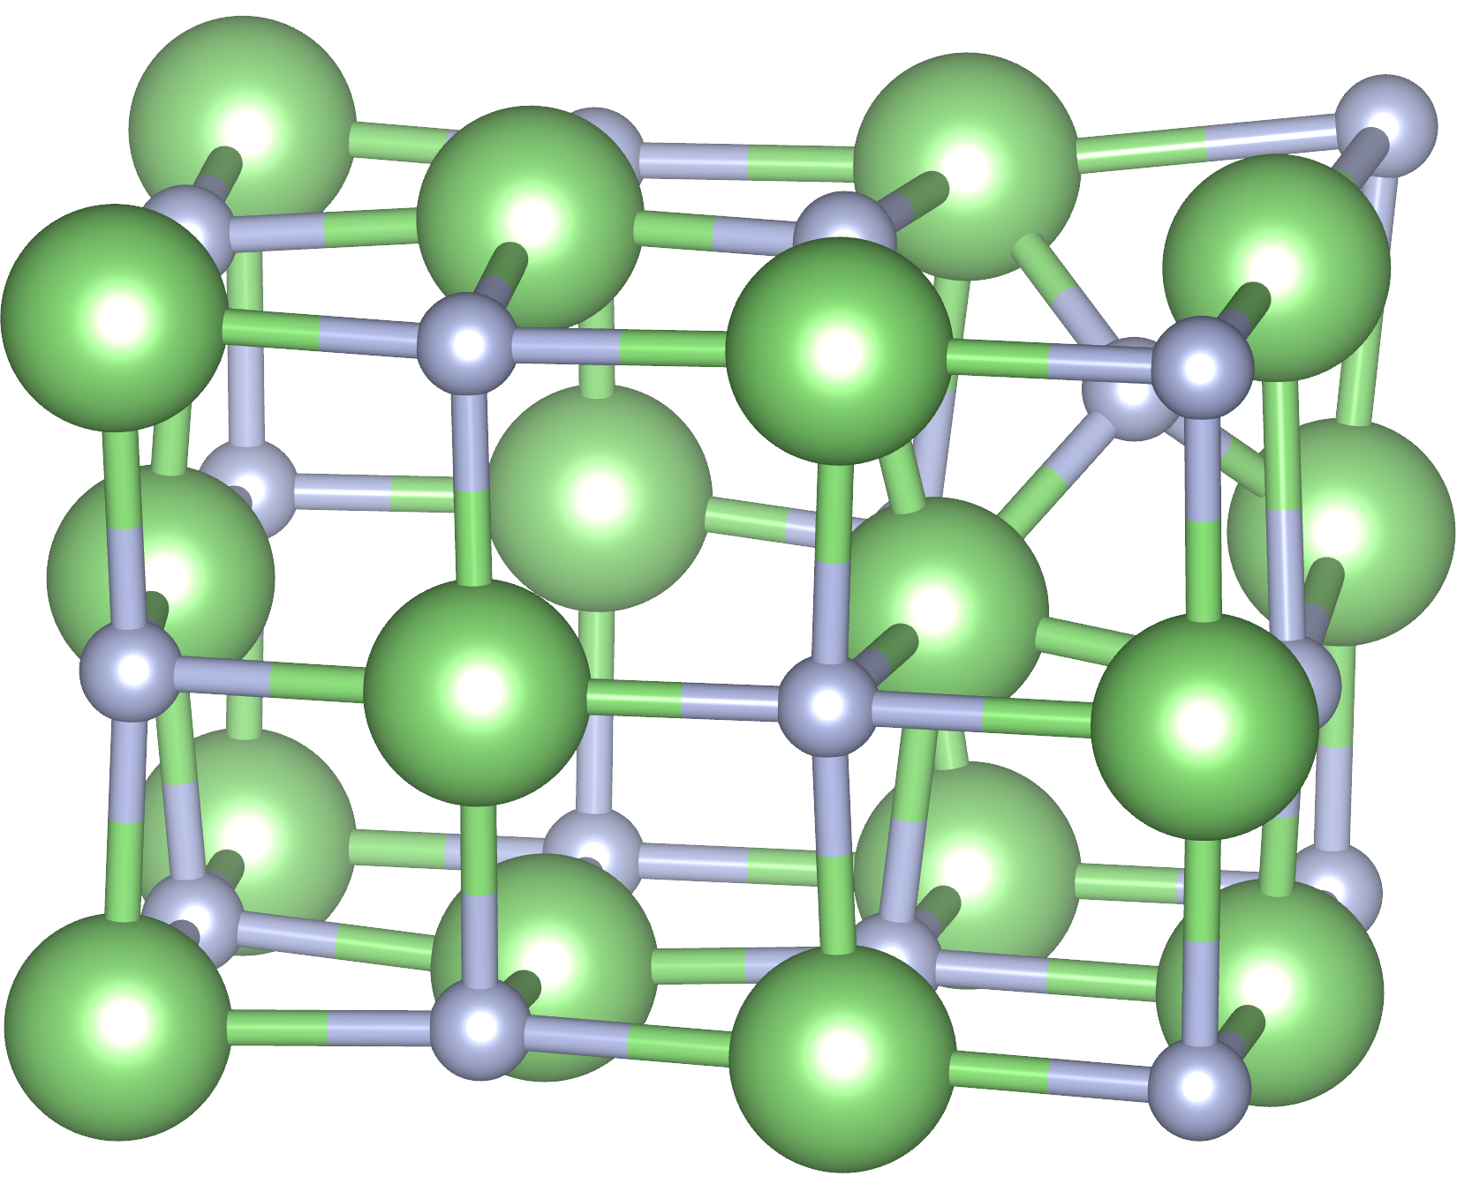
Nudged Elastic Band Method
Initial and final configurations are linked by a linear interpolation images. Structure relaxed with images constrained by connecting spring forces:
MDvDM | Yokohama | May 2025

Slide 29
Nudged Elastic Band Method
Initial and final configurations are linked by a linear interpolation images. Structure relaxed with images constrained by connecting spring forces:
MDvDM | Yokohama | May 2025

Slide 30
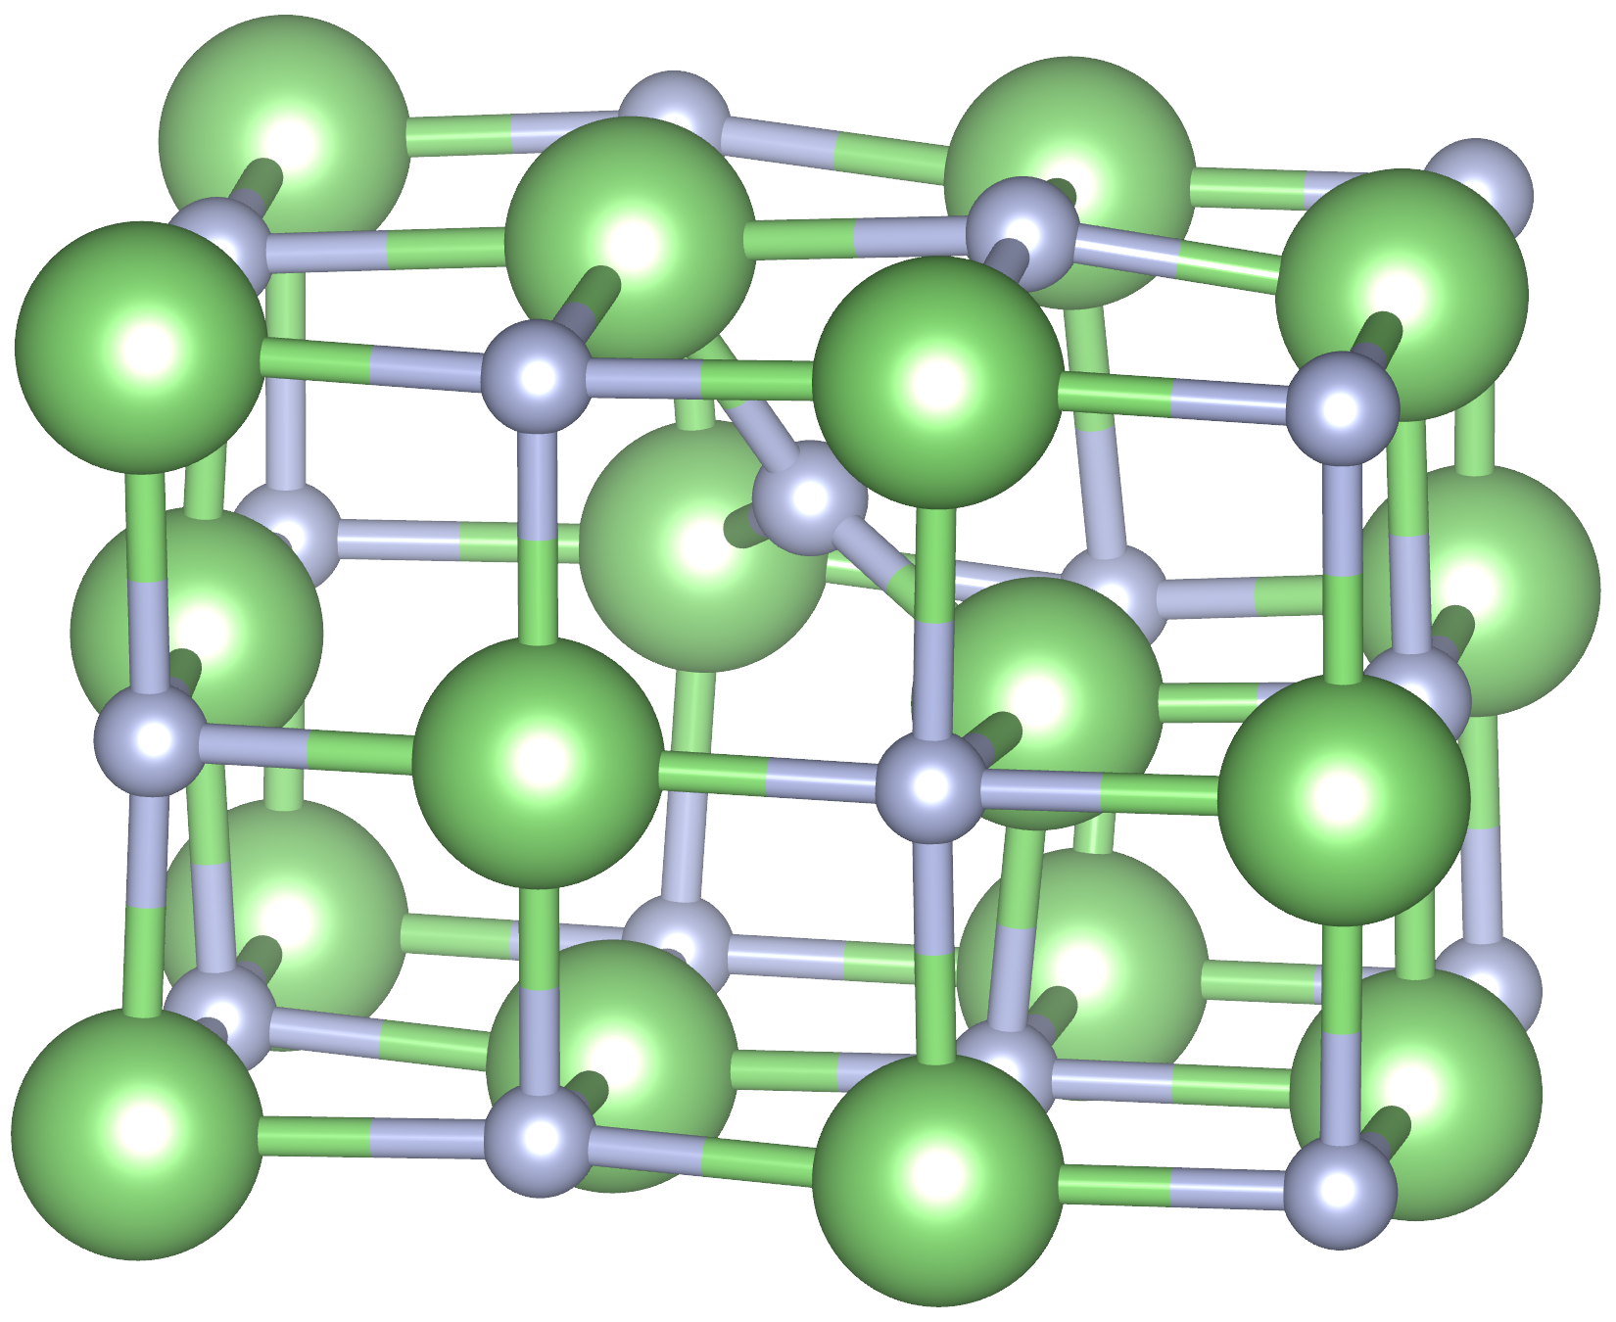
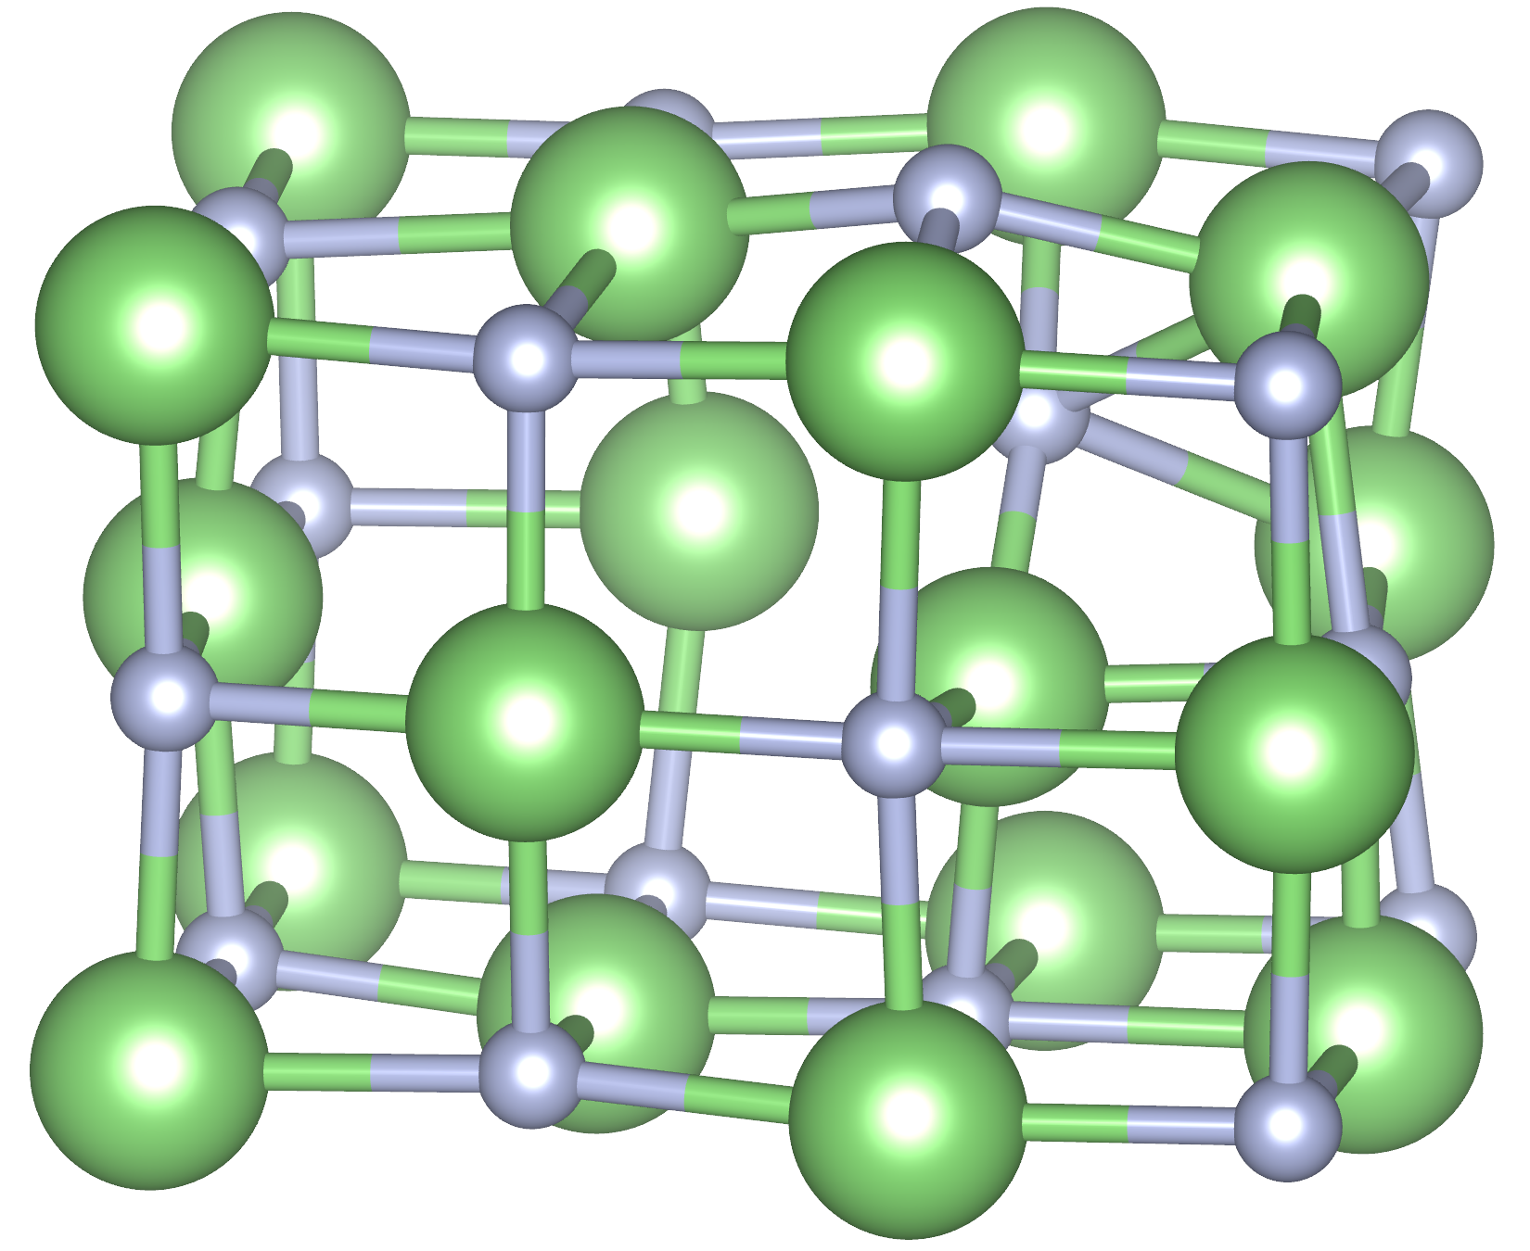
Nudged Elastic Band Method
Initial and final configurations are linked by a linear interpolation images. Structure relaxed with images constrained by connecting spring forces:
MDvDM | Yokohama | May 2025

Slide 31
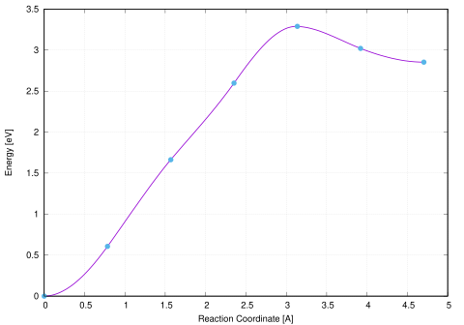
Nudged Elastic Band Method
E_{a} for formation is ~3.5 eV
E_{a} for recombination is only ~0.5eV
With increasing distance, end state energy will decrease
MDvDM | Yokohama | May 2025

Slide 32
Outline
Overview of PALEOCCENE & Material Requirements
Role of Color Center Defects
Candidate Minerals & Requirements
Alkali Halide Defects & Formation Mechanisms
Vacancy clusters in LiF
Computational Considerations - Koopman’s Tuning & Electron-Phonon Coupling
Formation mechanisms
Forsterite, Scheelite, Corundum, & Zircon
Which simple defects are optically bright and visible?
Nudged Elastic Band method for energy barriers

Slide 33
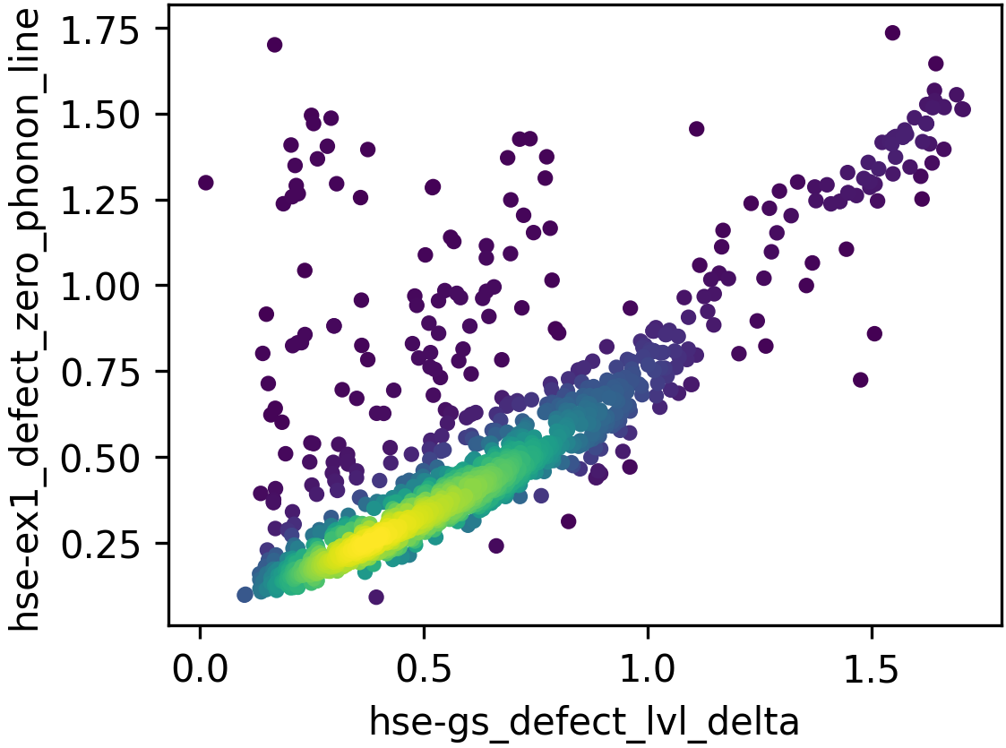
Screening Materials for MDDM (in progress)
Treat materials with HSE06 (reproduces band gap for non-polar materials)
“simple” defects, i.e. neutral vacancies/self-interstitials (clusters & charged in progress)
Ground state energy ∆ ~ ZPL ± 0.2eV (known from defect database). Visible: 3.1-1.8eV. For simplicity ignore el-ph effects.
The ideal material for MDDM will have mostly optically active “simple” defects.
MDvDM | Yokohama | May 2025

Slide 34
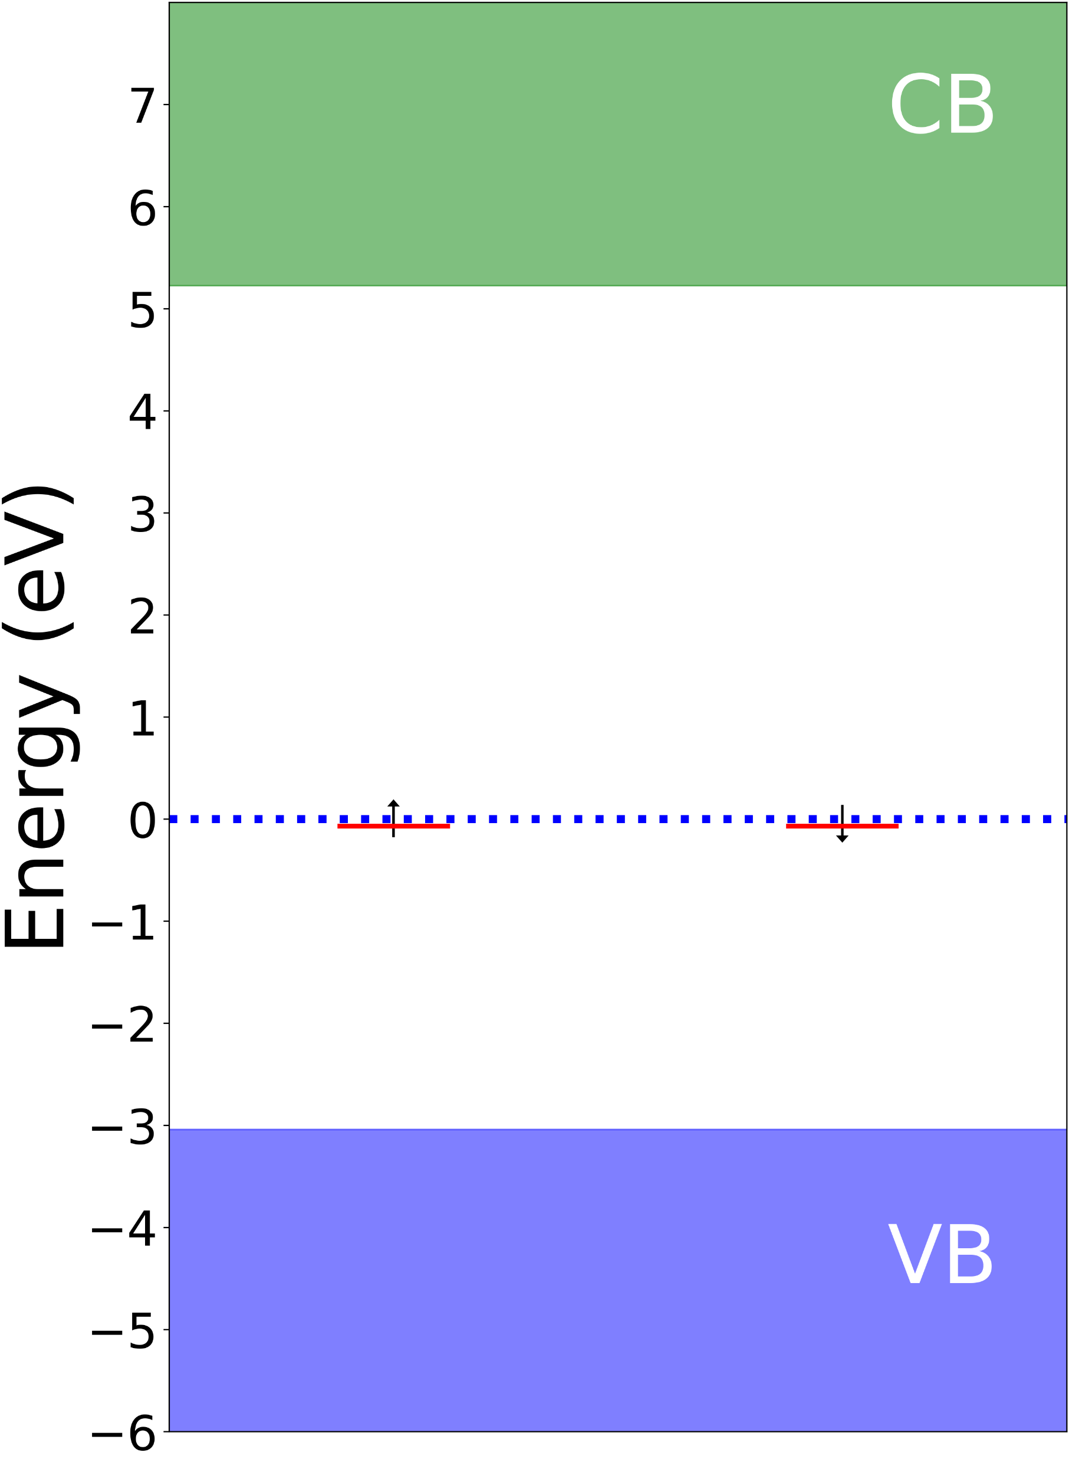
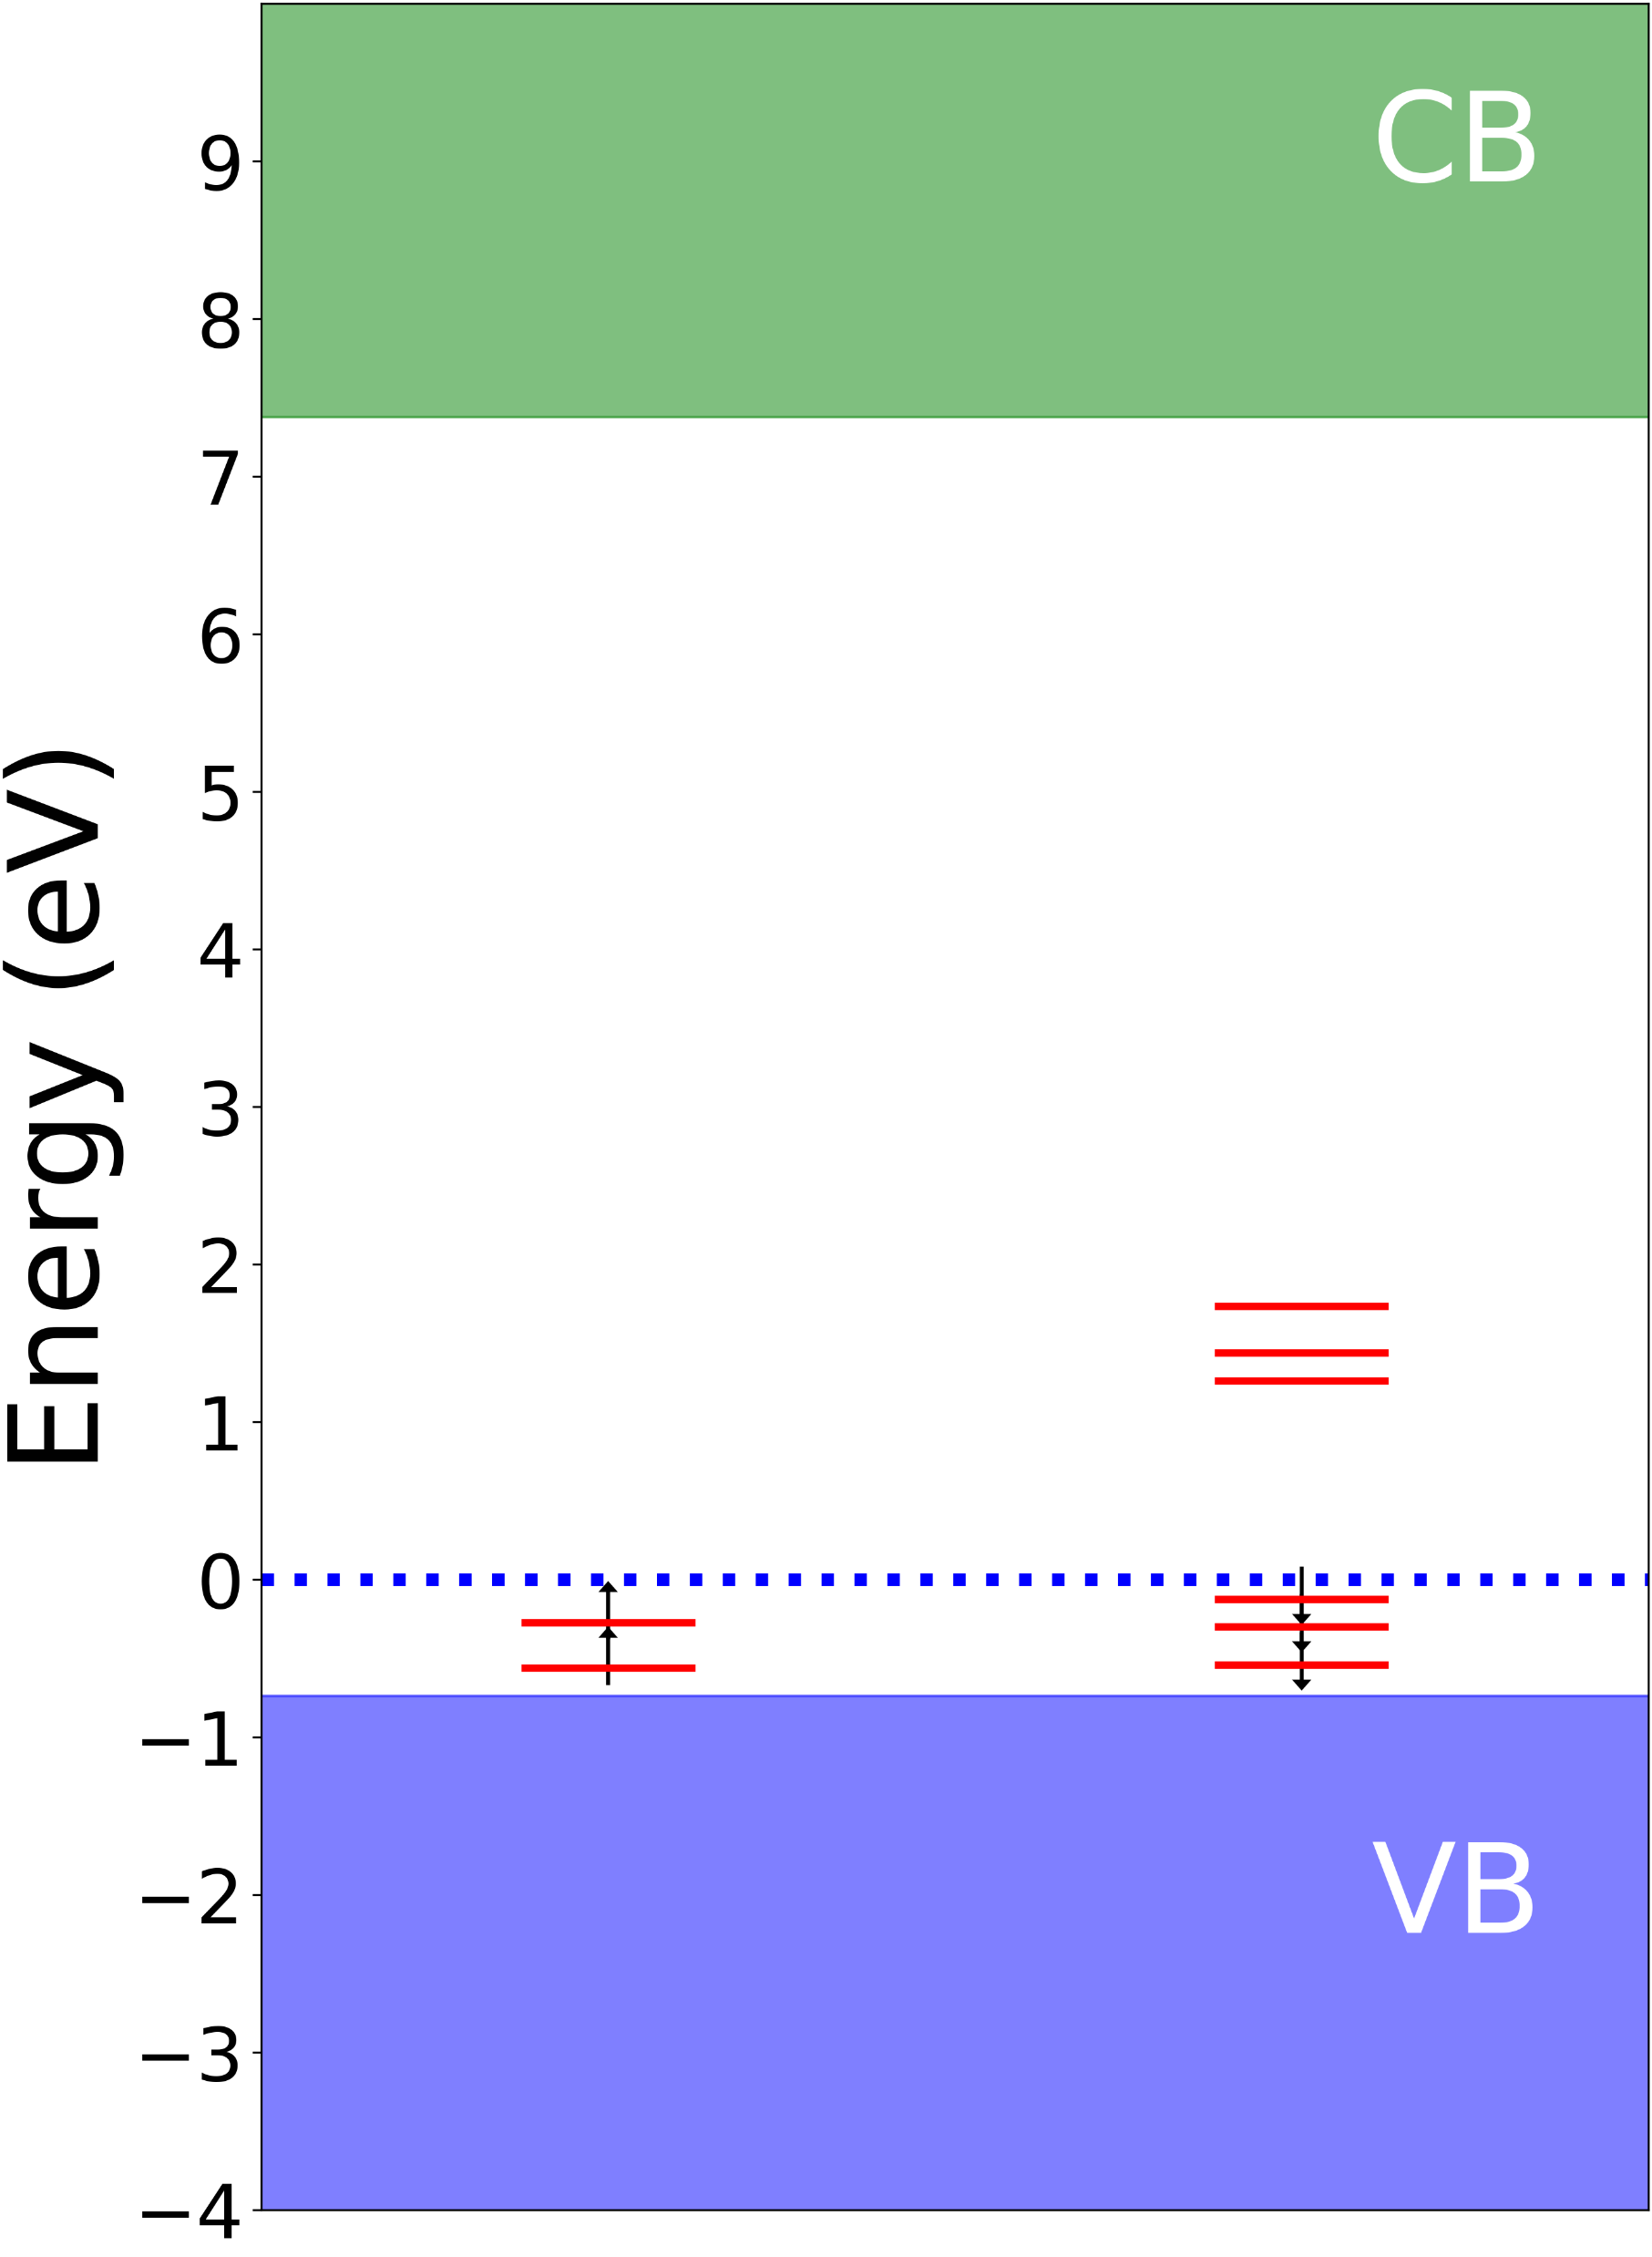
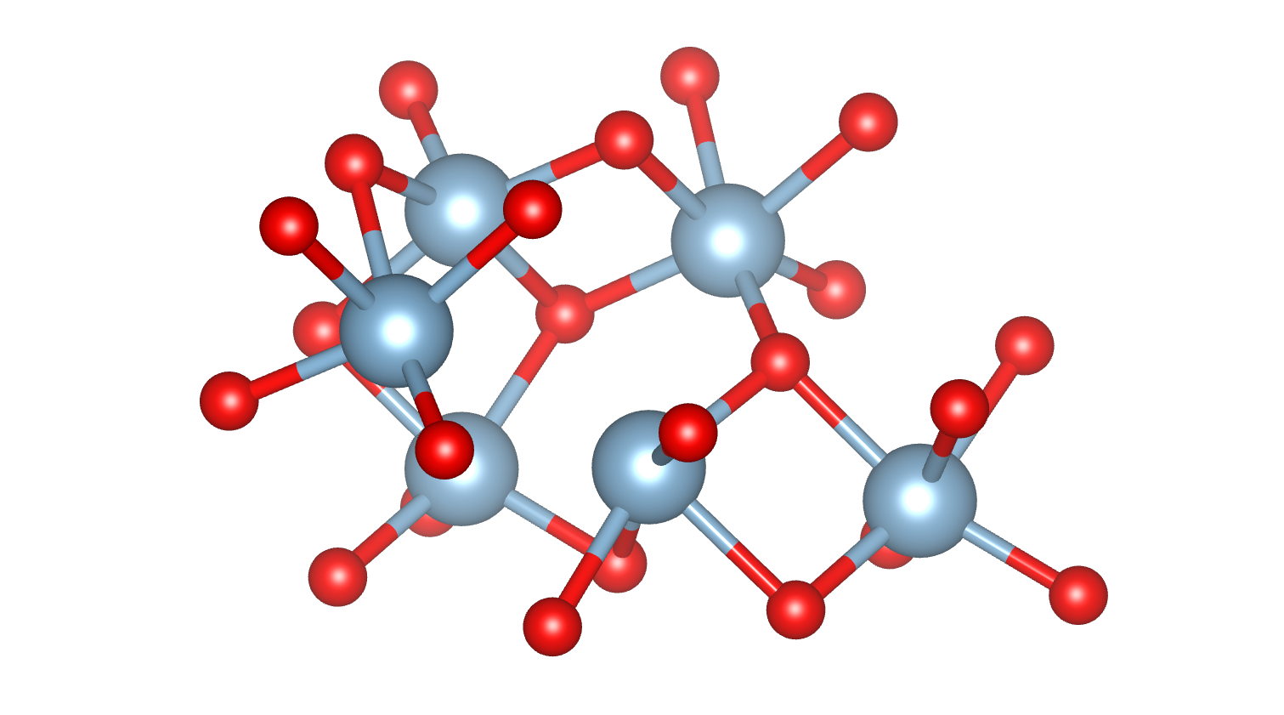
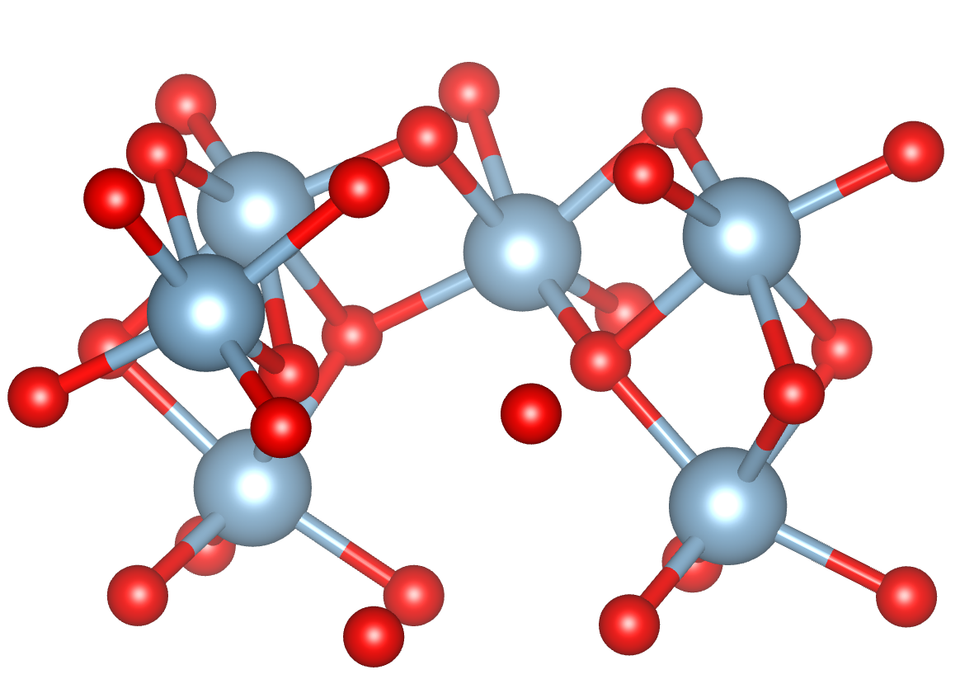
Corundum (Al₂O₃)
O-vac
Al-vac
O-vacancy has only 1 transition – outside vis (~250nm)
Al-vacancy has several transitions 1.4-2.3eV (545-890nm) , all relatively bright (0.2-1.4 Debye²)
MDvDM | Yokohama | May 2025

Slide 35
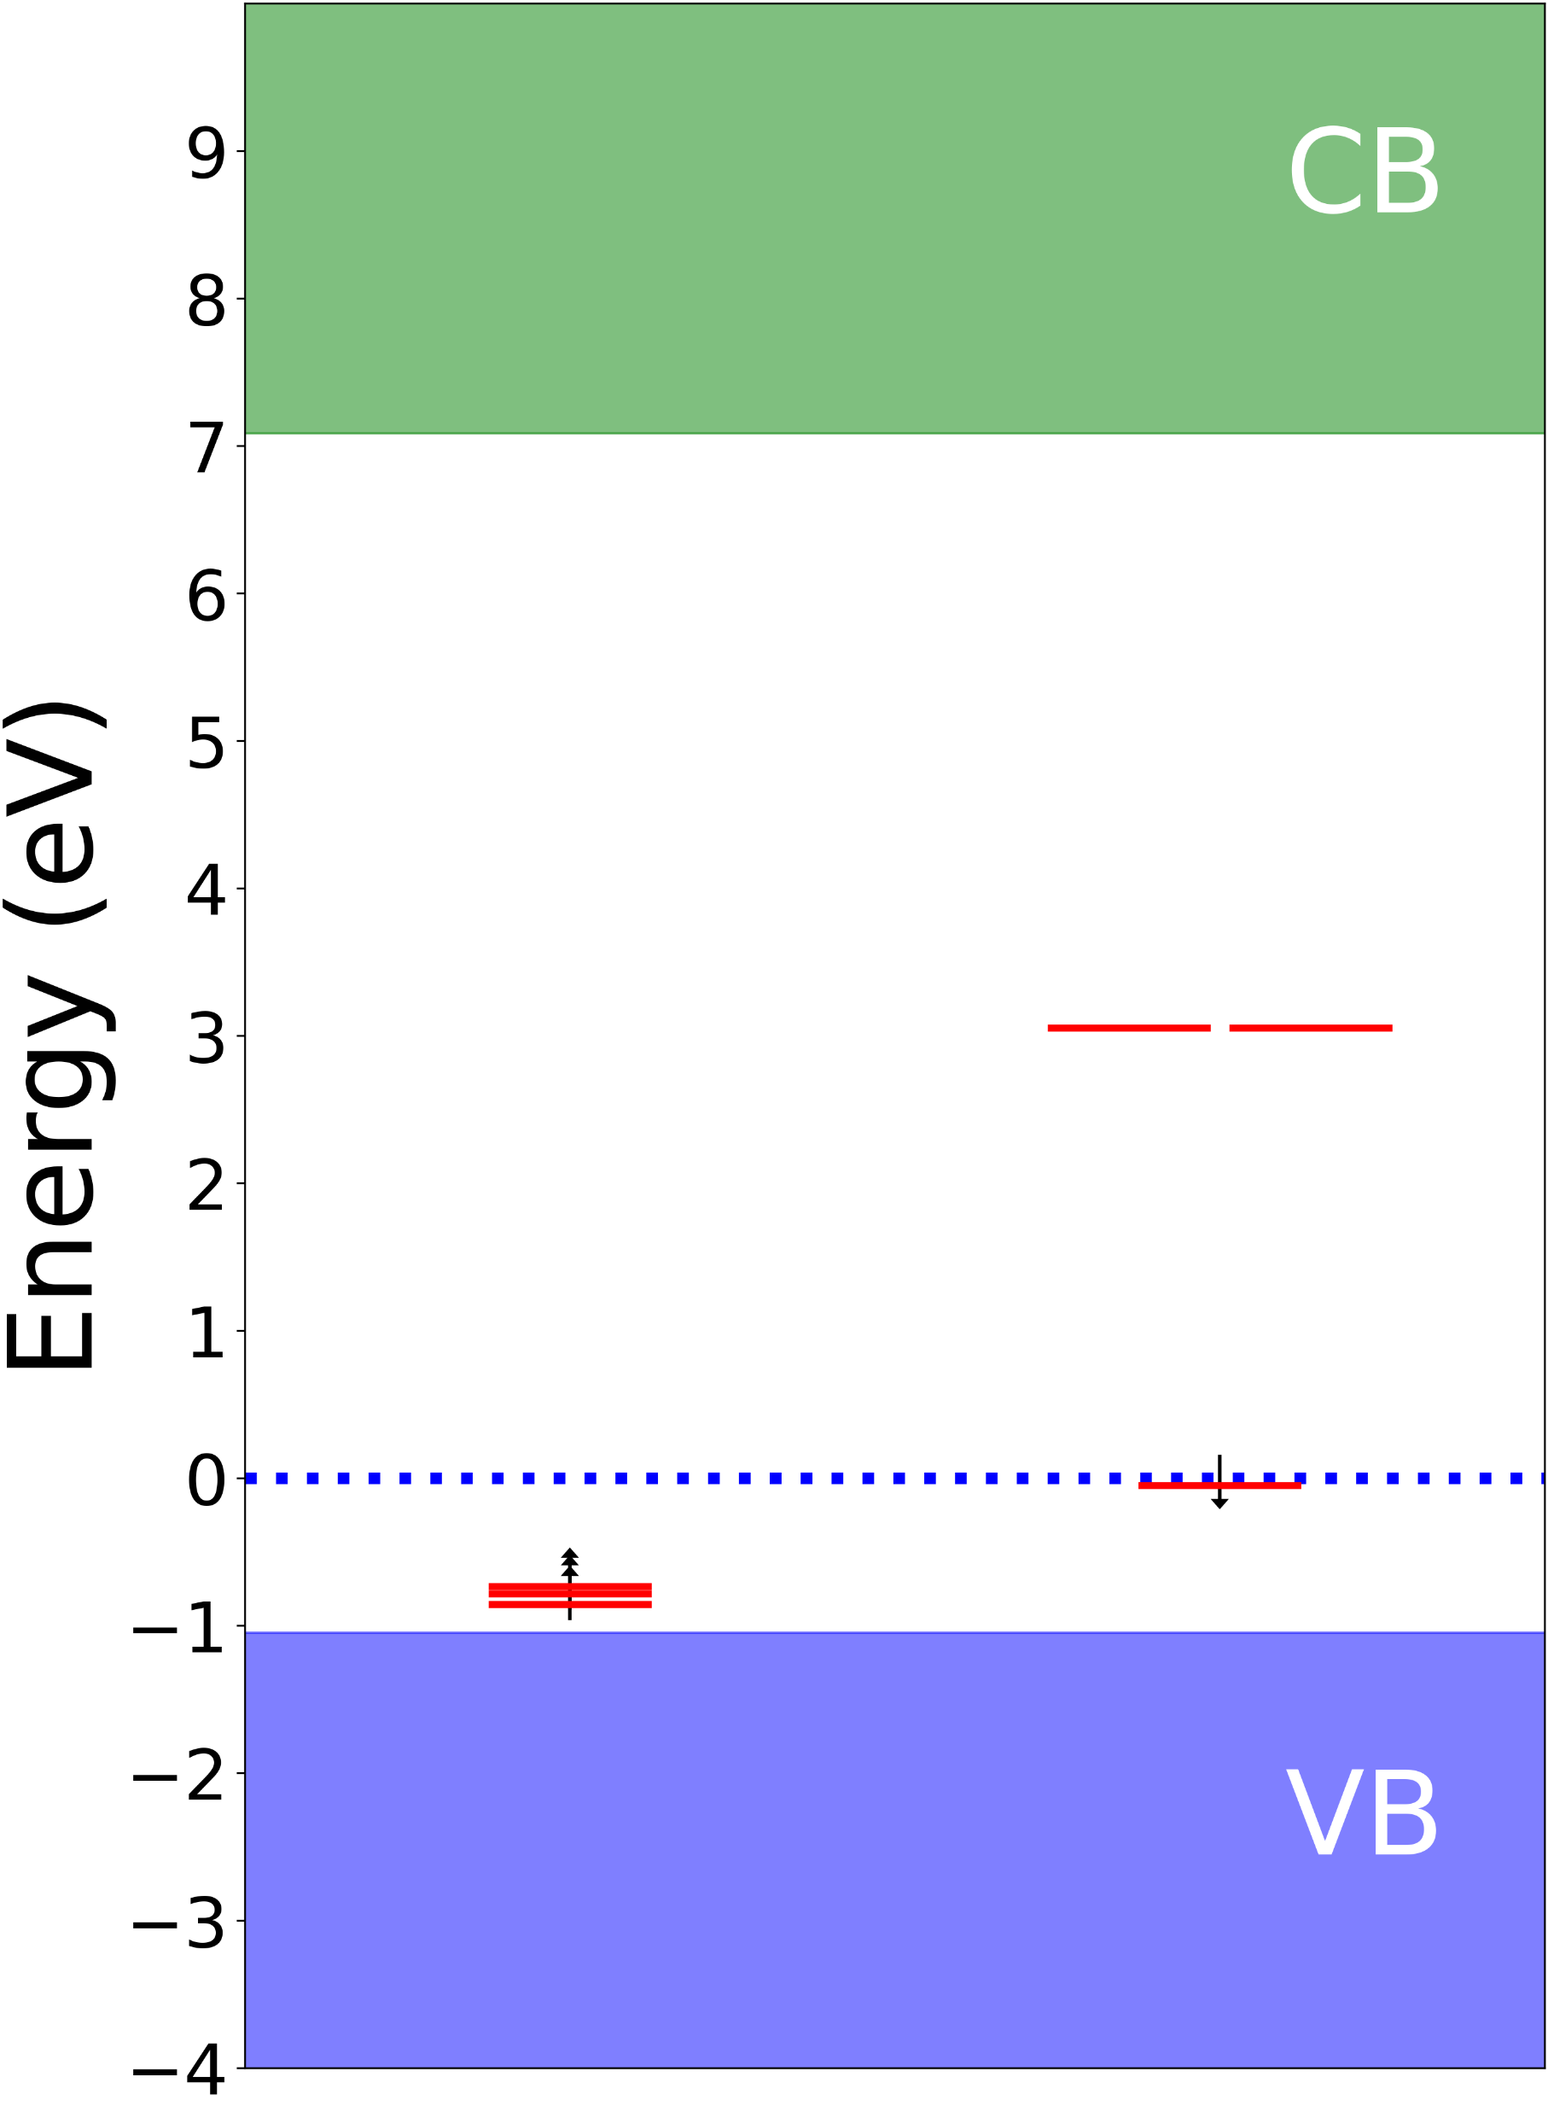
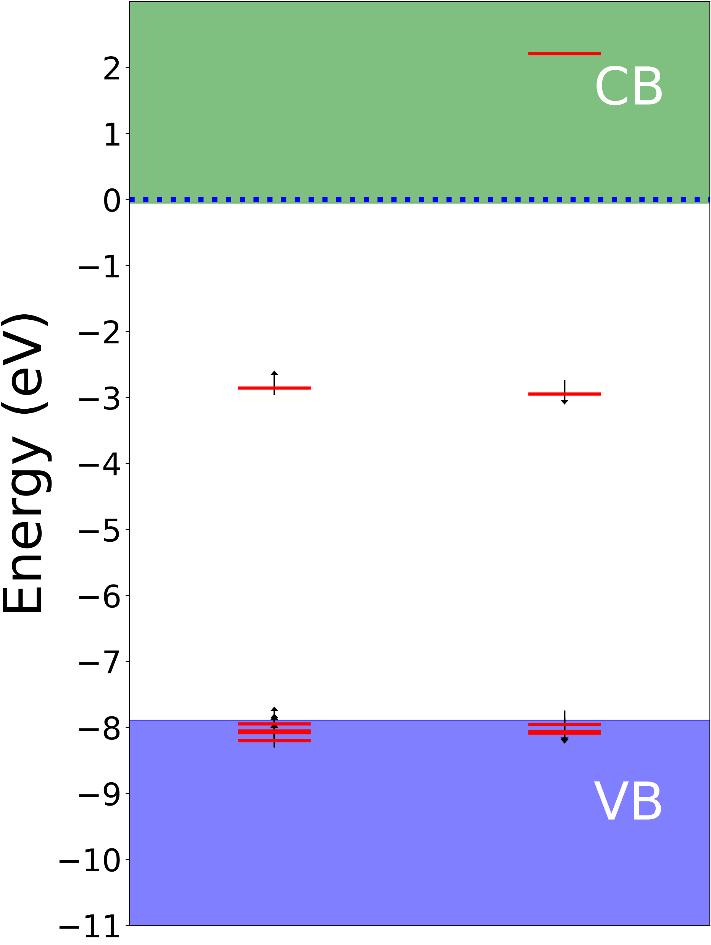
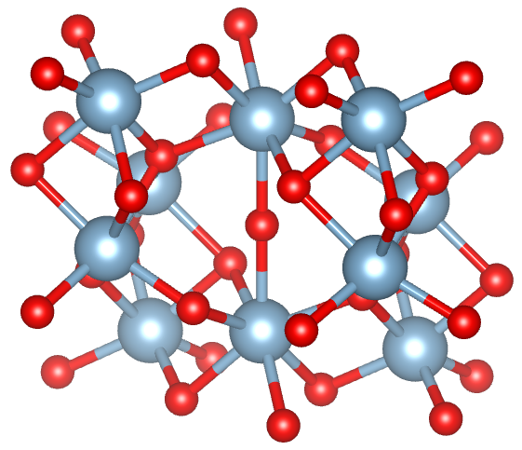
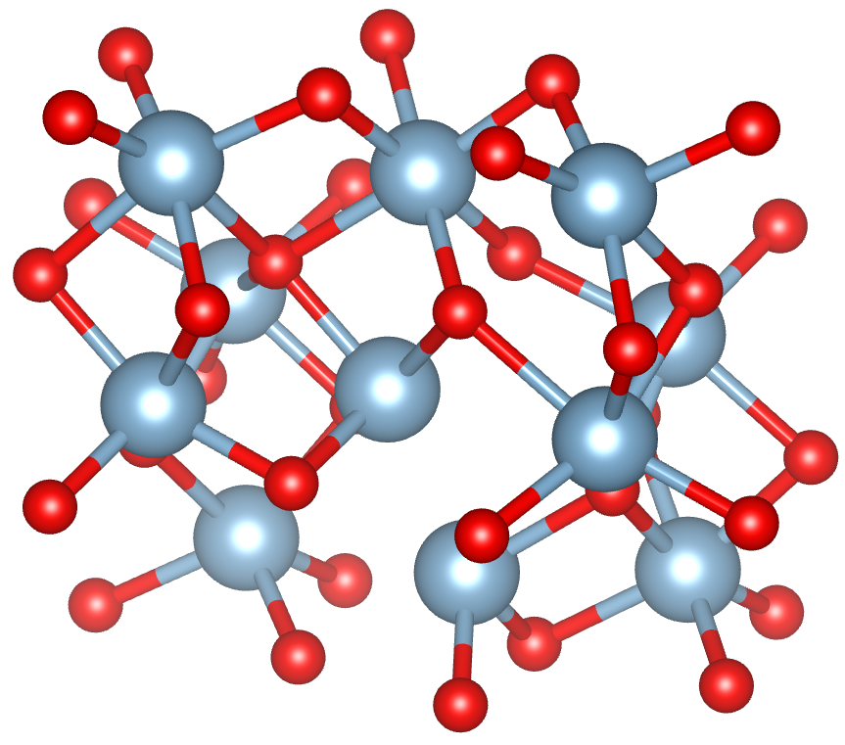
Corundum (Al₂O₃)
O-int
Al-int
Interstitial Al puts Fermi level in the conduction band (supercell may be too small?)
Interstitial O has two transitions at ~3.1eV, both dark
MDvDM | Yokohama | May 2025

Slide 36
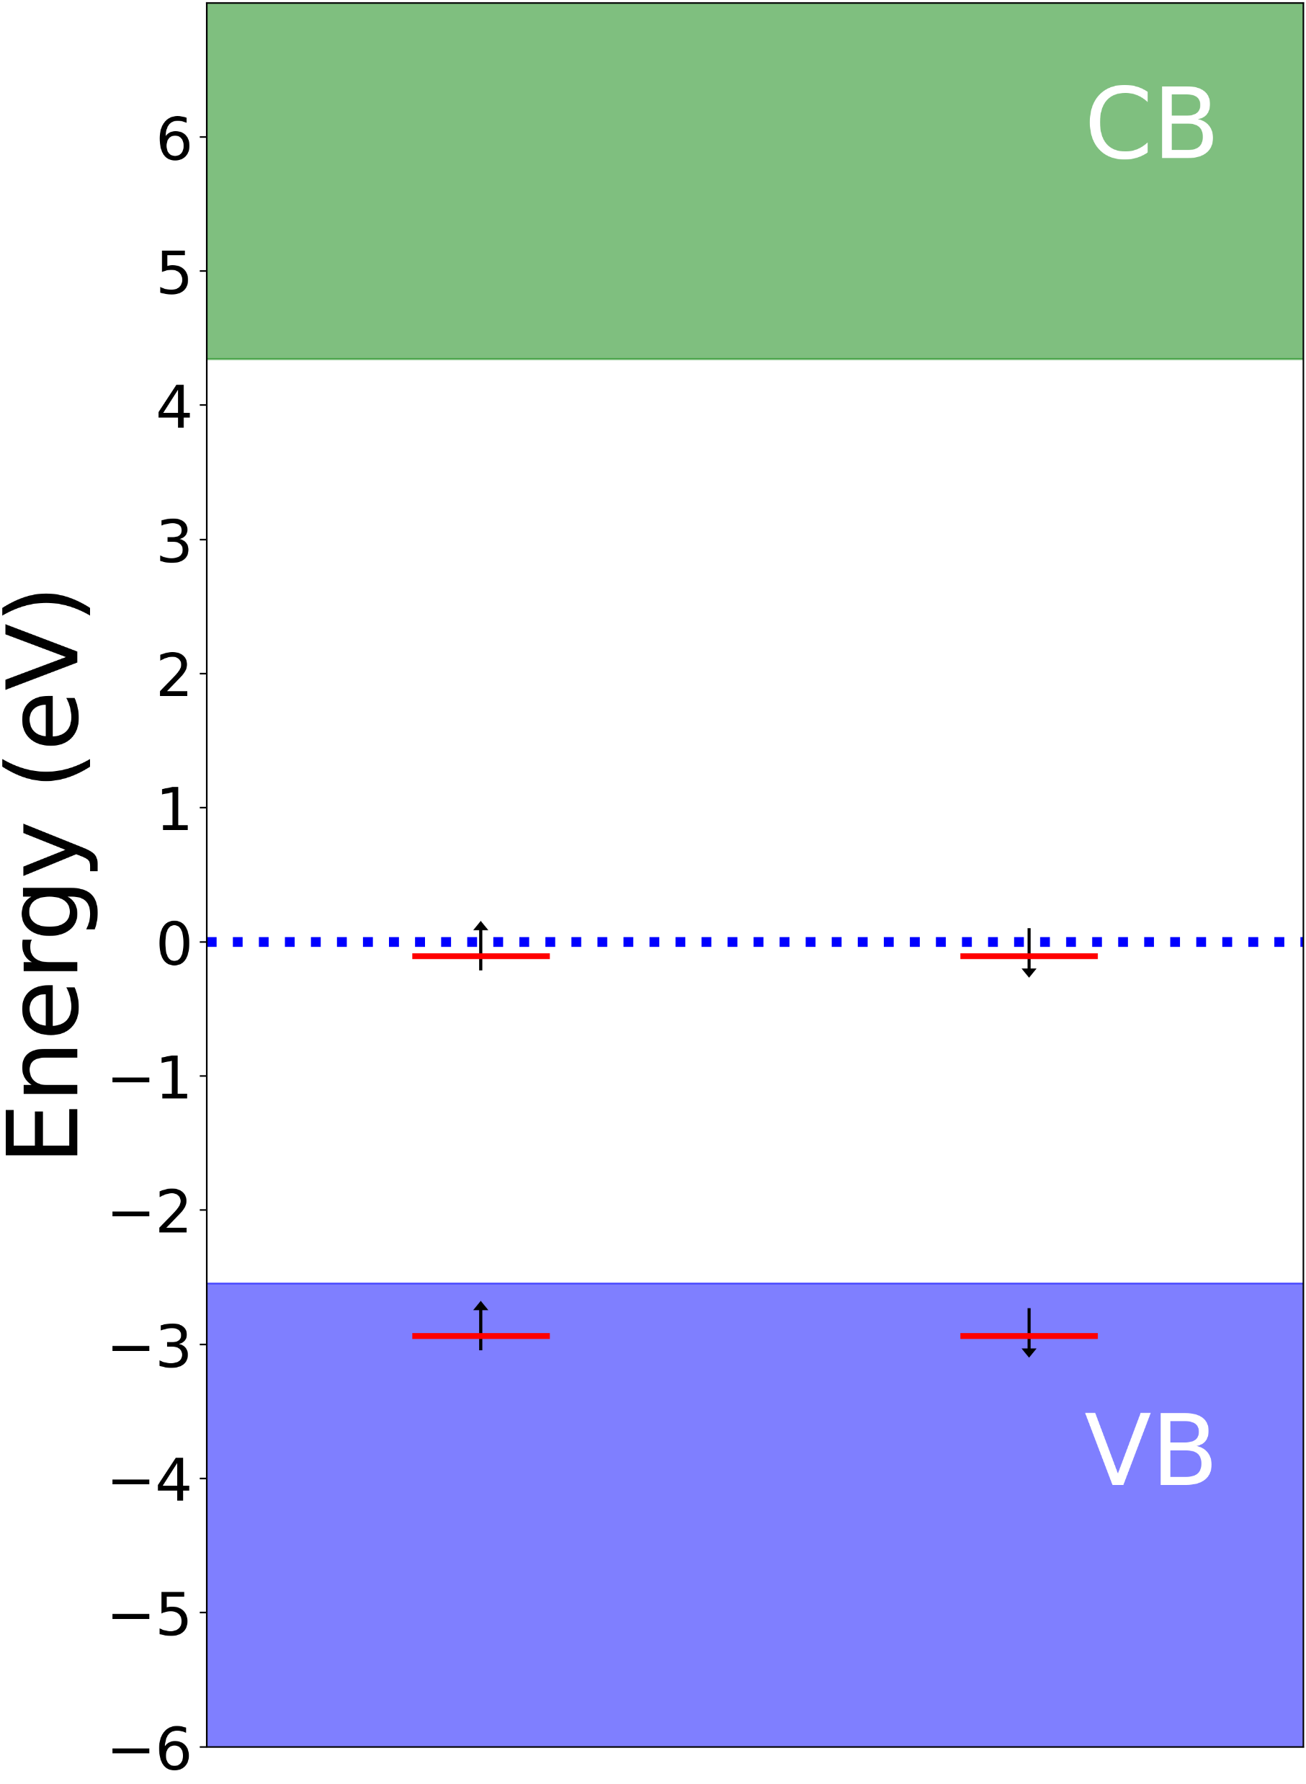
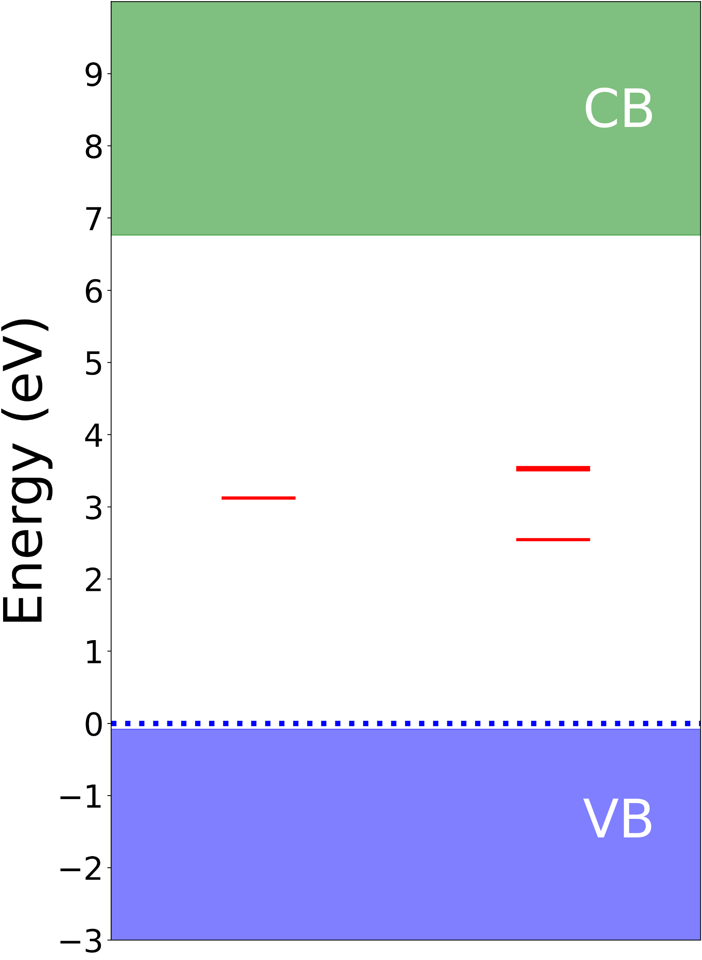
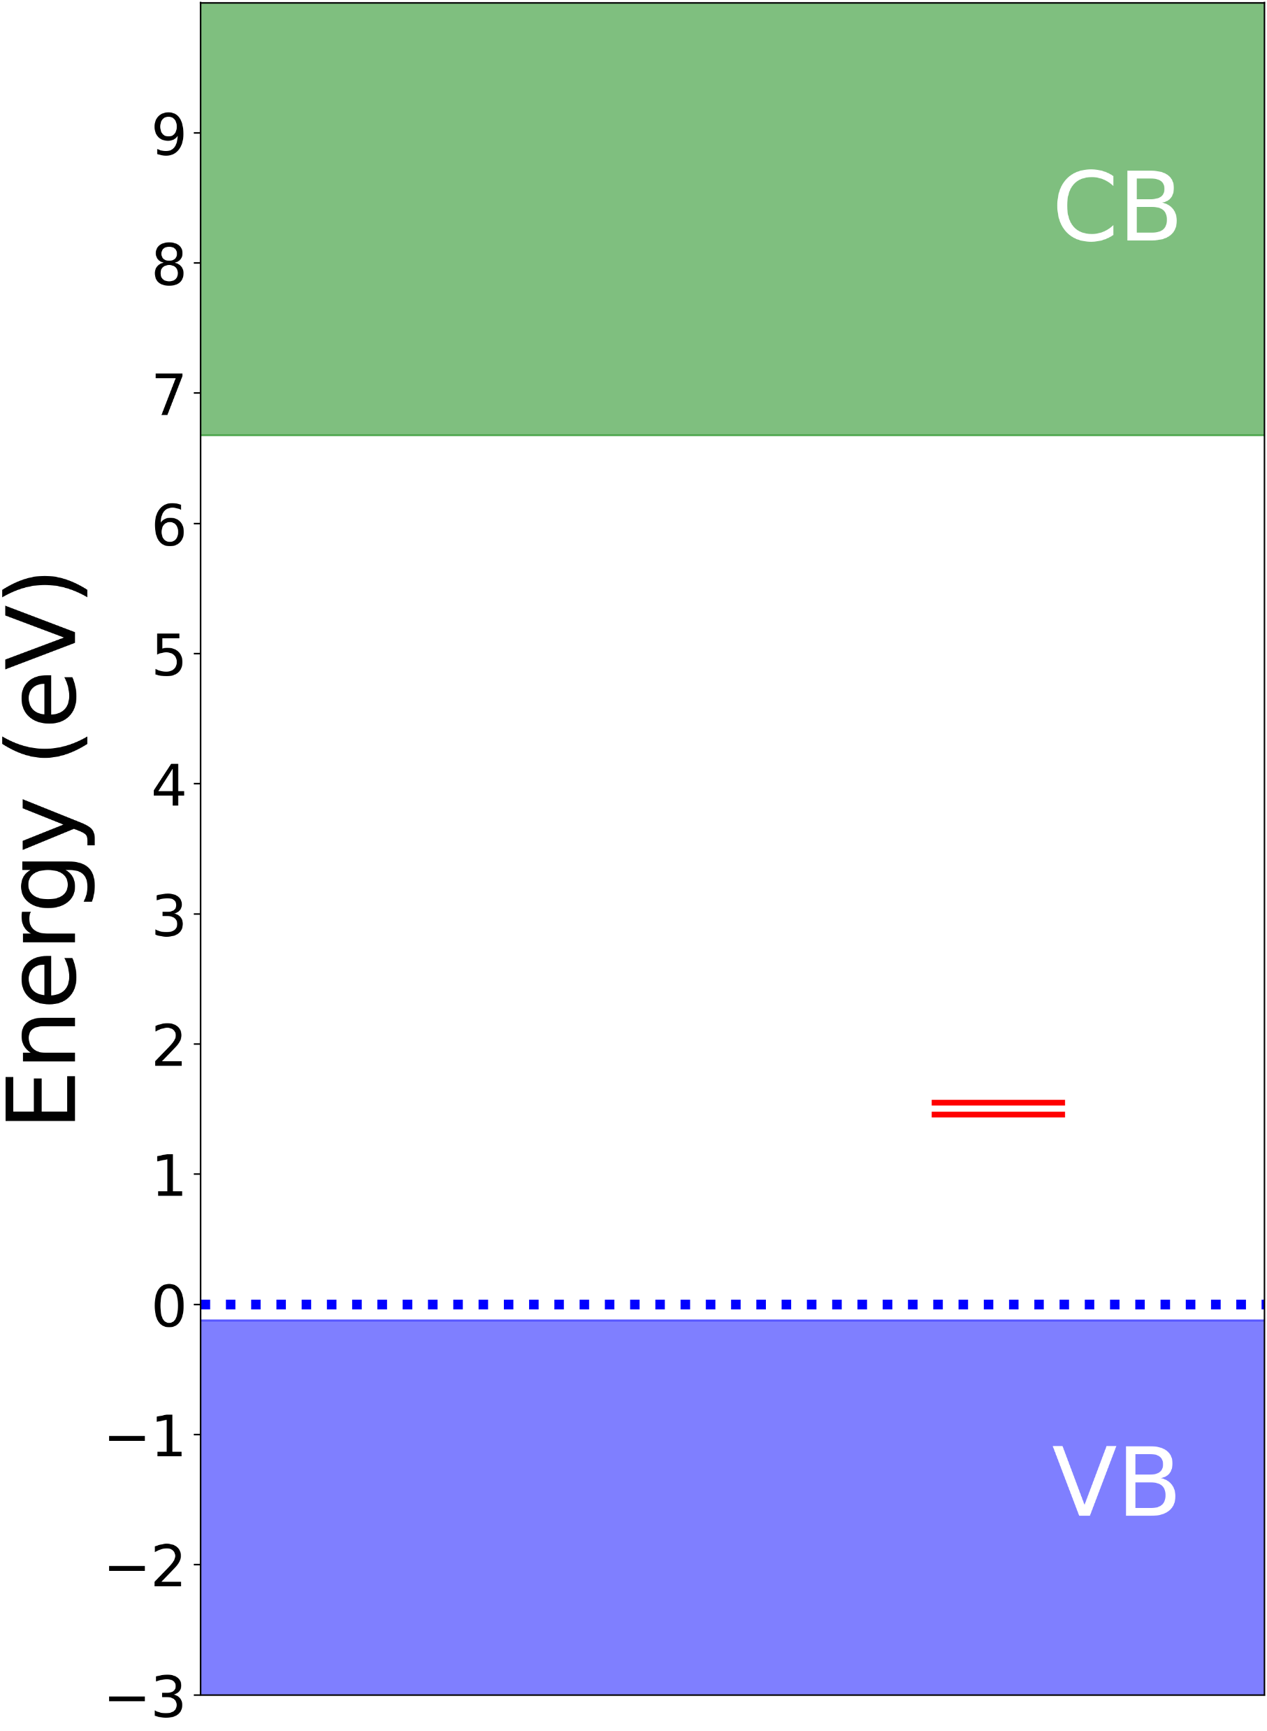
Olivine
Mixture of MgSiO₄ (forsterite) & FeSiO₄ (fayalite). Fayalite is magnetic, so focusing on forsterite
O-vac: (4.45eV/280nm), dim (TDM ~0.05 Debye²)
Si-vac: 4 transitions (2.6-3.6eV), two dark, two dim (TDM ~0.1 Debye²)
Mg-vac: 2 transitions (1.7eV/740nm), 1 very bright!
Natural olivine is a mixture of Mg/Fe – will cause broadening, other effects
O-vac
Si-vac
Mg-vac
MDvDM | Yokohama | May 2025

Slide 37
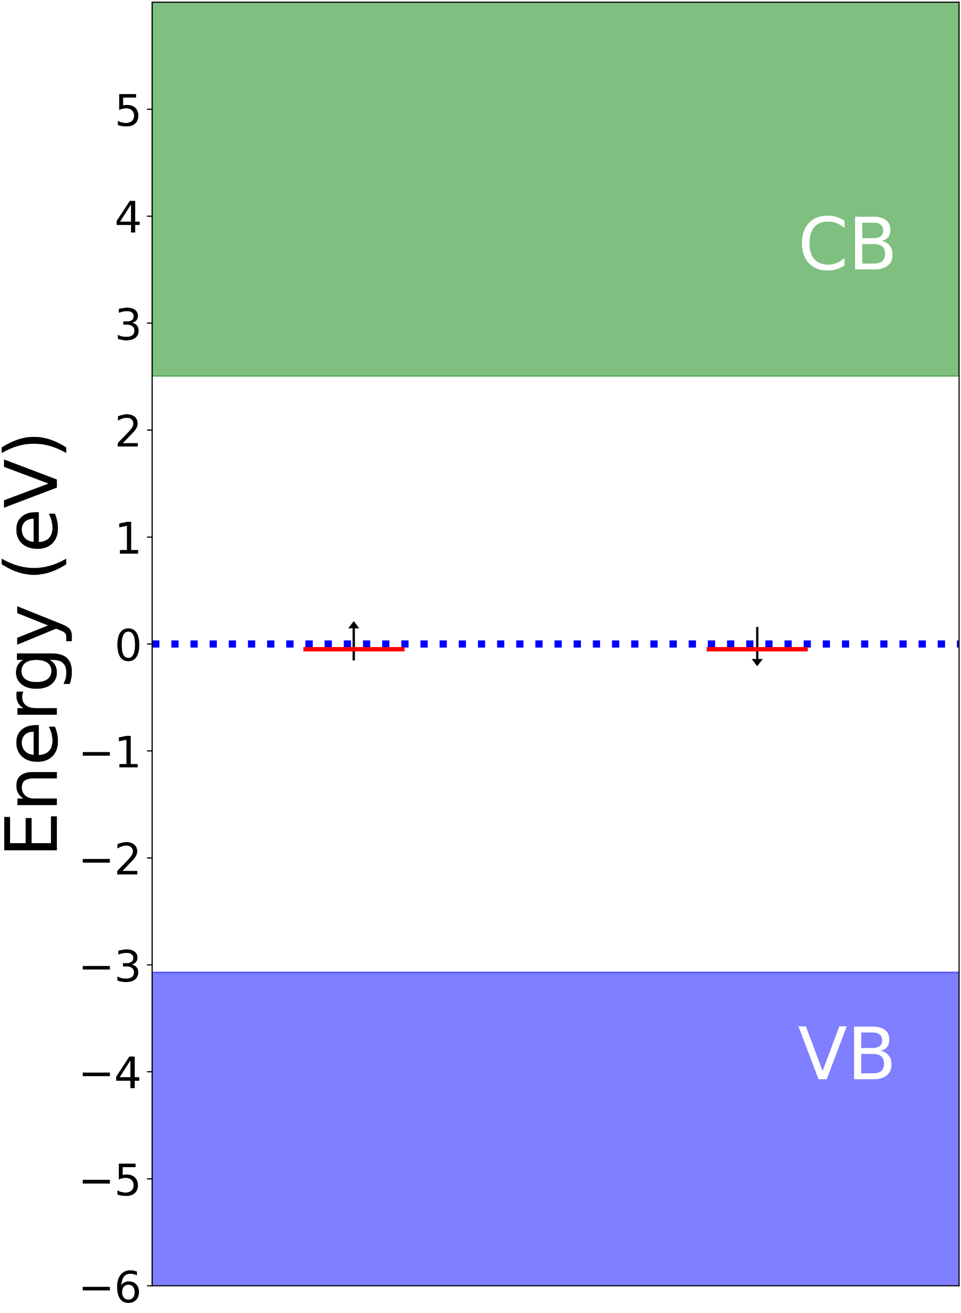
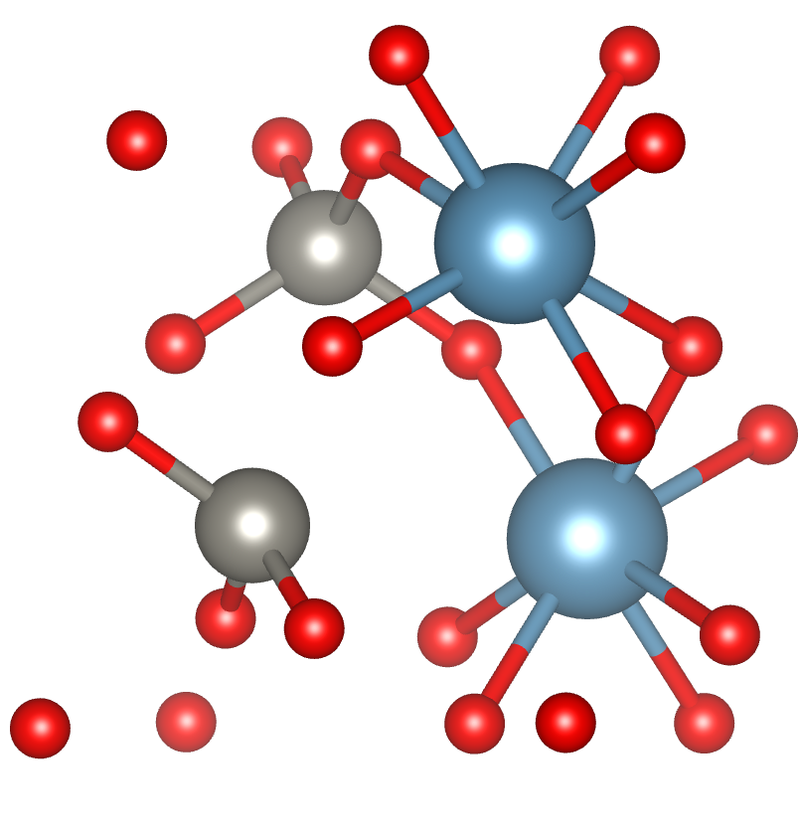
Scheelite (CaWO₄)
Only data for O-vac available:
1 transition (2.55eV/490nm), dim (TDM ~0.1 Debye²)
MDvDM | Yokohama | May 2025

Slide 38
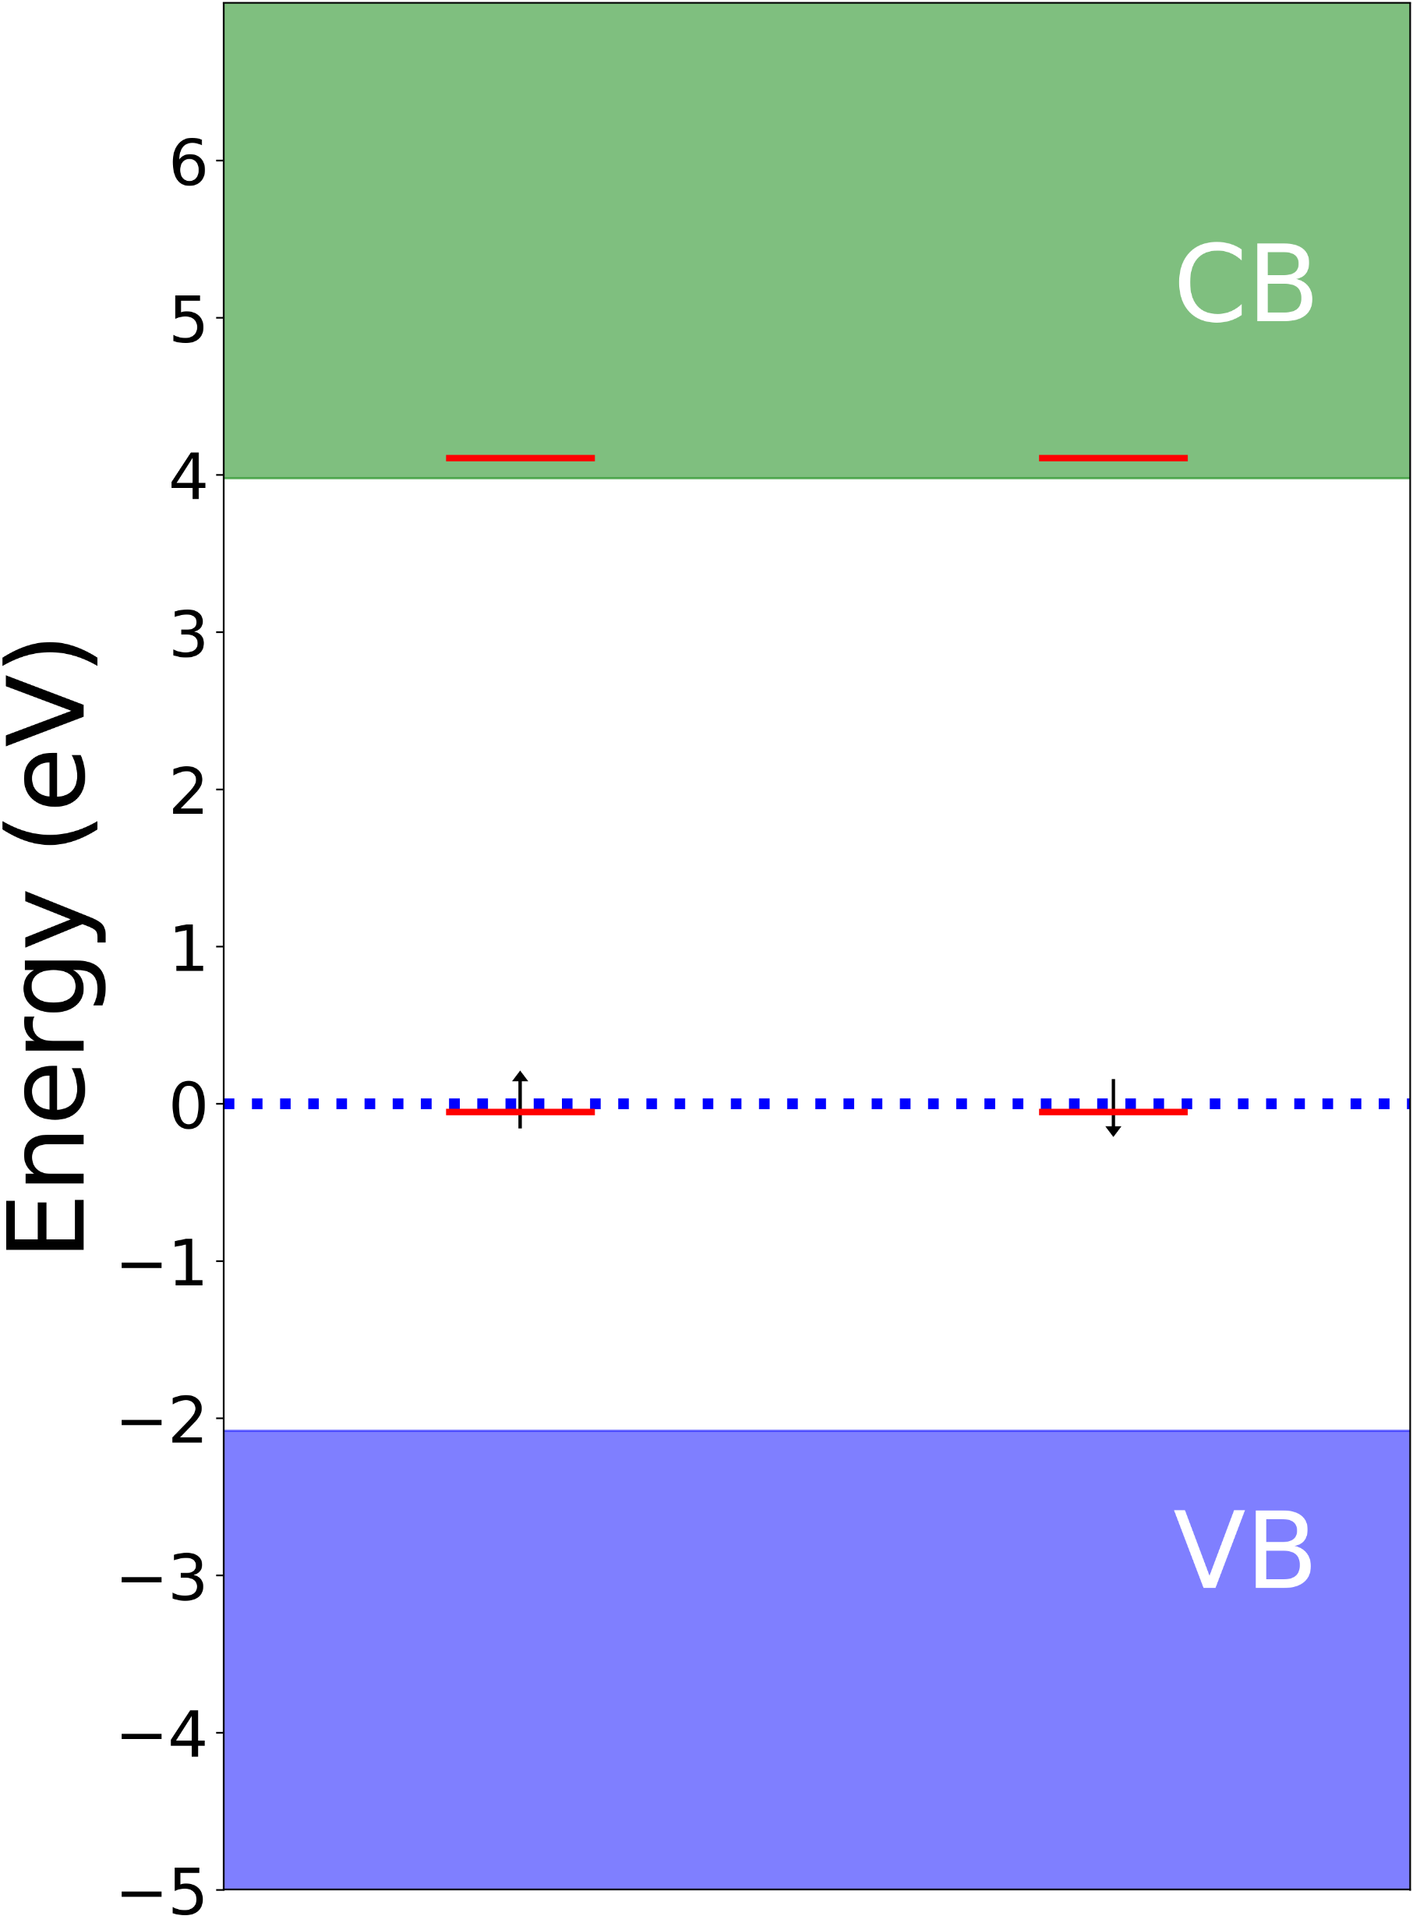
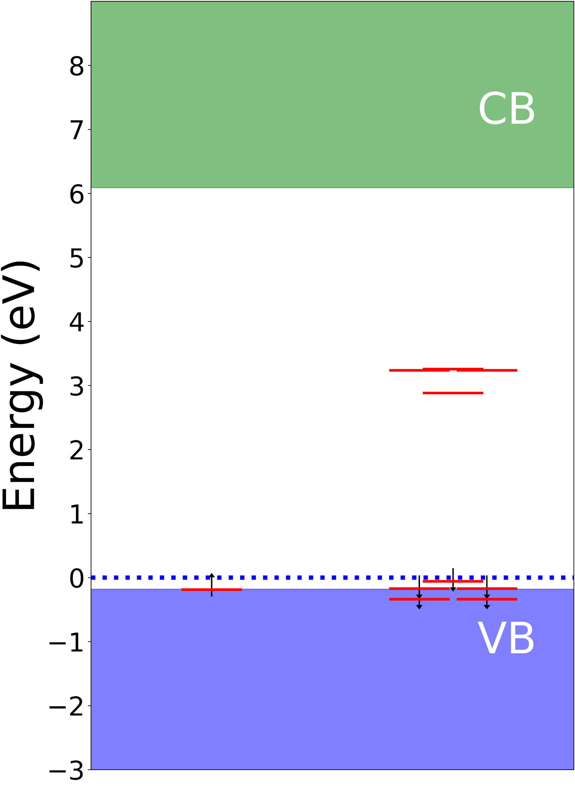
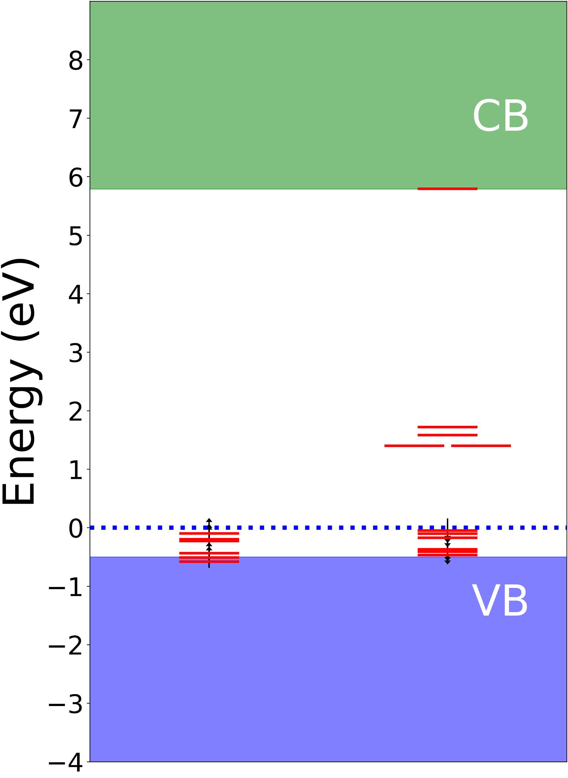
Zircon (ZrSiO₄)
Several defects (Si/Zr are high spin)
O-vac: 1 bright 4eV transition (TDM ~6.5 Debye²)
Si-vac: Several bright transitions 3-3.4eV
Zr-vac: Many transitions 1.4-2.2eV (860-570nm), most moderately bright
O-vac
Si-vac
Zr-vac
MDvDM | Yokohama | May 2025

Slide 39
Mineral Candidate Summary
Mineral Abundant Synth. ≥1 km Low U/Th__ Color Centers (400-700nm)
Olivine (MgSiO₄) ✓ ? ✓ ✓ 2-3/3*
Zircon (ZrSiO₄) ✓ ? ? ✓ 3/3
Corundum (Al₂O₃) ✓ ✓ ? ✓ 0-1/4
Scheelite (CaWO₄) X ✓ ? ✓ 1/1
Comments:
HSE energy level ∆ overestimates ZPL – true transitions will be shifted towards red/IR
For Olivine, effect of solid solution MgSiO4/FeSiO4 needs to be understood
Larger defect clusters/charge states need to be checked
Need to compare with absorption/PL spectra – experimental verification needed!
MDvDM | Yokohama | May 2025

Slide 40
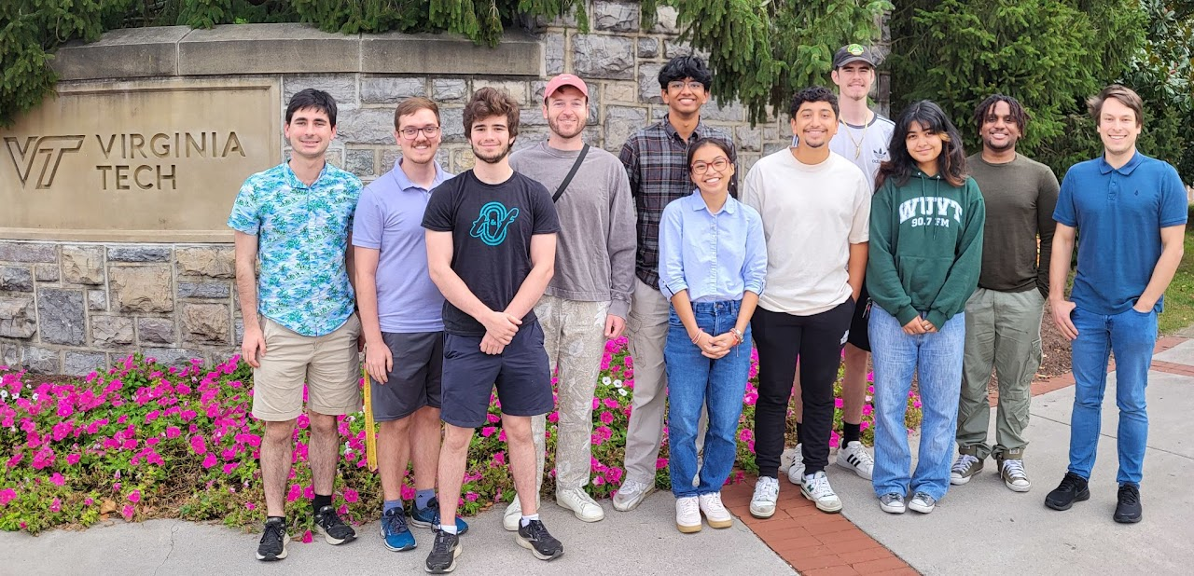
Thanks for Listening!
https://arxiv.org/abs/2412.21060
https://www.condensedmatters.com/
The group!
https://arxiv.org/abs/2503.20732
Thank you Keegan, Giti, Brenden, & Patrick for LiF measurements!
This work is supported by NSF GCR Grant OIA-2428507.
MDvDM | Yokohama | May 2025

