Slide 1
Open Discussion On
Imaging Techniques
----- For DM and Neutrinos Detections
MDvDM-2025, May 20~23, 2025, Yokohama, Japan
Imaging techniques play a key role in DM detections!

Slide 2
Screen copy from Patrick Huber’s talk
Any single imaging technique cannot do the job.

Slide 3
MSE-465
Structural and Chemical Characterizations of Materials
2024 Winter Semester
Department of Materials Science and Engineering, University of Michigan
Notes:
Covering the techniques commonly used in MSE research: Microstructures and Microchemistries

Slide 4
Techniques Covered
Light $↔$Matter interaction: IR/FTIR and Raman, UPS
X-ray $↔$ Matter interaction: XRD, XC, XRM, STXM, XRF, XPS/IPES, and XAS
Neutron $↔$ Matter interaction: ND, NM and NC
Electron $↔$ Matter interaction: SEM, EPMA (WDS) and EDS, CTEM/STEM, RHEED,
REELS and LEED, EC and ET, AES
Tip $↔$ Matter interaction: SPM: STM, AFM, EFM, MFM, etc.
Ion $↔$ Matter interaction: HIM/FIB, SIMS, RBS, ISS or LEIS and APT
Those techniques can be used for: Imaging, Diffraction and Spectroscopy
Techniques not covered: Photoluminescence, Cathodoluminescence, optical profiling, SQUID, ICP-MS etc.

Slide 5
Things Must be Considered for Imaging Techniques
Different “Imaging Techniques”:
Resolution
Structural imaging: Morphology, dimension, --- “Real imaging” or “Direct” imaging
Chemical imaging: Composition, electronic structure, bonding etc., --- “Black-box” imaging
Diffraction imaging: Crystallinity, phase distribution, etc., --- “Black-box” imaging --ptychography
Spatial resolution
Time resolution
Energy/wavelength resolution
Dimension of information
2D or 3D
Sampling volume
Performance
Operational conditions
Destructive or Non-destructive
Accessibility: Easy or difficult to access
Advantages & Limitations
Vacuum, Gas, or Liquid
Atmospheric pressure, or high pressure
Cryo-, RT or High temperature
Static or Dynamic
Is “To see is to believe” always correct?---Image analysis /processing

Slide 6
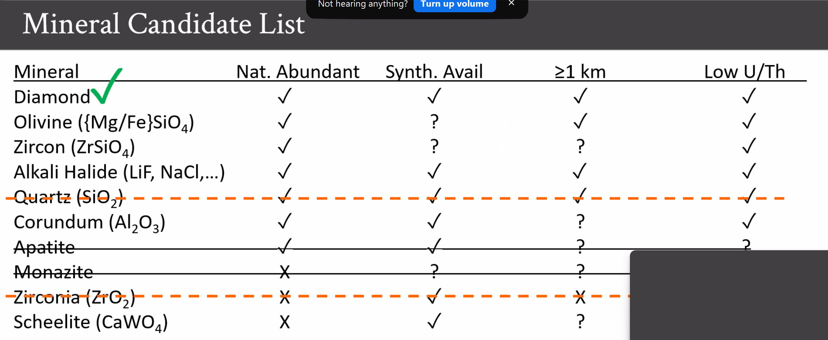
Modified from” Robert J. Bodnar
Dept. of Geosciences
Virginia Tech
Blacksburg, VA 24061
Screen copy from Vsevolod Ivanov’s talk
If you choose to use color-center imaging techniques, you can easily rule out Quartz in the candidate list
Mineral selections: “color-center” vs “tracks”

Slide 7
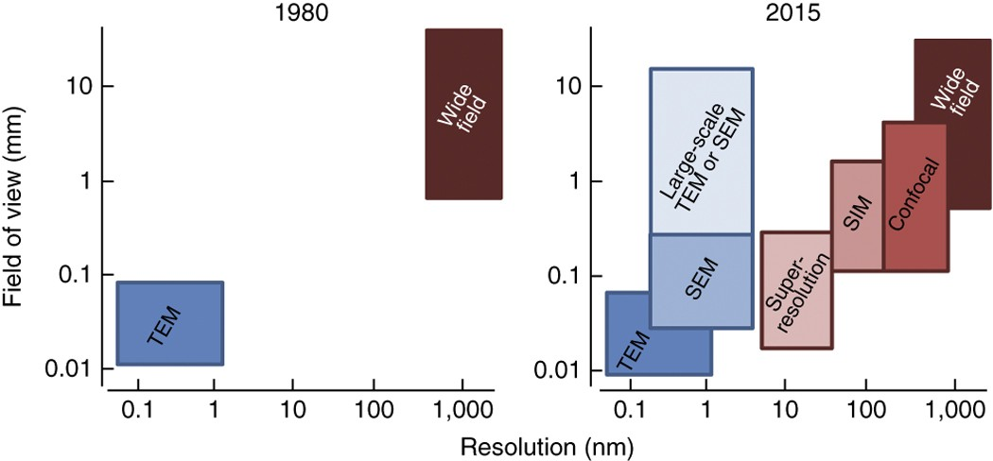
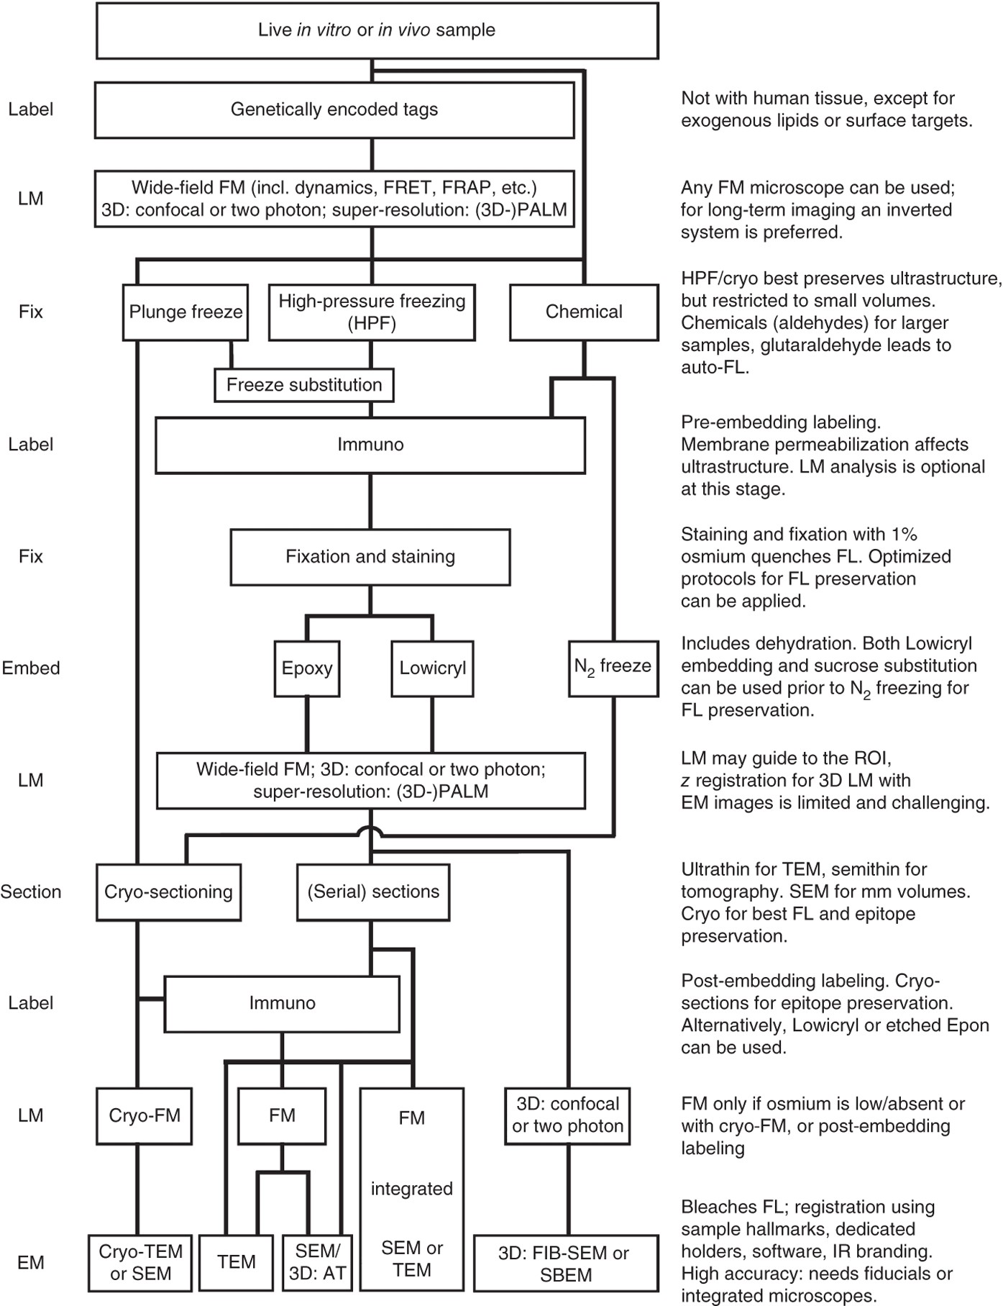
Learning from Biological Science
---Correlated light and electron microscopy (CLEM)
CLEM procedures and considerations
The gap between EM (blue) and FM (red) in lateral dimensions has been filled by increasing the EM field of view, imaged at high resolution, mainly by automation and digitization, and by 'breaking' the FM diffraction limit, resulting in nearly matching scales for CLEM. Note that all FM and EM approaches depicted here can be used for CLEM. SIM, structured illumination microscopy.
CLEM has been pioneered by overlaying fluorescence images on top of the same region imaged by EM
de Boer, P., Hoogenboom, J. & Giepmans, B. Correlated light and electron microscopy: ultrastructure lights up!. Nat Methods 12, 503–513 (2015)

Slide 8
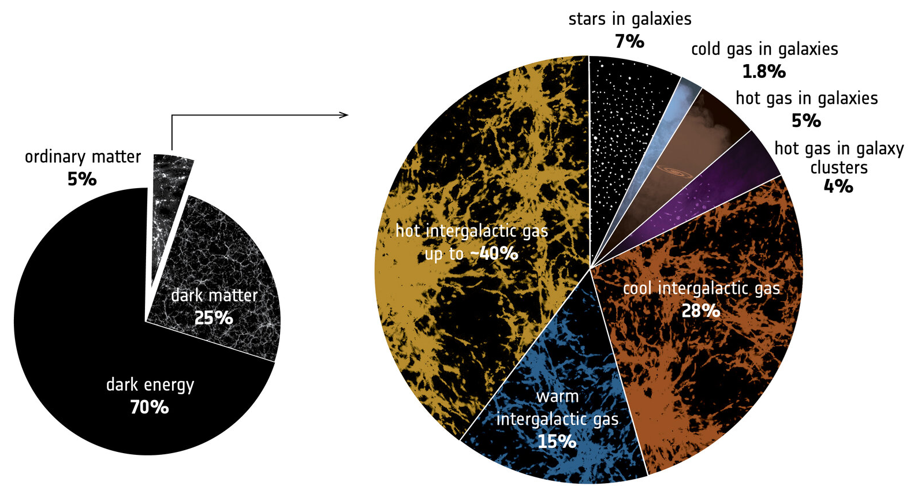
The Cosmic Budget of ‘Ordinary’ Matter
https://www.esa.int/ESA_Multimedia/Images/2018/06/The_cosmic_budget_of_ordinary_matter
Question: Can DM/DE be different states or different materials like “ordinary” matter? (WIMP, Q-Ball (Ayuki Kamada’s talk), Heavy charged DMs (Samuel Wong’s talk), and Many others)
Then, what techniques can be used for detecting those new DMs?
We may also think of ML and AI in data acquisition and analysis like Cloudio Galelli is doing

