Slide 1
Main sensor I-V measurements before and after irradiation
Bojan Hiti
HGTD Week, CERN
2 February 2026

Slide 2
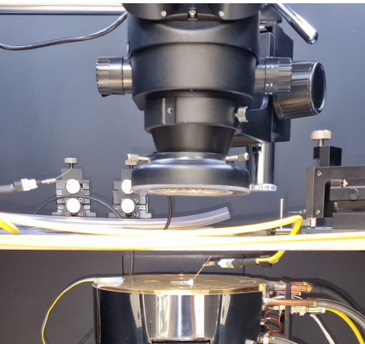
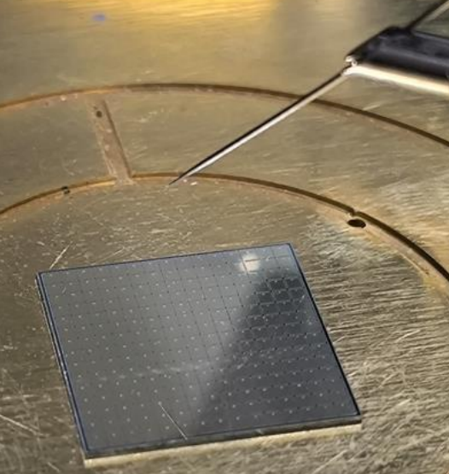
Introduction
Single bias voltage per HGTD module requires uniform sensor evolution with irradiation
In this study: measurement of leakage current in 15 x 15 main sensors after irradiation (irradiated SQC)
Measurement of per pad I-V (225 per sensor)
Determine breakdown voltage and leakage current at operating conditions
Measurements with an automatic probe station (1 sensor per day)
  Single pad contacted by probe needle
  Neighbor pads and guard ring floating
  Ambient temperature (25 °C), T is monitored and current scaling to 20 °C

Slide 3
Samples and irradiations
Pilot batch (batch 4) main sensors tested before irradiation:
  Class A (within HGTD specs)
  Class B1 (Vbd < 165 V)
  Class B2 (I_{pad,max} / I_{pad,min} > 3)
  Classes based on IME measurements on wafer before dicing (quoting Vbd from IME)
1A + 1 B1 + 2 B2 Four sensors irradiated with neutrons to 1e14:
  1 x A: W9-4 (Vbd 178.4 V)
  1 x B1: W5-3 (153.4 V)
  2x B2: W19-2 (183 V), W19-35 (179 V)
  Annealed 80 min at 60 °C
Irradiation in a central reactor channel → Expecting minimal fluence gradients

Slide 4
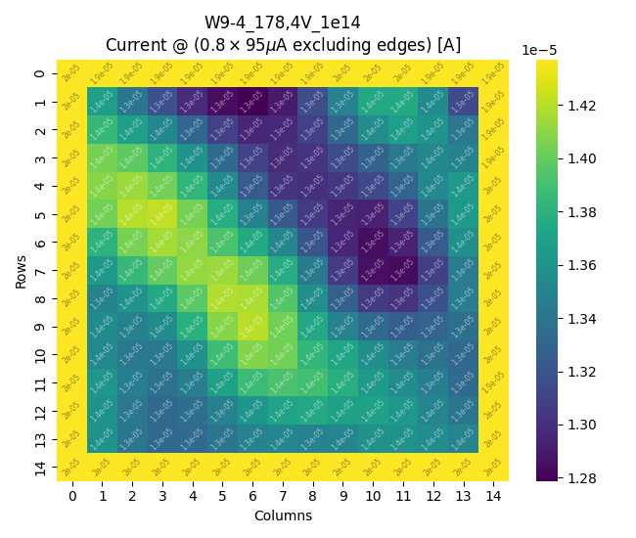
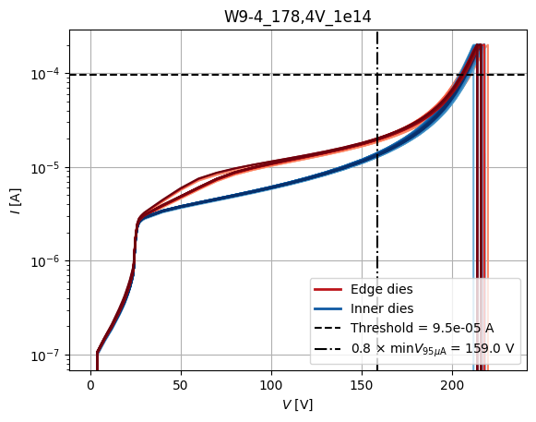
Measurement method
225 single pad I-V curves
V_{bd} = V_{95µA}
I = 95 µA
V = 0.8 × V_{95µA, min}
Also monitoring current
at 0.8 sensor V_{bd} – inner 13 × 13 pads
  Outside pads have a higher current
  (no guard ring)
Pad V_{bd} definition: current exceeds:
  500 nA before irradiation
  95 µA after irradiation
Sensor V_{bd}:
  minimal pad V_{bd}
  Labelled V_{500nA,min} or V_{95µA,min}
High leakage current at ambient (100 µA/pad, potential thermal runaway) → Cooling implementation ongoing

Slide 5
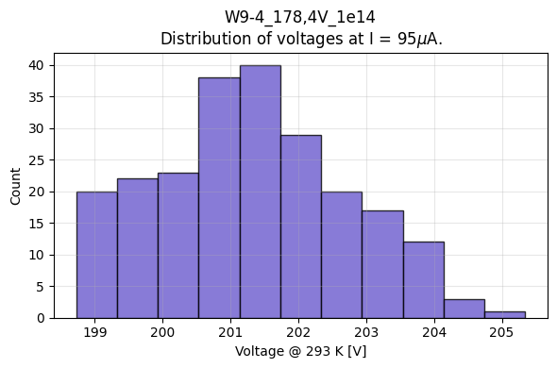
Results class A 1e14 (W9-4, 178.4 V)
T ≈ 25 °C
outer ring
V_{95µA} = (201.4 ± 1.4) V (min-to-max 6.6 V)
unirradiated V_{500nA} = (186.1 ± 1.3) V (min-max 6.6 V)
Current at 0.8 × V_{95µA,min} : (13.5 ± 0.3) µA (min-to-max 7.5 µA, 1.4 µA without outer ring)
unirradiated: (12.3 ± 1.1) nA (min-max 33 nA / 4.0 nA without outer ring)

Slide 6
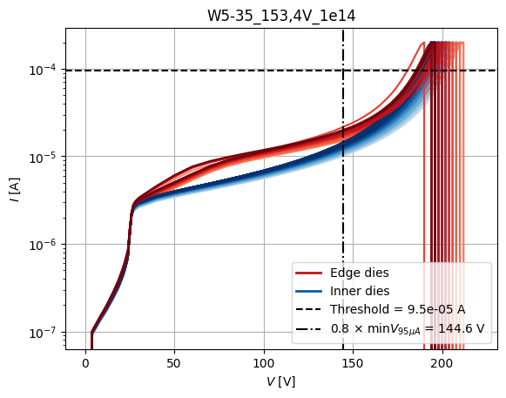
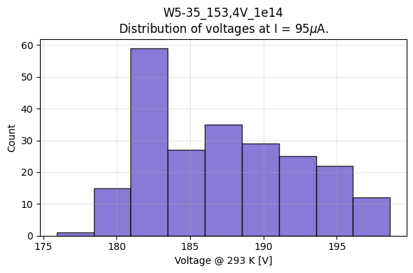
Results class B1 1e14 (W5-35, 153.4 V)
T = 20 °C
outer ring
V_{95µA} = (187.1 ± 5.2) V (min-to-max 22.7 V)
unirradiated V_{500nA} = (168.6 ± 5.2) V (min-max 18.7 V)
Current at 0.8 × V_{95µA,min} : (12.7 ± 1.3) µA (min-to-max 11.6 µA, 4.3 µA without outer ring)
unirradiated: (13 ± 2) nA (min-max 116 nA / 8 nA without outer ring)

Slide 7
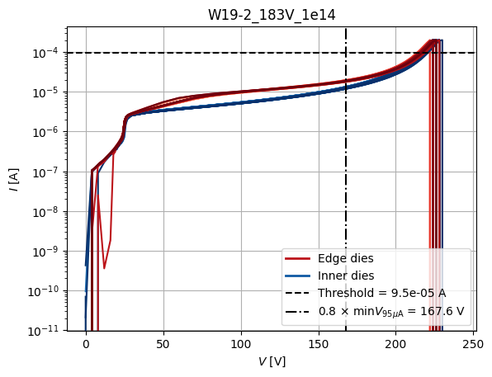
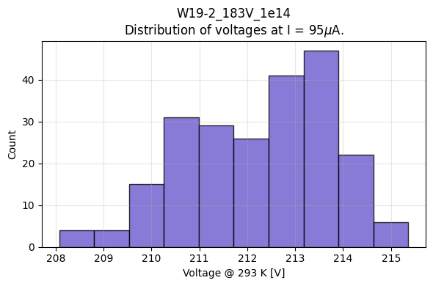
Results class B2 1e14 (W19-2, 183 V)
T = 20 °C
outer ring
V_{95µA} = (212.3 ± 1.5) V (min-to-max 7.3 V)
unirradiated V_{500nA} = (194.9 ± 1.4) V (min-max 6.9 V)
Current at 0.8 × V_{95µA,min} : (12.7 ± 0.3) µA (min-to-max 7.8 µA, 1.6 µA without outer ring)
unirradiated: (14 ± 2) nA (min-max 54 nA / 5 nA without outer ring)

Slide 8
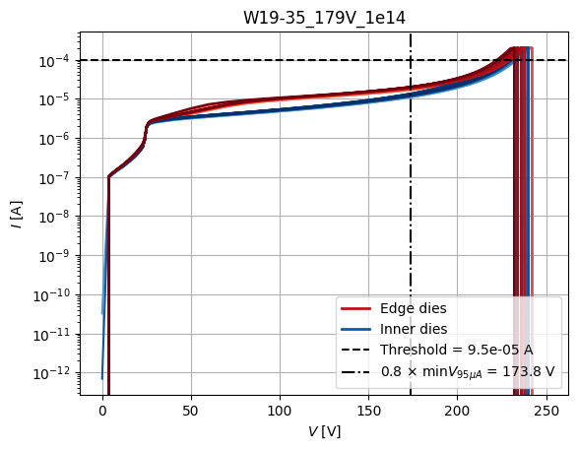
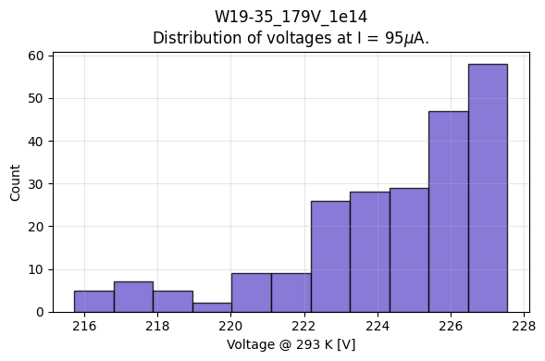
Results class B2 1e14 (W19-35, 179 V)
T = 20 °C
outer ring
V_{95µA} = (224.3 ± 2.7) V (min-to-max 11.8 V)
unirradiated V_{500nA} = (207.7 ± 2.7) V (min-max 11.5 V)
Current at 0.8 × V_{95µA,min} : (11.7 ± 0.6) µA (min-to-max 9.3 µA, 2.7 µA without outer ring)
unirradiated: (11 ± 2) nA (min-max 46 nA / 6 nA without outer ring)

Slide 9
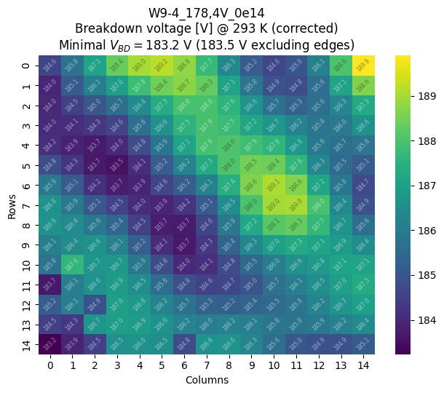
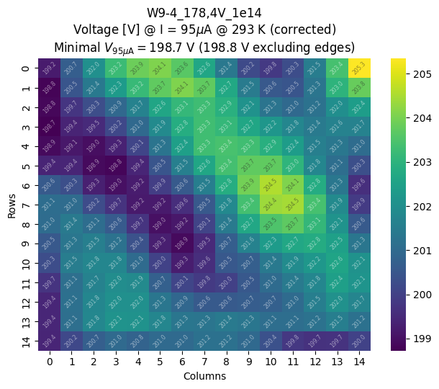
Example: Vbd before and after irradiation W9-4 (class A)
V_{500nA}
V_{95µA}
before irradiation
1e14n
features preserved after 1e14
similar on all four samples

Slide 10
Bonus: first cold measurement (–10 °C)

Slide 11
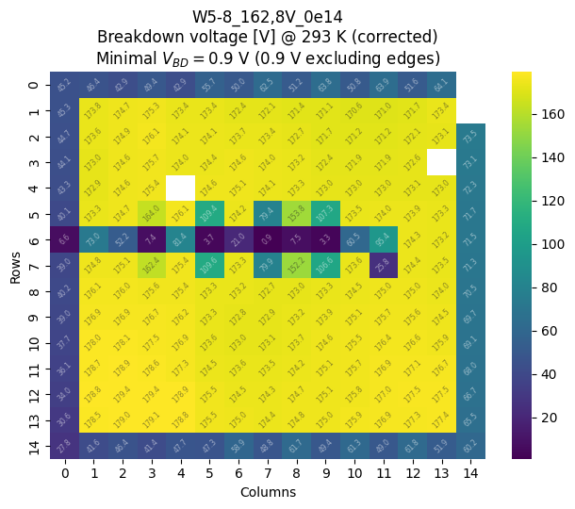
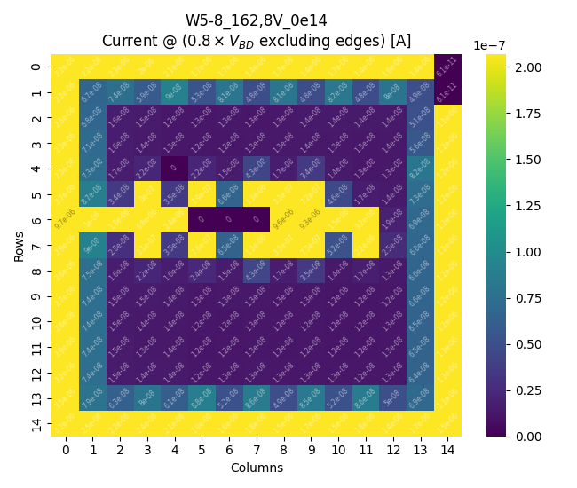
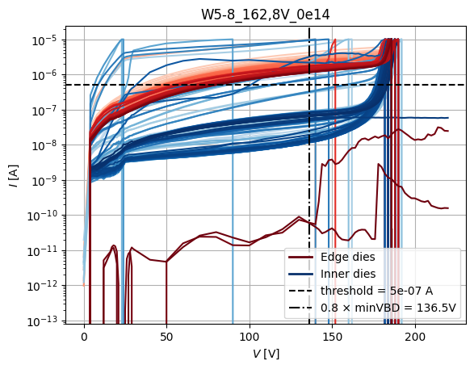
W5-8 (B1 162.8 V) – damaged, unirradiated
Sample scratched across multiple pads before irradiation

Slide 12
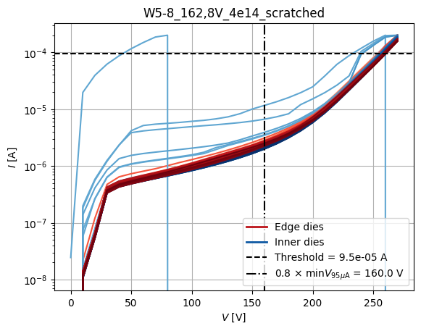
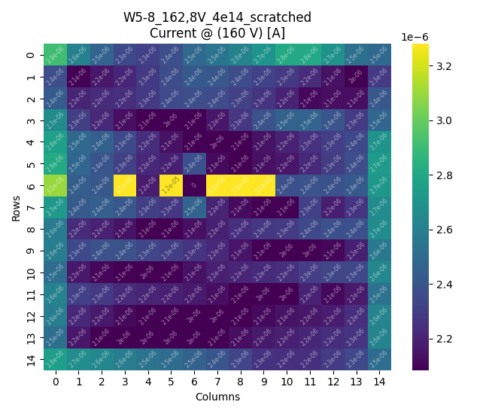
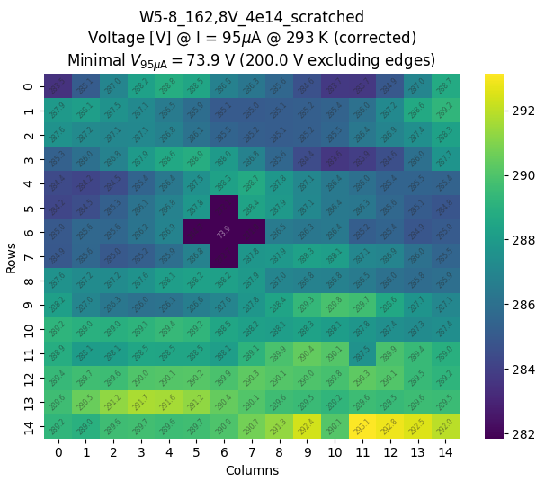
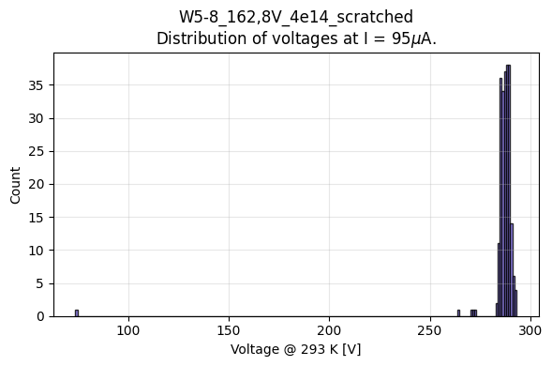
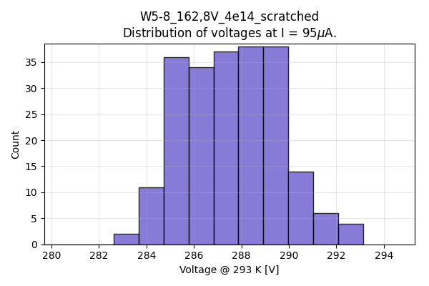
W5-8 (B1 162.8 V) – damaged, 4e14n
Sample irradiated to 4e14, SQC measured at –10 °C
Only the most damaged pads are still outliers, others pads behave as undamaged ones
  Three pads have high current and early breakdown
  Three pads have higher current at 160 V, but breakdown not affected
  Two pads slightly lower current, but earlier breakdown
Performance becomes more uniform with irradiation
Scaled to 20 °C
V_{95µA} = (288 ± 3) V

Slide 13
Summary
SQC-like tests done on main sensors after low irradiation (1e14n)
  1xA, 1xB1, 2xB2 from the production pilot batch (B4)
High leakage current at ambient conditions (100 µA/pad)
  Cooling system under implementation
Features across the sensor remain very similar as before irradiation
  Vbd gradient, Vbd spread are the same
Breakdown voltage increases by 15–20 V after 1e14
  (using working definitions V_{bd} = V_{500nA,min} / V_{95µA,min})

Slide 14
Backup

Slide 15
Example: Leakage current after 1e14 (W9-4, class A)
Current in the outer pads increases due to collection from outside of the matrix (guard ring is not connected)
Quoted leakage current is for inner 13 x 13 pads
Current at 0.8 × V_{95µA,min} : (13.5 ± 0.3) µA (7.5 µA peak-to-peak)

Slide 16
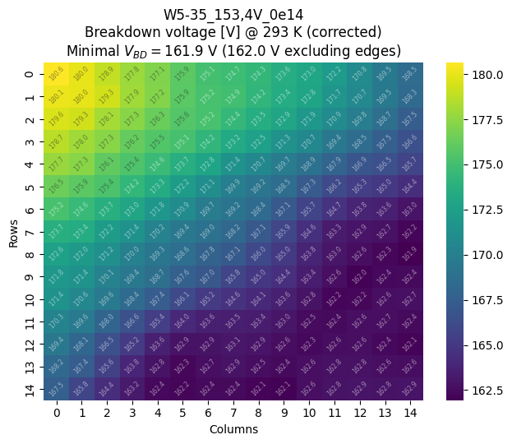
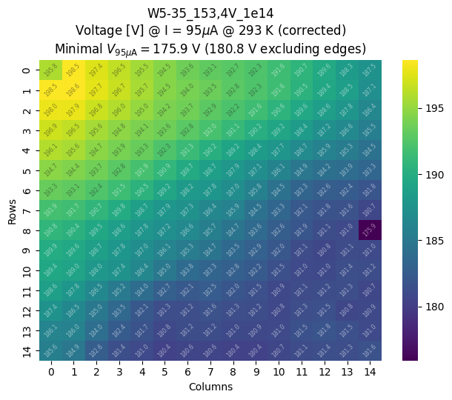
Example: Vbd before and after irradiation W5-35 (class B1)
V_{500nA}
V_{95µA}
before irradiation
1e14n
row0col0 and row8col14 tested individually before the main measurement and have “memory” – outlying Vbd which remains with retesting

Slide 17
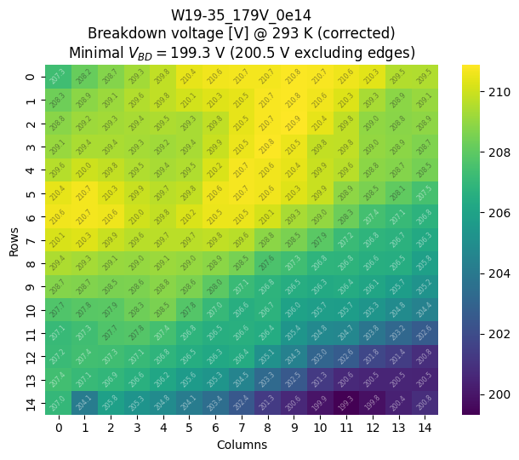
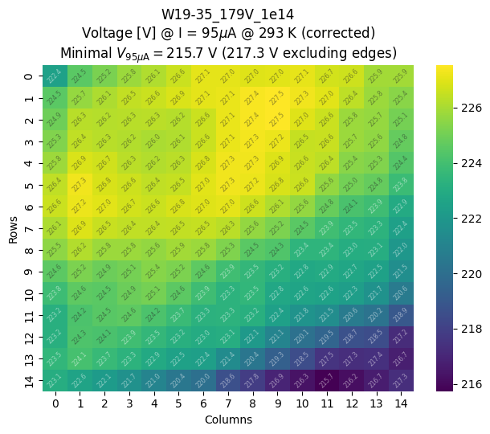
Example: Vbd before and after irradiation W19-35 (class B2)
V_{500nA}
V_{95µA}
before irradiation
1e14n
features preserved after 1e14
similar on all four samples

Slide 18
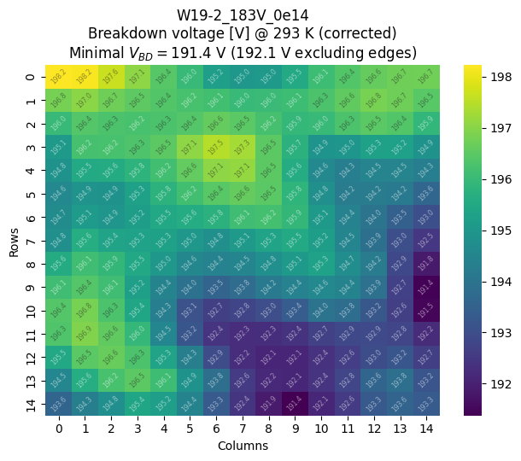
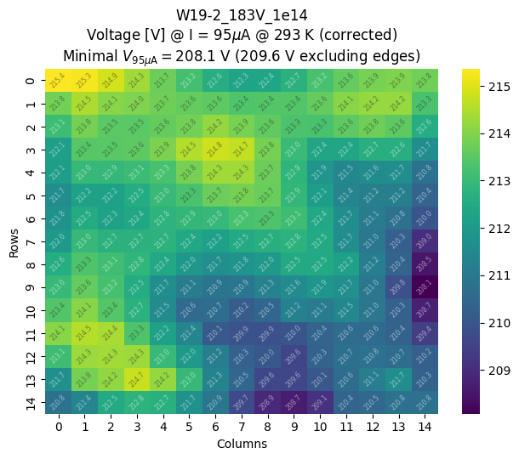
Example: Vbd before and after irradiation W19-2 (class B2)
V_{500nA}
V_{95µA}
before irradiation
1e14n
features preserved after 1e14
similar on all four samples

