Slide 1
TPA-TCT at IJS
Ajda Osterman
Mentor: dr. Bojan Hiti
6. 2. 2026

Slide 2
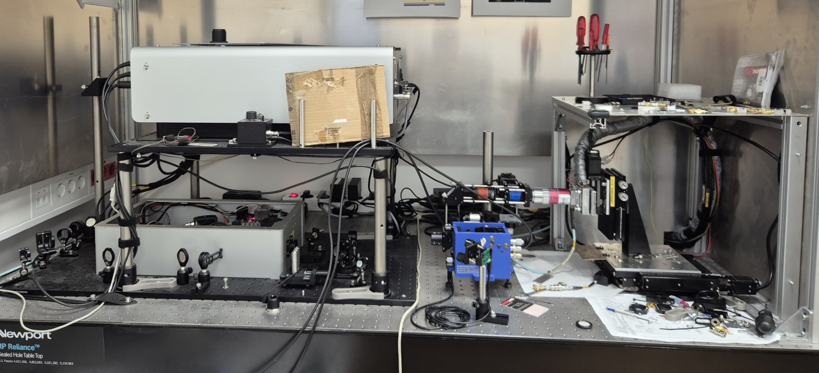
Setup
TPA laser, λ = 1550 nm
DUTs: W317, CNM W7-16-U; n = 3.48

Slide 3
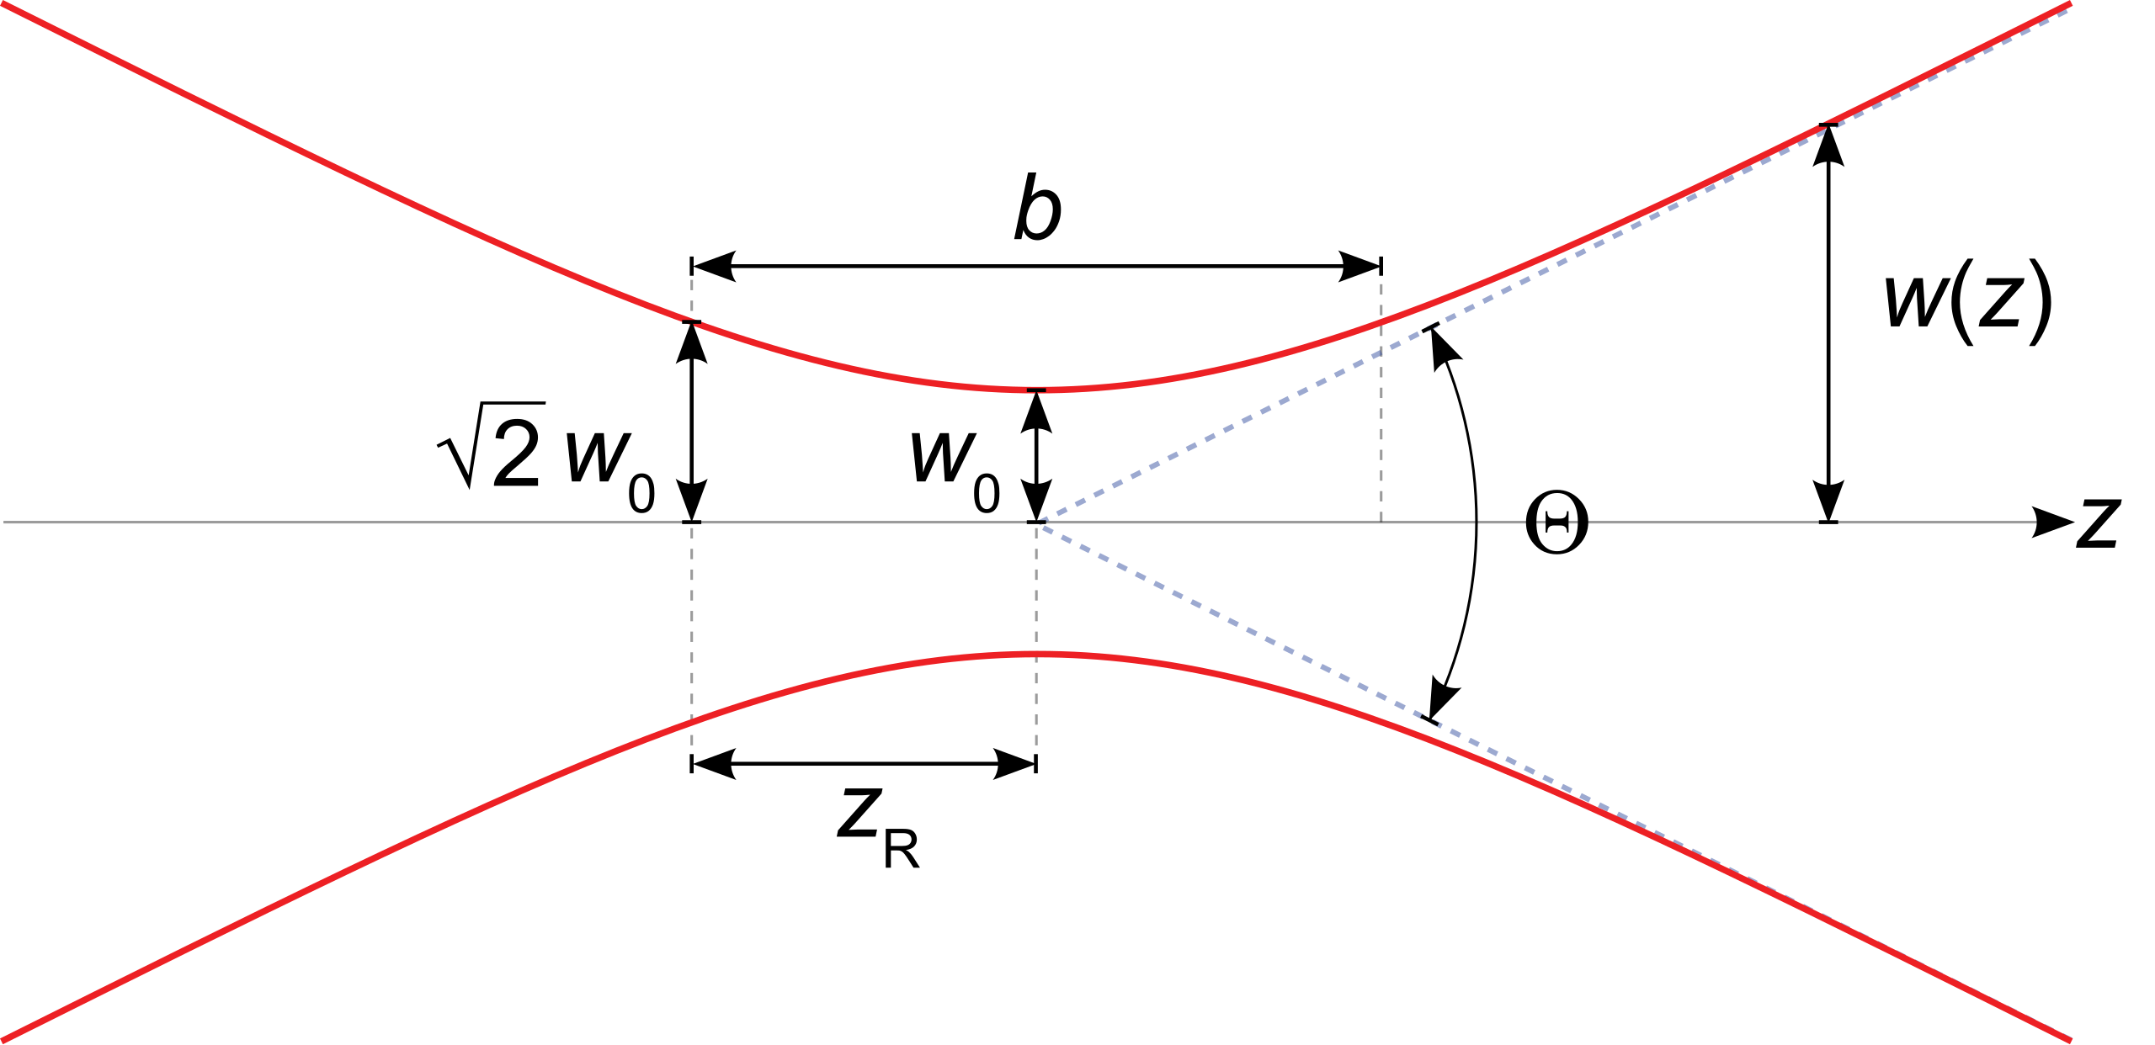
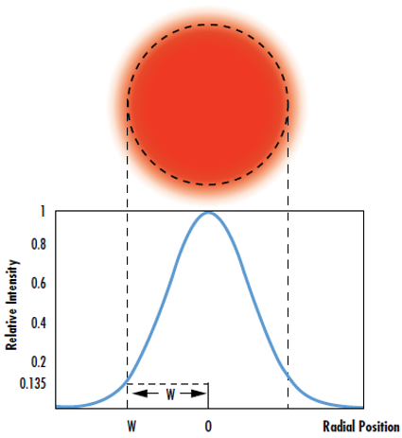

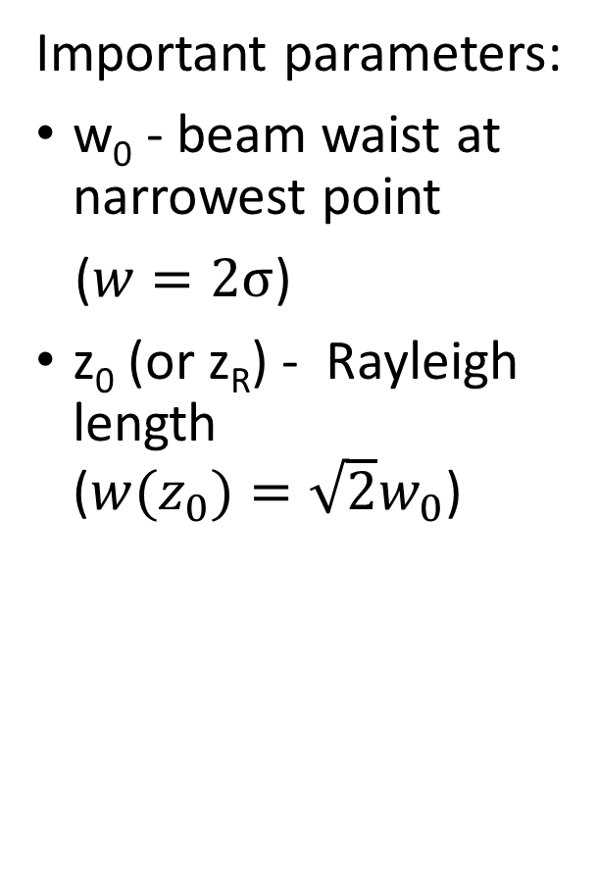
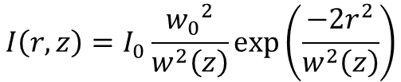
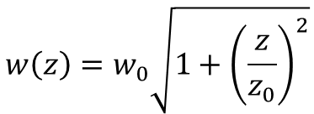
Gaussian beam
Important parameters:
w₀ - beam waist at narrowest point
($w=2σ$)
z₀ (or z_{R}) - Rayleigh length ($w(z_{0})=\sqrt{2}w_{0}$)
$$I\left(r,z\right)=I_{0}\frac{{w_{0}}^{2}}{w^{2}\left(z\right)}exp\left(\frac{−2r^{2}}{w^{2}\left(z\right)}\right)$$
$$w\left(z\right)=w_{0}\sqrt{1+{\left(\frac{z}{z_{0}}\right)}^{2}}$$
$$z_{0}=\frac{πw_{0}^{2}n}{λ}$$

Slide 4
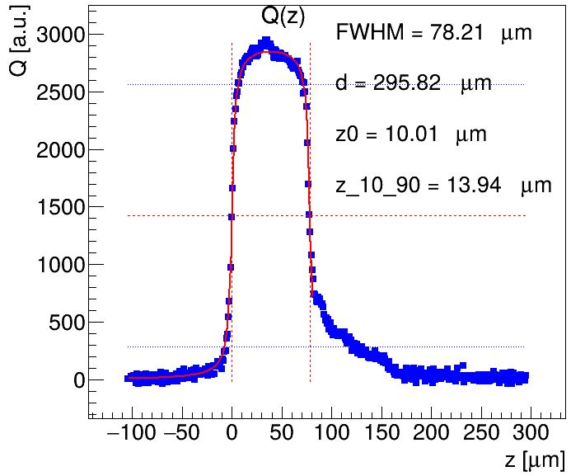

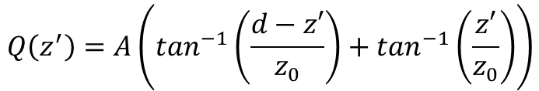
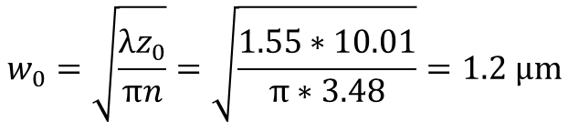
Z scan
Fit function:
Calculated w₀:
$$Q\left(z^{′}\right)=A\left(\tan^{−1}\left(\frac{d−z′}{z_{0}}\right)+\tan^{−1}\left(\frac{z′}{z_{0}}\right)\right)$$
$$z^{′}=z\sqrt{\frac{z_{0}πn^{3}}{z_{0}πn−λn^{2}+λ}}$$
$$w_{0}=\sqrt{\frac{λz_{0}}{πn}}=\sqrt{\frac{1.55∗10.01}{π∗3.48}}=1.2 μm$$
DUT: CNM W7-16-U (d = 280 μm)

Slide 5
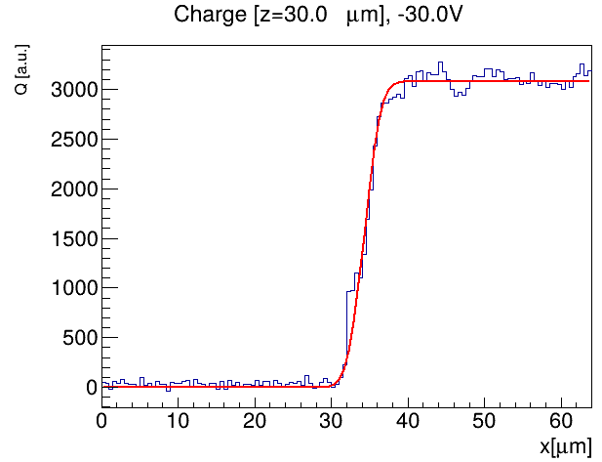
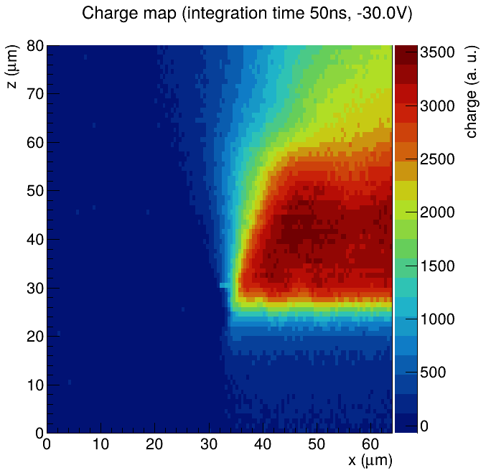
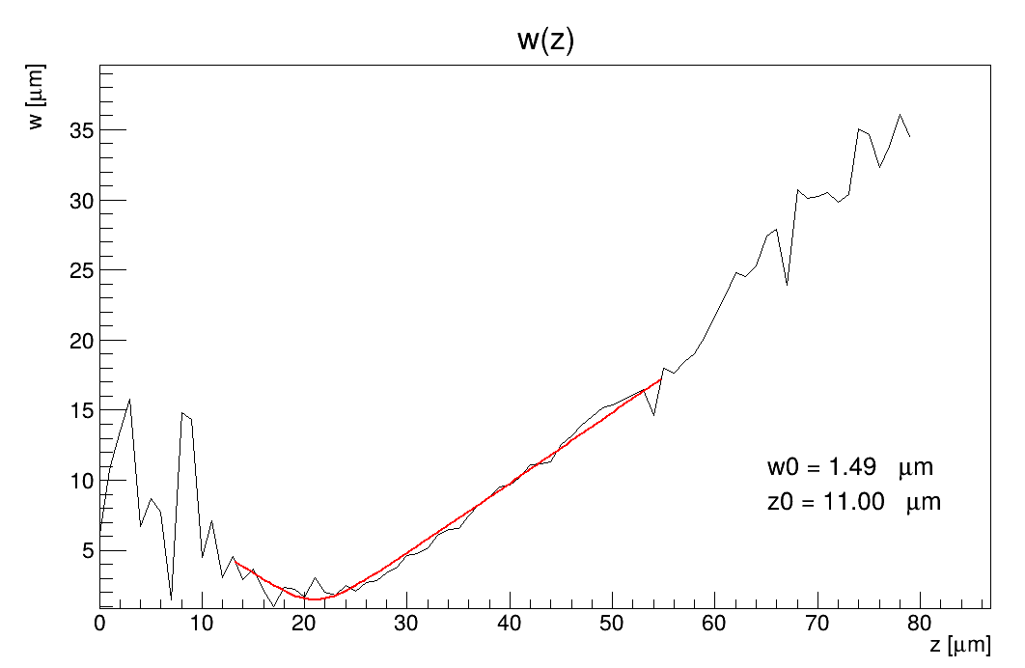
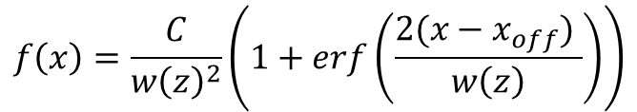

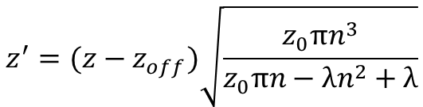
X-Z scan
Fit f(x) for each z → get w(z)
Fit w(z’)
$$f\left(x\right)=\frac{C}{{w\left(z\right)}^{2}}\left(1+erf\left(\frac{2(x−x_{off}) }{w\left(z\right)}\right)\right)$$
$$w\left(z′\right)=w_{0}\sqrt{1+{\left(\frac{z′}{z_{0}}\right)}^{2}}$$
$$z^{′}=(z−z_{off})\sqrt{\frac{z_{0}πn^{3}}{z_{0}πn−λn^{2}+λ}}$$
DUT: W317
Calculated w₀ = 1.3 μm

Slide 6
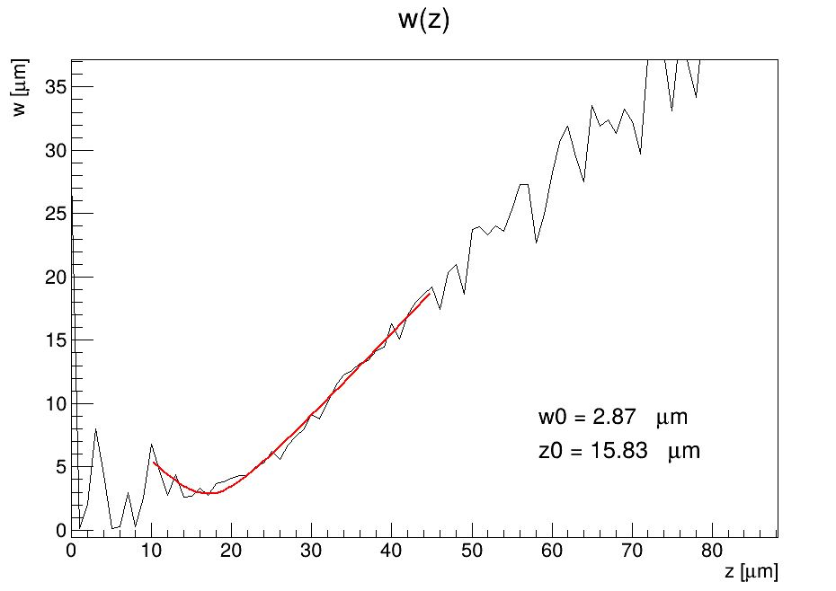
X-Z scan - CNM
Calculated w₀ = 1.5 μm
DUT: CNM W7-16-U

Slide 7
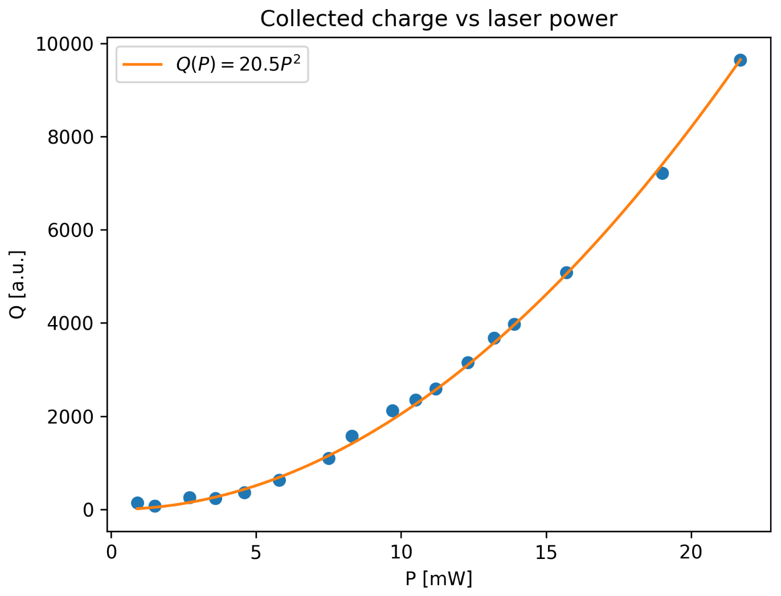
Collected charge vs laser power
TPA: Q ∝ I²

Slide 8
Thank you for your attention.

Slide 9

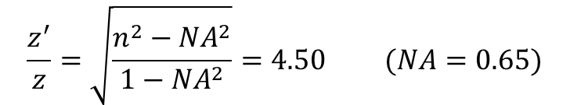
$$E(r,z,t)=E_{0}\frac{w_{0}}{w\left(z\right)}exp\left(ikz−iωt\right)exp\left(\frac{−r^{2}}{w^{2}\left(z\right)}\right)exp\left(\frac{ikr^{2}}{2R\left(z\right)}\right)exp(−iη)$$
Gaussian beam:
z’/z:
$\frac{z^{′}}{z}=\sqrt{\frac{z_{0}πn^{3}}{z_{0}πn−λn^{2}+λ}}=3.54 (z_{0}=11$ $μm)$
$$\frac{z^{′}}{z}=\sqrt{\frac{n^{2}−{NA}^{2}}{1−{NA}^{2}}}=4.50 (NA=0.65)$$

Slide 10
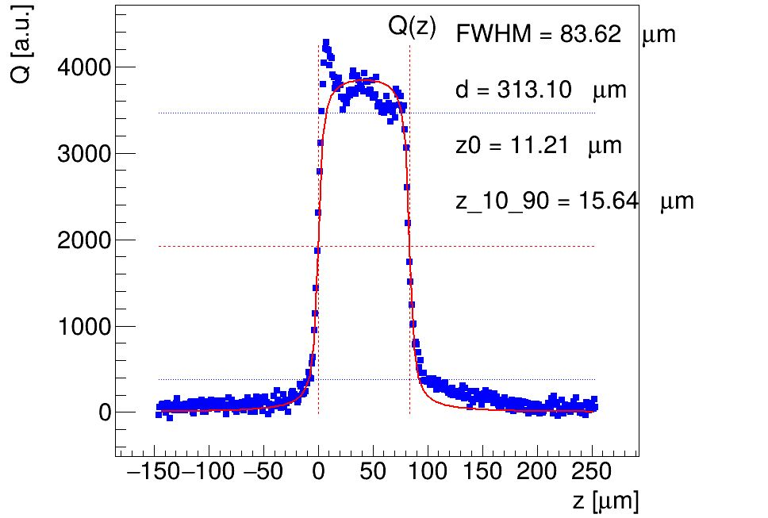
CNM W7-16-U
W317

