Slide 1
Measurements with a heavily annealed production QC-TS
Bojan Hiti on behalf of jsi group
HGTD Sensor meeting, 2 march 2026

Slide 2
Samples
Annealed at 40 °C for 80–120 kmin (2 – 3 months)
  Pilot batch
  B4-10-5, B4-16-5 → tested with Sr90
  B4-13-5 → todo
These samples have been used for C-V tests by Brigita
Bonded 1x1 LGAD + Guard Ring
  Large noise + breakdowns observed without GR starting at -200 V
    This probably also happens in TCT

Slide 3
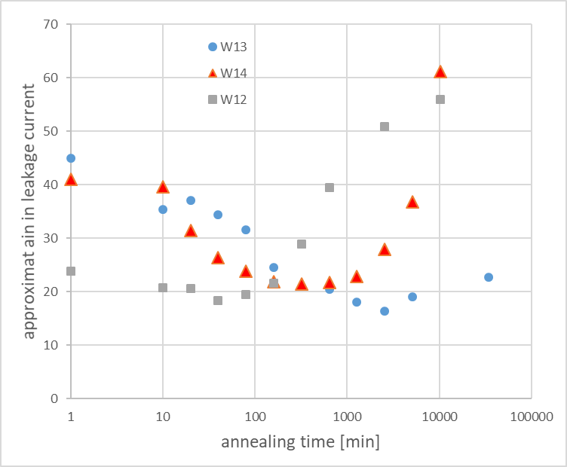
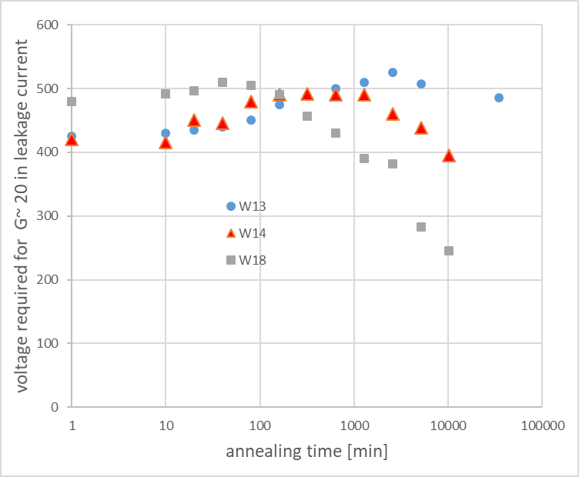
Annealing at different temperatures
G. Kramberger, HGTD week Feb 2026
Gain at 500 V vs time
Voltage required for G~ 20 vs time
(40ºC)
(60ºC)
(80ºC)
(40ºC)
(60ºC)
(80ºC)
Measured at 20ºC and 500 V
Measured at 20ºC and 500 V
around an order of magnitude difference in time constants (similar to long term reverse annealing of N_{eff})
sanity check: G_{I}=20 corresponds to G_{Q}=10 is around ~6 fC

Slide 4
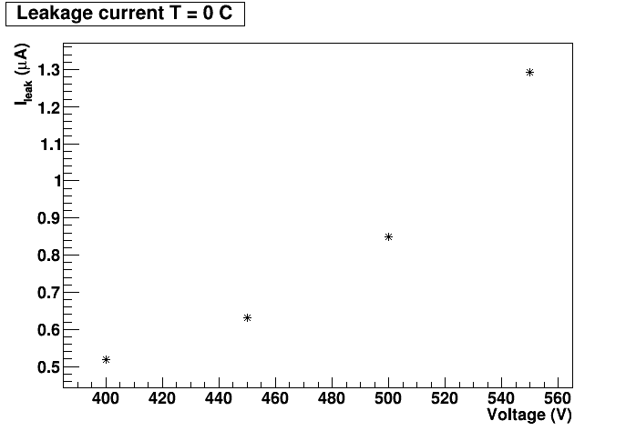
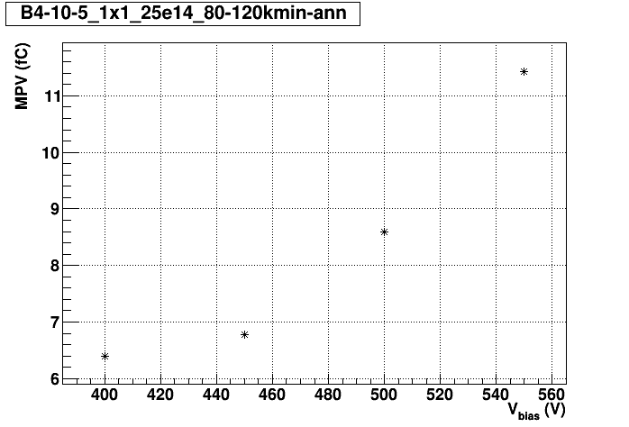

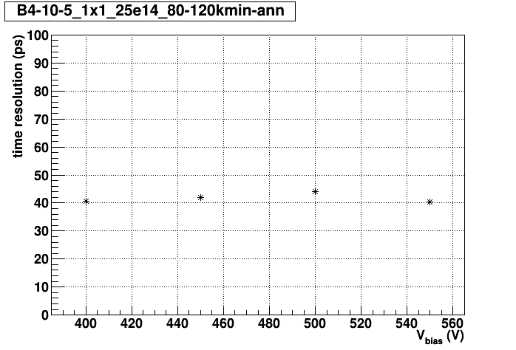
B4-10-5 (“worse performance”)
T = [-31, -30] °C
0.1 µA/fC

Slide 5
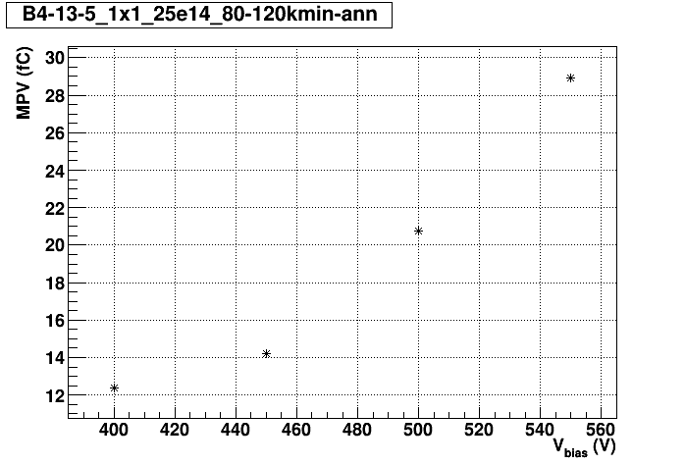
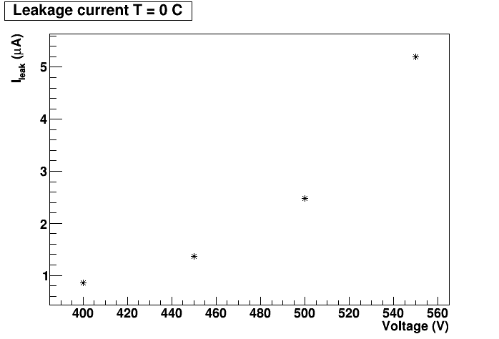


B4-13-5
T = [-29, -28] °C
< 0.1 µA/fC

Slide 6
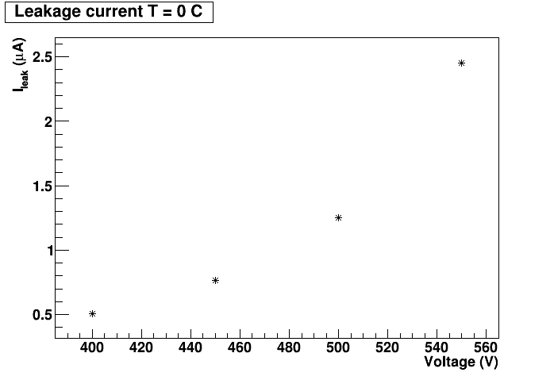



B4-16-5 (“better performance”)
T = [-31, -30] °C
< 0.1 µA/fC

Slide 7
B4-10-5 CV

Slide 8
B4-13-5 CV

Slide 9
B4-16-5 CV

Slide 10
BACKUP – 80 °C

Slide 11
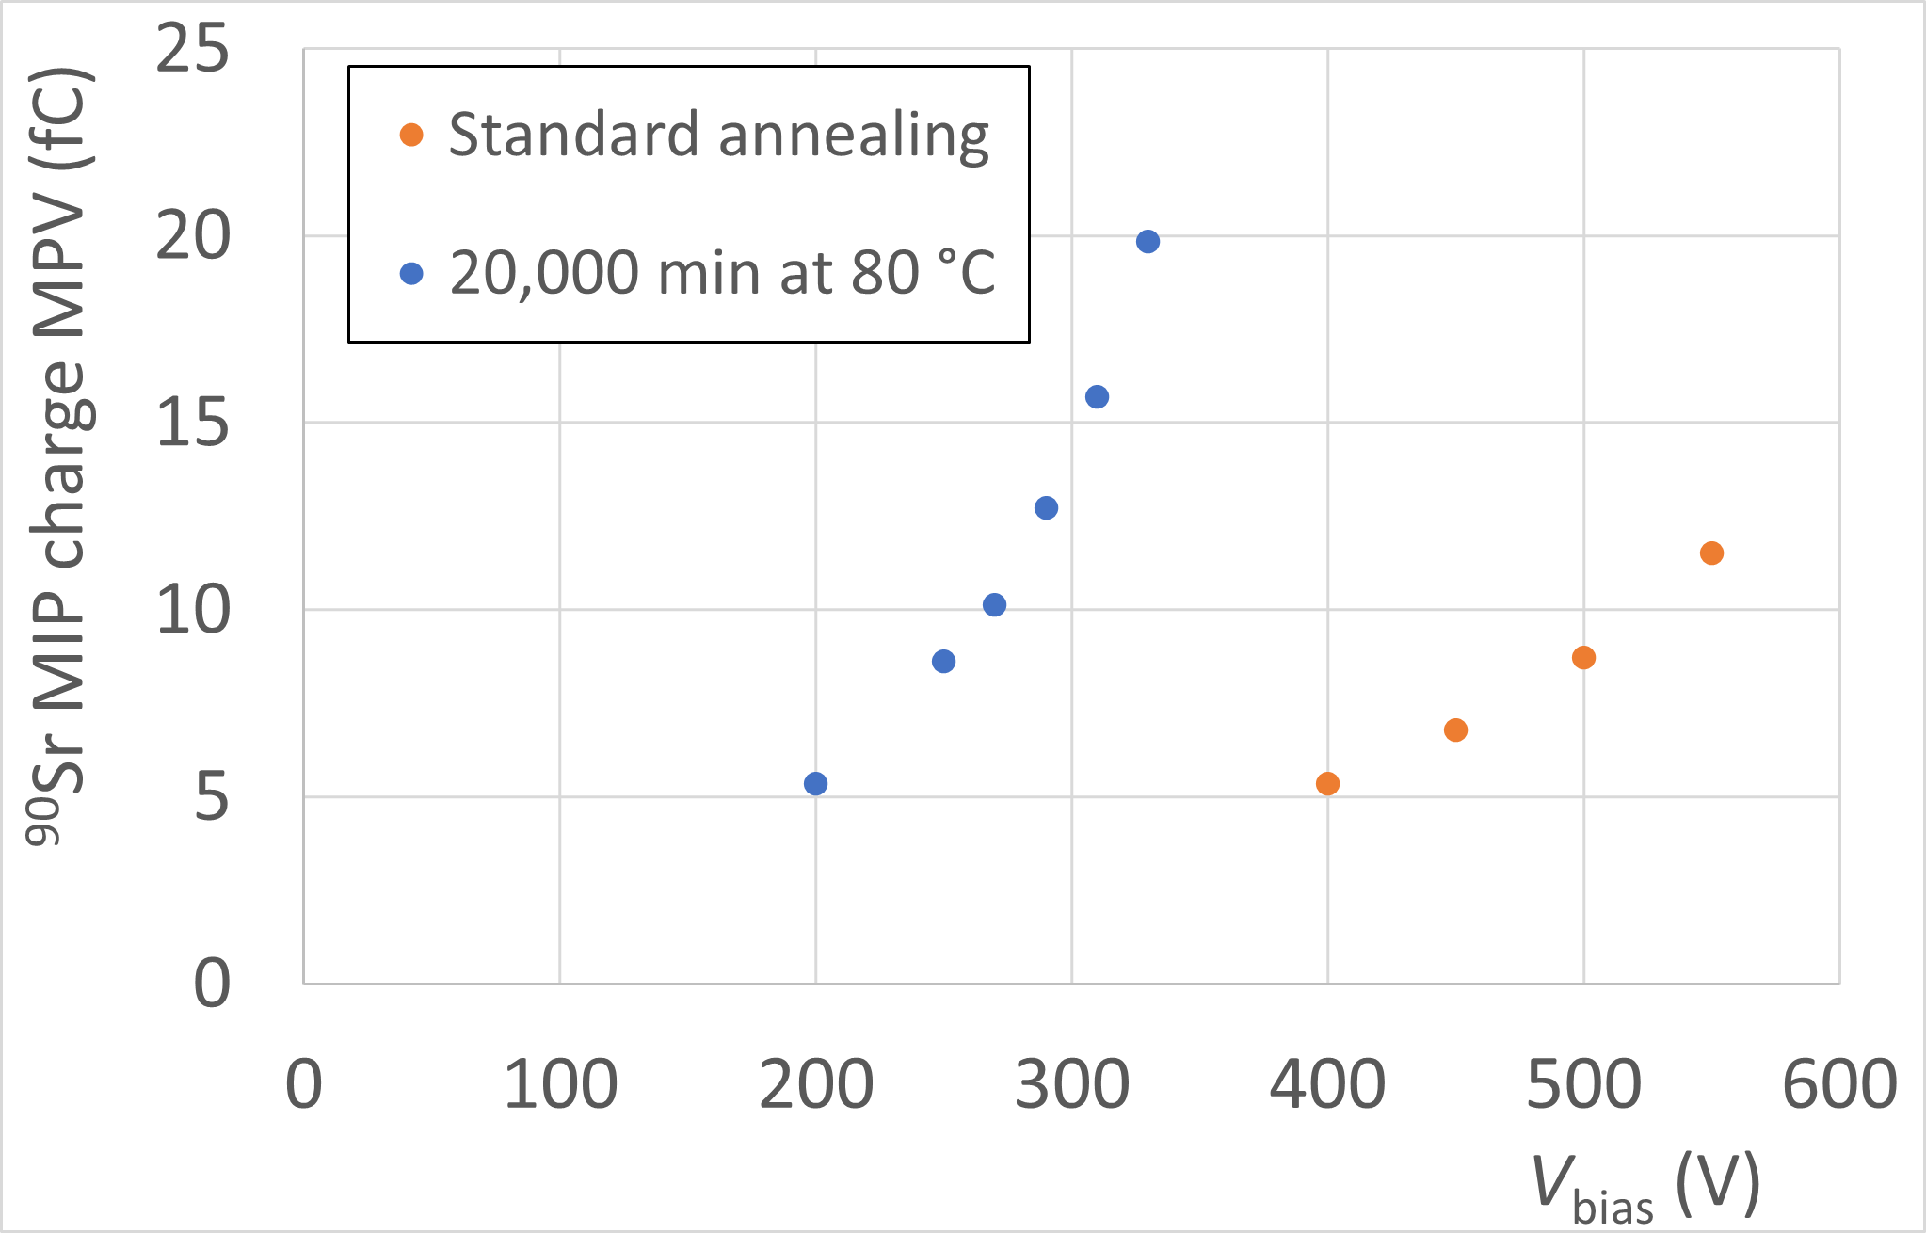
Sr90 collected charge
T = –27 °C
Heavily annealed sample can be operated 200–300 V lower than standard annealed sample
  V_{6 fC} = 220 V (prediction at 20 °C: 250 V), V_{6 fC} = 420 V (prediction at 20 °C: 470 V)
    Excellent agreement, taking into accout T scaling (-1.1 V/K ?)
  V_{10 fC} = 270 V, V_{10 fC} = 520 V

Slide 12
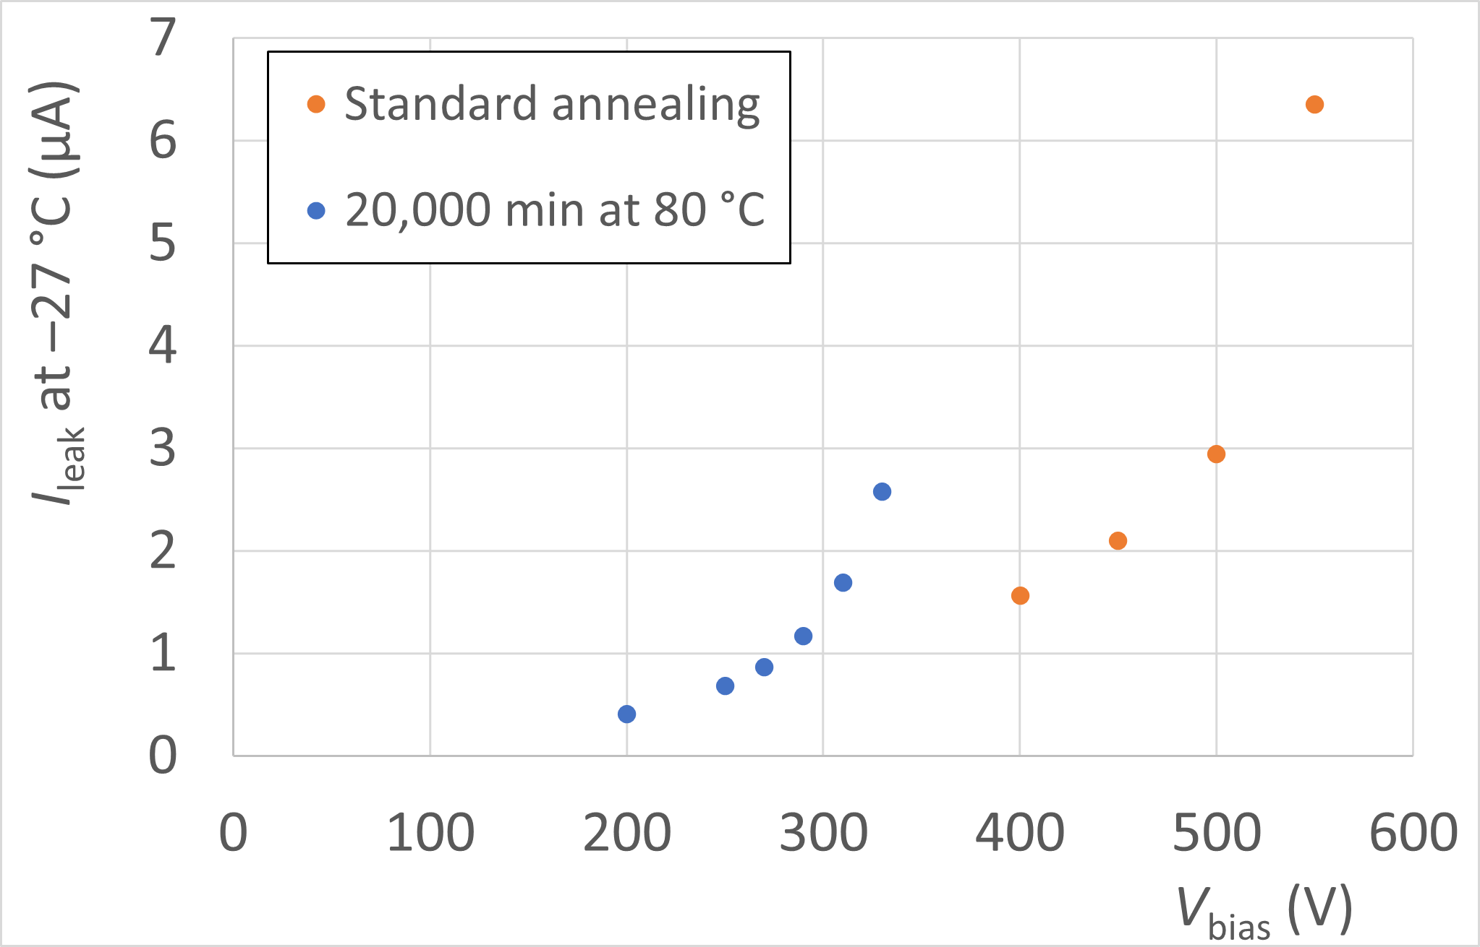
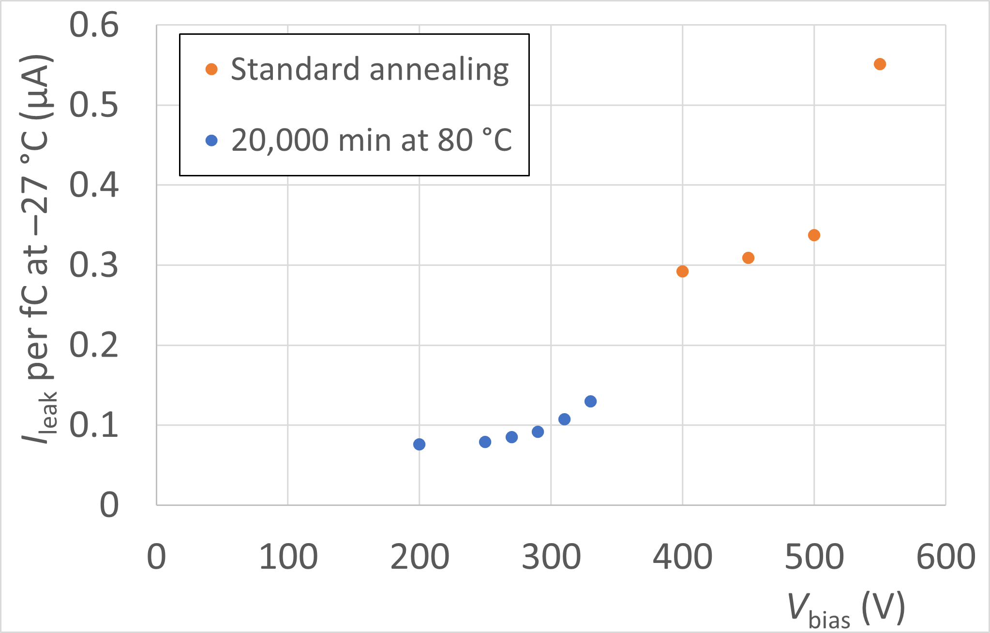
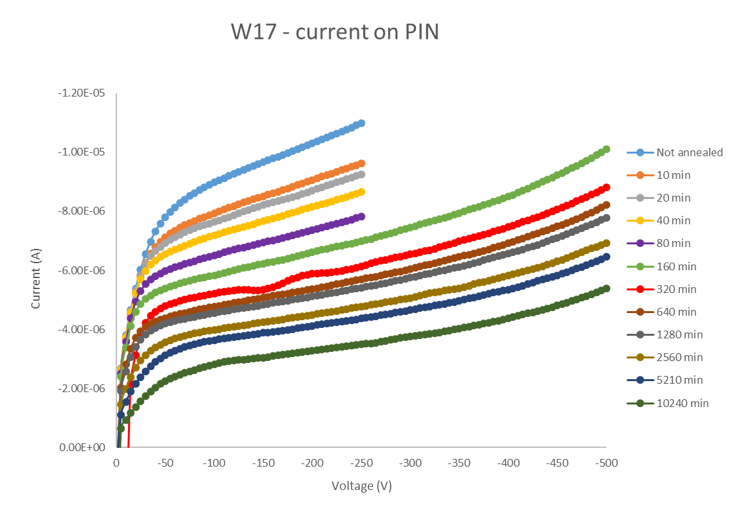
Leakage current
per fC
Leakage current measured during Sr90
  T uncertainty a few °C
    T is read out manually at the beginning of the measurement (highest voltage)
    Our logs say standard annealed was measured at –30 °C and heavily annealed at –27 °C
3x less current per fC in heavily annealed sample

Slide 13
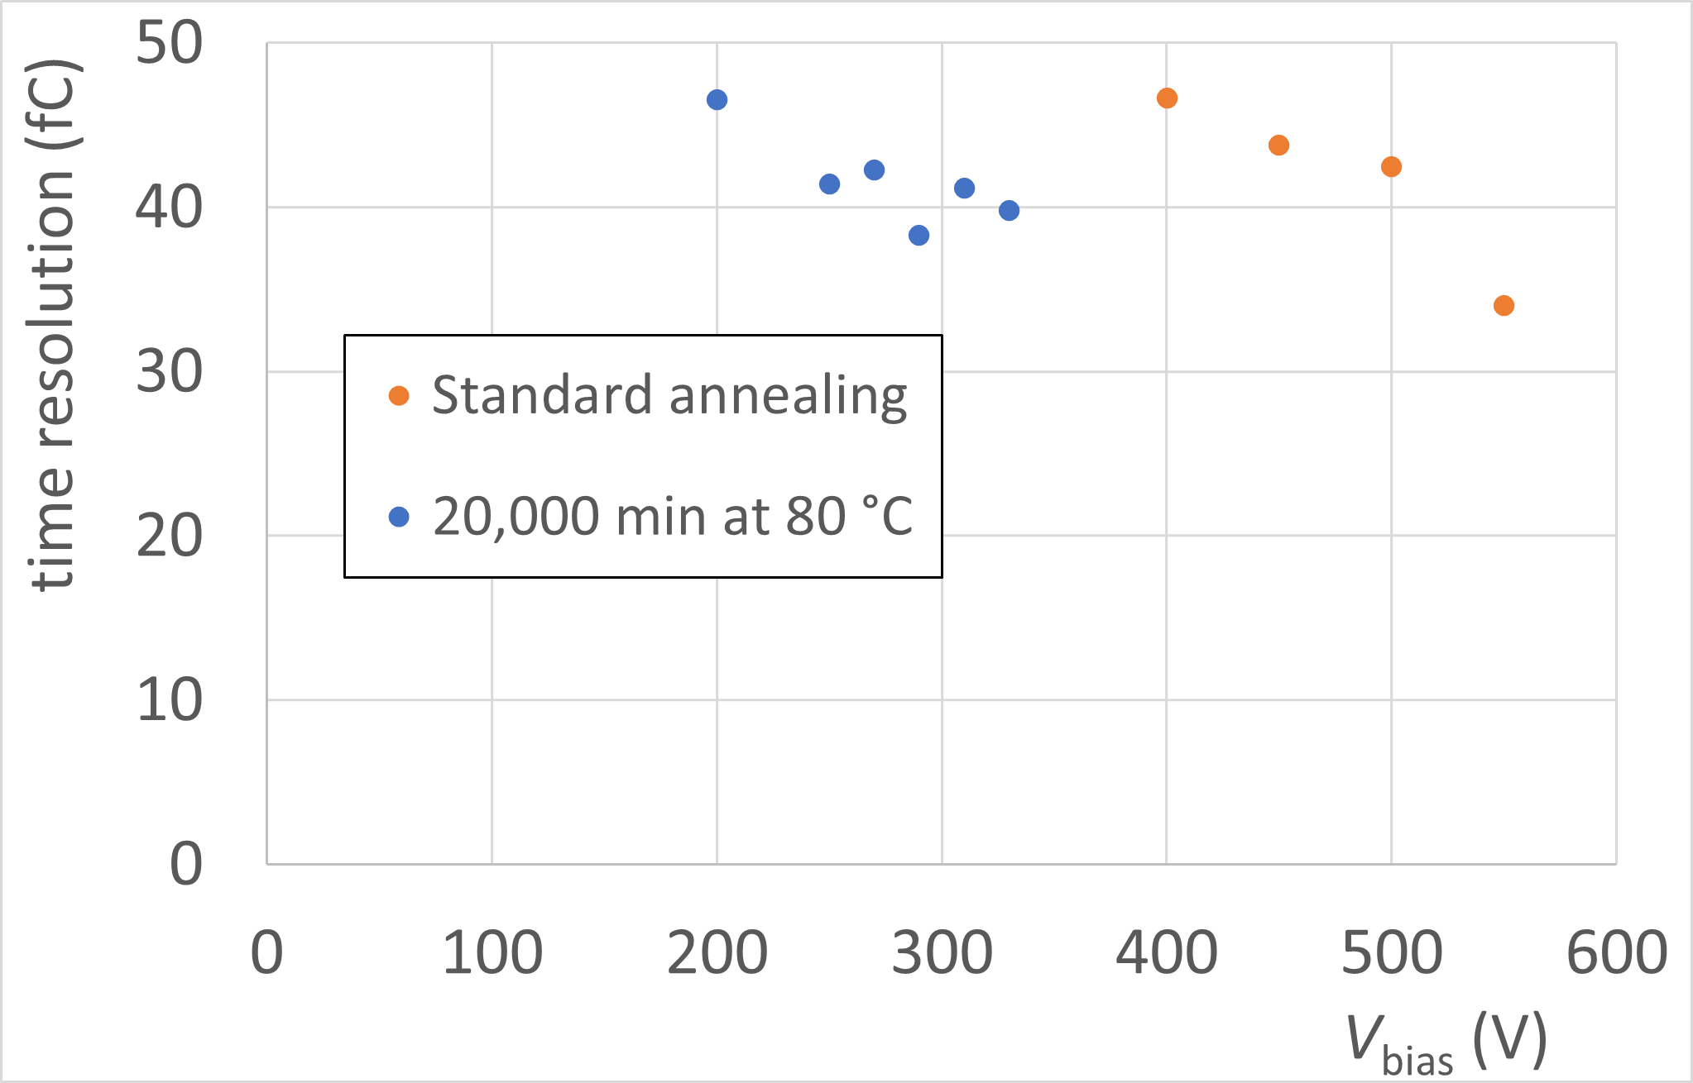
Time resolution
Time resolution consistent with charge collection results

Slide 14
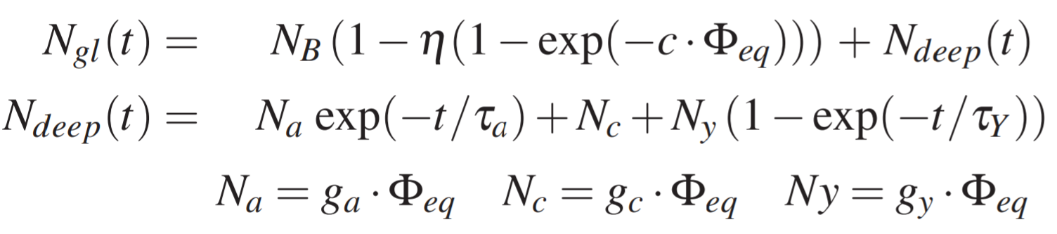
Dependence on time (space charge)
G. Kramberger, HGTD week Feb 2026
Hamburg model:
initial acceptor removal c(N_{B},Φ_{eq},t)
deep defects behaviour with time
deactivation of effective acceptors
defects constant in time
activation of effective acceptors
bulk layer dominated by deep defects (max. N_{deep}~10¹⁴ cm⁻³)
gain layer dominated by initial acceptor term (N_{A}~10¹⁶ cm⁻³)
The conclusion from the CV-IV measurements:
V_{gl} changes to less than 10% and remains almost constant after the initial period reached with standard annealing 80min@60C
V_{fd} changes as the annealing predicts for deep defects and reaches minimum in V_{fd} at around 80-300 min@60 C and then increases due to reverse annealing
At long and short annealing times LGADs perform better due to larger V_{gl} and at larger annealing times they perform better due to effects of the bulk on the electric field in the bulk.

Slide 15
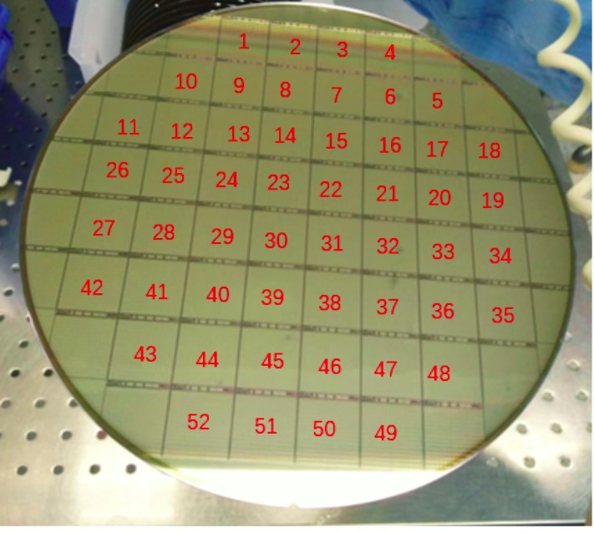
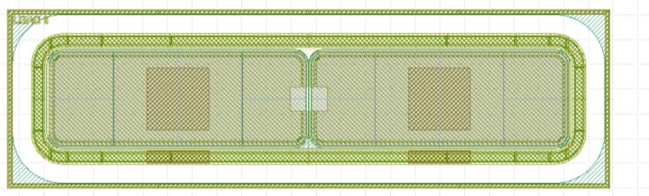
IT test structure and studied samples
  Irradiation Tests done on Quality Control Test Structure (QCTS) using 1 × 2 LGAD
    QCTS adjacent to each main sensor on wafer
    Channel size 2.1 mm × 0.8 mm (geometric capacitance same as pad on the main sensor)
    Same device measured with different methods to minimize systematics
    In production irradiate dies 10, 30 and 48 [•]
      Fluence 2.5e15 neq/cm2, annealing 80 min at 60 °C
  Electrical connections of 1 × 2 LGAD :
    CV/IV: one channel to Signal, one channel + guard ring to Guard
    Sr90: one channel to Signal, one channel + guard ring to Guard
    TCT: both channels to Signal, guard ring floating
main 15 x 15 sensor
QCTS
LGAD1
LGAD2
Optical window in the interpad region

Slide 16
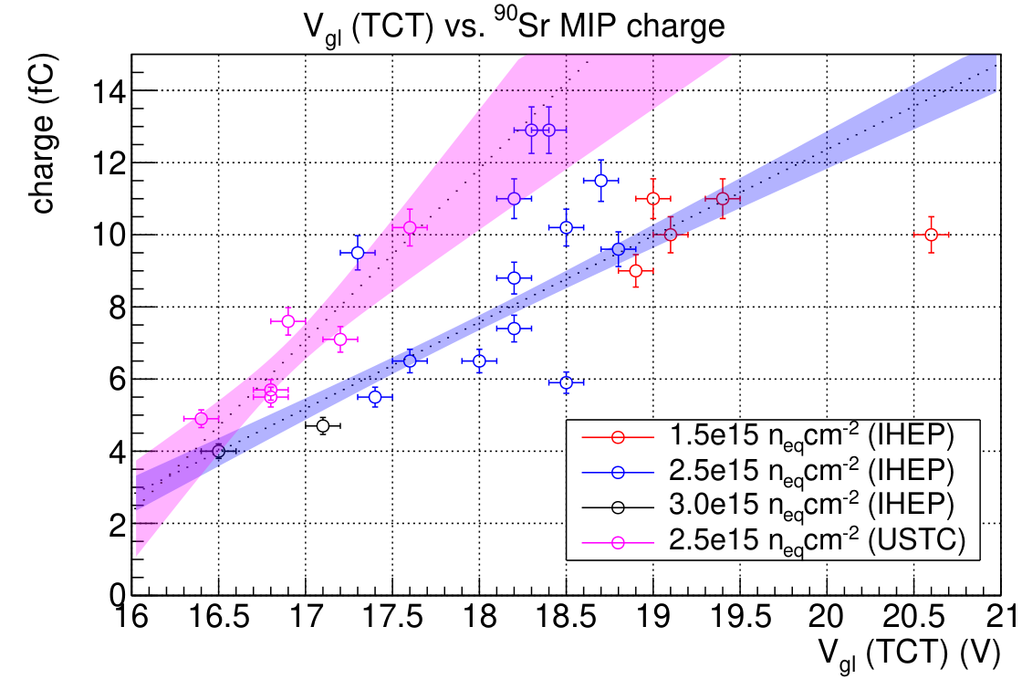
Correlation V_{gl}(TCT) vs. Sr90 charge (preproduction)
Cutoff V_{gl} (USTC-IME)
Cutoff V_{gl} (IHEP-IME)
Correlation between V_{gl} from TCT and collected charge with ⁹⁰Sr used to derive Acceptance Criteria
Cutoff V_{gl} corresponding to 5 fC (HGTD spec) is
  USTC-IME: 16.6 V
  IHEP-IME: 16.9 V

Slide 17
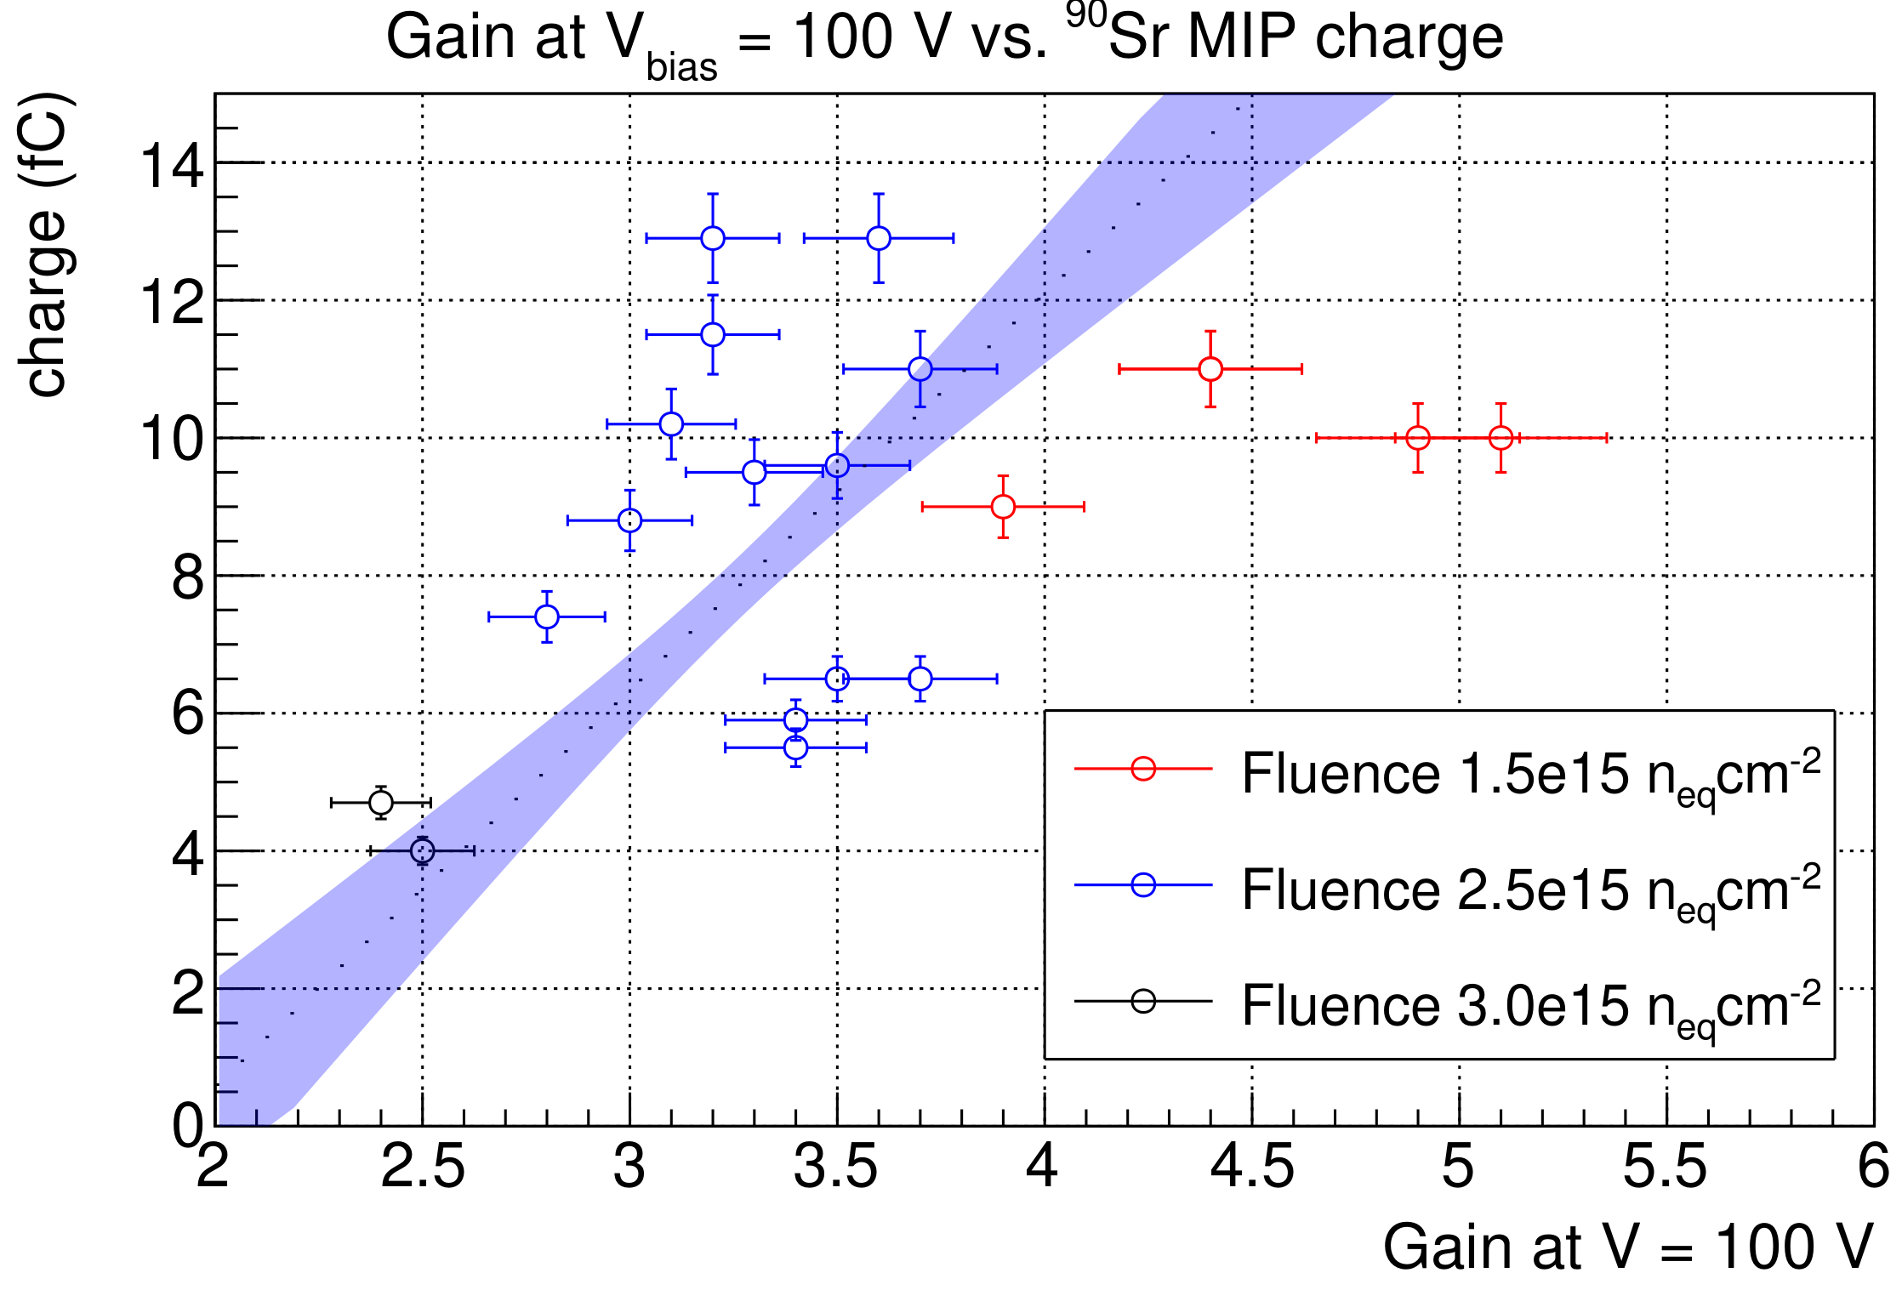
Correlation Gain(TCT) vs. Sr90 charge (IHEP-IME only)
IHEP-IME only
Cutoff Gain
Cutoff Gain(100 V) corresponding to 5 fC (HGTD spec) is 2.7 (IHEP-IME)
Not applicable for USTC-IME, since gain is smaller and uncertainty is large

Slide 18
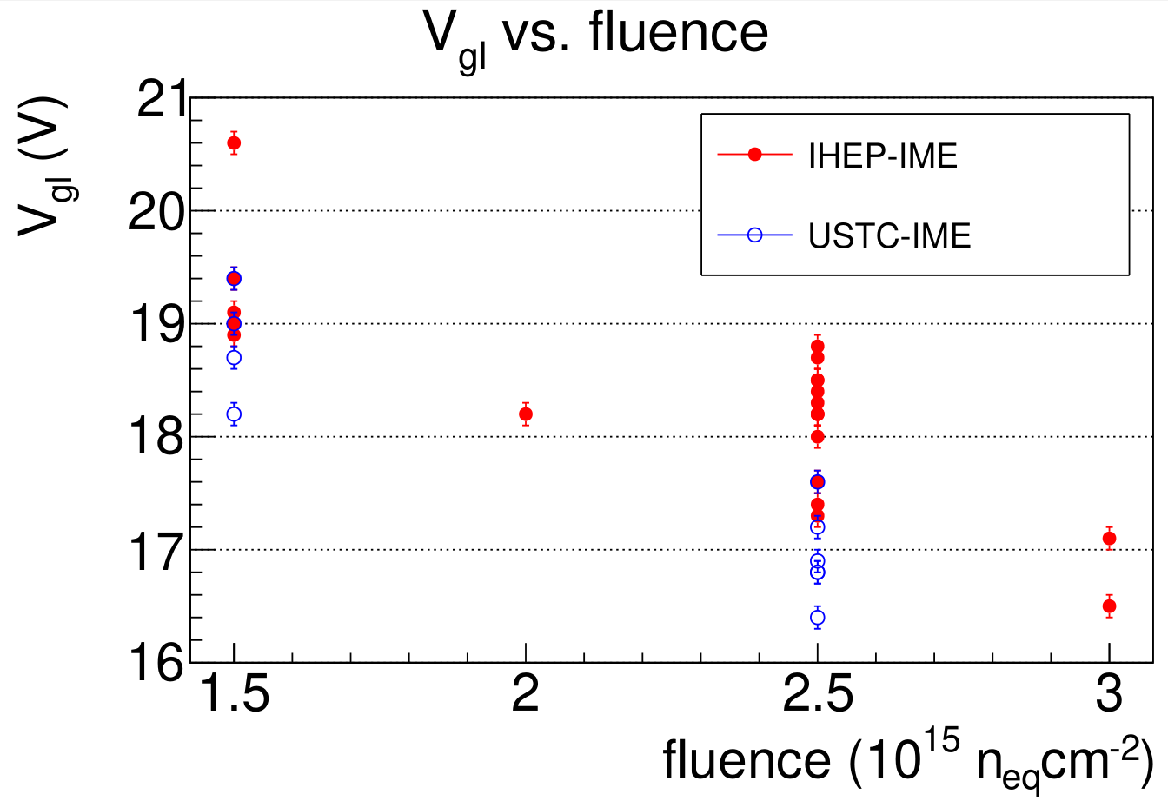
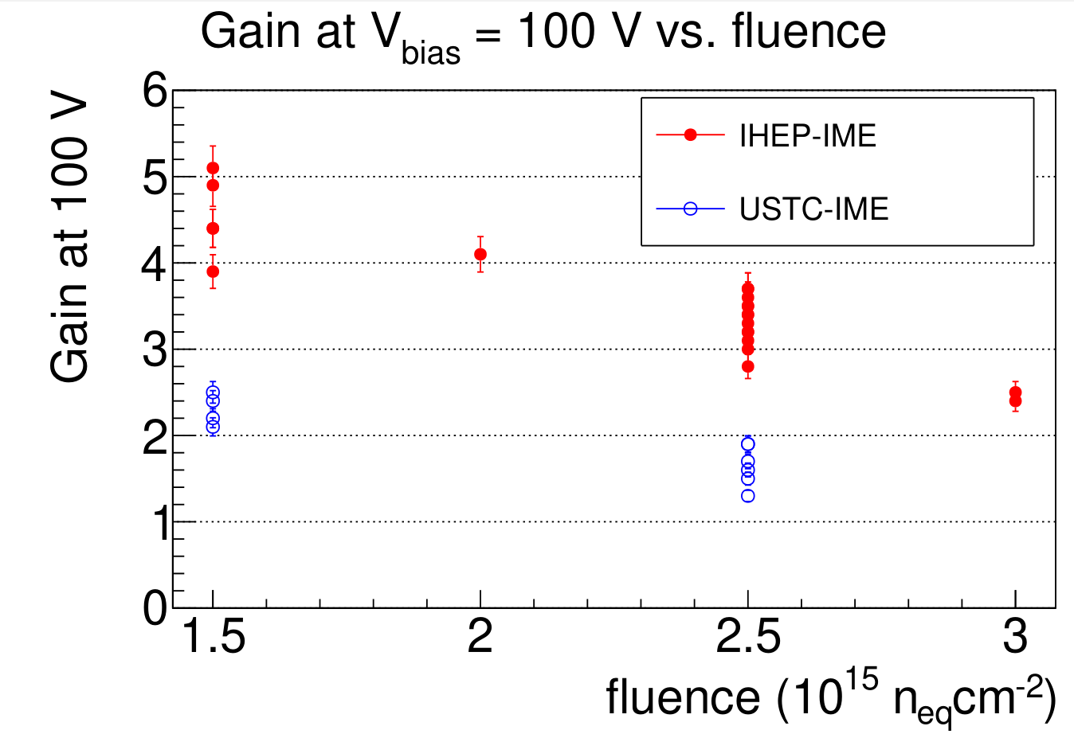
IT-QC: TCT results (preproduction)
Preproduction TCT results (V_{gl} and Gain (100 V)) as a function of fluence
  29 IHEP-IME wafers, 5 USTC-IME wafers
  Results slightly different between two designs (Gain (100 V)) not very sensitive on fluence in USTC-IME)
These results were correlated with ⁹⁰Sr measurements to derive Acceptance Criteria

