Slide 1


B6W8
B6W2
Link
Performed Sr90 tests with outlier wafers in PQC
B6W2 (2.5e15 only) – both “unirradiated” are used in UoB protin irradiation
B6W8 (unirradiated at – 30 °C and 20 °C, 2.5e15)
B6W25 for reference

Slide 2
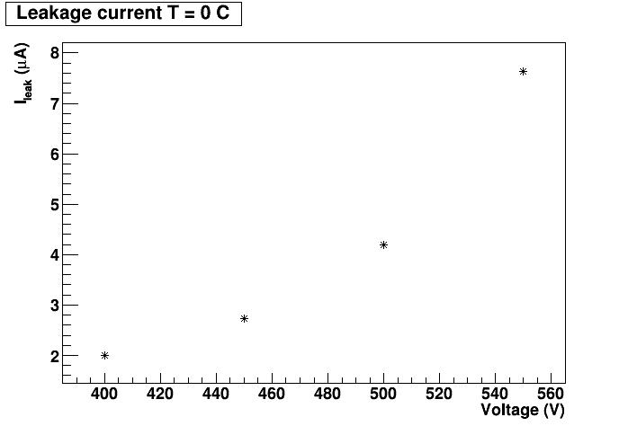
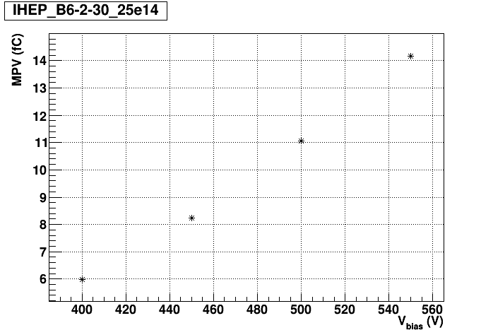
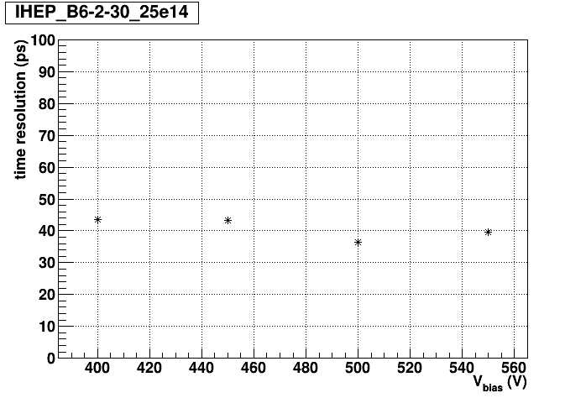
B6W2
1x2 + GR

Slide 3
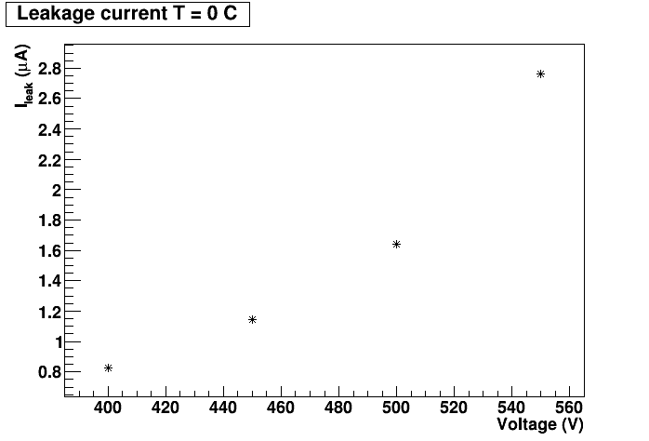
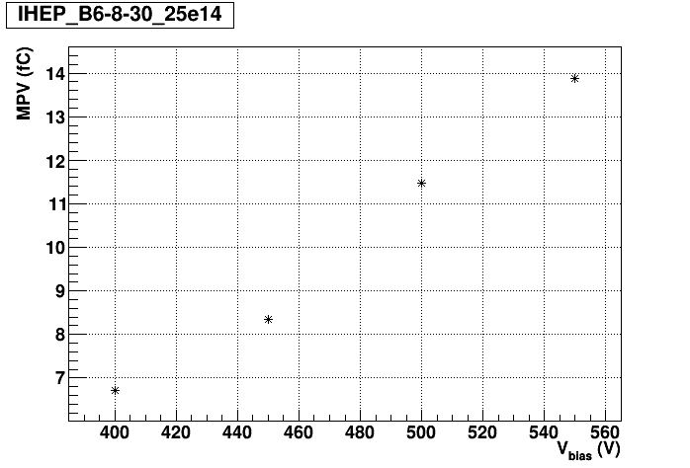

B6W8 2.5e15
1x1 + GR

Slide 4
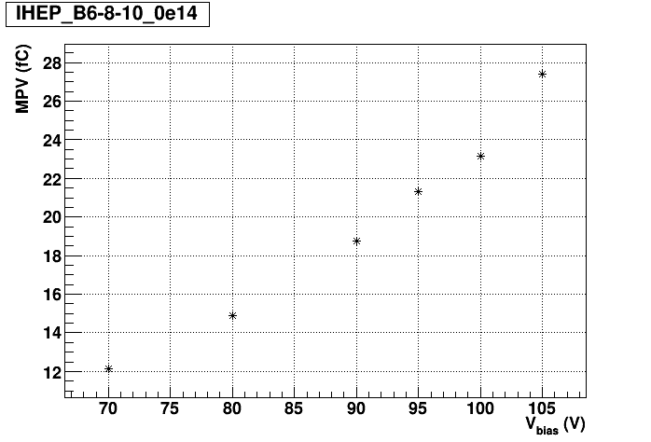



B6W8 unirradiated
-30 °C
ghosts at 3.2 fC 1 Hz
+20 °C

Slide 5



B6 ref
1x2 + GR

Slide 6

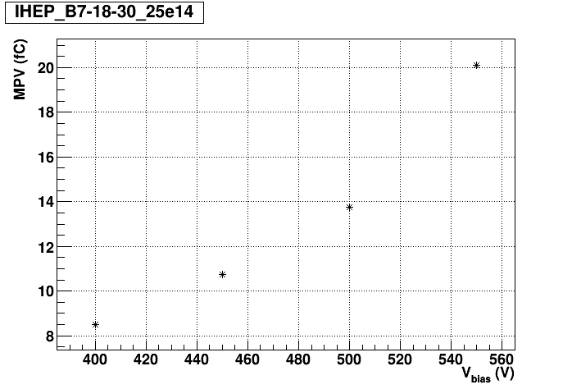
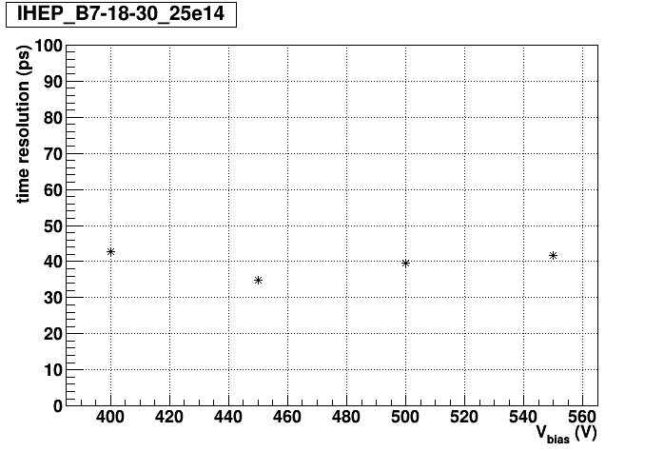
B7 ref

