Slide 1

Production status report: Wafer irradiation tests (JSI)
HGTD Sensor meeting, 2025

Slide 2
Overview IHEP-IME
 | Previous status | Change (Batch2) | New status
Wafers received | 117 | 95 | 213
Wafers irradiated | 117 | 95 | 213
Wafers tested | 117 | 22 | 139
Wafers accepted | 117 | 22 | 139
Need more tests | 0 | 0 | 0
Wafers rejected | 0 | 0 | 0
Received IHEP QCTS from 2nd batch
    Batches no 23, 31, 33 & 36
We only irradiated positions 5 and 30
Measured 22 samples, all of them on position 30
    1 sample (B23 W4) had too high current and broke down by 10V so I set it aside and will measure it on position 50

Slide 3
Batch 2 results – batch 23
ATLAS ID | Batch | Wafer | Position | Vgl 1 | Vgl 2 | Gain 1 | Gain 2
20WS2123000130 | 23 | 1 | 30 | 18.2 | 18.4 | 3 | 3.1
20WS2123000230 | 23 | 2 | 30 | 18.4 | 18.3 | 2.9 | 2.9
20WS2123000330 | 23 | 3 | 30 | 18.6 | 18.5 | 3 | 3.1
20WS2123000530 | 23 | 5 | 30 | 18.1 | 18 | 2.9 | 3
20WS2123000630 | 23 | 6 | 30 | 18.2 | 18.2 | 3.1 | 3
20WS2123000730 | 23 | 7 | 30 | 18.3 | 18.4 | 3 | 3
20WS2123000830 | 23 | 8 | 30 | 18.5 | 18.5 | 3 | 3
20WS2123000930 | 23 | 9 | 30 | 18.4 | 18.4 | 3.1 | 3.1
20WS2123001030 | 23 | 10 | 30 | 18.4 | 18.4 | 3.2 | 3.2
20WS2123001130 | 23 | 11 | 30 | 18.2 | 18.2 | 3 | 3
20WS2123001230 | 23 | 12 | 30 | 18.2 | 18.1 | 3 | 2.9
20WS2123001330 | 23 | 13 | 30 | 18.2 | 18.3 | 3 | 3
20WS2123001430 | 23 | 14 | 30 | 18.2 | 18.1 | 2.9 | 2.9
20WS2123001530 | 23 | 15 | 30 | 18.2 | 18.2 | 2.8 | 2.8
20WS2123002530 | 23 | 25 | 30 | 18.4 | 18.3 | 2.8 | 2.8
Preproduction acceptance criteria:
Vgl > 16.9 V
Gain > 2.7

Slide 4
Batch 2 results – batch 31, 33 & 36
ATLAS ID | Batch | Wafer | Position | Vgl 1 | Vgl 2 | Gain 1 | Gain 2
20WS2131000130 | 31 | 1 | 30 | 18.1 | 17.9 | 3.3 | 3.4
20WS2131002530 | 31 | 25 | 30 | 18 | 18.1 | 3.3 | 3.3
ATLAS ID | Batch | Wafer | Position | Vgl 1 | Vgl 2 | Gain 1 | Gain 2
20WS2133000130 | 33 | 1 | 30 | 18.8 | 18.6 | 3 | 3
20WS2133002530 | 33 | 25 | 30 | 18.3 | 18.5 | 3.4 | 34
ATLAS ID | Batch | Wafer | Position | Vgl 1 | Vgl 2 | Gain 1 | Gain 2
20WS2136000130 | 36 | 1 | 30 | 18.2 | 18.2 | 3 | 3
20WS2136002430 | 36 | 24 | 30 | 18.1 | 18.4 | 3 | 3
Preproduction acceptance criteria:
Vgl > 16.9 V
Gain > 2.7

Slide 5
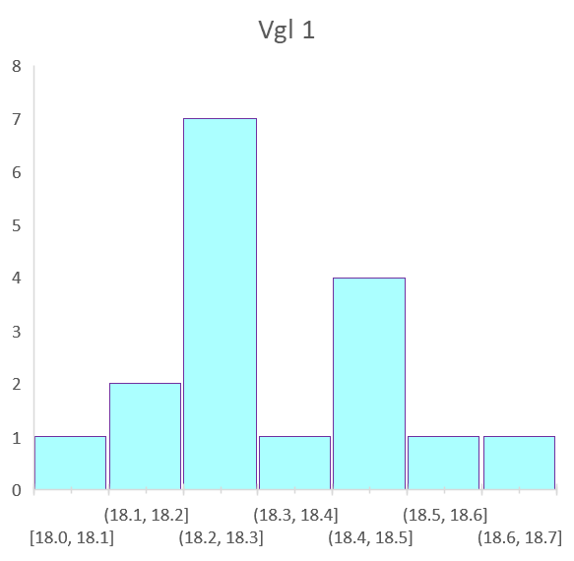
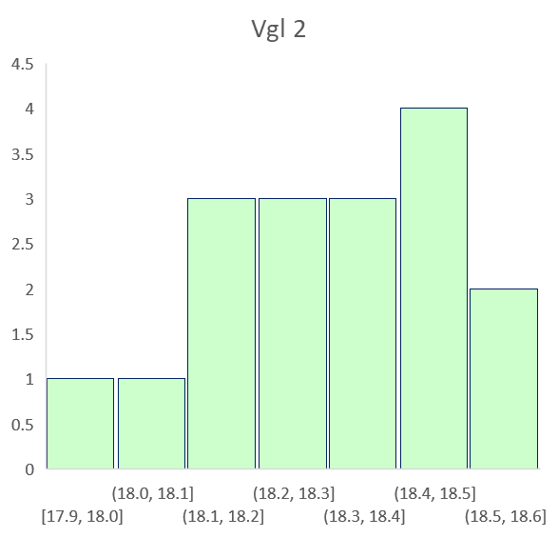
Batch 2 results - Vgl
Average Vgl 1
Batch 1 | 18.08
Batch 2 | 18.27
Average Vgl 2
Batch 1 | 18.07
Batch 2 | 18.24

Slide 6
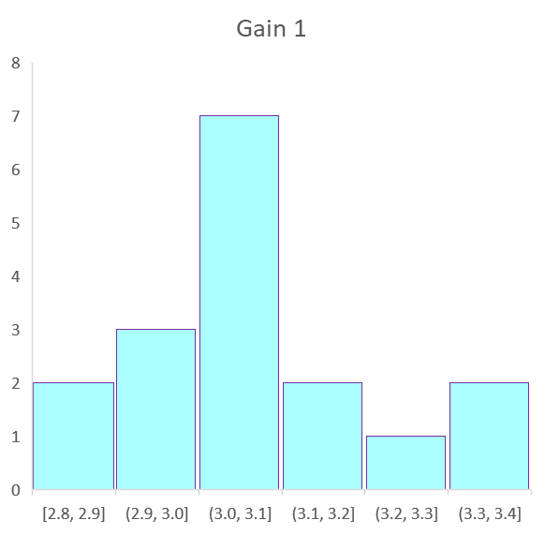
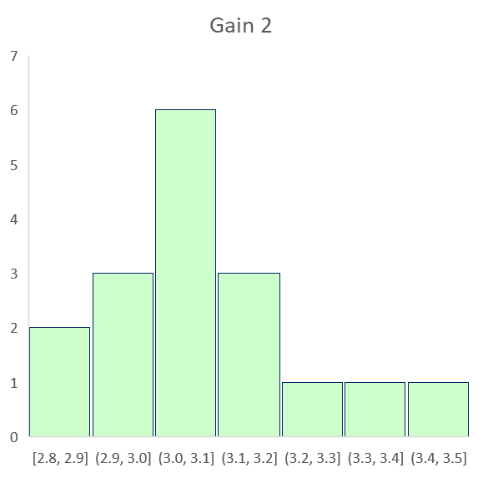
Batch 1.2 results
Average gain 1
Batch 1 | 3.08
Batch 2 | 3.02
Average gain 2
Batch 1 | 3.05
Batch 2 | 3.03

