Slide 1
UCSC Front End board T dependence
Urban Mernik

Slide 2
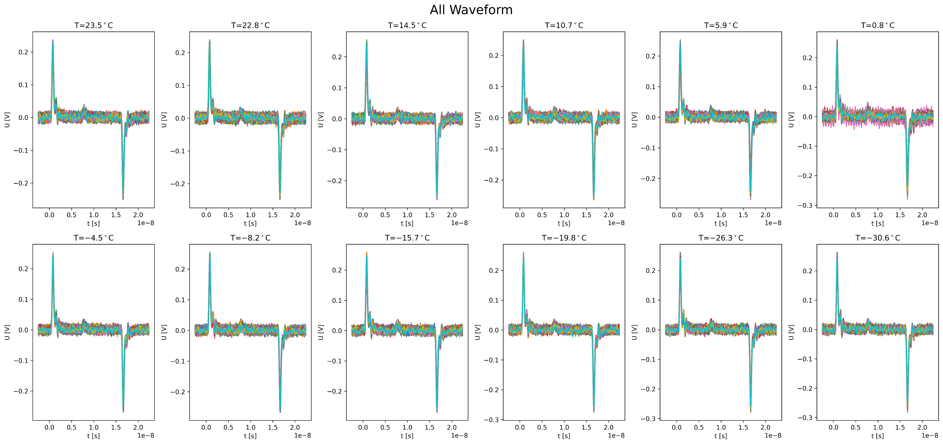
Urban performed a study of T dependence of UCSC board gain (-30 °C, +20 °C)
Analog pulse from pulse generator into CAL_IN input (0.3 pF)
  10000 waveforms (separate) per setting
Board with a bonded sample (Cdet = 5 pF)

Slide 3
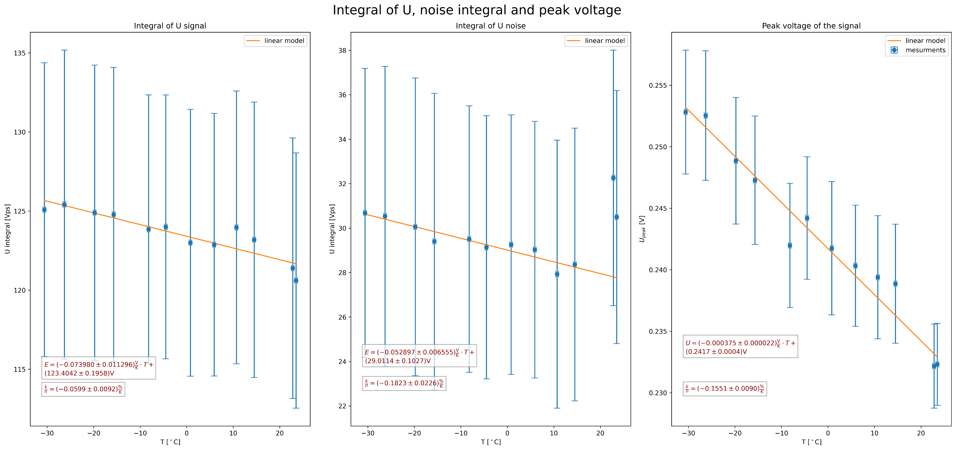
Pulse integral [0, 5 ns]
3.2 % difference between -30 °C and +20 °C
Pulse height
8.6 % difference between -30 °C and +20 °C
Noise integral [11, 16 ns]
10 % difference between -30 °C and +20 °C

