Slide 1
WP4 – Radioisotope production and radiopharmaceuticals T4.2. Identify best isotopes for production with LINAC
Marko Krošelj, MF, University of Ljubljana

Slide 2
Task 4.2.
This part of the project will focus on the:
(i) investigation of precise nuclear data for the selection of suitable radionuclides;
(ii) chemical and technical concept of the target materials providing radionuclides of interest;
(iii) investigation of the optimal chemical forms and the principal separation methods allowing high chemical yields of radionuclides of interest;
(iv) consideration of the activity scale with regard to radiation stability and radiation safety;
(v) as well as eventual recovery of the target material.
The exemplary radionuclides of interest will pre-dominantly focus on radiolanthanides. The produced radionuclides will significantly improve the relevance and robustness of performed preclinical experiments and simplify their supply and utilization in the clinics.

Slide 3
Selection process
Group | Radionuclide | Application | Monography in Ph.Eur.
Diagnostic | Technetium-99m (99mTc) | SPECT imaging (via Mo-99) | yes 01/2008:0124
Diagnostic | Molybdenum-99 (99Mo) | Parent isotope for Tc-99m SPECT imaging | yes 07/2022:1923
Diagnostic | Iodine-123 (123I) | Thyroid and neuroimaging (SPECT) | yes 01/2008:2314
Diagnostic | Iodine-124 (124I) | PET imaging | no
Diagnostic | Indium-111 (111In) | Tumor and infection imaging | yes 01/2008:1227
Diagnostic | Scandium-44 (44Sc) | PET imaging, theranostic pair | no
Diagnostic | Terbium-152 (152Tb) | PET imaging, theranostic pair | no
Therapeutic/Theranostic | Lutetium-177 (177Lu) | β-therapy, theranostics | yes 07/2017:2798
Therapeutic/Theranostic | Yttrium-90 (90Y) | β-therapy, radioembolization | yes 04/2019:2803
Therapeutic/Theranostic | Iodine-131 (131I) | Thyroid cancer therapy | yes 04/2021:0281
Therapeutic/Theranostic | Terbium-161 (161Tb) | β-/Auger therapy | no
Therapeutic/Theranostic | Holmium-166 (166Ho) | β-therapy, SIRT | no
Therapeutic/Theranostic | Actinium-225 (225Ac) | Targeted α therapy | no
Therapeutic/Theranostic | Astatine-211 (211At) | Therapy (α) | no
Therapeutic/Theranostic | Lead-212 (212Pb) | α/β therapy, theranostic use | no
Therapeutic/Theranostic | Scandium-47 (47Sc) | β-therapy, SPECT imaging | no
Step 1:
Proposed list of radionuclides (by intended use, application and available quality specifications)
Coordination with WP3

Slide 4
Selection process
Group | Radionuclide | Application | Monography in Ph.Eur.
Diagnostic | Technetium-99m (99mTc) | SPECT imaging (via Mo-99) | yes 01/2008:0124
Diagnostic | Molybdenum-99 (99Mo) | Parent isotope for Tc-99m SPECT imaging | yes 07/2022:1923
Diagnostic | Iodine-123 (123I) | Thyroid and neuroimaging (SPECT) | yes 01/2008:2314
Diagnostic | Iodine-124 (124I) | PET imaging | no
Diagnostic | Indium-111 (111In) | Tumor and infection imaging | yes 01/2008:1227
Diagnostic | Scandium-44 (44Sc) | PET imaging, theranostic pair | no
Diagnostic | Terbium-152 (152Tb) | PET imaging, theranostic pair | no
Therapeutic/Theranostic | Lutetium-177 (177Lu) | β-therapy, theranostics | yes 07/2017:2798
Therapeutic/Theranostic | Yttrium-90 (90Y) | β-therapy, radioembolization | yes 04/2019:2803
Therapeutic/Theranostic | Iodine-131 (131I) | Thyroid cancer therapy | yes 04/2021:0281
Therapeutic/Theranostic | Terbium-161 (161Tb) | β-/Auger therapy | no
Therapeutic/Theranostic | Holmium-166 (166Ho) | β-therapy, SIRT | no
Therapeutic/Theranostic | Actinium-225 (225Ac) | Targeted α therapy | no
Therapeutic/Theranostic | Astatine-211 (211At) | Therapy (α) | no
Therapeutic/Theranostic | Lead-212 (212Pb) | α/β therapy, theranostic use | no
Therapeutic/Theranostic | Scandium-47 (47Sc) | β-therapy, SPECT imaging | no
Step 2:
Usefulness & clinical relevance (bibliography review)
Scientific/medical interest in producing them with LINACs.
Feasibility of production using LINACs based on bibliography as well as on preliminary calculations.

Slide 5
Selection process
Selected Radionuclides for Further Investigation and Accelerator-Based Production
Step 2:
Usefulness & clinical relevance (bibliography review)
Scientific/medical interest in producing them with LINACs.
Feasibility of production using LINACs based on bibliography as well as on preliminary calculations.
Scandium
⁴³Sc, ⁴⁴^{g}Sc, ⁴⁷Sc
Selection
Lutetium
¹⁷⁷Lu
Technetium
⁹⁹ᵐTc

Slide 6
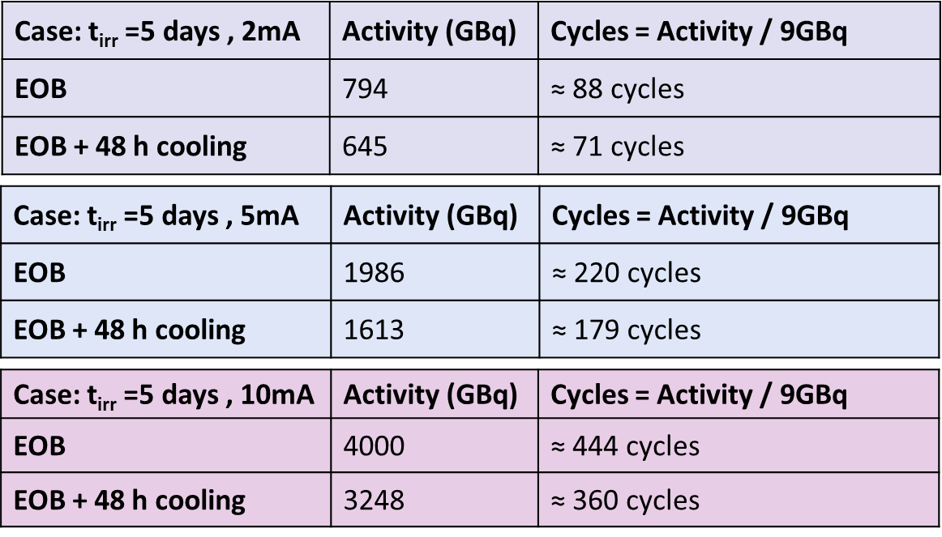
Selection process
Step 3:
¹⁷⁷Lu as a benchmark radionuclide:
Hospital survey on the use of radiopharmaceuticals (the use of therapeutic radiopharmaceuticals, shortages).
Clinical maturity, high potential for future clinical expansion.
WP4, T4.3.
WP3 feasibility assesment of 177Lu LINAC production for potential clinical use.

Slide 7
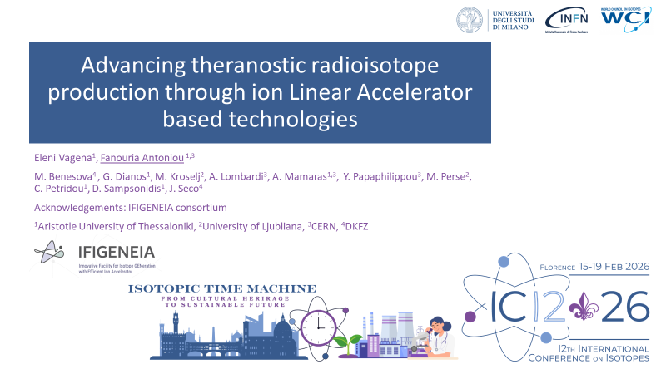
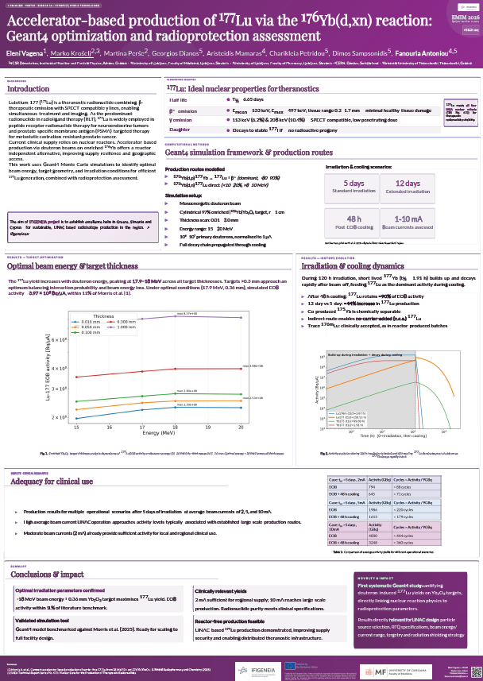
Dissemination

Slide 8
Future work
After benchmarking the ¹⁷⁷Lu, the new isotopes will be added (WP3, WP5).

