Slide 1

WP4 – Radioisotope production and radiopharmaceuticals T4.3 – T4.5 DKFZ´s participation
Adéla Šimková, DKFZ, Heidelberg

Slide 2
¹⁷⁷Lu-based targeted radiotheranostics – general design
Task 4.2:
¹⁷⁷Lu = nuclide of choise
Radionuclide
¹⁷⁷Lu
supply via WP3

Slide 3
¹⁷⁷Lu-based targeted radiotheranostics – general design
Task 4.2:
¹⁷⁷Lu = nuclide of choise
Radionuclide
¹⁷⁷Lu
supply via WP3
chelator
linker
targeting
¹⁷⁷Lu
radiolabeling
Cold ligand
Radiolabeled ligand

Slide 4
Radiotheranostics – development workflow (T4.3 – T4.5)
Task 4.2:
¹⁷⁷Lu = nuclide of choise
Radionuclide
¹⁷⁷Lu
supply via WP3
chelator
linker
targeting
¹⁷⁷Lu
radiolabeling
Cold ligand
Radiolabeled ligand
Molecular structure optimization
Task 4.4:
Radioactively labeled ligand & quality control
Task 4.3: Ligand development

Slide 5
Radiotheranostics – development workflow (T4.3 – T4.5)
Task 4.2:
¹⁷⁷Lu = nuclide of choise
Radionuclide
¹⁷⁷Lu
supply via WP3
Novel
radiopharma-ceutcals
chelator
linker
targeting
¹⁷⁷Lu
radiolabeling
Cold ligand
Radiolabeled ligand
Human
patients
Molecular structure optimization
Task 4.4:
Radioactively labeled ligand & quality control
Task 4.5:
Preclinical evaluation
Task 4.3: Ligand development

Slide 6
Radiolabeling (T4.4)
Radiolabeling optimization
Screening of conditions:
pH – buffer – temperature – molar activity
Supply via WP3
¹⁷⁷LuCl₃
European Pharmacopoeia standards:
Sufficient molar activity
Ultrapure, metal free
Solvent: diluted HCl
95°C
25 min
pH 4.5
NaOAc
PLUVICTO®
GLP standard (research purpose)
GLP standards:
Purity > 95%
HPLC, MS characterization
Solvent: ultrapure water
Quality control

Slide 7
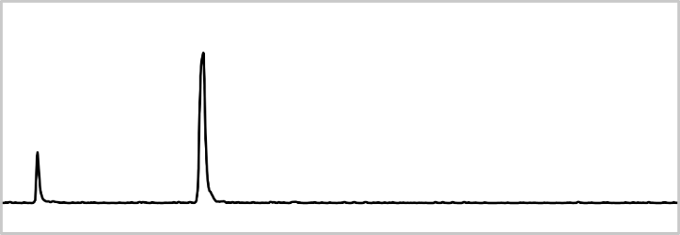
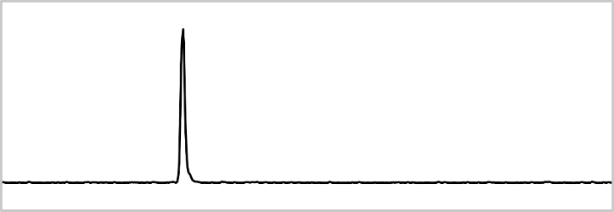
Radiotheranostics – quality control (T4.4)
RadioTLC
Task 4.2:
¹⁷⁷Lu = nuclide of choise
Radionuclide
RadioHPLC
¹⁷⁷Lu
Free
¹⁷⁷Lu³⁺
labeling failed
✘
chelator
linker
targeting
¹⁷⁷Lu
radiolabeling
OR
Cold ligand
Radiolabeled ligand
labeling successful
✓
> 95%
Chromatographic methods:
Reverse-phase radioHPLC
& radioTLC (thin-layer chromatography)
Radiolabeled ligand

Slide 8

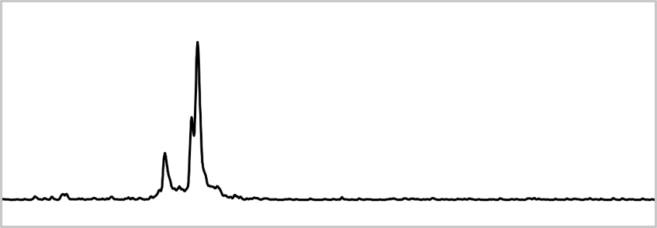
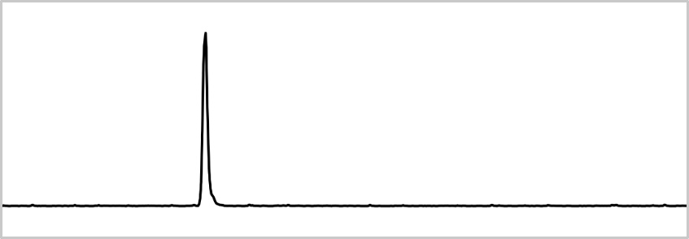
Radiotheranostics – stability (T4.4)
Radiation
& radicals
Task 4.2:
¹⁷⁷Lu = nuclide of choise
Radionuclide
H₂O
OH
¹⁷⁷Lu
supply via WP3
chelator
linker
targeting
¹⁷⁷Lu
radiolabeling
Cold ligand
Serum
enzymes
Radiolabeled ligand
Labile compound
Stable compound
Chromatographic methods:
RP-radioHPLC
✘
OR
✓

Slide 9
Radiotheranostics – in vitro (T4.4)
=
Task 4.2:
¹⁷⁷Lu = nuclide of choise
Radionuclide
Radiotheranostics
¹⁷⁷Lu
supply via WP3
On-off
kinetics
chelator
linker
targeting
¹⁷⁷Lu
radiolabeling
Targeted protein
Cold ligand
Radiolabeled ligand
Empty ligand
internalization
Cellular assays:
Binding affinity
Total cellular binding
Internalization
Cellular surface

Slide 10
Radiolabeling & quality control (T4.4)
(Radio)chemical & Serum stability (T4.4)
In vitro evaluation (T4.4)
Development of novel radiopharmaceuticals (T4.3)

Slide 11
New generation of PSMA-targeted radiopharmaceuticals (T4.3)
PLUVICTO®
Limitations:
~ 50% patients without response
- Resistance development
DOTA
chelator
PSMA-binding
motive
New generation of PSMA-targeted theranostics
Indication: Metastatic Castration-Resistant Prostate Cancer
Targeting: Prostate-Specific Membrane Antigen (PSMA)

Slide 12
New generation of PSMA-targeted radiopharmaceuticals (T4.3)
PSMA-617-3D
(trisDOTA analogue)
Strategy:
Multiple chelation sites → elevated molar activity
→ → higher radiation dose
PSMA-617-2D
(bisDOTA analogue)
PSMA-617

Slide 13
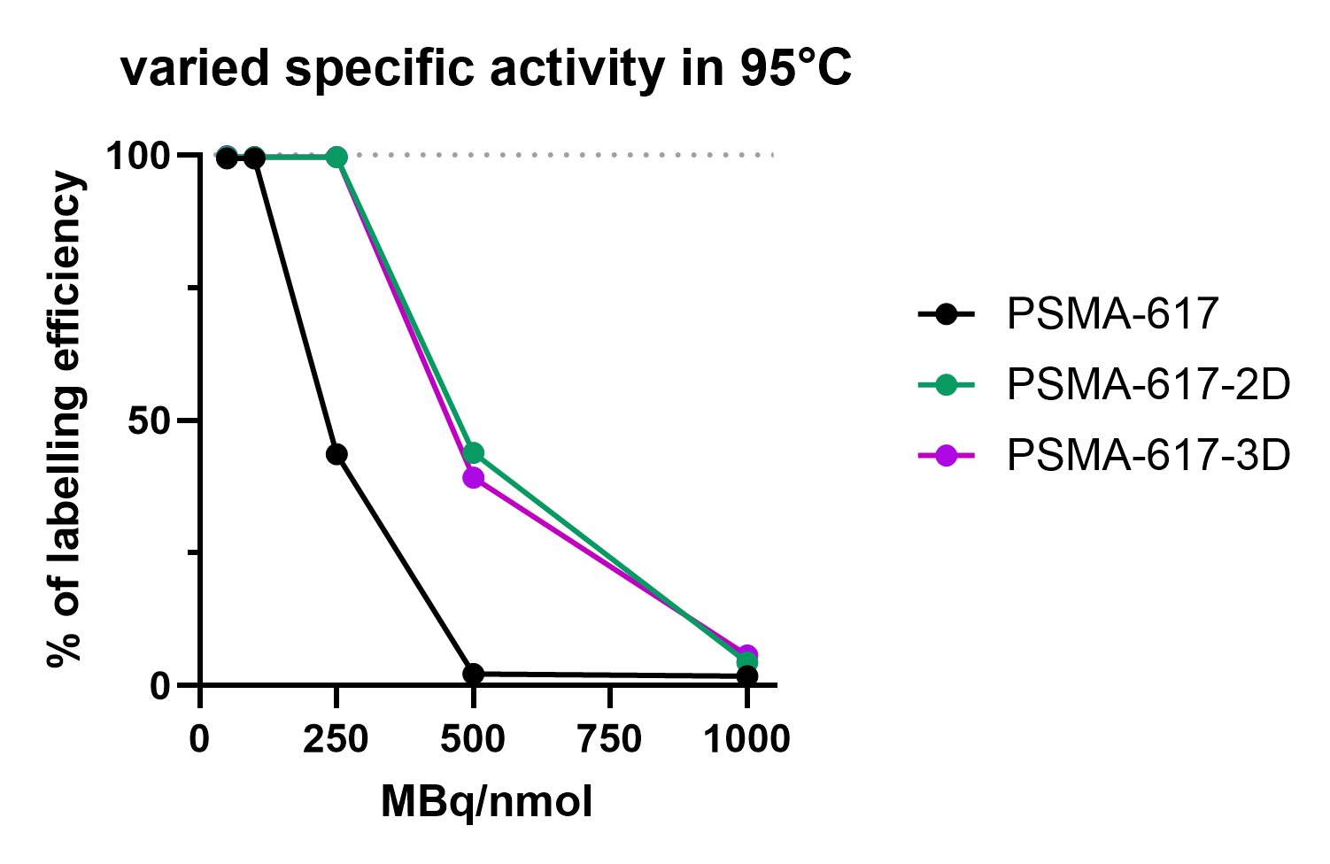

New generation of PSMA-targeted radiopharmaceuticals (T4.3 & T4.4)
PSMA-617-3D
(trisDOTA analogue)
Strategy:
Multiple chelation sites → elevated molar activity
→ → higher radiation dose
PSMA-617-2D
(bisDOTA analogue)
Specific activity
PSMA-617-2D
PSMA-617-3D
95°C
PSMA-617
PSMA-617-2D/3D reached
elevated molar activity

Slide 14
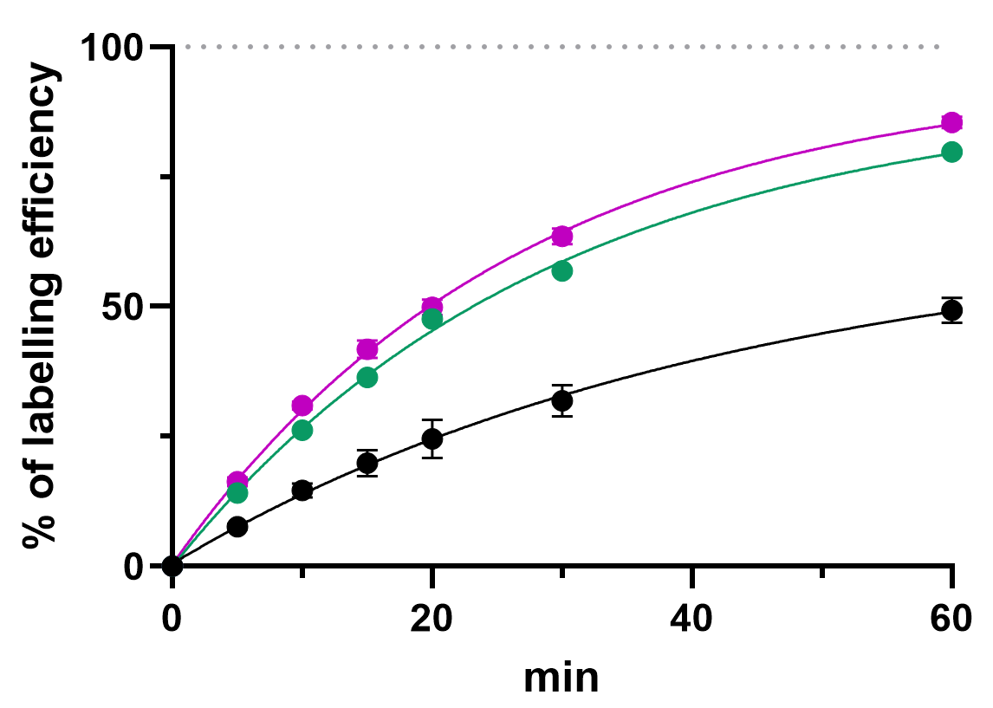
New generation of PSMA-targeted radiopharmaceuticals (T4.3 & T4.4)
PSMA-617-3D
(trisDOTA analogue)
Strategy:
Multiple chelation sites → elevated molar activity
→ → higher radiation dose
PSMA-617-2D
(bisDOTA analogue)
Specific activity
Radiolabeling kinetics
PSMA-617-2D
40°C
PSMA-617-3D
PSMA-617-3D
PSMA-617-2D
95°C
PSMA-617
PSMA-617
PSMA-617-2D/3D reached
elevated labeling rate

Slide 15
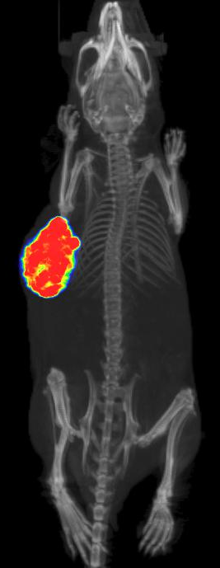
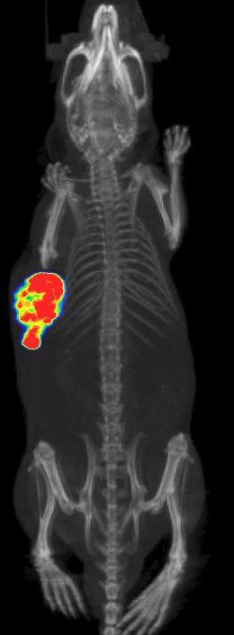
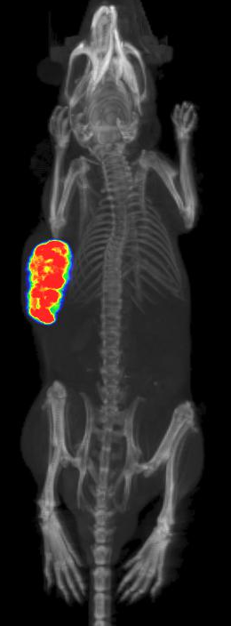
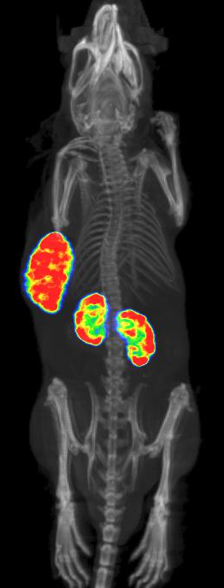
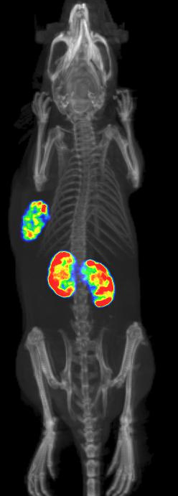
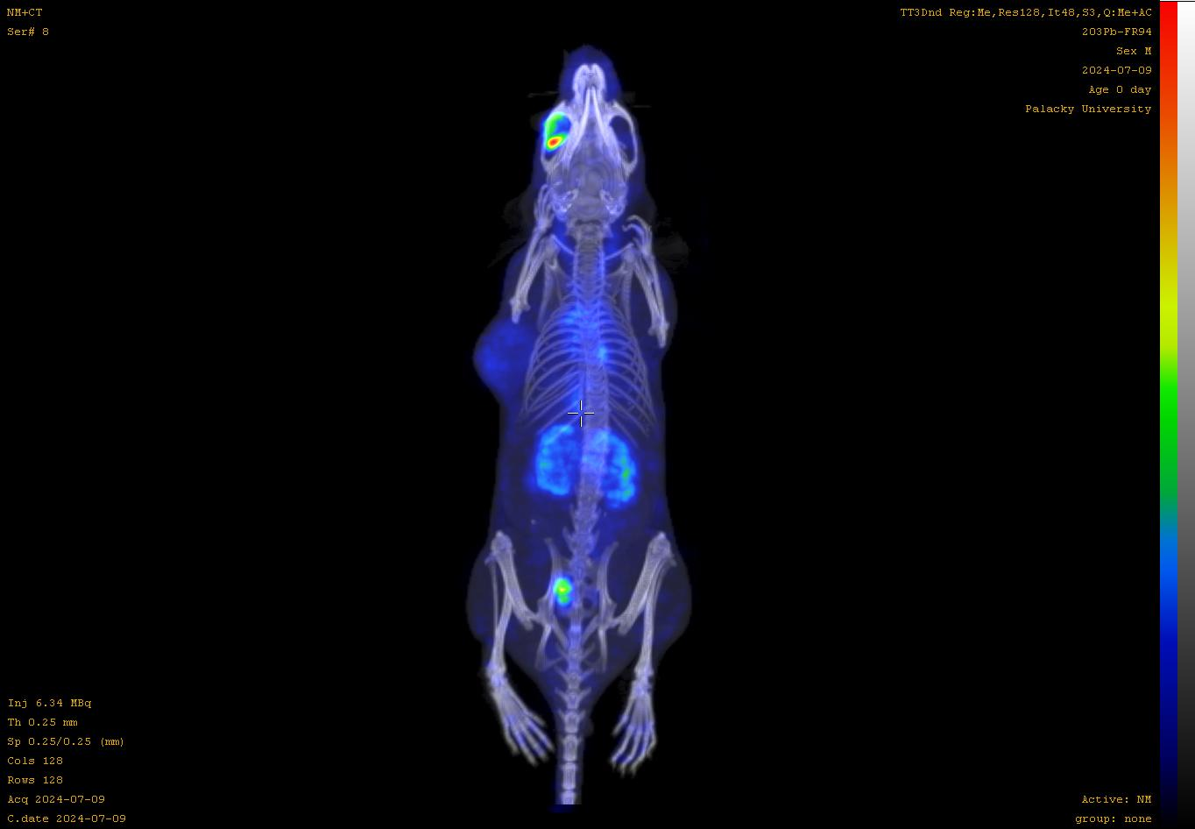
New PSMA-targeted radiopharmaceuticals
Preclinical evaluation (T4.5)
SPECT/CT – 24 h p.i.
5.0
PSMA-617-based compounds
PSMA I&T-based compounds
SUV_{max}
11.1
15.1
10.7
11.5
5.9
SUV
g/ml
0.5
[¹⁷⁷Lu]Lu-PSMA-617
[¹⁷⁷Lu]Lu-PSMA-617-2D
[¹⁷⁷Lu]Lu-PSMA-617-3D
[¹⁷⁷Lu]Lu-PSMA I&T
[¹⁷⁷Lu]Lu-PSMA I&T-2D

Slide 16



Research purpose vs clinical application (T4.5)
Research purpose
Clinical applications
In-house supply
GLP standards (Good laboratory practice)
= standard laboratory procedure
Manual / automated synthesis
Manual radiolabeling
Sterile GLP formulation for in vivo
Safety precautions
Chemical purity > 95%
Radiochemical purity > 95%
Official suppliers of radiopharmaceuticals
GMP standards (Good manufacturing practice)
= additional development of GMP procedure
(Semi)Automated synthesis
(Semi)Automated radiolabeling and purification
Sterile GMP formulation
Certified clean laboratories
Extensive administration
European Pharmacopoeia standards

Slide 17
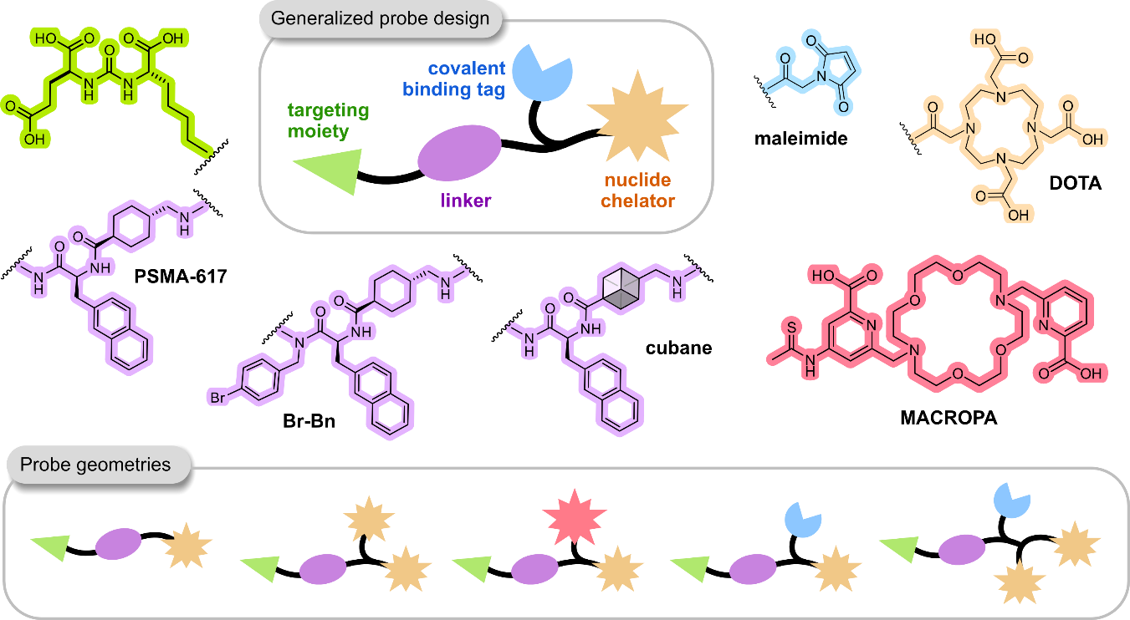
Next steps
T4.3
Follow-up study on PSMA-targeted ligands
T4.4
Optimization of radiolabeling conditions for ligands chosen in T4.3
Preparation of protocols and training
T4.5
Preclinical evaluation of chosen ligands from T4.3 and T4.4
Preparation of protocols

Slide 18

Thank you for your attention
Joao
Seco
Martina
Benešová-Schäfer

