Slide 1
T4.5 Develop protocols for pre-clinical evaluation
of ligand-isotope compound
GNP
Presenter: Chryssa Bekiari, Assistant Professor, AuTh

Slide 2
Overview of the task
Develop protocols and methodologies needed for in vivo testing of produced ligand-isotope compounds in an experimental animal facility.
1. Establish optimum lab conditions
(preparation room and animal room shielding, proper equipment)
2. Personnel training
(radiation protection, isotope handling, isotope administration to animals, contamination management, waste disposal, animal euthanasia and disposal).
3. In vivo experimentation protocols
(pharmacodynamics and pharmacokinetics, tissue distribution, prospective therapeutic applications)
Start Date: | M18
End Date: | M48

Slide 3
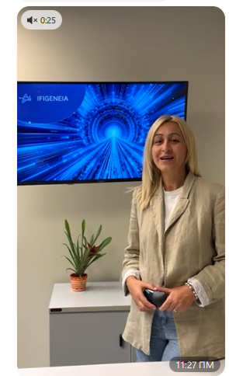
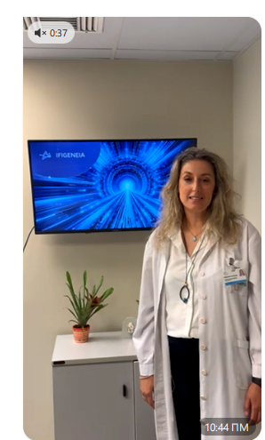
Progress so far (M13)
Participated in WP4 monthly meetings and GNP internal meetings.
Assisted in preparation and completion of hospital questionnaire on radionuclide use (GNP Radiophysicist, Mr Kosmas Badiavas).
Participated in administrative work (PMO officer, Ms Maria Bigaki).
Prepared, recorded and uploaded on Indigo two project videos (Ms Maria Bigaki and Assist. Professor Chryssa Bekiari).
Prepared and provided our own copyright-free photos related to GNP IFIGENEIA work.
Prepared and provided detailed steps of T 4.5 actions focused on ligand-177-Lu.
Identified and reported 4 Critical Risks during Risk Management session.

Slide 4
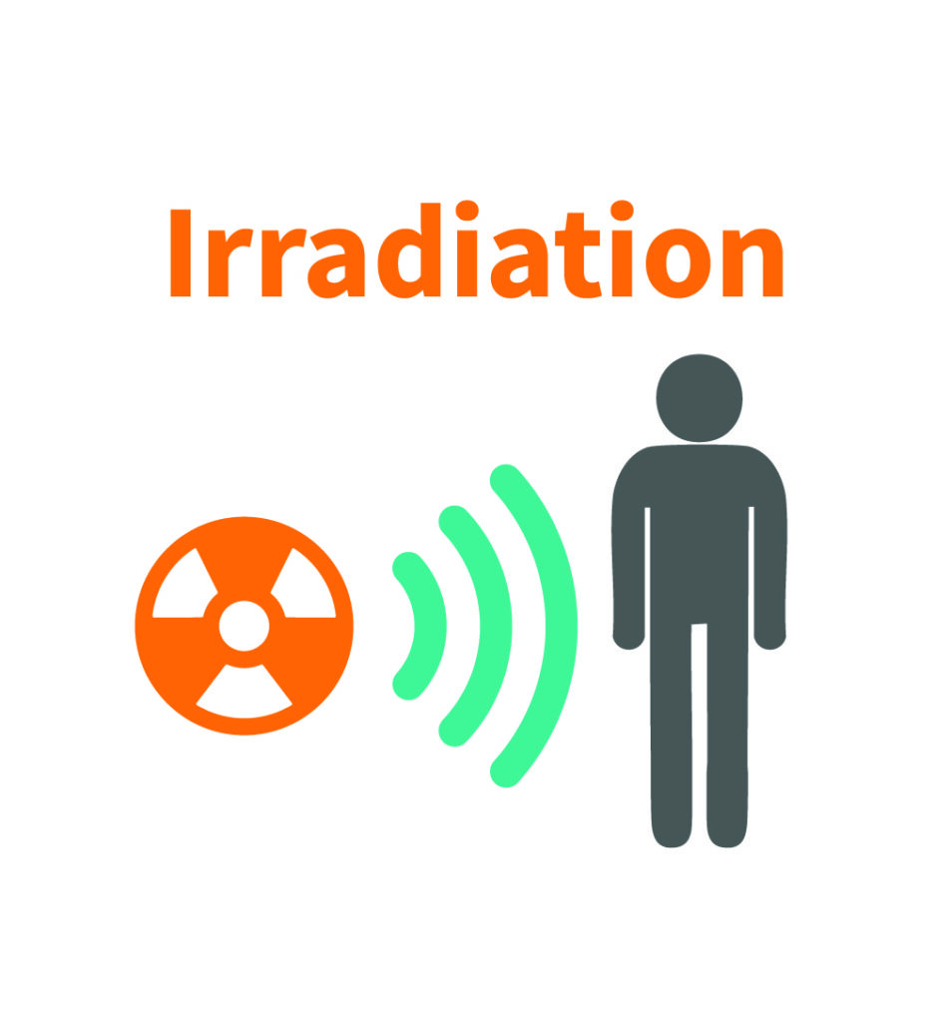

Next steps: To do until the mid-end of 2027
1. Establish optimum lab conditions
(preparation room and animal room shielding, proper equipment)
Follow comments/proposals from annual meeting (May 2026).
T4.1 Develop Lab conditions (radiation protection) needed for producing these isotopes (M1-M42) [BIOKOSMOS].
Secondments/ Visits to:
DKFZ (T4.4 Perform the development
and testing of ligand-isotope compound in vitro (M5-M42).
Optimum lab conditions for handling of ligand-isotope compounds.

Slide 5

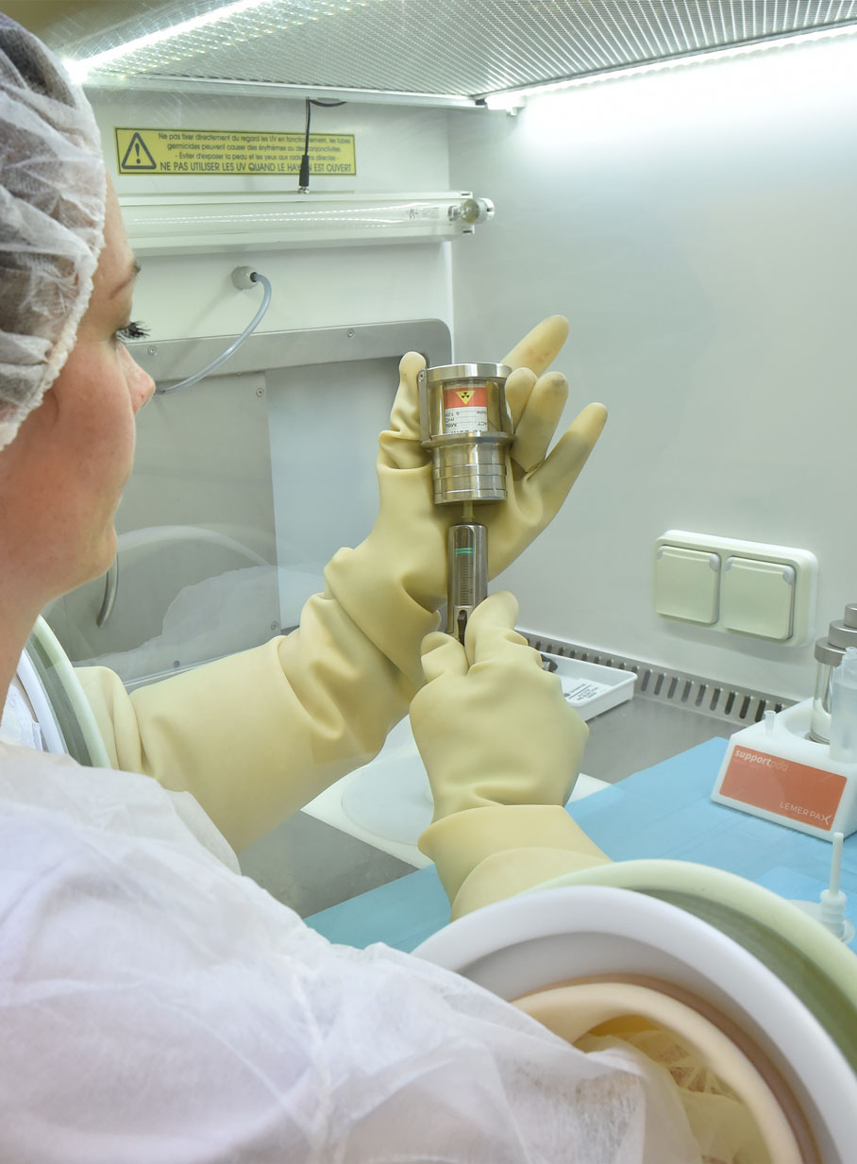

Next steps: To do until the mid-end of 2027
2. Personnel training
(radiation protection, isotope handling, isotope administration to animals, contamination management, waste disposal, animal euthanasia and disposal).
Secondments/ Visits to:
Bioemtech, Athens, Greece
(Assist. Professor C. Bekiari).
Member of IFIGENEIA’S
external advisory board.
EU regulations and legislation search.

Slide 6

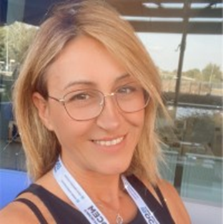
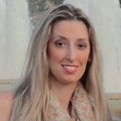
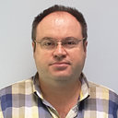
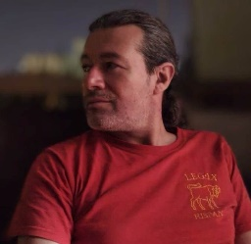

Thank you for your attention
Maria Bigaki, MBA, PMP®
Economist, Program Manager Papageorgiou General Hospital pmo@papageorgiou-hospital.com
Chryssa Bekiari, PhD
Assistant Professor,
Veterinary School, AuTh
chmpekia@vet.auth.gr
Kosmas Badiavas, PhD
Medical Physicist Papageorgiou General Hospital
badiavas@auth.gr
Georgios Parathyras, MBA
Experimental surgery nurse,
Papageorgiou General Hospital
mushashi74@yahoo.gr
www.rcph.gr

