Slide 1
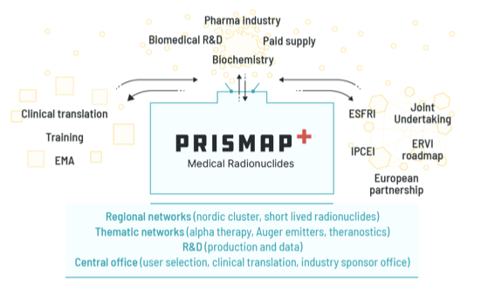
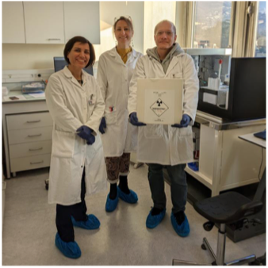
From PRISMAP to PRISMAP +
Furthering the European Medical Radionuclide Programme
T. Stora – CERN - on behalf of PRISMAP and PRISMAP +

Slide 2
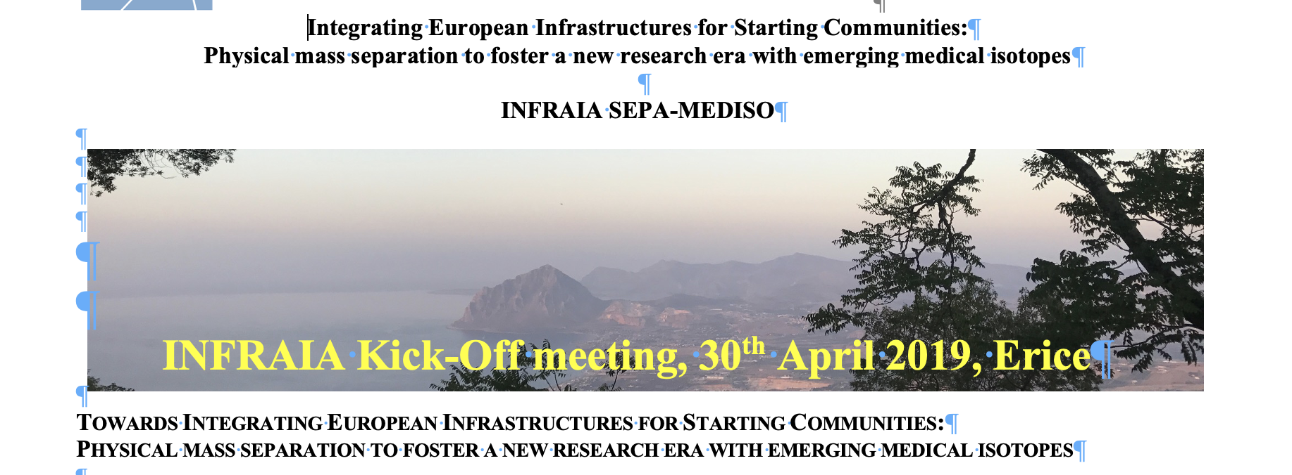
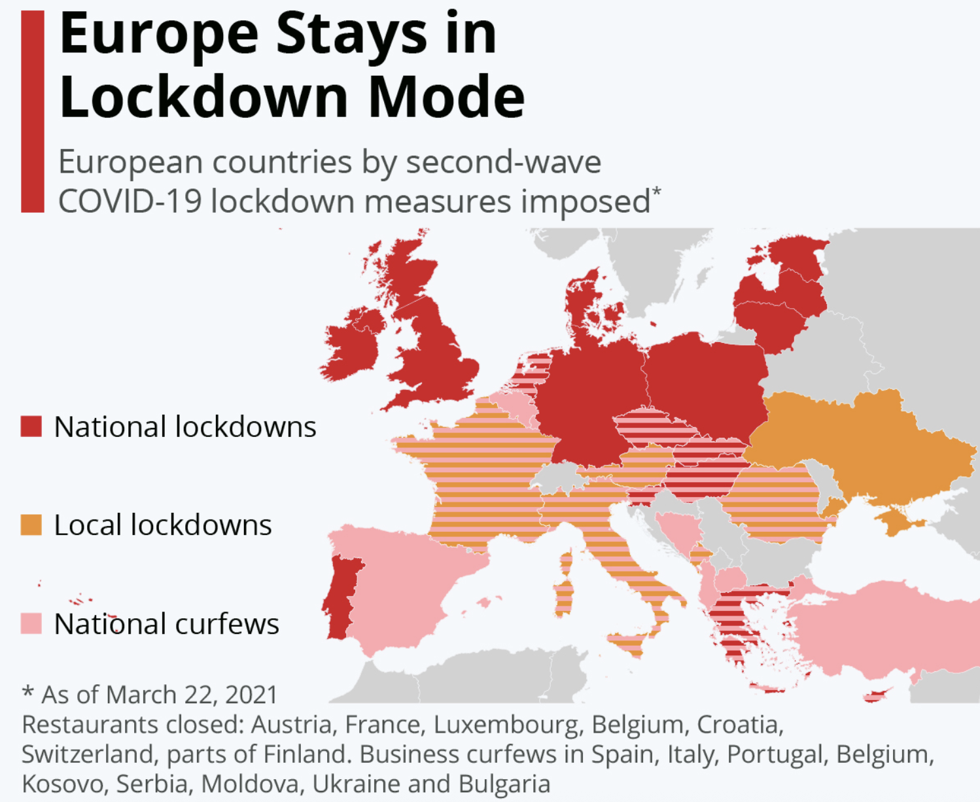
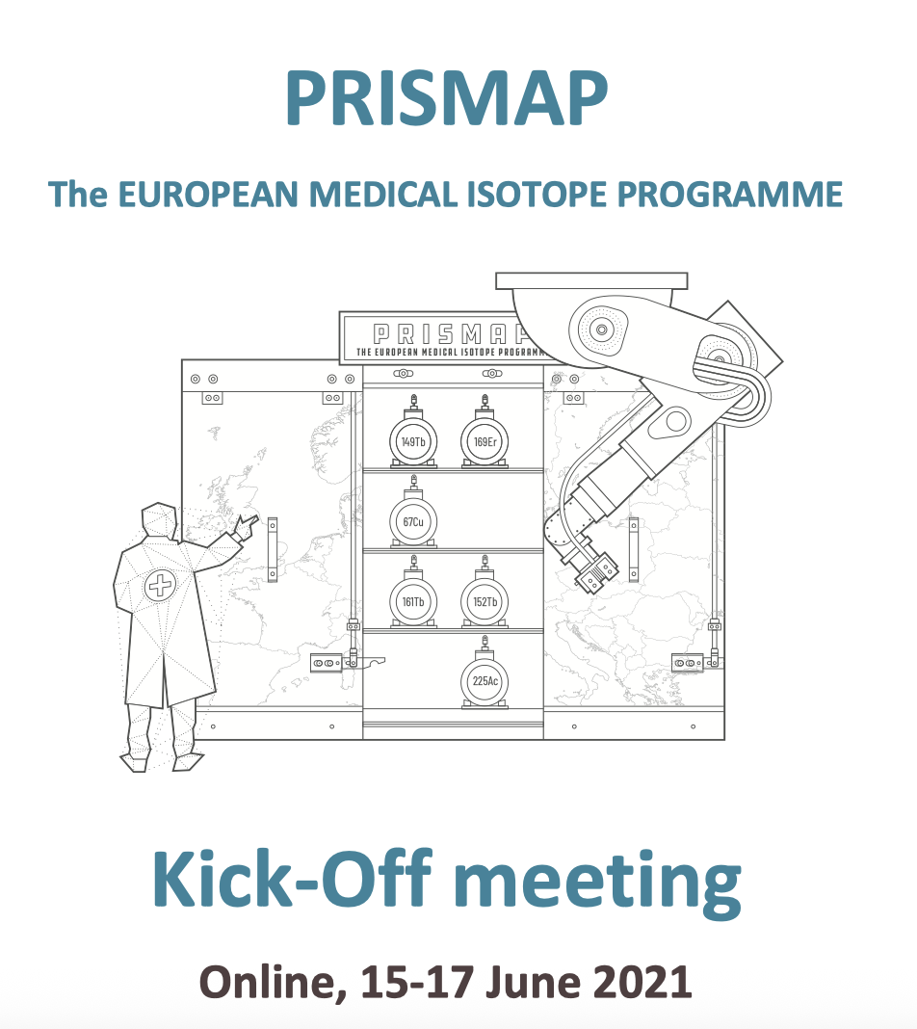
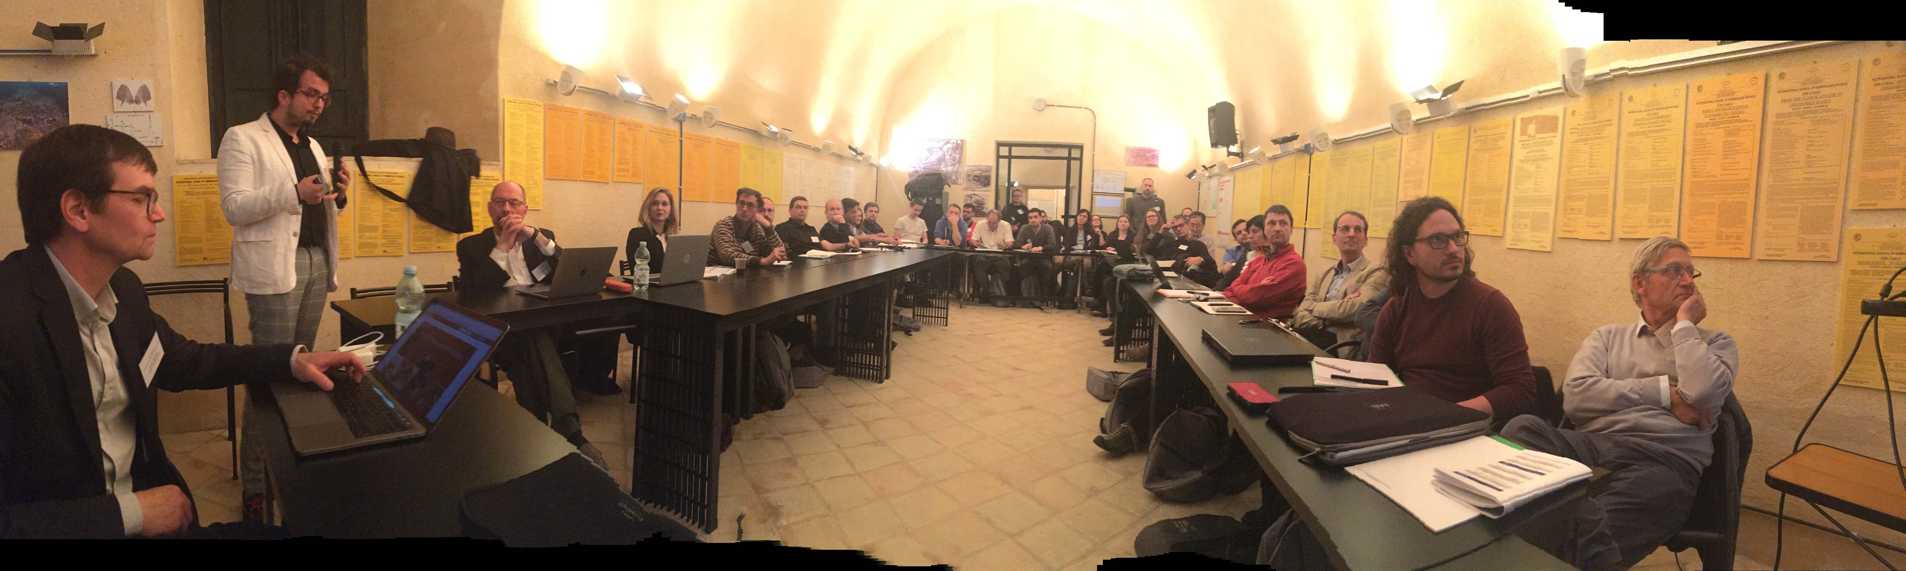
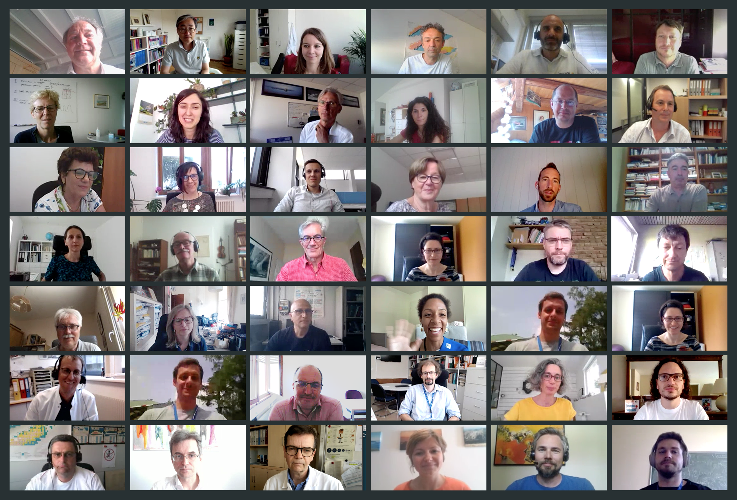

It all started there
From its preparation… … to its start during COVID times
T. Stora PRISMAP(+) furthering the European medical radionuclide programme IFIGENEIA – 07 May 2026

Slide 3
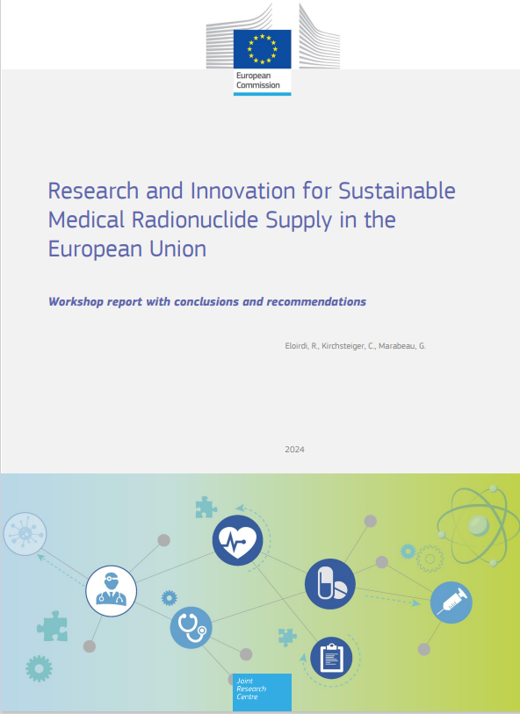


We provide innovative radionuclides as active ingredients to promote research in the field
ERVI European Radioisotope Valley Initiative and PRISMAP
is identified as strategic in Europe https://www.consilium.europa.eu/en/press/press-releases/2024/06/17/radioisotopes-for-medical-use-council-approves-conclusions/
HORIZON-INFRA-2025-01-SERV-02: Research infrastructure services to enable R&I addressing main challenges and EU priorities
USA is strongly supporting their program
T. Stora PRISMAP(+) furthering the European medical radionuclide programme IFIGENEIA – 07 May 2026

Slide 4


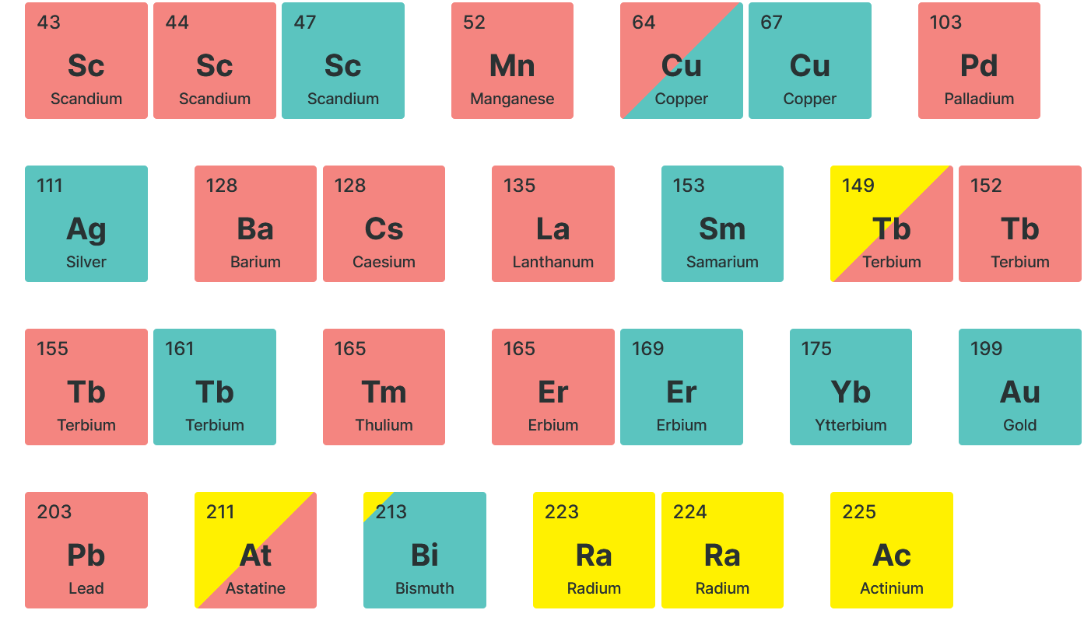
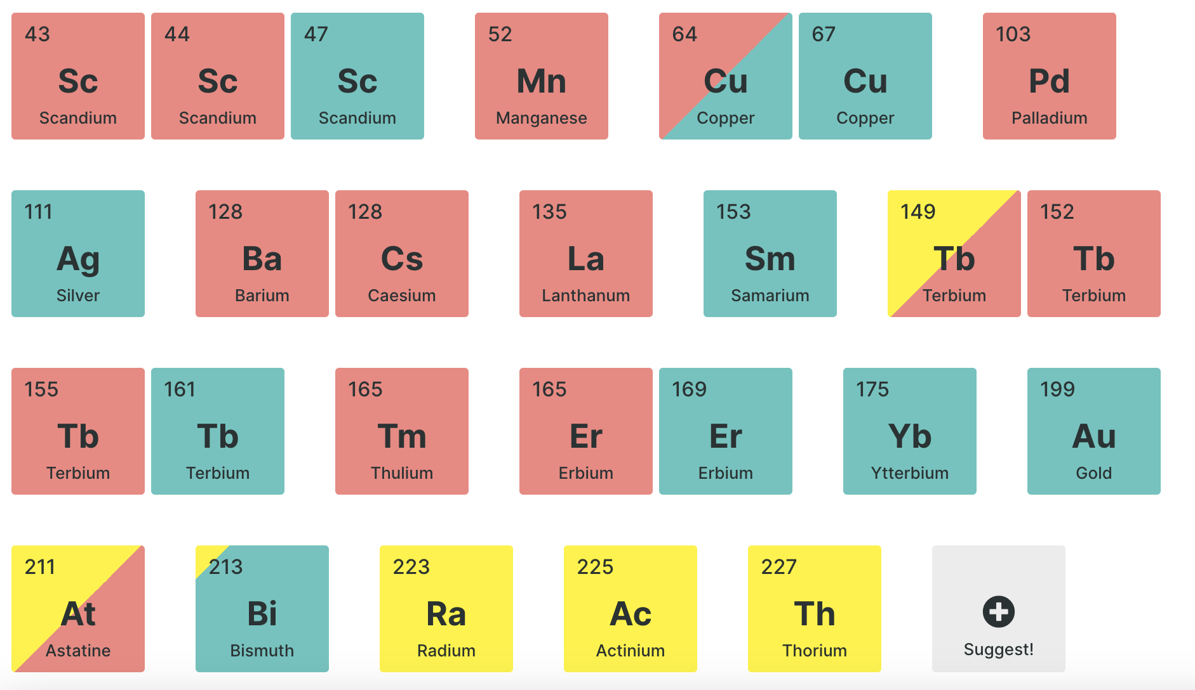
“Quote : We wish we would have a similar programme in the USA”
https://www.prismap.eu/access
An access platform with leading institutes
in the supply chain for European biomedical researchers from 2025…
T. Stora PRISMAP(+) furthering the European medical radionuclide programme IFIGENEIA – 07 May 2026

Slide 5
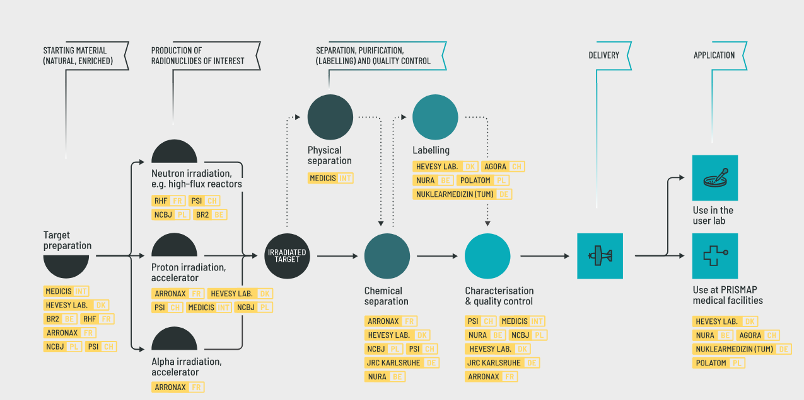
PRISMAP Supply chain (2020-2025)
New radionuclides offered
(Pb203/Pb212, Pd103, …)
4 hours door-to-door
delivery
by small aeroplane
MEDICIS->DTU
New nuclear data
T. Stora PRISMAP(+) furthering the European medical radionuclide programme IFIGENEIA – 07 May 2026

Slide 6
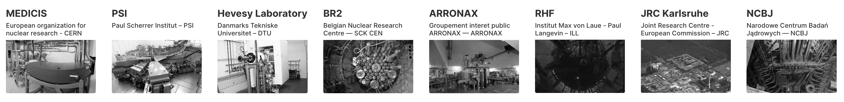
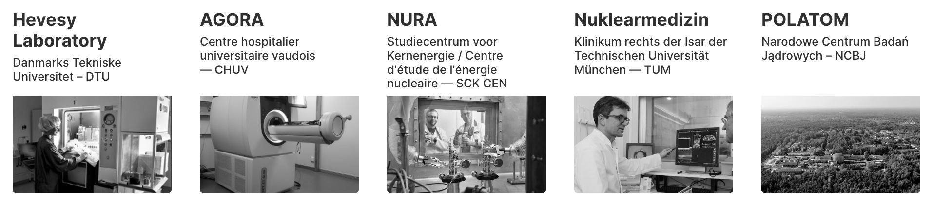
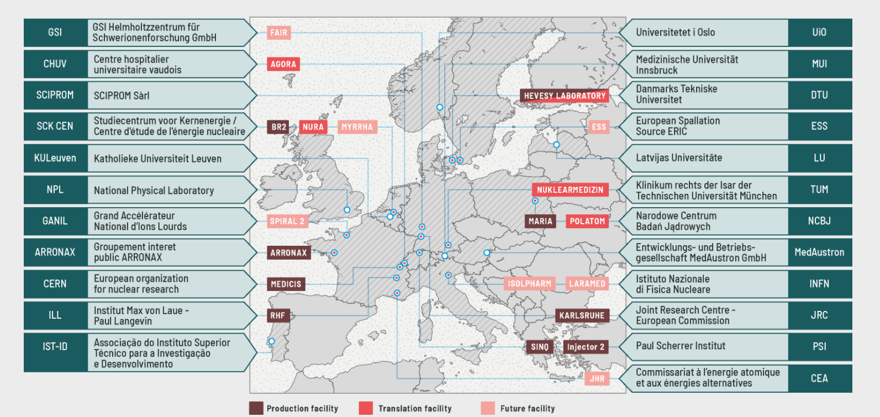
What is in the back of this success ?!
T. Stora PRISMAP(+) furthering the European medical radionuclide programme IFIGENEIA – 07 May 2026

Slide 7
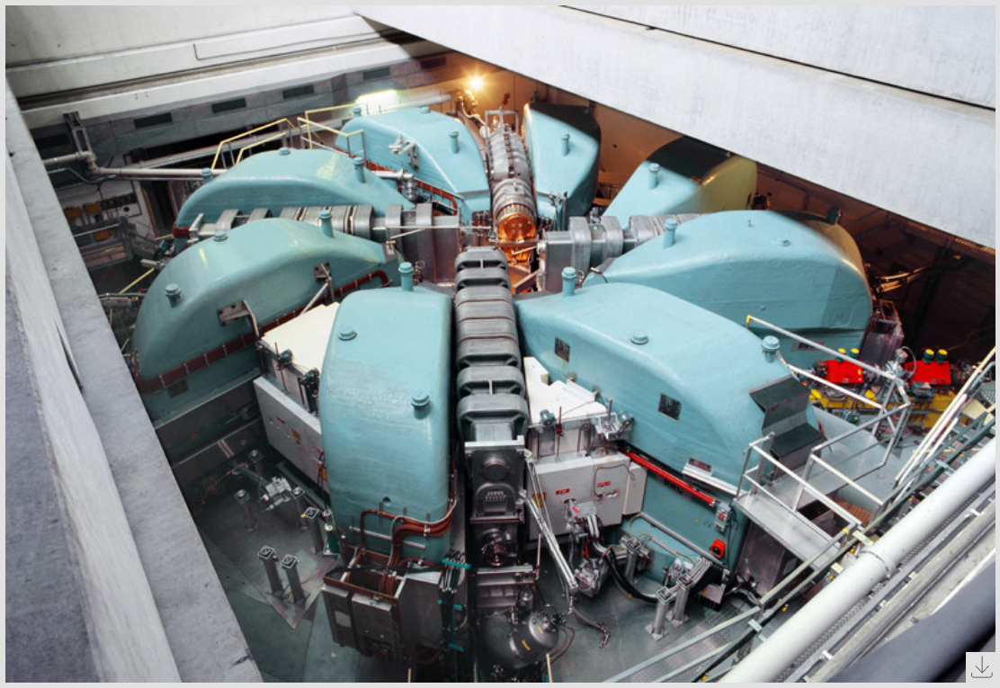
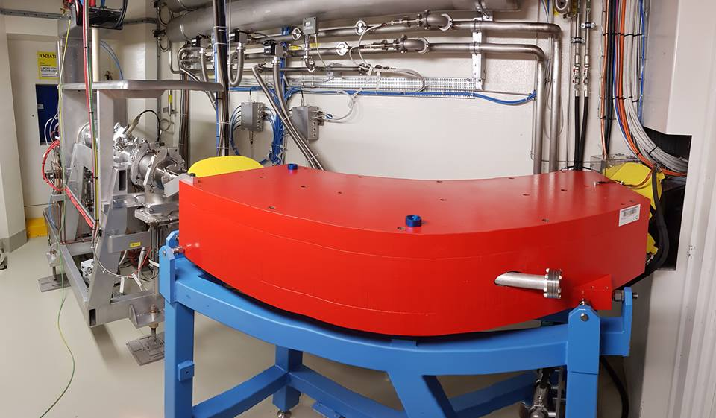
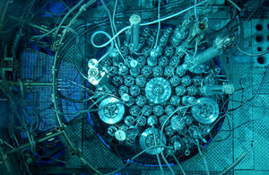
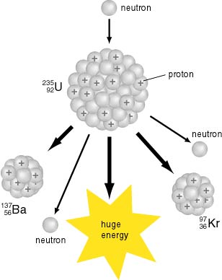
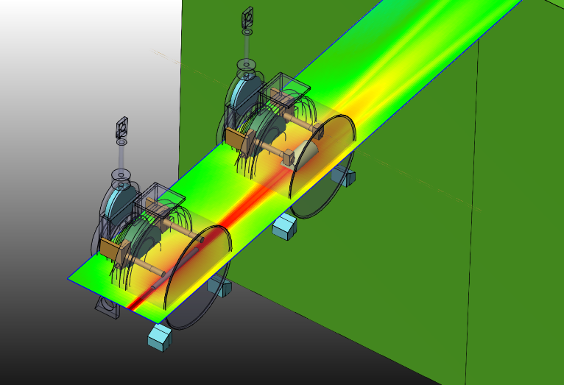

Characteristics of the irradiation facilities in PRISMAP
Underlying principle : irradiation, transfer, mass separation, purification for source dispatch
Accelerator
Isotope mass separation
Research reactor
T. Stora PRISMAP(+) furthering the European medical radionuclide programme IFIGENEIA – 07 May 2026

Slide 8

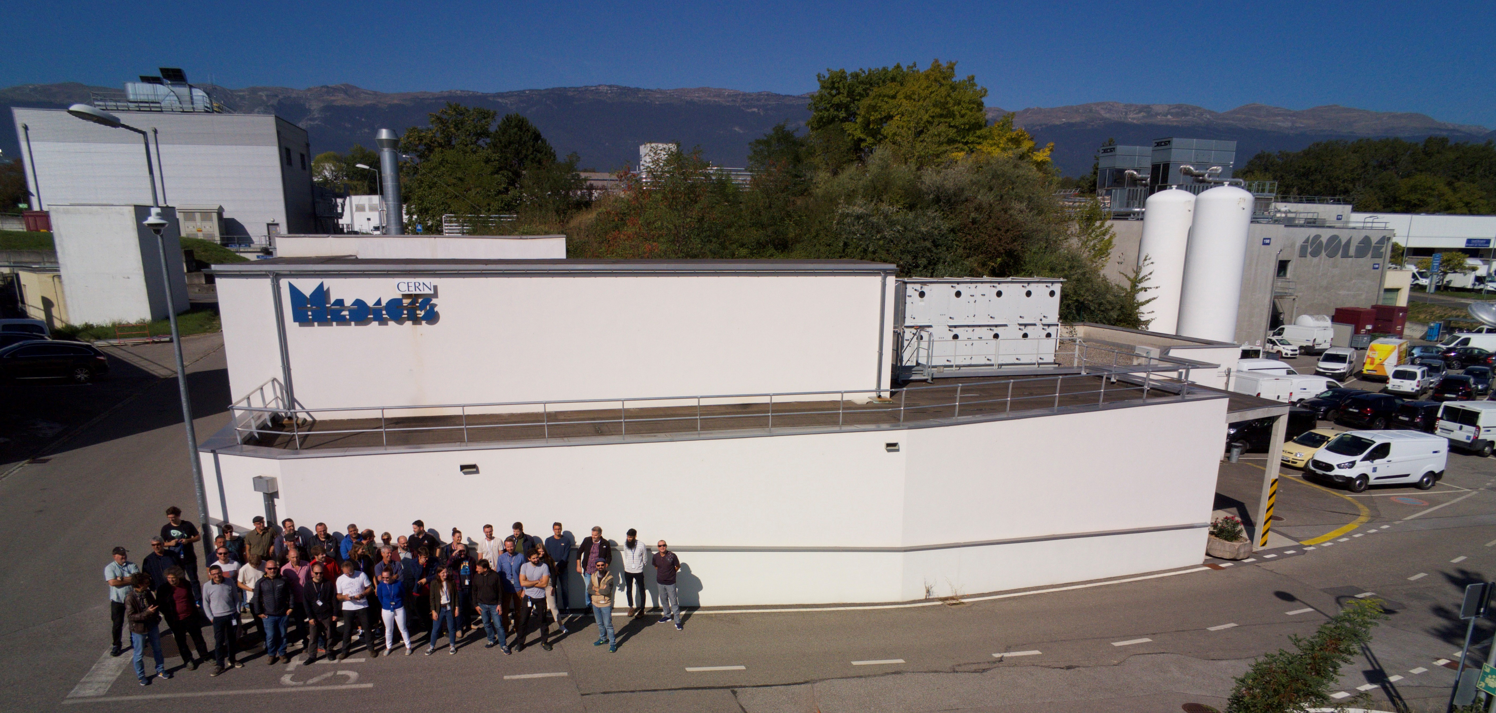


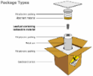

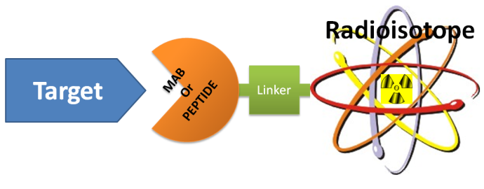
MEDICIS in PRISMAP Supply chain
“Free” proton beam
(otherwise lost in the dump)
Some MEDICIS isotopes :
High activity Sm-153, Ba/Cs-128, Tm/Er-165
MEDICIS
1.4 GeV protons
ISOLDE
120MBq Auger ¹⁶⁵Tm >99%
Produced/delivered in 24hr
A dedicated
medical isotope
Mass separation facility
in Europe.
From CERN- MEDICIS to the lab/Hospital
T. Stora PRISMAP(+) furthering the European medical radionuclide programme IFIGENEIA – 07 May 2026

Slide 9
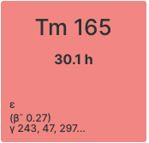
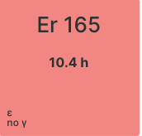
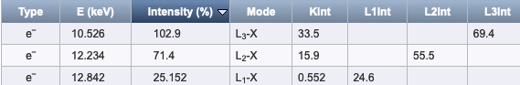
A few interesting cases : matched pure beta- & pure auger pair
Test batch production : 120MBq
>99% radionuclidic purity
Implanted in metallic foil
*
https://www.nucleonica.com/Application/Datasheet.aspx
( 65% higher energy Auger e- emission)
Generator to be developped (user project)
* Parallel collection with Tm-167
T. Stora PRISMAP(+) furthering the European medical radionuclide programme IFIGENEIA – 07 May 2026

Slide 10
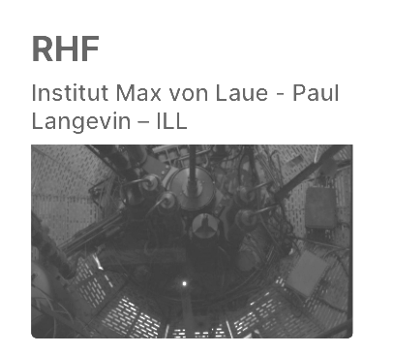
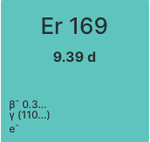
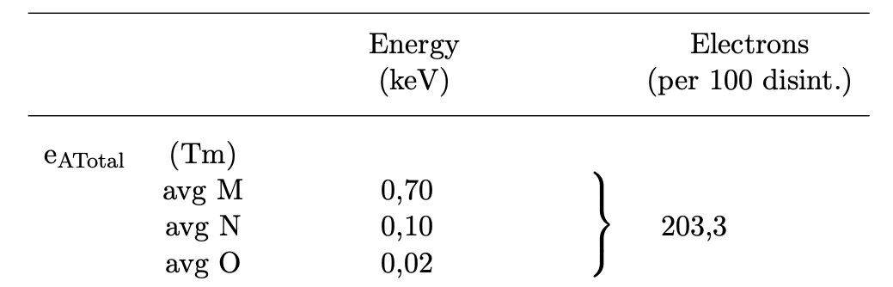
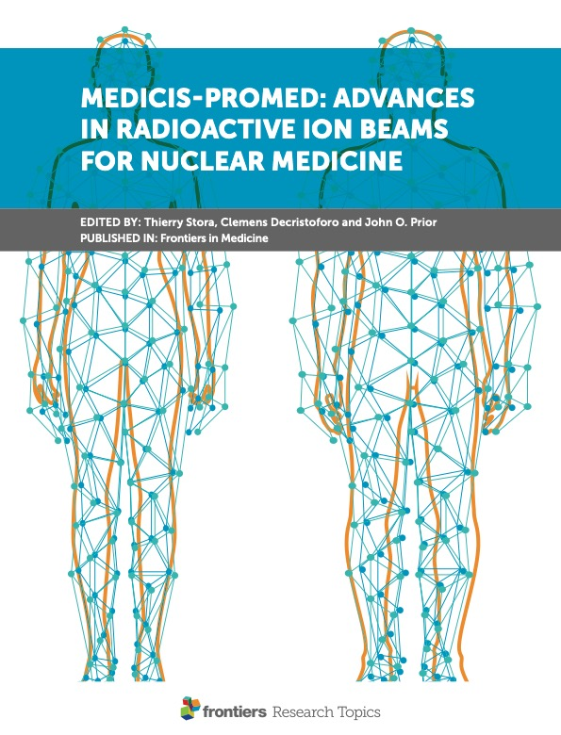
A few interesting cases : radiolanthanides
Low energy beta emitter 2(+1weak) transitions
(Low energy Auger electron emitter)
Radionuclidic impurities suppressed from Er2O3- >98%) by mass and chromatography (Yb 169, Er 171, Er 172)
High molar activity (isotopic ratio 168-169 from reactor produced <1%
to 30-50% after mass separation)
Test batch production 2023 : 150MBq
Z. Talip et al., frontiers in medicine - 2022
https://doi.org/10.3389/fmed.2021.643175
http://www.lnhb.fr/nuclides/Er-169_tables.pdf
T. Stora PRISMAP(+) furthering the European medical radionuclide programme IFIGENEIA – 07 May 2026

Slide 11
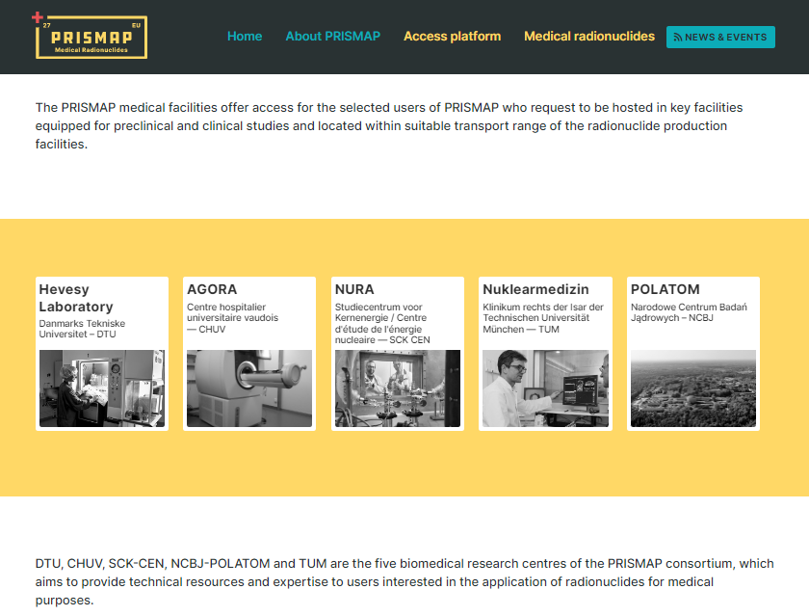
Access to our biomedical facilities
Our medical facilities: https://www.prismap.eu/radionuclides/medical-facilities/
T. Stora PRISMAP(+) furthering the European medical radionuclide programme IFIGENEIA – 07 May 2026

Slide 12
Projects selected in 5 subsequent calls for projects
User Selection Panel
Thierry Stora CERN - coord | Francesco Cicone Magna Graecia Univ Catanzaro - Nucl Medicine
Charlotte Duchemin CERN – techn manager | Sandra Heskamp Razdboud Univ Med Centre – Nucl imaging and Therapy
Ferid Haddad ARRONAX - access | Cornelia Hoehr Univ Victoria, TRIUMF – Life science dept head
Ulli Köster ILL - production | Paul Lecoq Metacrystal SA – head physics div. EURASC
David Viertl CHUV – medical app | Kristoff Muylle Vrije univ Brussels – former pres EANM
Kirsten Leufgen Sciprom – coord | Katherine Vallis Univ. Oxford – prof Radiotherapeutics
T. Stora PRISMAP(+) furthering the European medical radionuclide programme IFIGENEIA – 07 May 2026

Slide 13
Users Feedback
“Deliveries were always on schedule”
“Optimal characteristics such as elevated purity and specific activity”
“The communication was excellent”
“PRISMAP provided us with the opportunity to use an innovative radioisotope with unique characteristics for theranostic applications”
“Great opportunity to establish scientific relationships with like-minded researchers and offers access to unique infrastructures”
“The application process was straightforward, and logistical aspects were handled professionally”
“Communication with PRISMAP was consistently clear and timely throughout the project, particularly regarding radionuclide delivery coordination”
“The team demonstrated excellent responsiveness and provided comprehensive support from initiation to completion”
“The application process was smooth”
“Our experience with PRISMAP services has been exceptionally positive”
“The interest of this kind of project is the collaboration opportunities this can lead”
“Logistics for delivery were well-organized, and all shipments arrived on time”
“Thank you for the outstanding service”
“We appreciate the professionalism and efficiency demonstrated throughout the process”
“Thanks to the excellent communication and flexibility demonstrated by all involved partners, minor issues were effectively addressed”
“We are grateful to PRISMAP and to all our interlocutors for their kindness and dedication”
“The materials provided were of excellent quality, which underlines the uniqueness of the PRISMAP initiative”
T. Stora PRISMAP(+) furthering the European medical radionuclide programme IFIGENEIA – 07 May 2026

Slide 14
Feedback of Projects
“The application process was smooth”
“Our experience with PRISMAP services has been exceptionally positive”
“The interest of this kind of project is the collaboration opportunities this can lead”
“Thanks to the excellent communication and flexibility demonstrated by all involved partners, minor issues were effectively addressed”
Top Rated Oral Presentations @ EANM’25 congress in:
Combination Therapy - Shaping the Future of TRT
Innovations in Translational Oncology
Improving Radionuclide Production for Tracer Development
Congrat’s to our users !
and our PRISMAP R&D institutes !
“The materials provided were of excellent quality, which underlines the uniqueness of the PRISMAP initiative”
T. Stora PRISMAP(+) furthering the European medical radionuclide programme IFIGENEIA – 07 May 2026

Slide 15
Dispatch of radionuclides across projects and Europe, and beyond
T. Stora PRISMAP(+) furthering the European medical radionuclide programme IFIGENEIA – 07 May 2026

Slide 16
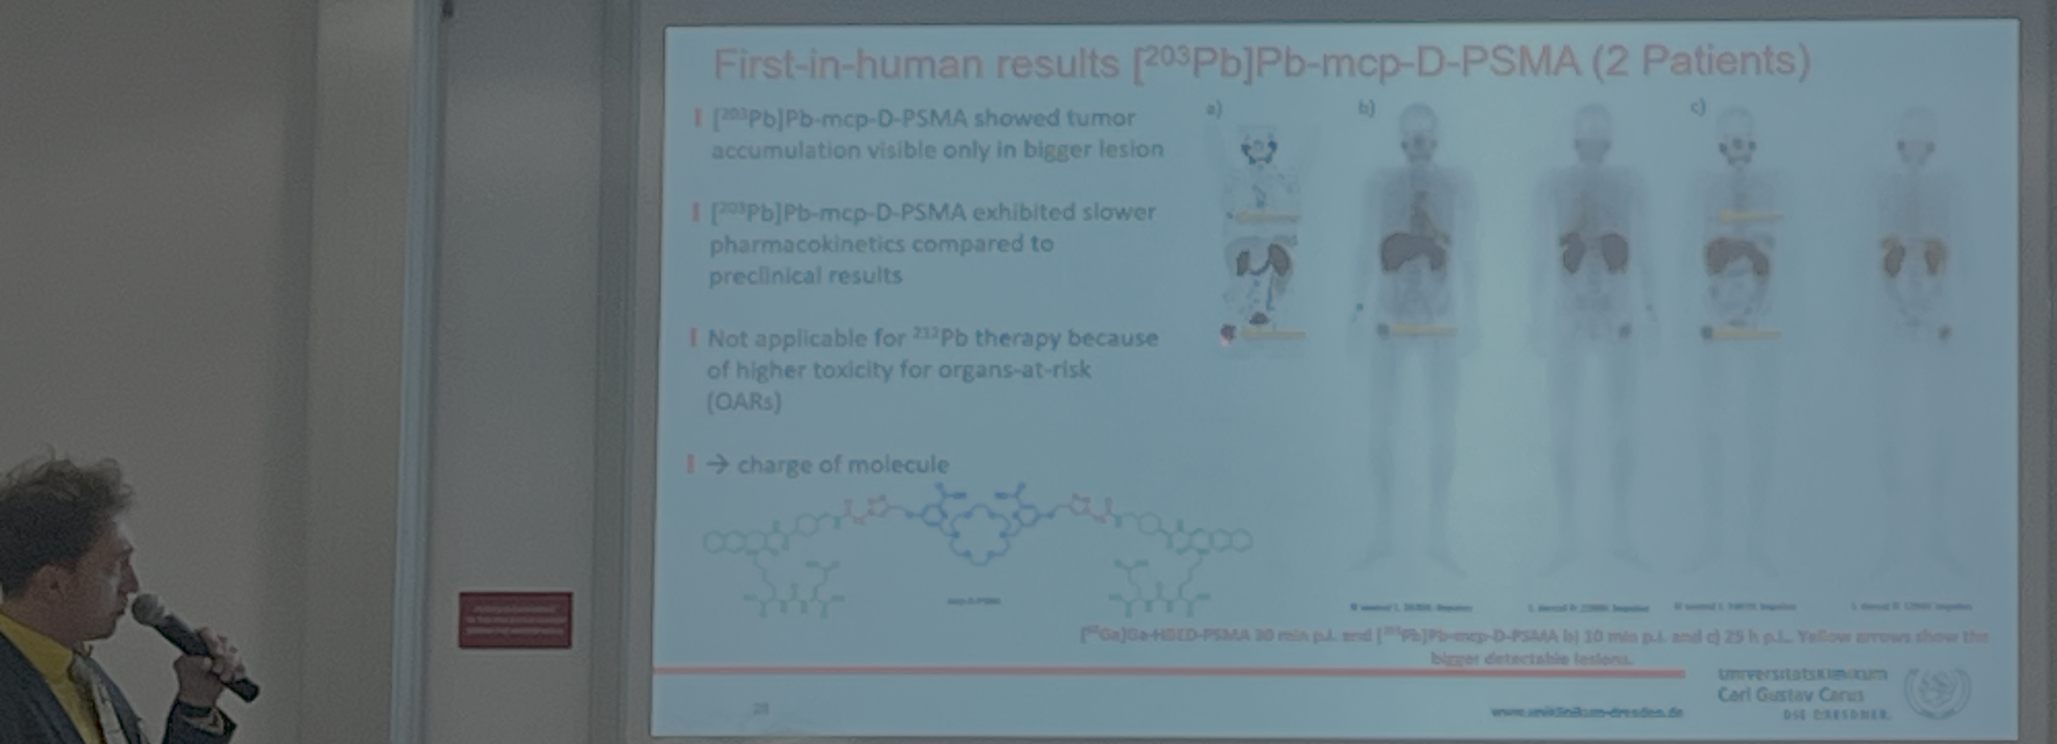
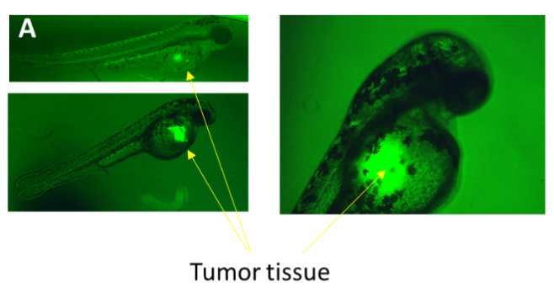
Biomedical translation in PRISMAP
3 projects aimed at performing clinical translation : first-in-human and phase-1/pilot trials
P4 Towards 161Tb-PSMA cell targeting treatment of prostate cancer biochemical recurrence: Comparison with 177Lu-PSMA | Tb-161 | Dr. M. Kirienko (IT)
A Single-Center Prospective Phase I Study to Evaluate Dosimetry and Safety Of [161Tb]Tb-PSMA I&T In Patients With Metastatic Prostate Cancer
P.I. - Dr. Margarita Kirienko.
EU #2026-5252-44-14.
Compassionnate care presented at public session and in the final report
P31 203/212Pb-mcp-D-PSMA for an improved tumor therapy: Preclinical evaluation, automatisation and translation to clinical application | Pb-203/Pb-212 | Dr. M. Pretze (DE)
P14
Zebrafish embryo as a novel model to
evaluate the efficacy of short range emitters
used for targeted radionuclide therapy
Prof. C. Morgat (FR)
Translation
with support letter from PRISMAP
T. Stora PRISMAP(+) furthering the European medical radionuclide programme IFIGENEIA – 07 May 2026

Slide 17
Clinical Trials with Tb-161
EValuation of radIOLigand Treatment in mEn With Metastatic Castration-resistant Prostate Cancer With [¹⁶¹Tb]Tb-PSMA-I&T (VIOLET) (2022-2026, Phase 1 and Phase 2)
Peter MacCallum Cancer Centre (Australia)
Combined Beta- Plus Auger Electron Therapy Using a Novel Somatostatin Receptor Subtype 2 Antagonist Labelled With Terbium-161 (¹⁶¹Tb-DOTA-LM3) (Beta plus) (2023-2025-Early Phase 1)
University Hospital Basel (Switzerland)
Targeted Radionuclide Therapy in Metastatic Prostate Cancer Using a New PSMA Ligand Radiolabelled With Terbium-161 (¹⁶¹Tb-SibuDAB) - Dose Identification/​Escalation Phase Ia/​b Study (PROGNOSTICS) (2024-2028 – Phase 1)
University Hospital Basel (Switzerland)
Tb-PSMA-I&T Radionuclide Before Radical Prostatectomy in Patients With Locally Advanced Prostate Cancer - TbeforePROST Trial (2025-2028, Phase I and Phase 2)
Rabin Medical Center (Israel)
Study on the Safety, Tolerability, and Preliminary Efficacy of ¹⁶¹Tb-NYM032 in Patients with Metastatic Castration-Resistant Prostate Cancer (2025-2026, Phase 1 and Phase 2)
Mianyang Central Hospital (China)
(courtesy WP12 radiolanthanides – Z. Talip)
T. Stora PRISMAP(+) furthering the European medical radionuclide programme IFIGENEIA – 07 May 2026

Slide 18
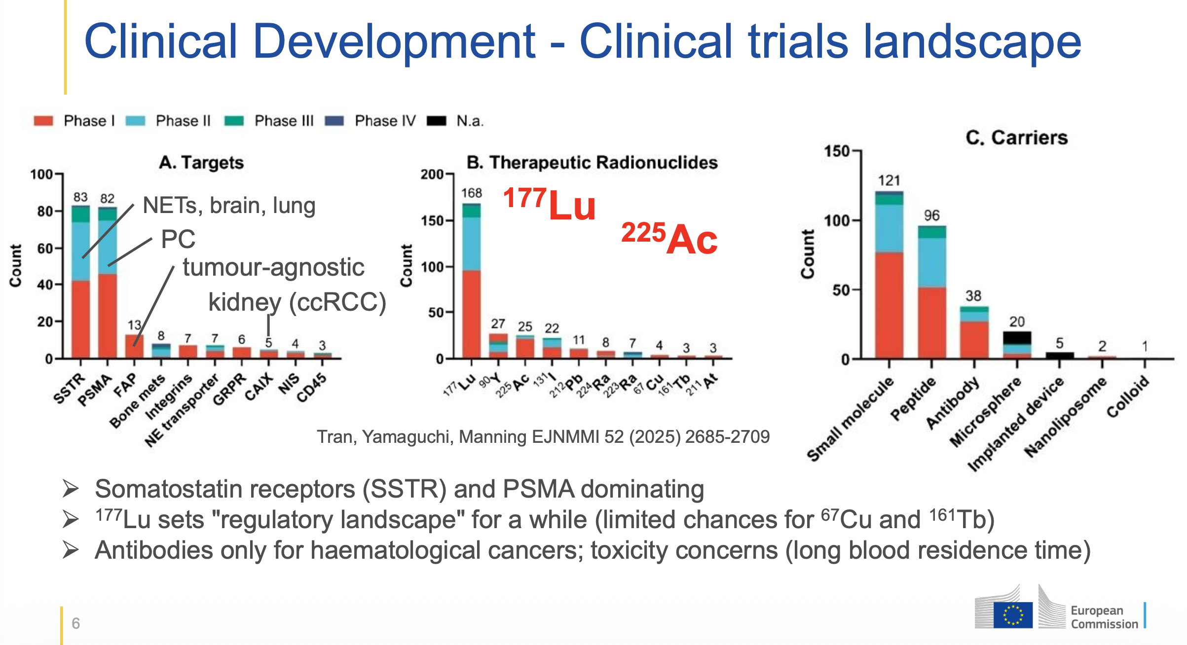
Clinical trials landscape
Courtesy Uwe Horwarth JRC , 03/2026
T. Stora PRISMAP(+) furthering the European medical radionuclide programme IFIGENEIA – 07 May 2026

Slide 19
PRISMAP funded projects
CALL 1 | Project Title | Involved radionuclides | Leading Scientist | Country
P4 | Towards 161Tb-PSMA cell targeting treatment of prostate cancer biochemical recurrence: Comparison with 177Lu-PSMA | Tb-161 | Dr. M. Kirienko | Italy
P5 | Dedicated phantom measurements to develop and validate quantitative 225Ac-(micro)SPECT imaging | Ac-225 and decay products | Dr. M. Koole | Belgium
P6 | The FIAPo project: Feasibility of increased 211At production by 210Po assessment | At-211 | Dr. M. Sevenois | Belgium
P7 | Selective oncological theragnostic based on radioactively labeled exosomes (TheragnEso) | Tb-161 | Dr. B. Salinas Rodríguez | Spain
P8 | Improved FAP-radiotheranostics for personalized cancer treatment. | At-211/F-18 | Prof. F. Elvas | Belgium
P9 | Dual 152Tb/149Tb radiolabeling and preclinical validation of an AAZTA-FAPi ligand for diagnostic and theranostic applications | Tb-149/152/161 | Prof. E. Terreno | Italy
P10 | Imaging applications of 165Er | Er-165/Tb-155 | I.Da Silva | France
P11 | Development and preclinical evaluation of a mesothelin-targeting theranostic agent | Tb-161 | Dr. A. Broisat | France
P12 | Added Value using Terbium-161 over Lutetium-177 in Combination with the metabolically more stable GRPR Ligand AMTG for Targeted Radiotherapy of GRPR-expressing Malignancies? – A Preclinical Evaluation | Tb-161 | Dr. T. Günther | Germany
CALL 2 | Project Title | Involved radionuclides | Leading Scientist | Country
P14 | Zebrafish embryo as a novel model to evaluate the efficacy of short-range emitters used for targeted radionuclide therapy | Tb-155/161 & Lu-177 | Dr. C. Morgat | France
P16 | ScandAL: Scandium-43 Antibody-fragment Labelling | Sc-43 | Dr. B. Kuhnast | France
P17 | Targeted radiotherapy of radioresistant cancers – a radiobiological study with advanced cell models | Cu-64/67 | Dr. J-P. Pouget | France
P18 | Theranostic targeting of fibroblast activation protein (FAP) with gold nanoparticles | Cu-67 | Prof. F. Elvas | Belgium
P19 | PSMA-targeted alpha therapy using novel 225Ac-labeled radioconjugates | Ac-225 | Dr. K. Zarschler | Germany
P20 | New chelators for complexation of medically useful lanthanide and actinide | Tb-161, Ac-225, Th-227 | Dr. M. Ma | UK

Slide 20
PRISMAP funded projects
CALL 3 | Project Title | Involved radionuclides | Leading Scientist | Country
21 | In vitro and in vivo validation of new chelators for Ac-225 targeted alpha-therapy | Ac-225 | Prof. L. Tei | Italy
CALL 4 | Project Title | Involved radionuclides | Leading Scientist | Country
P27 | Radioconjugates of 103Pd for Auger electron therapy of HER2+ breast and ovarian cancer and neuroendocrine tumors | Pd-103 | Prof. A. Bilewicz | Poland
P28 | UTOPY: Unleashing the Theranostic Potentiality of Silver-111 | Ag-111 | Dr. M. Asti | Italy
P29 | Antibody-based molecular radiotherapy: assessment of 161Tb-AKIR001 for potential treatment of CD44v6-positive cancer | Tb-161 | Pr M. Nestor | Sweden
P31 | 203/212Pb-mcp-D-PSMA for an improved tumor therapy: Preclinical evaluation, automatization and translation to clinical application | Pb-212/Pb-203 | Dr. M. Pretze | Germany
P33 | Targeted alpha-radioimmunotherapy with Ac-225 for Neuroblastoma using Dinutuximab beta | Ac-225 | Dr. P. Gawne | UK
P34 | The absorbed dose – response relationship of Auger electrons from La-135 | La-135 | Dr. M. Crabbe | Belgium
P35 | Radioligand Development for the Gastrin Releasing Peptide Receptor Targeting using the Theranostic Pair 44/47Sc | Sc-44/47 | Dr. E. Gourni | Suisse
P36 | Dual-Tracer PET Imaging – Proof-of-Concept Study with 44Sc and 18F on a MILabs VECTor4 Scanner System | Sc-44/47 | Dr. V. Felber | Germany
P38 | [64Cu/67Cu]Radiolabeled exosomes as a theranostic tool for lung metastasis | Cu-64/67 | Dr. A. Abrunhosa | Portugal
P39 | Delivering molecularly targeted radionuclide therapy to alleviate immune suppression in glioblastoma. | Tb-161 | Dr. G. Kramer-Marek | UK
P41 | Comparing radiolabelled PARP inhibitors: α, β, and Auger electron emissions | Ac-225 | Dr. B. Cornelissen | Netherlands
P42 | Impact of Tb-156 pollution on image quality and quantitative accuracy of gamma camera imaging with Tb-155 | Tb-155 | Dr. O. Bacri | France
P44 | Terbium Chelation for Nuclear Medicine | Tb-161 | Dr. M. Meyer | France
P45 | Exploratory investigations on DNA damage and stress responses inflicted in cancer cells by therapeutic radionuclides - monotherapy and combinatorial therapies approach | Cu-67 | Dr. D. Niculae | Romania
P46 | Identification and assessment of A20FMDV2-derived compounds for a theranostic approach to αVβ6-targeted alpha therapy with lead-203 and lead-212 | Pb-212/Pb-203 | Dr. M. Palmer | UK
P48 | Efficacy and Safety of [211At]At-Substance P as Adjuvant Therapy in Recurrent Glioblastoma Multiforme | At-211 | Dr C. Domingos | Portugal

Slide 21
PRISMAP funded projects
CALL 5 | Project Title | Involved radionuclides | Leading Scientist | Country
P50 | Accurate determination of the activity and nuclear decay data of 175Yb | Yb-175 | Dr Kossert | Germany
P51 | Theranostic terbium-labeled immunoconjugates targeting prostate cancer (TheraTerb | Tb-161 | Dr Meyer | France
P52 | Palladium/rhodium chemistry for next generation radiopharmaceutical therapy (PATH) | Pd-103 | Dr Morgat | France
P54 | Novel Macrocycles for Stabilizing Radium-223: Advancing Targeted Alpha Therapy | Ra-223 | Dr Battistin | France
P55 | In vitro and in vivo characterization of novel FAP-targeting small molecule based radioconjugates designed to selectively bind to FAP with either covalent irreversible manner or reversible manner and prolonged residence time | Tb-161 | Dr Goutopoulos | USA
P57 | Development and assessment of 161Tb-targeted therapeutics in novel models of neuroendocrine cancer | Tb-161 | Dr Grayson | UK
P58 | Terbium-161 radiolabelling of an engineered PARP1 inhibitor bearing AAZTA chelator | Tb-161 | Dr Destro | Italy
P61 | Druglike FAPIs with extended tumor residence time | At-211 | Dr Elvas | Spain
P62 | Novel chelators for scandium radionuclides for theranostic applications in a prostate cancer model | Sc-47 | R. Kornmann | UK
P63 | Actinium for AlphaMet | Ra-225 | Dr Rusnak | Tcheque Republic
P66 | Novel prosthetic groups for the 211At-astatination of biomolecules via disulphide rebridging | At-211 | Dr Krzyczmonik | Poland
P68 | The Marvel of Advanced Radiolanthanides: Next-Generation Radio-Optical Nanoparticles in Modern Nuclear Medicine | Er-169 | Dr Zajdel | Poland
P71 | Manganese-52 for applications on multiple coincidence detection in Positron Emission Tomography | Mn-52 | Dr Moskal | Poland
P72 | Terbium radiolabelling of new multimodal PET/MRI cyclodextrin inclusion complexes | Tb-161 | Dr Sneddon | UK
T. Stora PRISMAP(+) furthering the European medical radionuclide programme IFIGENEIA – 07 May 2026

Slide 22
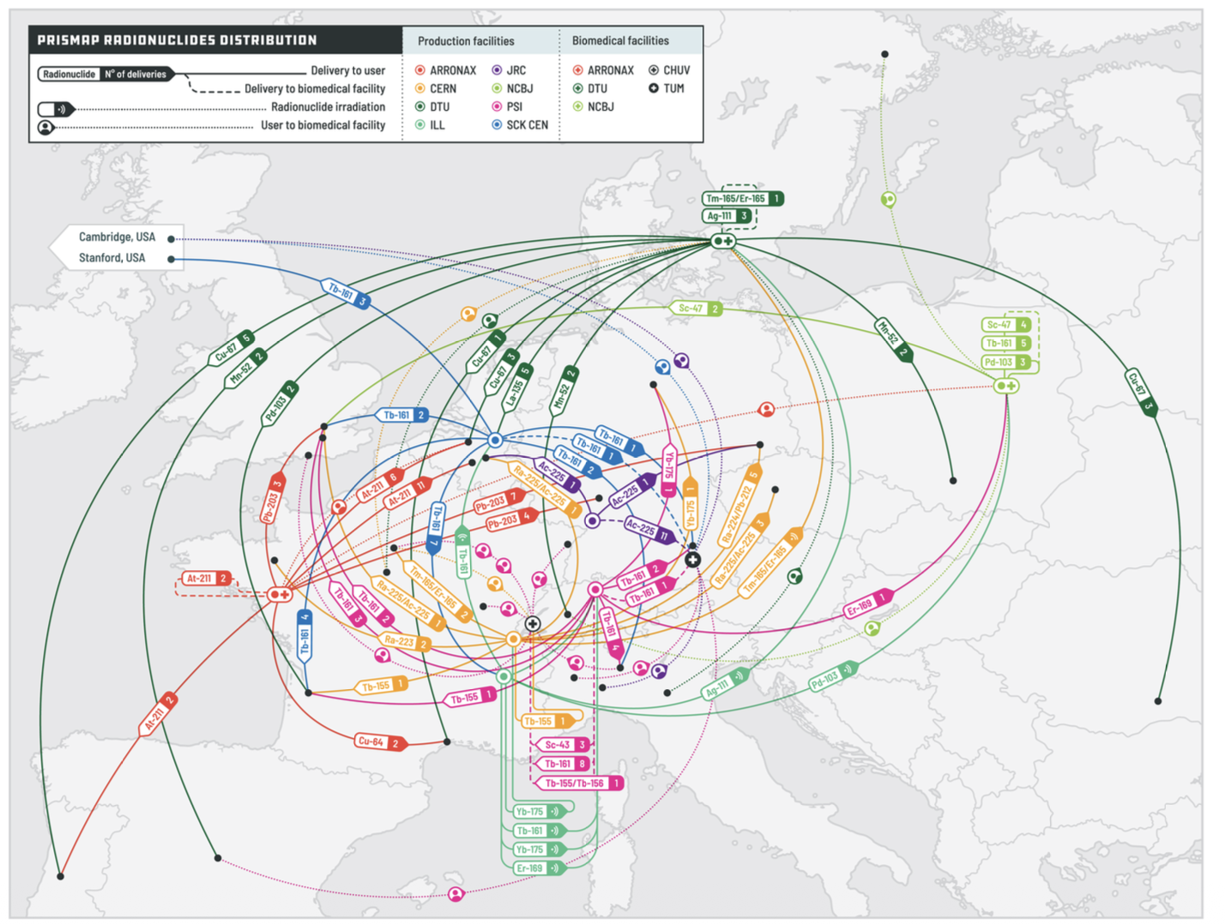
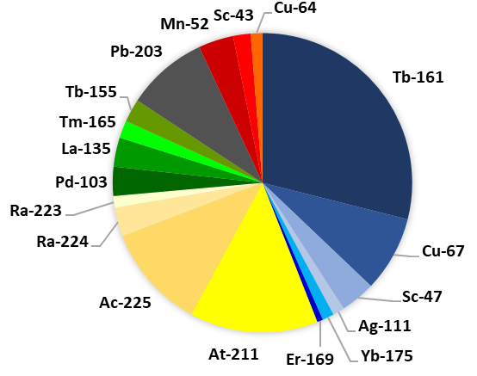
Radionuclides supplied and User access

Slide 23
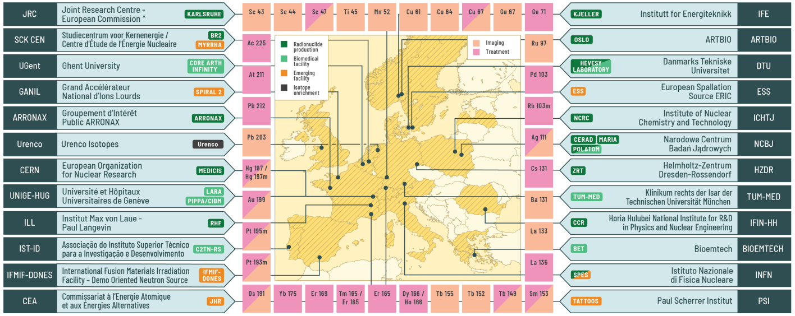
Key emerging infrastructures in PRISMAP+
Charged-particle irradiation mass separation
SPES – INFN-LNL (Italy)
ISOL@MYRRHA – SCK CEN (Belgium)
TATTOOS – PSI (Switzerland)
(Fast) neutron-irradiation
IFMIF-DONES (Spain)
ESS (Sweden)
JHR – CEA Cadarache (France)
SPIRAL2 – GANIL (France)
T. Stora PRISMAP(+) furthering the European medical radionuclide programme IFIGENEIA – 07 May 2026

Slide 24
PRISMAP+, Furthering the European medical radionuclide programme
White Paper on Emerging Facilities for Production of Novel Radionuclides for Use in Nuclear Medicine
L. Zanini, ESS, editor, 2025 https://doi.org/10.5281/zenodo.17257280
T. Stora PRISMAP(+) furthering the European medical radionuclide programme IFIGENEIA – 07 May 2026

Slide 25
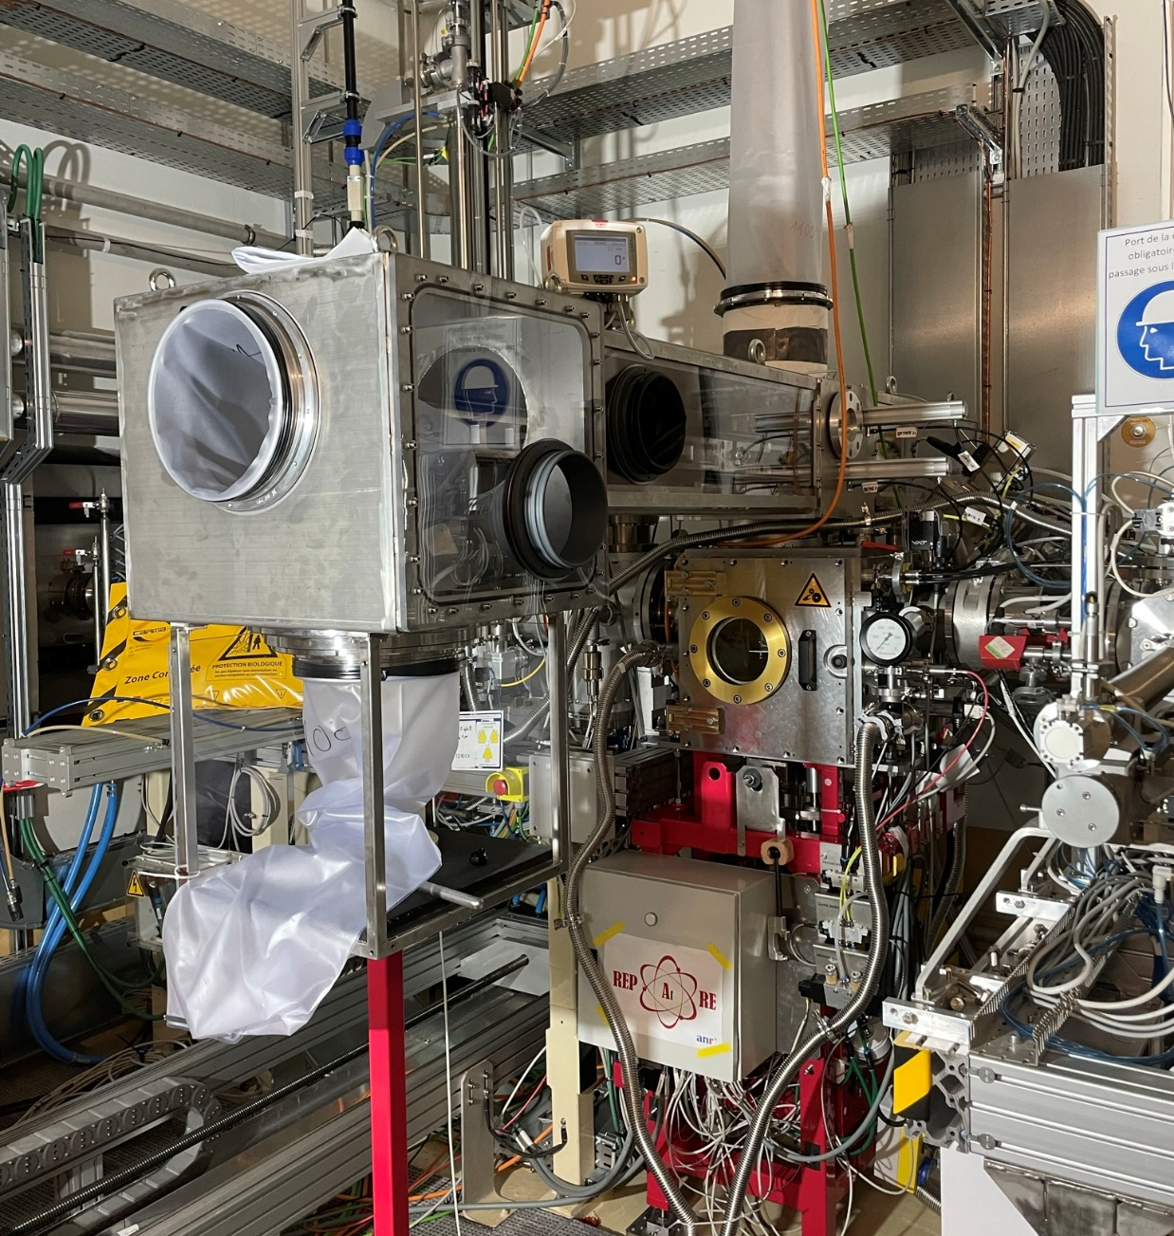
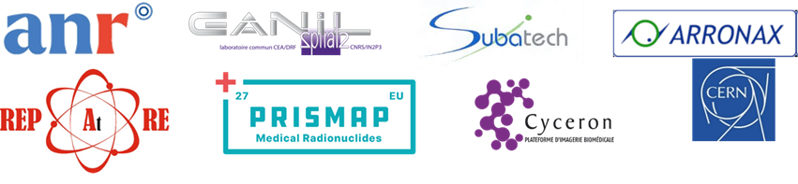
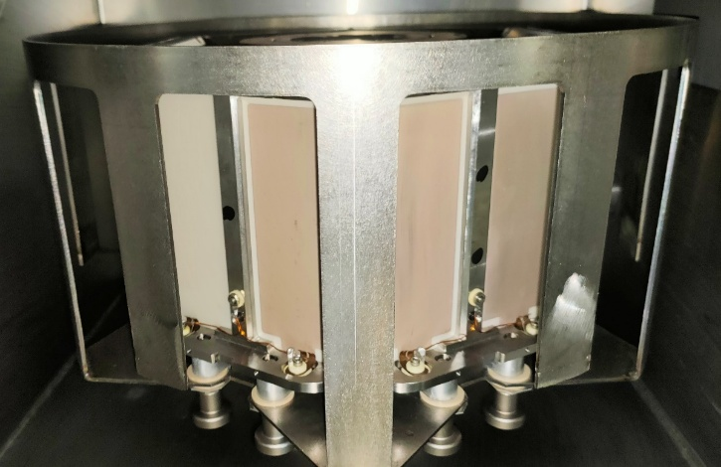
Task 1- Target design and characterisation: Targets for Direct Production
High power targetry at GANIL (Gilles Defrance, GANIL)
High Power (10 kW) Bismuth Target
(²¹¹At prod. via alpha+²⁰⁹Bi reaction channel)
2023: preliminary tests
September 2024: main test
α beam, 7MeV/A, 2 kW beam power: 3 targets irradiated during 12 h
100 rpm (target rotational speed)
~1 GBq each target
Courtesy WP10 targets ion sources separation
M. Manzolaro
T. Stora PRISMAP(+) furthering the European medical radionuclide programme IFIGENEIA – 07 May 2026
Notes:
Three in-beam tests were made. The last one was aborted since we lost the connection with the automatic system+failure of a card => stop rotation of the target station wheel => stop the beam. Also the beam structure we had to have low energy was not good (in order to get 10 W from a beam which could reach 700 microA we use a system which deliver beam on short period. So in average we have 10W but with intense instantaneous beam; This was wrong). To cure the problems, we already have solutions which are easy to implement.
The task of GANIL within the WP10 is the design of high-power targets for the synthesis of innovative radioelements with a special focus on ²¹¹At (Astatine) to start with. Very high beam intensities are available at SPIRAL2 and the final goal is to efficiently use these intensities in a safe manner. We propose to investigate the production of ²¹¹At in the alpha+²⁰⁹Bi reaction channel, very constraining since it requires a bismuth target, which has a low melting point.
The first design specification is a power dissipation of 10 kW corresponding to an intensity of more than 600 eμA on target, i.e., more than one order of magnitude to what is feasible today at ARRONAX. Standard rotating targets are not capable to dissipate such a high power. New ideas have been applied, combining different cooling techniques, and supported by complex thermal calculations.

Slide 26
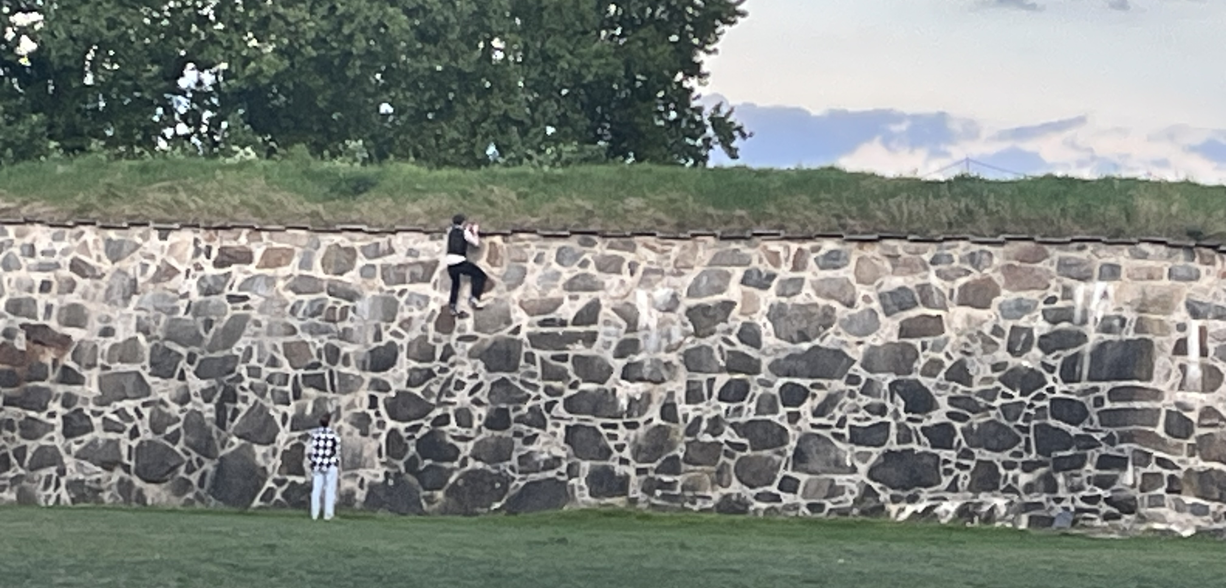
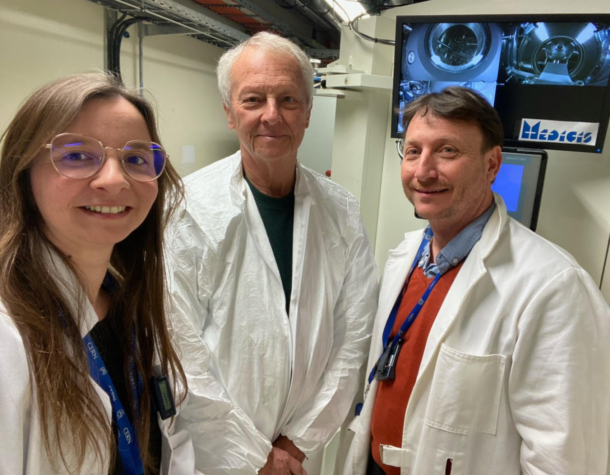
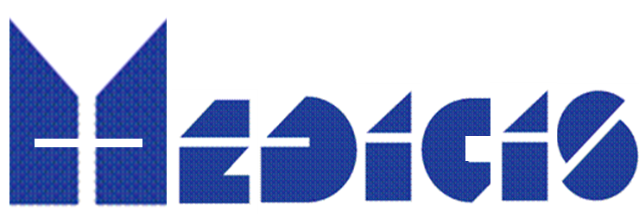
Medical-radionuclides.eu and beyond : The way to cross the valley of death on the long term for european biomedical research in Europe on the long(er) term ?
www.medical-radionuclides.eu
DO NOT MISS www.prismap.eu/news/
Prof Dave Townsend –
co-inventor of PET-CT
visiting
T. Stora PRISMAP(+) furthering the European medical radionuclide programme IFIGENEIA – 07 May 2026

Slide 27
Onboard for the european medical radionuclide programme ! https://www.prismap.eu/news/

