Slide 1
Deliverable D3.1 - LINAC-RFQ prototype design
Dimitrios Lamboudis
YFOS
Notes:
Fonts:
Headings: Dubai bold, available at: https://font.download/font/dubai
Body: Roboto, available at: https://fonts.google.com/specimen/Roboto

Slide 2
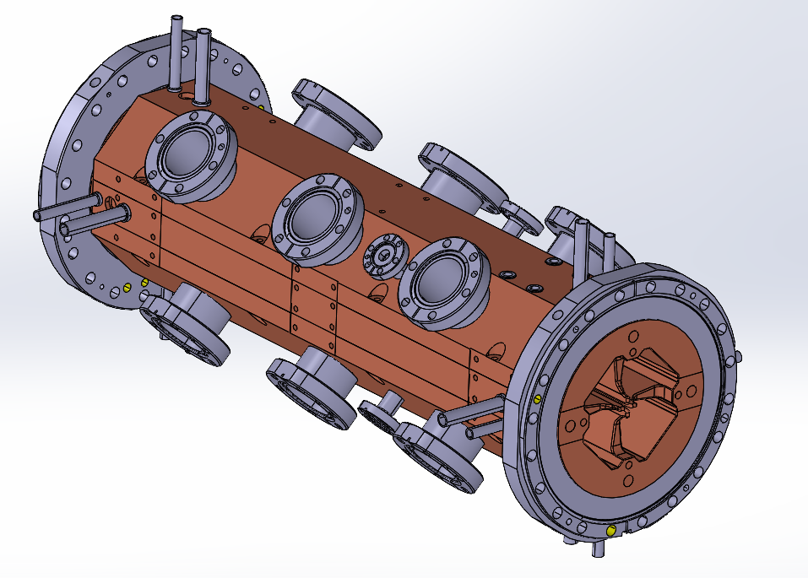
LINAC-RFQ Prototype
All the information presented regarding the drawings, the machining strategy, the heat treatment and the technical specifications, have been provided by CERN.

Slide 3
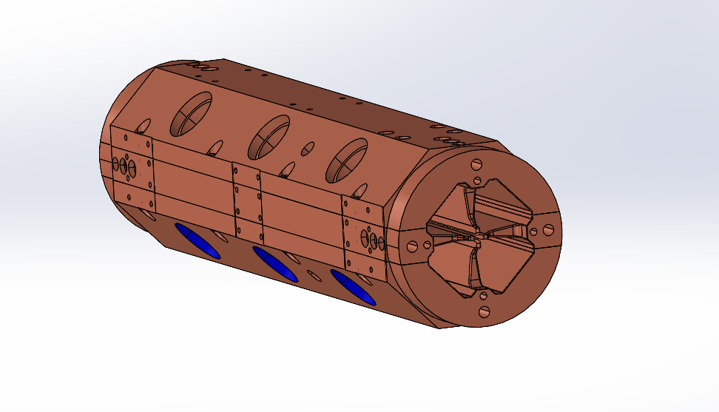
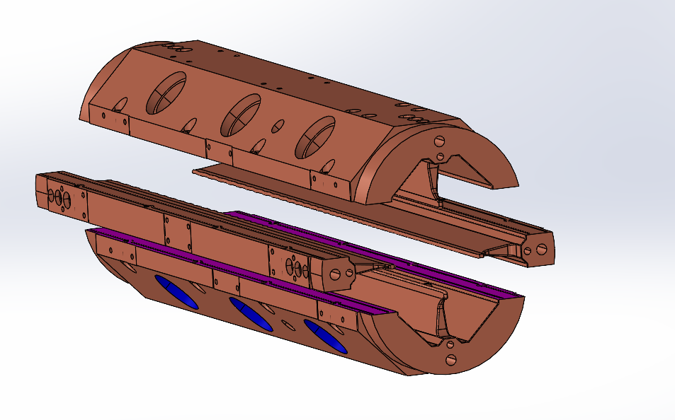
LINAC-RFQ Prototype
Major vane
Minor vane

Slide 4
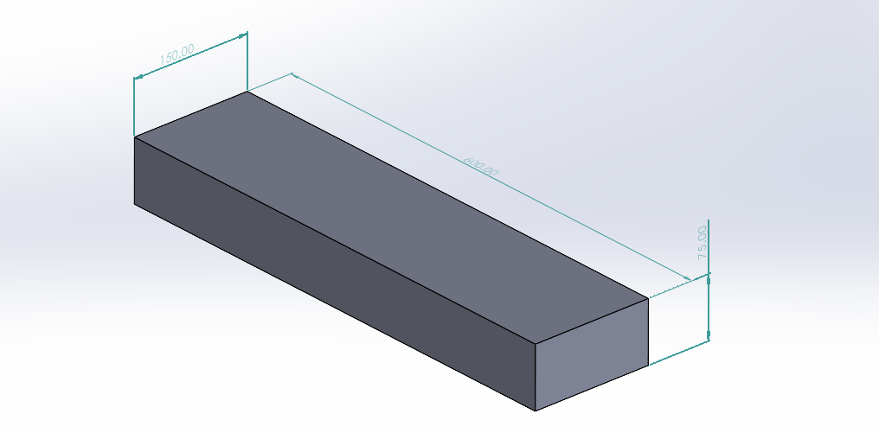
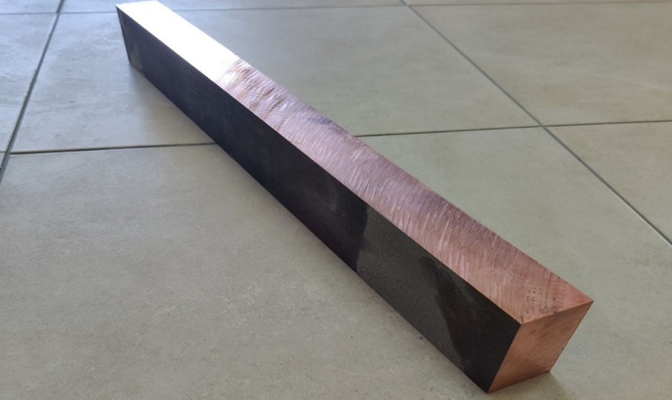
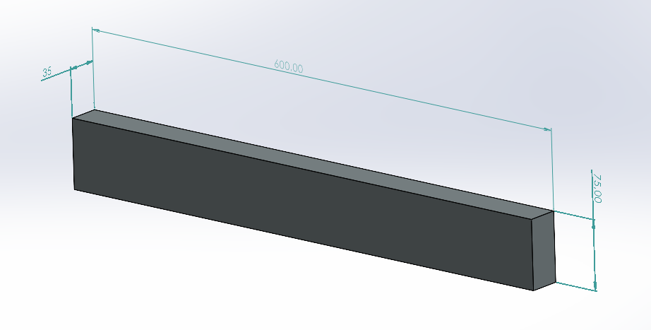
Stock material specifications
Minor vane stock provided by LUVATA Pori
Major vane stock 600mm X 150mm X 75mm
Minor vane stock 600mm X 75mm X 35mm

Slide 5
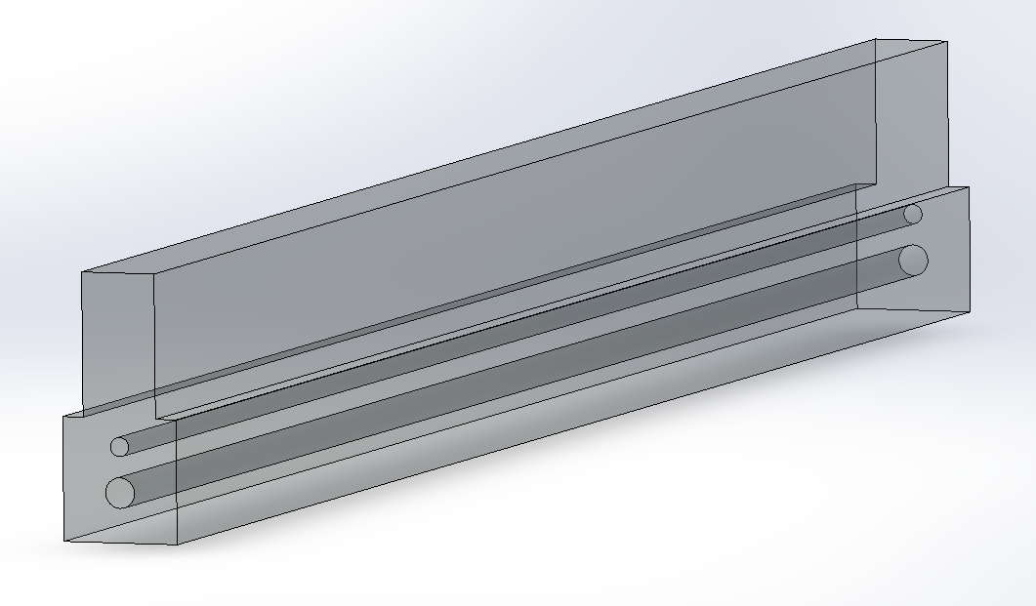
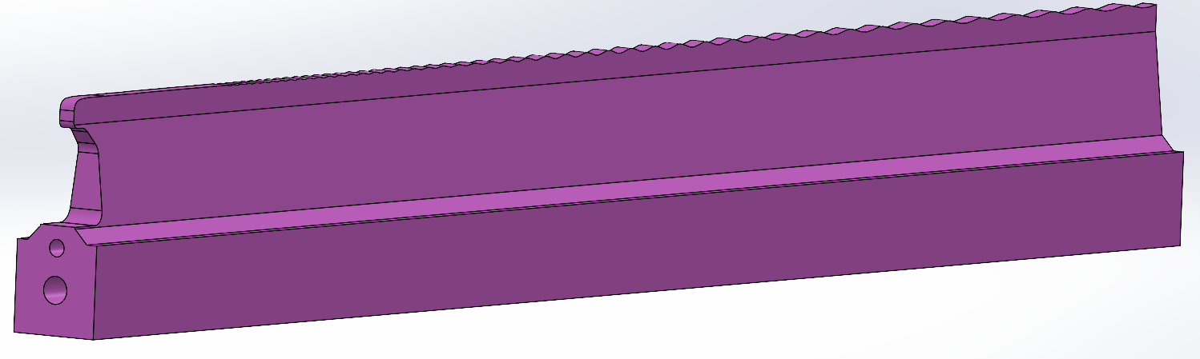
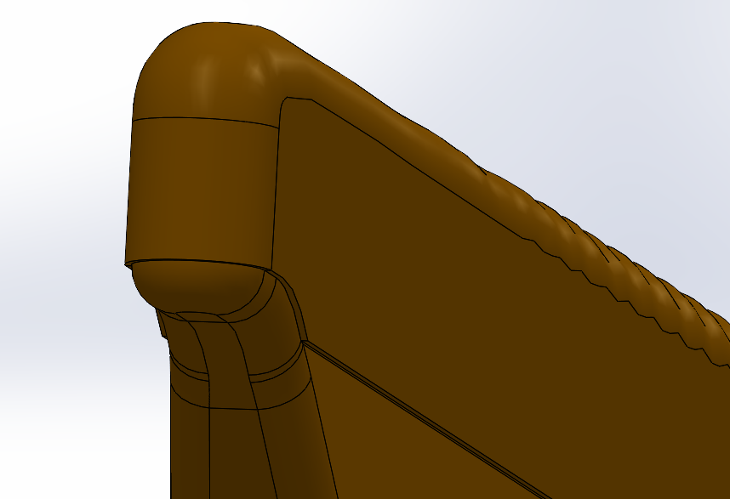
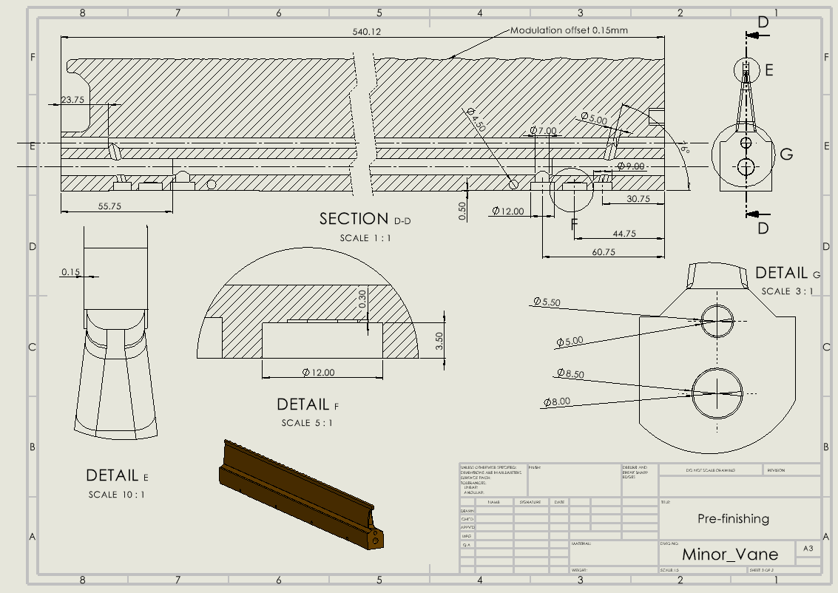
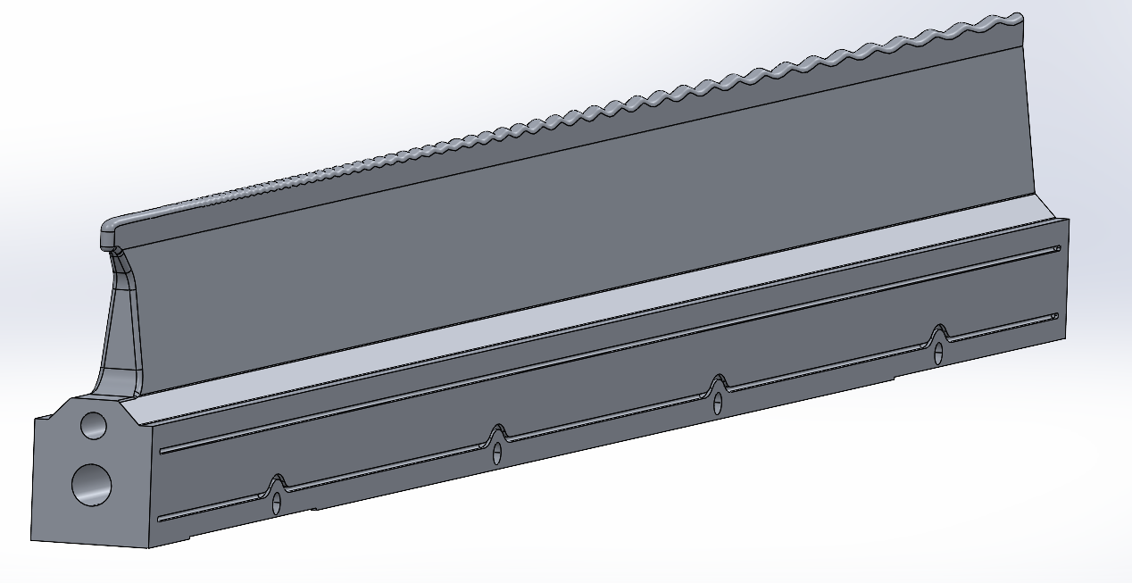
Minor vane machining stages
Pre-rough machining 3mm offset
Rough machining 1mm offset
Pre-finishing, 0.15mm excess material on the modulation
Pre-finishing, mechanical drawing
Finished minor vane before brazing

Slide 6
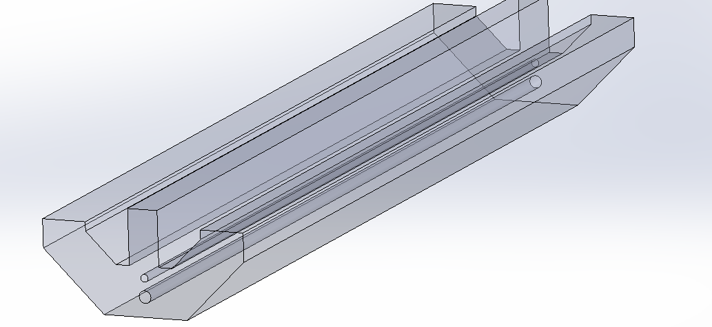
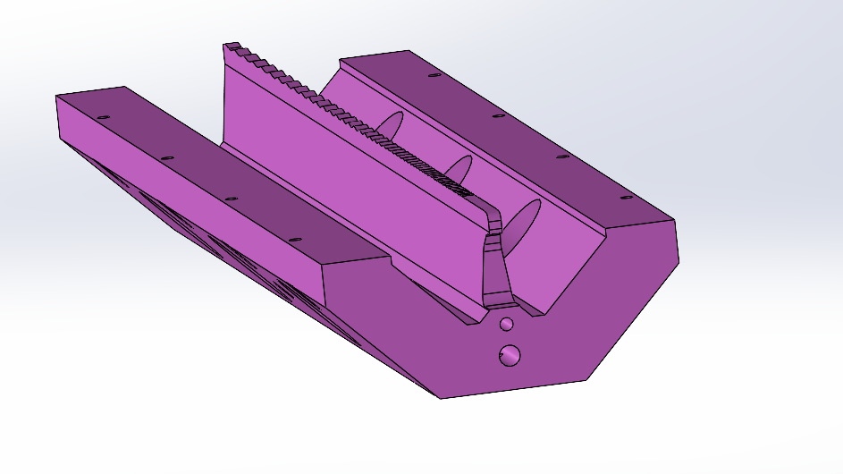
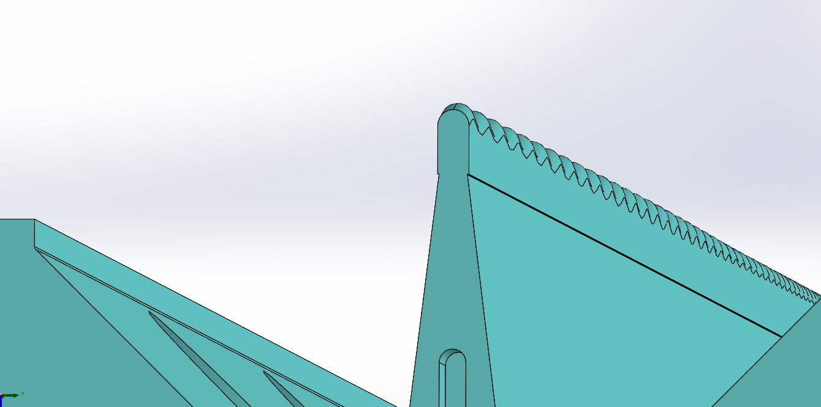
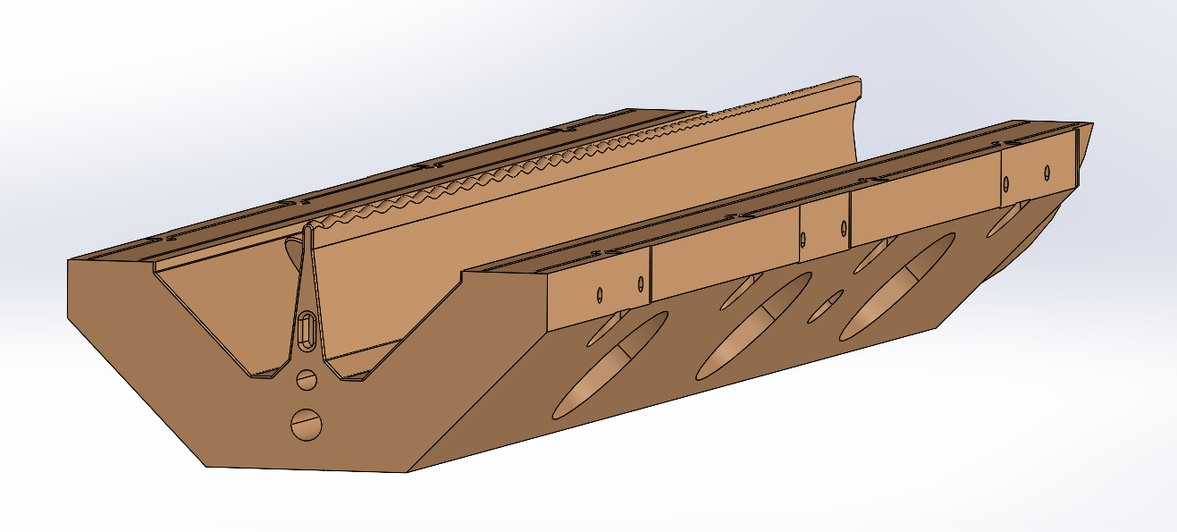
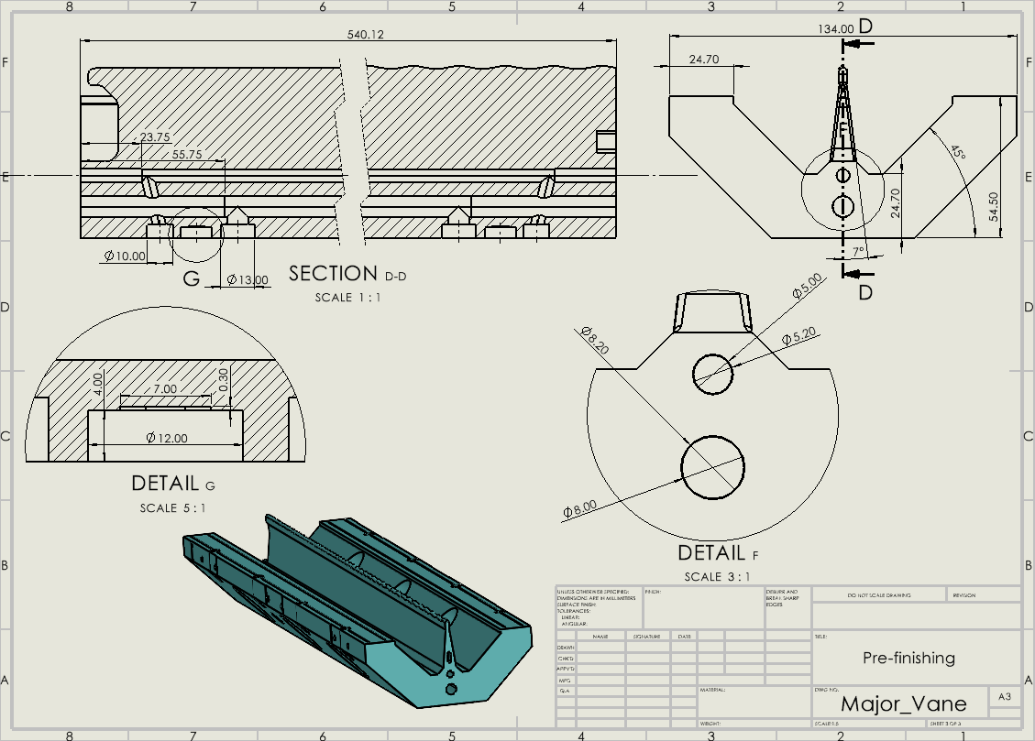
Major vane machining stages
Pre-rough machining 3mm offset
Rough machining 1mm offset
Pre-finishing, 0.15mm excess material on the modulation
Finished minor vane before brazing
Pre-finishing, mechanical drawing

Slide 7
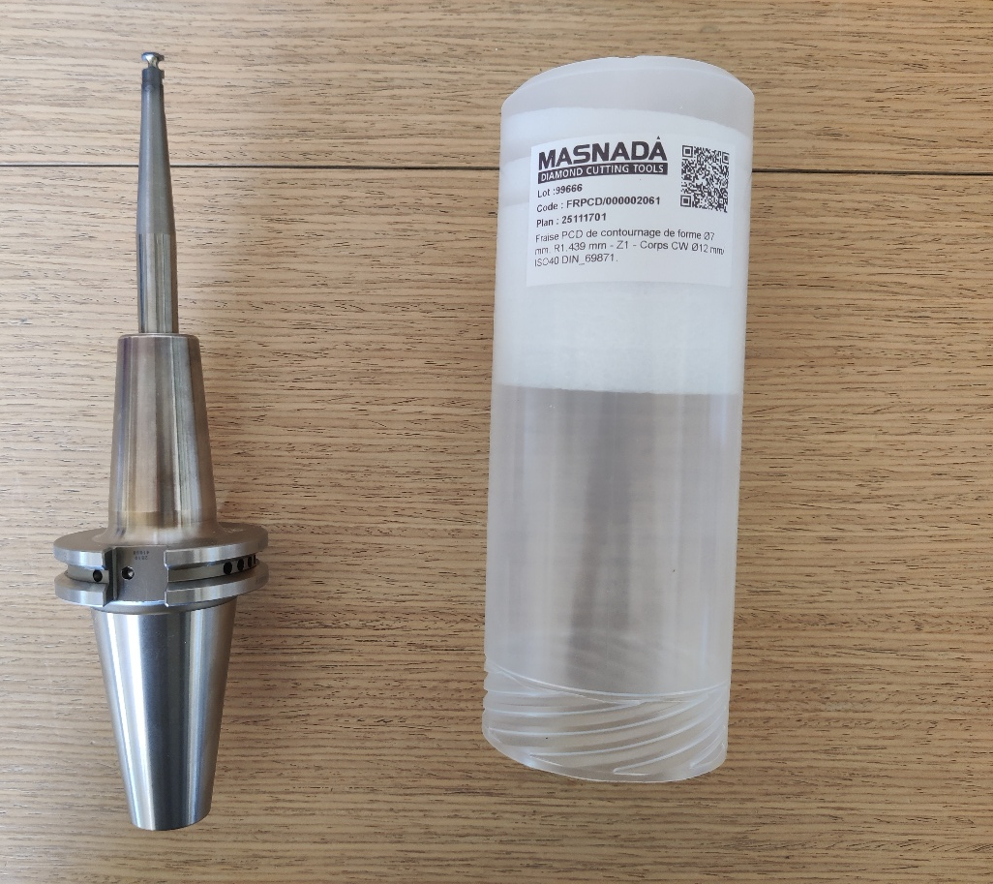
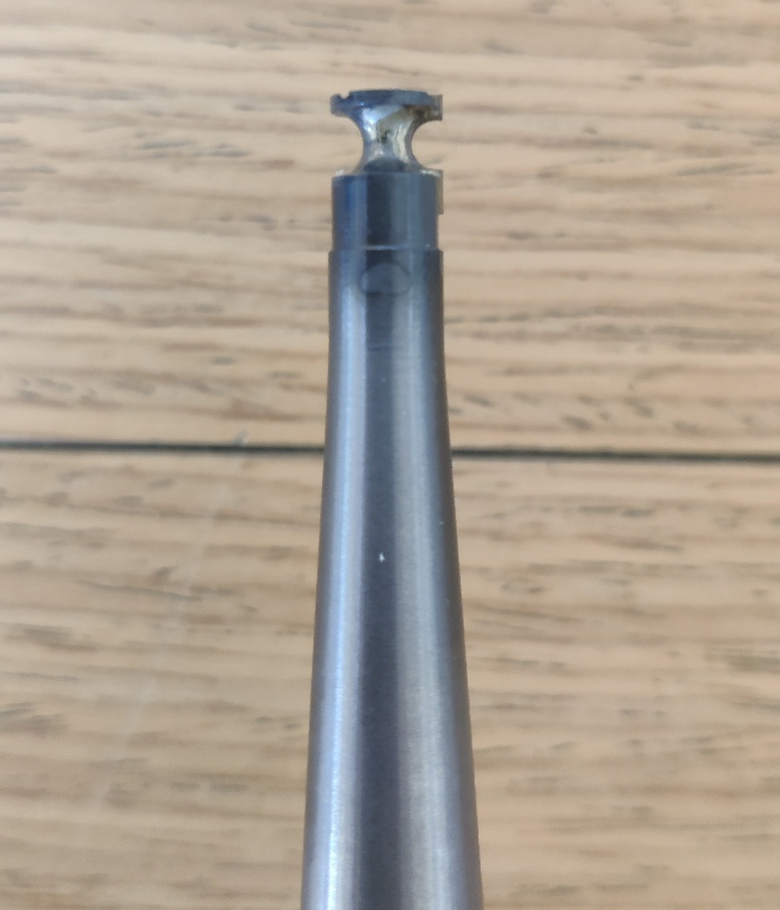
Modulation machining principle
Modulation finishing principle

Slide 8
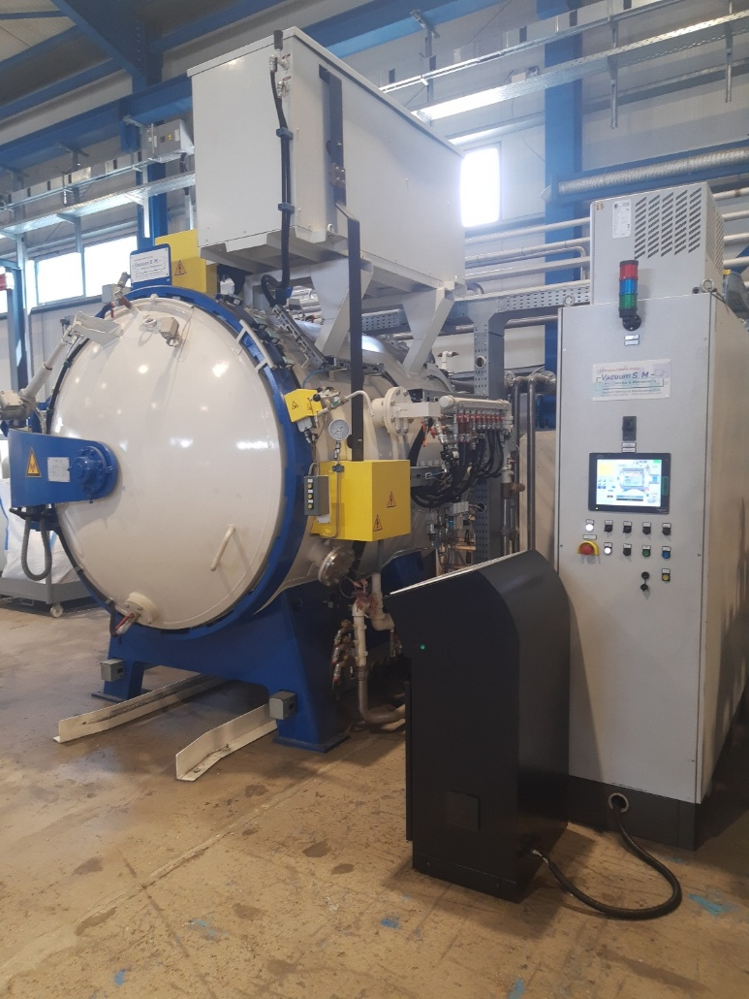
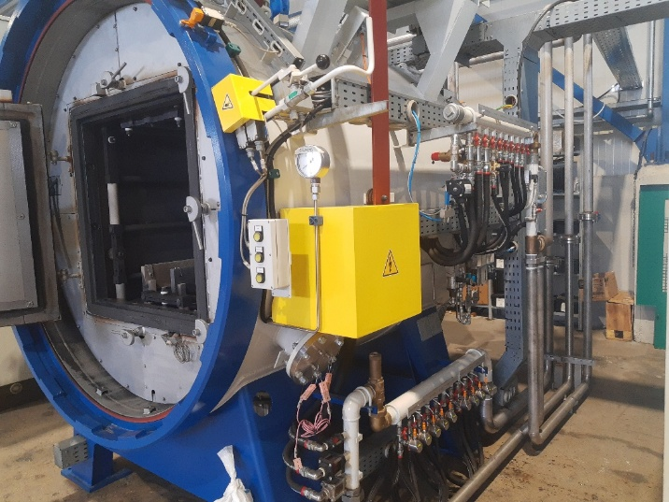
Heat treatment
The heat treatment processes between the machining stages will take place in a vacuum oven provided by our external partner MATREX.

Slide 9
Thank you for your attention

