Slide 1
IFIGENEIA 2nd annual meeting:
T3.2 - Beam parameters and hardware specifications for different operational scenarios
F. Antoniou^{1,2}, G. Dianos¹ , J.B. Lallement² , A. Lombardi² , A. Mamaras¹ , Y. Papaphilippou² , C. Petridou¹, D. Sampsonidis¹, A. Tsiamis¹ , N. Vagena¹
¹AUTH, ²CERN
Slovenia, Ljubljana
07/05/2026
Notes:
Fonts:
Headings: Dubai bold, available at: https://font.download/font/dubai
Body: Roboto, available at: https://fonts.google.com/specimen/Roboto

Slide 2
Outline
T3.2 context and objectives
LINAC design approach / methodology
Ion Source selection
Operational Mode
Baseline design
Extension to flexible production design

Slide 3
T3.2 overview and organization
Deliverable D3.3: Beam parameters and hardware specifications for the LINAC (M24, M36)
Led by CERN
Main partners actively involved: CERN, AUTH, UNSA
CERN guidance and expertise very important for capacity building in the domain of LINAC design and beam dynamics simulations
In close connection with all other tasks
  Input to T3.3, T3.4, T3.5 and T3.6
In close collaboration with WP4
Coordination
Weekly internal meetings to coordinate our studies (T3.2 & T3.3 common internal discussions)

Slide 4
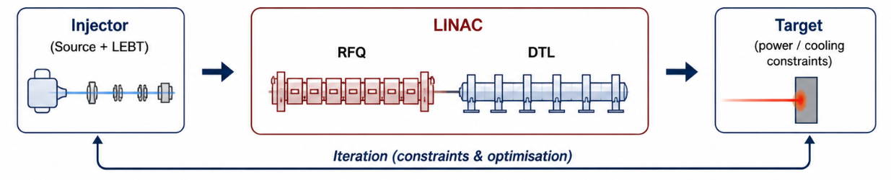
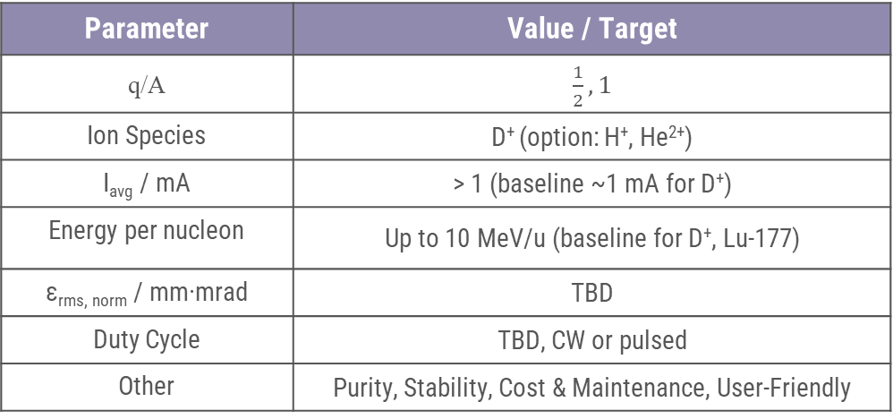
LINAC Design Workflow and Beam Definition
Goal: Define optimal beam characteristics to deliver adequate activity for required yield and high purity
An iterative approach
Particle species and beam energy defined by the radioisotope choice (nuclear interaction)
Main constraints coming from target engineering (head load handling)
  Limitation on maximum current on the target
  Optimal duty cycle
  CW or pulsed operation
Final beam specifications : optimization procedure between yield and purity requirements, target constraints and source capabilities
Parameter | Value / Target
q/A | $\frac{1}{2}, 1$
Ion Species | D⁺ (option: H⁺, He²⁺)
I_{avg} / mA | > 1 (baseline ~1 mA for D⁺)
Energy per nucleon | Up to 10 MeV/u (baseline for D⁺, Lu-177)
ε_{rms, norm} / mm·mrad | TBD
Duty Cycle | TBD, CW or pulsed
Other | Purity, Stability, Cost & Maintenance, User-Friendly

Slide 5
Ion Source choice for IFIGENEIA
PARTICLE SOURCE
(d, α , p)
Low Energy Beam Transfer (LEBT) line
RFQ
Bunch and Pre-acceleration (352 or750 MHz)
Final acceleration
(DTL-type)
TARGET
Irradiation
(i.e. ¹⁷⁶Yb(d,n)¹⁷⁷Lu, ²⁰⁹Bi(α,2n)²¹¹At, ⁶⁴Ni(p,n) ⁶⁴Cu)
Source choice driven by production requirements
The ion source type will be defined by the required radioisotope production scenarios:
  Βeam species, current, duty cycle, stability, and availability.
Bibliographic review of existing sources for deuteron production performed and discussed with CERN experts (ABP/HSL)
Comparison of research facilities, medical accelerators, and commercial systems
Assessment of beam performance, operational complexity, and maintainability

Slide 6
Ion Source choice for IFIGENEIA
PARTICLE SOURCE
(d, α , p)
Low Energy Beam Transfer (LEBT) line
RFQ
Bunch and Pre-acceleration (352 or750 MHz)
Final acceleration
(DTL-type)
TARGET
Irradiation
(i.e. ¹⁷⁶Yb(d,n)¹⁷⁷Lu, ²⁰⁹Bi(α,2n)²¹¹At, ⁶⁴Ni(p,n) ⁶⁴Cu)
ECR ion sources appear to be the most suitable option
Multi-species capability: H⁺ / D⁺ / He²⁺
Proven use in accelerator facilities and compatible with operational flexibility
Start with commercial ECR source
  Reduce development risks
  Industrial reliability and support
Adapt to IFIGENEIA specifications
  Tune to required beam parameters
  Integration with LEBT and LINAC
Next steps:
Investigate measurements possibilities at CERN (in collaboration with CERN and UNSA)
Refine specifications based on T3.2

Slide 7
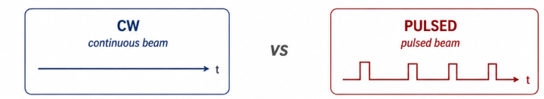
Operational mode: CW vs Pulsed
The operation mode is not a free parameter; it results from the optimization of the target–beam–accelerator system (including cost).
Key decision still open
No decision yet
Under study within T3.2 & T3.3
Will be defined by:
  Production yield
  Target limitations
  Facility cost
No big impact on beam dynamics simulation studies
CW
High yield capabilities
High average beam power
Demanding RF system
Strong cooling requirements
Higher construction and operational costs
Pulsed
Lower average beam power
High peak current
Less demanding RF system
Simpler infrastructure
Lower construction and operational costs

Slide 8
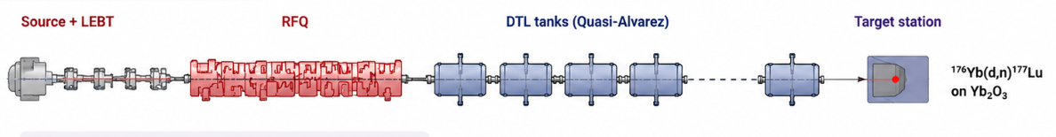
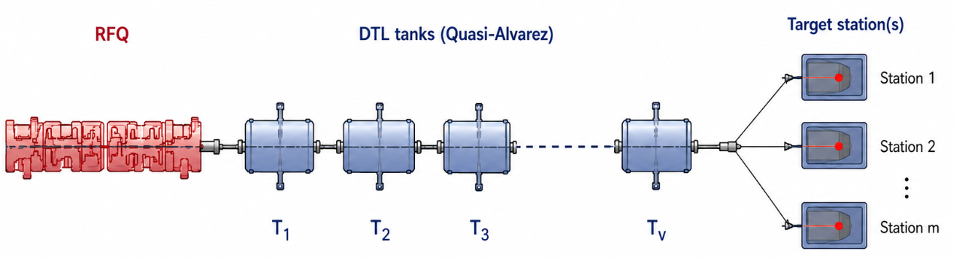
Towards a design of a flexible production LINAC
Step 1: Baseline design for Lu-177 production
D+ beam, En ~ 10 MeV/u, 1-2 mA average beam current (CW or pulsed)
Target : ¹⁷⁶Yb(d,n)¹⁷⁷Lu (Yb₂O₃)
Step 2: Extension to flexible production
Multiple particle species (H⁺, D⁺, He²⁺)
Energy and intensity range (driven by the targeted radioisotope portfolio)
One or multiple sources
Various target stations
Modular and scalable design
Different tank configurations for different final energies
  Quasi-Alvarez DTL provides this flexibility
Note: Schematics are illustrative and not to scale

Slide 9
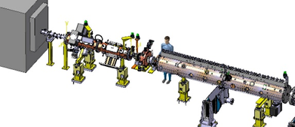
Summary and Outlook
Approach:
Design driven by target constraints & production needs
Iterative workflow: Target ↔ Beam ↔ LINAC
Start from Lu-177 as a baseline case
Current status:
Beam parameters under definition
ECR source selected as baseline option
LINAC design in development
CW vs pulsed operation under study
Next steps
Provide a baseline design (Lu-177)
Extend to flexible multi-isotope operation
Define:
  Energy range
  Beam intensity range
  Operational mode (CW / pulsed)

Slide 10
Thank you for your attention!
Many thanks to the local organizers for this very nice event!

