Slide 1
Overview:
Studied Targets & Challenges so far
Eleni Vagenaª, Fanouria Antoniou^{b}, Georgios Dianosª, Aristeidis Mamaras^{b}, Vasilis Vlachoudis^{b}, Ioannis Papaphilippou^{b}, Charikleia Petridou^{ac}, Dimos Sampsonidis^{ac}
ªAristotle University of Thessaloniki: University Campus, Thessaloniki, 54124, Greece;
^{b}CERN, CH-1211 Geneva 23, Switzerland;
^{c}Center for Interdisciplinary Research and Innovation (CIRI-AUTH), Thessaloniki 57001, Greece;

Slide 2
List of the radionuclides: that have been already studied and the ones that are currently under ongoing work
Radionuclide | Emission Type | Application | Beam Energy
COMPLETED STUDIES
¹⁷⁷Lu | β⁻ emitter (+ γ) | Therapeutic | d, 17.9 MeV
¹⁶¹Tb | β⁻ emitter (+ Auger e⁻) | Therapeutic | d, 18 MeV (12-26 MeV)
¹⁵⁵Tb | γ emitter | Theranostic / Diagnostic | d, 15 MeV (13-20 MeV) p, 10-20 MeV
¹⁵²Tb | β⁺ / EC | Diagnostic / Dosimetry | d, 16 MeV (10-24 MeV) p,12 MeV (10-24 MeV)
ONGOING STUDIES
⁴⁷Sc | β⁻ emitter (+ γ) | Therapeutic
^{44g}Sc | β⁺ emitter | Diagnostic
⁶⁷Cu | β⁻ emitter (+ γ) | Therapeutic
⁶⁴Cu | β⁺ / β⁻ / EC | Diagnostic / Theranostic

Slide 3
Simulation Framework
Cross-section validation
Simulation Code
1st step:
Thin target simulations compared against:
Experimental data from EXFOR database
Evaluated data: IAEA-therapeutic
Goal: how well does our model work for specific beams and energies?
Tool: Geant4 Monte Carlo (Agostinelli et al.)
Physics model: INCLXX
Clinical Adequacy Assessment
Thick-Target Calculations
3rd step:
Is what we produce useful for clinical use?
Comparison with standard protocols for therapeutic doses
2nd step:
Simulate realistic targets under various irradiation conditions, regarding the irradiation time and beam current to estimate the yields.

Slide 4
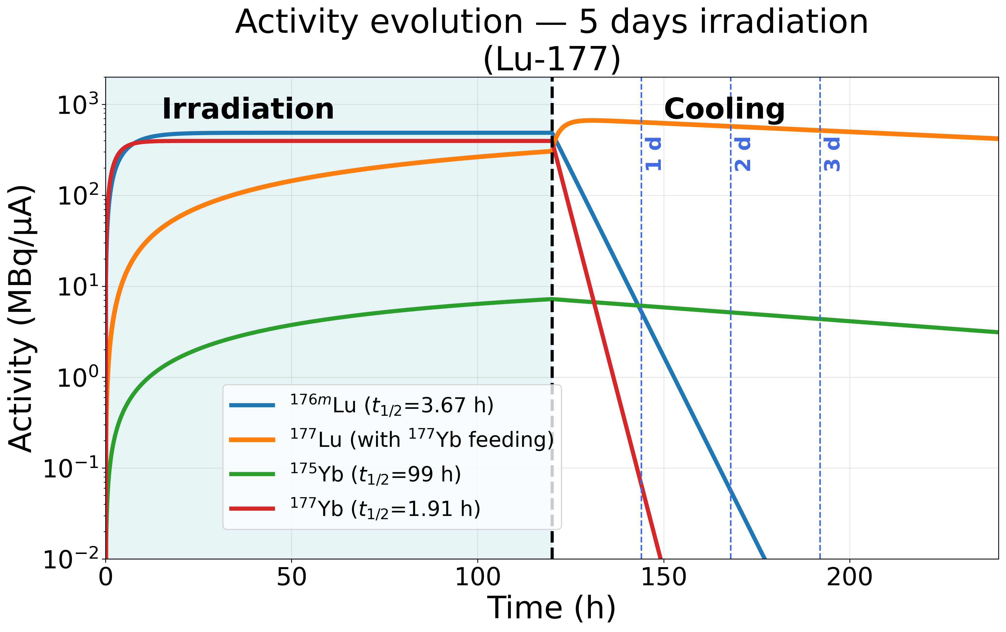
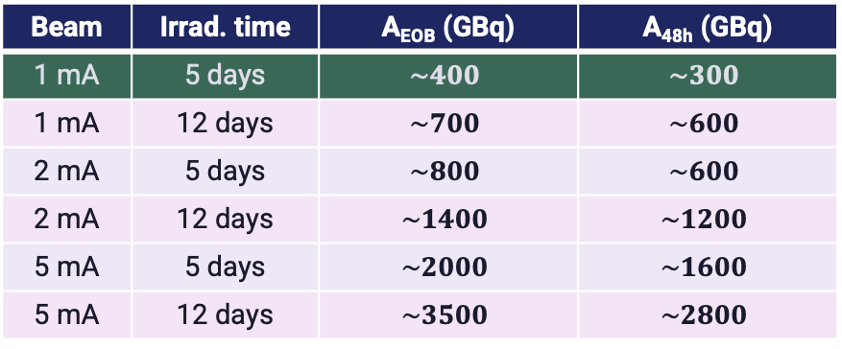
Results for ¹⁷⁷Lu Production
Target: 97% enriched ¹⁷⁷Yb₂O₃ | production routes: (d,n)
Graph: How the activity evolves during a 5-day irradiation scenario and during 48 h cooling
growing even after the beam stops
(¹⁷⁷Yb decay)
Lu-177
Main impurity: ¹⁷⁵Yb
Short-lived: decay quickly
Activity at EOB & after 48h cooling (GBq) — beam current scaling
Beam | Irrad. time | A_{EOB} (GBq) | A_{48h} (GBq)
1 mA | 5 days | $$\sim 400$$ | $$\sim 300$$
1 mA | 12 days | $$\sim 700$$ | $$\sim 600$$
2 mA | 5 days | $$\sim 800$$ | $$\sim 600$$
2 mA | 12 days | $$\sim 1400$$ | $$\sim 1200$$
5 mA | 5 days | $$\sim 2000$$ | $$\sim 1600$$
5 mA | 12 days | $$\sim 3500$$ | $$\sim 2800$$
Clinical Adequacy
(Standard protocol: 9 GBq/cycle, 4 cycles/patient)
1 mA / 5 days → ~44 cycles | ~11 patients/run
2 mA / 12 days → ~155 cycles | ~38 patients/run
10 mA / 12 days → ~777 cycles | ~194 patients/run

Slide 5
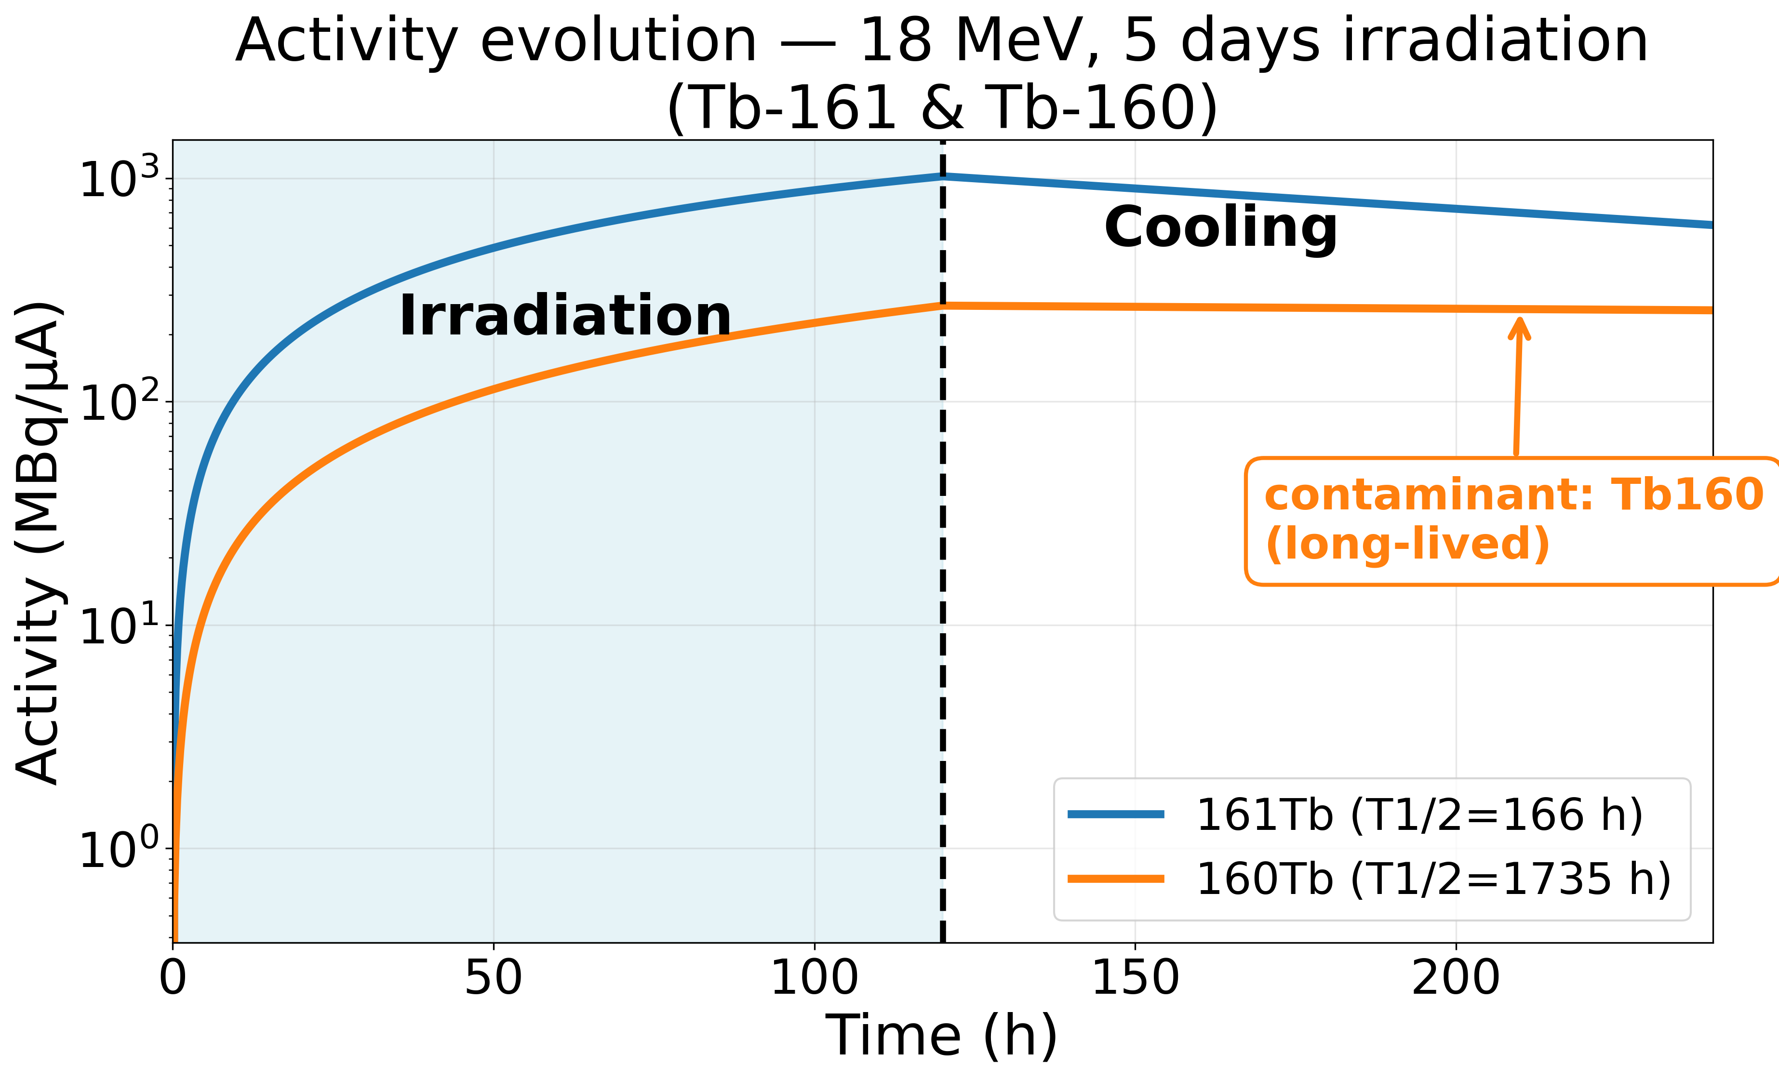
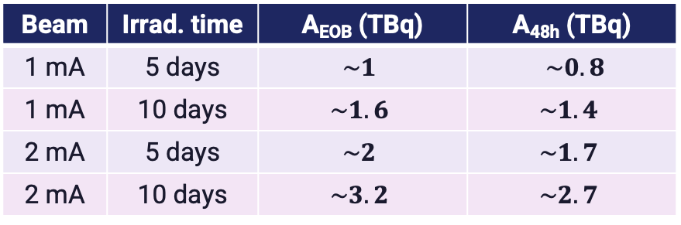
Results for ¹⁶¹Tb Production
Target: 95% enriched ¹⁶⁰Gd₂O₃ | production routes: (d,n)
Activity at EOB & after 48h cooling (GBq) — beam current scaling
The plot shows the activity evolution of ¹⁶¹Tb and its main contaminant ¹⁶⁰Tb during and after a 5-day irradiation at 18 MeV
Beam | Irrad. time | A_{EOB} (TBq) | A_{48h} (TBq)
1 mA | 5 days | $$\sim 1$$ | $\sim 0.8$
1 mA | 10 days | $$\sim 1.6$$ | $$\sim 1.4$$
2 mA | 5 days | $$\sim 2$$ | $$\sim 1.7$$
2 mA | 10 days | $$\sim 3.2$$ | $$\sim 2.7$$
At 1mA we get $\sim 1$ TBq that supports ~28 patients
Clinical Adequacy (9 GBq/cycle, 4 cycles/patient)
Need for Tb-161 / Tb-160 separation
1 mA / 5 days → ~113 cycles | ~28 patients
1 mA / 10 days → ~181 cycles | ~46 patients
2 mA / 5 days → ~226 cycles | ~57 patients
2 mA / 10 days → ~363 cycles | ~90 patients
The main concern with Tb-161 production is Tb-160 — due to its long half-life of 72 days

Slide 6
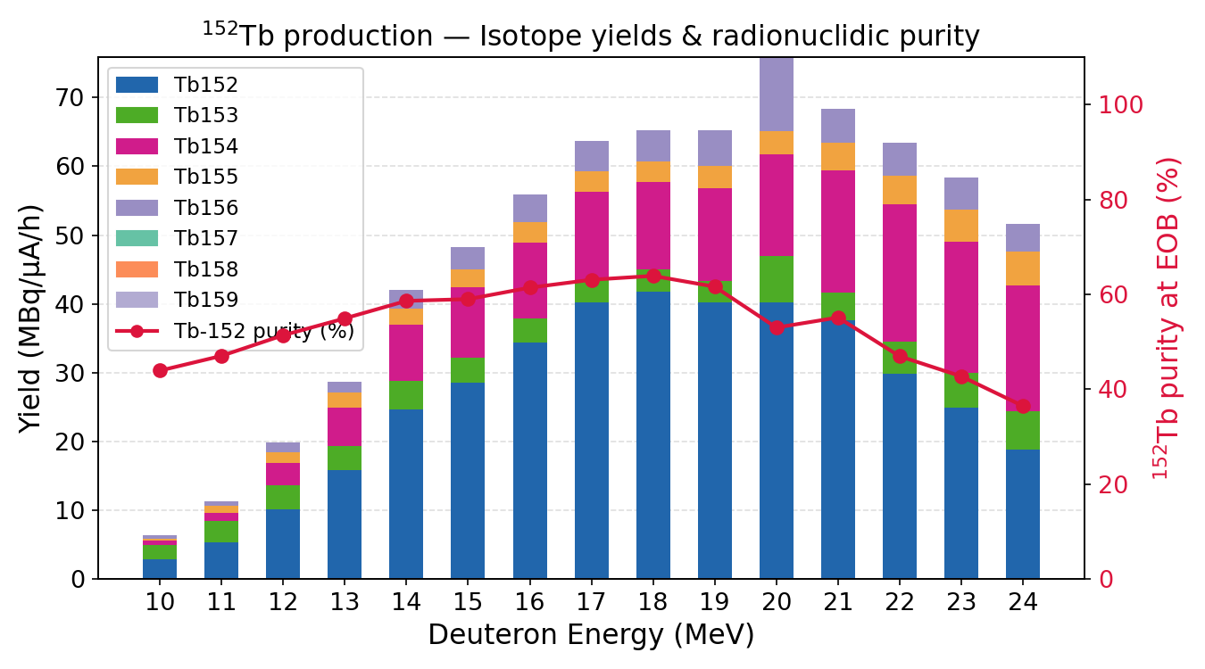
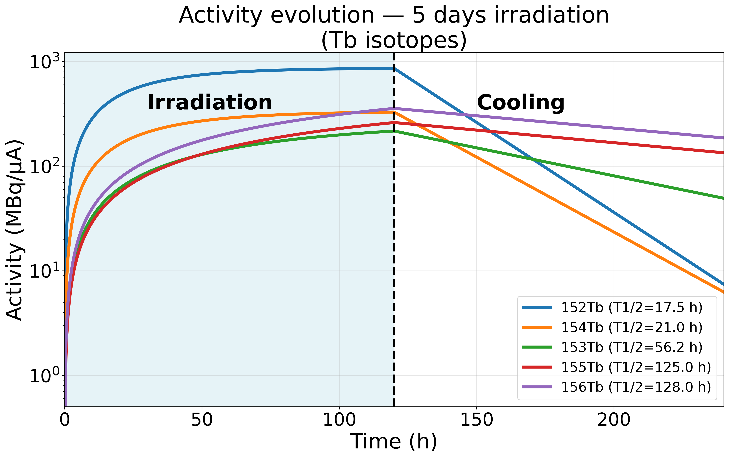
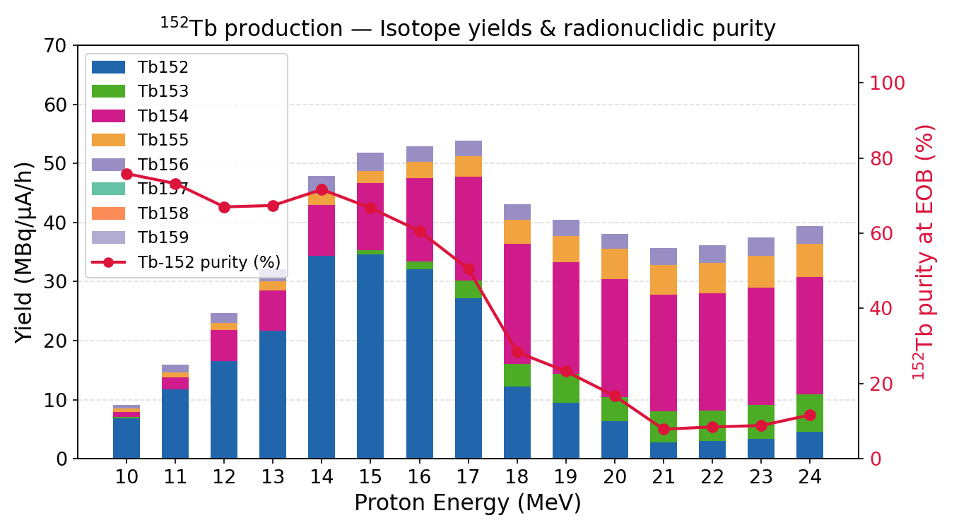
Results for ¹⁵²Tb Production
Comparison of yields – purity: deuteron vs proton beams
Target: 30% enriched ¹⁶⁰Gd₂O₃ | 2 production routes: (d,n) & (d,p)
After 48 h of cooling, short-lived ¹⁵²Tb significantly decrease, while longer-lived isotopes remain relatively stable
Both deuteron and proton beams yield comparable Tb-152 activities (~40–55 MBq/μA/h) and purity (~65–70%) in their optimal energy windows (deuterons at around 18 MeV & protons at around 15 MeV)
Tb-152 can be produced equally, regardless of the available beam type (advantage).

Slide 7
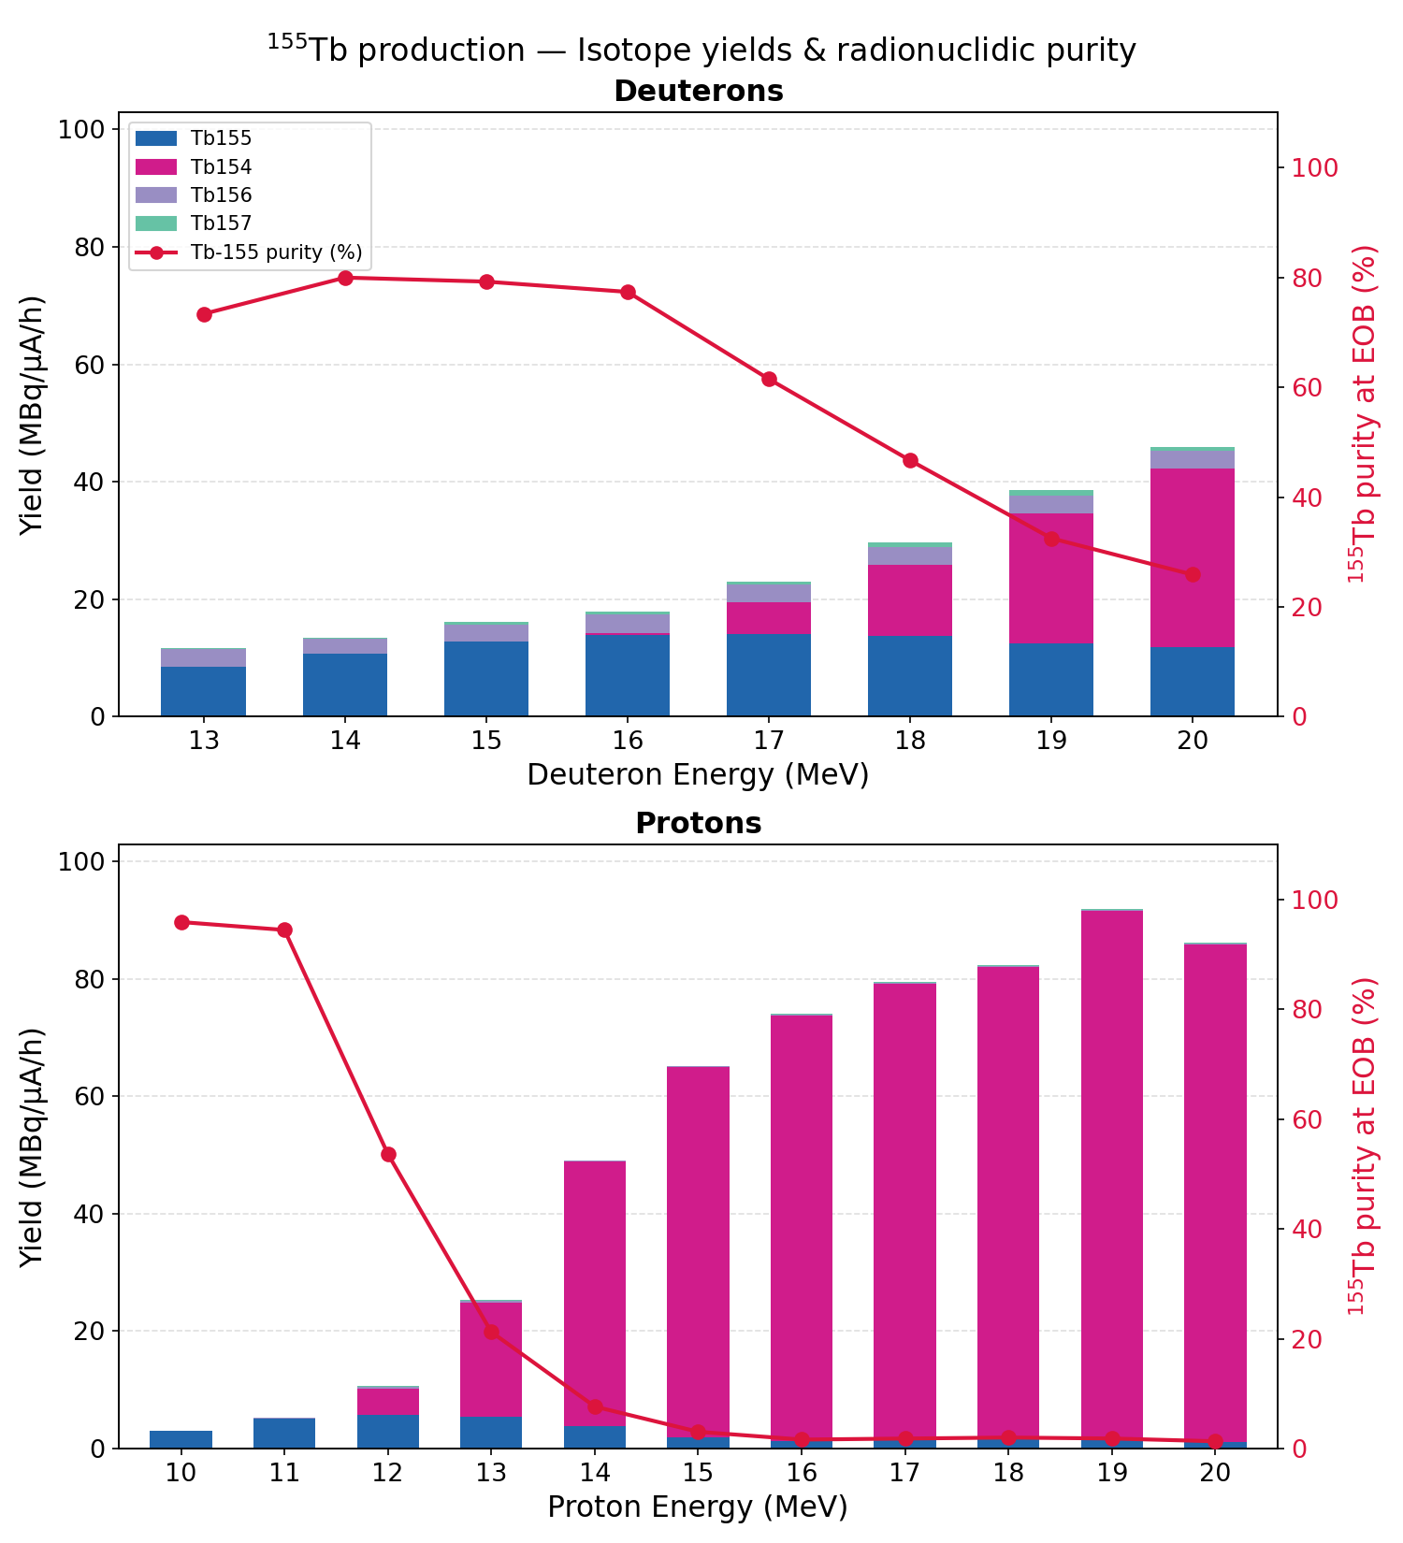
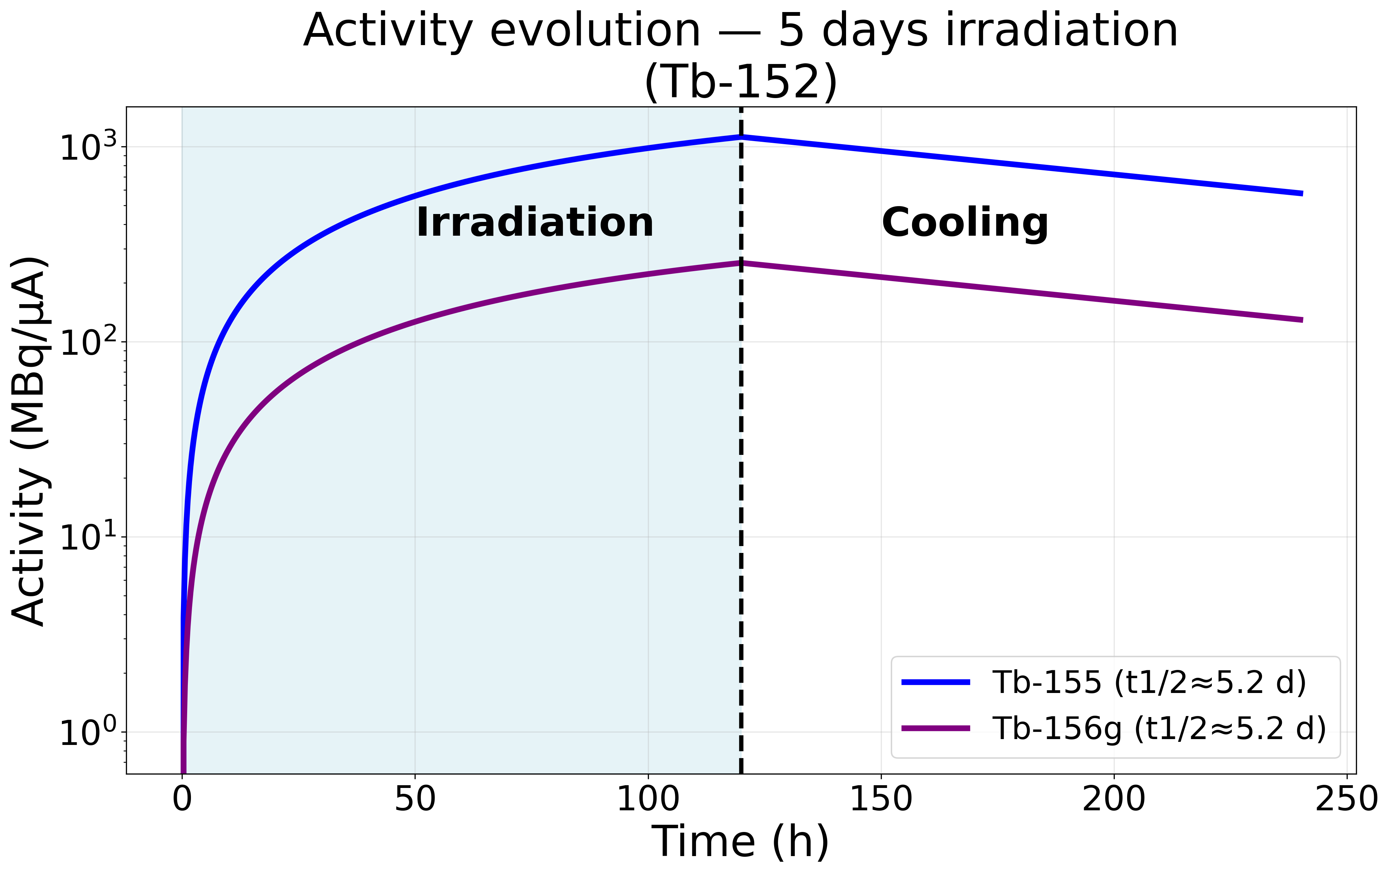
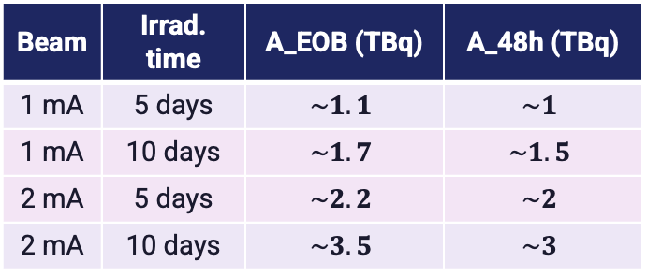
Results for ¹⁵⁵Tb Production
Target: 93% enriched ¹⁵⁵Gd₂O₃ | 2 production routes: (d,n) & (d,p)
1 TBq@1mA,5d
250 GBq@1mA,5d
Deuterons: purity ~75–80% at 13–16 MeV with increasing yield (a good production window).
Protons: purity collapses already at 13 MeV. Above 14 MeV, production of Tb-154 dominates due to the opening of the (p,2n) channel.
Deuterons offer better combination of yield and purity.
Beam | Irrad. time | A_EOB (TBq) | A_48h (TBq)
1 mA | 5 days | $$\sim 1.1$$ | $$\sim 1$$
1 mA | 10 days | $$\sim 1.7$$ | $$\sim 1.5$$
2 mA | 5 days | $$\sim 2.2$$ | $$\sim 2$$
2 mA | 10 days | $$\sim 3.5$$ | $$\sim 3$$

Slide 8
Main challenge: Target’s (¹⁷⁶Yb₂O₃ ) Thermal Stress due to High-Currents
Material properties of ¹⁷⁶Yb₂O₃
Thermal conductivity k: 4–9 W m⁻¹ K⁻¹
Thermal exp. coeff. (TEC): (8.5 ± 0.6) × 10⁻⁶ K⁻¹
Young's modulus E: 130–170 GPa
Poisson's ratio ν: ≈ 0.30
Fracture strength: 100–200 MPa
BEAM CONDITIONS
Projectile: Deuterons, 17.9 MeV
Beam current: 1 mA → up to 5 mA
Beam area: 3.14 cm² (r = 1 cm)
Energy deposited ΔE: ≈ 9.9 MeV (17.9 – 8 MeV exit)
Target thickness: 0.36 mm ¹⁷⁶Yb₂O₃
We ESTIMATED THERMAL IMPACT @ 1 mA
Quantity | Value
Deposited power | ~9.9 kW
Heat flux | ~3.15 kW/cm²
Temperature rise (ΔT) | ~800 K
Thermal stress | ~1.7 GPa
Thermal stress is 10 times the fracture strength of material (100–200 MPa fracture strength)
proper cooling is essential

Slide 9
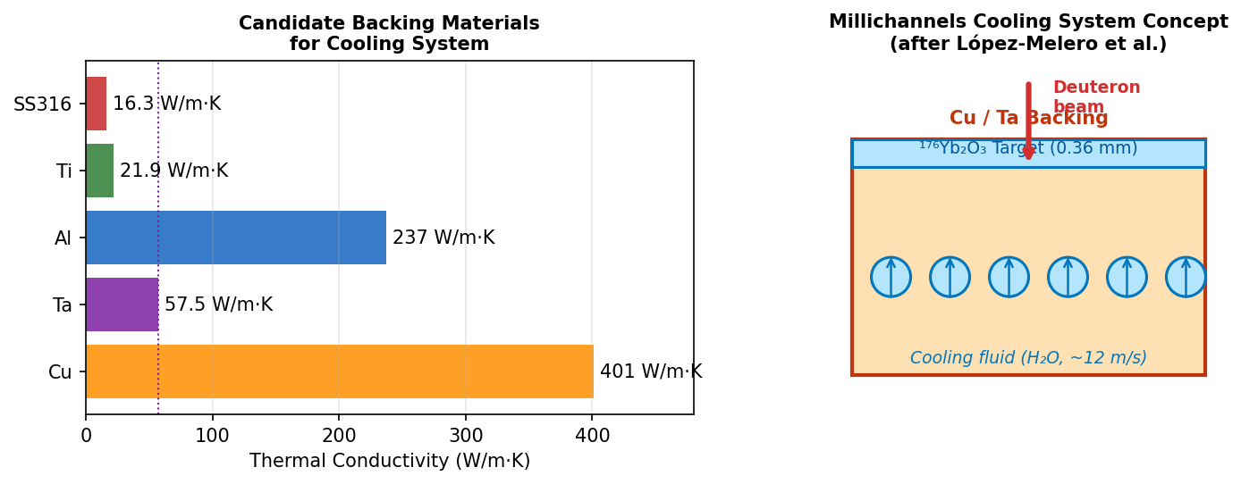
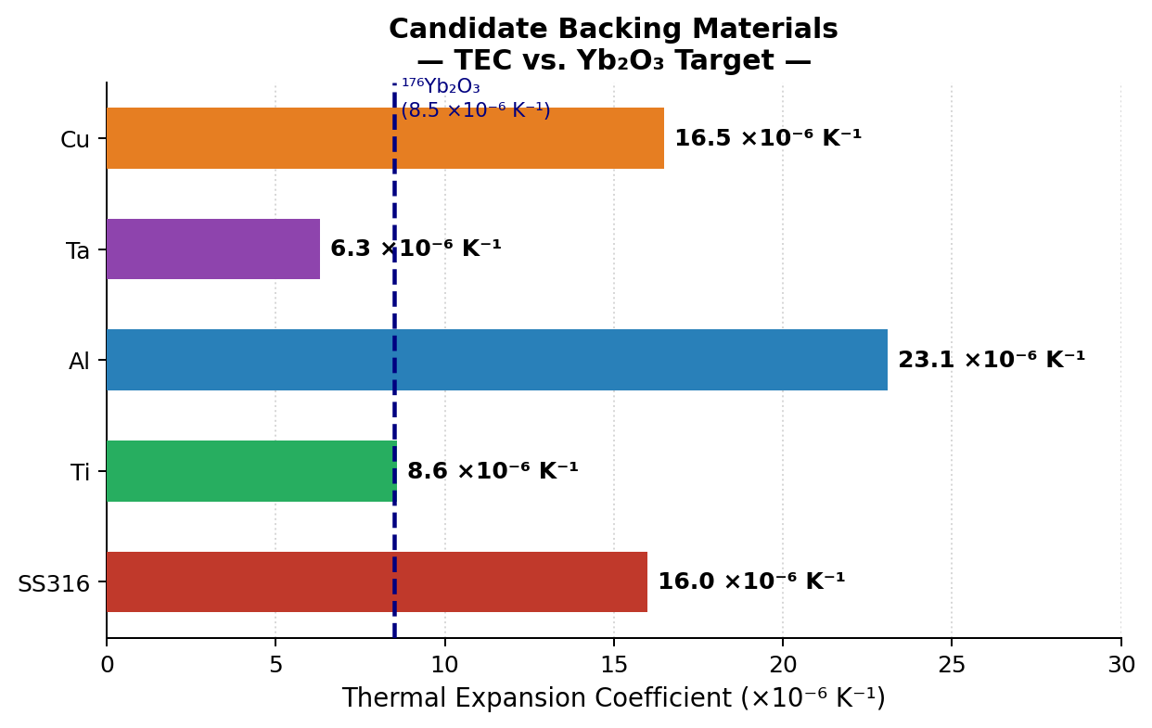
Addressing Thermal Challenges: Solutions & Ongoing Collaboration
ANSYS software for Thermal-Mechanical Analysis (Ongoing)
Recently started Collaboration
Goal: simulate a proper target-backing system model.
Group: Praena et al., University of Granada
Recent Publication: Proposed a Cooling system design for ¹⁷⁷Lu production using Copper backing with milichannel water cooling @ IFMIF-DONES
López-Melero et al. (2021)
Candidate Backing Materials Under Study
Backing material is crucial: We’ll start study materials such as Ta, Al, Ti and SS316
Possible good candidates: Tantalum, Titanium: which based on their TEC parameters are much closer to Yb₂O₃ and this may lead to more mechanically robust target-backing system.

Slide 10
Summary
COMPLETED
¹⁷⁷Lu — d, 17.9 MeV | ¹⁷⁶Yb₂O₃
~11 patients/run @ 1mA /5 days
¹⁶¹Tb — d, 18 MeV | ¹⁶⁰Gd₂O₃
~28 patients @ 1 mA / 5 days
¹⁵⁵Tb — d/p, 15 MeV | ¹⁶⁰Gd₂O₃
>1 TBq @ 1 mA / 5 days
¹⁵²Tb — d 16 MeV / p 12 MeV
Yield vs purity studied
Key Findings
Geant4-based simulation:
successfully reproduce experimental cross-sections
enables reliable thick-target yield predictions across the studied radionuclides.
Activities achieved are clinically adequate
Proper cooling must be designed to minimize the target’s thermal stress
Ongoing Work
⁴⁷Sc, ⁴⁴Sc, ⁶⁷Cu, ⁶⁴Cu production studies in progress
ANSYS thermal-mechanical simulations for target design
Optimal backing material selection (Cu, Ta, Ti..) under study
Thank you

