Slide 1
^{IFIGENEIA 2nd annual meeting:} ^{WP3 Overview} F. Antoniou on behalf of all WP3 members ^{AUTH / CERN}
Slovenia, Ljubljana
07/05/2026
Notes:
Fonts:
Headings: Dubai bold, available at: https://font.download/font/dubai Body: Roboto, available at: https://fonts.google.com/specimen/Roboto

Slide 2
Outline
The WP3 role within the IFIGENEIA Project
WP3 structure and workflow
Organization
Collaborations with other WPs
Summary and Next steps

Slide 3
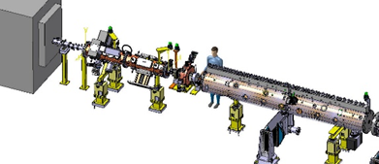
The WP3 role within IFIGENEIA
Designing a LINAC-target system for efficient and reliable radioisotope production
PARTICLE SOURCE
(d, α , p)
Low Energy Beam Transfer (LEBT) line
RFQ
Bunch and Pre-acceleration (352 or 750 MHz)
Final acceleration
(DTL-type)
TARGET
Irradiation
(i.e. ¹⁷⁶Yb(d,n) ¹⁷⁷Lu, ²⁰⁹Bi(α,2n)²¹¹At, ⁶⁴Ni(p,n) ⁶⁴Cu)

Slide 4
The WP3 role within IFIGENEIA
Designing a LINAC-target system for efficient and reliable radioisotope production
PARTICLE SOURCE
(d, α , p)
Low Energy Beam Transfer (LEBT) line
RFQ
Bunch and Pre-acceleration (352 or 750 MHz)
Final acceleration
(DTL-type)
TARGET
Irradiation
(i.e. ¹⁷⁶Yb(d,n)¹⁷⁷Lu, ²⁰⁹Bi(α,2n)²¹¹At, ⁶⁴Ni(p,n) ⁶⁴Cu)

Slide 5
The WP3 role within IFIGENEIA
Designing a LINAC-target system for efficient and reliable radioisotope production
PARTICLE SOURCE
(d, α , p)
Low Energy Beam Transfer (LEBT) line
RFQ
Bunch and Pre-acceleration (352 or 750 MHz)
Final acceleration
(DTL-type)
TARGET
Irradiation
(i.e. ¹⁷⁶Yb(d,n) ¹⁷⁷Lu, ²⁰⁹Bi(α,2n)²¹¹At, ⁶⁴Ni(p,n) ⁶⁴Cu)

Slide 6
The WP3 role within IFIGENEIA
Designing a LINAC-target system for efficient and reliable radioisotope production
PARTICLE SOURCE
(d, α , p)
Low Energy Beam Transfer (LEBT) line
RFQ
Bunch and Pre-acceleration (352 or 750 MHz)
Final acceleration
(DTL-type)
TARGET
Irradiation
(i.e. ¹⁷⁶Yb(d,n) ¹⁷⁷Lu, ²⁰⁹Bi(α,2n)²¹¹At, ⁶⁴Ni(p,n) ⁶⁴Cu)

Slide 7
The WP3 role within IFIGENEIA
Designing a LINAC-target system for efficient and reliable radioisotope production
PARTICLE SOURCE
(d, α , p⁾
Low Energy Beam Transfer (LEBT) line
RFQ
Bunch and Pre-acceleration (352 or750 MHz)
Final acceleration
(DTL-type)
TARGET
Irradiation
(i.e. ¹⁷⁶Yb(d,n) ¹⁷⁷Lu, ²⁰⁹Bi(α,2n)²¹¹At, ⁶⁴Ni(p,n) ⁶⁴Cu)
Conceptual design for the Source-LINAC-Target system
Integrated and coherent design addressing performance, reliability, feasibility and flexibility
RFQ as a key element
Design and construction of an RFQ demonstrator (knowledge transfer from CERNs expertise)
Broader use for societal applications (archaeometry, training)
Beam parameters defined by target requirements
Ensure compatibility between beam parameters and target constraints
Critical for isotope production yield and feasibility

Slide 8
The WP3 role within IFIGENEIA
Designing a LINAC-target system for efficient and reliable radioisotope production
PARTICLE SOURCE
(d, α , p⁾
Low Energy Beam Transfer (LEBT) line
RFQ
Bunch and Pre-acceleration (352 or750 MHz)
Final acceleration
(DTL-type)
TARGET
Irradiation
(i.e. ¹⁷⁶Yb(d,n) ¹⁷⁷Lu, ²⁰⁹Bi(α,2n)²¹¹At, ⁶⁴Ni(p,n) ⁶⁴Cu)
Iterative design approach
Integrating source, beam and target constraints
Adapted to different radioisotope production scenarios (emphasizing on Lu-177 as a test-case)
Safety, radiation protection and controls
Integrate radiation protection requirements from early design stages
Develop the control system architecture
Proven technology foundation
LINAC technology has been demonstrated within the relevant regime (A. Lombardi, J.B. Lallement, M. Vretenar et al)
Mission:
Provide an efficient, safe and scalable radioisotope production facility in the region

Slide 9
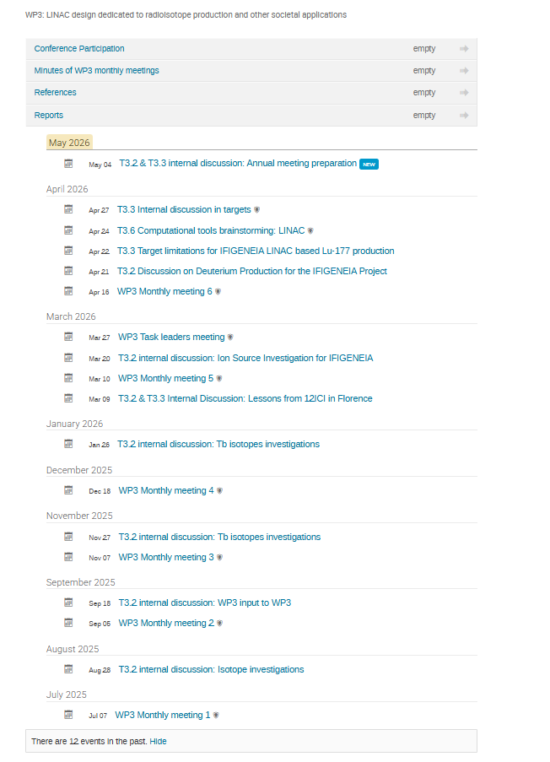
WP3 organization
Leadership
Led by AUTH, Co-led by COSYLAB
Scientific guidance: CERN
Structure
6 technical tasks covering LINAC design and radioisotope production
Coordination
Monthly WP3 meetings
Discussing Project general news
Follow up the status of the different activities
Discussing specific topics (i.e. related to the preparation of deliverables)
Regular task-level discussions ensuring progress and alignment
Key milestones:
M15, 24, 36, 42
Deliverables D3.1 and D3.2 are progressing according to plan
WP3 - leader (1-AUTH) · IJS Indico

Slide 10
WP3 organization
T3.1: LINAC/RFQ design and beam dynamics studies
→ D3.1: M12, 24, 42
→ D3.2: M15, M42
T3.2: Beam parameters and hardware specifications for different operational scenarios
→ D3.3: M24, 36
T3.3: Targets’ optimization and handling for different isotope production scenarios
→ D3.3: M24, 36
T3.5: Study of the Safety and Radiation protection requirements
→ D3.5: M24, 36
T3.4: Control system development project plan
→ D3.4: M36, 46
COSYLAB
NCSRD
T3.6: Development of Computational tools
→ Horizontal Task
AUTH
AUTH
AUTH
CERN
Leadership
Led by AUTH, Co-led by COSYLAB
Scientific guidance: CERN
Structure
6 technical tasks covering LINAC design and radioisotope production
Coordination
Monthly WP3 meetings
Discussing Project general news
Follow up the status of the different activities
Discussing specific topics ((i.e. related to the preparation of deliverables)
Regular task-level discussions ensuring progress and alignment
Key milestones:
M15, 24, 36, 42
Deliverables D3.1 and D3.2 are progressing according to plan

Slide 11
WP3 collaborations
Close collaboration with CERN experts
Source design (T3.2)
RFQ expertise (T3.1)
Beam dynamics & LINAC design (T3.2)
Targets (T3.3)
Controls (T3.4)
Close collaboration with WP4 on isotope portfolio definition
Information exchange through WP meetings and task-specific communication
Active contributions to:
Preparation of communication materials (WP2)
Preparation of KPIs (WP5)
Risk management (WP1)
Training / Master Classes (WP6)
Participation in conferences / workshops
12th International Conference of Isotopes (12ICI)
WP3 connects accelerator design, target development, and isotope production across the consortium.

Slide 12
WP3 progress and outlook
Year 1 – Key progress
Lu-177 selected as case study (with WP4)
Beam & target requirements defined (simulations, T3.2–T3.3)
RFQ demonstrator on track (with CERN guidance) (T3.1)
Radiation protection studies initiated (T3.5)
Control system development plan initiated (T3.4)
Computational tools under implementation (T3.6)
Deliverables D3.1–D3.2 on track
Next steps – Year 2
Continue RFQ demonstrator construction & integration
Refine beam dynamics and linac design studies
Target design simulations (Lu-177)
Advance radiation protection and shielding
Develop control system architecture based on more detailed input from the LINAC design
Explore additional isotopes and beam specifications
Extend simulation tools to different scenarios
Detailed results for each activity will be presented in the following task presentations.

Slide 13
Thank you for your attention!
Many thanks to all WP3 members and collaborators for the very nice collaboration and exchanges!
Many thanks to the local organizers for this very nice event!

