Slide 1
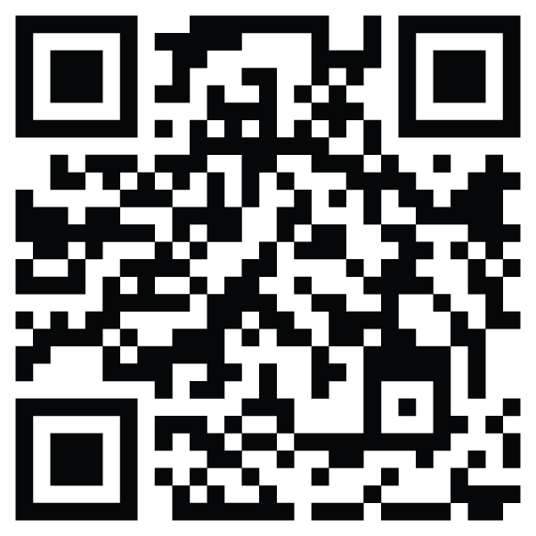
2nd Ifigeneia Annual Meeting WP2 - Education, Dissemination, Inclusion and Diversity T2.3 – Secondments and good practices exchange 7-8 May 2026, Ljubljana, Slovenia
Maria Bigaki, MBA, PMP, Head of PMO
Papageorgiou General Hospital

Slide 2
Overview of the task
Title: T2.3 – Secondments and good practices exchange Duration: M25 – M48 (March 2027 - February 2029) Leader: GNP The purpose of the task: The aim of T2.3 is to facilitate the exchange of expertise between IFIGENEIA’s partners and research/academia and business/NGO stakeholders of each Hub with the goal of closing the gaps. The task will prepare a proposal (including who, where, when, and how long) and address related logistics. Indicatively, it is envisaged that 2 staff members, for 2–4 weeks per year, will have the chance to experience new working environments with hands-on learning.
Targeted exchanges aim at building bridges (skills/perceptions) among academia/NGO/business. Indicatively, secondments can take place in the Accelerator Technology Sector (CERN), Knowledge Transfer Office (Slovenia, GSI), professional expert centres (e.g., medical personnel), at CERN, DKFZ, and vice versa.

Slide 3
Overview of the task
Title: T2.3 – Secondments and good practices exchange Duration: M25 – M48 (March 2027 - February 2029) Leader: GNP The result: • Structured secondment plan prepared and agreed (who/where/when/duration) • Staff mobility enabling hands-on learning in new environments • Transfer of expertise and good practices across Hubs and stakeholders • Stronger bridges among academia, industry/NGOs and healthcare actors • Contribution to capacity building and closing skills gaps

Slide 4
Description of the task
Task 2.3 organises and implements inter-institutional secondments and exchanges of good practices among consortium partners and relevant stakeholders. Key activities: • Define secondment framework (selection, hosts, duration, timing) • Identify participant profiles and matching host institutions • Coordinate logistics (travel, approvals, scheduling) • Monitor outcomes and capture lessons learned for reporting • Facilitate knowledge transfer between sectors and regions

Slide 5
Milestones & Deliverables
Milestones Milestone 1: Training Activities finalized — Month 48 (February 2029) Means of verification: Deliverable D2.3 Deliverables Deliverable D2.3: Report of Training, Secondments and good practices exchange activities — Month 24 (updated in Month 48) - TPOLIS

Slide 6
Critical risks
Risk 1: Budget limitations affecting mobility
No dedicated budget is allocated for T.2.3 activities, requiring possible budget reallocations or EU approval, which may cause delays. Mitigation: early financial planning and timely coordination with the project coordinator/EU officers regarding possible budget adjustments.
Risk 2: Availability of specialised host organisations.
Limited availability of host organisations may affect the implementation and quality of secondment activities. Mitigation: early identification of hosts and advance coordination with partners.
Risk 3: Limited participation in secondment activities • Low engagement may reduce impact. Mitigation: early planning, clear benefits, flexible scheduling.
Risk 4: Logistical and administrative challenges • Approvals/scheduling may delay implementation. Mitigation: advance coordination with hosts

Slide 7
Tasks KPIs
KPI1: Professionals engaged in secondments — Due M48 — Target: ~50 KPI2: Secondment/exchange activities implemented — Due M48 — Target: Programme completed KPI3: Knowledge transfer & capacity building outcomes — Due M48 — Target: Skills/links strengthened

Slide 8
Next steps: To do until the end of 2026
Preparatory phase for T2.3
Secondment framework development: objectives, eligibility criteria, duration schemes and draft agreement templates aligned with WP3/WP4.
Partner mapping & matching: identification of sending/hosting organisations and preliminary skills-gap analysis.
Monitoring tools design: reporting templates, KPIs and logistical planning to ensure operational launch in M25 (March 2027).
The next phase will focus on finalising the secondment programme, confirming participants and host institutions, and launching the first mobility activities.

Slide 9
Thank you for your attention Maria Bigaki pmo@papageorgiou-hospital.gr https://ifigeneia.eu/

