Slide 1
WP4 – Radioisotope production and radiopharmaceuticals
T4.3. Investigate best ligands for development within excellence hub
Marko Krošelj, MF, University of Ljubljana

Slide 2
Task 4.3.
The aim of T4.3 is to investigate the relevance of several promising cancer targets. In this regard, we will examine promising targets in various cancer types. Targets of interest will be selected and evaluated in the literature.
Native ligands and their shorter variants will be subsequently designed and synthesized by mean of classical organic chemistry and solid-phase support techniques. Such pharmacophores will be further equipped with radionuclide-tailored chelating ligands. The ultimate aim is to develop highly stable, affine and specific radiotracers and radiopharmaceuticals for the most promising targets strongly and commonly over-expressed in cancer tissues.

Slide 3
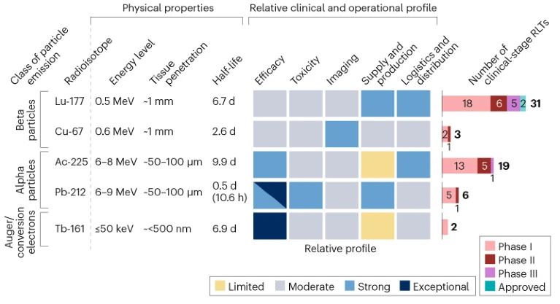
Selection of targets
Based on the WP3 and T4-2 outcomes – ¹⁷⁷Lu as a benchmark radionuclide
¹⁷⁷Lu: the clinically most relevant RN (Pluvicto®, Lutathera® + clinical trials)
Nature Reviews Drug Discovery 24, 584-585 (2025) doi: https://doi.org/10.1038/d41573-025-00096-w

Slide 4
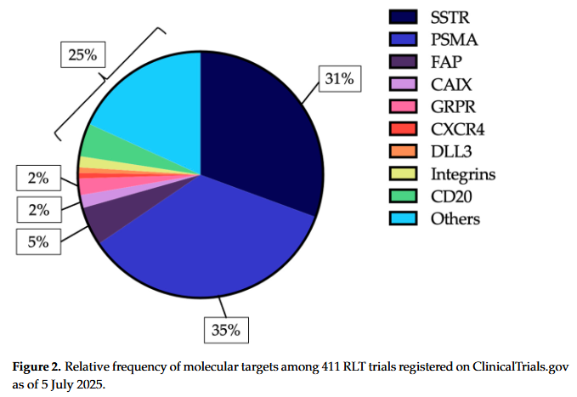
Selection of targets
Based on the WP3 and T4-2 outcomes – ¹⁷⁷Lu as a benchmark radionuclide
¹⁷⁷Lu: PSMA & SSTR clinically most mature targets (> 2/3 of current CT)
Ninatti, G.; Lee, S.T.; Scott, A.M. Radioligand Therapy in Cancer Management: A Global Perspective. Cancers 2025, 17, 3412

Slide 5
Internal deliverables
1. Consolidate current knowledge base
  Goal: Build a comparative scientific foundation for the three targets (PSMA, SSTR, FAP).
  1.1: Prepare detailed literature review for each target:
    Target expression profile across cancer types (e.g. prostate for PSMA, neuroendocrine tumors for SSTR, multiple epithelial cancers for FAP).
    Overview of current clinical use of existing radiopharmaceuticals (e.g. 177Lu-PSMA-617, 177Lu-DOTATATE, 177Lu-FAP compounds).
    Known ligand scaffolds and chelation strategies.
  Output: Review report — “A comprehensive overview of PSMA, SSTR, and FAP? as theranostic targets for ¹⁷⁷Lu.”
  2 reports:
    Summary and review of PSMA targeted radionuclide therapy
    Summary and review of SSTR targeted radionuclide therapy
  Dissemination level: Consortium
  Deadline: first draft - M15 (31.5.2026)

Slide 6
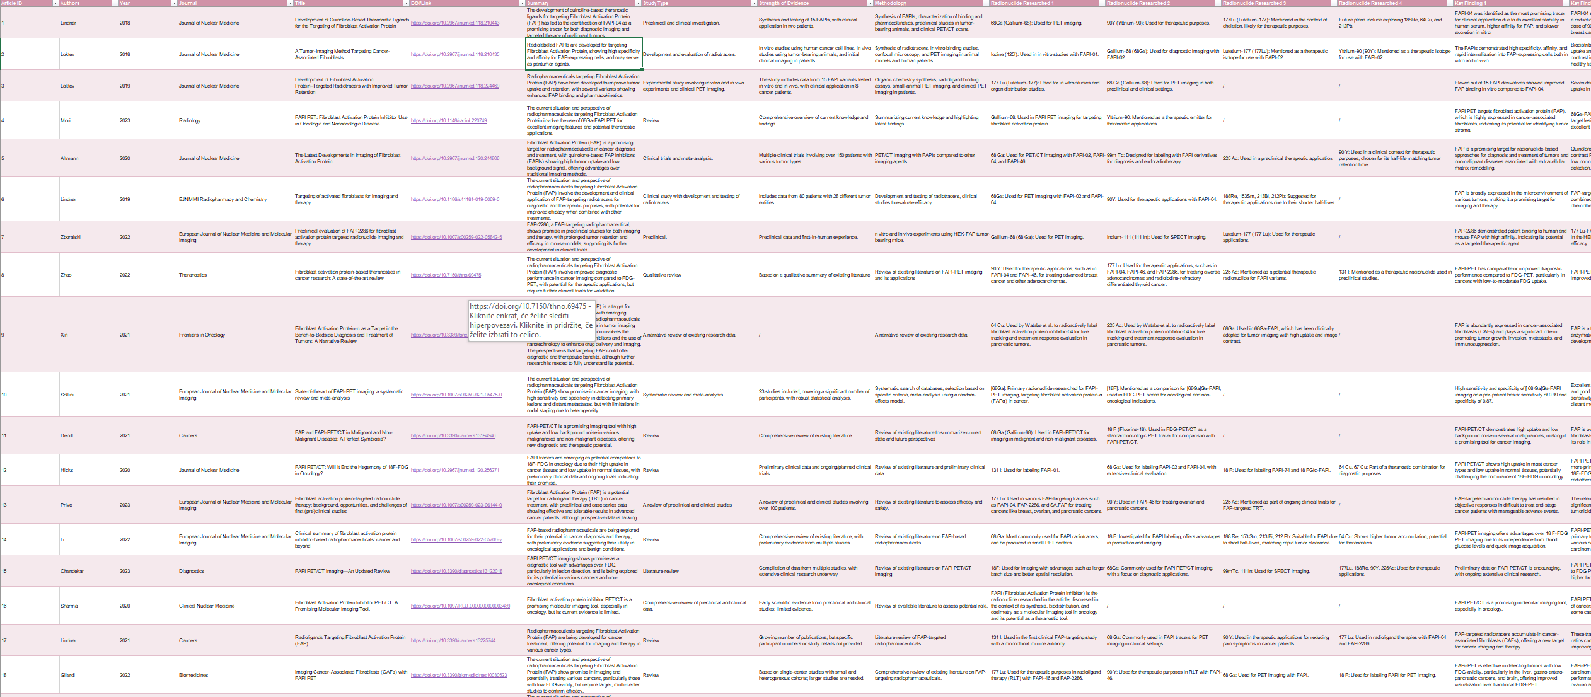
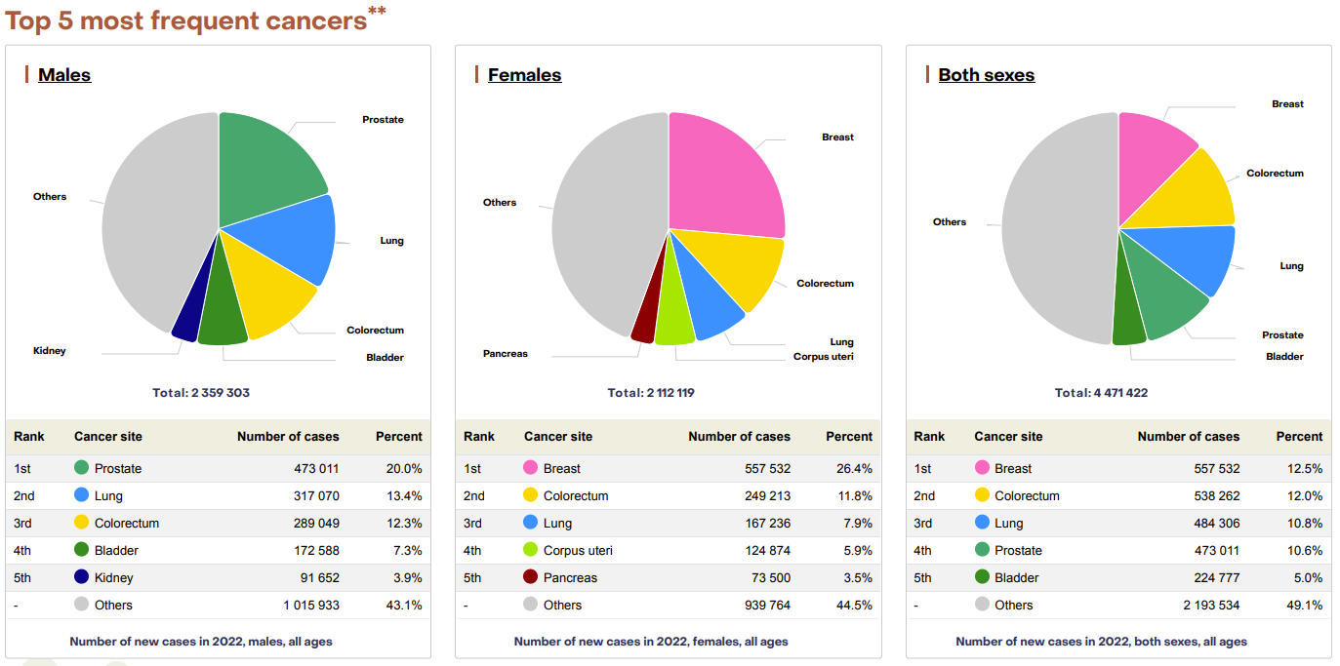
PSMA comprehensive report
Overview of top 30 cited articles (Clinical stage)– Excel repository
Overview of Pca burden, treatment protocols

Slide 7
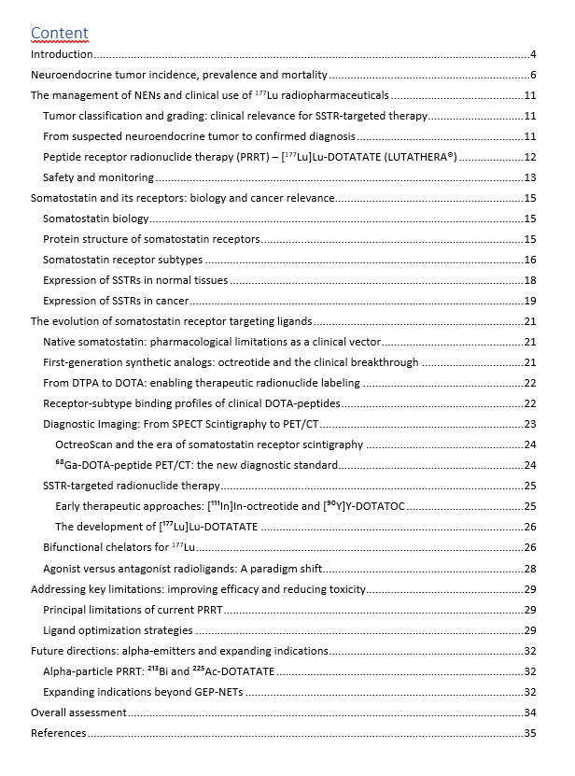
SSTR comprehensive report

Slide 8
Future work
Comprehensive analysis of FAP (targeting tumor microenivronment)
Possible extension to novel, emerging biological targets in NM

