Slide 1
IFIGENEIA 2nd annual meeting: T3.6 – Development of computational tools F. Antoniou^{1,2}, G. Dianos¹, Ch. Georgiadis³, N. Laloumis³, R. Lingas³, A. Mamaras¹, C. Petridou¹, D. Sampsonidis¹, A. Tsiamis¹, S. Tzamarias¹, N. Vagena¹ ¹AUTH, ²CERN, ³CERTH
Slovenia, Ljubljana
07/05/2026
Notes:
Fonts:
Headings: Dubai bold, available at: https://font.download/font/dubai Body: Roboto, available at: https://fonts.google.com/specimen/Roboto

Slide 2
Outline
T3.6 context and objectives
Possible applications in WP3
Possible applications in WP4
Possible applications in WP1

Slide 3
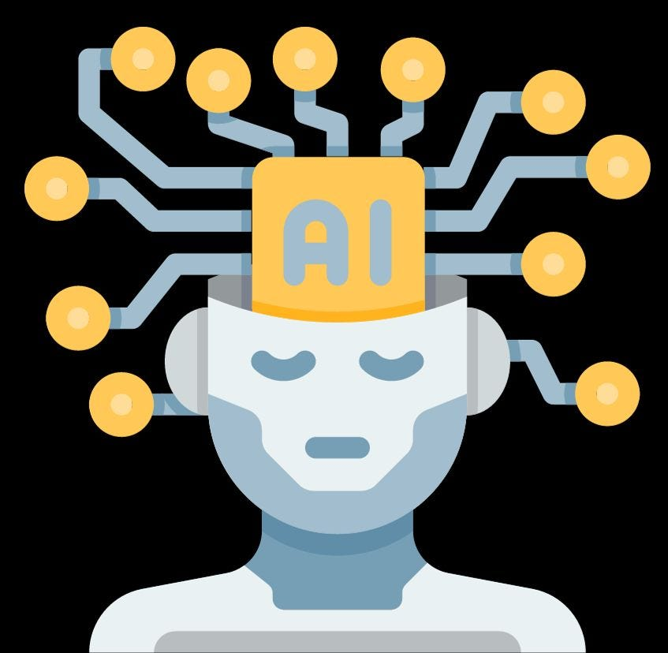
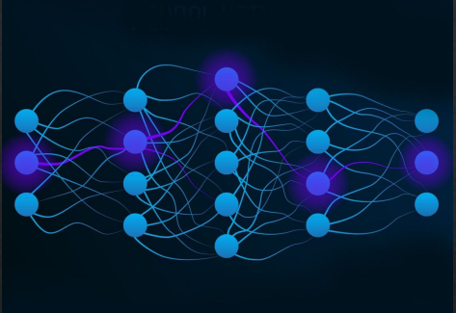
T3.6 overview
Led by AUTH
Partners: AUTH, CERTH, CERN
Coordination
Discussions and brainstorming within T3.6 to identify possible applications.
Proof of principle studies on various fronts
T3.6: Computational Tools
Horizontal Task supporting the technical WPs. It concerns the development of simulation, optimization and modelling tools based on classical and ML/AI algorithms:
On the simulation and computational studies of T3.1-T3.5.
Computational modelling support to the tasks of WP4

Slide 4
Possible applications in WP3
T3.2 related: Development of tools related to machine commissioning / operation efficiency :
Work in progress :
Understanding existing simulation tools (being trained starting from simple examples)
Neural Network reconstruction of initial beam parameters from downstream phase-space measurements — proof-of-concept study
Next step:
Once available, use the finale accelerator design to identify the most impactful application points — ion source, beam extraction, or transport line.
Fast predictions / decisions for different operational scenarios

Slide 5
Possible applications in WP3
T3.3 related: Targets engineering
Targets operate under radiation flux, thermal shocks, mechanical stress, and corrosive coolants
Experimental data is scarce and expensive → ML as surrogate model
Structural integrity: predict fatigue & fracture in tungsten/tantalum under cyclic beam loading
Thermal management: ML replaces costly FEM simulations for cooling optimization
Radioactive material extraction: optimize isotope yield and separation efficiency post-irradiation
T3.4 related: Automation of controls

Slide 6
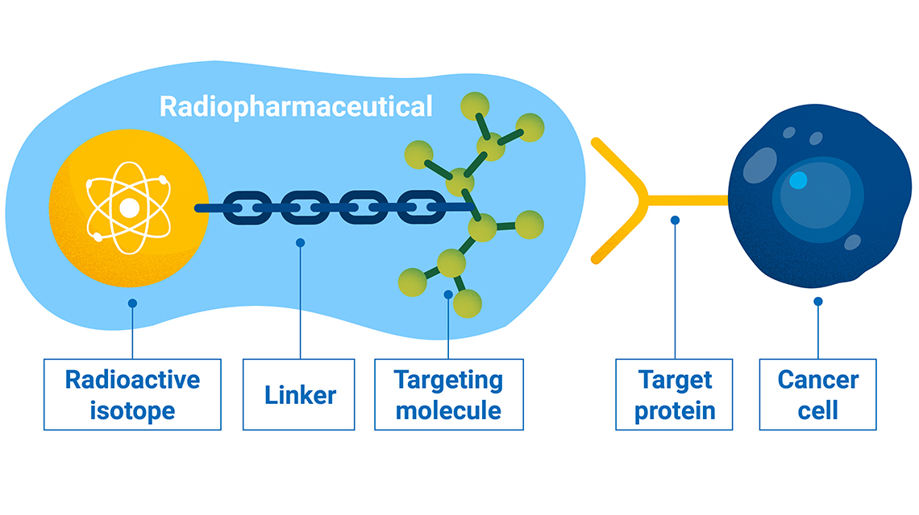
Possible applications in WP4
ML in radiopharmaceuticals development
Target molecule design: ML screens databases for high-affinity PET tracer ligands
Image reconstruction: deep networks can improve low-dose PET/SPECT resolution; automated tumor segmentation for dosimetry
Real-time monitoring: ML can detect extravasation events during radiopharmaceutical infusion

Slide 7

Possible application in WP1
An early-stage idea: a supervisory AI tool with access to project documentation, emails, and technical reports.
Would handle information aggregation, correspondence, and serve as a living memory for the project
To be explored further as the project matures.

Slide 8
Summary and outlook
Horizontal task supporting mainly WP3 & WP4
Development of:
Simulation tools
Optimization methods
ML/AI-based models
WP3 Applications – Accelerator & Targets
Beam reconstruction & commissioning tools
Fast prediction for operational scenarios (T3.2)
ML surrogate models for target engineering (T3.3)
WP4 – Radiopharmaceuticals
Molecule screening
Image reconstruction
Dosimetry support
WP1 - Project-level AI assistant
A very early-stage idea
Next Steps
Identify high-impact use cases across the project
Develop proof-of-concept tools
Integrate with:
Final accelerator design
Experimental and / or simulation data

Slide 9
Thank you for your attention!
Many thanks to the local organizers for this very nice event!

Slide 10
AI-Driven Virtual Screening of Lutetium Chelators for Radiopharmaceuticals
AI Screening
Model pre-trained on large molecular databases
Fine-tuned on metal-ligand coordination data
Screens millions of molecules
Prioritization
Fast filters: donor atoms, ring size, geometry
Rank candidates by predicted affinity
DFT Validation
Geometry Optimization
Complexation energy
Aromaticity Analysis (NICS)

Slide 11
AI vs ML
Machine Learning
A subset of AI — one specific approach to achieving it
Systems learn patterns from data — no hand-coded rules
Deep Learning ⊂ ML: multi-layer neural networks
Today's dominant AI implementation method
Artificial Intelligence
Any system performing tasks requiring human-like reasoning
Covers: planning, perception, language, decision-making
Concept from the 1950s — predates ML by decades
Can be implemented without ML (rule-based, expert systems)

Slide 12
ML Categories
Supervised Learning
Trained on labeled (input, output) pairs
Tasks: regression, classification
Example: predict beam emittance from phase space
Unsupervised LEarning
Finds structure in unlabeled data
Tasks: clustering, dimensionality reduction
Example: anomaly detection in accelerator diagnostics
Reinforcement Learning
Agent learns via reward/penalty feedback
Tasks: optimization, control, planning
Example: real-time adaptive tuning of magnets
Deep Learning
Neural networks with many layers
Strong on high-dimensional inputs (images, spectra)
Example: histogram-based beam reconstruction

Slide 13
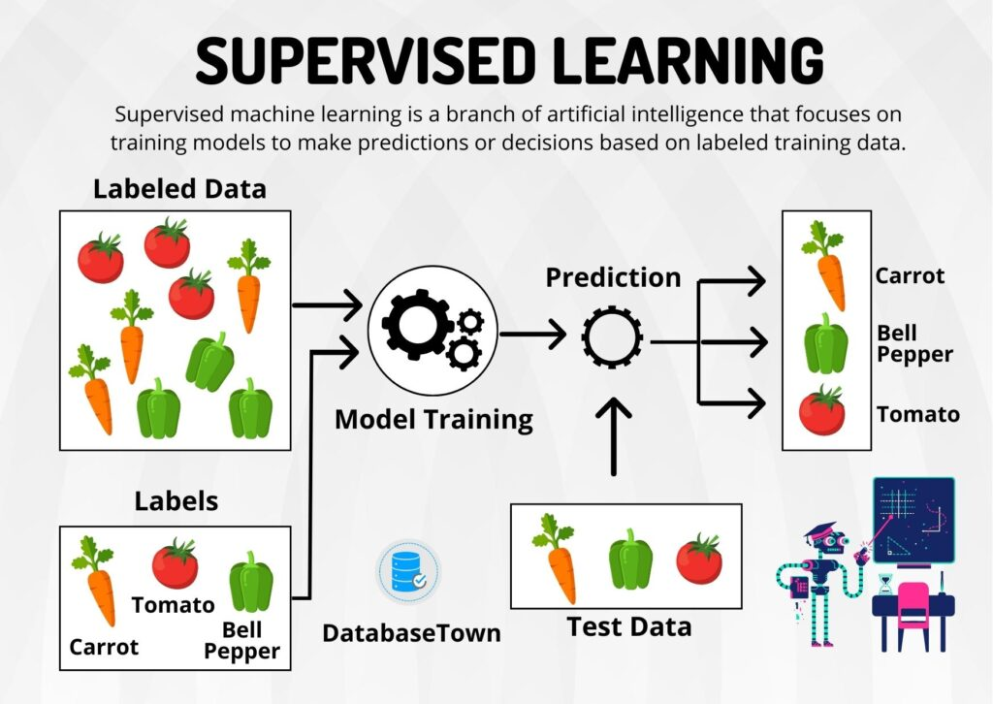
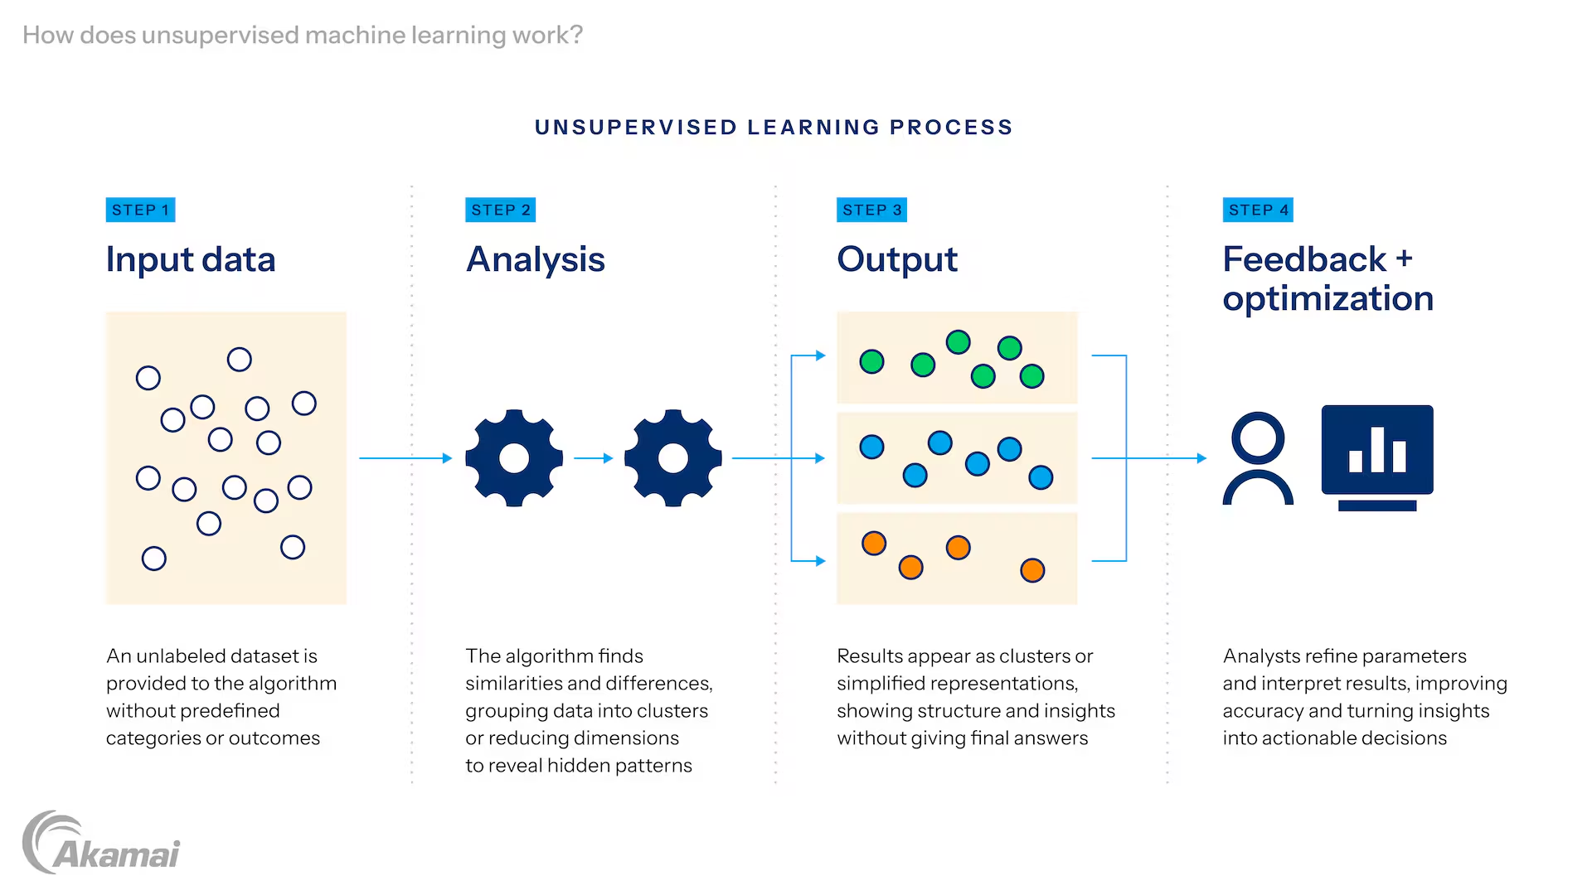
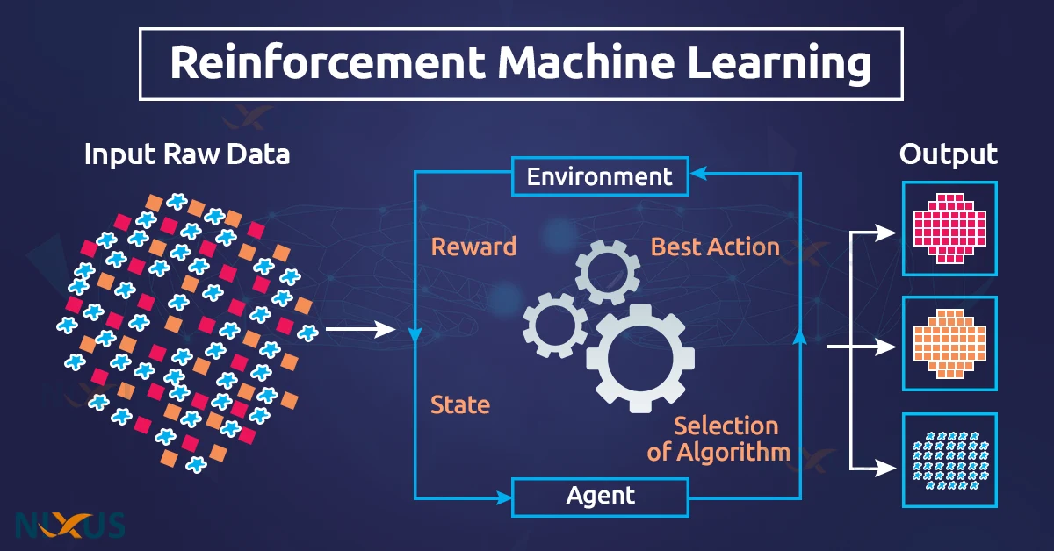
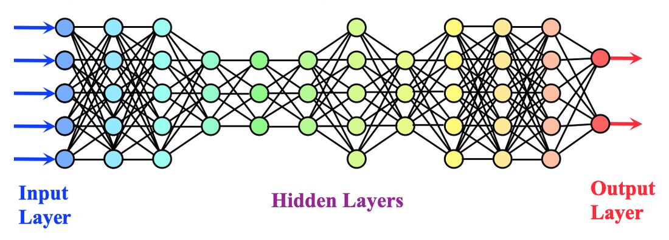
ML Categories
Supervised Learning
Trained on labeled (input, output) pairs
Tasks: regression, classification
Example: predict beam emittance from phase space
Unsupervised LEarning
Finds structure in unlabeled data
Tasks: clustering, dimensionality reduction
Example: anomaly detection in accelerator diagnostics
Reinforcement Learning
Agent learns via reward/penalty feedback
Tasks: optimization, control, planning
Example: real-time adaptive tuning of magnets
Deep Learning
Neural networks with many layers
Strong on high-dimensional inputs (images, spectra)
Example: histogram-based beam reconstruction

