Slide 1
LINAC based production of Lu-177 : target limitations
Eleni Vagena
¹Aristotle University of Thessaloniki, ²University of Ljubliana, ³CERN, ⁴DKFZ

Slide 2

The IFIGENEIA project
IFIGENEIA aims to develop LINAC based production on medical radioisotopes.
IFIGENEIA focuses on establishing an infrastructure in the Balkan region, combining expertise from CERN, DKFZ and other academic partners.
Aristotle University of Thessaloniki (AUTH) is the coordinator.
It is funded by the European Union and its duration is 4 years.
Notes:
HORIZON WIDENING EUROPE 2023:
Widening participation and strengthening the European Research Area
IFIGENEIA is an Excellence Hub initiative introducing ion LINAC technology as a complementary production route. We are establishing coordinated hubs in Southeast Europe, under the scientific guidance of CERN, DKFZ and GSI, to develop regional isotope production capacity

Slide 3
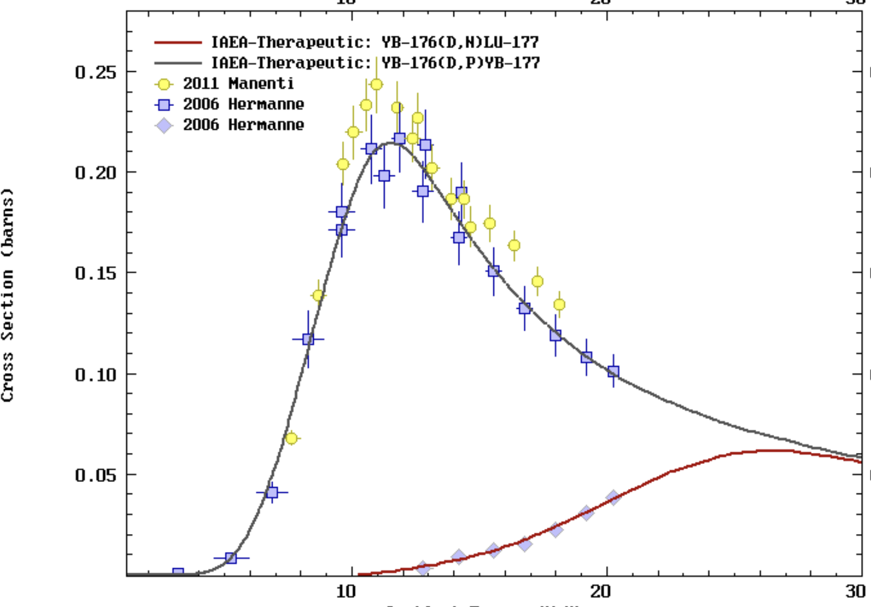
Lu-177 production
We began our portofolio with the Lu-177 production
Two production reaction channels:
  The indirect d,p:
  The direct d,n:
  The direct route contributes less and becomes relevant at higher energies
  (above 14 MeV)
Reaction cross sections
¹⁷⁶Yb(d,p)¹⁷⁷Yb → ¹⁷⁷Lu + β-
¹⁷⁶Yb(d,n)¹⁷⁷Lu

Slide 4
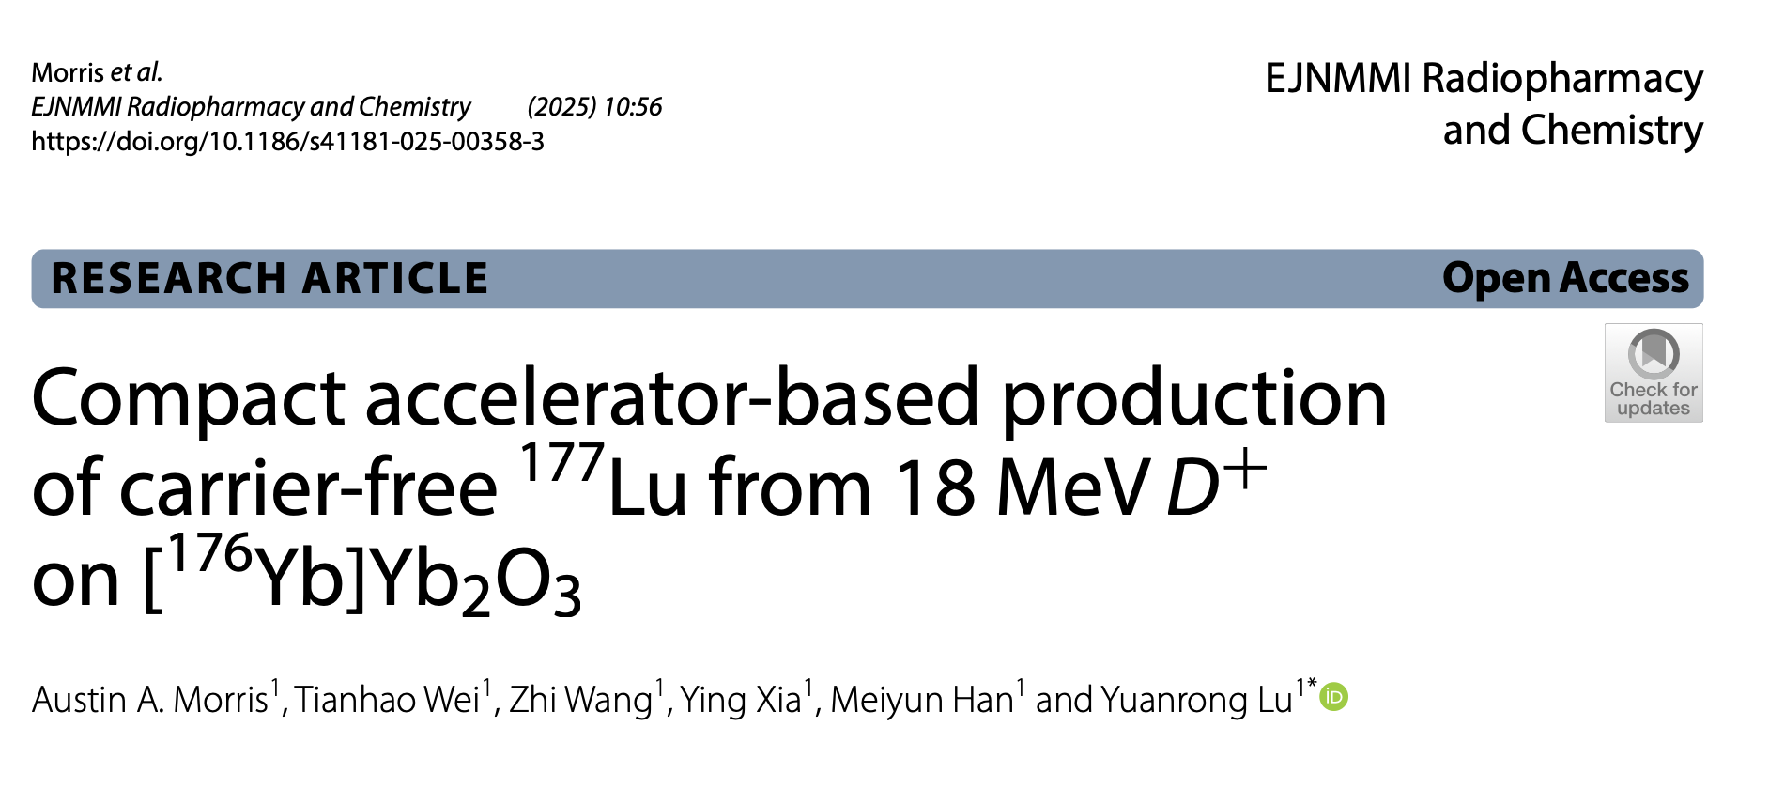
¹⁷⁷Lu Geant4 simulations
The starting point of our simulations was a recent study by Morris et. al.
We conducted Geant4 simulations to identify the optimal target parameters .
The target thickness and beam energy were chosen to maximize the overlap between the deuteron energy-loss profile and the high cross-section region, maximizing the reaction probability thus, Lu177 yield.
Deuteron beam optimal energy ≈ 18 MeV
Optimized target thickness: 0.36 mm

Slide 5
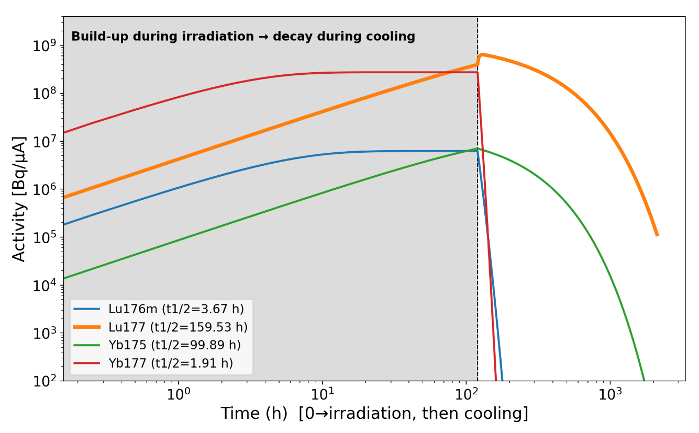
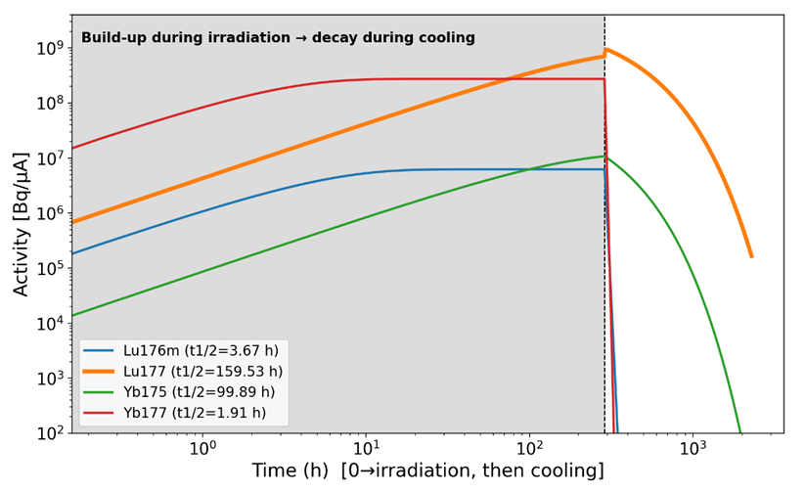
Evaluation of radionuclidic purity under different irradiation scenarios
Standard irradiation: 5 days.
Average beam currents: 1mA-10mA
Extended irradiation: 12 days.
Average beam currents: 1mA-10mA
Activity at EOB after 5‑day irradiation
Activity at EOB after 5‑day irradiation
Isotope | 1 mA | 2 mA | 5 mA | 10 mA
Lu‑176m | 6.242 × 10⁹ | 1.248 × 10¹⁰ | 3.121 × 10¹⁰ | 6.242 × 10¹⁰
Lu‑177 | 3.973 × 10¹¹ | 7.946 × 10¹¹ | 1.986 × 10¹² | 3.973 × 10¹²
Yb‑175 | 7.055 × 10⁹ | 1.411 × 10¹⁰ | 3.528 × 10¹⁰ | 7.055 × 10¹⁰
Yb‑177 | 2.746 × 10¹¹ | 5.492 × 10¹¹ | 1.373 × 10¹² | 2.746 × 10¹²
Isotope | 1 mA | 2 mA | 5 mA | 10 mA
Lu‑176m | 6.242 × 10⁹ | 1.248 × 10¹⁰ | 3.121 × 10¹⁰ | 6.242 × 10¹⁰
Lu‑177 | 7.068 × 10¹¹ | 1.414 × 10¹² | 3.534 × 10¹² | 7.068 × 10¹²
Yb‑175 | 1.079 × 10¹⁰ | 2.158 × 10¹⁰ | 5.395 × 10¹⁰ | 1.079 × 10¹¹
Yb‑177 | 2.746 × 10¹¹ | 5.492 × 10¹¹ | 1.373 × 10¹² | 2.746 × 10¹²

Slide 6
Is the expected production yield adequate for clinical use?
The table shows the activity/9GBq that represents 1 therapeutic cycle after 5 days of irradiation for 2, 5 & 10 mA.
Case: t_{irr} =5 days , 2mA | Activity (GBq) | Cycles = Activity / 9GBq
EOB | 794 | ≈ 88 cycles
EOB + 48 h cooling | 645 | ≈ 71 cycles
At high beam current we reach large scale activity.
Even moderate beam currents (2 mA) provide sufficient activity for local and regional clinical use.
Case: t_{irr} =5 days , 5mA | Activity (GBq) | Cycles = Activity / 9GBq
EOB | 1986 | ≈ 220 cycles
EOB + 48 h cooling | 1613 | ≈ 179 cycles
Case: t_{irr} =5 days , 10mA | Activity (GBq) | Cycles = Activity / 9GBq
EOB | 4000 | ≈ 444 cycles
EOB + 48 h cooling | 3248 | ≈ 360 cycles

Slide 7
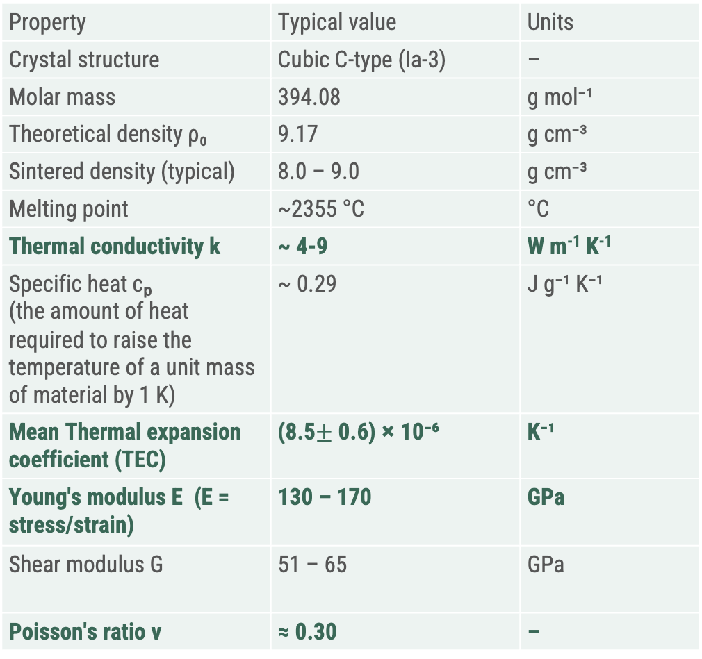
Parameters for target & beam
Material properties of Yb²O³
Parameter | Value
Irradiation conditions
Projectile | Deuterons (D⁺)
Incident energy | 17.9 MeV
Average Beam current (DC 10%) | 1 mA (1000 µA)
Beam radius | 1 cm (circular)
Beam area | 3.14 cm²
Target material | ¹⁷⁶Yb₂O₃ (97% enriched)
Target thickness | 0.36 mm
Irradiation time | 120 h (5 d) / 288 h (12 d)
EOB ¹⁷⁷Lu activity | 3.97 × 10⁸ Bq/µA → 0.40 TBq @ 1 mA, 5 d
Exit deuteron energy | ≈ 8 MeV
Energy deposit | ≈ 9.9 MeV (ΔE = 17.9 – 8)
Beam power on target | ≈ 17.9 kW (total) / 9.9 kW (deposited) (U·I and ΔE·I)
Property | Typical value | Units
Crystal structure | Cubic C-type (Ia-3) | –
Molar mass | 394.08 | g mol⁻¹
Theoretical density ρ₀ | 9.17 | g cm⁻³
Sintered density (typical) | 8.0 – 9.0 | g cm⁻³
Melting point | ~2355 °C | °C
Thermal conductivity k | ~ 4-9 | W m⁻¹ K⁻¹
Specific heat cₚ (the amount of heat required to raise the temperature of a unit mass of material by 1 K) | ~ 0.29 | J g⁻¹ K⁻¹
Mean Thermal expansion coefficient (TEC) | (8.5$±$ 0.6) × 10⁻⁶ | K⁻¹
Young's modulus E (E = stress/strain) | 130 – 170 | GPa
Shear modulus G | 51 – 65 | GPa
Poisson's ratio ν | ≈ 0.30 | –
Thermal analysis

Slide 8
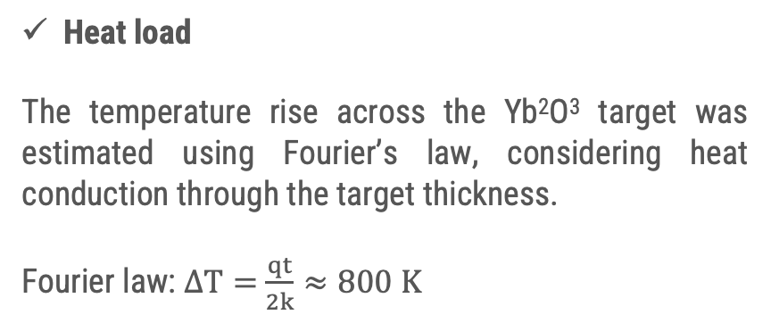
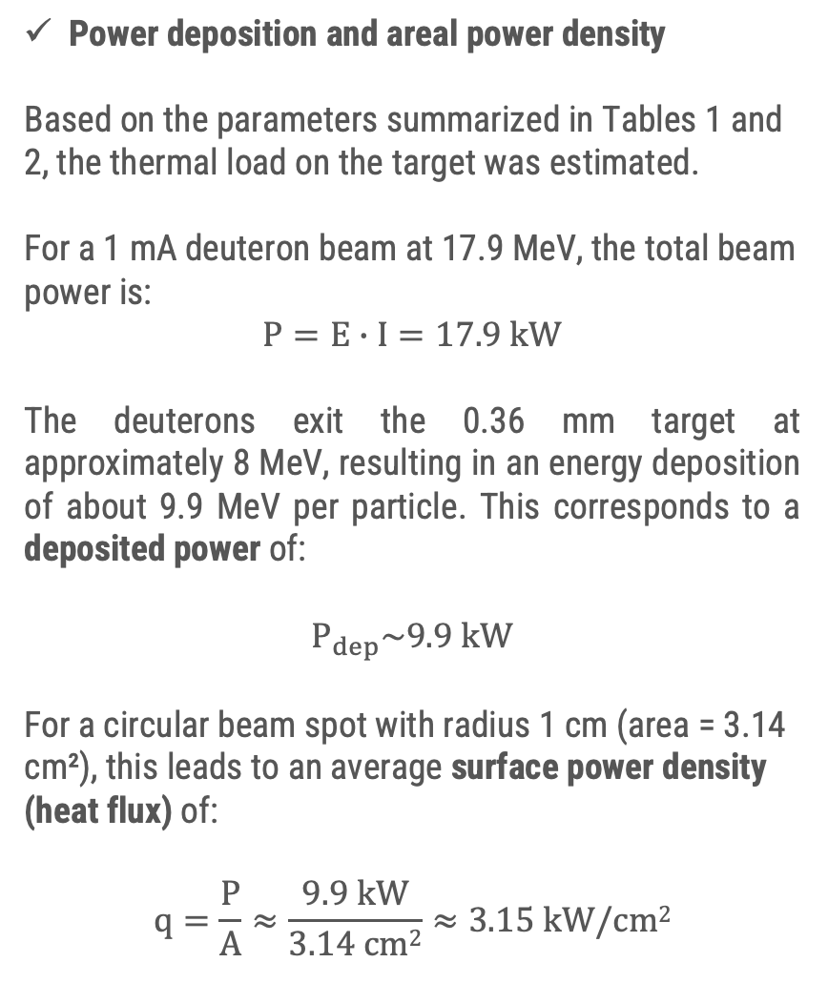
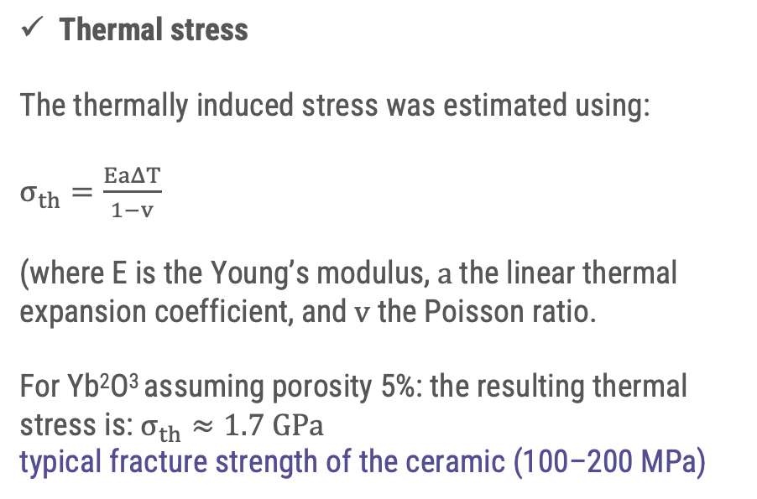
Power Deposition, Heat Load and Thermal Stress
Power deposition and areal power density
Based on the parameters summarized in Tables 1 and 2, the thermal load on the target was estimated.
For a 1 mA deuteron beam at 17.9 MeV, the total beam power is:
$$P=E∙I=17.9 kW$$
The deuterons exit the 0.36 mm target at approximately 8 MeV, resulting in an energy deposition of about 9.9 MeV per particle. This corresponds to a deposited power of:
$$P_{dep}\sim 9.9 kW$$
For a circular beam spot with radius 1 cm (area = 3.14 cm²), this leads to an average surface power density (heat flux) of:
$$q=\frac{P}{A}≈\frac{9.9 kW}{3.14 cm2}≈3.15 kW/cm2$$
Heat load
The temperature rise across the Yb²O³ target was estimated using Fourier’s law, considering heat conduction through the target thickness.
Fourier law: $ΔΤ=$ $\frac{qt}{2k}≈800 K$
(for k=7 W/mK)
Thermal stress
The thermally induced stress was estimated using:
$σ_{th}=\frac{EaΔΤ}{1−v}$
(where E is the Young’s modulus, $a$the linear thermal expansion coefficient, and $v$the Poisson ratio.
For Yb²O³ assuming porosity 5%: the resulting thermal stress is: $σ_{th}≈1.7 GPa$
typical fracture strength of the ceramic (100–200 MPa)

Slide 9
Summary of Thermal Loading and Stress Estimates
Quantity | Value | Comment
Total beam power | ~17.9 kW | (E · I)
Deposited power | ~9.9 kW | energy loss in target
Beam area | 3.14 cm² | r = 1 cm
Heat flux | ~3.15 kW/cm²
Temperature rise (ΔT) | ~800 K | (k = 7 W/m·K)
Thermal stress | ~1.7 GPa
Fracture strength | ~100–200 MPa | Yb₂O₃ ceramic
High level of thermal stress

Slide 10
Possible Strategies to Reduce Thermal Stress
To reduce the thermal stress on the target, two possible approaches were preliminarily investigated in Geant4: beam spreading and tilted-target geometry.
First results indicate that beam spreading can lower the surface power density by distributing the deposited power over a larger irradiated area, although this may lead to partial beam loss and a reduction in ¹⁷⁷Lu yield if the target dimensions remain unchanged
(beam diameter: 20 → 24 mm, heat flux ↓ ~30%, ¹⁷⁷Lu yield ↓ ~11%)
A second option is the use of a tilted target. In this first simulation study, a tilted target by 60° was used. The target radius was set larger than the beam spot radius to ensure full beam interception in both geometries.
Tilted target (60°): heat flux ↓ ~50%, yield ≈ constant
These findings are preliminary, so the practical implementation (such as the tilt angle value) depends on realistic operational constraints of the accelerator and target station.

Slide 11
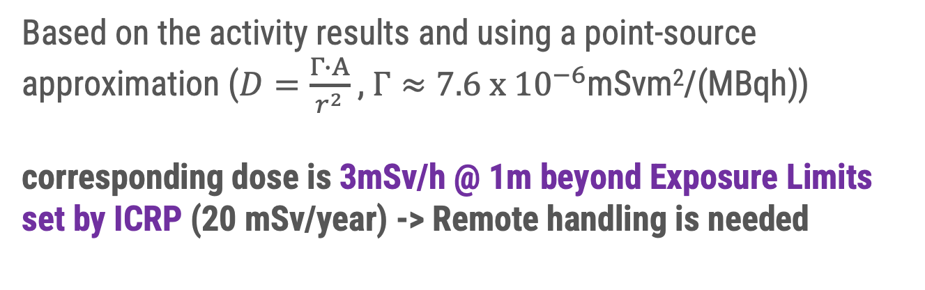
How radioactive does the target become?
Estimated Isotope Activities at EOB for 1 mA, 5-Day Irradiation
Isotope | t½ | Activity per µA at EOB | At 1 mA / 5-day irradiation
¹⁷⁷Lu | 6.65 d | 3.97 × 10⁸ Bq | 3.97 × 10¹¹ Bq
¹⁷⁷Yb | 1.91 h | 2.75 × 10⁸ Bq | 2.75 × 10¹¹ Bq
¹⁷⁶ᵐLu | 3.66 h | 6.24 × 10⁶ Bq | 6.24 × 10⁹ Bq
¹⁷⁵Yb | 4.19 d | 7.06 × 10⁶ Bq | 7.06 × 10⁹ Bq
Short-lived light fragments (¹³N, ¹⁵O, ¹⁷F, ¹⁹O …) | s–min | ~10⁸ Bq combined | Decays to negligible levels within ≤ 1 h cooling
For neutrons (Geant4 results):
The simulated neutron yield is ~3 x 10⁻³ neutrons per primary deuteron ->
1.85 x 10¹⁰ n/s per μA
Based on the activity results and using a point-source approximation ($D=\frac{Γ∙Α}{r^{2}}$ , $Γ≈7.6 x {10}^{−6}$mSvm²/(MBqh))
corresponding dose is 3mSv/h @ 1m beyond Exposure Limits set by ICRP (20 mSv/year) -> Remote handling is needed

Slide 12
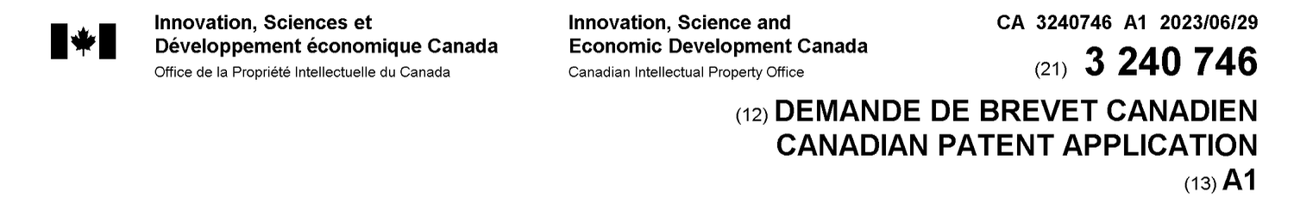
Alternative Design Option and Ytterbium Recycling
Alternative Design Option
Ytterbium Recycling
Based on literature and patent studies (e.g. WO 2023/121967 A1), the irradiated target can be chemically processed and the material reused.
Form | Pros | Cons
Yb₂O₃ pellet (reference) | Chemically stable, established | Low thermal conductivity (k ~ 4–9 W/m·K)
Yb metal foil | High thermal conductivity (k ~ 35 W/m·K) | Melting point is low (819°C)

Slide 13
Points to discuss
Target engineering very challenging. We will need to address if the translation to large scale production is finally feasible.
Target density and form (metallic, pellet?)
Backing material you used?
  Contaminations from backing material?
Target cooling
Experience with experimental data?
Main challenges faced during your simulations or experimental campaigns?
Crucial parameters that we will need to consider
Pulsed or CW operation of a LINAC preferable with respect to target irradiation effects (e.g., fatigue, stress damage, thermal shock)?

Slide 14
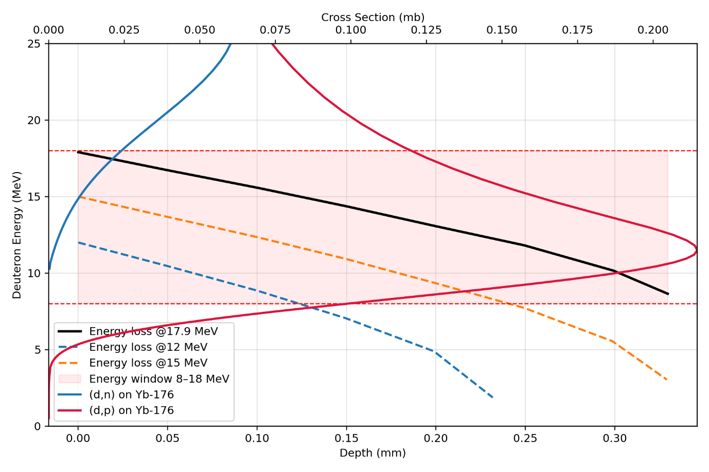
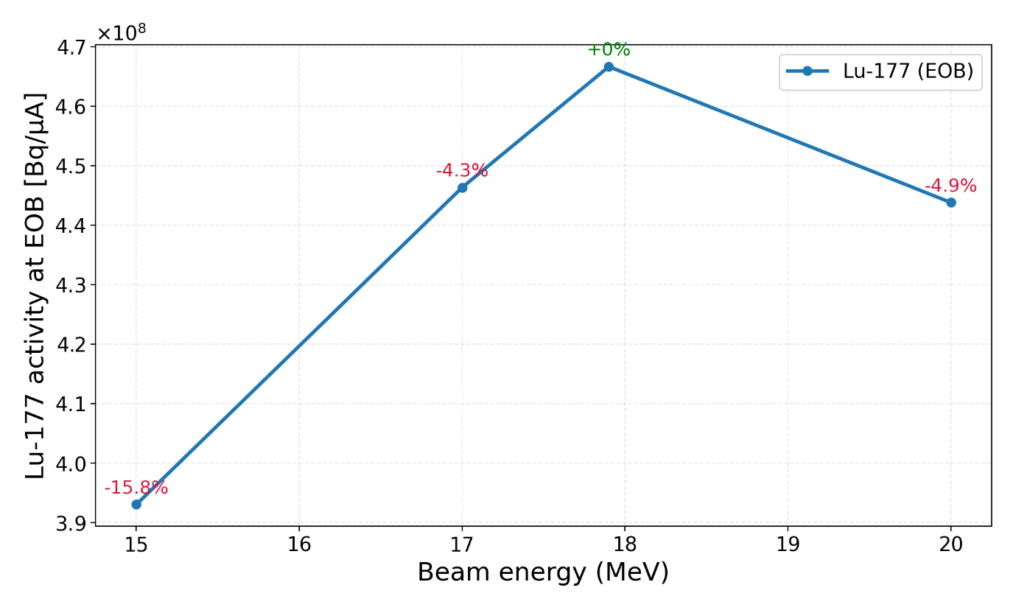
d,p dominant
Higher energies -> more impurities and
we have seen that the Lu177 yield reaches a plateau.
At 17.9 MeV the deuteron traverses the entire (d,p) excitation function on its way through the 0.36 mm pellet, slowing down from 17.9 MeV at the entrance to ~8 MeV at the exit and thereby sampling every energy in the productive window — including the 12 MeV cross-section peak — so that the integrated yield is maximised
The thickness 0.36 mm is optimal because it lets the deuteron slow from 17.9 MeV down to ~8 MeV, covering the full productive window of the (d,p) cross section; thinner pellets (e.g. 0.20 mm, exit ~13 MeV) cut off the beam above the peak and lose the low-energy half of the yield, while thicker pellets (≥0.55 mm) bring the deuteron to a full stop in a region where σ → 0, adding mass and heat without any additional Lu-177 production.

