Slide 1

Source Investigation for Deuterium Production
22/04/2026
Aristeidis Mamaras
Special Topic Meeting

Slide 2
Outline
IFIGENEIA Project
Linac for IFIGENEIA
¹⁷⁷Lu
Iterative Design Workflow
Facilities with Experience in D beams
CERN Experience in D beams
Commercial Ion Sources
Commercial Medical Accelerators
Overview & Conclusions

Slide 3

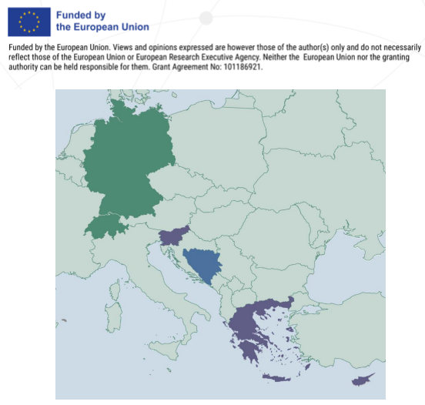
The IFIGENEIA Project
Funded by the European Union, approved in 2024, and started in March 2025 (4 years in total).
Advanced Linac technology as a complementary approach to cyclotrons and nuclear reactors: a safe, flexible, and sustainable production of a wide range of radioisotopes in the Balkans.
Establishing Excellence Hubs in Greece, Slovenia, Cyprus and Bosnia & Herzegovina for capacity building, scientific excellence and regional impact in the Balkans.
Under the scientific guidance of: CERN (Linac expertise), DKFZ (radiopharmaceutical development), GSI (mentoring activities).
Coordinated by the Aristotle University of Thessaloniki (AUTh).
Under the umbrella of PRISMAP⁺.
Courtesy of F. Antoniou

Slide 4
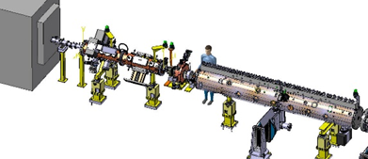
Linac for IFIGENEIA
PARTICLE SOURCE
(H⁺, ²H⁺, He²⁺)
(TBD)
Low Energy Beam Transfer (LEBT) line
(TBD)
RFQ
Bunch and Pre-Acceleration
(e.g., 352 or 750 MHz)
(TBD)
DTL-type:
Final Acceleration
(e.g., QA-DTL)
(TBD)
Target
Radioisotope Production (e.g., Lu-177: Yb-176
At-211: Bi-209...)
Linac technology has been demonstrated within the relevant regime (ref. A. M. Lombardi, J. B. Lallement); parameters of the specific linac should be properly defined.

Slide 5

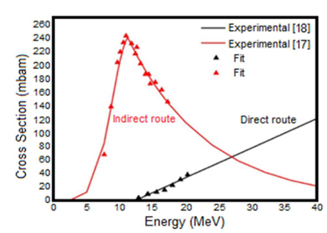
¹⁷⁷Lu (T_{1/2}=6.65 d)
Linac design driven by isotope production requirements → ¹⁷⁷Lu benchmark case via ¹⁷⁶Yb(d,p)¹⁷⁷Yb route.
¹⁷⁷Lu benefits:
average emission energies of electrons 40-150 keV.
gamma radiation for diagnosis
β⁻ emitter for therapy
chemical properties allow its binding to antibodies
Target most-used: ¹⁷⁶Yb₂O_{3.} The power sustained by the Yb sample constrains the ¹⁷⁷Lu production.
Ref. [1, 2, 3]

Slide 6
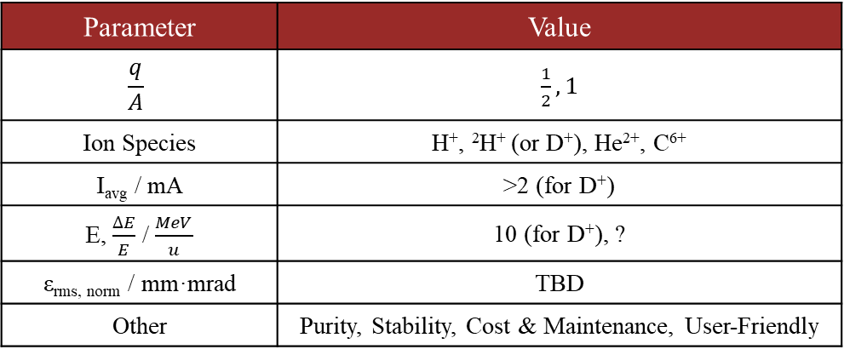
Iterative Design Workflow
Ion Source
Linac Design
Targetry
Parameter | Value
$$\frac{q}{A}$$ | $\frac{1}{2}, 1$
Ion Species | H⁺, ²H⁺ (or D⁺), He²⁺, C⁶⁺
I_{avg} / mA | >2 (for D⁺)
E, $\frac{∆E}{E}$ / $\frac{MeV}{u}$ | 10 (for D⁺), ?
ε_{rms, norm} / mm·mrad | TBD
Other | Purity, Stability, Cost & Maintenance, User-Friendly
Limitations stemming from the target.
Integrate operational flexibility for additional ion species, enabling radioisotope production for theragnostic applications.

Slide 7
Accelerator-Based Facilities with experience in D^{+/-} beams
Facility / Company (Ion Source) | City, Country | Scope
IPHI (SILHI) | Saclay, France | Develop/test high intensity beam diagnostics E ≤ 3 MeV, 1 ≤ I_{peak} ≤ 100 mA, thermal studies at high power, test beam intercepting targets, irradiate samples with protons or neutrons, optimise neutron moderators or test neutron diagnostics.
SPIRAL2 (SILHI upgrade) | Caen, France | 5 mA D beam @ 40 keV in continuous and pulse mode for Spiral2 requirements.
IFMIF-DONES LIPAc Injector (SILHI upgrade) | Granada, Spain | 125 mA D⁺ beam accelerated to 40 MeV, delivering 5 MW CW on a liquid lithium target, producing a 14 MeV neutron flux of 10¹⁸ m⁻²s⁻¹ for fusion material testing.
INFN (AISHa) | Catania, Italy | Produce high intensity, low emittance highly charged ion beams for hadron therapy purposes.
IAP (SMIS-37) | Nizhniy Novgorod, Russia | Development of a new type of ion source, high current gas dynamic ion source 37.5 GHz gyrotron radiation with power up to 100 kW.
Linac4 (IS03b) | Geneva, Switzerland | Main workhorse for LHC injection. Experience with ²H⁺.
D-Pace (ISV.F-040 & ISV.RF-040) | Nelson, Canada | Development of multicasp ion sources for multipurpose activities.
Pantechnik (Supernanogan) | Bayeux, France | Production of a variety of ions for multipurpose studies.
Nusano | Valencia, USA | Production of a variety of ions for radioisotope production.

Slide 8
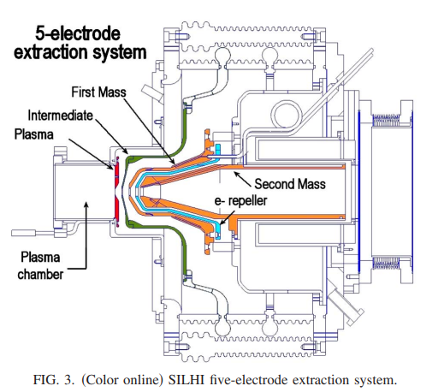
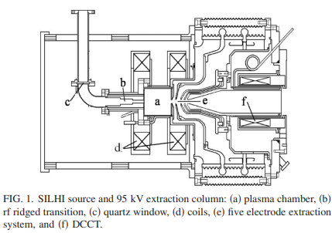
SILHI
Parameter | Value
Microwave Frequency / GHz | 2.45
Magnetic Resonance Field / mT | 87.5
I _{H}⁺_{, D}⁺ / mA | 100, 140
Extraction Voltage / kV | 95
RF Power (Magnetron) / kW | 1.2 – 2.0
Plasma Chamber Diameter / mm | 90 (TE₁₁)
ε_{rms, norm} / mm·mrad | 0.2
Operational performance of SILHI is heavily dependent on the Boron Nitride (BN) disks at the ends of the plasma chamber.
BN disk replacement (due to high duty cycle) is the primary maintenance interval for SILHI-like sources, with lifetimes ranging from 500 hours for deuterium operation to 1,000 hours for proton production.

Slide 9
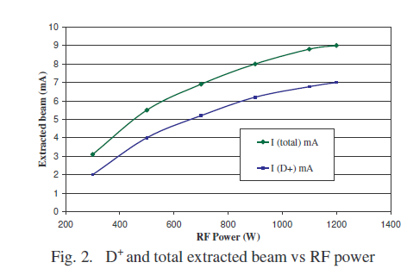
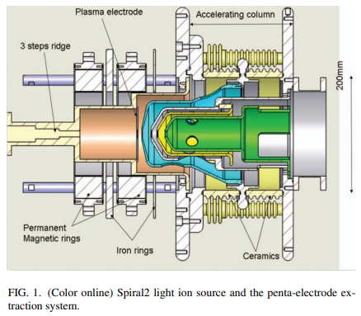
SPIRAL2
Parameter | Value
Microwave Frequency / GHz | 2.45
Magnetic Resonance Field / mT | 87.5
I_{avg, D}⁺ / mA | 5
Extraction Voltage / kV | 40
RF Power (Magnetron) / kW | 1.2 – 2.0
ε_{rms, norm} / mm·mrad | <0.2
The Spiral2 injector requirements are a 50 Hz pulse with a 50% duty cycle up to continuous mode.
Ref. [1, 2, 3]

Slide 10
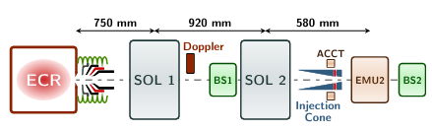
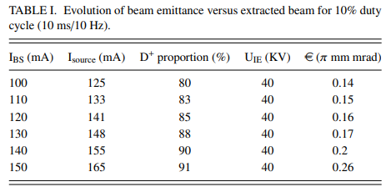
IFMIF – LIPAc
Ion Source – LEBT - Diagnostics
Parameter | Value
Microwave Frequency / GHz | 2.45
I_{avg, H}⁺_{, D}⁺ / mA | <170 (140 target)
Extraction Voltage / kV | 100
Operation Mode | CW
ε_{rms, norm} / mm·mrad | <0.25
LIPAc ECR source based on the SILHI design.
Operating at 2.45 GHz, optimized to extract at 100 keV.
Total beam intensity from 150 mA to 175 mA in order to meet the required 140 mA of D⁺, as D₂⁺ and D₃⁺ are co-produced.
B is tuned to 87.5 mT to match the electron gyrofrequency with the injected microwave signal.
Pentode extraction system defined due to high spark rate.
*Through the RFQ Cone
Ref. [1, 2, 3, 4, 5]

Slide 11
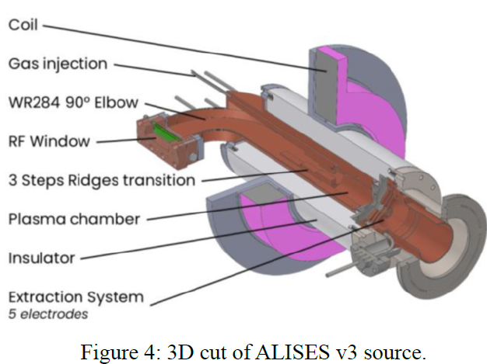
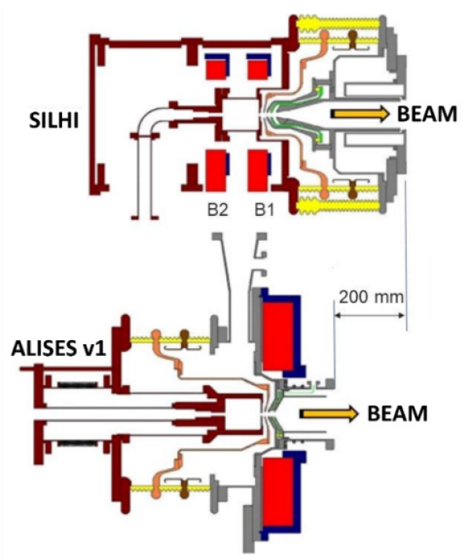
ALISES v3
Commissioned up to 600 W
*Mean Time To Repair
ALISES (Advanced Light Ion Source Extraction System) was developed to overcome maintenance constraints (simple, compact, reduced MTTR*) and emittance growth in the original SILHI design.
By placing the insulation upstream of the plasma electrode, the first LEBT solenoid can be moved closer to the extraction aperture, reducing emittance growth and keeping particles within the linear solenoidal field region.
ALISES also investigates using LEBT solenoid stray fields to generate the ECR resonance inside the plasma chamber, simplifying the magnetic layout and reducing power consumption.
Ref. [1, 2]

Slide 12
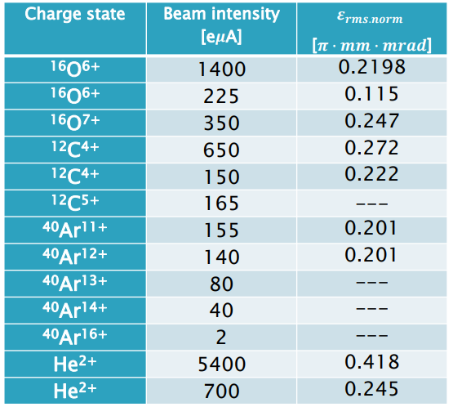
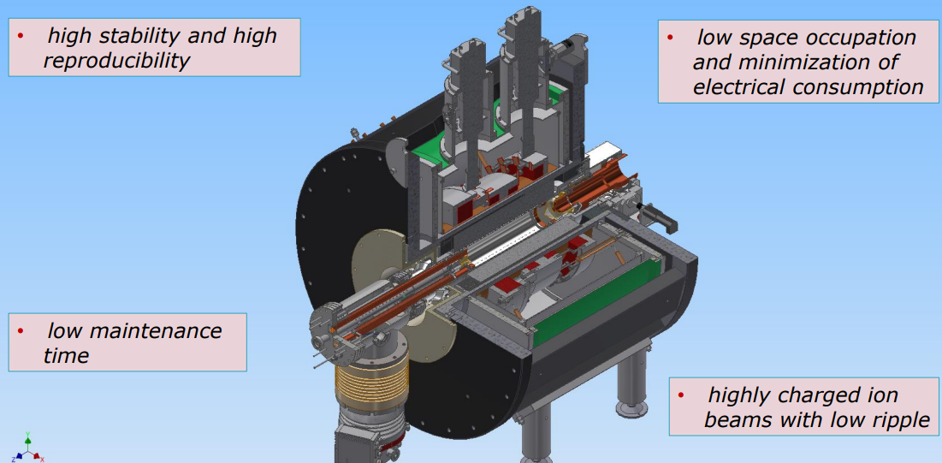
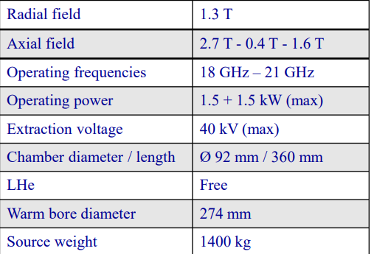
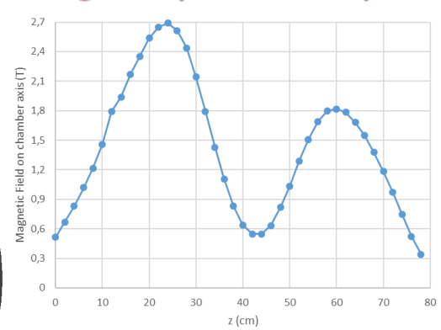
AISHa
Advanced Ion Source for HAdrontherapy:
a hybrid ECRIS: capable of producing, among others, hydrogen beams with intensities up to 8 mA (H⁺), which can include deuteron production when using heavy water (D₂O) or deuterium gas.
Ref. [1, 2, 3]

Slide 13
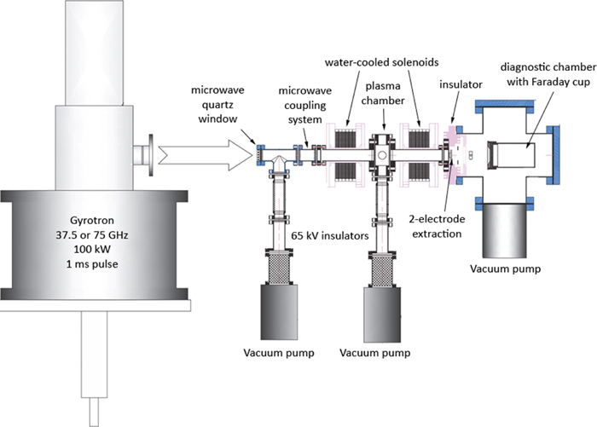
SMIS-37
Parameter | Value
Microwave Frequency / GHz | 2.45
I_{peak, H}⁺_{, D}⁺ / mA | 500
Extraction Voltage / kV | 40 – 100
Operation Mode | 1 ms pulses / Hz
ε_{rms, norm} / mm·mrad | 0.07 – 0.12
Very high fraction of (H⁺, D⁺), typically exceeding 90–95%, significantly higher than standard ECR sources.
Norm. RMS emittance below 0.1 mm·mrad for a 100 mA H⁺, due to low transverse ion temperature in the gasdynamic discharge and the absence of strong magnetic fields in the extraction region.
CW mode requires significant cooling of the extraction electrodes and high-power microwave windows → breakdown and discharge.
Gasdynamic regime requires higher neutral gas pressure in the discharge chamber compared to conventional ECRIS.
Ref. [1, 2]

Slide 14
CERN Experience?

Slide 15
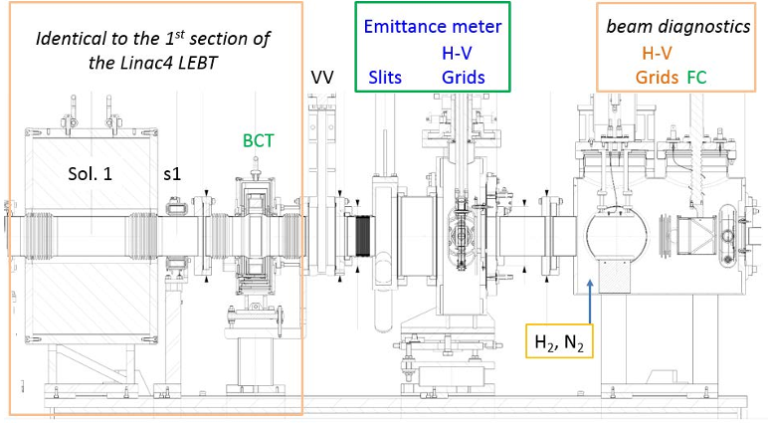
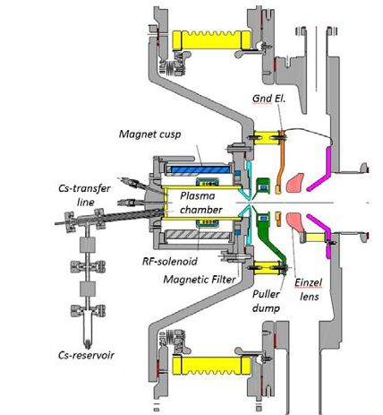
Linac4 IS03b
IS03b Operational Regime | I _{D}⁻ / mA | e/D⁻ | ε_{rms, norm} / mm·mrad
Volume Mode (Pre-Cesiation) | 11 | 34 | 0.4
Surface Mode (Post-Cesiation) | 20 | 2 | 0.3
Very dynamic behavior of the effective work function of the Cesiated Molybdenum plasma electrode.
Constant Cs-flow proved necessary to stabilize the beam parameters.
Ref. [1]

Slide 16
Commercial Sources

Slide 17
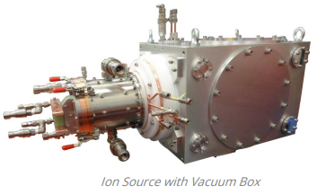
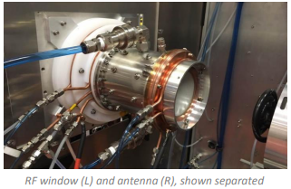
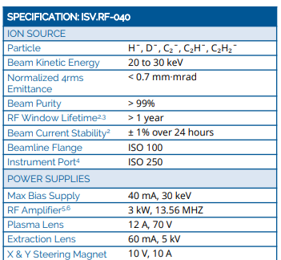
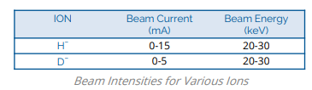
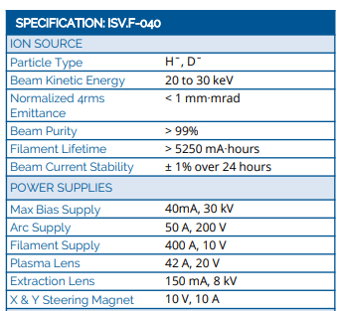
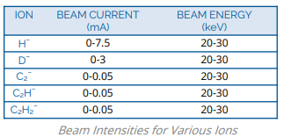
D-Pace
ISV.F-040
ISV.RF-040

Slide 18
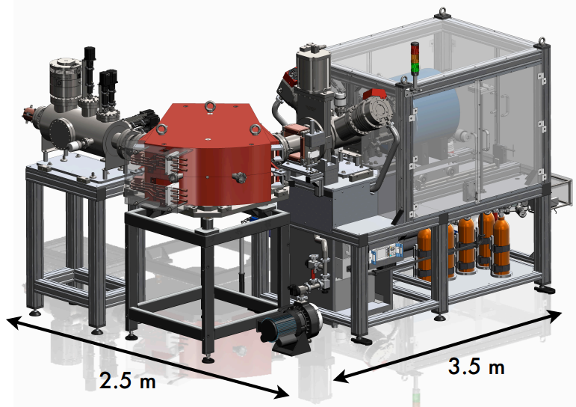
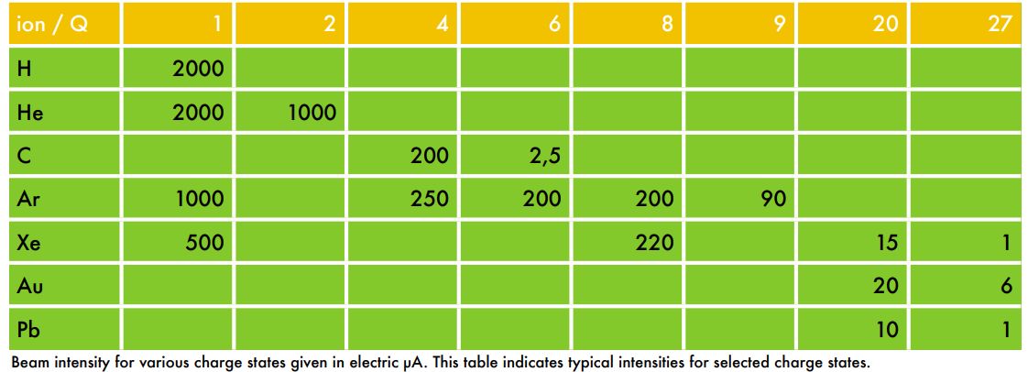
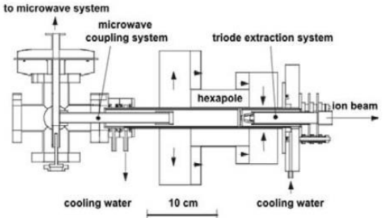
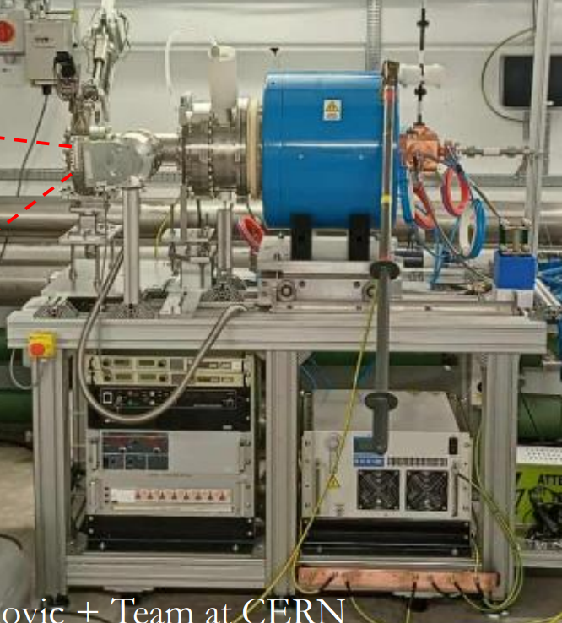
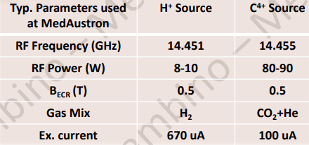
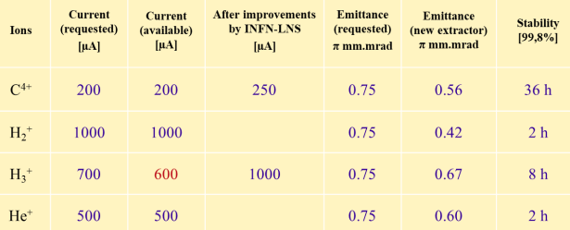
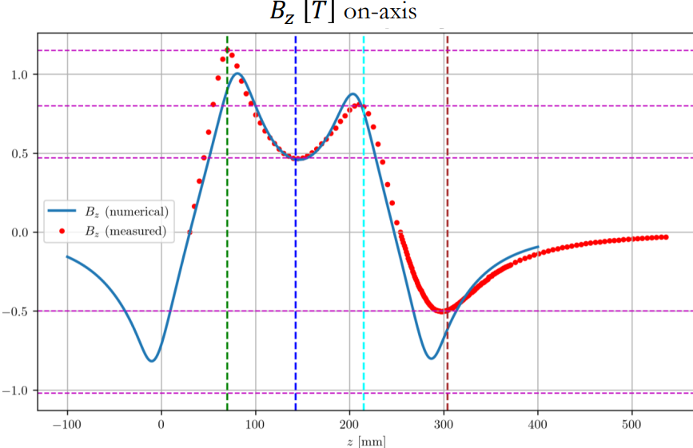
Supernanogan
Supernanogan:
ECR entirely made with permanent magnets → electrical power very low.
14.5 GHz RF power, powered up to 600 W.
Max. extraction voltage 30 kV.
Source Body & Magnet
Extraction System
RF & Gas Injection
Courtesy of N. Gambino
Courtesy of L. G. Celona
Ref. [1, 2, 3]

Slide 19
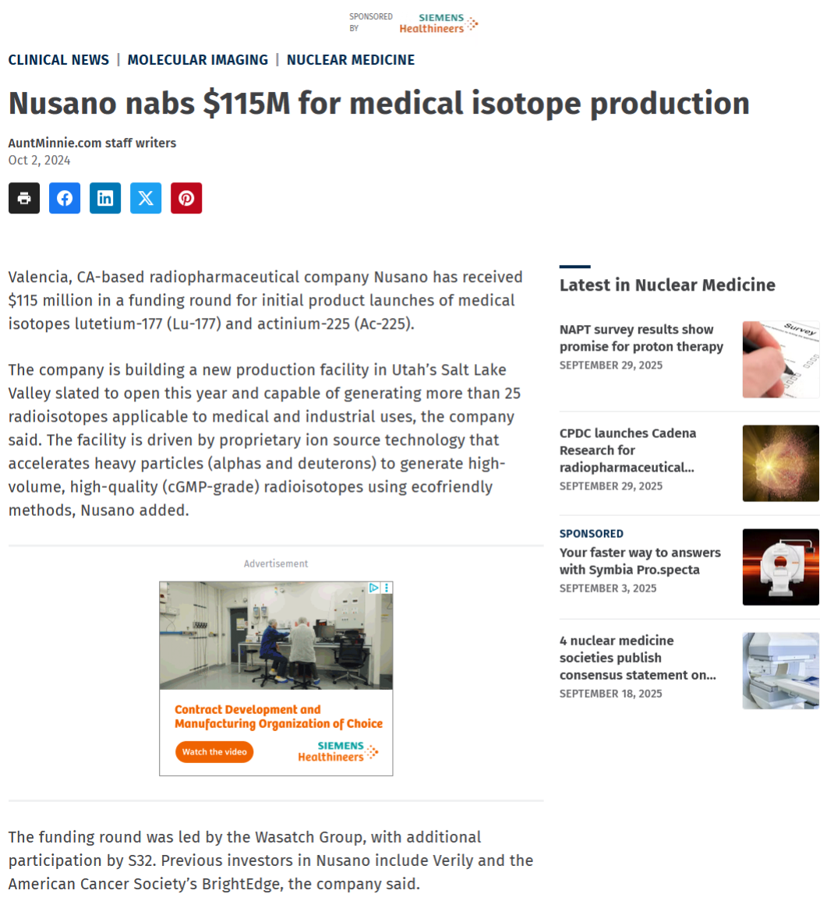
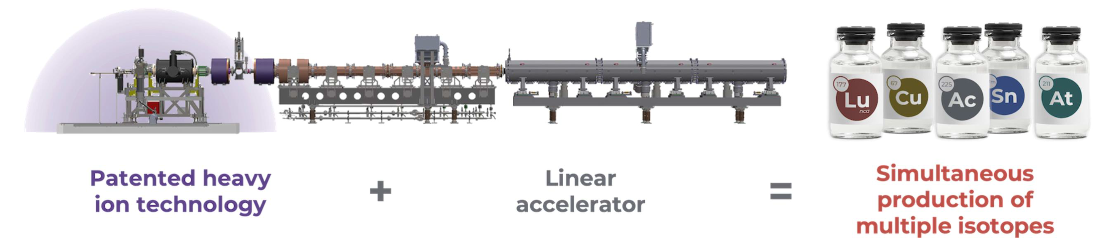
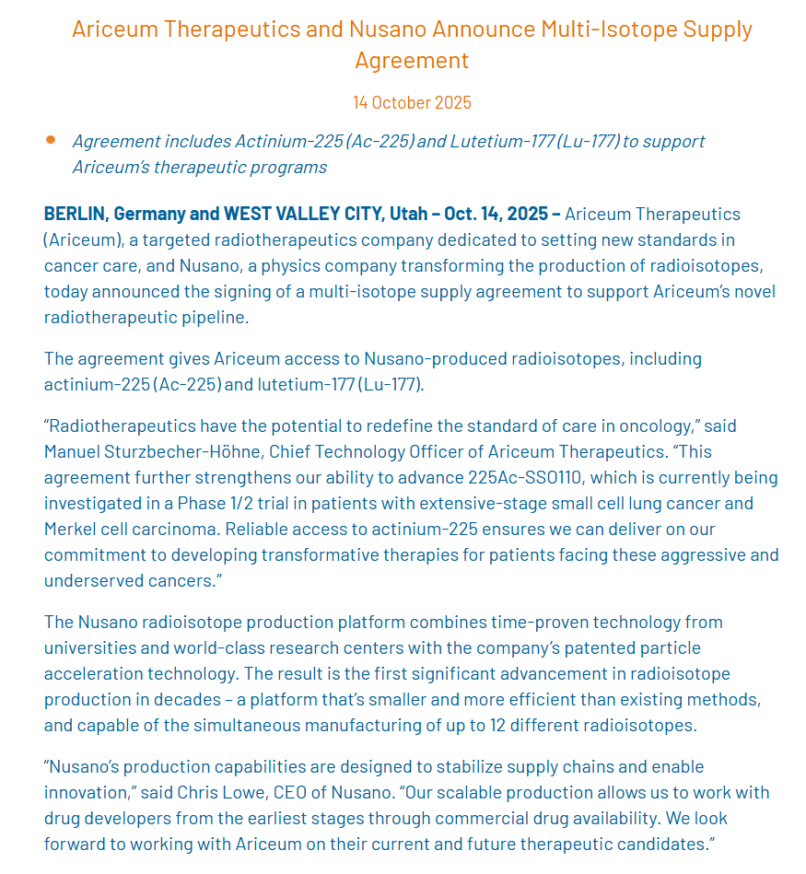
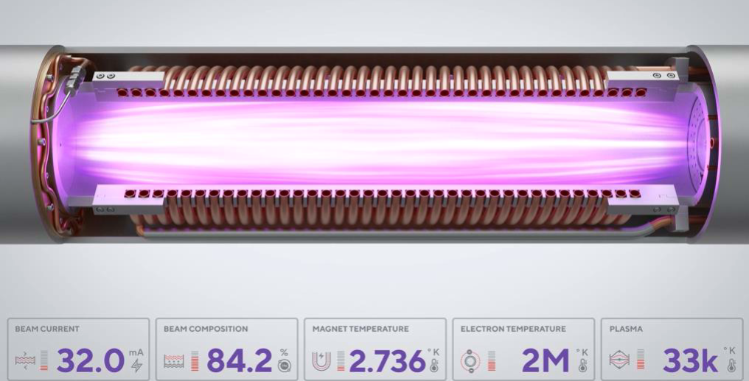
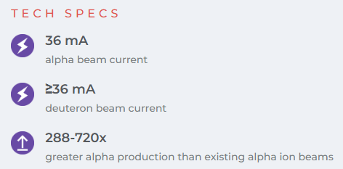
Nusano
Confinement time: 800-900 us leading to He²⁺ fraction of 84%
Ref. [1, 2]

Slide 20
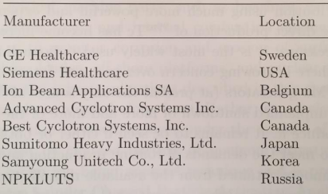
Commercial Medical Accelerators and their Ion Source Types
Accelerator Model | Type of Ion Source | Energy (MeV) | Max Current | Particles
IBA Cyclone KEY | Internal PIG | 9.2 | >100 uA | p
IBA Cyclone KIUBE | Internal PIG | 18 (variable 13-18) | ≤300 uA (based on versions) | p
IBA Cyclone IKON | External Multicusp | 13 - 30 | ≤1500 uA (based on versions) | p
IBA Cyclone 30 XP | External Multicusp | 15 - 30 (p); 9 - 15 (D); 30 (He²⁺) | 400 uA (p); 50 - 100 uA (D; He²⁺) | p, D, He²⁺
IBA Cyclone 70 | External Multicusp | 30 - 70 | 750 uA (p) | p, D, He²⁺
ACSI TR-19 | External Cusp Volume | 12 – 19 (p), 9 (D) | 400 uA (p), 75 uA (D) | p, D
ACSI TR-24 | External Cusp | 15 - 25 | 800 - 1000 uA | p
ACSI TR-FLEX | External Multicusp | 12 - 30 | 800 uA | p
ACSI TR-30 | External Multicusp | 15 - 33 | 1600 uA | p
GE PETtrace 800/880 | Internal PIG | 16.5 (p); 8.4 (D) | 130 uA (p); 60 uA (D) | p, D
GE MINItrace Qilin | Internal PIG | 9.6 | 50 uA | p
Siemens Eclipse HP | Internal PIG | 11 | 60, uA, 120 uA (dual) | H⁻, p
Sumitomo HM-12 | Internal PIG | 12 (p); 6 (D) | 150 uA (p); 40 uA (D) | p, D
Sumitomo HM-20 | Internal PIG | 20 (p); 10 (D) | 150 uA (p); 50 uA (D) | p, D
Sumitomo SC230 | Hot-cathode PIG | 233 - 238 | 1 uA | p
Sumitomo MP-30 | Cusp Volume | 30 (p), 15 (D), 30 (He²⁺) | 350 uA (p), 100 uA (D), 50 (He²⁺) | p, D, He²⁺
Best ABT BG-75 | Internal PIG | 7.5 | 5 uA | p
Best 15p | External Multicusp Volume | 15 | 400 - 1000 uA | p
Best 35p | External Multicusp | 35 | 800 - 1000 uA | p
Ionetix ION-12SC | Cold-cathode PIG | 12.5 | 25 uA | p
AccSys Pulsar-7 (Linac)* | Microwave / Duoplasmatron | 7 | 15 - 45 mA (peak) | p
Nusano Platform (Linac) | Patented High-Current ECR | Variable | 36 mA | He²⁺, D, Li, C
Ion Source Manufacturers for RI
Ref. [1]
*Varian, Scanditronix & Hitachi accelerators to be added
**More versions of accelerators in each webpage for IBA, BEST, Sumitomo etc.

Slide 21
Overview & Conclusion
The selection of the IFIGENEIA ion source must be tailored to the specific requirements of RI production, while also considering operational stability/flexibility and future scalability.
The ion source must deliver sufficient beam intensity (μA range up to mA), support multiple charge states (at least q/A = 0.5, 1), and provide high beam quality to ensure efficient transmission through subsequent linear accelerator stages.
These requirements point toward an ECR ion source. The use of a commercially available, well-validated system, already deployed in facilities such as ARRONAX (radioisotope production) and CNAO/MedAustron (particle therapy), is recommended → Supernanogun?
Experimental campaigns for D beams within CERN are of interest for Linac3 & Linac4? at B2250 with the ECRs (Monogan, Supernanogan)?
Any other known experiences of H/D/He production ion sources? Challenges and Limitations on D production?
Is there a point of considering D⁻?
Can such a facility operate with one source or multiple sources?

Slide 22


Thank you!

Slide 23
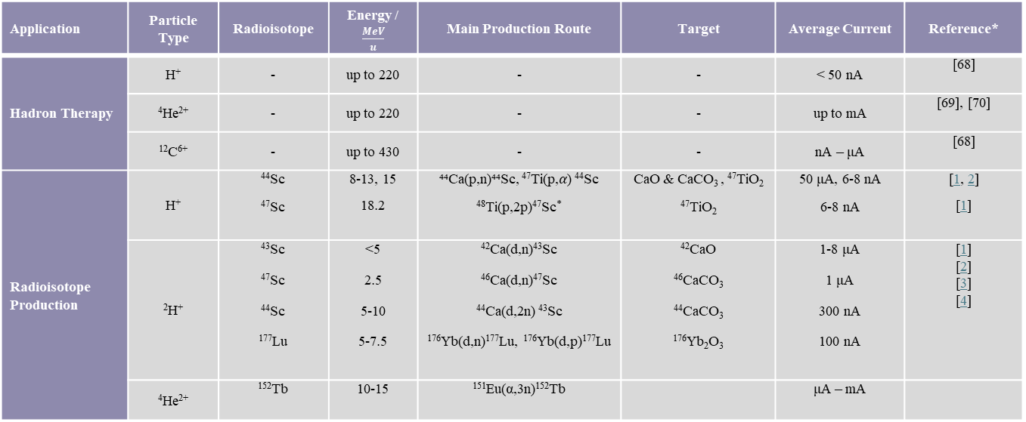
Work in Progress…
Application | Particle Type | Radioisotope | Energy / $\frac{MeV}{u}$ | Main Production Route | Target | Average Current | Reference*
Hadron Therapy | H⁺ | - | up to 220 | - | - | < 50 nA | [68]
 | ⁴He²⁺ | - | up to 220 | - | - | up to mA | [69], [70]
 | ¹²C⁶⁺ | - | up to 430 | - | - | nA ‒ μA | [68]
Radioisotope Production | H⁺ | ⁴⁴Sc ⁴⁷Sc | 8-13, 15 18.2 | ⁴⁴Ca(p,n)⁴⁴Sc, ⁴⁷Ti(p,𝛼) ⁴⁴Sc ⁴⁸Ti(p,2p)⁴⁷Sc* | CaO & CaCO₃ , ⁴⁷TiO₂ ⁴⁷TiO₂ | 50 μA, 6-8 nA 6-8 nA | [1, 2] [1]
 | ²H⁺ | ⁴³Sc ⁴⁷Sc ⁴⁴Sc ¹⁷⁷Lu | <5 2.5 5-10 5-7.5 | ⁴²Ca(d,n)⁴³Sc ⁴⁶Ca(d,n)⁴⁷Sc ⁴⁴Ca(d,2n) ⁴³Sc ¹⁷⁶Yb(d,n)¹⁷⁷Lu, ¹⁷⁶Yb(d,p)¹⁷⁷Lu | ⁴²CaO ⁴⁶CaCO₃ ⁴⁴CaCO₃ ¹⁷⁶Yb₂O₃ | 1-8 μA 1 μA 300 nA 100 nA | [1] [2] [3] [4]
 | ⁴He²⁺ | ¹⁵²Tb | 10-15 | ¹⁵¹Eu(α,3n)¹⁵²Tb |  | μA ‒ mA
*promising route: 10-20 MeV for the enriched ⁵⁰Ti target , ⁵⁰Ti(p,𝛼)⁴⁷Sc, ref.1
Targets for R&D, targets for RI prod -> check IC12 Conference

Slide 24
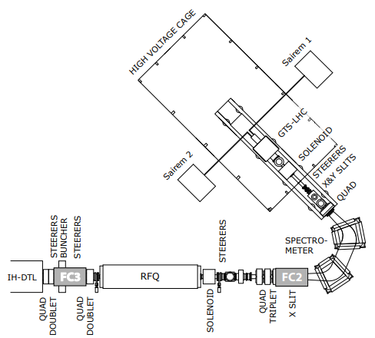
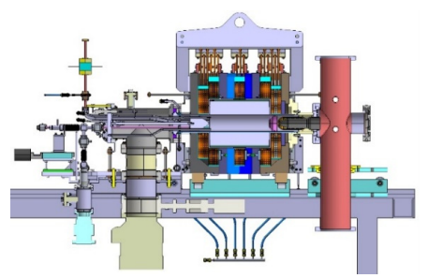
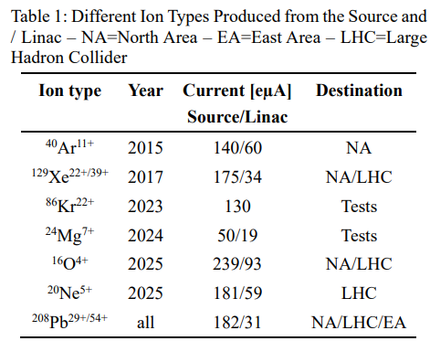
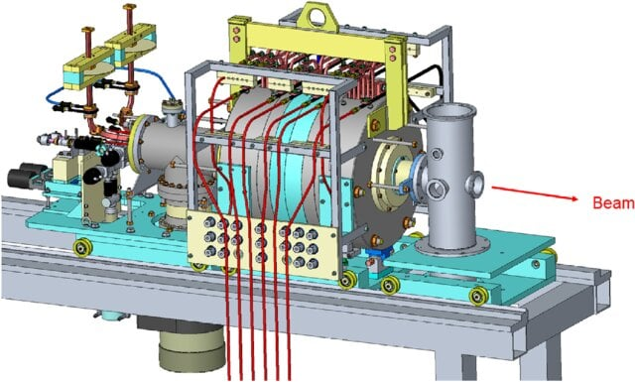
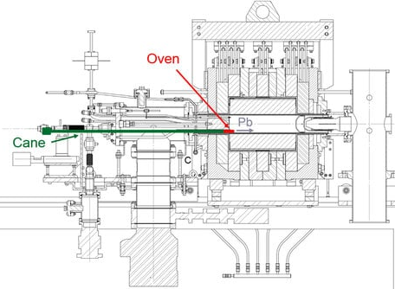
L3 ECR Ion Source
GTS-LHC:
ECR ion source based on the Grenoble Test Source.
Operates with a 50 ms, 14.5 GHz microwave pulse at 10 Hz, 50% d.c., running in the afterglow mode
Up to 2.2 kW of power.
Contains two micro-ovens (Sairem) that can be operated independently.
Sample lock system allows oven maintenance without venting the source → only ~10 hours of downtime for oven refilling.
Ion Species:
L3 GTS-LHC source
Boron, Calcium, and Indium are of interest for future runs.
Ref. [1, 2, 3, 4, 5]

