Slide 1
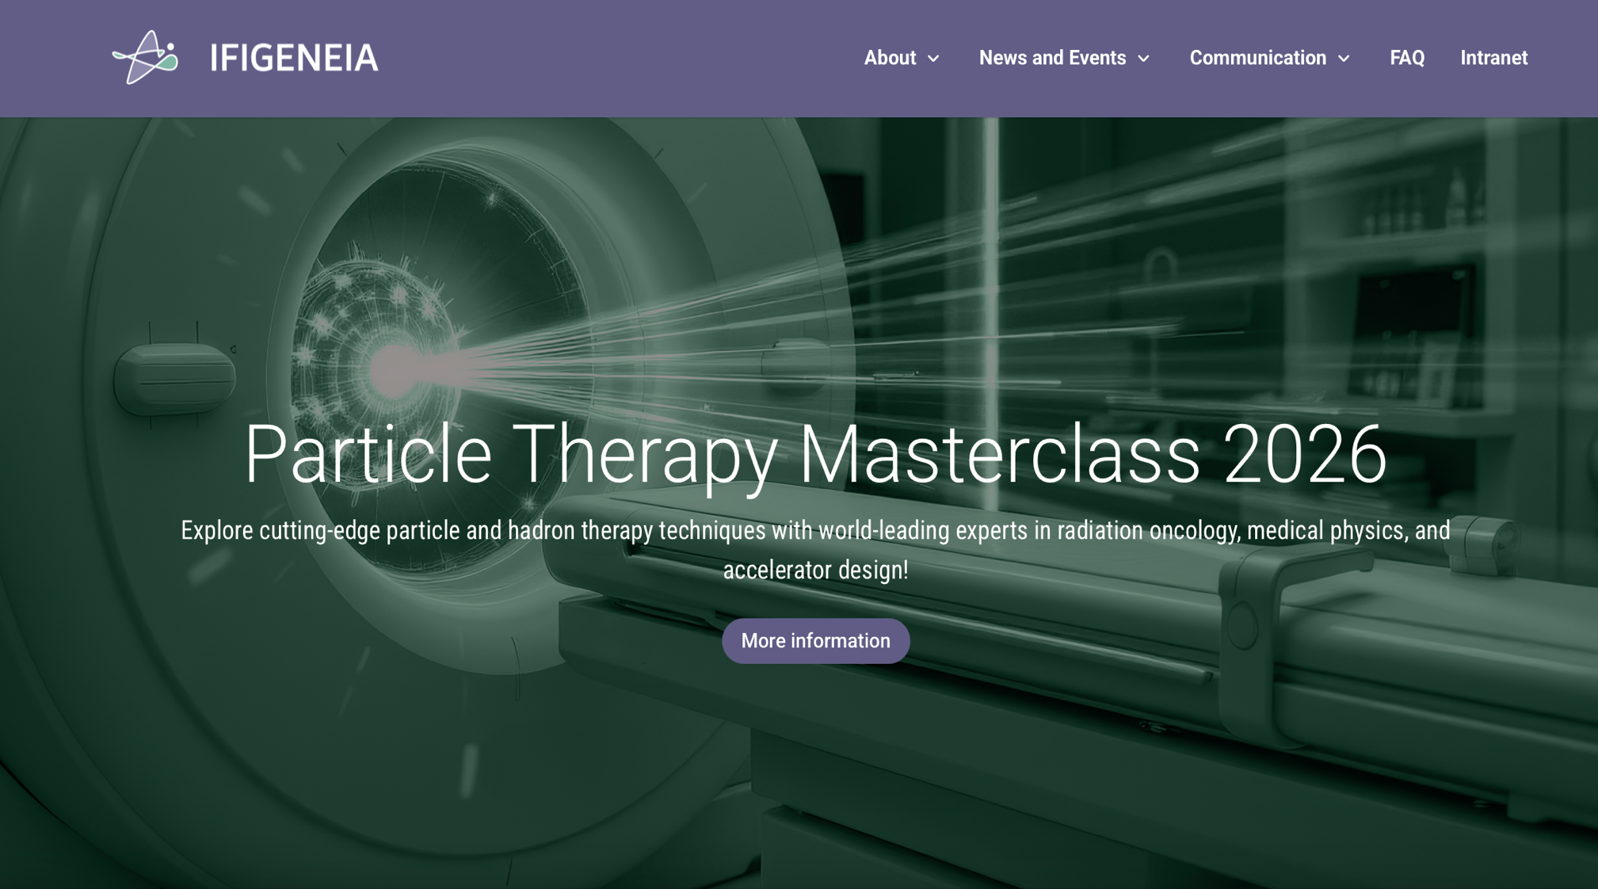
Introduction To
Yiota Foka
(GSI/CERN)

Slide 2

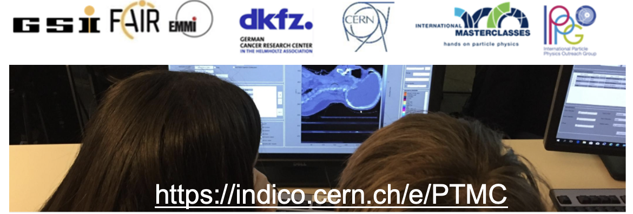
From Particle Physics
to Particle Therapy
From PTMCs for high-school students
to university students and professionals

Slide 3
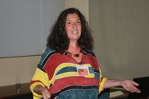
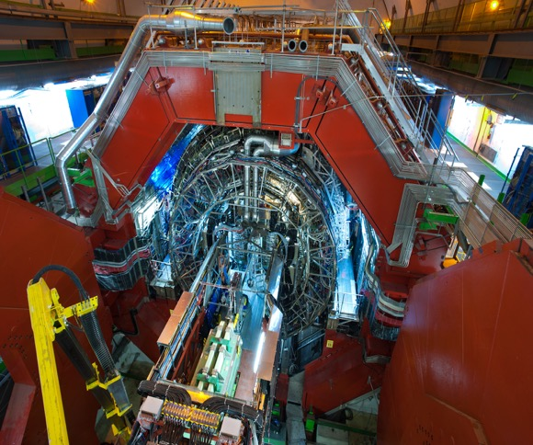
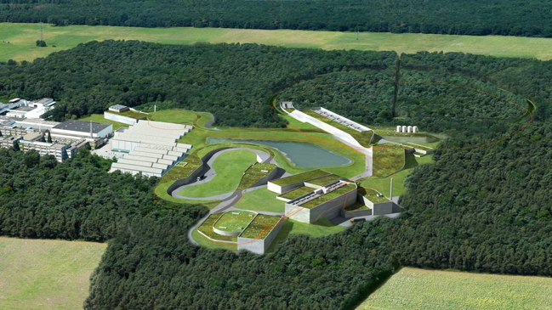
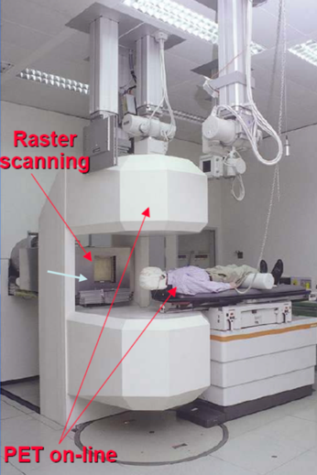
Heavy-ion research and heavy-ion therapy
Heavy-ion Physicist, involved with medical applications of heavy-ions for cancer therapy
ALICE heavy-ion experiment at CERN
GSI, pioneering heavy-ion cancer therapy in the 90s
GSI therapy room
ALICE at the CERN LHC
GSI and future FAIR

Slide 4
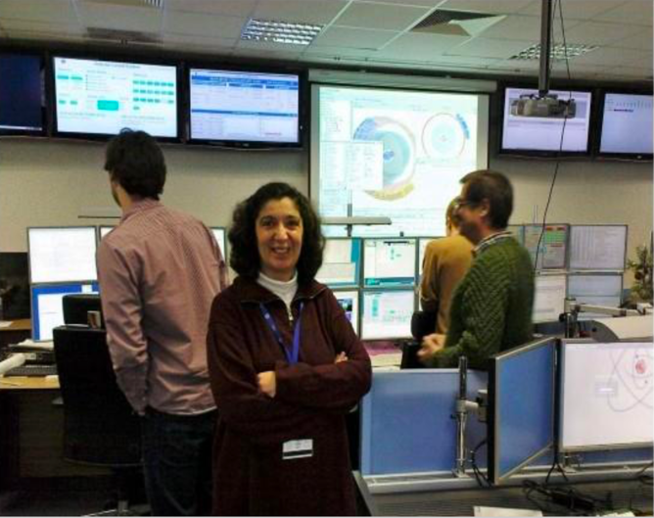
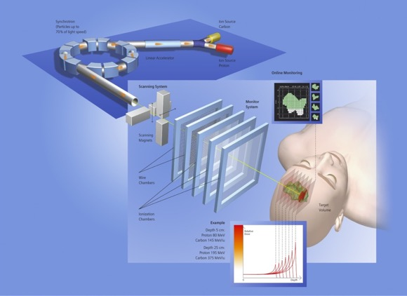
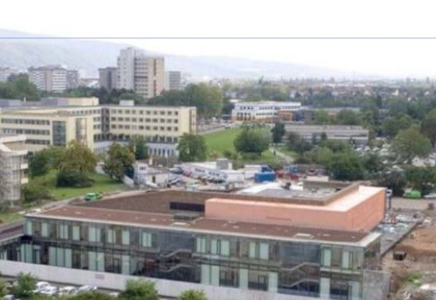
Heavy-ion research and heavy-ion therapy
Heavy-ion Physicist, involved with medical applications of heavy-ions for cancer therapy
ALICE heavy-ion experiment at CERN
GSI, pioneering heavy-ion cancer therapy in the 90s
Heidelberg Ion Therapy HIT centre
ALICE Control Room
ALICE at the CERN LHC
Implemented at HIT, Heidelberg Ion Therapy centre
Milestone treating 10 000 patients reached
GSI and future FAIR
ALICE at the CERN LHC

Slide 5
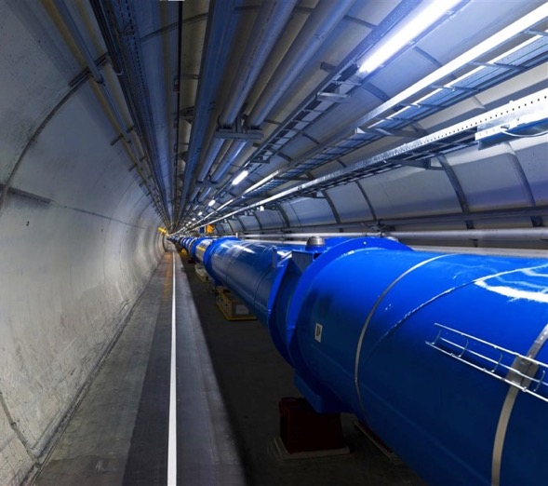
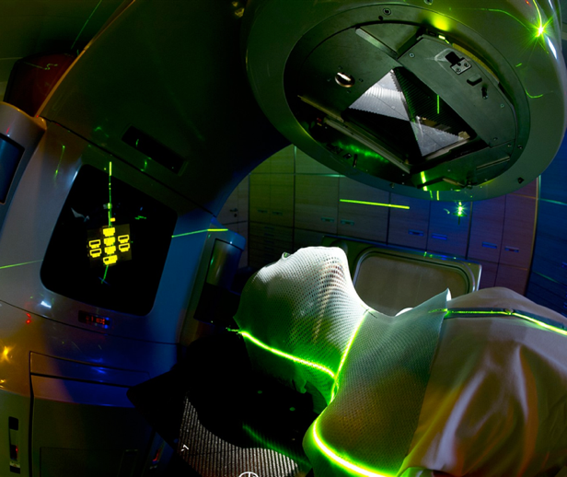
Heavy-ion research and heavy-ion therapy
Next Steps: Next Ion Medical Machine Study, NIMMS, CERN group
ALICE heavy-ion experiment at CERN
Innovative technologies for next generation ion facilities
From LHC Technologies
to medical applications
GSI therapy room
ALICE Control Room
ALICE at the CERN LHC
CERN LHC
Cancer Therapy Facility
GSI and future FAIR
ALICE at the CERN LHC

Slide 6
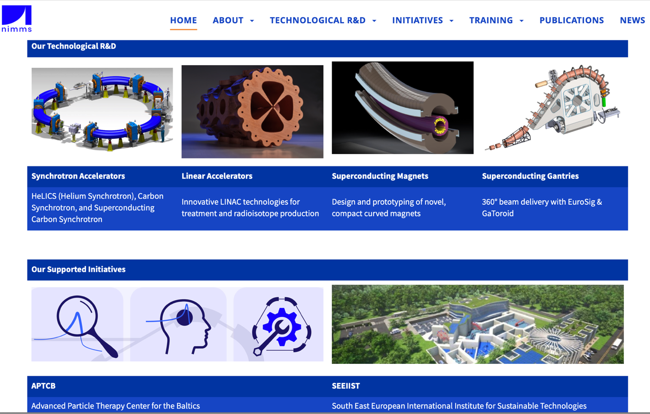
Next Ion Medical Machine Study Group Developments
EU projects funding:
HITRIplus, I.FAST,
just finished
Continuation: EPITA

Slide 7
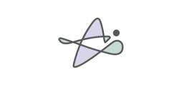
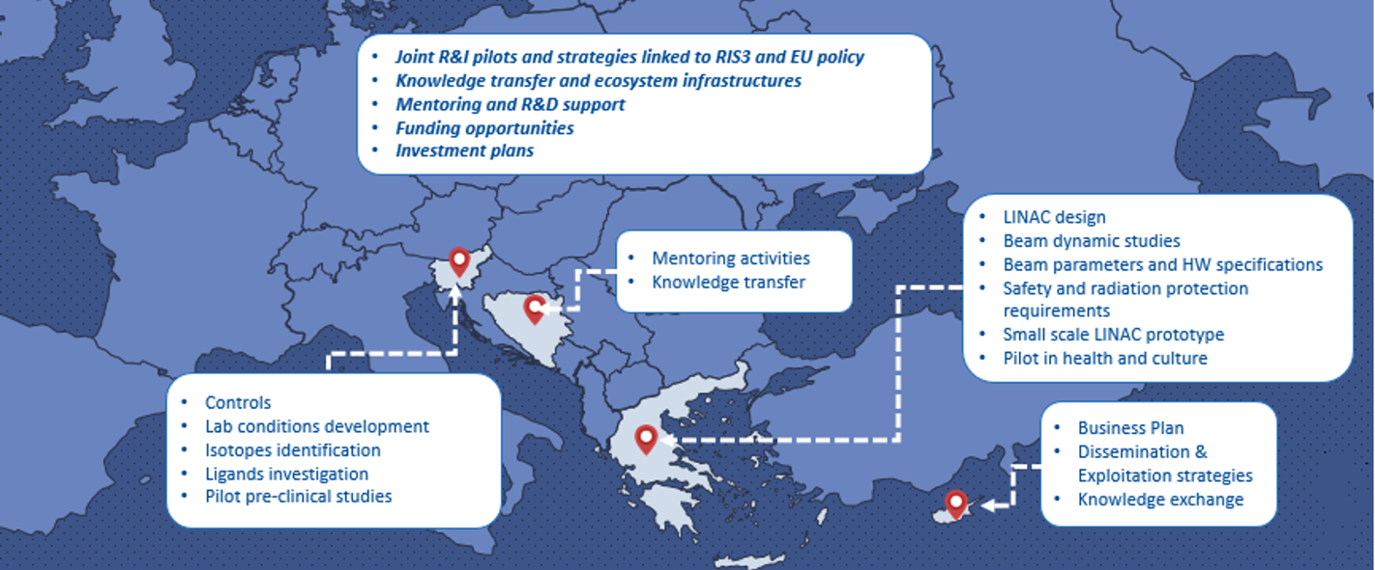
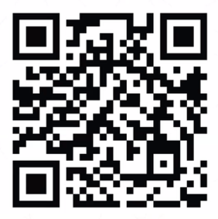
IFIGENEIA Excellence Hubs
Success!!
Details UM
Greece, Slovenia, Cyprus Complete Hubs
with Quadruple Helix: academia/research, business, social actors, public authorities
BiH Mentoring Scheme
PTMC
is part of the
IFIGENEIA
Mentoring Scheme
IFIGENEIA
https://ifigeneia.eu/news/
Development of
Innovative
Compact Linear Accelerator for
Radioisotope
Production

Slide 8
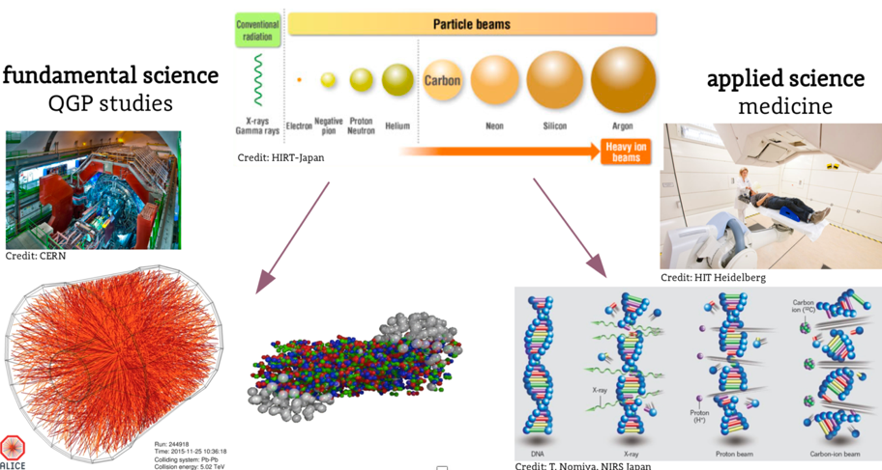
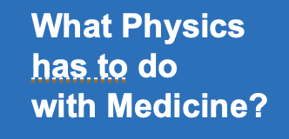
Heavy-ion research and heavy-ion therapy
Pb-Pb at 5.5 TeV
pp at 14 TeV
88-430 MeV/u carbon
50-221 MeV/u protons
An example of applications of fundamental research for the benefit of society

Slide 9
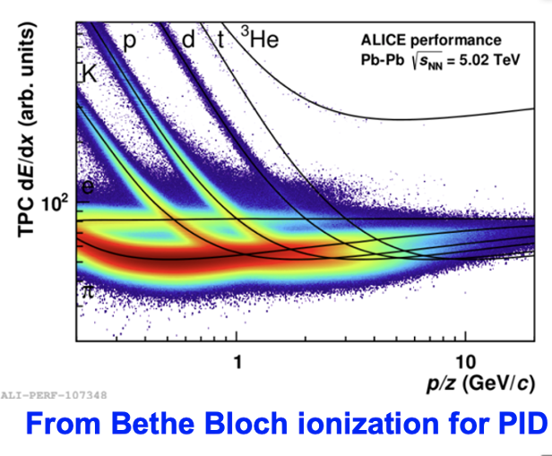
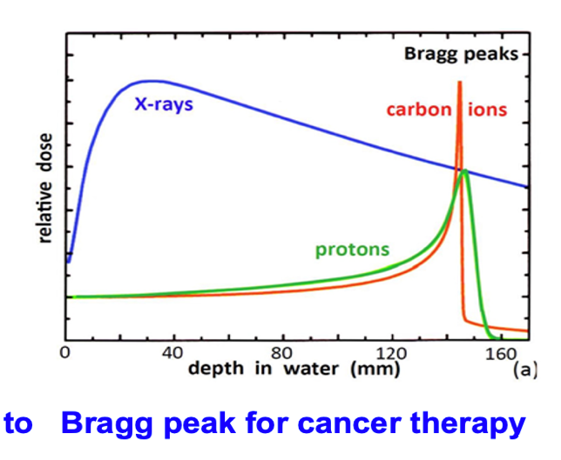
Heavy-ion research and heavy-ion therapy
Pb-Pb at 5.5 TeV
pp at 14 TeV
88-430 MeV/u carbon
50-221 MeV/u protons
fundamental properties
of particles
and their interaction with matter
in the service of society

Slide 10
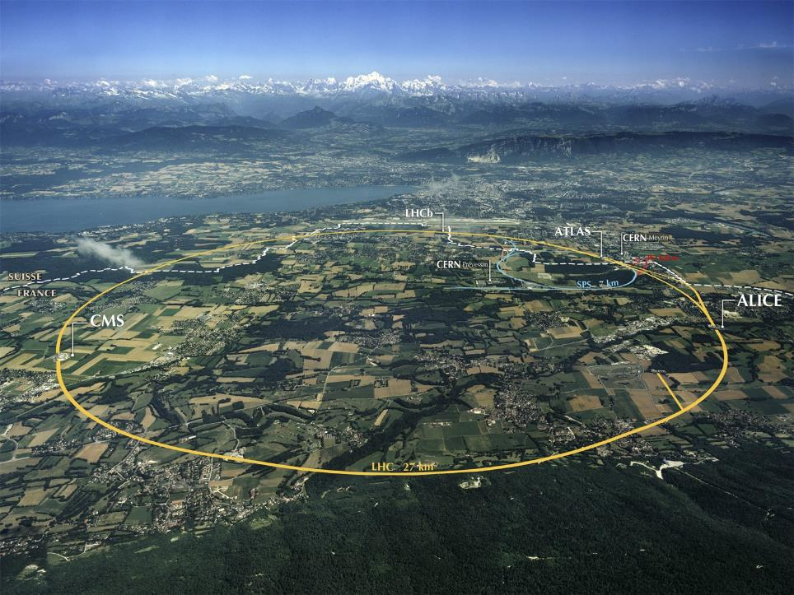
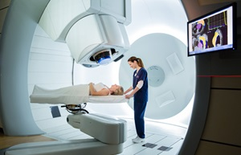
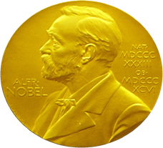

From Fundamental Research….
What are
the benefits
for society?
…..to Medical Applications
The developed accelerator technology is used for cancer research and therapy
Innovative technologies developed for future projects find already applications in medicine
Accelerators for Health

Slide 11
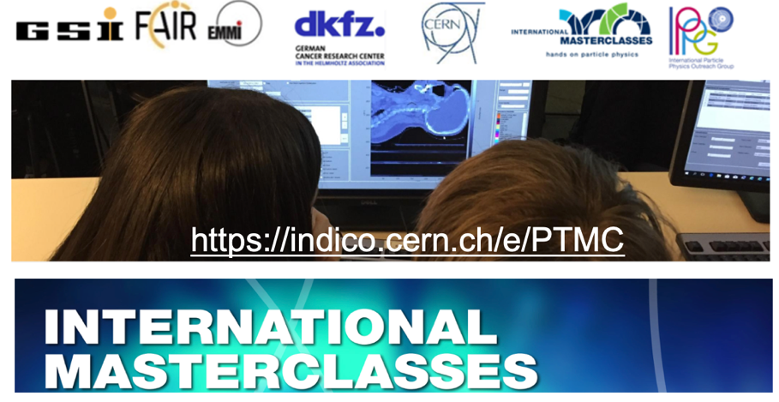
hands-on by A.S.
et al
What are the
International MasterClasses IMC
and
Particle Therapy MasterClasses PTMC

Slide 12
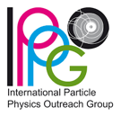

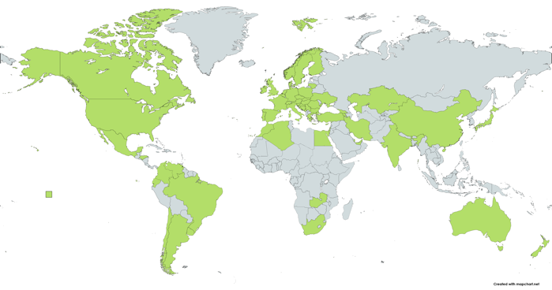
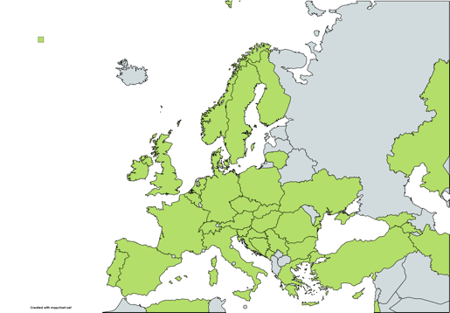
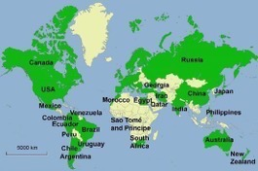
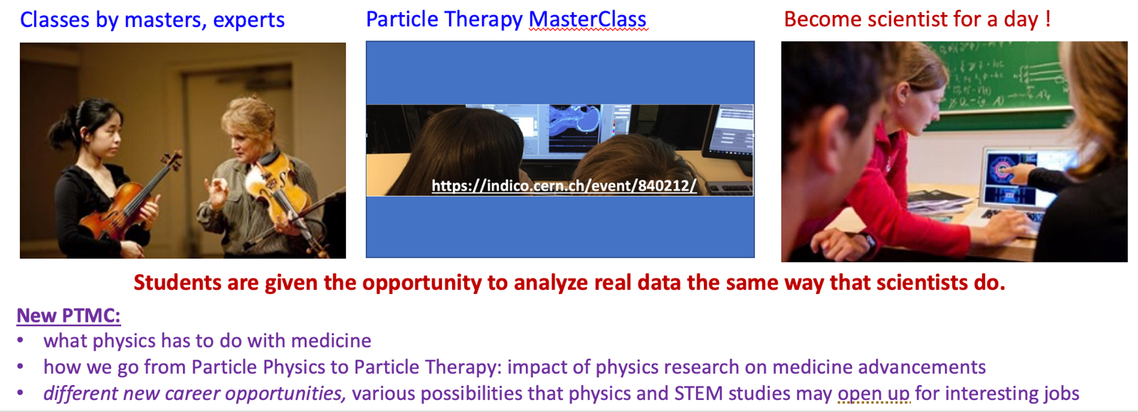
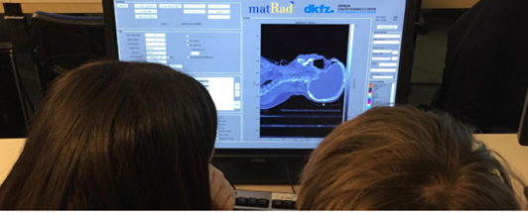
International MasterClasses
Flagship project of IPPOG
Brings scientific methods to schools!
IMC: 6 weeks
65 countries
310 institutes
15 000 students
Coordination QuarkNet / TU Dresden
188 institutes (177)
266 LHC Masterclasses (257)
  30 ATLAS W (35)
  101 ATLAS Z (104)
  64 CMS (58)
  41 LHCb (39)
  27 ALICE SP (18)
  3 ALICE R_AA (3)
51 institutes (48)
54 LHC Masterclasses (50)
  22 ATLAS (19)
  32 CMS (31)
12 MINERvA Masterclasses
https://indico.cern.ch/e/PTMC

Slide 13
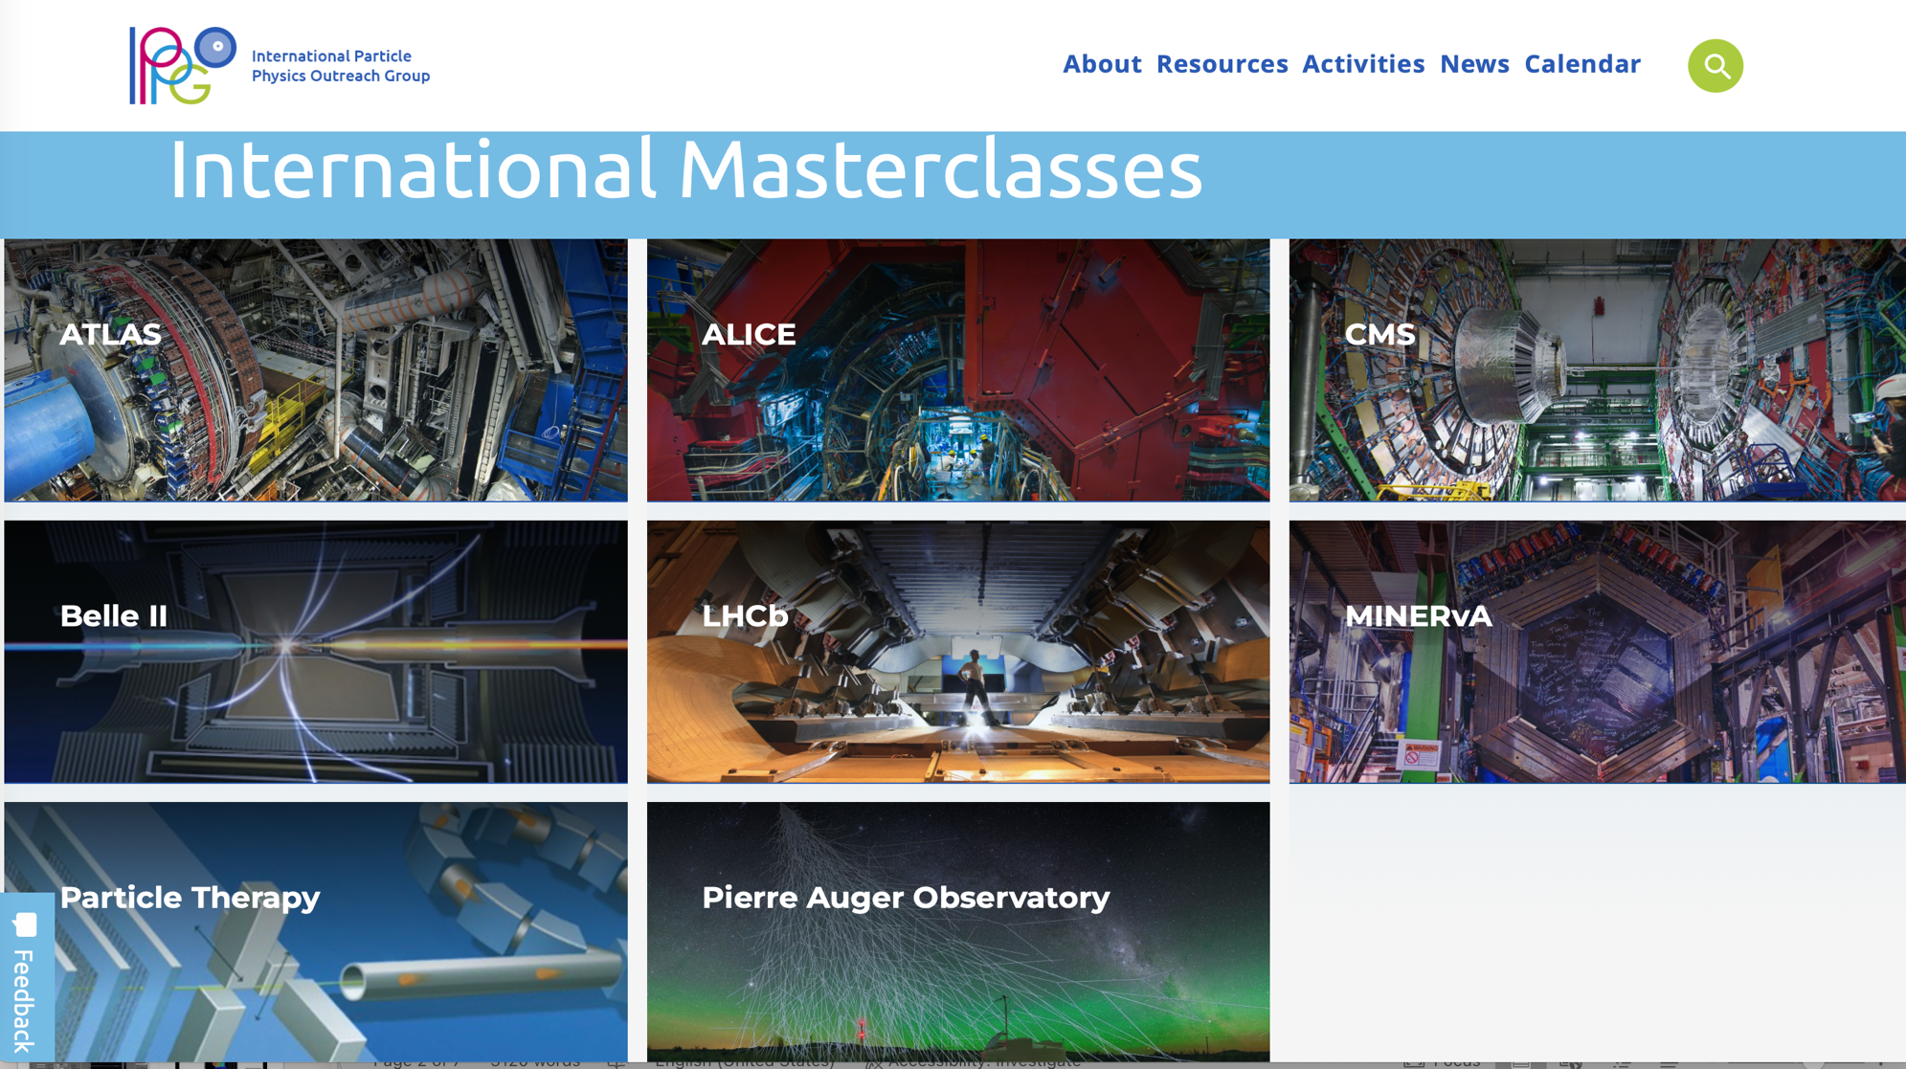

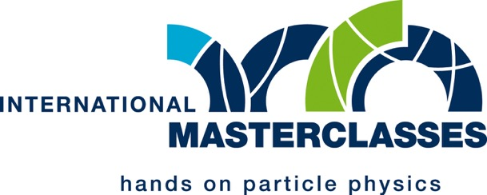
Coordinated and moderated by GSI

Slide 14
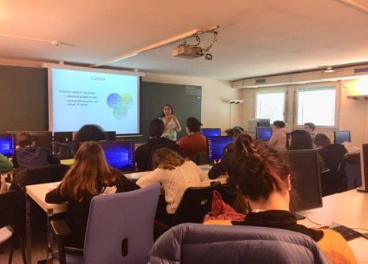
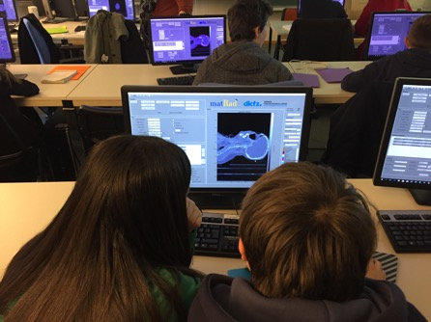
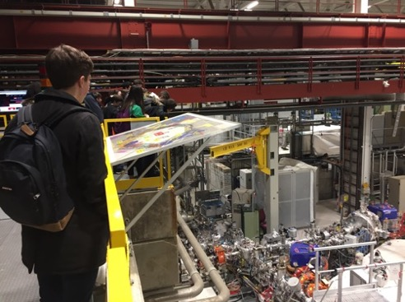
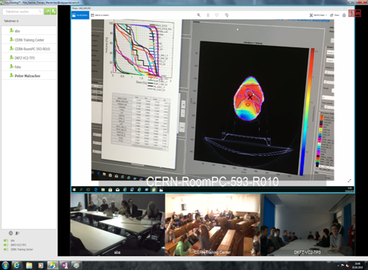
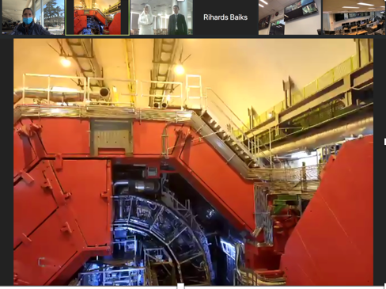
PTMC: Typical MasterClass Day Agenda
Adapted: online/hybrid modes
Local: Morning Presentations
Local: Afternoon Hands-on
Every day 3-5 institutes participate,
during the months of February-April.
School-children (15-19 year old)
are invited at/by an institute of their area.
LOCAL TIME: ACTIVITY
8:30 - 9:00 Registration and Welcome
9:00 - 10:00 Introductory lectures
10:30 - 11:30 Visit of a lab or experiment
12:00 - 13:00 Lunch
13:00 - 15:00 Hands-on session
15:00 - 16:00 Discuss results locally
16:00 - 17:00 Common Video Conference
Local: Morning Visits
real-time online ALICE visit
Common: Afternoon at 16:00
Video-Conference
Importance of collaboration for common projects

Slide 15
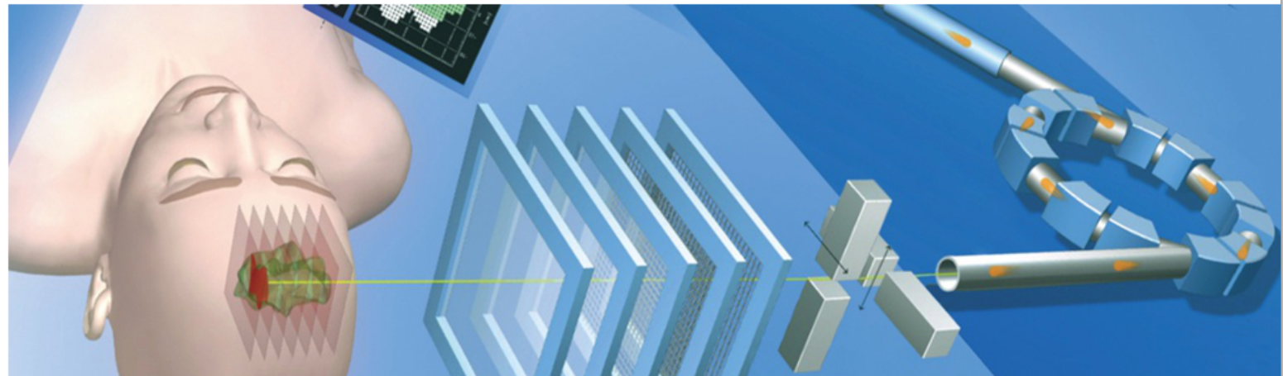
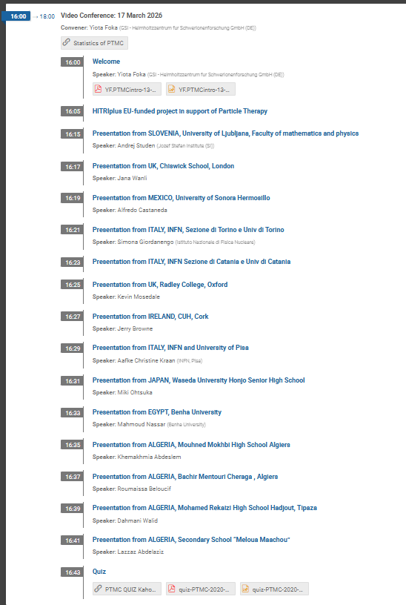
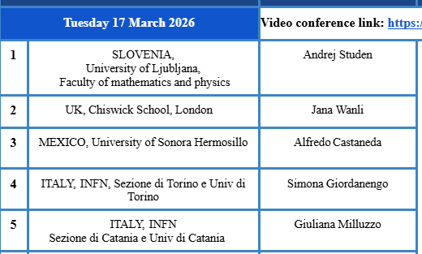
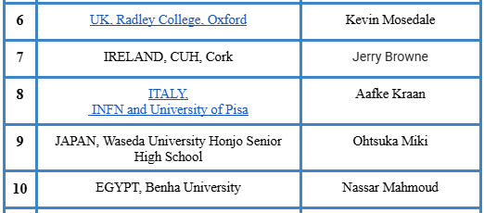
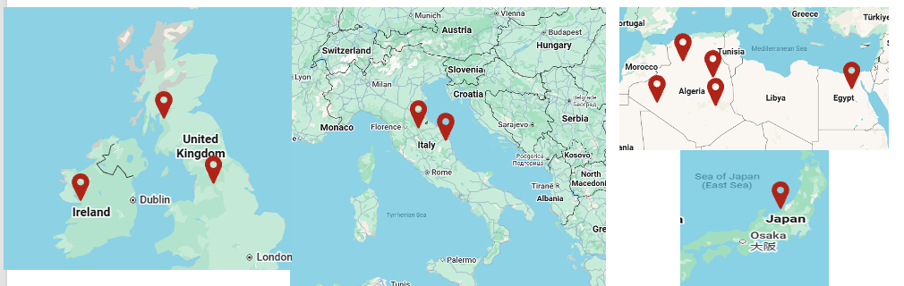
PTMC Video Conference 17 March 2026
Andrej Studen et al in IJS Slovenia
for high-school students
https://indico.ijs.si/event/3241/
https://indico.ijs.si/event/2679/
https://indico.ijs.si/event/1830/
https://indico.ijs.si/event/1552/
Moderators: Yiota Foka (GSI), Marco Pullia (CNAO), Maria Chiara Martire (GSI)
Assistants: Nermine Muradi (AUTH &UT)

Slide 16
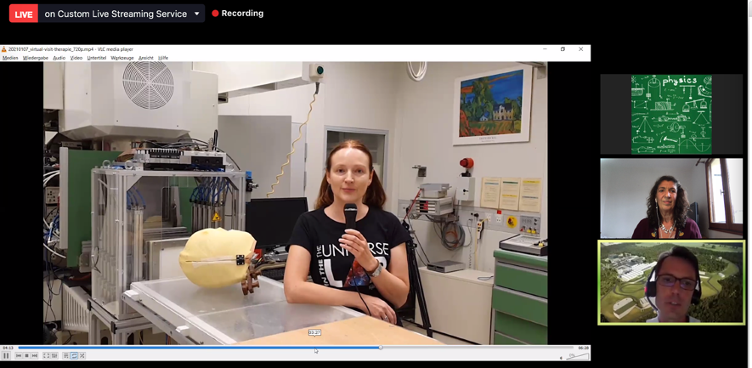
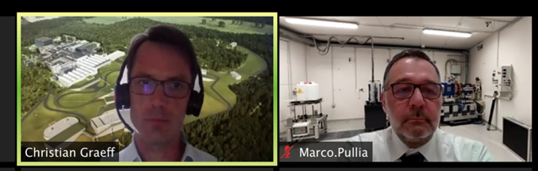
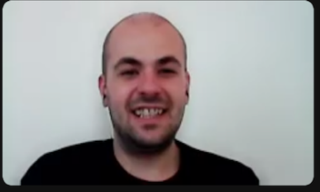
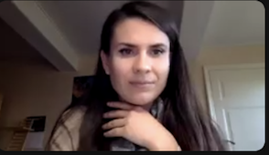
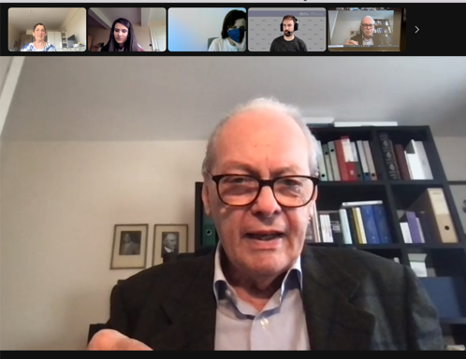
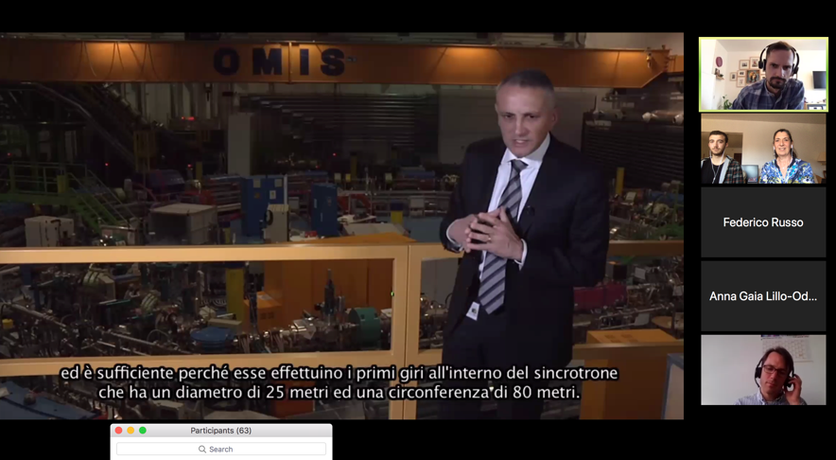
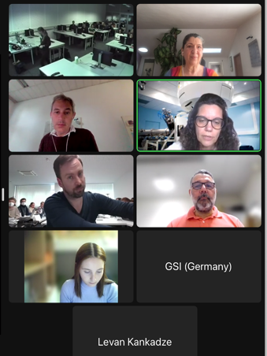
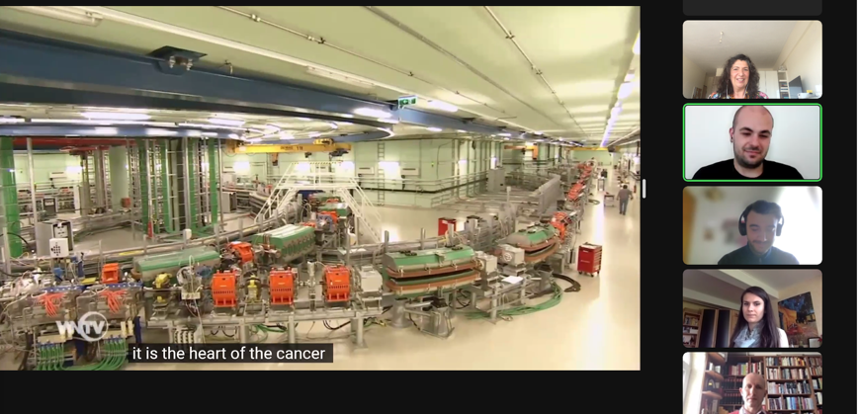
Virtual visits and video-conferences
Virtual visits during video-conference: GSI research institute, CNAO, MedAustron therapy centers
GSI moderators
CNAO moderator
medAustron moder.
U. Amaldi: HI therapy pioneer

Slide 17
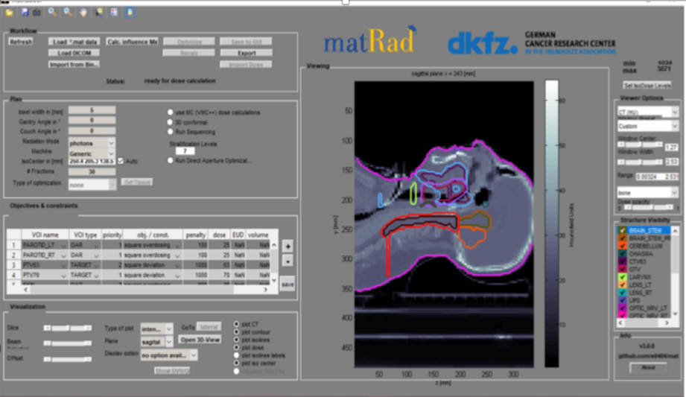


PTMC hands-on Treatment Planning
Based on professional open source treatment planning: matRad
developed by DKFZ, Heidelberg www.matrad.org
How do we “see”
the target volume?
Dose prescription using photons, protons and carbon, helium ions
multidisciplinary facets of hadron therapy
present overall process
what happens from the beginning to the end
Importance of radio-isotopes for diagnosis and treatment, in the same facility, in-room imaging, thera-gnostics
Importance of Artificial Intelligence methods for contouring the target volume
IAEA-CN301-059
Slide 10
Panagiota Foka
Yiota Foka , HITM 17-15 May 2021

Slide 18

Importance of “seeing”
Multidisciplinary field, importance of collaboration
Including collaboration with our AI friends !!

Slide 19


Emerging Technics
https://videos.cern.ch/record/1611721

Slide 20


PTMC Evolution
IFIGENEIA https://ifigeneia.eu/news/
https://ifigeneia.eu/masterclass-2026/

Slide 21



New PTMC and Treatment Planning
First Local Test: GSI Feb 2019
International Pilot: CERN, GSI, DKFZ April 2019
Positive feedback from first pilots
IMC Steering Group Approval: GSI May 2019
Web pages: Sarajevo Uni students Aug 2019 at CERN
Survey: positive results from students

Slide 22

5-year Particle Therapy MasterClass Anniversary
Total: 70 institutes from 37 countries
participated at least once since the first pilots
1500 high-school students every year
involving uni students and high-school teachers
in-person and online to reach remote places
5-years PTMC : 31 March 2025 online
recap and continuation
Notes:
MESSAGE
Particle Therapy MaserClasses and their impact

Slide 23

5-year Particle Therapy MasterClass Anniversary
Total: 81 institutes from 40 countries
24 Algerian schools
participated at least once since the first pilots
52 moderation common video-conferences
30 online (3 hours) training sessions

Slide 24





Total 30 Online
Training Session
About 90 hours
matRad
By N.M.

Slide 25



Particle Therapy MasterClass Material
Enriching with material for university students

Slide 26






PTMC 11 Feb 2025
Historic GSI Cave M
where carbon ion therapy was pioneered in Europe
Particle Therapy MasterClasses
https://indico.cern.ch/e/PTMC/

Slide 27
Particle Therapy MasterClasses
within IFIGENEIA
IFIGENEIA https://ifigeneia.eu/news/
https://ifigeneia.eu/masterclass-2026/

Slide 28



First PTMCs within IFIGENEIA, at Sarajevo
Sarajevo Medical School of the University Sarajevo School of Science and Technology (SSST): 7 October 2025
a large audience of medical and dentistry students, lecturers, and staff,
explore how fundamental physics contributes to modern clinical medicine. also introduced to matRad
https://ifigeneia.eu/news/
SSST students were joined
by the University’s founder and academician Prof. Ejup Ganić, and Dr. Adnan Beganović, active contributor to IFIGENEIA
ARTICLE: https://ifigeneia.eu/from-physics-to-clinics-a-journey-through-science-and-medicine-at-ssst/
Thanks to Azra Gazibegović-Busuladžić (UNSA) and Lejla Civa (SSST) Senior Teaching Assistant and Student Adviser
Medical Physics and Biophysics Digital Health

Slide 29




First PTMCs within IFIGENEIA, at Sarajevo
Sarajevo UNSA University, Physics Department: 10 October 2025
Training university students as tutors: to use matRad during future PTMCs for high-school students
https://ifigeneia.eu/news/
11 Feb 2026: PTMC for high-school students, hybrid for BiH
Among lecturers:
Amer Ajanovic (CERN),
Damir Skrijeil (medAustron)….
Thanks to Azra Gazibegović-Busuladžić (UNSA)
ARTICLE: https://ifigeneia.eu/unsa-hosts-ifigeneia-mentoring-event-and-rector-support/

Slide 30




1 April, in-person, university students
PTMC in Greece Online
LIVE: https://www.youtube.com/live/GQFfDSTEUrQ?is=M43vVgSpyhbQLi0v
23 March, in-person, high-school student
28 March, online
WELCOME: Prof Anastasiadis,
AUTH Rector

Slide 31


PTMC at CERN
Visit point for PTMC
Ion Source and RFQ element
After testing and training at CERN,
equipment will move at UNSA
Videos for training within IFIGENEIA
photos: https://cds.cern.ch/record/2924190

Slide 32

PTMC for Uni Students at Sarajevo
IFIGENEIA NEWS https://ifigeneia.eu/news/

Slide 33

















PTMC and HITRIplus Schools Assistants
5 years later
Greece
Sarajevo
At AUTH
Dafni Giannakeri
Iliana Mitsiou
Aristeidis Mamaras
Elpida Theodoridou
At CERN
Eirini Xanthopoulou
Tetova
At UNSA
Marios Dallas
Kostakis Konstantinos
Alexandros Puckett Anastasiou
Lara Jana Pacak
Kostis Koritsidis
Nermine Muradi
At AUTH
and DKFZ
Fehima Ugarak
Benjamin Dedić
Mak Mesanovic
At Goethe uni
At medical
centre BiH
Thanos Athanasiou
Pinelopi Ladopoulou
Damir Škrijelj
Giorgos Ntinas
Eirini Gantia
Amila Avdić
Mirsad Tunja
At MedAustron
Amra Ibrahimović
Following related studies: to come back !
At UNSA
At DKFZ
Notes:
MESSAGE:
Some of the students involved with the PTMC and HITRIplus schools (as assistants or/and tutors) motivated to continue with related studies

Slide 34
From Particle Physics To Particle Therapy
Particle Therapy Facilities
IFIGENEIA https://ifigeneia.eu/news/
https://ifigeneia.eu/masterclass-2026/

Slide 35

How is physics related to medicine?
What is particle therapy?
How one can use particles for
cancer treatment?
Accelerators for research
and accelerators for
cancer treatment
One of the aims of PTMC:
address such questions

Slide 36


From Physics to Clinics
1946: R. Wilson (Nobel, dir Fermilab)
proposed protons for cancer treatment
1954: Berkeley US, Lawrence brothers,
start of hadron therapy with various ions

Slide 37


Hadron Therapy Centres
Carbon therapy centres
411 000 patients
worldwide
Proton therapy centres
A Carbon-ion therapy centre in construction phase
by Mayo Clinic in Florida US
Hadron therapy is an advanced niche in cancer therapy:
22,000 patients/year (2018) treated with particle beams against 25,000,000 patients/year with conventional RT.
For some of them, C-ion therapy is the only option.

Slide 38

Hadron Therapy Centres
Carbon therapy centres
411 000 patients
worldwide
Proton therapy centres
Proton facilites commercially available
Carbon-ion facilities start being produced by industry
Including the ones under construction
almost 200
A Carbon-ion therapy centre in construction phase
by Mayo Clinic in Florida US
Hadron therapy is an advanced niche in cancer therapy:
22,000 patients/year (2018) treated with particle beams against 25,000,000 patients/year with conventional RT.
For some of them, C-ion therapy is the only option.

Slide 39


Hadron Therapy Centres
Upcoming new hadron therapy centres
1 additional proton machine at CNAO to complement the existing infrastructure
2 proton centres around Milan
1 proton centre in Portugal ….
ions photons
European carbon ion centres:
waiting list of TWO months
10 proton centres in Spain
via donation

Slide 40





Carbon-ion cancer therapy centres in Europe
Why only four heavy ion therapy centres in Europe?
MedAustron, Αustria
CNAO, Ιtaly
HIT, Germany
Accelerator of MedAustron
MIT, Germany
challenges set by the research projects’ ambitions push high-tech technology which ultimately translates to benefits for society
IAEA-CN301-059
MIT, Germany
Slide 9
Panagiota Foka

Slide 41


From Physics to Clinics: can we do better?
Use novel accelerator technologies developed the last years
More Compact, Precise, Efficient AND Affordable
Medical Accelerators for Cancer Tumour Therapy
about 70% of the cost of a facility
is due to the accelerator and gantry
Multidisciplinary project
Virtual Therapy Centre

Slide 42

SEEIIST
South East European International Institute
for
Sustainable Technologies
Proposal for a facility in South East Europe: SEEIIST
50% research and 50% therapy
with multiple ions, optimized for carbon
Architectural design, Kaprinis Architects

Slide 43

SEEIIST 2.0
South East European International Institute
for
Sustainable Technologies
Compact design
Benefits from HITRIplus
and I.FAST developments
Proposal for a facility in South East Europe: SEEIIST
50% research and 50% therapy
with multiple ions, optimized for helium
Architectural design, Kaprinis Architects

Slide 44



Innovative Gantry Development
Of interest also for upgrades of running therapy centres
Development of a rotating SC gantry for Carbon ions:
CERN-INFN-CNAO-MedAustron: magnets, dose delivery, range verification, scanning system.
HITRIplus EU project (CNAO, RTU, SEEIIST, CERN: optics and mechanics design.
600 tons
Gantry at HIT
Courtesy L. Piacentini (CERN, RTU),
E. Felcini, M. Pullia (CNAO)

Slide 45




Publications as CERN Yellow Reports
Proposal for a facility for tumour therapy in SEE (published 2019)
Conceptual (pre-TRD) design report of an accelerator-based infrastructure (published 2024)
Pre-TDR of compact synchrotron-based facility with helium beams (in progress)
In progress

Slide 46

WP7 goal – analyse and optimise the main accelerator components
Task5 gantry design
Task2 synchrotron design
Develop beam optics and mechanical design of a superconducting ion gantry
develop the conceptual design of a compact and innovative SC heavy ion synchrotron
Task3 linac design
(50% daily beam time for research, 50% for therapy)
New compact linac for high-intensity injection and parallel isotope production
Task4 operational modes
Develop a plan for operating the facility
Can be used as stand-alone facility
for radio-isotope production
Curtesy Sandro Rossi, CNAO

Slide 47





Linear accelerators for radio-isotope production
Success!
AUTH coordinator
IFIGENEIA: Excellence Hub, Widening Era
Innovative Facility for Isotope GENeration with Efficient Ion Accelerator
https://ifigeneia.eu/
Inspiration for standalone facility for RI production:
first studies by AUTH student: diploma and master theses
on C, F and At
IPAC22: Vretenar, M., Mamaras, A., Bisoffi, G., Foka, P. (2022).
"Production of radioisotopes for cancer imaging and treatment with compact linear accelerators."
Basic Unit
RadioFrequency Quardopole
Broadly know: Fluoride for PET scans
Emerging radioisotope: Astatine,
possibility to treate diffuse cancers

Slide 48
Accelerators by P. Pelicon
Particle Accelerators
coupling
Particle Therapy and Nuclear Medicine
https://ifigeneia.eu/masterclass-2026/

Slide 49



Slide 50

Accelerators: our key to the subatomic world
Particle accelerators are our door to access the subatomic dimension… and exploit the atom and its components

Slide 51

Accelerators: can precisely deliver energy

Slide 52


A particle beam in the matter
BRAGG PEAK
proton
A particle loses energy very slowly, until the time spent next to an atom becomes short enough to let it lose large fractions of its energy, and then the particle stops.

Slide 53




And if the cells has the cancer?
Killed !
A particle beam can break the DNA and kill a cell

Slide 54





Comparing photons, protons, and heavier ions
Particle properties and cancer therapy
Carbon ions cause double strand DNA breaking
→ are effective against «radioresistant» tumours
γ-rays
iron
Induce Direct Damage
with Densely Ionizing Radiation

Slide 55





Particle properties and cancer therapy
Why protons and heavier ions for cancer tumour therapy?
Fundamental properties of particles and their interaction with matter
Bragg peak
x-rays
x-rays
photons
Bragg peak
ions
ions
ions
Contrary to x-rays or electrons, protons and heavier ions
deposit their energy at a given depth inside the tissues,
minimizing dose to the traversed tissues, sparing nearby organs.
Bragg peak

Slide 56

Particle properties and cancer therapy
Why protons and heavier ions for cancer tumour therapy?
Fundamental properties of particles and their interaction with matter
Spread-out Bragg peak
x-rays
x-rays
Bragg peak
ions
ions
But the tumour is not point-like; it has volume and irregular shape.
By tuning the energy, the Bragg peak moves at different depths;
Spred-Out Bragg Peak (SOBP)

Slide 57



Painting and “seeing” the tumour
What is the technology behind?
GSI therapy room
Raster scanning Method
Haberer et al., NIM A , 1993
30 000 accelerator settings
needed per treatment room
at HIT
scanning of focussed ion beams in fast dipole magnets
active variation of the energy, focus and intensity in the accelerator and beam lines
  Raster Scanning and PET on-line: importance of in-therapy imaging
Notes:
57

Slide 58


Heidelberg Ion Therapy Centre, HIT
Η δέσμη αδρονίων επιτυγχάνεται με επιταχυντή σωματιδίων ο οποίος αποτελεί μέρος της όλης εγκατάστασης στο ειδικό Κέντρο Θεραπείας. Η δέσμη κατευθύνεται με διάταξη μαγνητών στα δωμάτια θεραπείας.
Περιστρεφόμενος γερανός για χειρισμό ακριβείας της κατεύθυνσης της δέσμης
600 tons

Slide 59


Proton Therapy Facility
Fundamental properties of particles
and their interaction with matter
Same principles
Curtesy P. Bamidis, AUTH

Slide 60
Is it Effective?
Advantages
IFIGENEIA https://ifigeneia.eu/news/
https://ifigeneia.eu/masterclass-2026/

Slide 61



Pioneering carbon ion cancer therapy at GSI
Is it effective?
Success rate
Assessed by clinical trials results
Chondrosarcoma discovered and surgically
removed in 2003
Recurring tumor in 2007 at age 8
Treated in GSI Cave M with carbon ions
Local control of tumor for 10 years and counting
Under regular supervision in Heidelberg
2017 - enrollment in informatics
No long-term side effects
Historic Therapy room at GSI (Cave M)
http://www.deutsche-uniklinika.de/themen-die-bewegen/hinter-den-kulissen-patienten-erzaehlen/chondrosarkom/

Slide 62



Carbon ion cancer therapy
Is it effective?
Carbon ions: a “different drug”
5-year control probability
Treating pregnant women and pediatrics,
deep seated tumours, close to organs at risk
Higher RadioBiological Efficiency RBE (x3), overcoming radioresistant, hypoxic tumours

Slide 63




Particle Therapy Advantages
What are the advantages ?
High precision, better sparing healthy tissues, tumour control
Treatment Plans: abdomen
ions X-rays

Slide 64

Particle Therapy Advantages, Pediatric Cases
Importance for pediatric cases: proton therapy is the standard
reduce secondary effects, handicaps, burden to society, preserve quality of life
Cost/Benefit Analysis?
Hadron Therapy Workshop 23-25 March 2025
https://indico.cern.ch/event/1488001/

Slide 65



Treatments with Particle Beams
What kind of diseases are treated?
HIT 10000 patients
CNAO 6000 patients
ions photons
For some of them, C-ion therapy is the only option

Slide 66
CNAO Particle Therapy Advantages
Curtesy Sandro Rossi, CNAO

Slide 67









Different accelerators for different kinds of radiotherapy
Heavy ions deliver more energy to the tissues but
need more energy to enter the body → higher energy accelerator, factor 2.8 in diameter with respect to protons
multi-ions up to carbon
CNAO, Ιtaly
HIT, Germany
protons
courtesy IBA
Conventional x-ray
Radiotherapy
Synchrotron, heavy ions
~5,000 m²
~200 M€
Cyclotron, protons
~500 m²
~40 M€
Linac, X-rays
~50 m²
~5 M€
Better results come at a price
Commercially available
Notes:
MESSAGE:
Hadron therapy is an advanced type of “radio-therapy” using hadrons (charged particles such as protons, helium, carbon ions) instead of x-rays (photons) that can be used for some difficult cases in a complementary way.
The accelerator size (and price) increases with the size of the ions used (e.g. carbon ions are heavier than protons and this reflects on the size of the respective accelerating structures).
Best results come at a price (costs on the slide are aproximate and before the Ukraine war).

Slide 68


Theranostics by M. Kroselj
Emerging Therapies
FLASH therapy
Multiple ions
Combination with immunotherapy
Trigger the immune response, and preserve immune system (toxicity, leukopenia)

Slide 69
Role of IFIGENEIA
IFIGENEIA https://ifigeneia.eu/news/
https://ifigeneia.eu/masterclass-2026/

Slide 70
WP7 goal – analyse and optimise the main accelerator components
Task5 gantry design
Task2 synchrotron design
Develop beam optics and mechanical design of a superconducting ion gantry
develop the conceptual design of a compact and innovative SC heavy ion synchrotron
Task3 linac design
(50% daily beam time for research, 50% for therapy)
New compact linac for high-intensity injection and parallel isotope production
Task4 operational modes
Develop a plan for operating the facility
Can be used as stand-alone facility
for radio-isotope production
Curtesy Sandro Rossi, CNAO

Slide 71

NIMMS supported designs: linear accelerators for RI production
see presentation/recordings of Maurizio Vretenar
https://indico.cern.ch/event/1455173/contributions/6125577/attachments/2949949/5185160/NIMMS_thessaloniki_10_24.pdf
Thera-nostic
by M. Kroselj

Slide 72




Linear accelerators radio-isotope production in US
Based on technology developed
for LINAC4 at CERN
NUSANO
Inaugurated in US, UTAH

Slide 73


IFIGENEIA Vision

Slide 74




IFIGENEIA Collaborators
Kick-off meeting in Thessaloniki
Annual meeting in Ljubljana

Slide 75



Dedication to cancer victims with the hope of a better future
that creativity, innovation and collaborations can bring
Thank you
for your attention
https://videos.cern.ch/record/2002120

