Slide 1


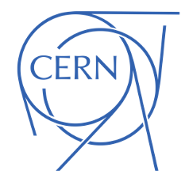
What is matRad?
31st IPPOG meeting 1-4 June Slovenia PARTICLE THERAPY MASTERCLASS
Nermine Muradi,
University of Tetova & AUTH
Slides by:
Nermine Muradi
Aris Mamaras
Viridiana Badillo
Enrique Sánchez
Yiota Foka

Slide 2
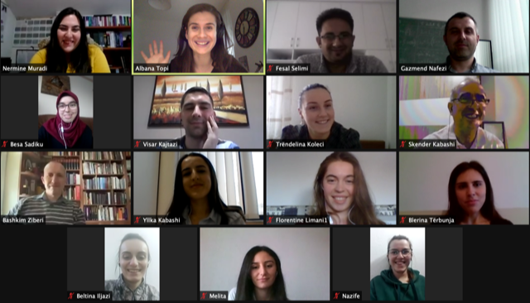
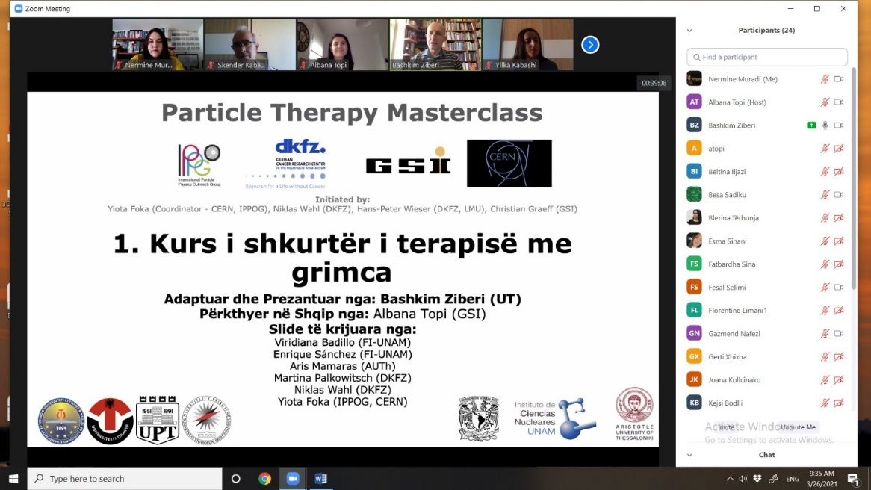
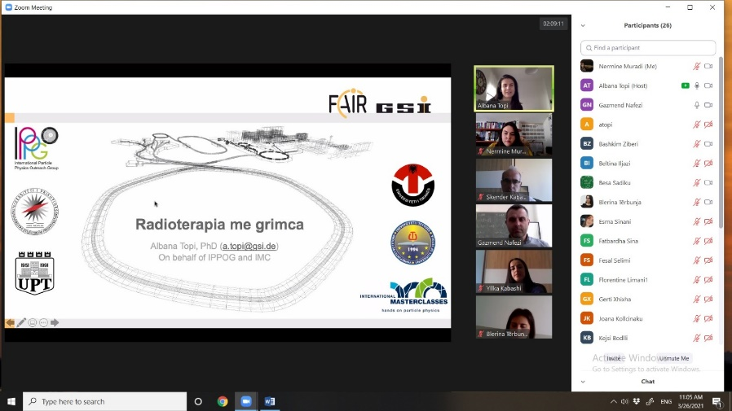



Particle Therapy Masterclass 2021
Albana Topi GSI :
North Macedonia
Kosovo
Albania

Slide 3
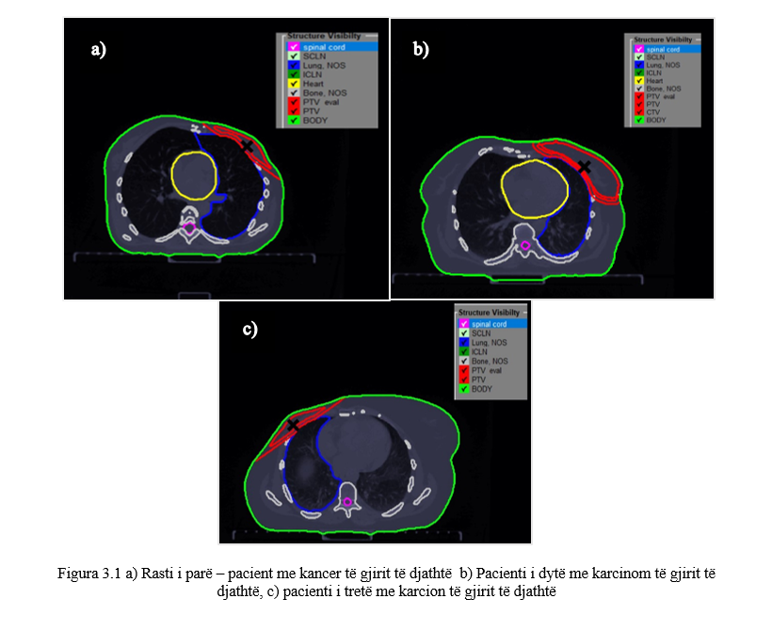
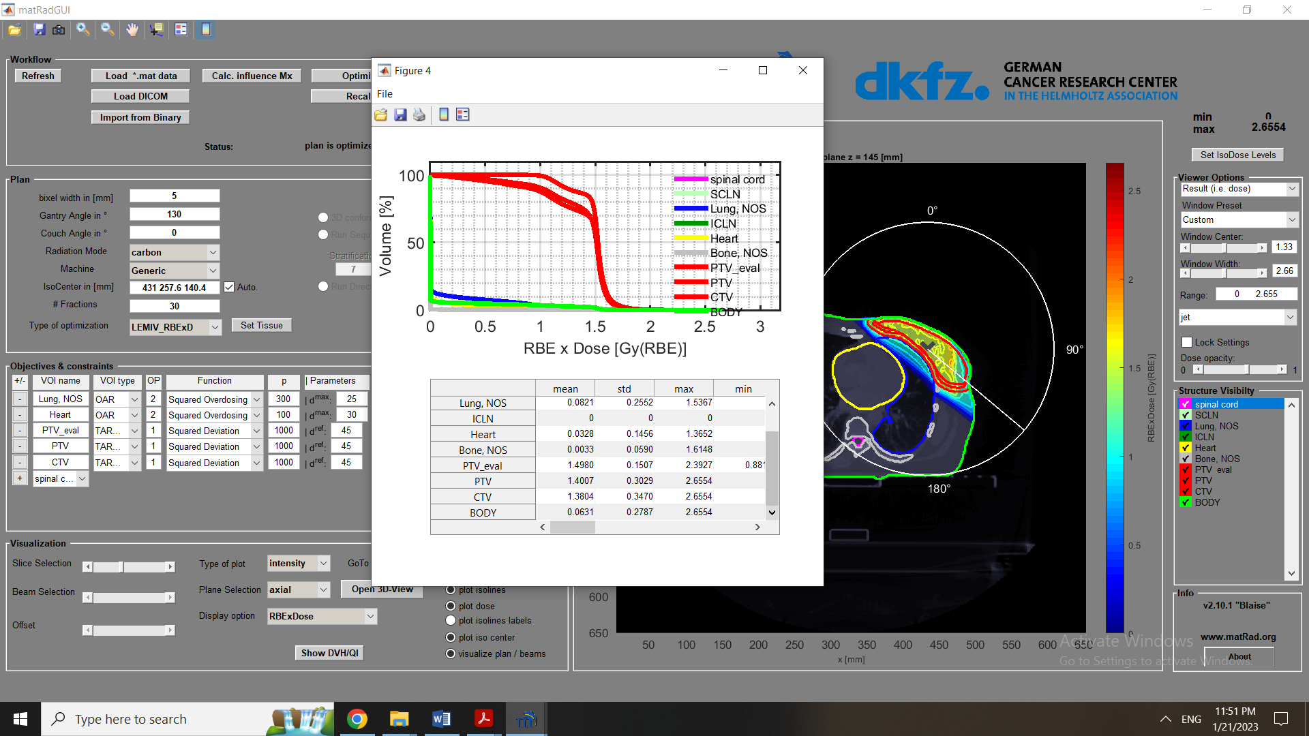


Particle Therapy Masterclass 2021
“Simulations of treatment planning of breast cancer and comparison with real cases”

Slide 4








Radiotherapy
Patient fixation
Imaging (esp. CT, but also MRT or PET)
Identification & delineation of tumor volume and organs on 3D image
Treatment Planning
Verification & quality assurance
Patient positioning
Irradiation (several “fractions“)
Adapted from W. Schlegel & A. Mahr: 3D Conformal Radiation Therapy Springer Multimedia DVD & from the presentation of Joao Seco and Niklas Wahl

Slide 5
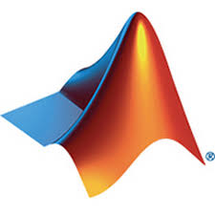


What is MatRad?
matRad is an open-source software tool for designing radiation therapy plans with a modulated beam of photons, protons and carbon ions (and helium in the latest version).
Its name derives from the combination of two words:
MatLab + Radiation = matRad
Developed by scientists at the German Cancer Research Center, DKFZ in Heidelberg.
Implemented for educational and research purposes.
Benchmarked with professional hospital software, giving similar results
BUT it is not to be used at hospitals!
www.matrad.org
Source: http://bit.ly/3sX756v
Source: http://bit.ly/3uXfNDt

Slide 6
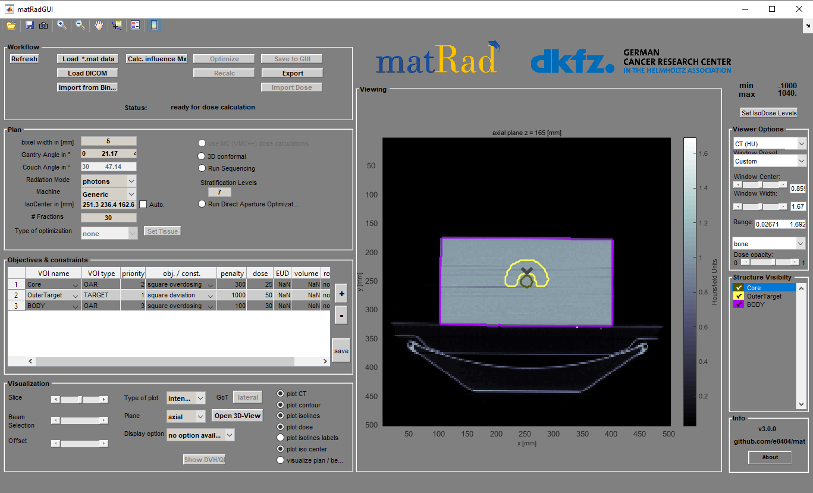
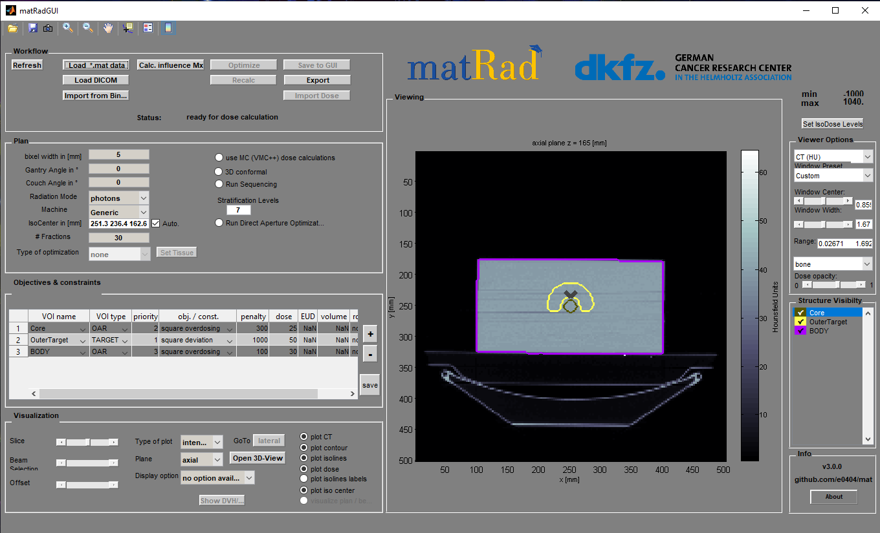
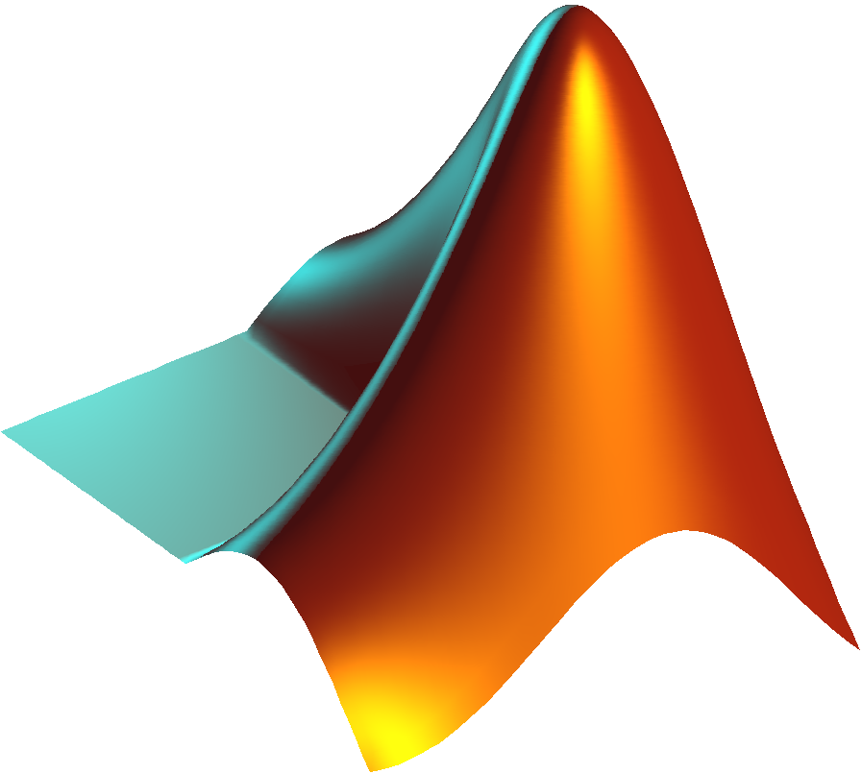

How can you use the software?
For research purposes:
The program gives the possibility to use many parameters, for more realistic simulations.
- Uses the complete Mat Lab code for detailed analysis.
- Requires more computing power.
For educational use:
For educational use, the simplified form of the software on Windows, Linux, Mac is recommended.
Requires less storage space and computing power.
Does not require IDE (integrated development environment) for the use of the software.
⚡⚡⚡
-Computing Power
⚡⚡⚡⚡⚡⚡
+Computing Power

Slide 7

Where is Matrad used today?
+30 INSTITUTES
With thousands of users worldwide.
The matRad webpage is:
www.matrad.org
A simplified version
was provided for the PTMC

Slide 8
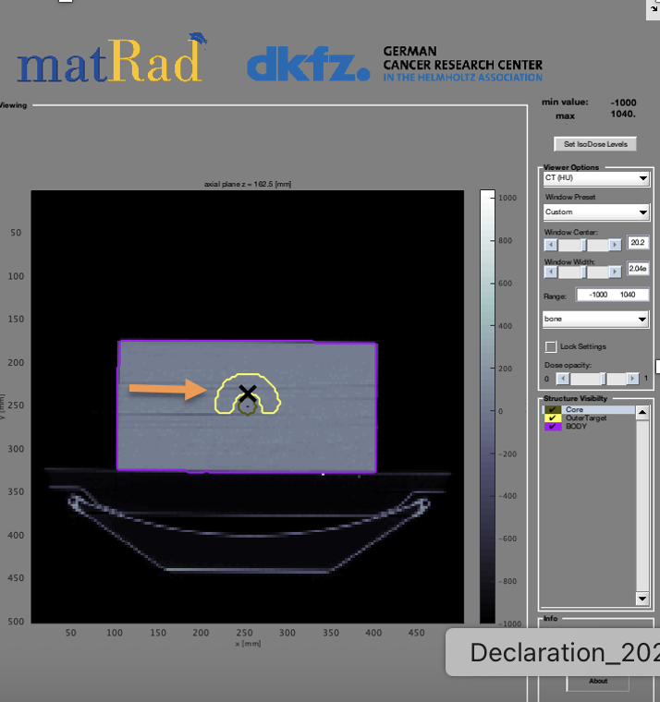
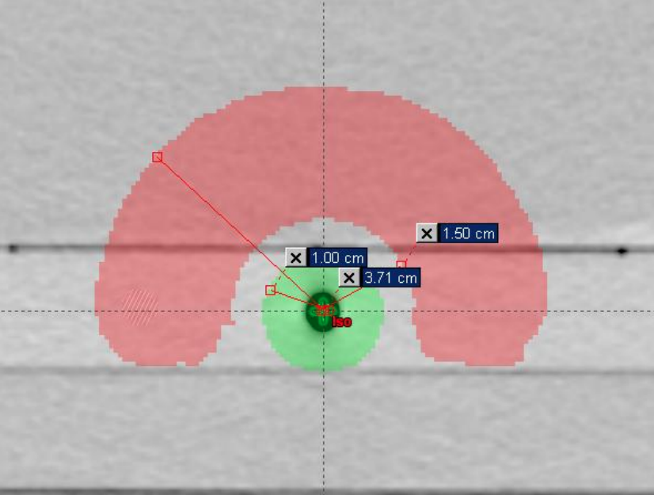
MatRad cases for PTMC
The program installation package comes with 6 case studies:
  TG 119 or phantom C
  Liver
  Prostate
  Head & Neck (H&N)
  Box phantom
  Alderson case
Irradiation part
Avoid the center

Slide 9
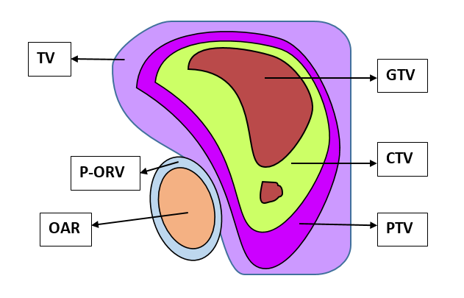
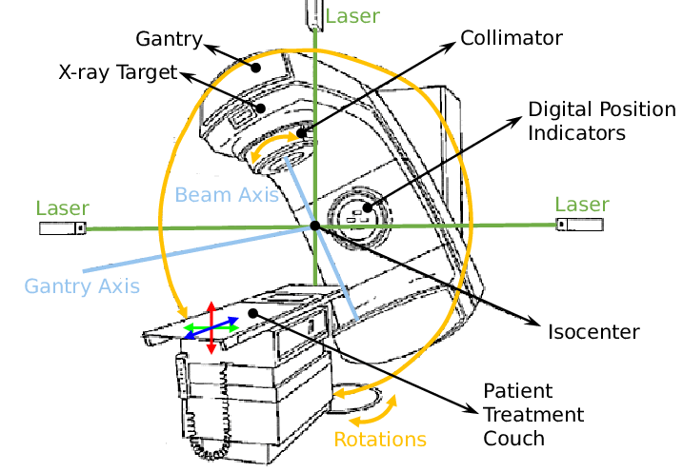
Fundamental Definition
used by matRad
GTV or gross tumor volume is defined as the macroscopic target tumor and is the exact location of the malignancy, as evidenced by imaging methods. It may consist of the inital tumor, metastatic lymphadenopathy or other meatastases.
CTV or clinical target volume is defined as the target clinical tumor, where the radio physicist assumes that cancerous tissue is still present. It consists of the tumor that is shown, if there is any, and any tissue with suspected tumor.
CTV = GTV + 1 cm – 2 cm.
PTV or "Planning Target Volume” is the area we plan to treat with radiation. It includes the CTV—the area where cancer might be—and adds extra space around it. This extra margin helps make sure the treatment still hits the right spot, even if the patient moves a little or is not in the exact same position each time.
OAR or “Organs At Risk", which are the organs that are more sensitive compared to healthy tissue. Organs in danger need adequate protection. Once the endangered organs are identifying an extra safety margin should be added to include their movement.
Gray (Gy) A gray is a unit used to measure how much radiation energy is absorbed by the body. One gray means that one kilogram of tissue has absorbed one joule of energy.

Slide 10
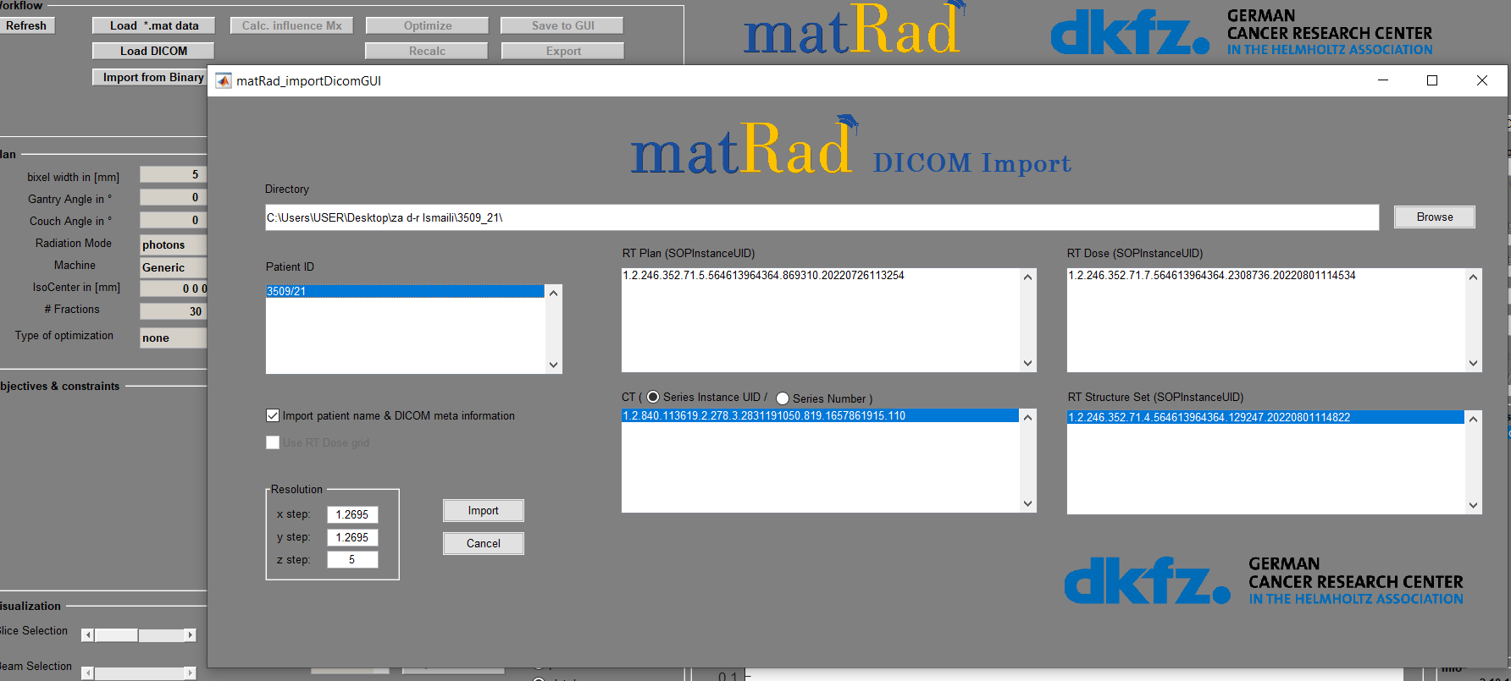
Import of images (CT) , structure set and RT plans

Slide 11
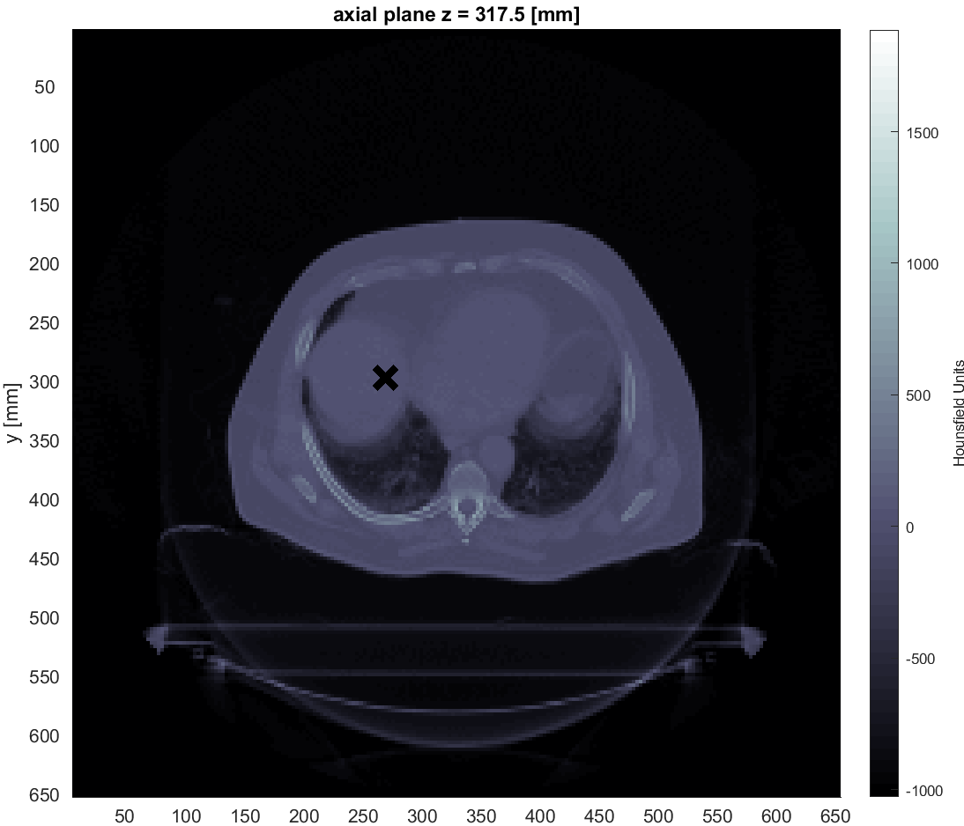
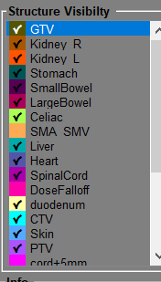
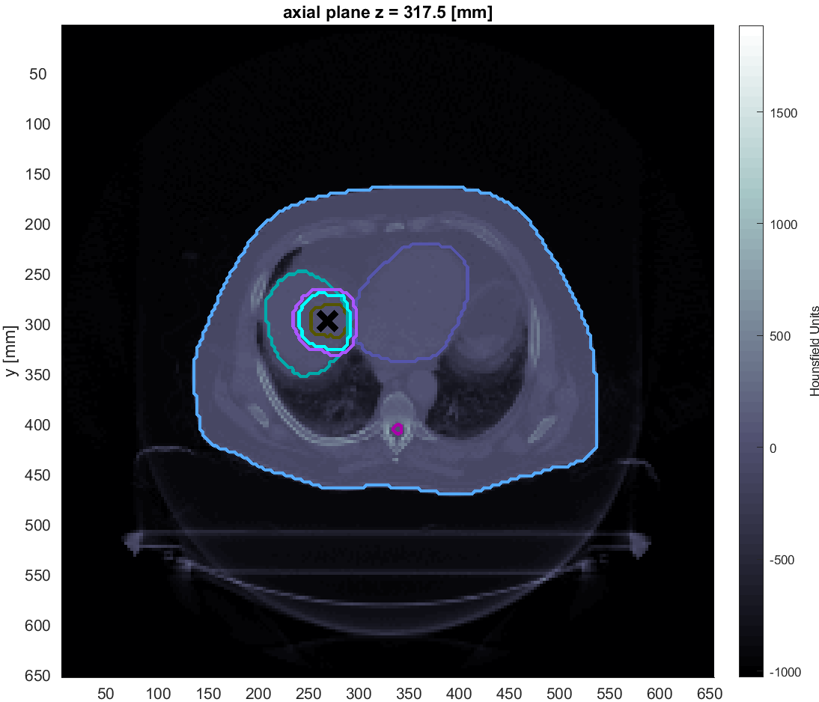
Images

Slide 12
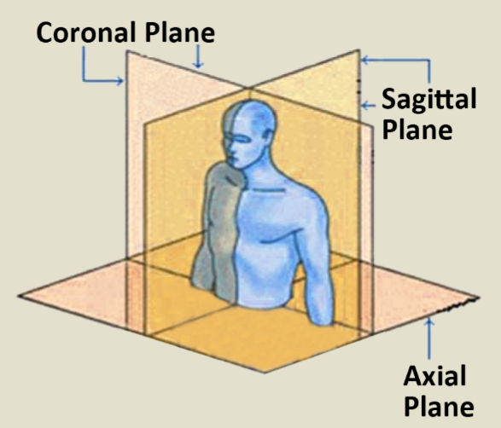
Planes
Source: https://bit.ly/3cZqM72
Sagittal plane: It separates the body equally in left and right parts.
Coronal plane: It separates the body into two parts, anterior and posterior.
Transverse/Axial/Horizontal plane: It separates the body at the upper and bottom parts.
Source: https://bit.ly/3tY42v1

Slide 13
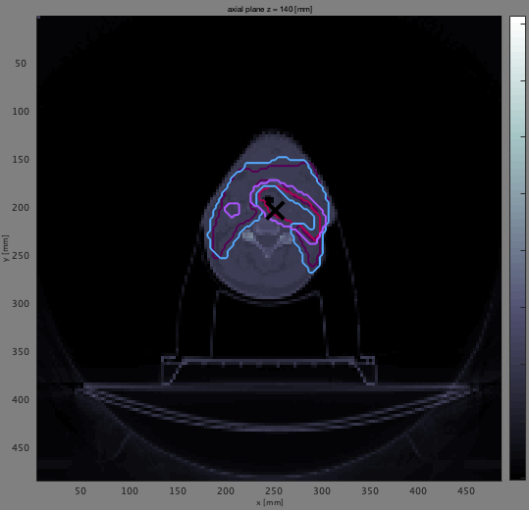
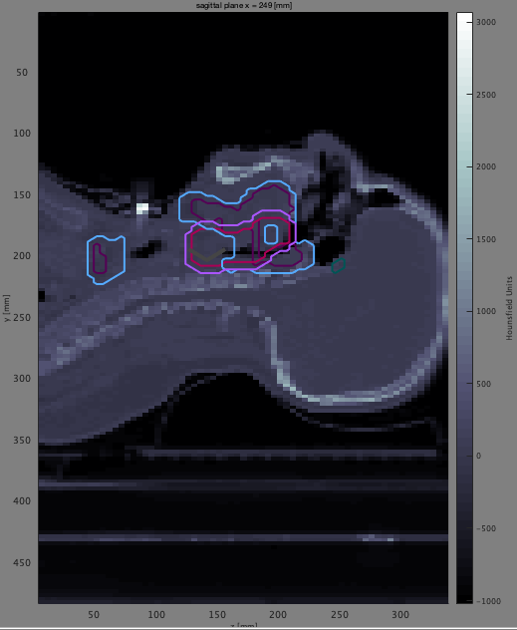
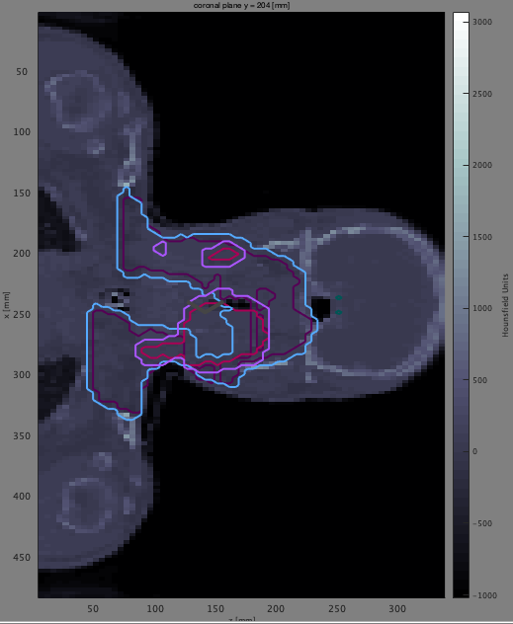
Head & Neck case
Axial view
Sagittal view
Coronal view

Slide 14
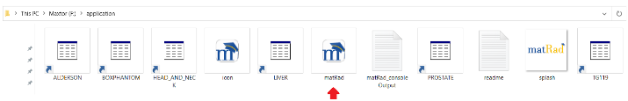
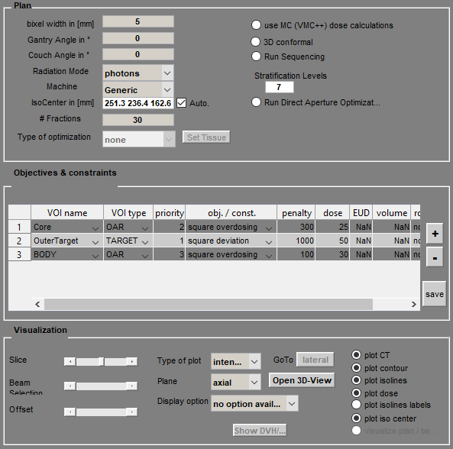
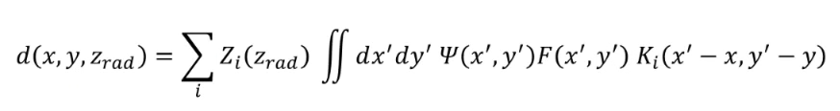
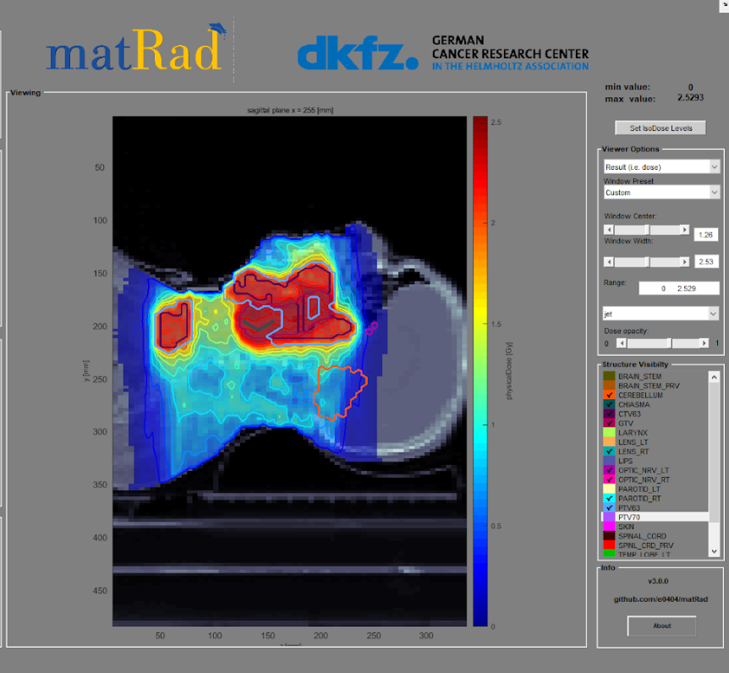
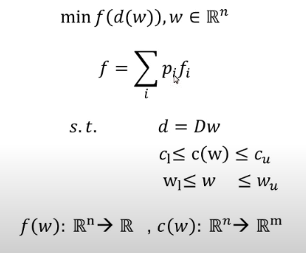
How does Matrad works?
We enter the patient data
We set the parameters of the treatment plan (Radiation geometry etc.)
Data files:
Test Sample (C-phantom)
Liver
Head n Neck
Procedure
We calculate the dose of distribution to the cancerous tissue through algorithms
Visualization of the plan with the reverse planning technique (Inverse planning)
Completion of Simulation

Slide 15
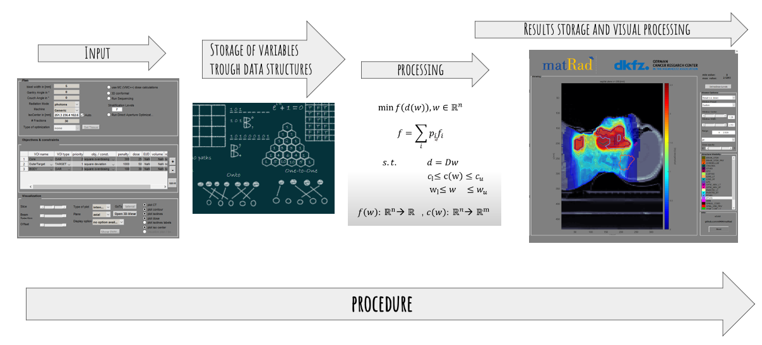
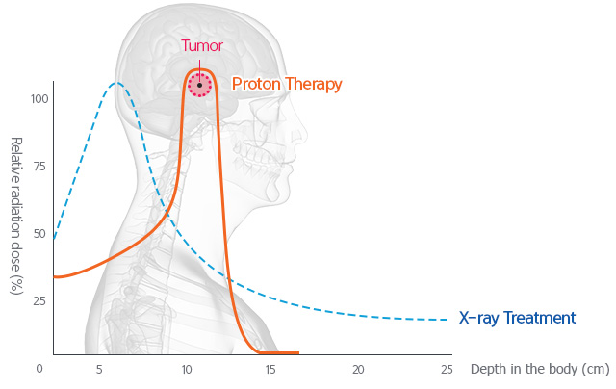
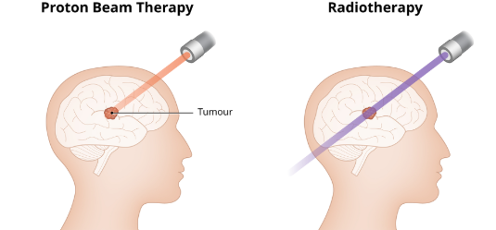
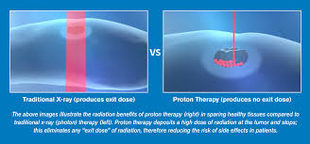
Treatment Planning System
– TPS matRad
Photons: Base data for the photon dose calculation algorithm are obtained from the clinically approved photon dose calculation engine PDC++ and describes the decomposed lateral scattering kernels and depth dose components as detailed in for a 6 MV linear accelerator for multiple source to surface distances (SSDs).
Protons: Analytical calculations according are
used to approximate integrated proton depth dose profiles in water for 114 proton beam energies ranging from 31.72 MeV to 236.1 MeV which correspond to peak positions from 7 mm to 347 mm.
Carbon ions: Integrated carbon ion depth dose profiles
are based on FLUKA Monte Carlo simulations. Monte Carlo simulations were performed in water. In total, 121 carbon ion depth dose profiles linearly spaced from 115.23 MeV to
398.84 MeV depicting peak positions from 32 mm to 294 mm are part of the carbon ion base data file.

Slide 16
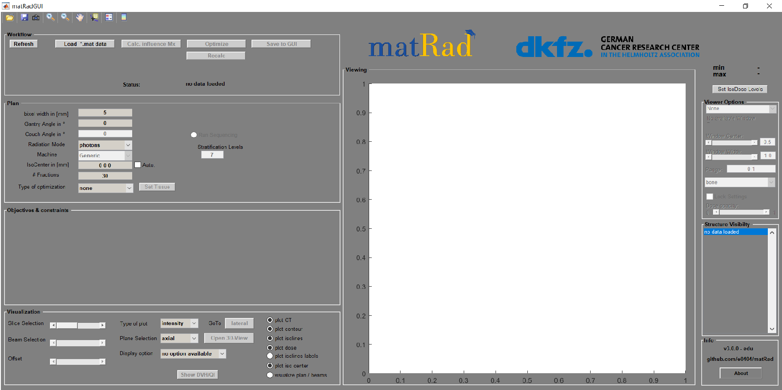
Starting the program
It is important to click only once at each command; otherwise, the software may freeze.

Slide 17
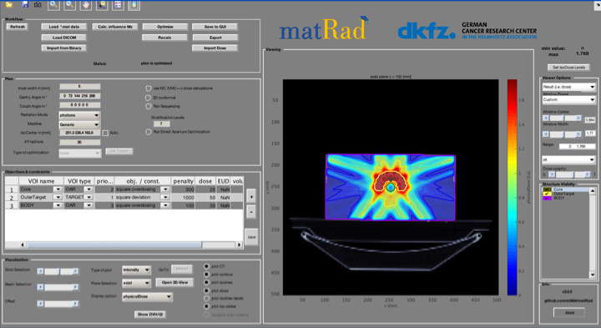
Graphical User Interface of matRad
WORKFLOW
PLAN
VIEWING
VISUALIZATION

Slide 18
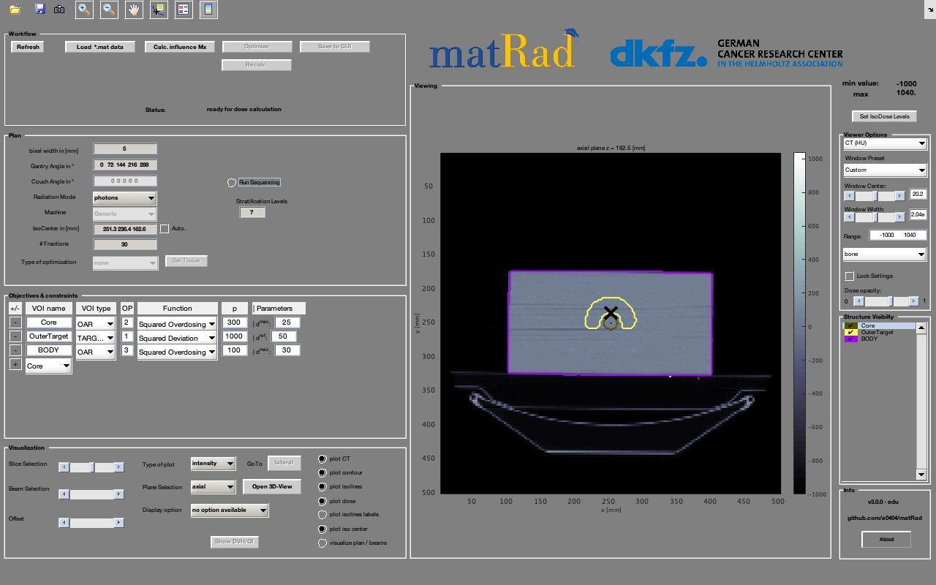
Isocenter
Make sure you can see the isocentre, marked “X”, at all times.
The isocenter is the point where the radiation beam is aimed.

Slide 19
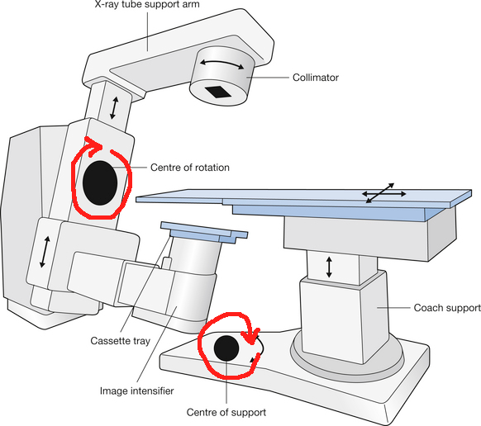
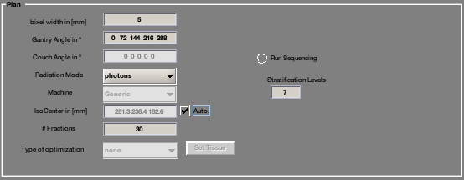
Panel: Plan
Bixel width: size of each square where the radiation is delivered.
Gantry and couch angles: Set the angle values ​​for the Gantry and the couch (patient's bed). If 5 angles are used for the Gantry, then we will have 5 angles for the bed as well. These angles have values ​​from 0º to 359º.
Radiation mode: what particle will be used (photons, protons and carbon ions).
Isocenter: Always verify that “automatic isocenter” is active. It is the center where the radiation beam passes.
Fractions: Number of fractions = number of sessions needed for the total prescription dose to be deliver.
Run sequencing: (in our case it is not active) used to collimate the beam

Slide 20
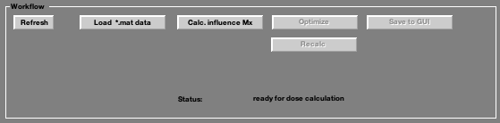
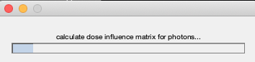
Panel: Workflow
To find the data files of the different cases depending your computer:
Load > This PC> WIN (C)> program files>matrad>application
Load > My computer> (LOCAL DISK c)>program files>matrad>application
If you have trouble finding it, you can download the files (.mat) from the Indico page under the section: https://drive.google.com/drive/folders/1CiCDZBjl_hRZ-1JGsgJNfc52-13n_zuj

Slide 21
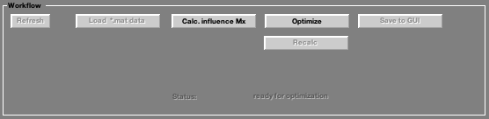
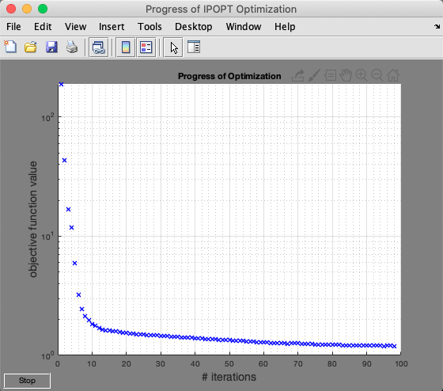
Panel: Workflow
Here the program will look for the minimum radiation flux per bixel.

Slide 22
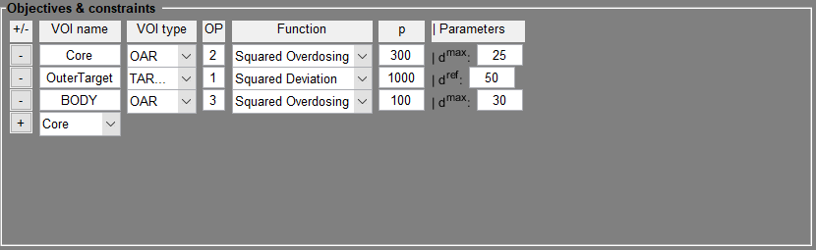
Workflow
Exponential distribution
The optimizer adjusts the radiation plan to get the best result, while following limits and conditions set by the algorithm.
The objective function and constraint functions are built from the specific objectives one can set in the table.
Objectives and constraints include the organs of interest (e.g. target), as well as the organs at risk (e.g. body, core etc.) that are about to be irradiated and, we want to avoid obtaining more dose.

Slide 23
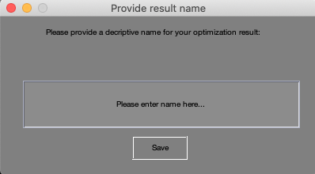
Workflow: Save to GUI
This command saves the set-up and requires to name it.
This step is important so the Dose-Volume Histogram DVH can be shown.
File Name:
Case study_ (TG199) + Particle (Photons) _+ No. of Angles (two angles)_:
TG199_photons_twoangles

Slide 24
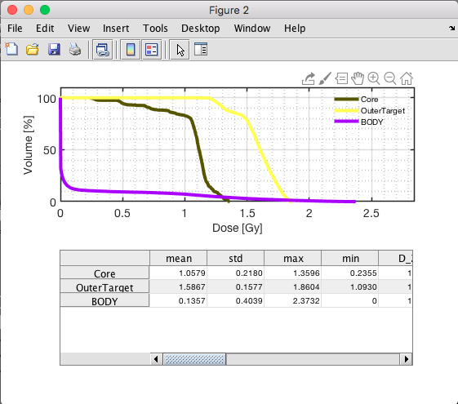
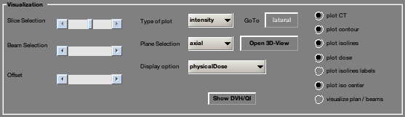
Visualization
TG119 Phantom C case
“Show DVH/QI” shows the Dose-Volume Histogram.
TG119 Phantom C
Yellow line: the outer target, meaning the tumor area that should receive the full dose.
Green line: the core (organ-at-risk).
Purple line: the whole body.
A significant amount of radiation reached the organs at risk (OAR) and the rest of the body, which ideally should be avoided.
With protons, the DVH would likely show a more “box-shaped” curve, meaning almost all of the dose goes precisely to the outer target, with very little to surrounding tissue.
Carbon ions would show a similar or even better pattern that protons, depending on the plan.

Slide 25
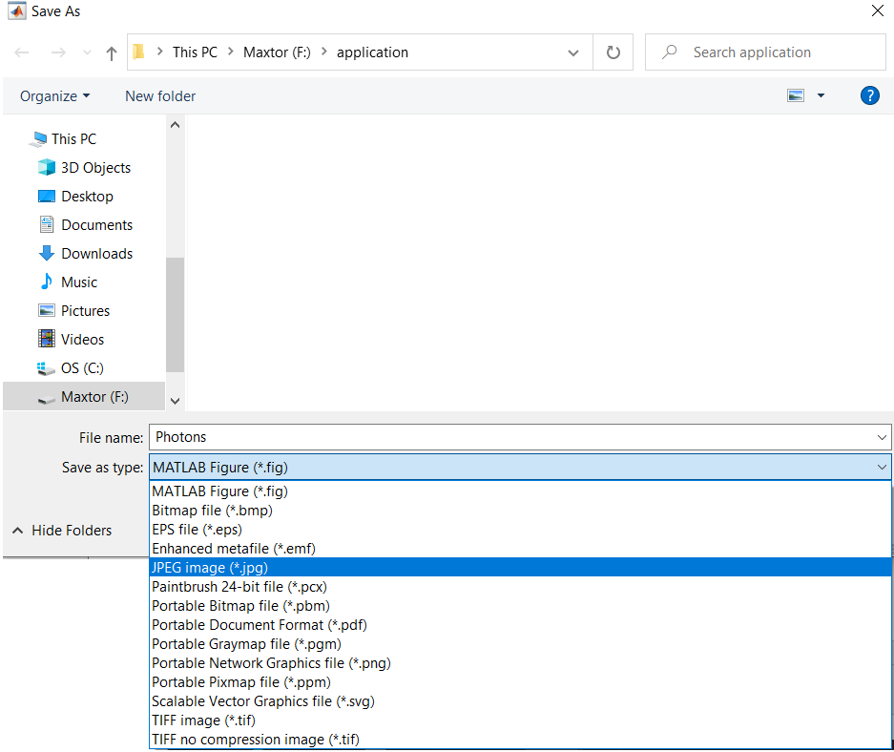
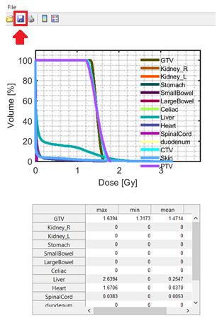
DVH for each case of study

Slide 26
Summary of the processes
Choose the plan settings
*
Choose a study case
Repeat every time you change a setting
You can find the instructions here: https://indico.cern.ch/event/1539515/contributions/6478667/attachments/3091862/5476361/Oxford%20Hands%20on%20Excersice.pdf

Slide 27
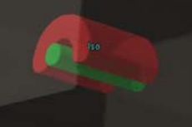
TG119 Phantom case
Phantom TG119 or phantom C is used by professionals to verify that equipment is functioning properly. They have standard shape and dimensions.
The aim is to irradiate the “C” shaped area and avoid the central area.
Irradiation part
Avoid the center

Slide 28
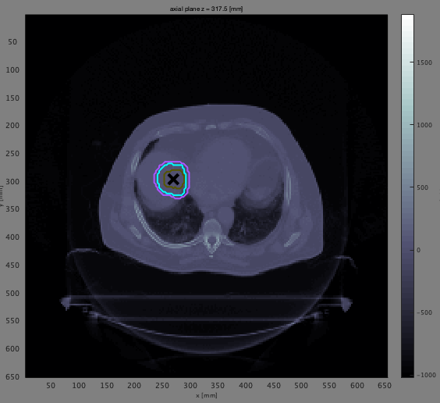
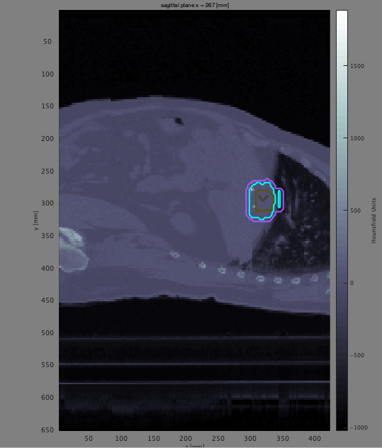
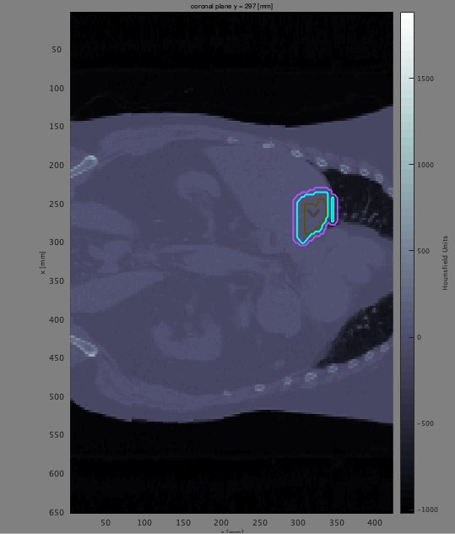
Liver case
Axial view
Sagittal view
Coronal view

Slide 29



Prostate case
Axial view
Sagittal view
Coronal view

