Slide 1


DEPARTMENT OF EXPERIMENTAL PARTICLE PHYSICS — F9
Astroparticle Physics at F9
Ultra-high-energy cosmic rays and very-high-energy gamma rays
Pierre Auger Observatory · CTAO
Jožef Stefan Institute, Ljubljana
in collaboration with the Center for Astrophysics and Cosmology (CAC), University of Nova Gorica
15-minute overview · Group activities & collaboration

Slide 2
Outline
01
The problem
04
F9 group activities
Open questions in ultra-high-energy astrophysics
What we contribute, hardware to analysis
02
Motivation
05
Collaboration with CAC UNG
Why cosmic rays and gamma rays together
A joint Slovenian astroparticle effort
03
The experiments
06
Outlook
Pierre Auger Observatory and CTAO
Summary and what's next
F9 · Jožef Stefan Institute | Pierre Auger Observatory & CTAO
2

Slide 3
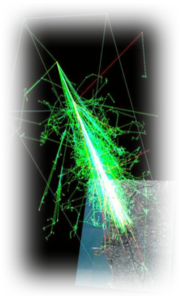
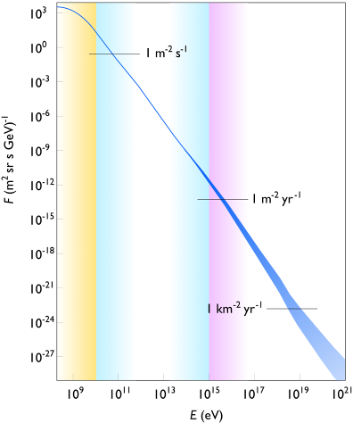



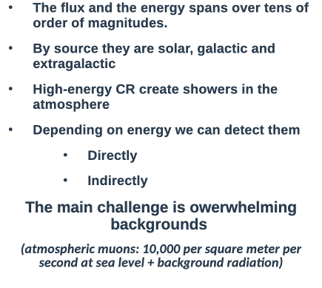





01 · THE PROBLEM
The highest-energy particles in the Universe
F9 · Jožef Stefan Institute | Pierre Auger Observatory & CTAO
3

Slide 4
01 · THE PROBLEM
The highest-energy particles in the Universe
Ultra-high-energy cosmic rays (UHECRs) reach energies beyond 10²⁰ eV — millions of times higher than any accelerator on Earth can produce. Fundamental questions remain open:
1
2
3
4
Origin
Composition
Propagation
New physics
Where and how are these particles accelerated? Which astrophysical sources reach such extreme energies?
Are the primaries protons, or heavier nuclei? The answer shapes every other conclusion.
How do cosmic magnetic fields and interactions with the CMB (the GZK effect) shape what we observe?
Do interactions at these energies, far above collider reach, hint at physics beyond the Standard Model?
F9 · Jožef Stefan Institute | Pierre Auger Observatory & CTAO
3

Slide 5
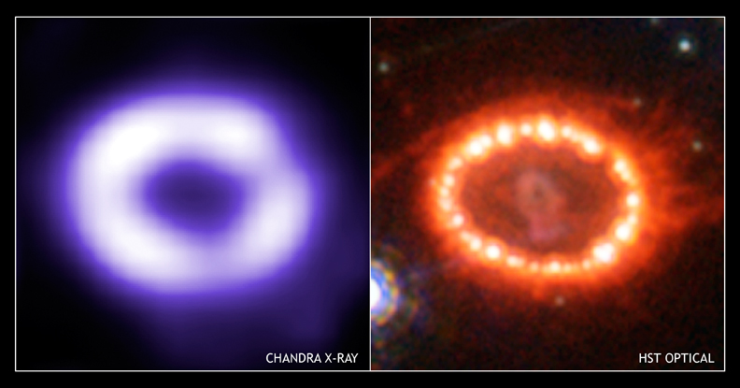
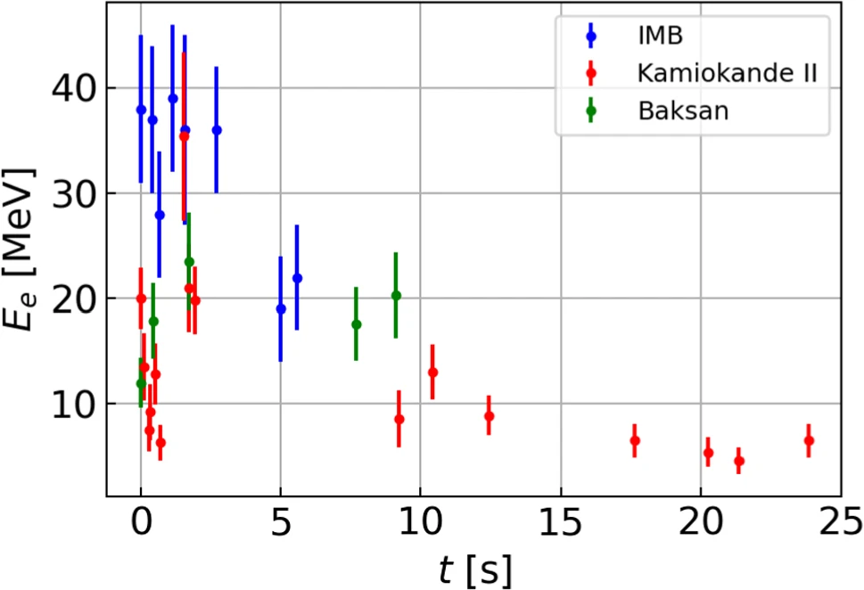
02 · MOTIVATION
Two windows on the extreme Universe
Cosmic rays and gamma rays are two messengers from the same extreme accelerators (there are others like Neutrinos, Gravitational waves, WIMPs ..)
Studying them together is the core motivation for multi-messenger astrophysics.
SN1987A
Kamiokande II
Ultra-high-energy cosmic rays
Very-high-energy gamma rays
charged nuclei, 10^18–10^20+ eV
neutral photons, 20 GeV–300 TeV
Deflected by galactic & extragalactic magnetic fields
Traced indirectly via giant particle showers in the atmosphere
Pierre Auger Observatory
Travel in straight lines — point back to their sources
Probe particle acceleration, dark matter, extreme environments
CTAO (Cherenkov Telescope Array Observatory)
F9 · Jožef Stefan Institute | Pierre Auger Observatory & CTAO
4

Slide 6
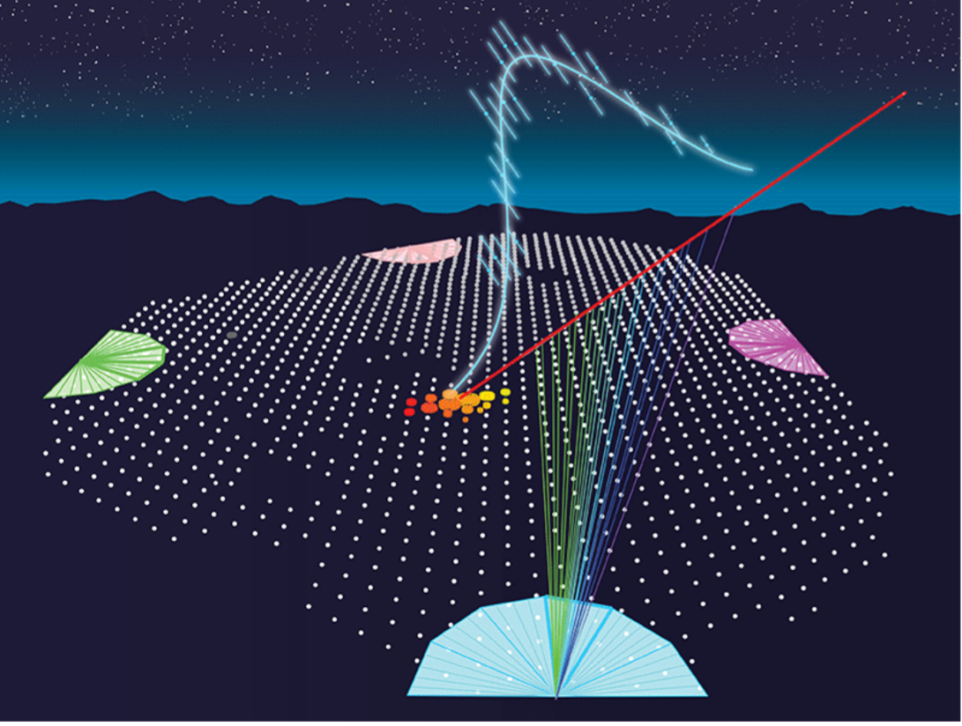
03 · THE EXPERIMENTS
Pierre Auger Observatory
The world's largest cosmic-ray observatory — Malargüe, Mendoza Province, Argentina
3,000 km²
1,660
27
17
surface array area
water-Cherenkov stations
fluorescence telescopes
countries
Hybrid detection technique
Surface Detector (SD)
Water-Cherenkov tanks sample the shower's particle footprint at ground level — full duty cycle, day and night.
Fluorescence Detector (FD)
Telescopes image the faint UV fluorescence trail of a shower developing in the atmosphere, on clear moonless nights.
Hybrid events
Combining SD and FD data cross-calibrates energy and direction, anchoring the observatory's whole energy scale.
F9 · Jožef Stefan Institute | Pierre Auger Observatory & CTAO
5

Slide 7
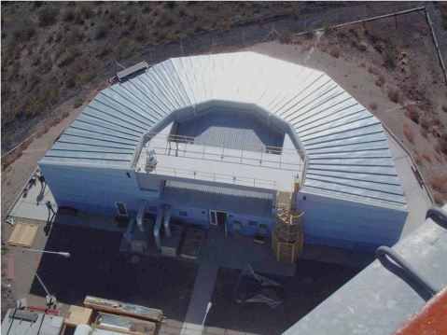
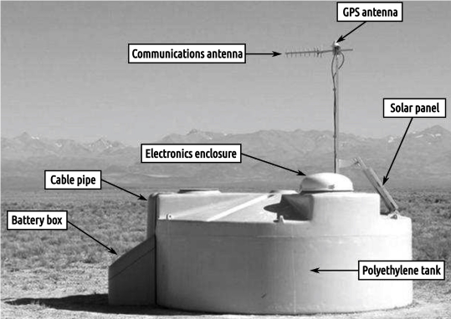
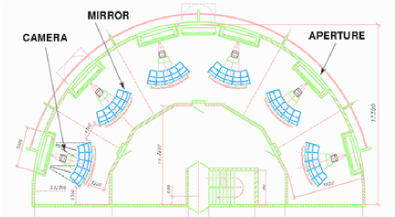
03 · THE EXPERIMENTS
Fluorescence Detector
Pierre Auger Observatory
Ground Detector
4 buildings
6 sectors each with camera
Reflector: r=3,4m, 13m2
Camera: 440hex xp3062 PM
(30 x 30)º field of view
1.6 m height, 3,6 m radius, 12 t deionized water
Solar cell power supply 110W + 210 Ah batterie
3x Photonis XP1805
GPS Oncore UT for timming (10 ns RMS)
Extended WLAN 902-928 Mhz for coms.
F9 · Jožef Stefan Institute | Pierre Auger Observatory & CTAO
5

Slide 8
03 · THE EXPERIMENTS
AugerPrime — upgrading the Observatory
Auger data show the highest-energy cosmic rays are dominated by heavy nuclei — but disentangling the muonic and electromagnetic parts of a shower, event by event, needs new instrumentation.
◧
◍
≋
⌁
Scintillator panels
Underground muon detectors (AMIGA)
Radio antennas
Upgraded electronics
Installed atop every water-Cherenkov station to separate the muonic and electromagnetic shower components.
Buried particle counters give a direct, shielded measurement of the shower muon content.
Extend measurements to showers arriving at high zenith angles, complementing the surface array.
Faster sampling and small-area PMTs extend the dynamic range of every station.
Spectrum, Composition, Anisotropy, Sources, Multi-messenger
Multi-messenger observations of a binary neutron star merger. The astrophysical journal. Letters. 2017, vol. 848, no. 2, str. 1-59, ilustr.
3614 co-authors
LIGO, Virgo, Auger, IceCube, Antares, Fermi-LAT, Agile, AstroSat, ALMA, LOFAR …
F9 · Jožef Stefan Institute | Pierre Auger Observatory & CTAO
6

Slide 9
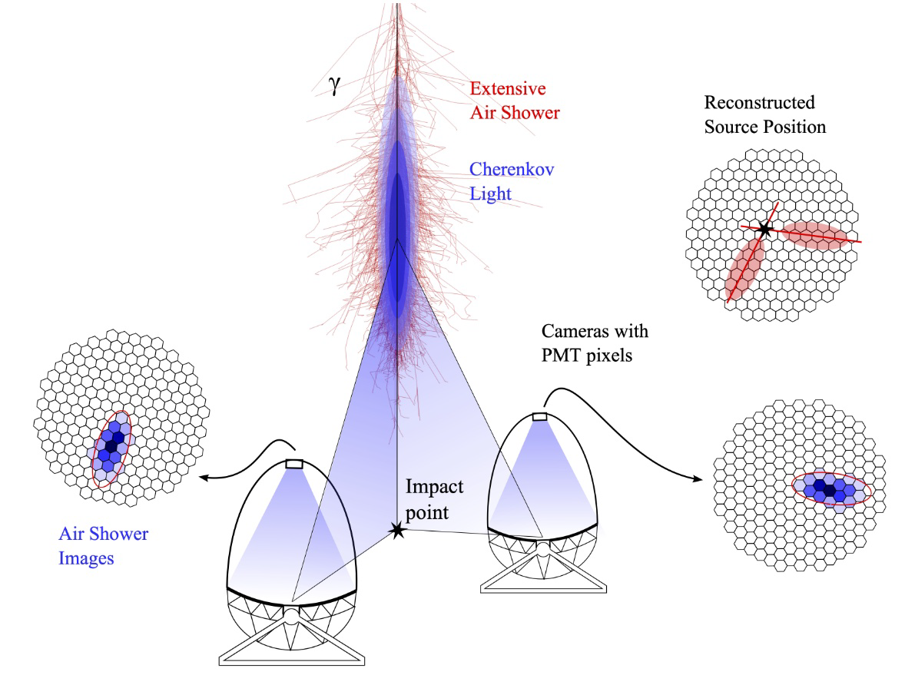
03 · THE EXPERIMENTS
CTAO — Cherenkov Telescope Array Observatory
The next-generation ground-based observatory for very-high-energy gamma-ray astronomy — established as a European Research Infrastructure Consortium (ERIC) in January 2025, with Slovenia a founding member.
2 sites
64 telescopes
20 GeV–300 TeV
10×
La Palma & Paranal, Chile
large, medium & small
energy range covered
sensitivity vs. current arrays
How it works
A gamma ray striking the atmosphere produces a cascade of secondary particles that briefly emit Cherenkov light — a faint blue flash a few nanoseconds long. Telescope arrays image the flash to reconstruct the gamma ray's energy and direction, and reject the much larger cosmic-ray background.
Science goals: cosmic-ray origins, extreme accelerators (black holes, pulsars, supernova remnants), dark matter, fundamental physics.
An imaging atmospheric Cherenkov telescope, capturing the blue flash of an air shower
F9 · Jožef Stefan Institute | Pierre Auger Observatory & CTAO
7

Slide 10
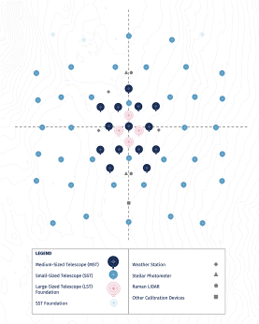
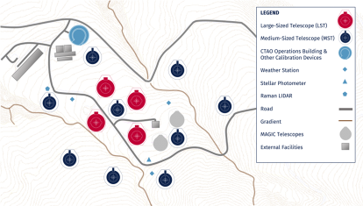
03 · THE EXPERIMENTS
CTAO — Cherenkov Telescope Array Observatory
Northern site
Instituto de Astrofisica de Canarias, Roque de los Muchacos, La Palma, Canarias
SST 0, MST 15, LST 4
Southern site
European Southern Observatory, Paranal, Chile
SST 70, MST 25, LST 4
F9 · Jožef Stefan Institute | Pierre Auger Observatory & CTAO
7

Slide 11
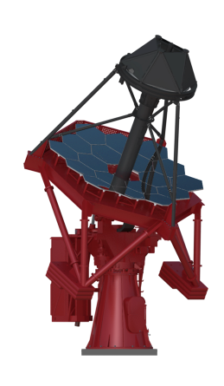
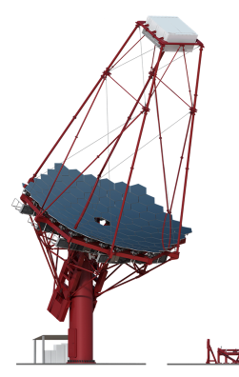
03 · THE EXPERIMENTS
CTAO — SST MST
5 Tev – 300 TeV
4,3 m diameter
70 S, 0 N
150 GeV – 5 TeV
12,5 m diameter
25 S, 15 N
F9 · Jožef Stefan Institute | Pierre Auger Observatory & CTAO
7

Slide 12
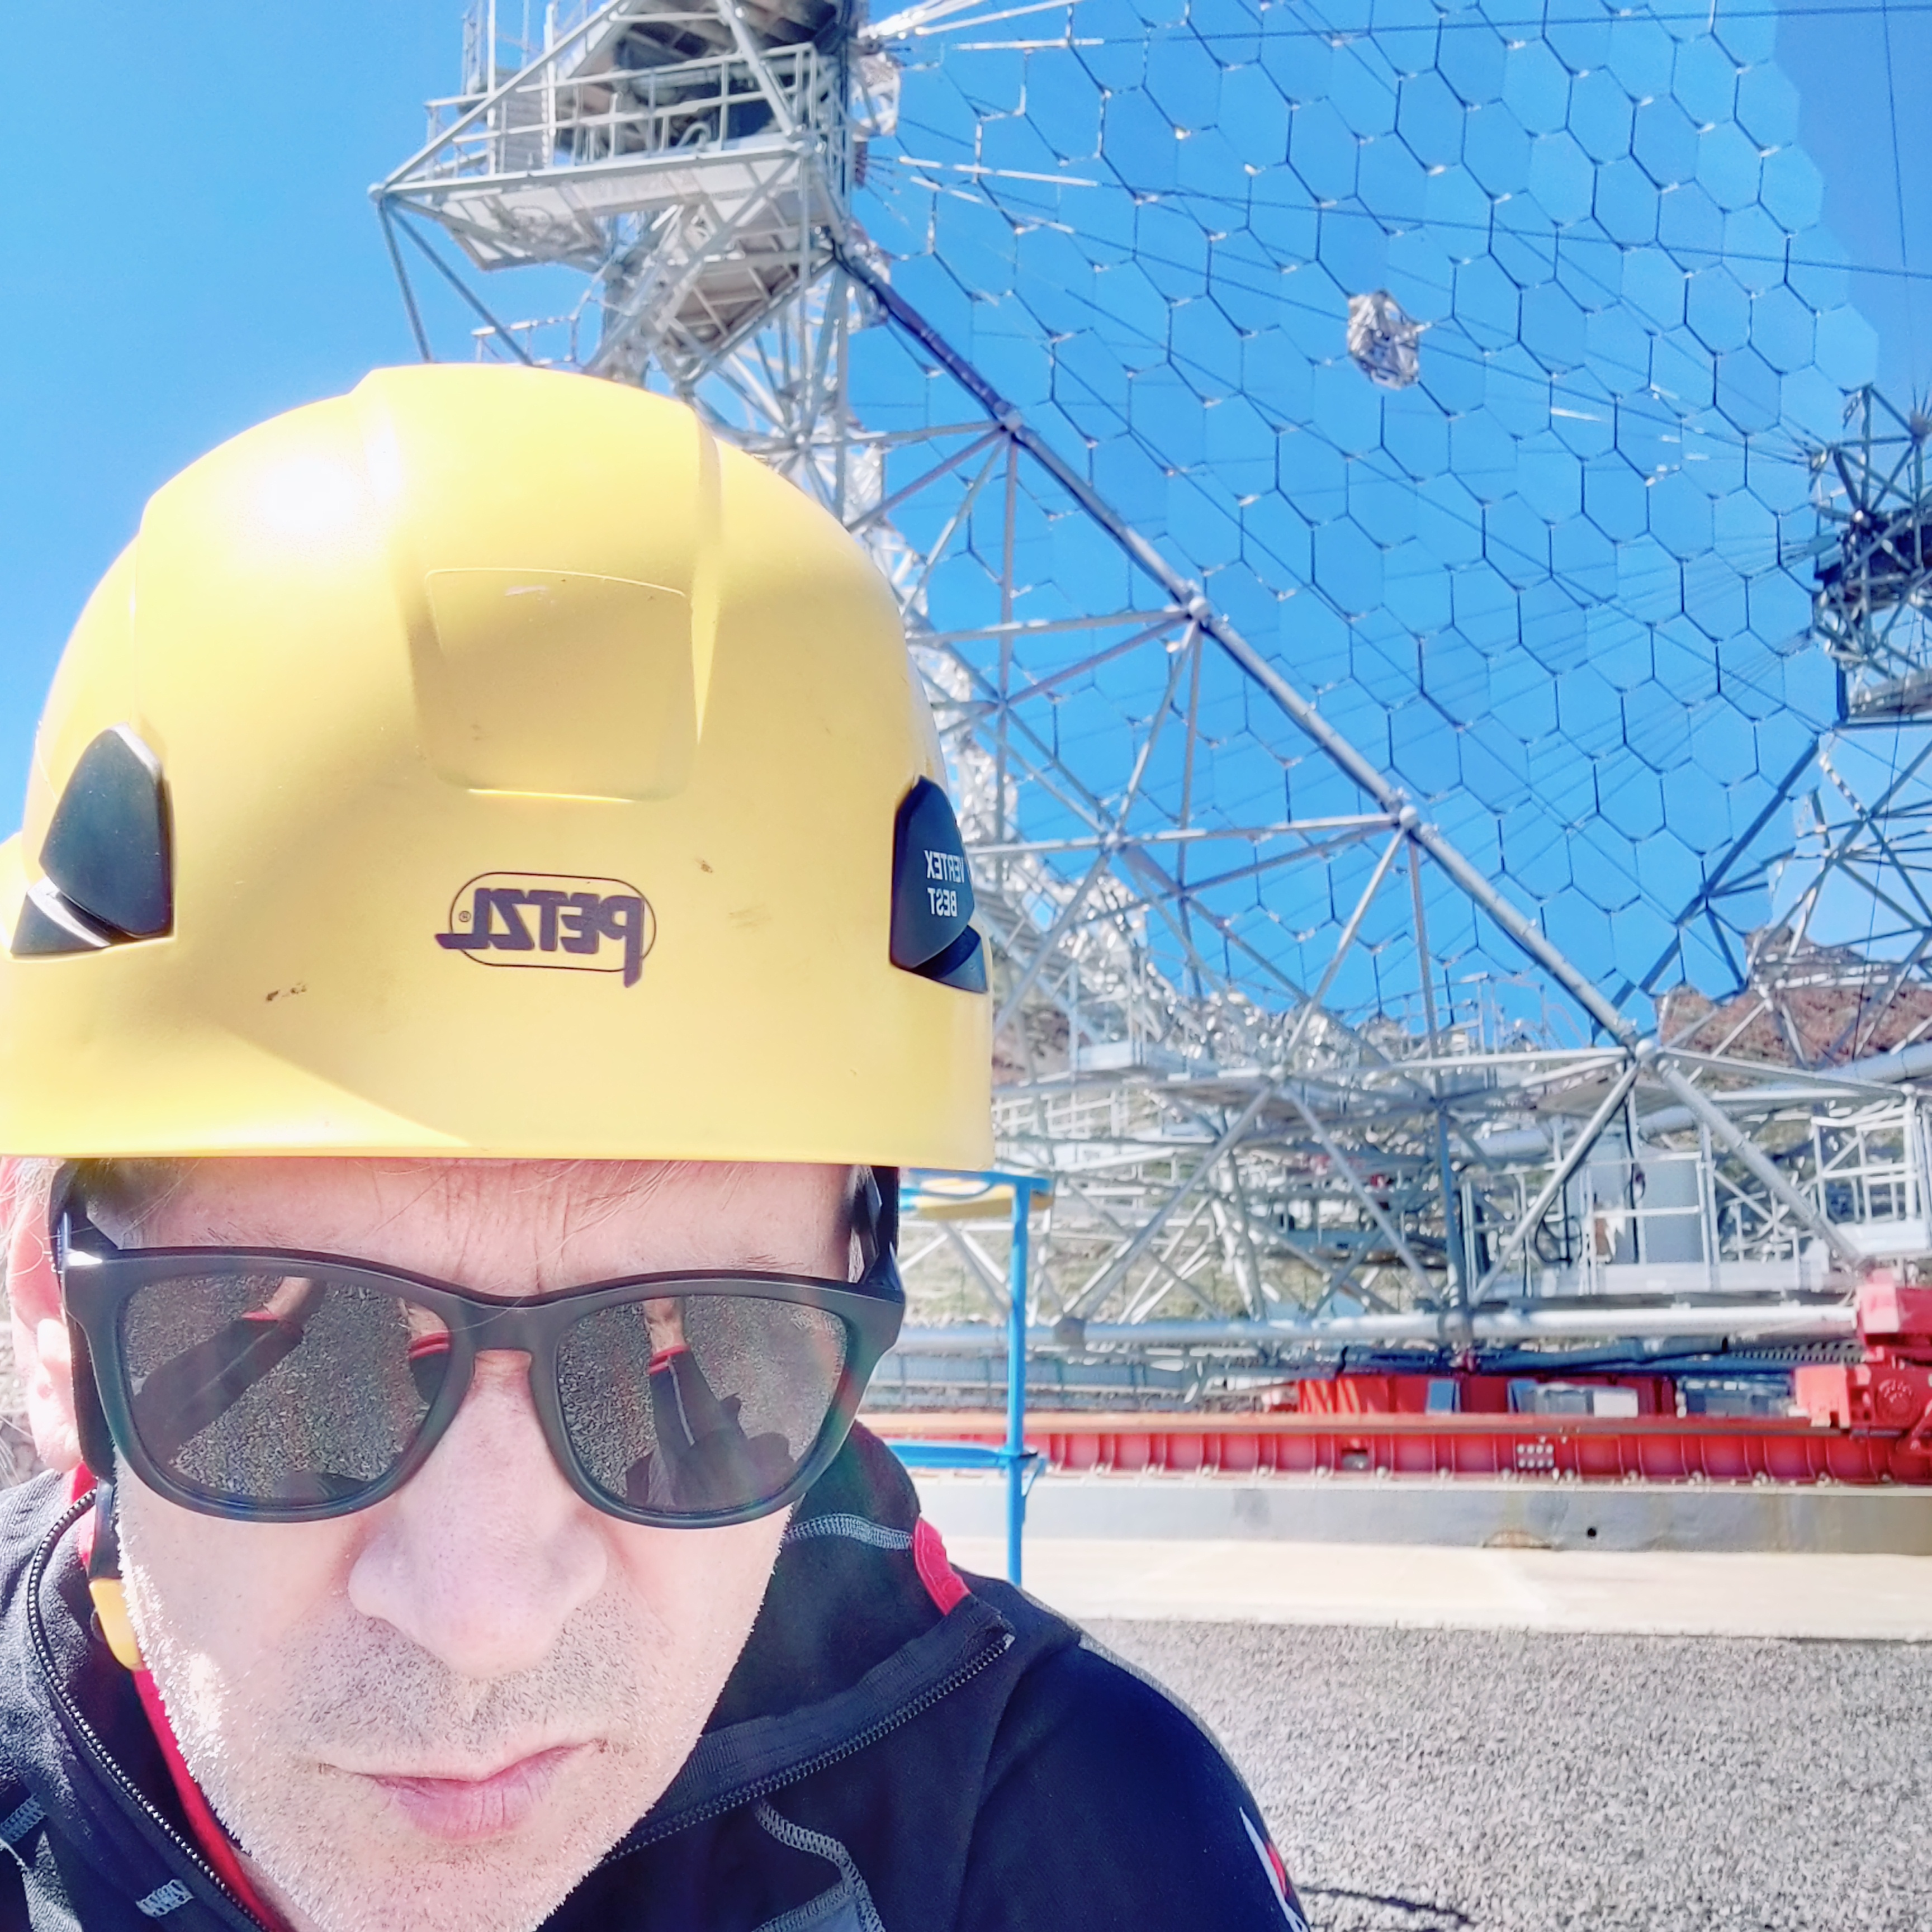
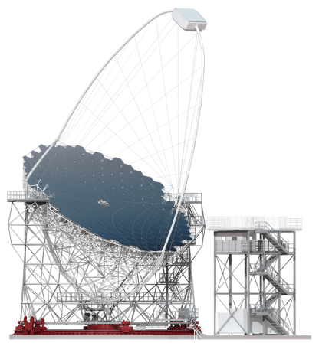
03 · THE EXPERIMENTS
CTAO — LST
20 Gev – 150 GeV
23 m diameter
400 m2
Camera: 1855 PM, 2T
4 S, 4 N
F9 · Jožef Stefan Institute | Pierre Auger Observatory & CTAO
7

Slide 13
CTAO — Current Activities
Cherenkov Telescope Array Observatory · status as of September 2026
CTAO-North (La Palma, Spain)
CTAO-South (Paranal, Chile)
Organization & Operations
LST-1 operating; LST-2–4 under deployment at ORM
LST-4 camera installed, commissioning underway
Inauguration of the 4 LSTs planned for Oct 2026
First 5 MST installations progressing; infrastructure tenders launching
Groundbreaking held; telescope foundation construction begun
First SSTs and MSTs expected by early/late 2027
MST and SST pathfinders to be deployed in 2027
Established as a European Research Infrastructure Consortium (ERIC), Jan 2025
ERIC enables construction of full 64-telescope array to begin
ACADA control & data-processing software being integrated
Intermediate array configurations targeted from 2026, ahead of full science operations
Source: CTAO, ESO, IAC public updates (2025–2026)

Slide 14
CTAO — Current Analysis & Simulation Results
Monte Carlo–based performance and recent science-simulation studies
Baseline Performance (Alpha Configuration)
Recent Science Simulation Studies
Tools & Methodology
Official sensitivity curves from Prod5 Monte Carlo simulations (CORSIKA + sim_telarray)
North: 4 LSTs + 9 MSTs (~0.25 km²); South: 14 MSTs + 37 SSTs (~3 km²)
5σ point-source sensitivity published for 0.5h, 5h and 50h exposures
Instrument Response Functions (IRFs) define effective area, angular/energy resolution, background
PeVatron candidates (Cas A, RX J1713.7-3946, HESS J1731-347) excluded at >5σ using simulated CTAO data
Simulations show sensitivity to cosmic-ray spectral cutoff shape (β) in SNRs, aiding proton-vs-heavy-ion discrimination
Forecasts for blazar jets, FR0 radio galaxies and binary neutron star mergers assess multi-messenger detectability
Gammapy used for ON/OFF simulated observations and IRF-based forecasting
Visibility and zenith-angle studies (North vs South) optimize simulated exposure times
MC simulation remains the primary basis for analysis ahead of on-sky science data
Source: CTAO Performance page (ctao.org), arXiv:2410.21199, arXiv:2603.05927, arXiv:2605.21320, arXiv:2604.08748

Slide 15
04 · F9 GROUP ACTIVITIES
F9 in the Pierre Auger Collaboration
The F9 astroparticle group has been a member institution of the Pierre Auger Collaboration for over two decades, contributing to both hardware and physics analysis.
Physics analysis
Instrumentation
Atmospheric monitoring
Mass composition studies (X_max, muon content) of ultra-high-energy cosmic rays
Searches for large- and small-scale anisotropies in arrival directions
Searches for ultra-high-energy photons and neutrinos
Machine-learning-based mass reconstruction with AugerPrime data
Design and characterisation of the silicon photomultiplier (SiPM) front-end for AMIGA underground muon detectors
Contributions to the AugerPrime detector upgrade
Involvement in atmospheric monitoring instrumentation (LIDAR and robotic photometric telescopes such as FRAM) that calibrates fluorescence measurements
M. Zavrtanik – PAO CB member
F9 · Jožef Stefan Institute | Pierre Auger Observatory & CTAO
9

Slide 16
04 · F9 GROUP ACTIVITIES
F9 in the CTA Consortium / CTAO
Since 2013, F9 has been part of the Cherenkov Telescope Array Consortium (CTAC), together with CAC UNG, helping shape the observatory's design, strategy and early science.
Dark matter & new physics
Site & atmospheric infrastructure
Strategy & governance
Searches for dark-matter signatures in gamma-ray data using machine-learning methods
Preparatory studies for CTAO's sensitivity to new physics beyond the Standard Model
Co-development of a Raman LIDAR system for atmospheric monitoring at the La Palma (north) site
Joint work with IFAE Barcelona, Universitat Autònoma de Barcelona and Università di Padova
Contributions to the CTAO scientific programme and publications during the preparatory phase
Slovenia is a founding member of CTAO ERIC (2025); UNG represents Slovenia in CTAO bodies
M. Zavrtanik – vice-chair of the CTAO ERIC AFC, K.Schlegel – member CTAO ERIC AFC
K. Schlegel & S. Stanic – CTAO Council members
F9 · Jožef Stefan Institute | Pierre Auger Observatory & CTAO
10

Slide 17
05 · COLLABORATION
A joint Slovenian astroparticle effort
F9 (JSI) and the Center for Astrophysics and Cosmology (CAC) at the University of Nova Gorica form Slovenia's astroparticle physics community, active together in both experiments since 2013.
Shared publications
Joint CTAC / CTAO membership
F9 and CAC UNG appear together as co-authors on Pierre Auger Collaboration papers, e.g. searches for ultra-high-energy photons.
Both institutes have been members of the CTA Consortium since 2013, contributing jointly to design and strategy.
Instrument development
National representation
Collaboration extends to shared infrastructure work, such as atmospheric-monitoring instrumentation for CTAO.
CAC and F9 represents Slovenia in CTAO governance bodies; F9 and UNG together sustain Slovenia's role as a CTAO ERIC founding member.
F9 · Jožef Stefan Institute | Pierre Auger Observatory & CTAO
11

Slide 18
BEYOND RESEARCH
Education & outreach
The Pierre Auger Collaboration runs education and outreach activities across its 17 member countries — International Masterclasses, European Researchers' Night events, and remote observatory visits bring cosmic-ray physics to students and the public, with Slovenian participation part of this wider effort.
1
2
3
International Masterclasses
European Researchers' Night
Public engagement in Slovenia
Students analyse real Auger data remotely, guided by collaboration scientists.
Public demonstrations — from fluorescence-light displays to VR air-shower experiences.
F9 and CAC UNG bring astroparticle physics to Slovenian students and the public.
F9 · Jožef Stefan Institute | Pierre Auger Observatory & CTAO
12

Slide 19
06 · OUTLOOK
SWOT analysis
F9's position in the Pierre Auger and CTAO collaborations, and in the partnership with CAC UNG.
Strengths
Weaknesses
20+ years in Auger, 10+ in CTAO — deep institutional knowledge
Combined hardware (SiPM/AMIGA, atmospheric monitoring) and analysis expertise
Close, complementary partnership with CAC UNG
Direct access to unique, large-scale research infrastructure
Small group size relative to large international collaborations
Limited local computing/data infrastructure for large-scale analysis
Hands-on hardware work depends on remote sites (Argentina, La Palma, Chile)
Funding tied to national research-agency cycles
Opportunities
Threats
CTAO entering construction and early-science phase — room to grow scientific role
AugerPrime data enabling new machine-learning-based analyses
Growing multi-messenger astrophysics field and visibility
EU/ERC project funding to recruit PhD students and postdocs
Competition from larger, better-resourced groups for leading analysis roles
Budget pressure on national science funding
Coordination overhead in large international collaborations
Long observatory-upgrade timelines can delay scientific payoff
F9 · Jožef Stefan Institute | Pierre Auger Observatory & CTAO
13

Slide 20
06 · OUTLOOK
Summary
Open questions about UHECR origin, composition and propagation, and about the extreme gamma-ray Universe, motivate two flagship experiments.
Pierre Auger Observatory (surface + fluorescence detectors, now upgraded as AugerPrime) and CTAO (arrays of Cherenkov telescopes) tackle these from complementary angles.
F9 contributes hardware, atmospheric monitoring and physics analysis to both, building on more than two decades of involvement in Auger and over a decade in CTAO.
This work is carried out in close, long-standing collaboration with the Center for Astrophysics and Cosmology at the University of Nova Gorica — together forming Slovenia's astroparticle physics community.
Looking ahead: continued AugerPrime data taking and analysis, and growing involvement as CTAO construction and early science proceed at La Palma and Paranal.
F9 · Jožef Stefan Institute | Pierre Auger Observatory & CTAO
14

Slide 21
Thank you
Questions & discussion welcome
F9 — Department of Experimental Particle Physics, Jožef Stefan Institute
Center for Astrophysics and Cosmology, University of Nova Gorica

