Slide 1

LHCb RICH Upgrades
Strateško srečanje F9
Krvavec
28.9.2026

Slide 2
LHCb RICH upgrade
Outline of today’s presentation:
- Context and LHCb experiment upgrade
- FastRICH ASIC based electronics
- Photodetectors
- Prototypes and operation at the SPS beam tests
28.3.2026
Andrej.Seljak@ijs.si
Page 1

Slide 3
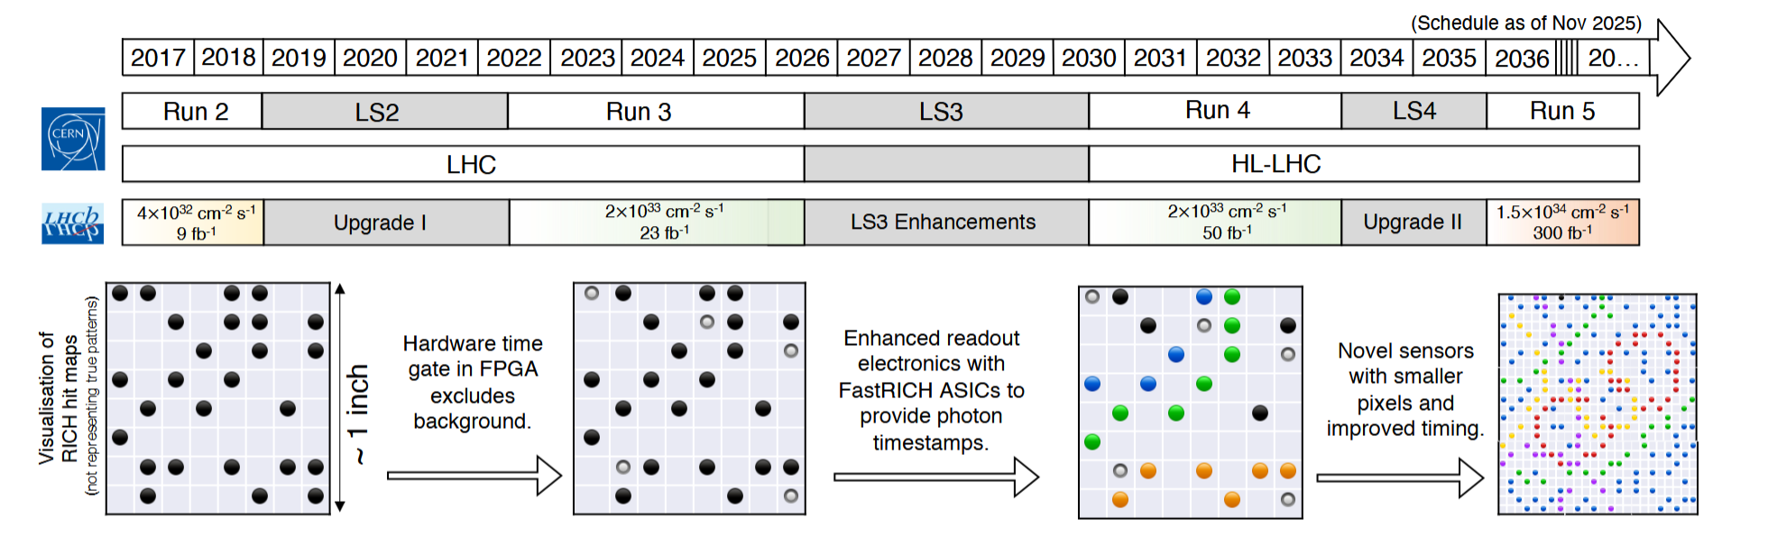
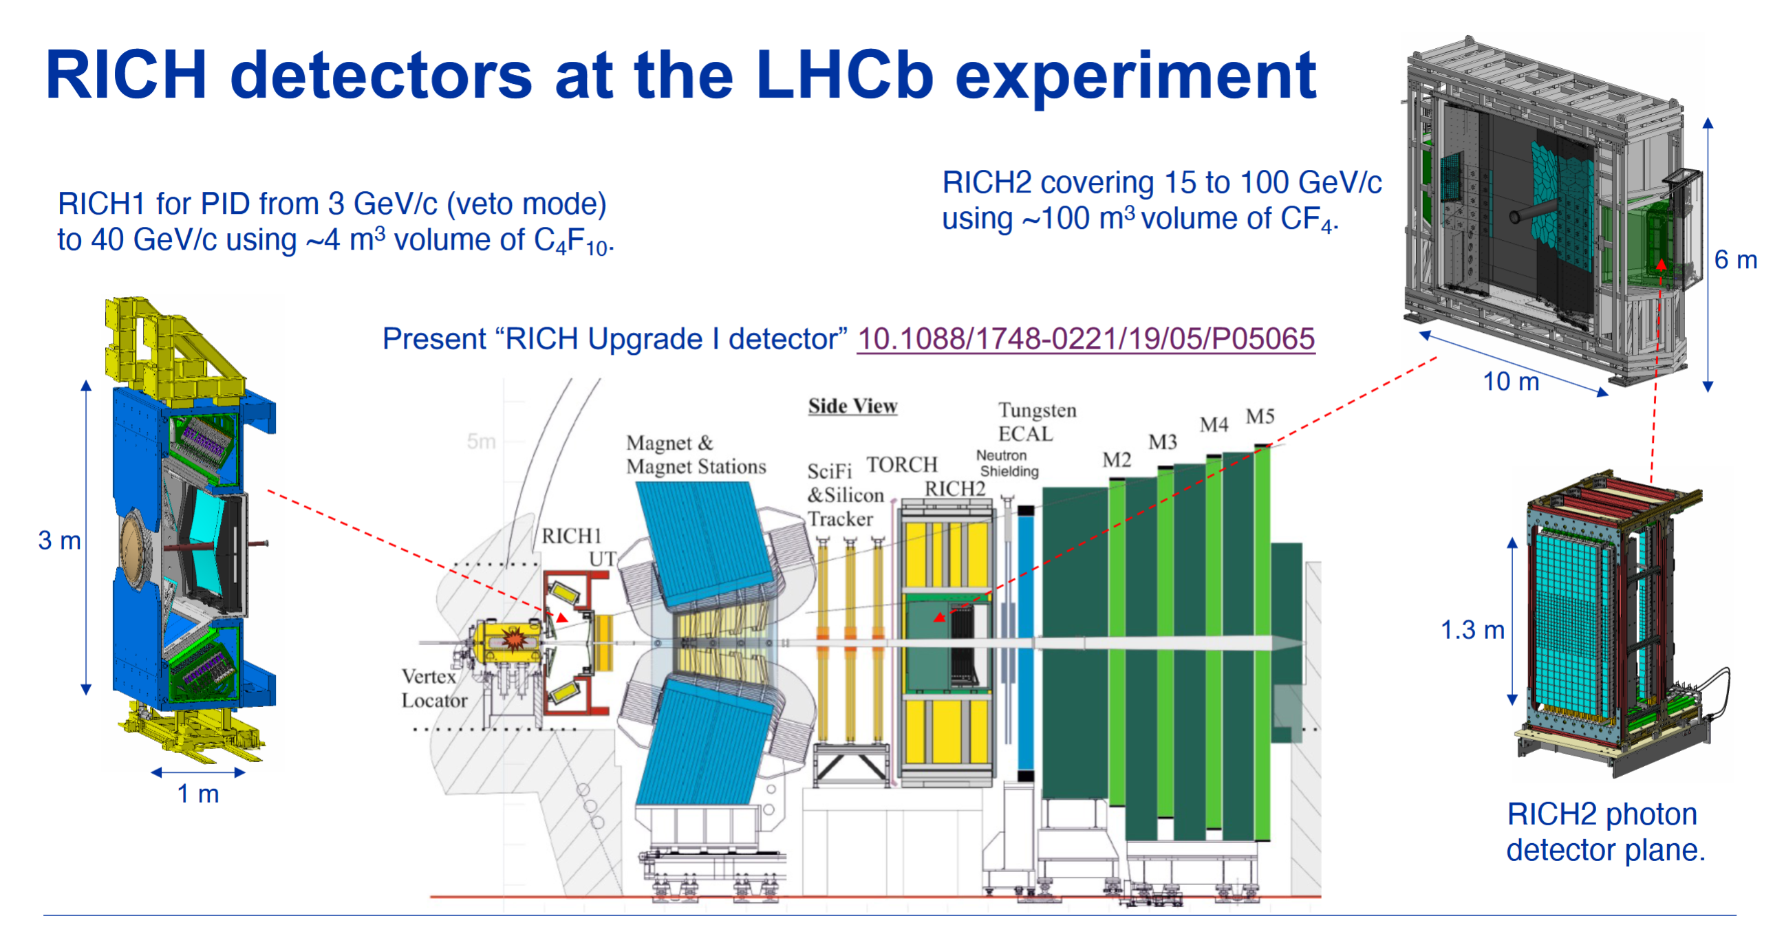
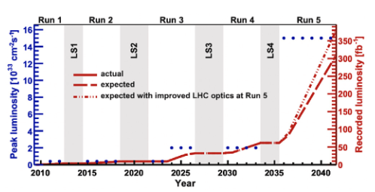


LHCb RICH upgrade
LINK: Floris Kaizer Talk
28.3.2026
Andrej.Seljak@ijs.si
Page 2

Slide 4
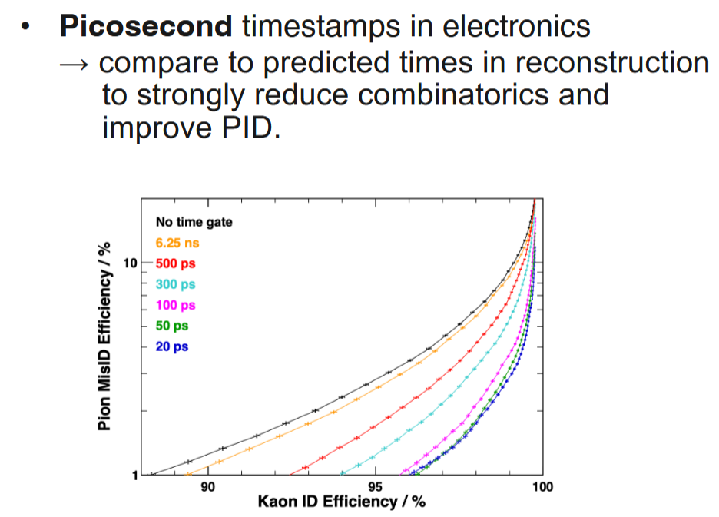
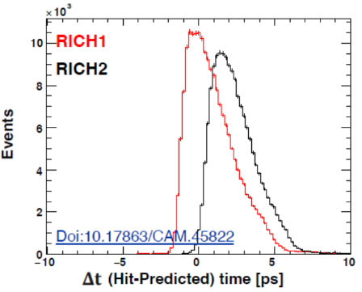
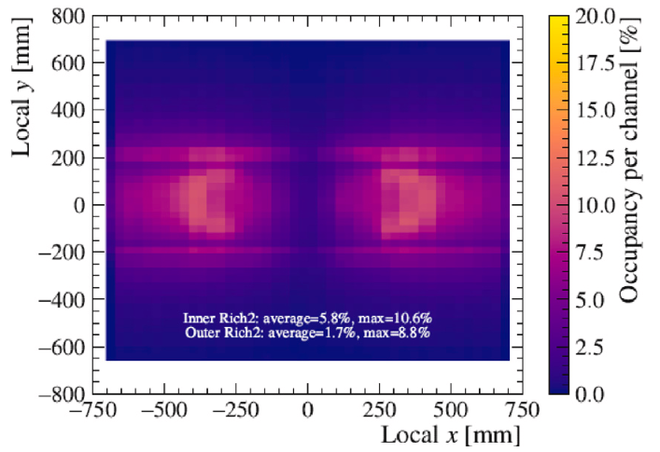
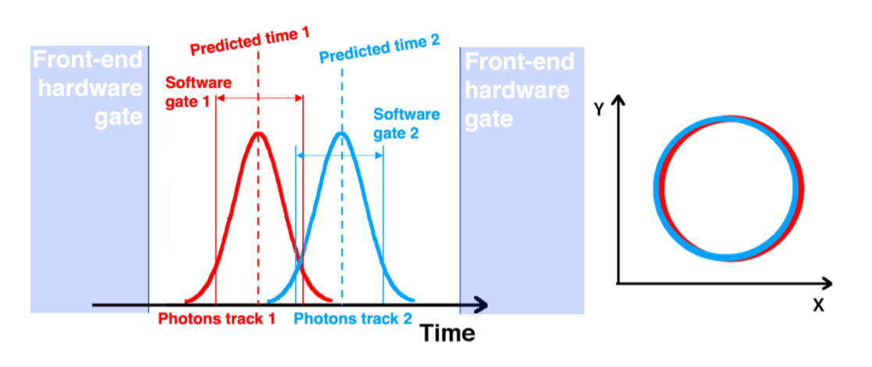
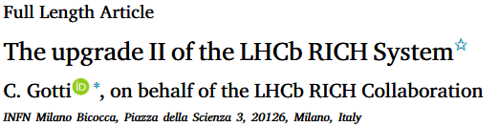
LHCb RICH upgrade
LINK: Floris Kaizer Talk
28.3.2026
Andrej.Seljak@ijs.si
Page 3

Slide 5
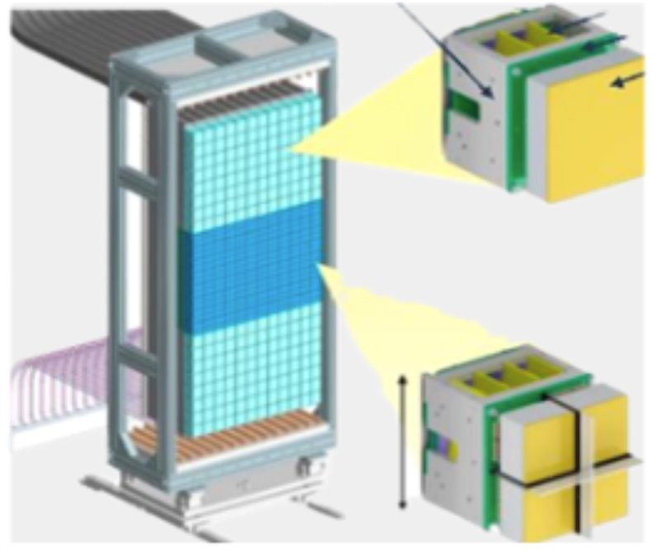
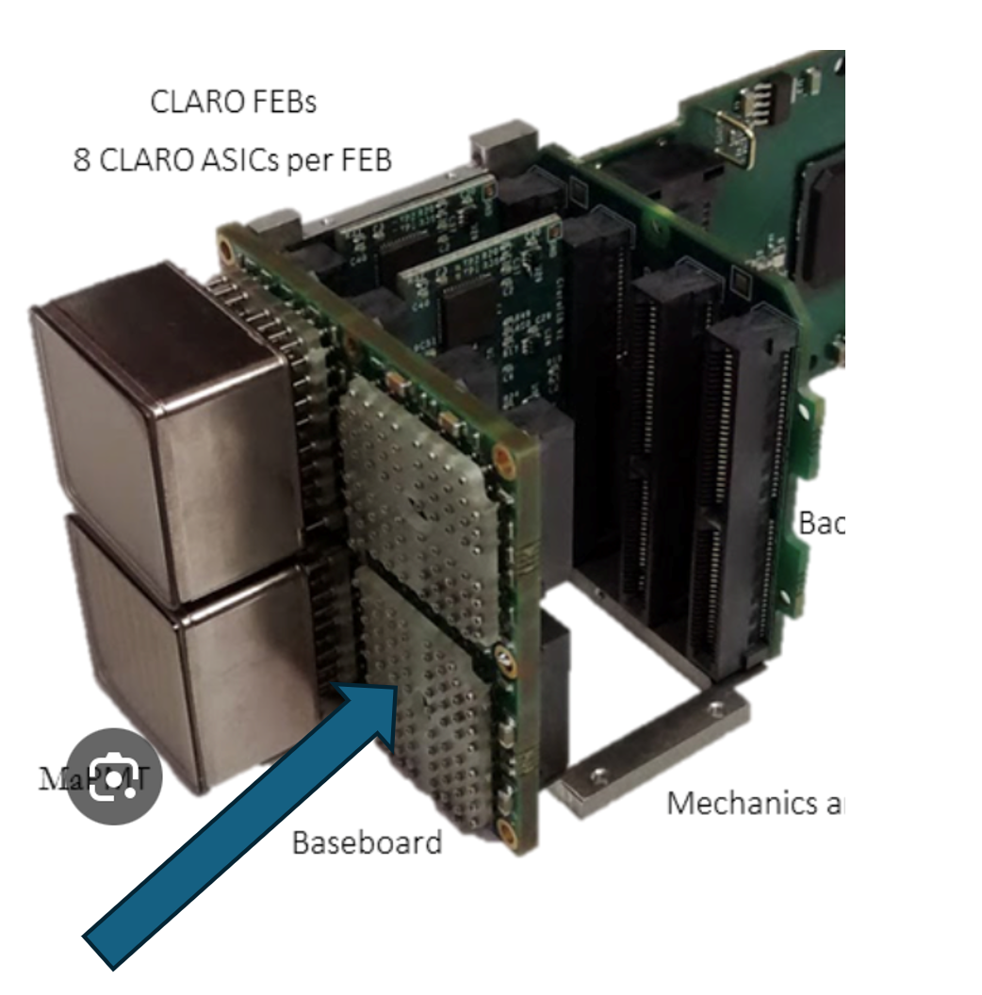
LHCb RICH upgrade
LINK: Floris Kaizer Talk
frame
frame
half resolution
full resolution
half resolution
Backboard
Elementrary cell (5x5 cm)
- 4 x 64ch MA PMT
Baseboard (BB)
Front end board (FEB)
Backboard
Carrier boards
Two frames, 12 columns each
(populated with elemtentary cells)
Each frame has: 2x12x8 (half resolution)
24576 channels
1x12x8 (full resolution)
24576 channels
Total: around 100k channels
Carrier
MaPMT
FEB
28.3.2026
Andrej.Seljak@ijs.si
Page 4

Slide 6
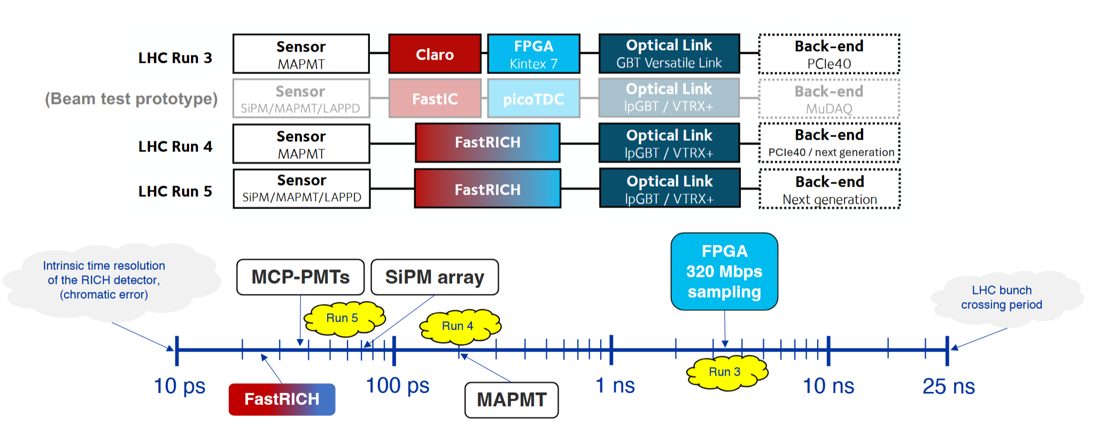
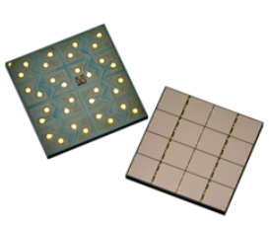
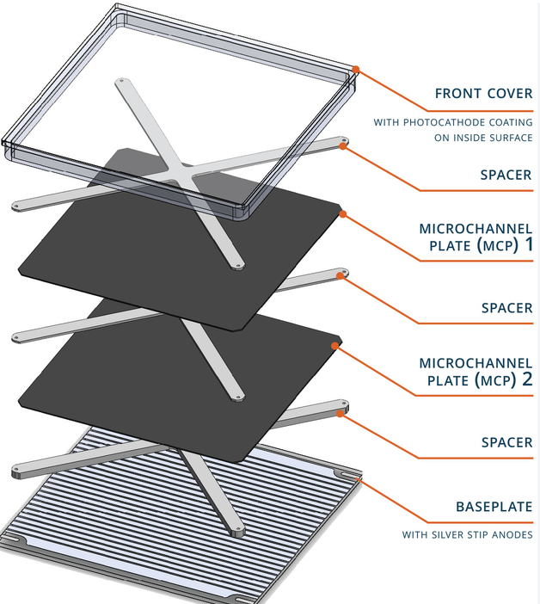
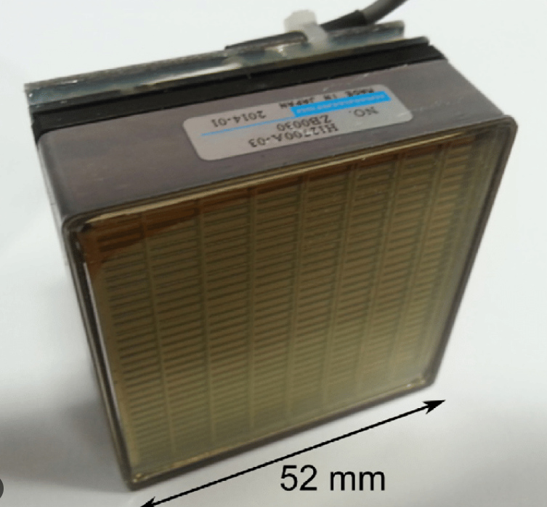
LHCb RICH upgrade
LINK: Floris Kaizer Talk
Photo detector candidates:
- Ma PMT : - No device with pixel smaller than 3mm pitch
- Signal sturation at high rates
- SiPM: - Small pixel – good for solving occupancy
- high hadron fluences damages the silicon lattice
- MCP PMT - Large area
- Requiers complex electronics to reach mm pixel
Ma PMT
SiPM
MCP PMT
28.3.2026
Andrej.Seljak@ijs.si
Page 5

Slide 7
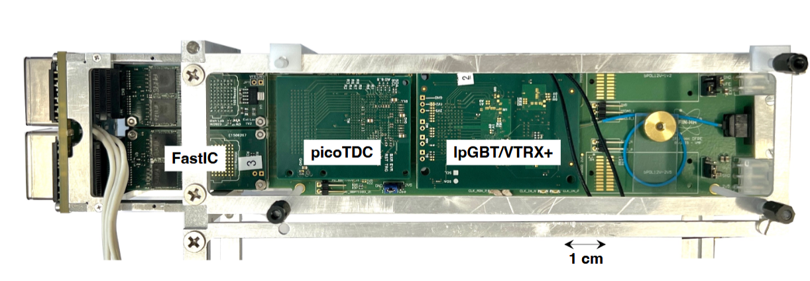
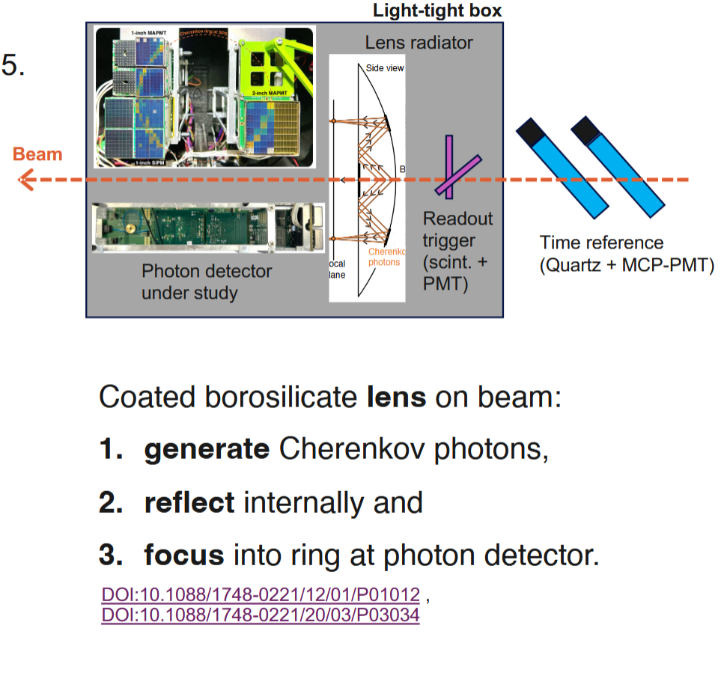
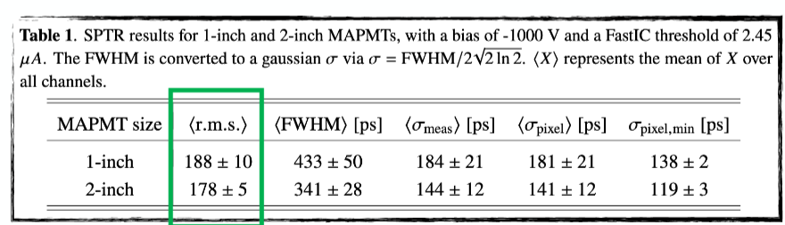
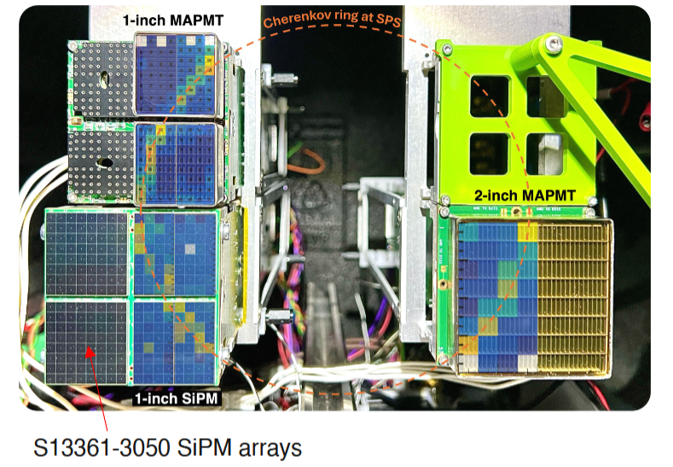
LINK: Floris Kaizer Talk
FASTIC based electronics
5x5 cm, 256 channels
28.3.2026
Andrej.Seljak@ijs.si
Page 6

Slide 8

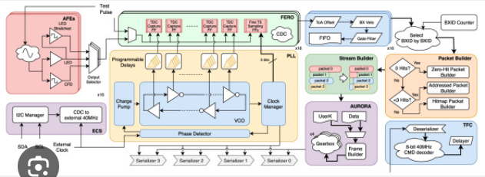
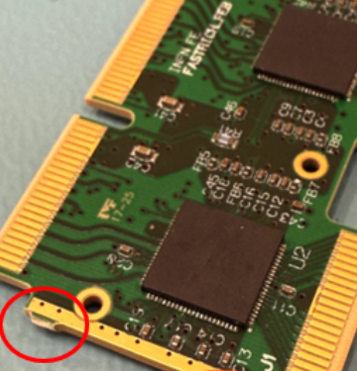
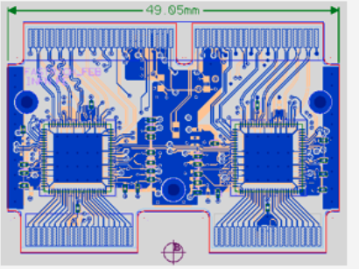
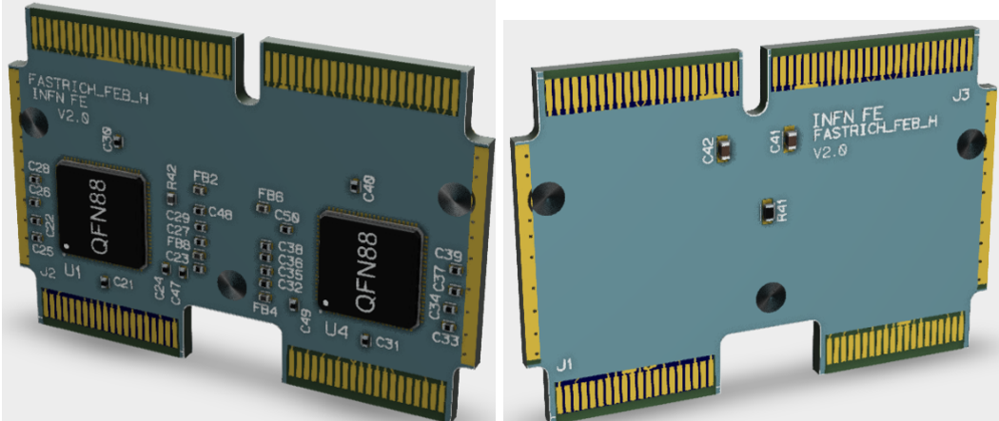
FASTRich based electronics
New FEBs:
FASTRICH ASIC, 65 nm CMOS QFN 88 package, 12mW/channel
(16 channel, Front End, TDC and event driven transmission)
Two versions:
Type R (1 inch MAPMT)
4 FASTRICH ASICs –64 channels/FEB
Type H (2 inch MAPMT)
2 FASTRICH ASIC - 32 channel FEB
28.3.2026
Andrej.Seljak@ijs.si
Page 7

Slide 9
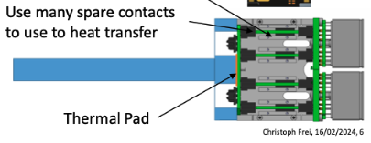
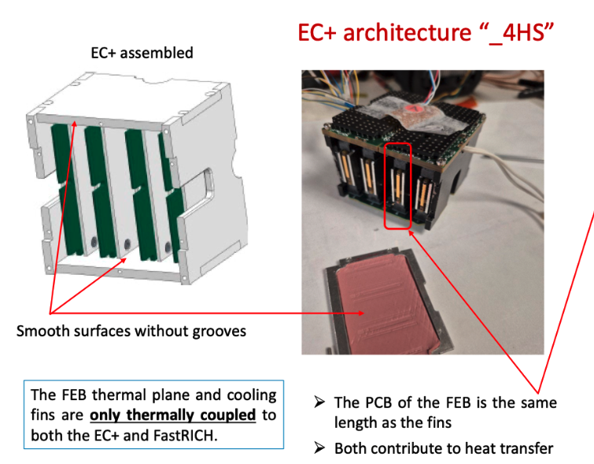
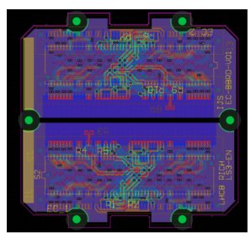
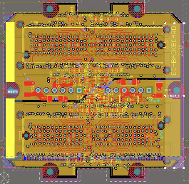
Electronics description
FASTRich based electronics
New Backboards
New design is improved respect the to the original CLARO backboard
We managed to obtain symmetricity (more clean and efficient routing, simpler system)
Two versions for H (in development) and R (tested)
Details in the following talks
28.3.2026
Andrej.Seljak@ijs.si
Page 8

Slide 10
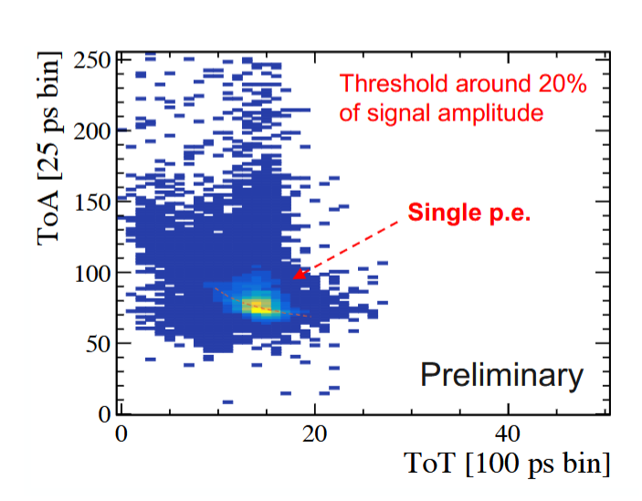
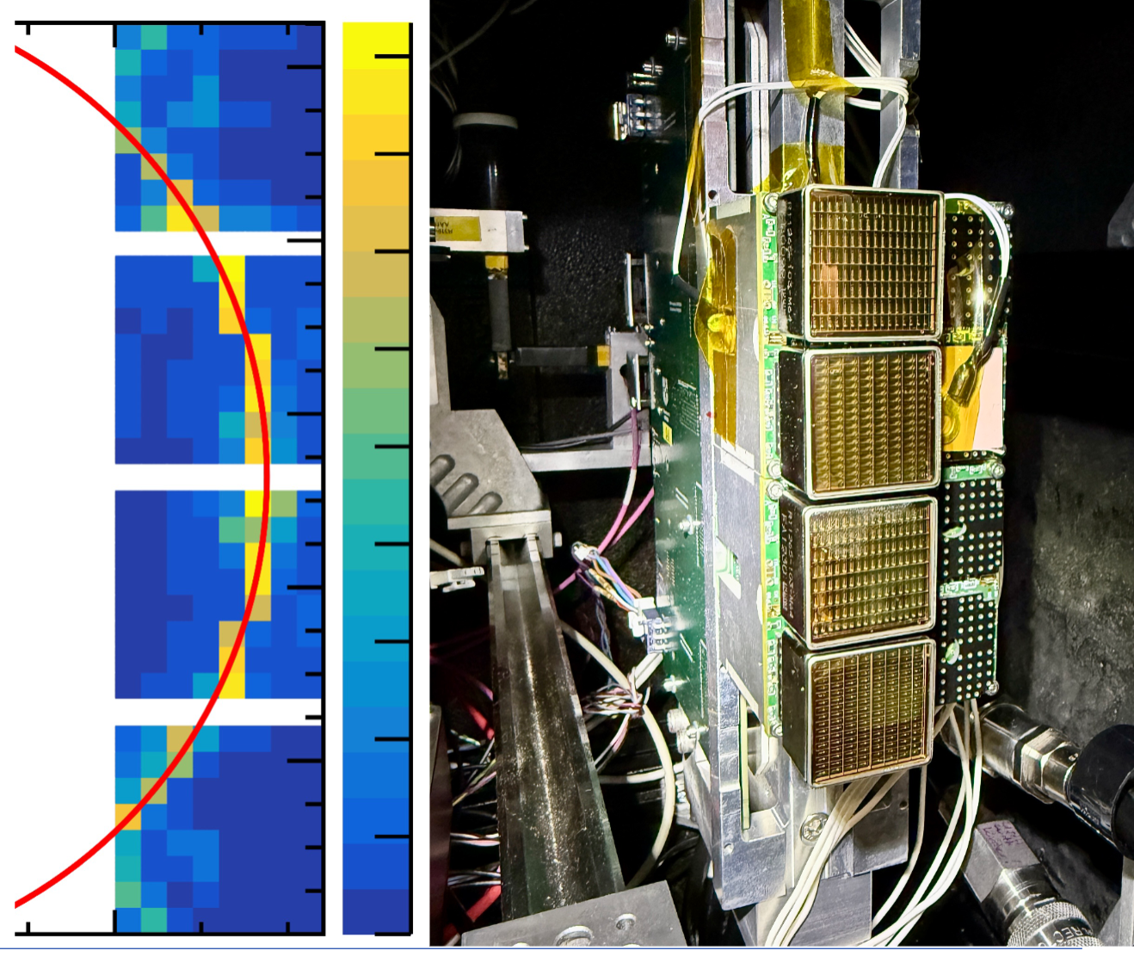
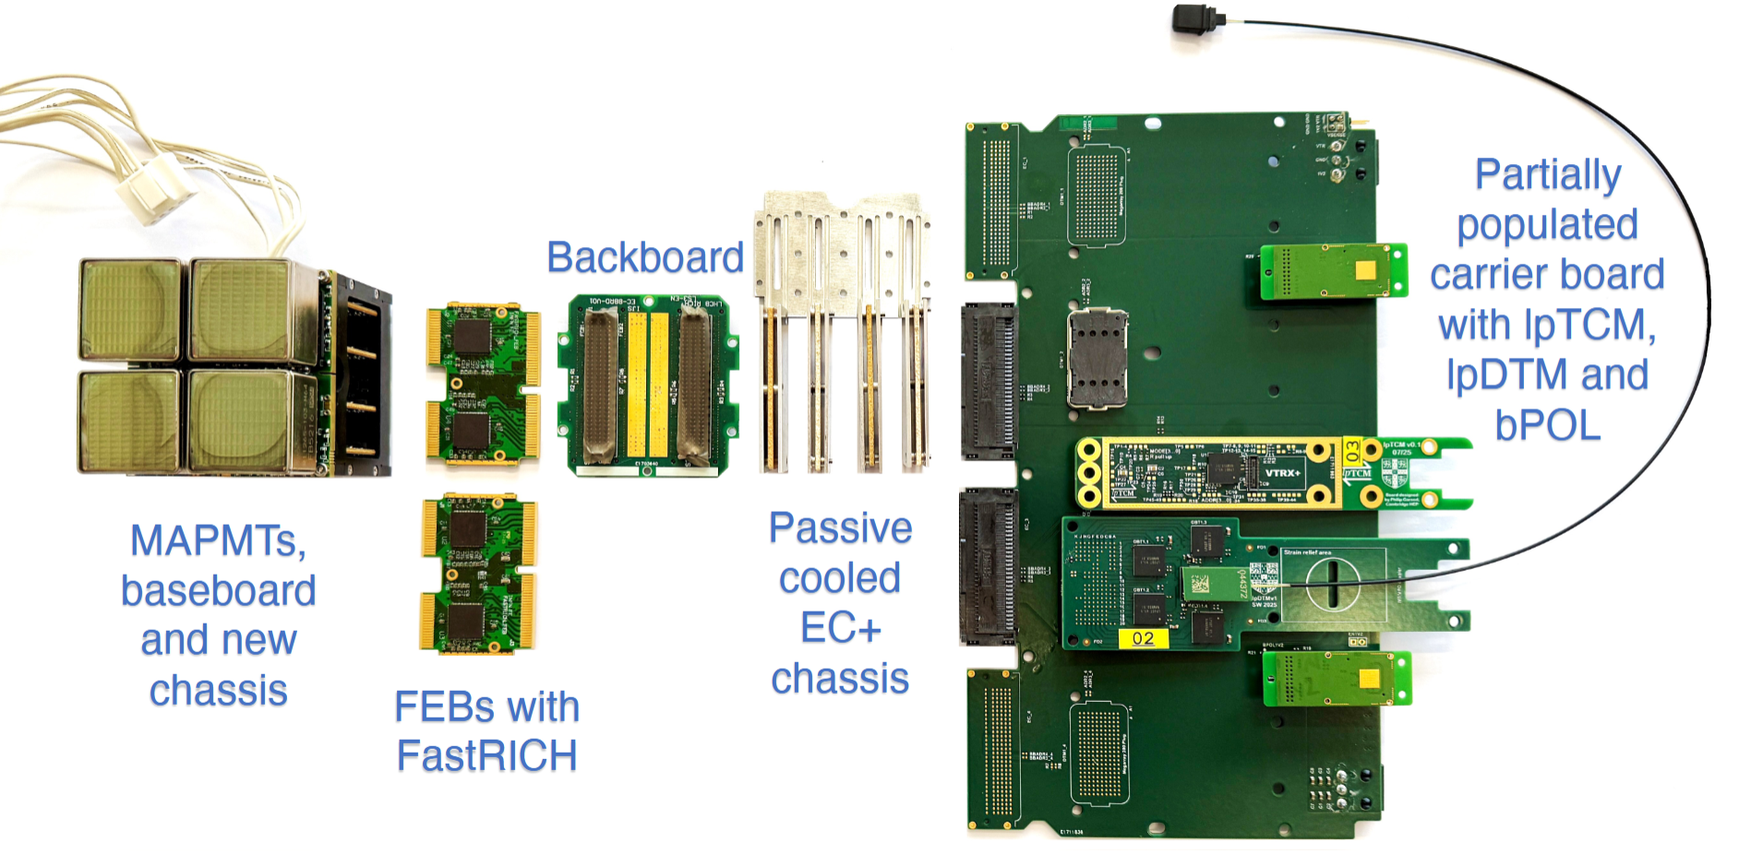
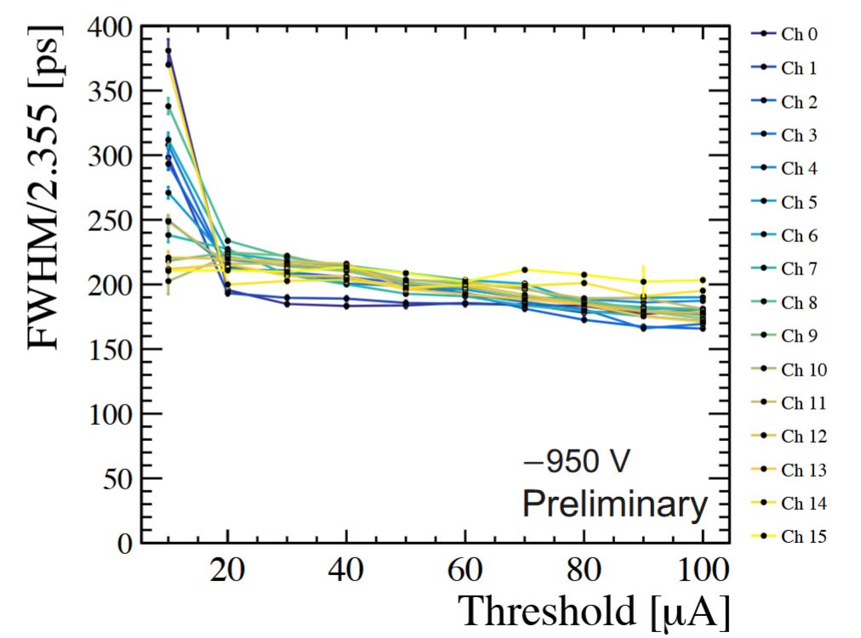
LINK: Floris Kaizer Talk
LHCb upgrade
28.3.2026
Andrej.Seljak@ijs.si
Page 9

Slide 11
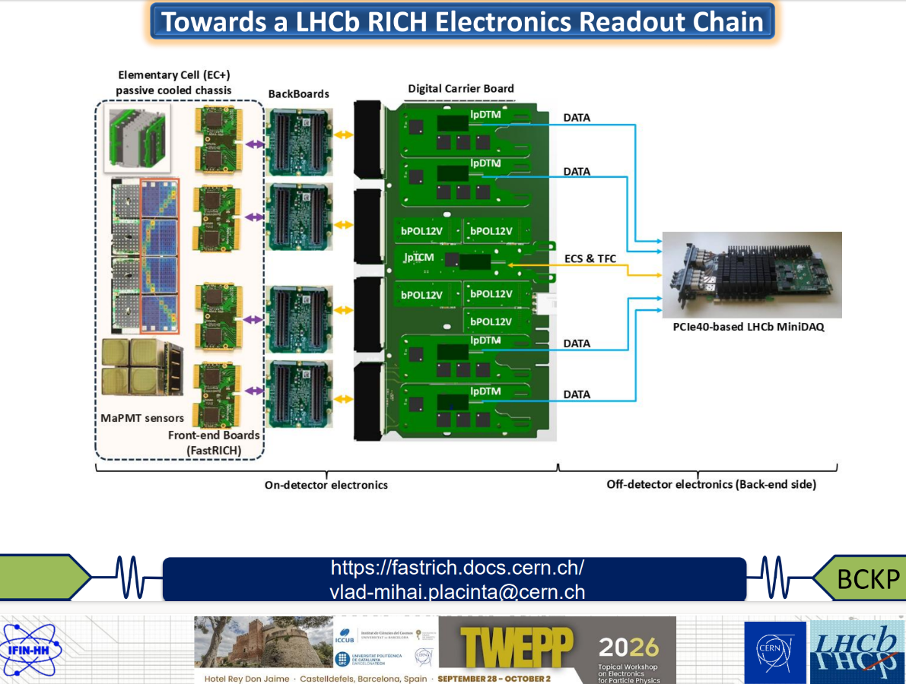
Vlad Mihai Placinta
LHCb upgrade
28.3.2026
Andrej.Seljak@ijs.si
Page 10

Slide 12
Outlook
Outlook of today’s Context and LHCb experiment upgrade:
FastRICH ASIC based electronics
Proven technology
Photodetectors
Mitigate SiPM radiation hardness isuess
LAPPD needs electronics development (new ASICs)
Prototypes and operation at the SPS beam tests
Promising results, development continues
Integration into frame is challenging
Future forecast:
This sytem will note work with pixel pitch below 3 mm, needed for high lumi.
Someting completly new needs to be tought for the future! Some ideas are emerging!
28.3.2026
Andrej.Seljak@ijs.si
Page 11

