Slide 1

DRD3: Overview of activities linked to JSI/F9
G. Kramberger for the colleagues involved in the DRD3 activities
Bojan Hiti, Alissa Howard, I. Mandić, Marko Puklavec, Ajda Osterman, Iskra Velkovska, Marko Zavrtanik
a special mention goes to our BSc. and MSc. students:
Bor Kokovnik
Urban Mernik
Matic Terglav
DRDs started with the “bible” document for detector RD in the next decades – F9 took a visible role in shaping of that document (for Solid State Detectors - DRD3 and Photon detection – DRD4)

Slide 2
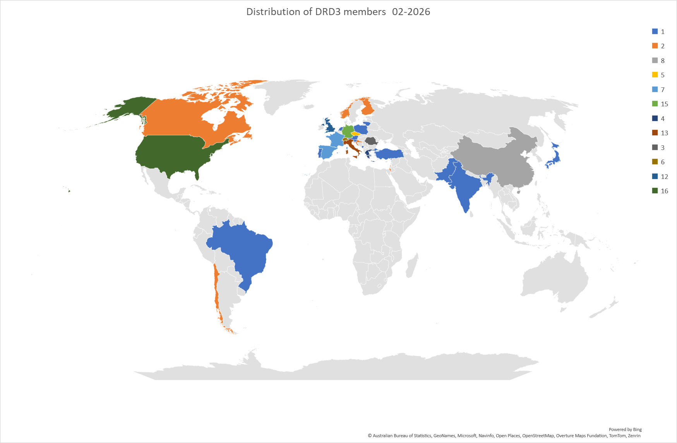
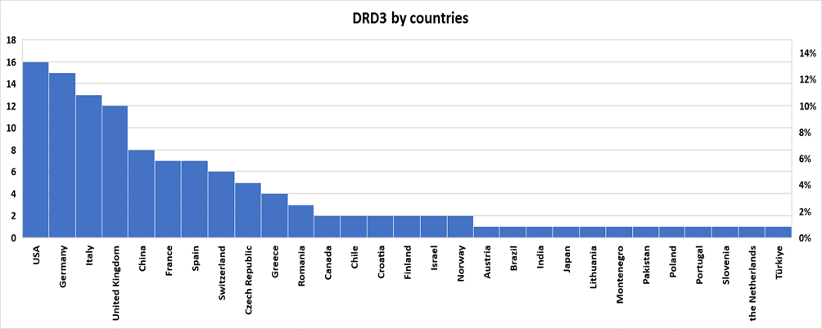
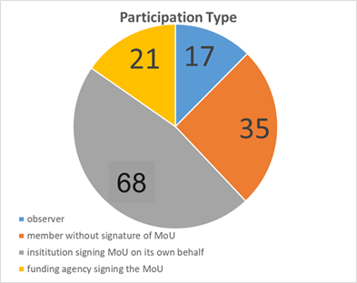
DRD3 Collaboration
124 institutions (+17 observers) / 700++ people in the community e-group
Status of Collaboration – timeline of past years:
12-2023 - provisional approval
01-2024 - formation of CB
03-2024 - election of SP
05-2024 - formation of WG-WPs
06-2024 - approval (scientific proposal)
06-2024 - first DRD3 week
07-2024 - start of scientific meetings
and preparation of
WP projects
10-2024 - approval of the DRD3 rules
12-2024 - second DRD3 week
01-2025 - finalization of WP projects
(adjustment to funding reality)
02-2025 - first DRDC review
06-2025 - third DRD3 week
approval of the first WP projects
10-2025 – Jamboree week
11-2025 - fourth DRD3 week
12-2025 - draft of MoU Annex sent to CERN
2-2026 - second DRDC review
5-2026 - rules on the formation of RB
6-2026 - fifth DRD3 week
Large interest from the community:
collaboration regularly receives requests for joining it
Large presence at DRD3 weeks (~250 people, ~80 contributions)

Slide 3
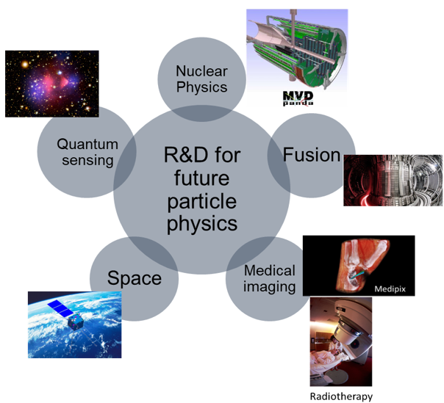
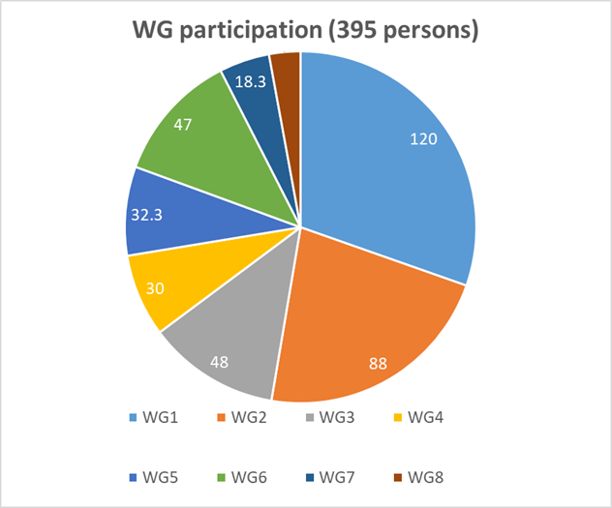
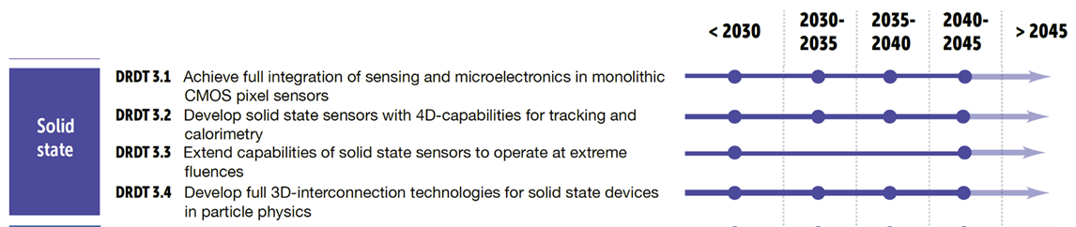
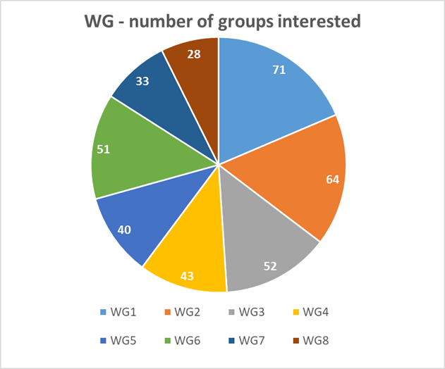
Our mission and organization
Working group (WG) - long term collaborative R&D activity linked to certain technology/purpose/application/method aiming to fulfil the research goals. This encompasses R&D that can be also outside DRDTs, but is related to semiconductor detectors, e.g.:
    R&D outside particle physics application with benefits for HEP
    novel semiconductor material characterization ideas
    technologies not yet listed in the DRDTs
Working package (WP) - short/midterm strategic R&D activity reflected in the ECFA detector roadmap document – DRD Themes. The research should not be related to a specific approved experiment.
Common Collaboration Fund – finance Blue-sky R&D, small projects, common hardware, common activities (e.g. organization of the schools, thesis awards, test-beam/laser-test/irradiation campaigns) – not meant for funding the labour.
WG1 – monolith
WG2 – hybrid
WG3 – silicon at extreme fluences
WG4 – simulations
WG5 – facilities and techniques
WG6 – WBS
WG7 – interconnections
WG8 – outreach

Slide 4
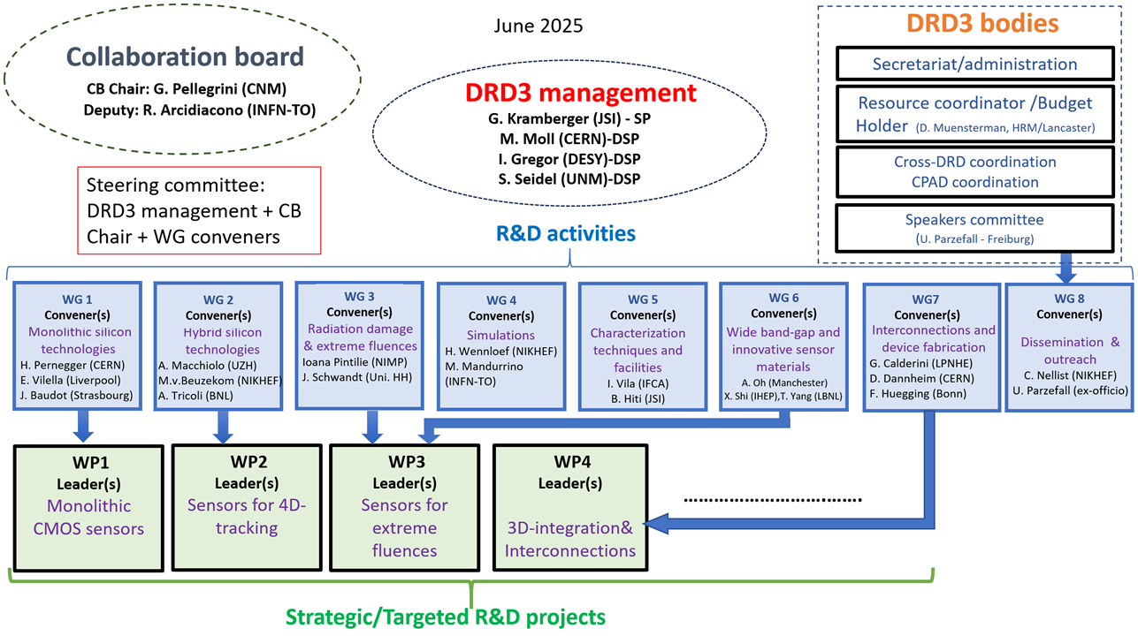
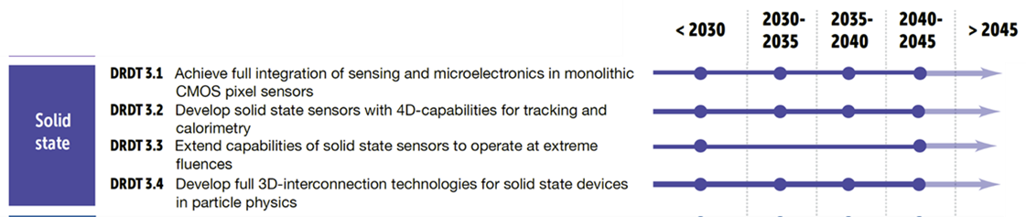
DRD3 – structure of the collaboration
September 2026
Resource Board is in formation.
We have also a role or Resource Coordinator to communicate with FA
WG conveners serve also as WP conveners
Each work package consist of several WP projects – all not yet fully resource loaded
Each work package project should address the themes from the road map document (one-to-one)

Slide 5
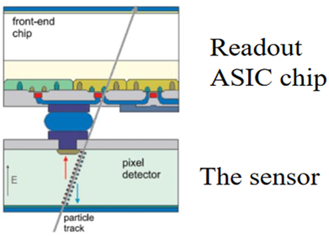
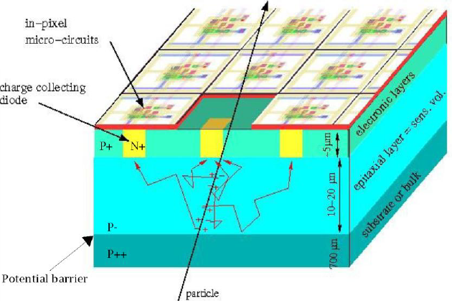
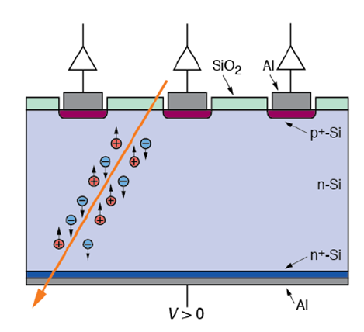
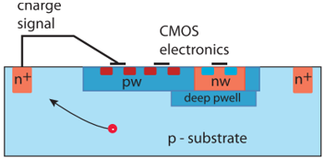
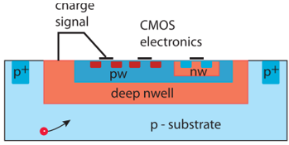
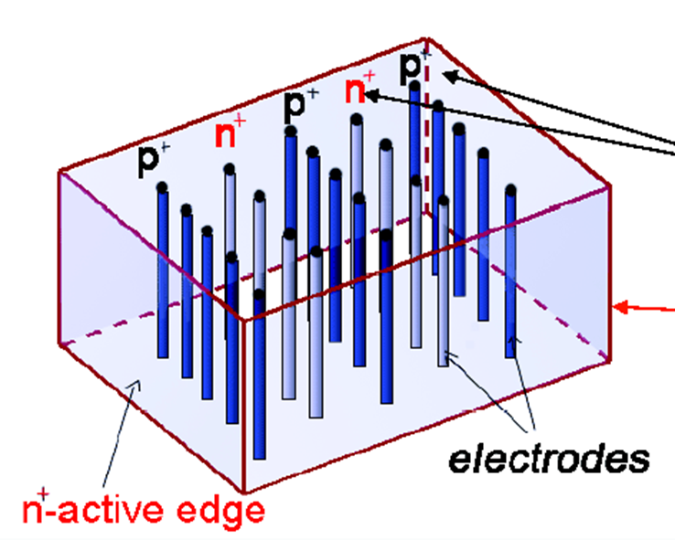
Paths of present silicon sensor R&D
F9 - involvement
Monolithic devices
( WG1/WP1-CMOS )
55-180 nm processes
Hybrid devices
(WG2/WP2-4D tracking)
Small electrode devices
Large electrode device
Planar
3D devices
large area passive devices
(strips)
MAPS
with Gain
(LGAD)
trench
3D
column 3D
with gain
DepletedMAPS
w/o gain
depleted MAPS
w/o gain
with gain
proof of concept ongoing
with Gain
optimized for power, material and position resolution
optimized for hit rates, radiation hardness and temporal resolution
recent research (working prototype)
proven/demonstrated

Slide 6
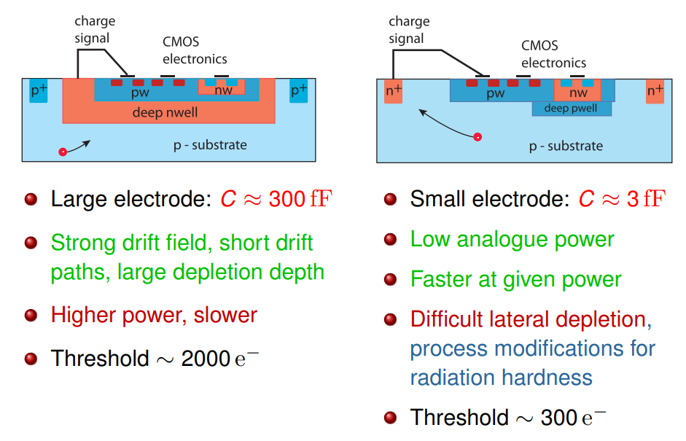
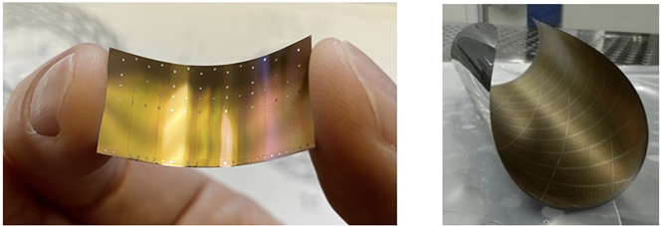
WG1/WP1 Monolithic silicon sensors
This is likely the long term direction that we need to start preparing for!
(on the sensing part and testing we are well set – Marko moves to ASICs readout)
MAPS for FCC-ee
Vertexing application:
  very high spatial resolution (≤3 µm) - pixels 15-25 μm²
  high data rate (~100 MHz/cm2)
  radiation tolerance (>10¹³ n_{eq}/y cm² NIEL , and <1 Mrad/y)
  low mass (0.05% X₀ inner layers ITS3 like, to 0.2-0.3% X₀ staves at outer layers)
  good timing/time stamping (~20 ns – power consumption driven)
  small power (<40 mW/cm²)
Tracking application:
  high spatial resolution (~5-7 µm in r-phi) - elongated pixels
  data rate (~100 kHz/cm2)
  radiation tolerance – negligible (>10¹⁰ n_{eq}/y cm² NIEL , and <4 krad/y)
  Material budget (~1% X₀)
  good timing/time stamping (>100 ns)
  small power (~<150 mW/cm²)
Calorimetry
  are present standard planar technologies good enough?
Constraints:
  process : CiS or HVCMOS inherently linked to small and large electrode designs
  enough epi-thickness (CiS) and application of hi-res wafers (HVCMOS)?
  stitching option for vertex detectors
  enough wells and metal layers for complex processing
TWO approaches
LARGE ELECTRODE DESIGN
SMALL ELECTRODE DESIGN
taken from N. Wermes

Slide 7
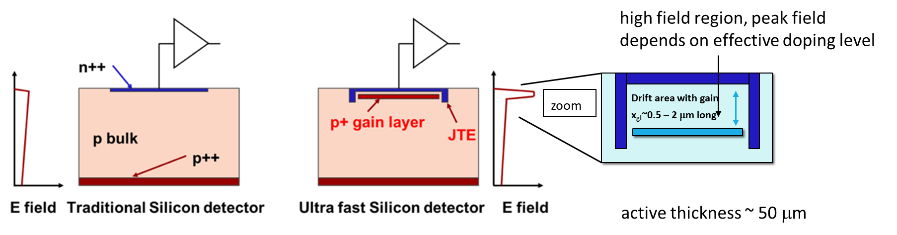
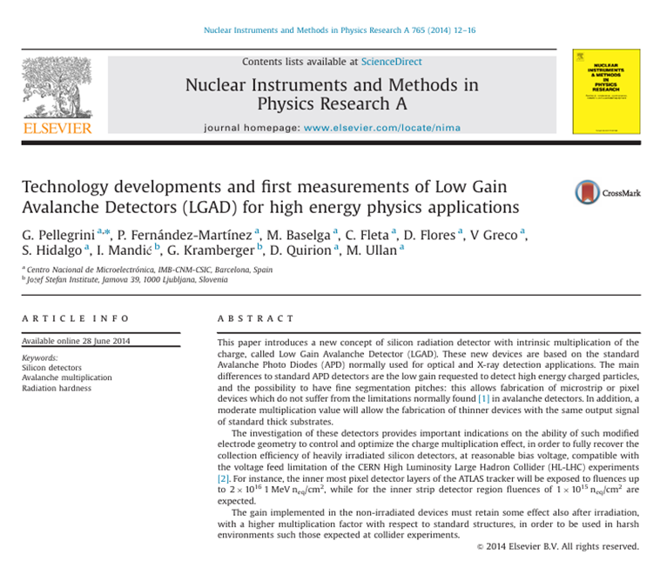
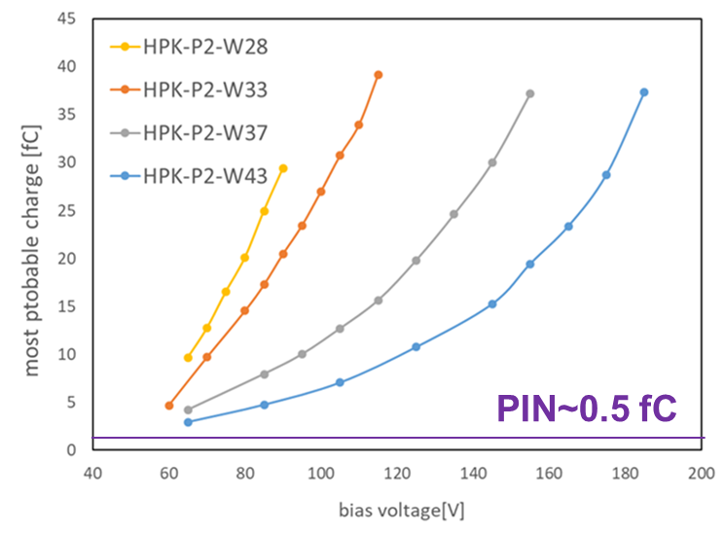
WG2/WP2: Hybrid silicon technologies and 4D tracking - LGAD
LGAD are planar technology that can provide superb temporal and position resolution.
Typically 20-55 μm thick with signals of 20fC (G~40)
Limitations for conventional LGADs:
Fill factor (large cell devices) due to JTE
Radiation harness – currently to ~3e15 cm⁻²
Future R&D is all about the precision in 4D (~10 μm, <30 ps):
small pitch or resistive sharing for lower hit rates environments
timing resolution with small power consumption. In planar technology fast/thin detectors with gain to reduce electronics jitter, landau fluctuations and ToA contribution (weighting field)
Examples
We were among proposers of the LGADs

Slide 8
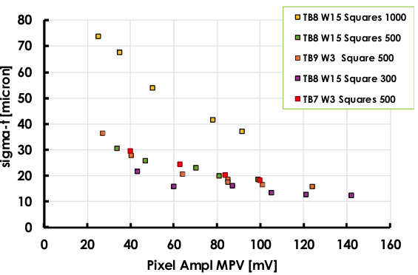
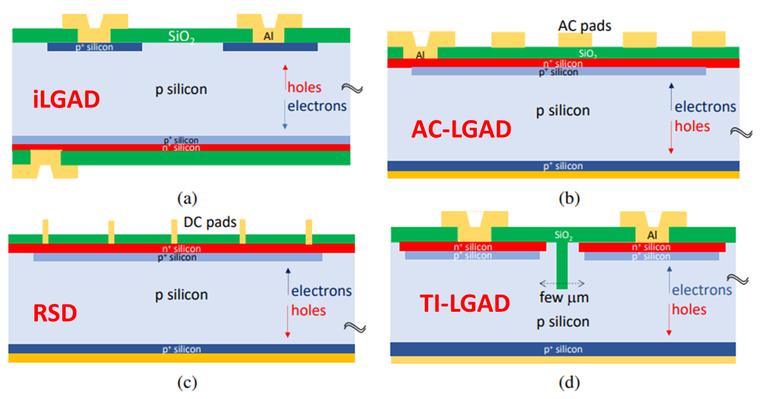
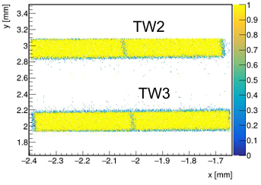
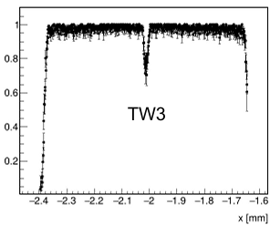
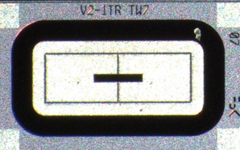
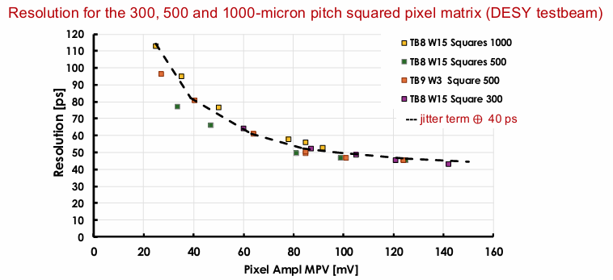
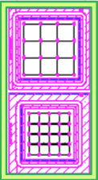
WG2/WP2: 4D tracking – LGADs
(FCC-ee, HL-LHC Run5 upgrades, EiC, …)
Radiation hardness (highly active field of research) is almost 2 orders of magnitude lower for FCC-ee applications. No special treatment of gain layers (carbon enrichment) is needed.
Fill factor
  relatively low rates at larger radii allow for Resistive Silicon Detector approach
  (AC-LGAD, DC-LGAD)
  possible use of iLGAD – collection of holes is not a problem
  TI-LGAD designs (high rate & small pitch devices)
Novel algorithms to exploit ML/AI to reconstruct position/hit time
Production of LGADs has been transferred to CMOS foundries – integration of electronics may be feasible
4D tracking may be sacrificed for lower power consumption
Our group involved in two WP2 projects on LGADs (Marko/Ajda –AC-LGAD and Iskra TI-LGAD)
4% of the pitch
A small pitch LGAD with close to 100% fill factor for high rate environments.
FBK TI-LGADs
(AIDAINNOVA design)
RSD – FBK
Test Beam
INFN -TO
RSD – FBK
Test Beam

Slide 9
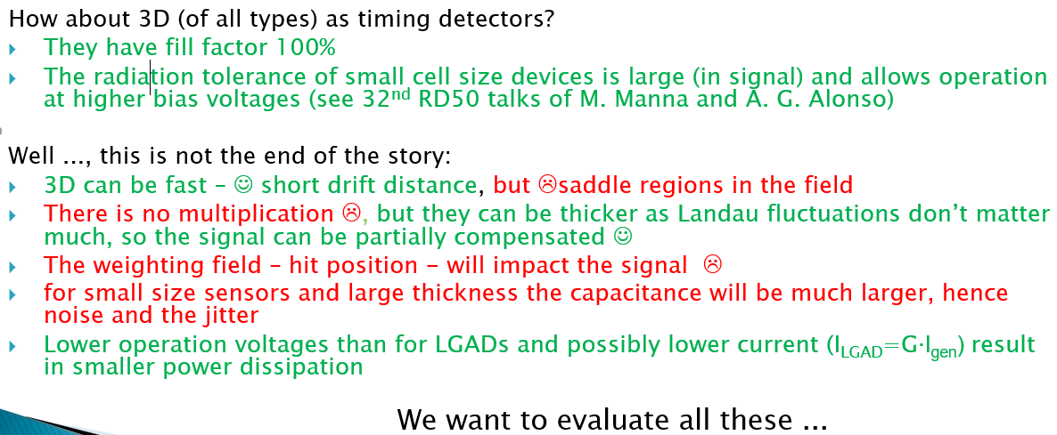
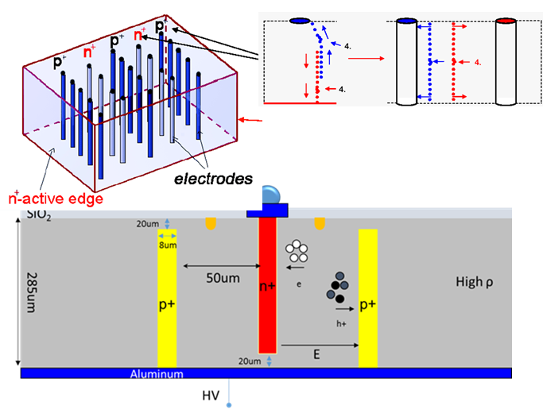
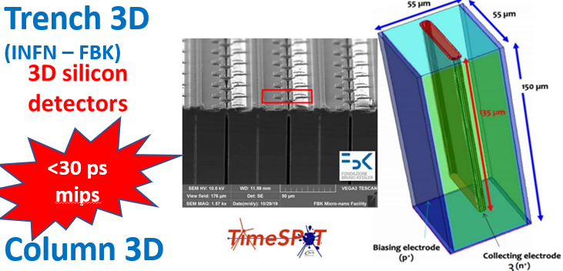
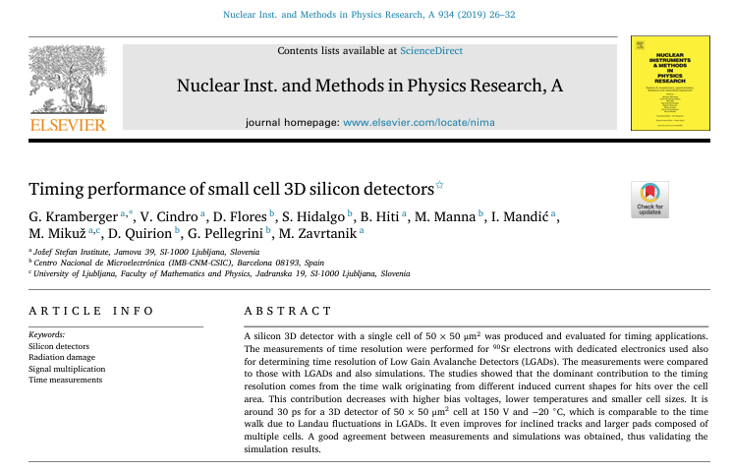
WG2/WP2: 3D sensor technologies with gain
(LHCB-Velo upgrade, FCC-hh, …)
2018-RD50 workshop

Slide 10
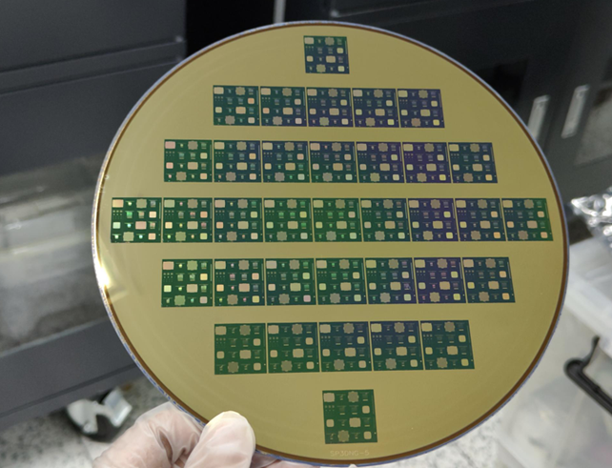
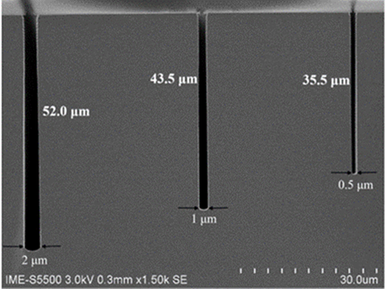
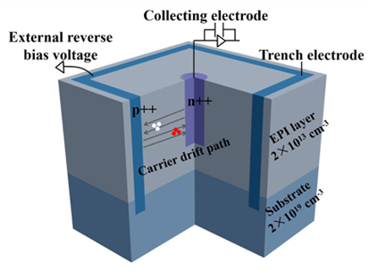
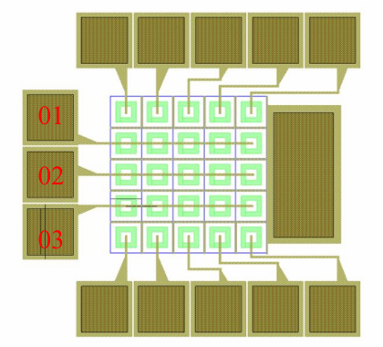
3D sensors with gain – new advances
During the ECFA detector roadmap document preparation:
“Improvements of aspect ratio to 100:1 would lead to manufacturing of very narrow columns <1 μm with thicknesses of ~100 μm which could lead to electric fields high enough (~30 V/μm) for multiplication”
IME 8” CMOS process
30-35 μm thick epi on thick substrate
n⁺ columns on p type bulk
N_{eff}=2∙10¹³ cm⁻³
ASPECT RATIO OF 100:1
DRD3 WP2 project
“Novel silicon 3D-trench pixel detectors based on 8-inch CMOS process”
(Marko and Ajda are involved)

Slide 11
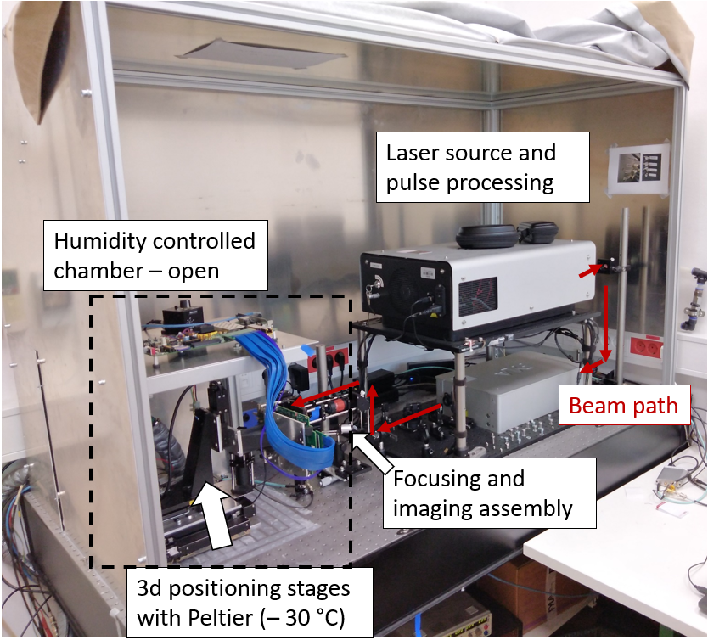
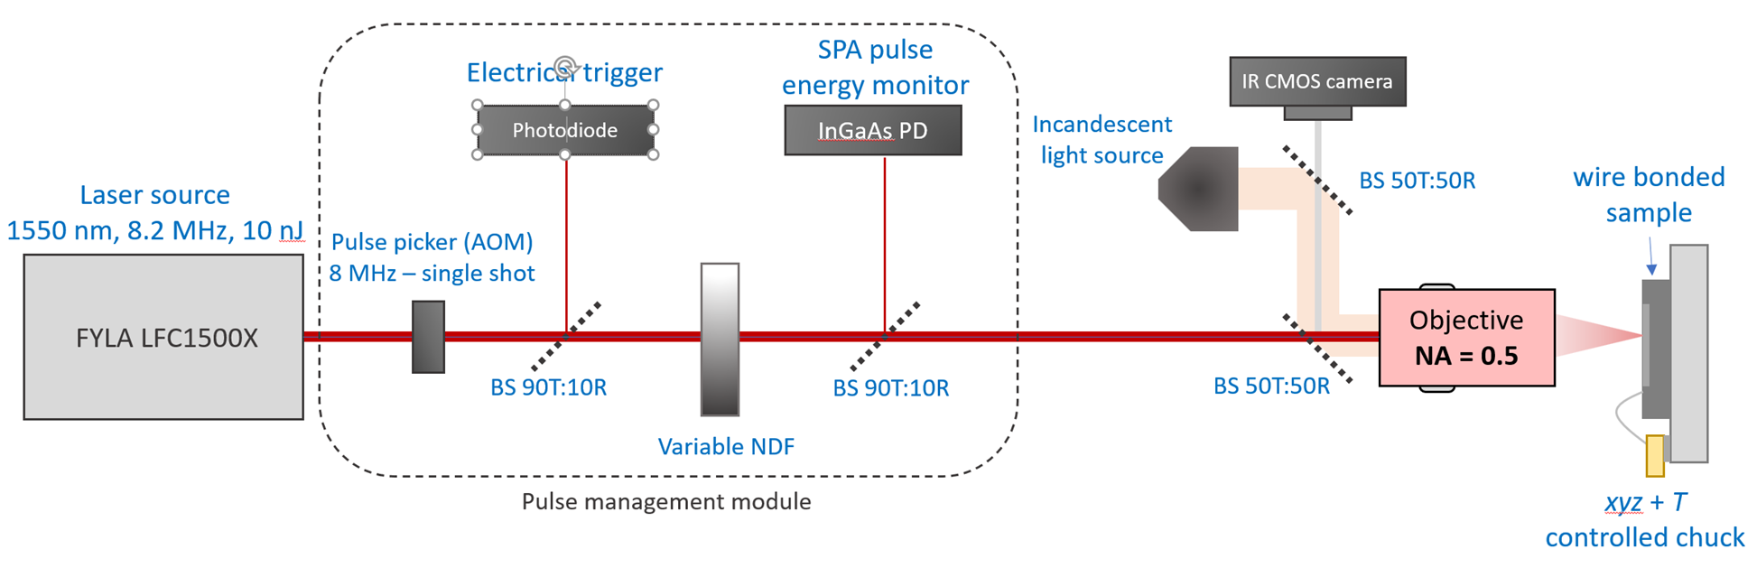
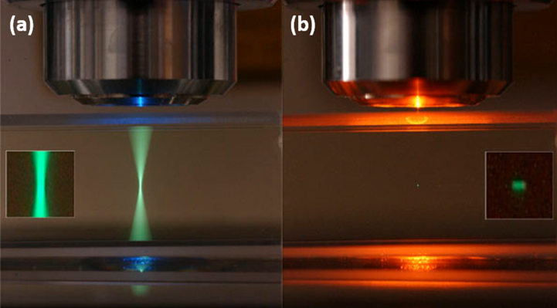
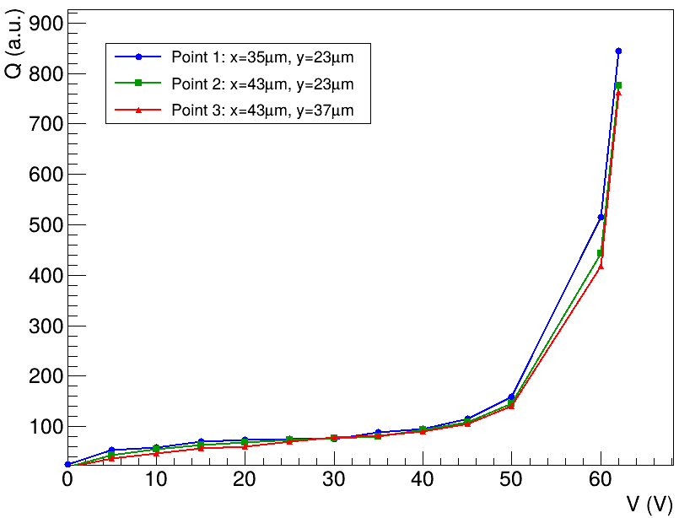
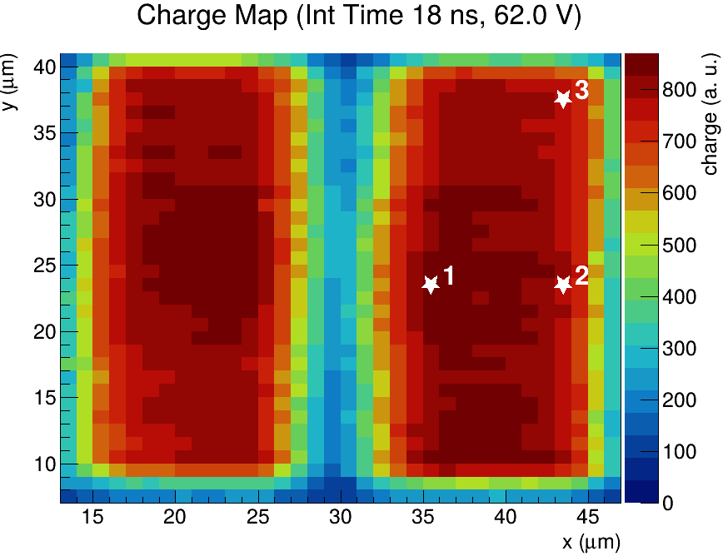
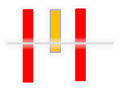
3D sensors with gain – F9/TPA
JSI TPA setup
(Marko Z. & Bojan’s development)
gain region
fully depleted wo gain
z=17 μm
depletion
accepted to IEEE TNS

Slide 12
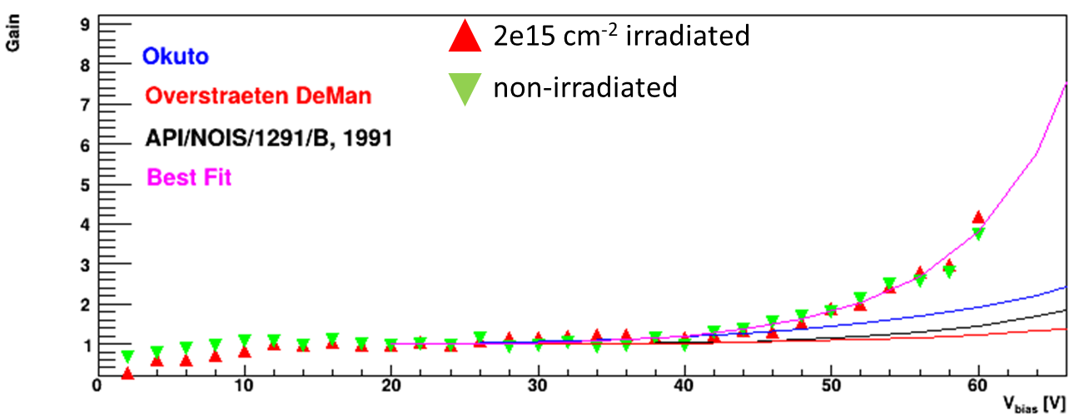
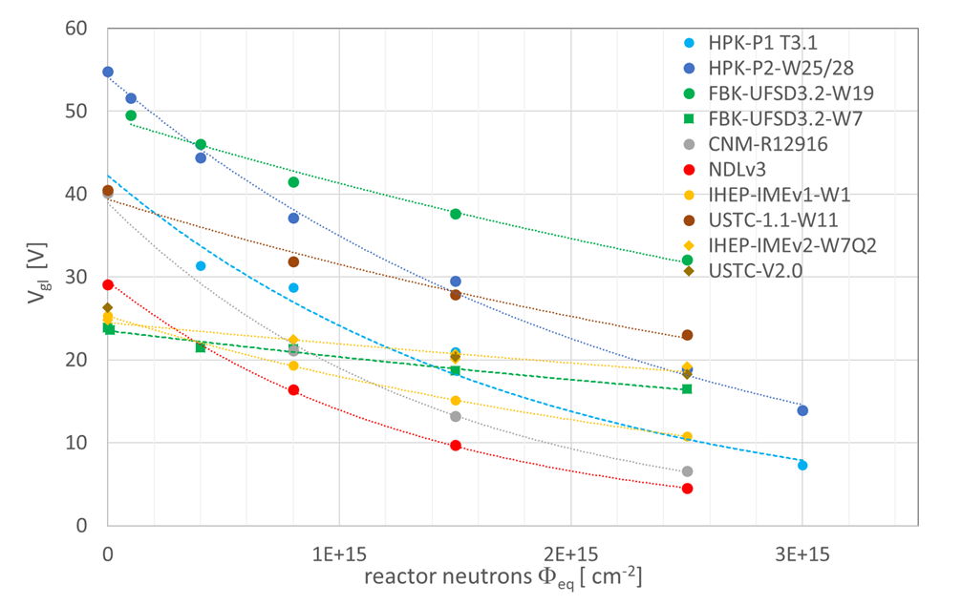
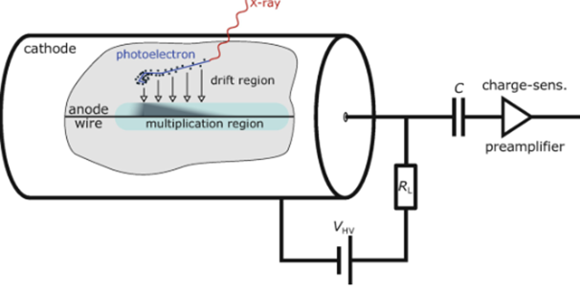
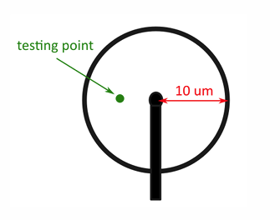
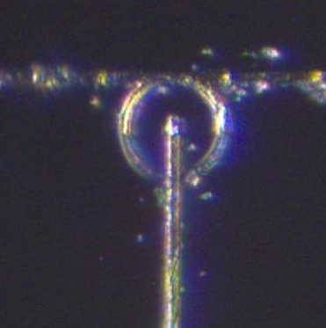
WG3&WG6 – defects and extreme fluences
Our group is very active in radiation damage studies and extreme fluences
  impact ionization and mobility measurements up to FCC-hh levels (Ajda’s thesis, Marko’s thesis)
  initial dopant removal – mainly acceptors (Alissa’s – just defended and Iskra’s thesis)
    long term and high temperature annealing studies (Ajda’s thesis)
    compensated LGADs – parametrization
    partially activated boron (Iskra’s thesis)
We are active in WBS semiconductors (GaN/SiC projects) – mainly for irradiations and materials (Igor)
C B
Alissa's thesis
B still activate
B deactivated

Slide 13
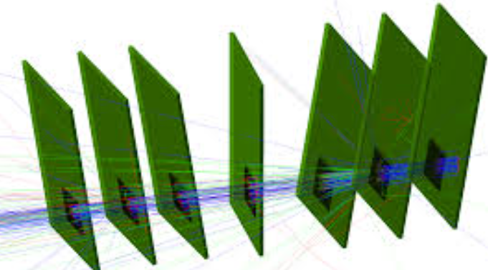
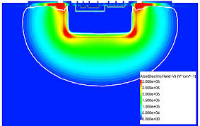
WG4 – simulations
At some point we will have to touch TCAD
Plans to have software suits as ISF-I center
“Monte Carlo”
(predicting the performance of complex detector assemblies)
GEANT4
TCAD
(understanding the sensors)
AllPix2 / Garfield++ as the main tool
complement by other ones (KDetSim, WF2)
Synopsis, Silvaco …
GOALS:
Developing and verification of damage models (effective and defect based)
Establish how to benchmark/evaluate the models against the measured properties (important milestone)
Improving the TCAD with new findings (WBS, extreme fluences)
Develop a flexible framework to simulate performance of different processes (CMOS)
GOALS:
Implementation of improved semiconductor models (e.g. mobility, impact ionization, trapping …)
Adaptation of WBS sensors
Adaptation of dynamic /adaptive E,E_{w}
Implementation of common electronics/digitization
E,E_{w}
KDetSim used in most of our simulations!

Slide 14
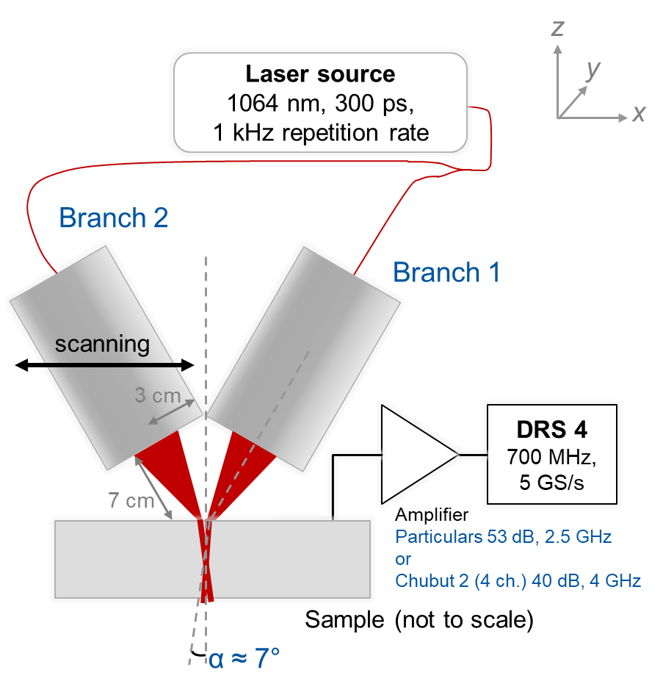
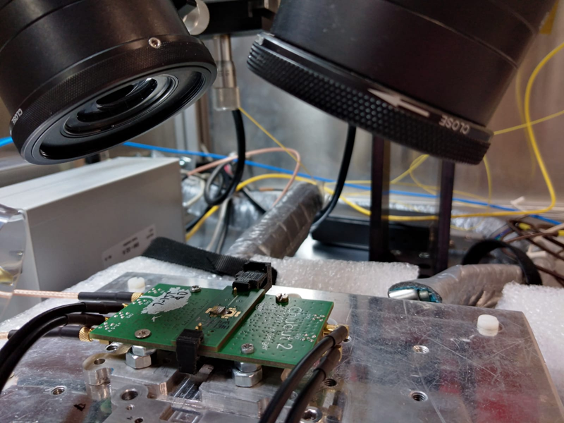


WG5 – techniques and facilities
Example: development of new techniques for AC-LGADs where double-pulse/rate capabilities can be fully tested DB-TCT (double beam TCT) – positioning beams to micron precision with tuneable delays
New scanning ⁹⁰Sr timing setup (Marko P.’s thesis in the scope of DRD3/HGTD developments)
Irradiation facility – still and will remain to be the reference in HEP (Igor is the main force behind e.g. organization of extreme fluence campaigns 1e18 cm⁻²)

Slide 15





WG8 – Outreach
1st TCT school at CERN
2nd TCT school
CERN
Organization of the DRD3 TCT schools (schools are heavily oversubscribed)
Bojan is the key person – already 3rd edition)
Particulars (JSI-F9 spin out company) provides two measurement setups

Slide 16
Conclusions
DRDs are general R&D frameworks therefore it is our mission to bring the technological readiness of a certain technology to the point where approved experiments can take it and tailor it to the specifics of the project.
F9 is a very visible member of the collaboration with currently 3 theses in preparations (Iskra, Marko and Ajda):
  We take part in total of 3 WP2 projects (AC-LGADs, TI-LGADs, 3D with gain)
  We take part in 1 WP3 project (radiation damage of LGADs)
  We take part in 2 WP3/WG6 projects (GaN and SiC – mainly irradiations)
  We are very active in WG5 convened by Bojan (TBs, new setups)
  We take part in WG8 program (TCT school)
Very near future R&D (HGTD replacements)
  TI-LGADs (improvement of fill factor)
Near future oriented R&D (FCC-ee):
  Our involvement in MAPS is the next important decision (hardware infrastructure is being built, TCAD tools, …) in the first stage mainly in testing and concentrating to sensor-element. FCC-ee is the main driver for Vertex and Tracker detectors with MAPS
  AC-LGADs is the hybrid choice for ToF tracker/wrapper for some detector concepts (e.g. IDEA)
Long term and blue sky R&D (FCC-hh, ….)
  3D with gain
  Extreme Radiation Hardness – Wide-Band-Gap semiconductors
Developments outside HEP – military, medical, fusion

