Slide 1
ATLAS HGTD
Bojan Hiti
for HGTD F9 (Gregor, Bojan, Jernej, Iskra, Marko P., Brigita, Ajda)
F9 Strategic meeting, Krvavec, 28 September 2026

Slide 2
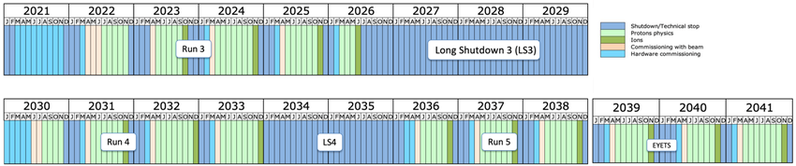
LHC Long term schedule
Long Shutdown 3 (2026-29) :
High Luminosity LHC upgrade
Long Shutdown 4 (2034-36)
Opportunity for detector replacements

Slide 3
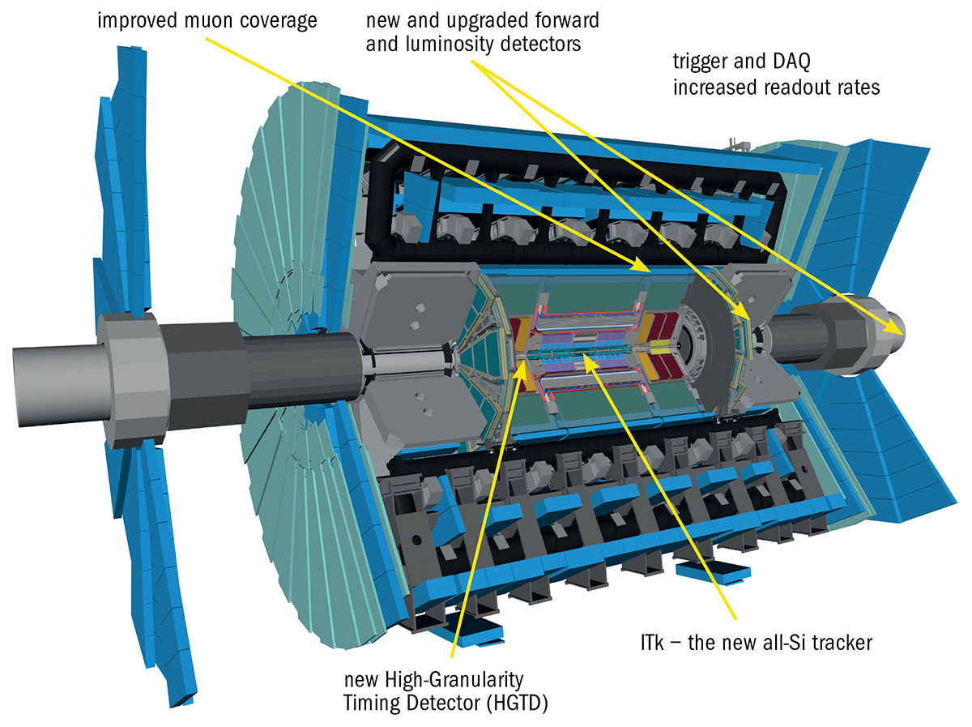
ATLAS phase 2 upgrade

Slide 4
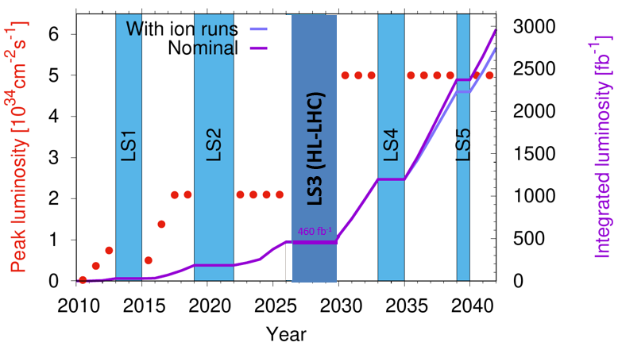
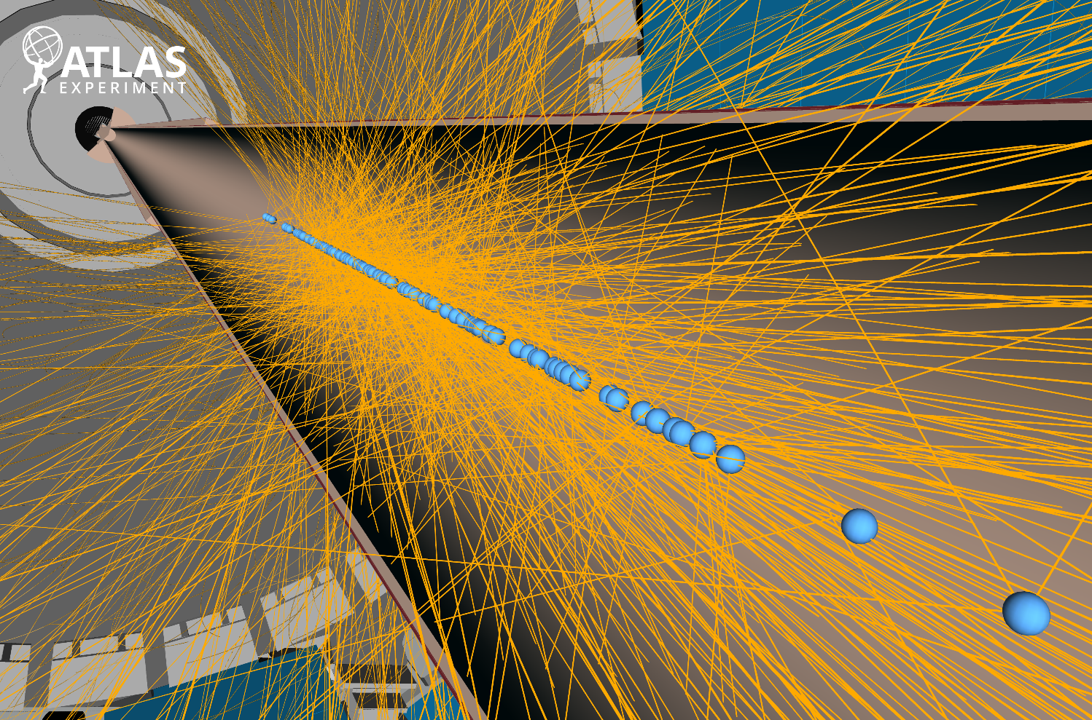
HL-LHC collision environment
Collision envelope σ
30–60 mm
175–260 ps
ℒ_{inst} = 5 × 10³⁴ cm²/s at HL-LHC
3000 fb⁻¹ total in High Lumi phase
(2010–2026: 460 fb⁻¹, peak 2.3 × 10³⁴ cm²/s)
Pile-up value of 200 in experiments
Extreme vertex density & radiation damage

Slide 5
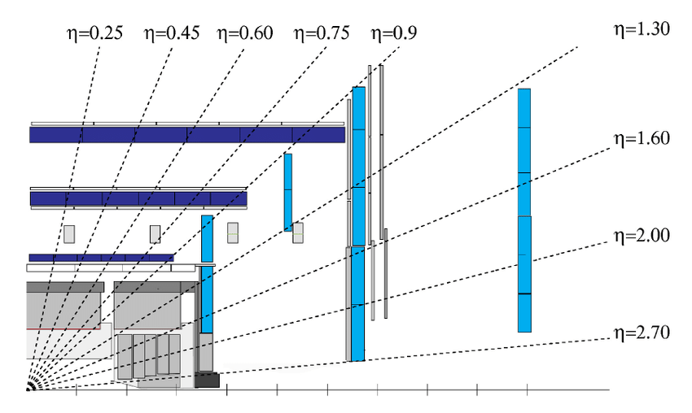
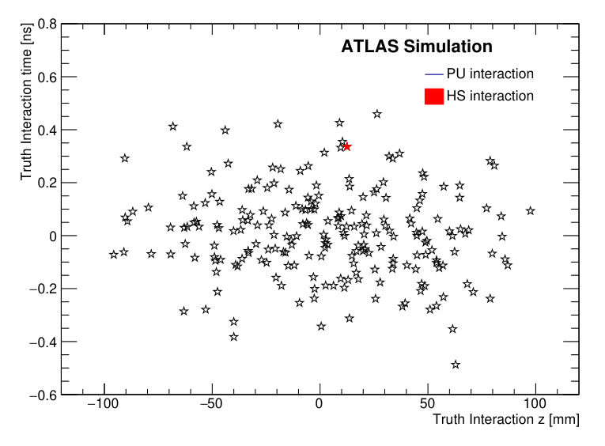
Why High Granularity *Timing* Detector?
HGTD
σ = 50 ps
ITk
Interaction point
ITk spatial resolution insufficient
HGTD will complement ATLAS Inner Tracker (ITk) with track time measurement (50 ps resolution)
Improved matching of tracks to vertices (bonus: luminosity measurement)

Slide 6
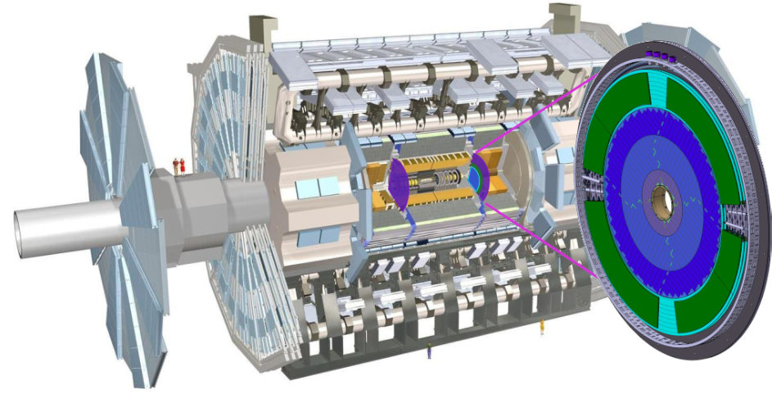
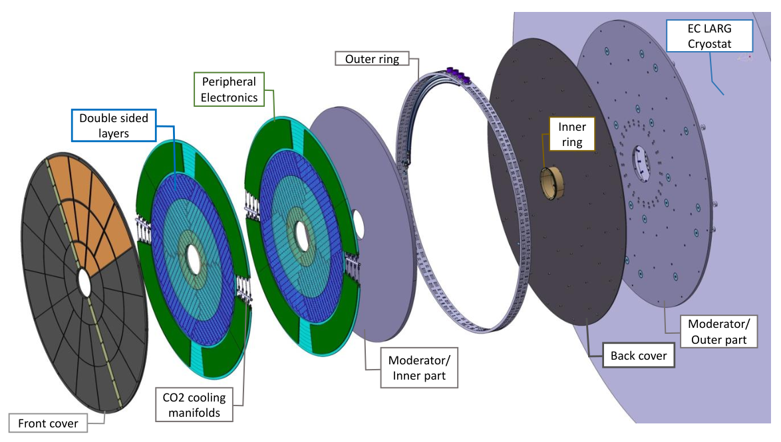
ATLAS HGTD
Two disks between calorimeter barrels and endcap
Active area
12 cm < r < 64 cm
4 sensor layers in each disk
Total thickness 75 mm
Rapidity coverage | 2.4 < |η|< 4.0
z position | ± 3.5 m
No. of readout channels | 3.6 M
Working temperature | –30 °C (CO₂)

Slide 7
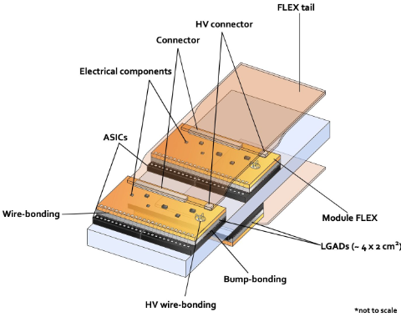
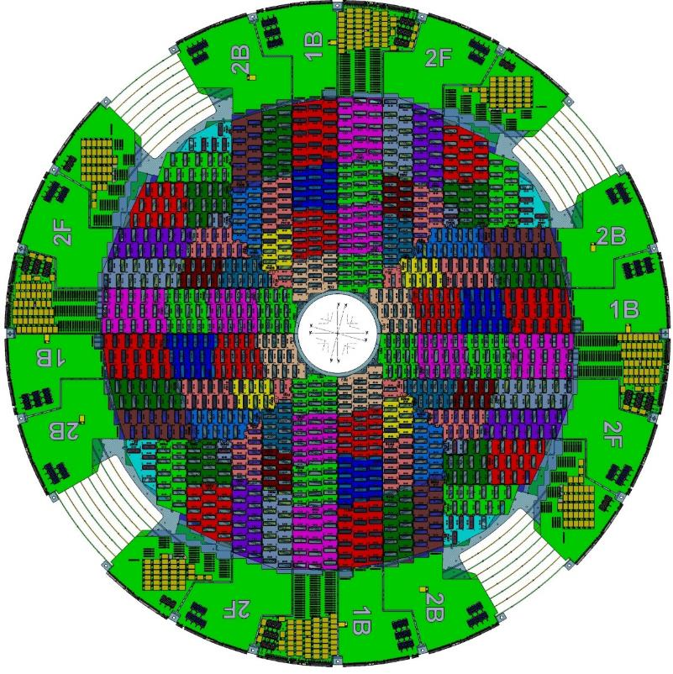
HGTD components
Peripheral electronics
In
Mid
Out
Modules arranged in Detector Units
3 independently replaceable regions
(LS4)
Module: 2 hybrids (sensor + ASIC) + flex circuit
8032 modules in total

Slide 8
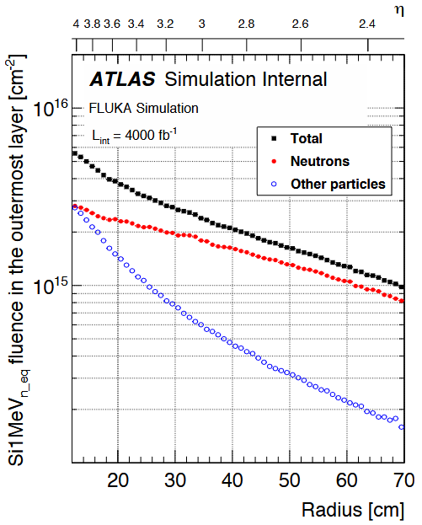
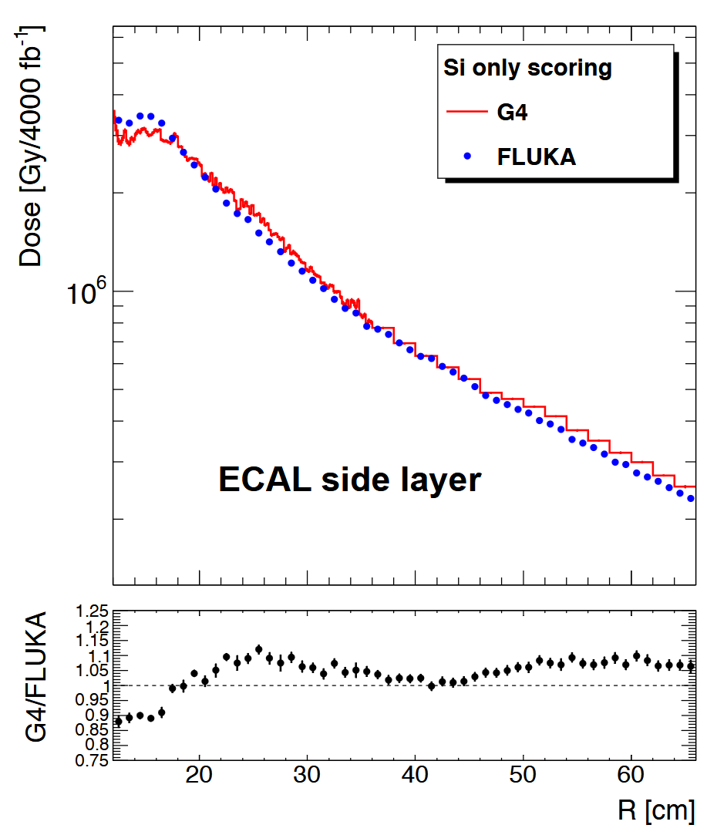
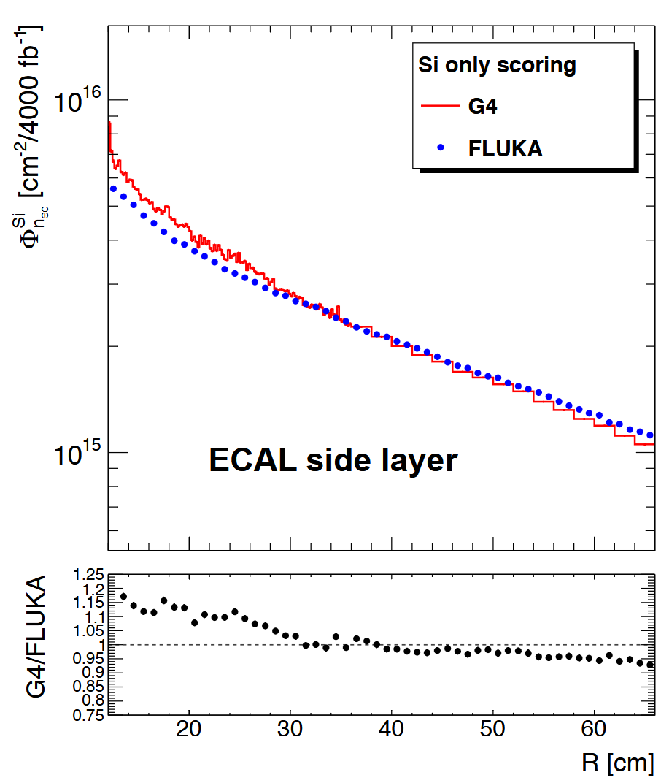
HGTD radiation environment
Simulation of TID, NIEL damage and particle composition in HGTD (for 4000 fb⁻¹)
HGTD is designed for 2.5 ×10¹⁵ n_{eq}/cm², 2 MGy
TID
NIEL
50n:50p
90n:10p
[M. Huhtinen, CERN]

Slide 9
F9 HGTD activities
F9 group activities in HGTD:
Sensor group
  G. Kramberger is a convener
  Heavily involved in testing & production quality control (QC)
  Irradiation test QC performed exclusively at JSI
  Additional radiation hardness studies – see Iskra’s talk on Wed
Hybrid and module testing
  Emerged as leading site for tests after irradiation (see Marko P.’s talk on Wed)
  Extending our skillset to ASIC readout
Flex tail procurement
  Minor contribution of procuring 8.5 % of flex cables

Slide 10
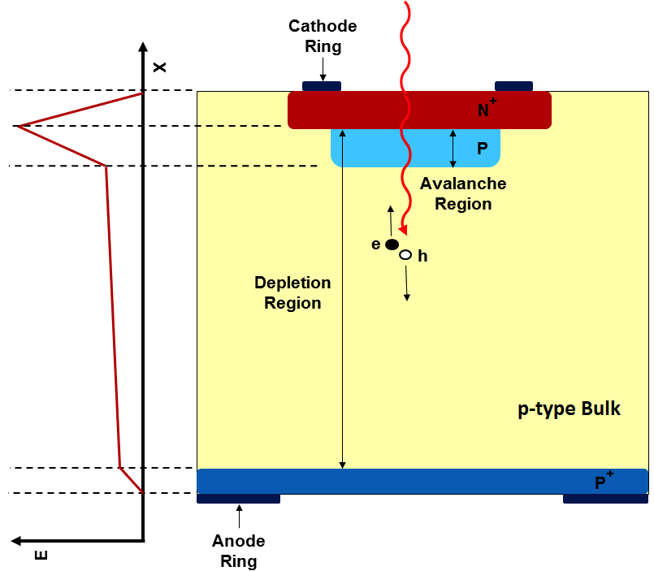
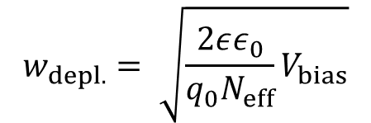
HGTD sensors: Low Gain Avalanche Diodes (LGAD)
Time resolution on 50 ps level requires specialized sensors
  Radiation hard (2.5e15 n_{eq}/cm² in HGTD ≈ as ATLAS IBL)
  Fast rise time
  High signal-to-noise
Low Gain Avalanche Diode (LGAD)
  Planar n⁺⁺-p⁺-p silicon sensor with internal gain
  Highly doped p⁺ gain layer
    High electric field → charge multiplication by impact ionization
    Typically 1 µm thick, 25 V to deplete (V_{gl})
  Gain factor 10–30
    HGTD sensors 50 µm thick
    Required charge 4 fC (but 10 fC would be nice)
$$w_{depl.}= \sqrt{\frac{2εε_{0}}{q_{0}N_{eff}}V_{bias}}$$
1 fC = 6250 e₀

Slide 11
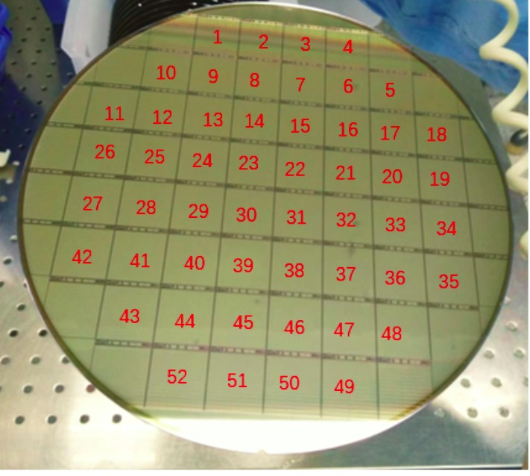
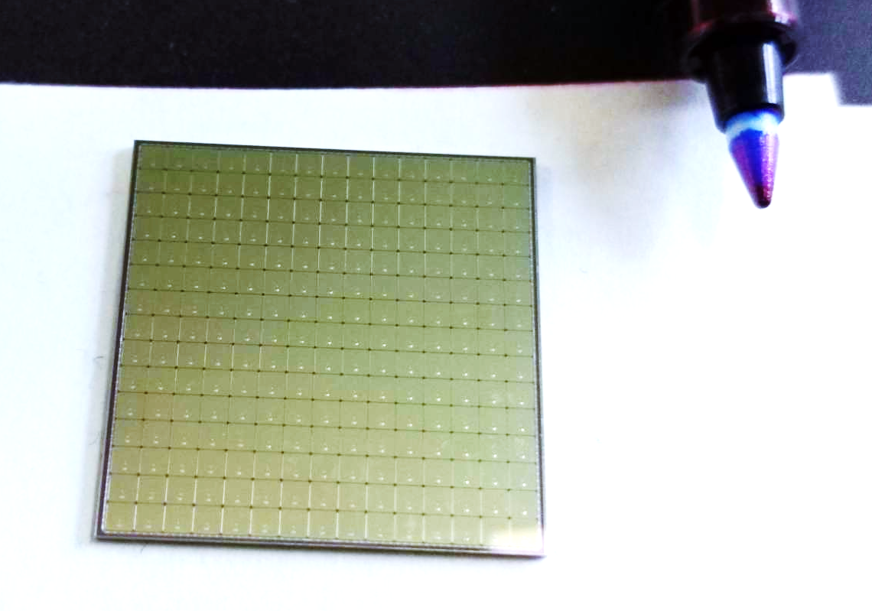
HGTD production sensors
HGTD sensors produced by IMECAS (China)
Sensor production is ongoing until mid 2027
  > 20,000 main sensors required for production ~ 1000 wafers
  Samples from each wafer irradiated and tested at JSI (Brigita)
Readout ASIC: ALTIROC A (bump bonded)
  ToA + ToT, 20 ps bin TDC
Number of pads | 15 × 15
Pad size | 1.3 mm × 1.3 mm
Effective fill factor | > 85 %
Total size | 2 cm × 2 cm
Active/physical thickness | 50 µm / 775 µm
8-inch wafers (52 sensors)

Slide 12
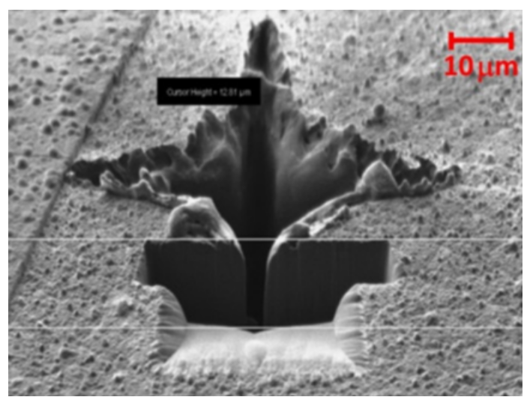
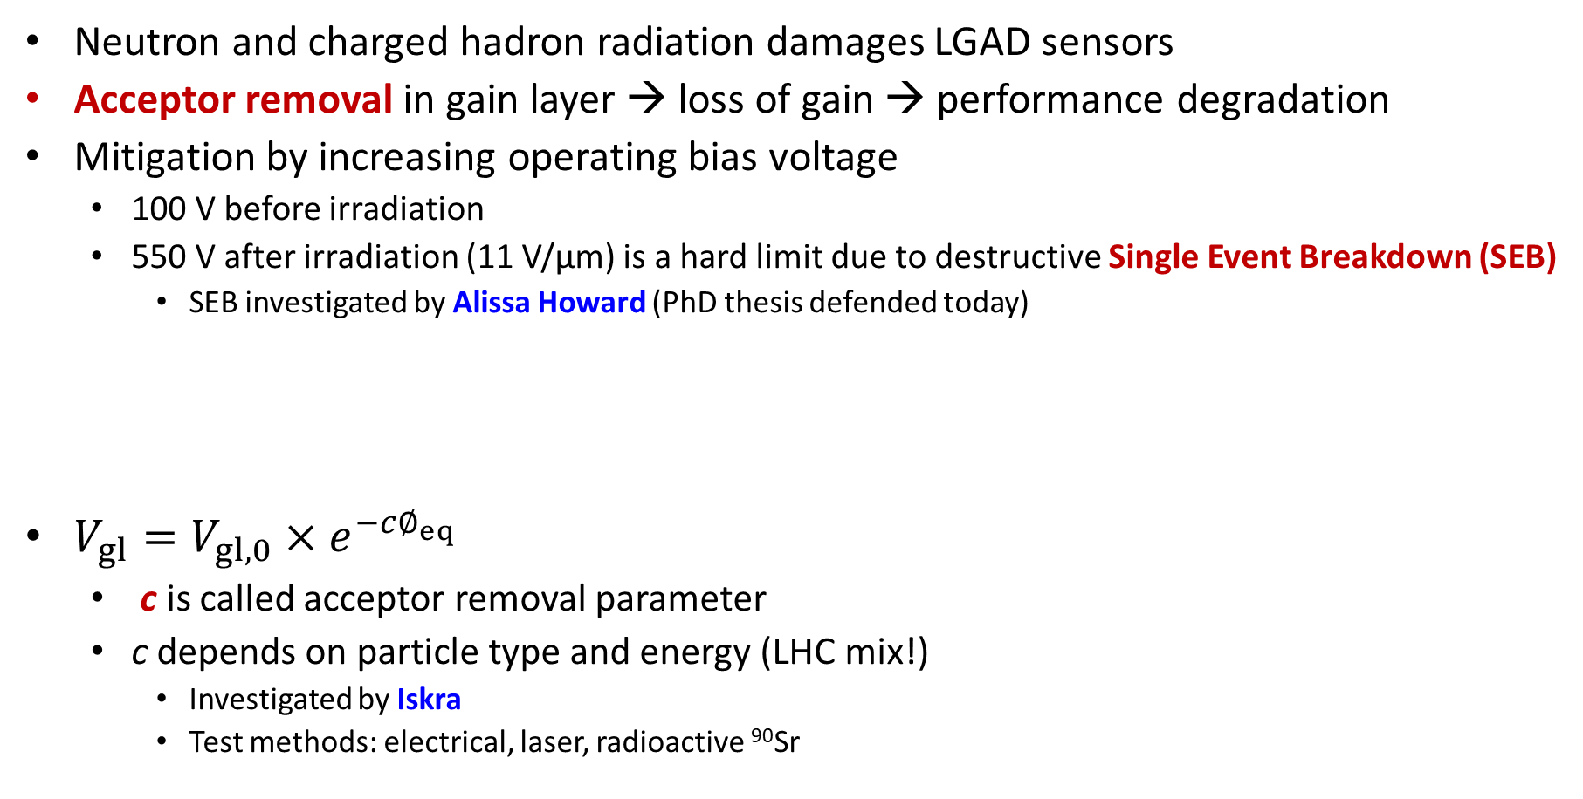
Radiation damage in LGAD
Neutron and charged hadron radiation damages LGAD sensors
Acceptor removal in gain layer → loss of gain → performance degradation
Mitigation by increasing operating bias voltage
  100 V before irradiation
  550 V after irradiation (11 V/µm) is a hard limit due to destructive Single Event Breakdown (SEB)
    SEB investigated by Alissa Howard (PhD thesis defended today)
$V_{gl}=V_{gl,0}{×e}^{−c∅_{eq}}$
  c is called acceptor removal parameter
  c depends on particle type and energy (LHC mix!)
    Investigated by Iskra
    Test methods: electrical, laser, radioactive ⁹⁰Sr
Why do we not observe electrical discharge over a 100 µm gap between sensor (550 V) and ASIC (0 V)?
Hot Topic:

Slide 13
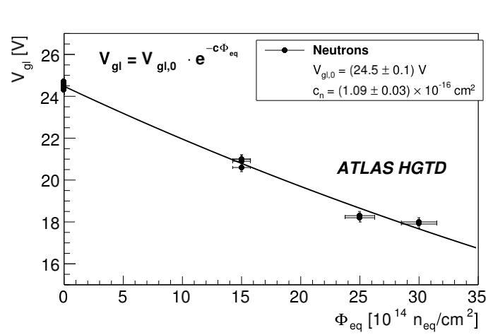
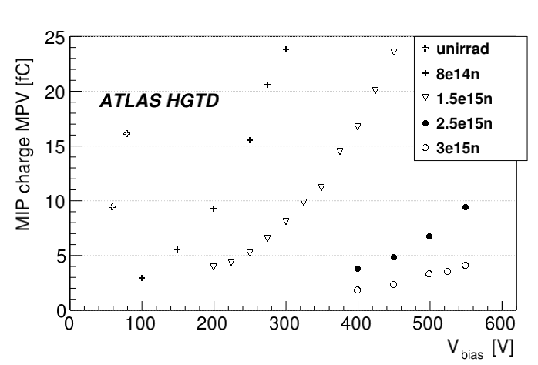
HGTD irradiated sensor performance
Protons are more damaging – see Iskra’s talk
Higher voltage is required at higher fluences to collect a fixed charge

Slide 14
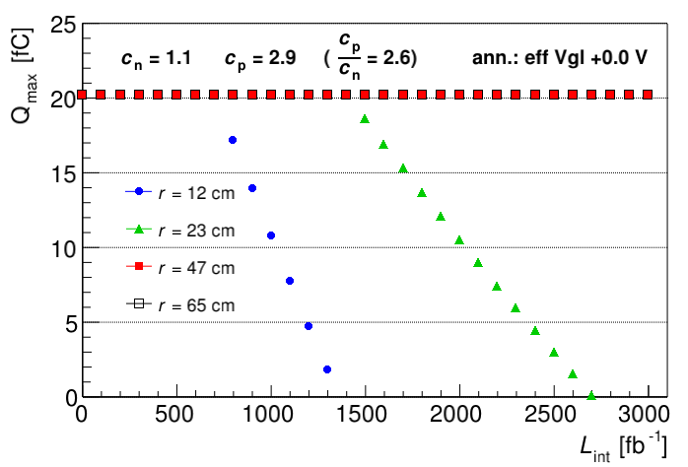
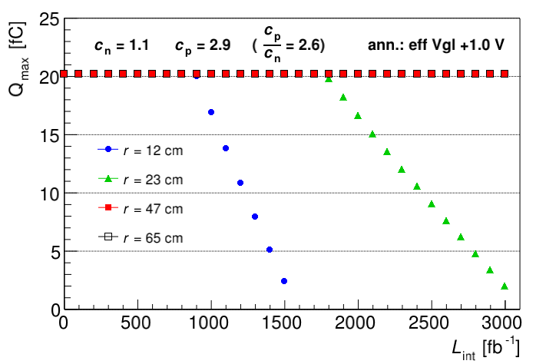
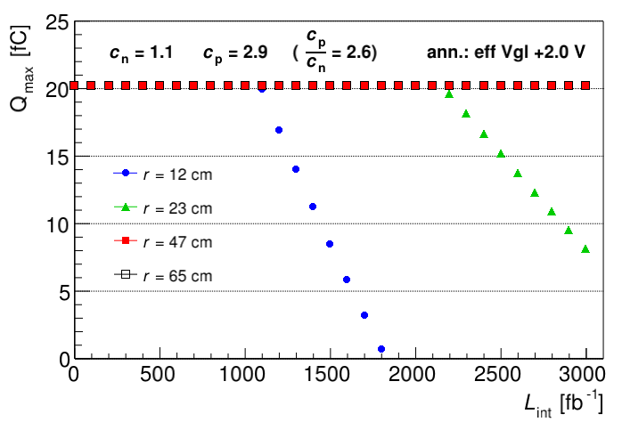
Simulation of sensor performance at HL-LHC
Simulation of collected charge at HL-LHC
Degradation at small radius quite fast
Positive effects of long term annealing will be studied by Ajda

Slide 15
HGTD F9 Outlook
Production: Sensors 50 % done, (finished in 2027)
System assembly: at CERN 2027–2029
Performance studies: will continue at JSI (see Iskra, Marko P. talks)
Integration into ATLAS software tools

