Slide 1
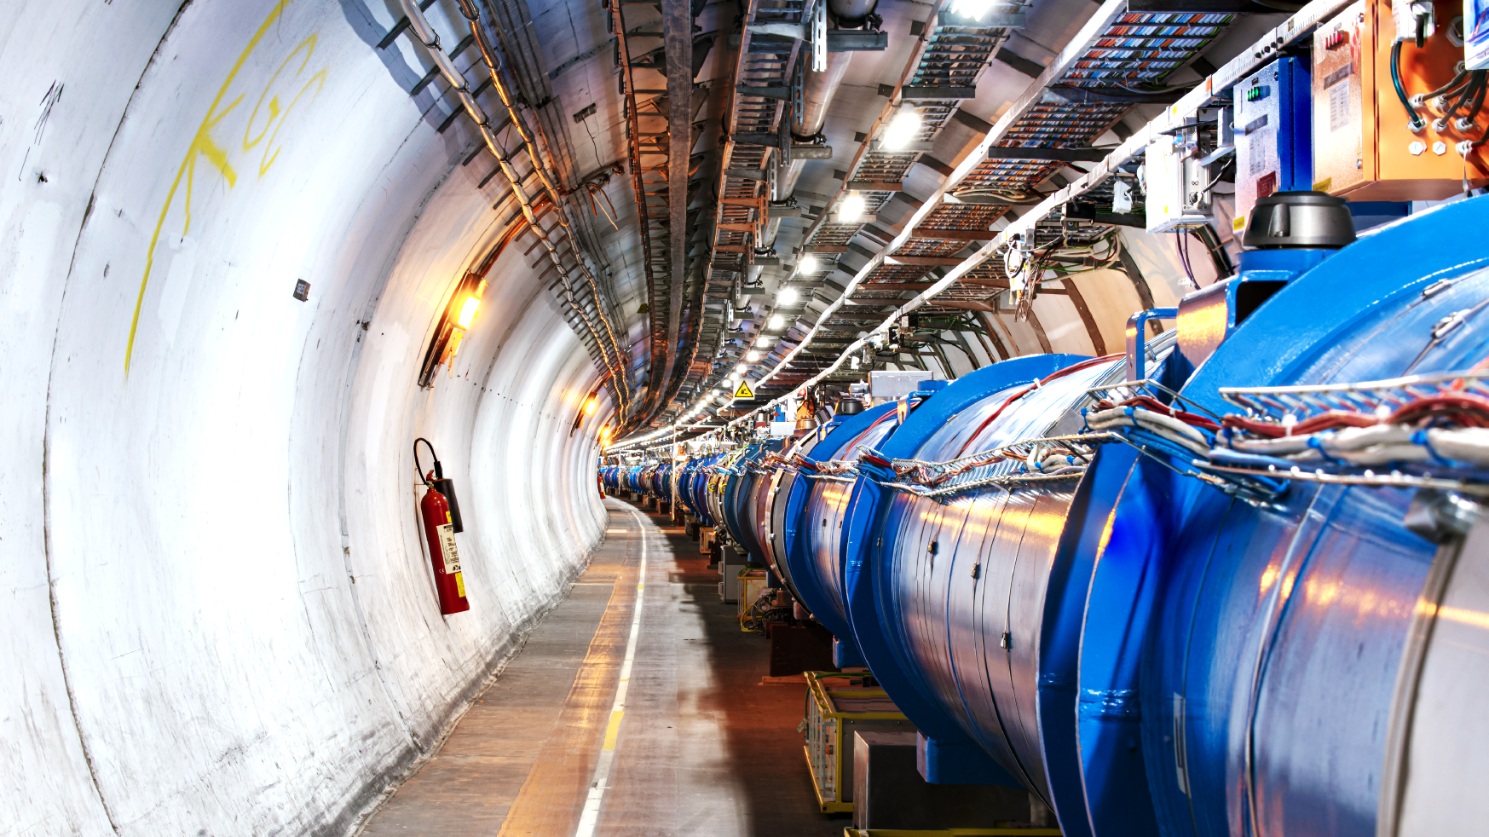



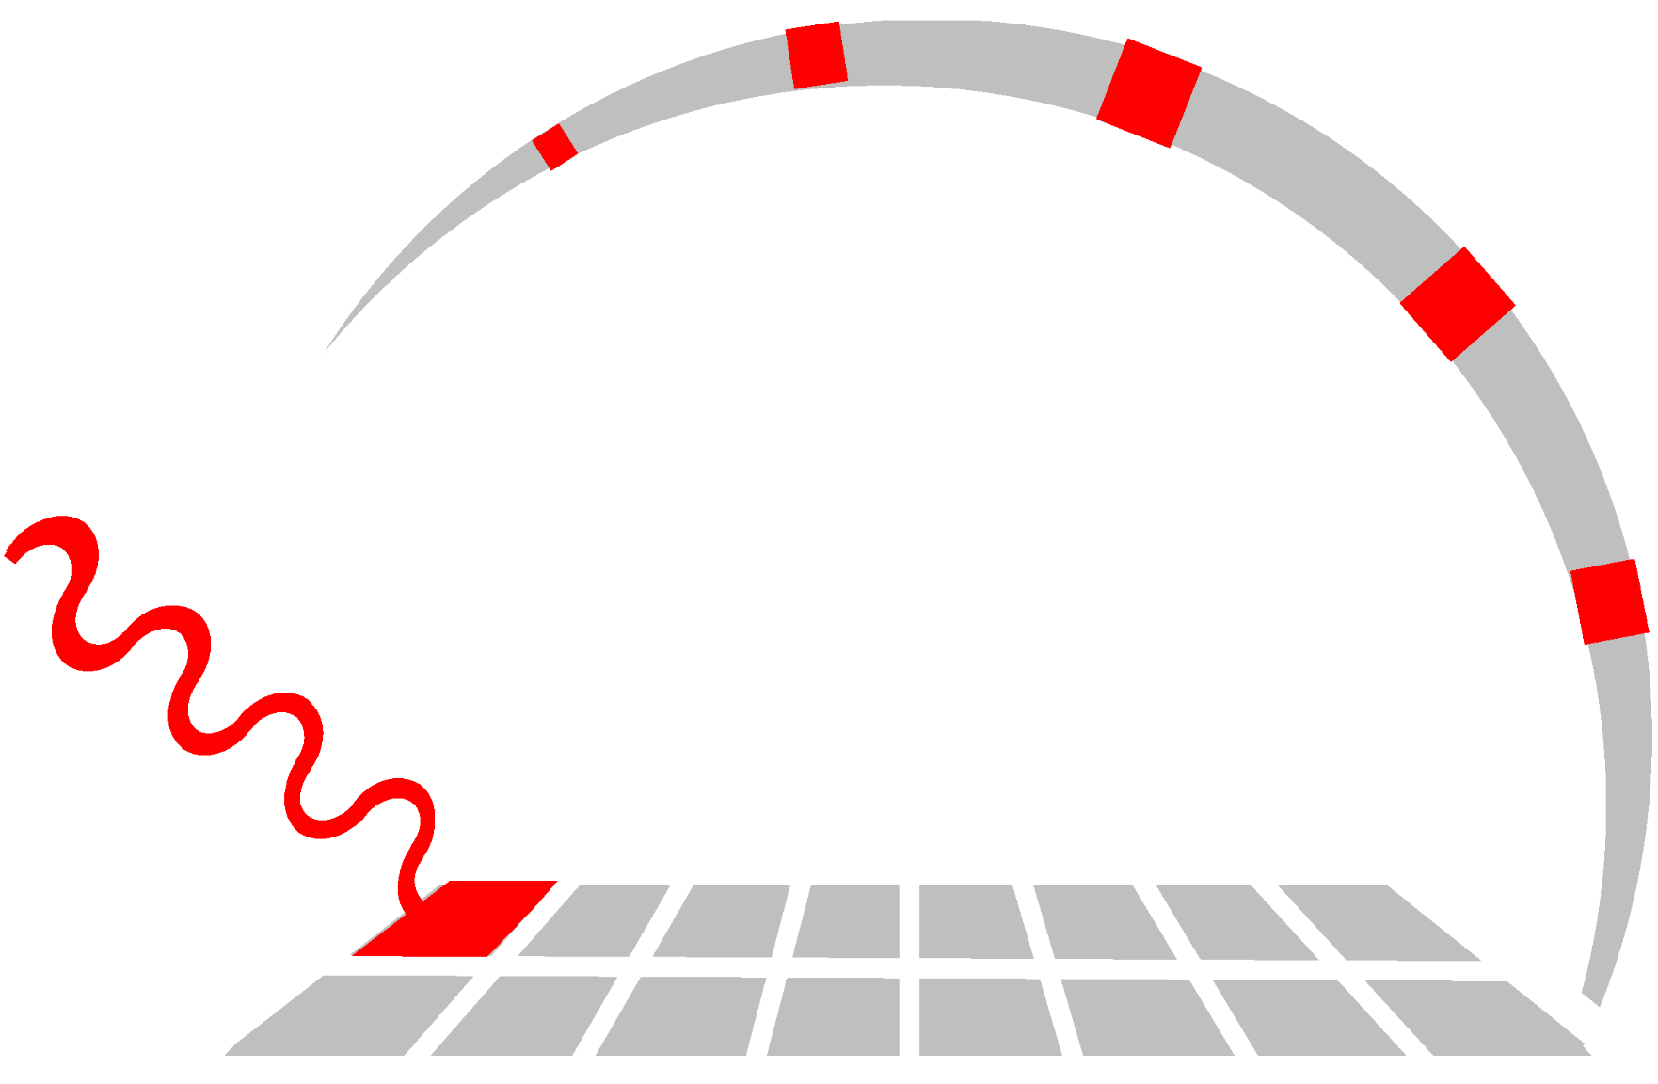




Intro to LAPPD for Belle-II ARICH upgrade
for Particle Identification
This is the .pptx conversion of Google Slides. Formatting, animations, and content might be corrupted or missing. Check the link for the original version: https://docs.google.com/
Trey Grijalva
29 Sept 2026
1
Notes:
Welcome, my name is Trey and I’m going to introduce the Large Area Picosecond PhotoDetector research we’re working on in the Photolab.

Slide 2
Outline
3. About me
4. Belle II’s ARICH system
5. ARICH is for Particle IDentification (PID)
6. Very sensitive photodetectors are required
7 & 8. LAPPD details
9. Current experimental setup
10. What I have accomplished in my first year
11 & 12. Status of current work
13. Plans
14. Major sources
Trey Grijalva

Slide 3
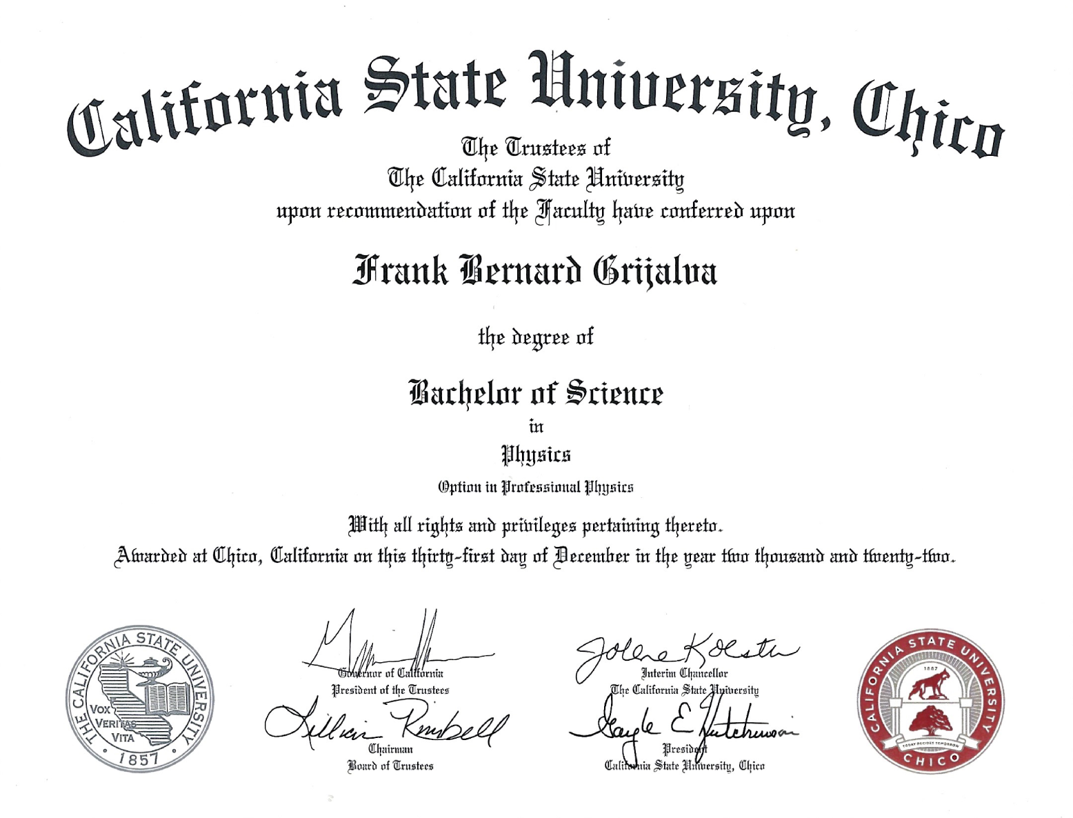
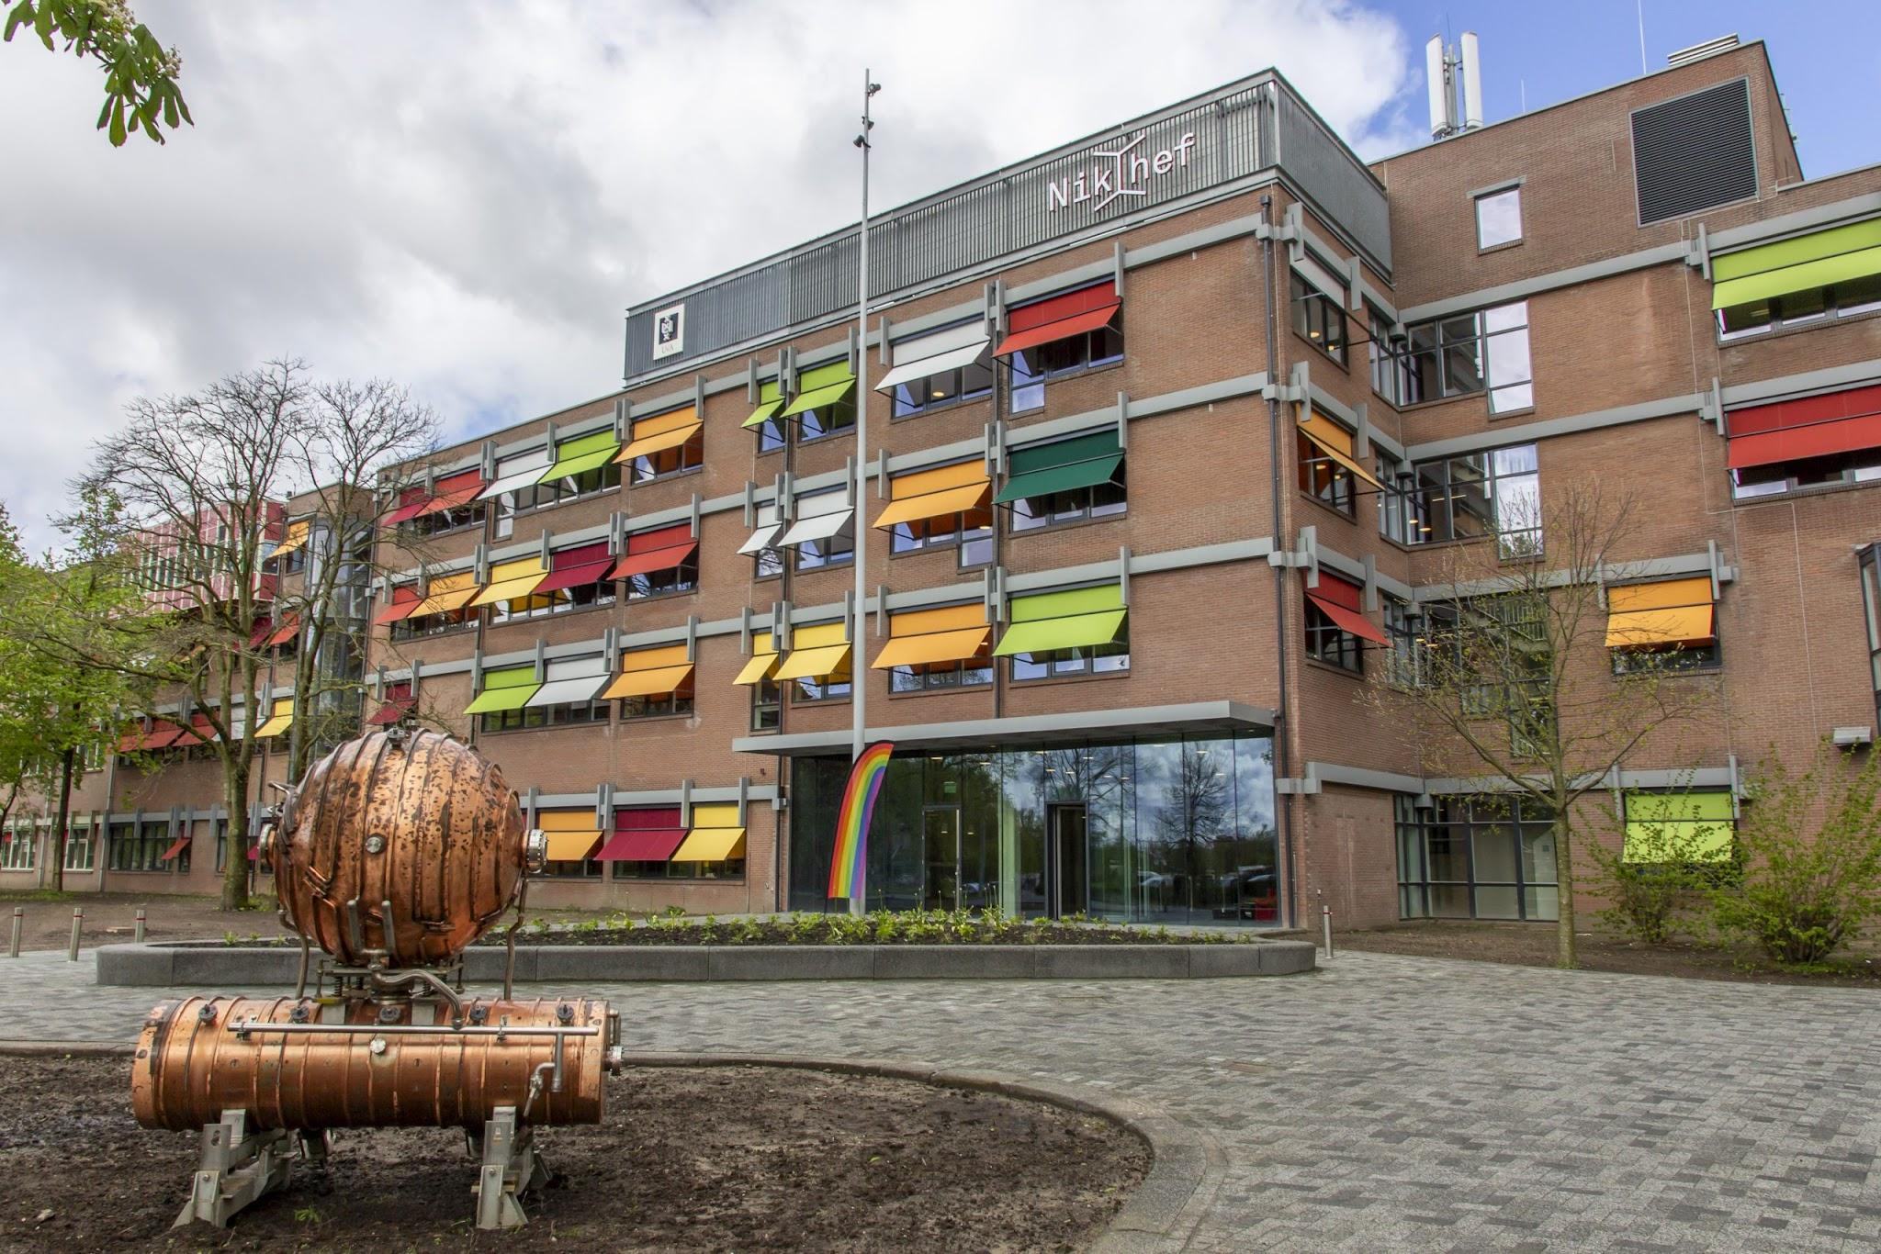



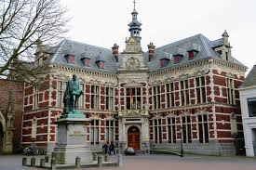

About me
Chico State ‘22
CERN ‘22
Utrecht & Nikhef ‘25
Ljubljana
BS Professional Physics
ATLAS summer internship
MSc
PhD · UL FMF & IJS F9
Trey Grijalva
Notes:
People always ask me some version of what I’m doing here. The short answer is that it’s not a great time to be a scientist in the US...
Here’s how the journey went:
During the summer of 2022, I finished my Bachelor’s while interning at CERN in the ATLAS collaboration.
I learned about how collaboration in a large experiment actually works and that I prefer hardware work to control software or analysis.
Also during this time, I befriended some Dutch people that convinced me to come to their institute, Nikhef. There I studied Trench Isolated Low Gain Avalanche Diodes and the limitations of TCT characterization.
Now, I am here, working on LAPPDs with Connor, Samo, Peter, and Rok.

Slide 4

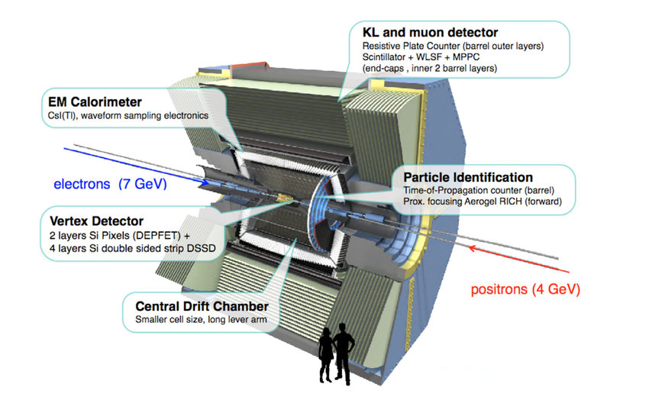
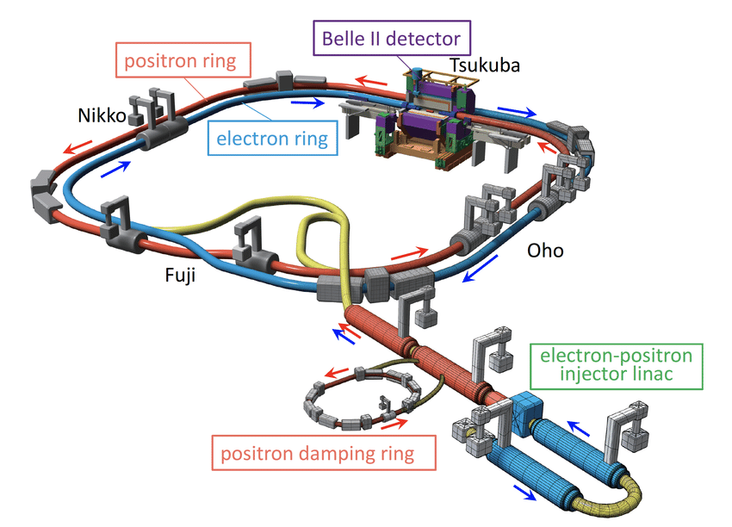
Belle-II
At SuperKEKB in Japan:
ARICH
Trey Grijalva
Notes:
In Japan, at KEK, there is the SuperKEKb collider that smashes electrons and positrons in the Belle-II detector to investigate rare decays, as my colleagues have mentioned.
A critical subsystem in the detector is the Aerogel Ring Imaging CHerenkov detector, “ARICH”

Slide 5
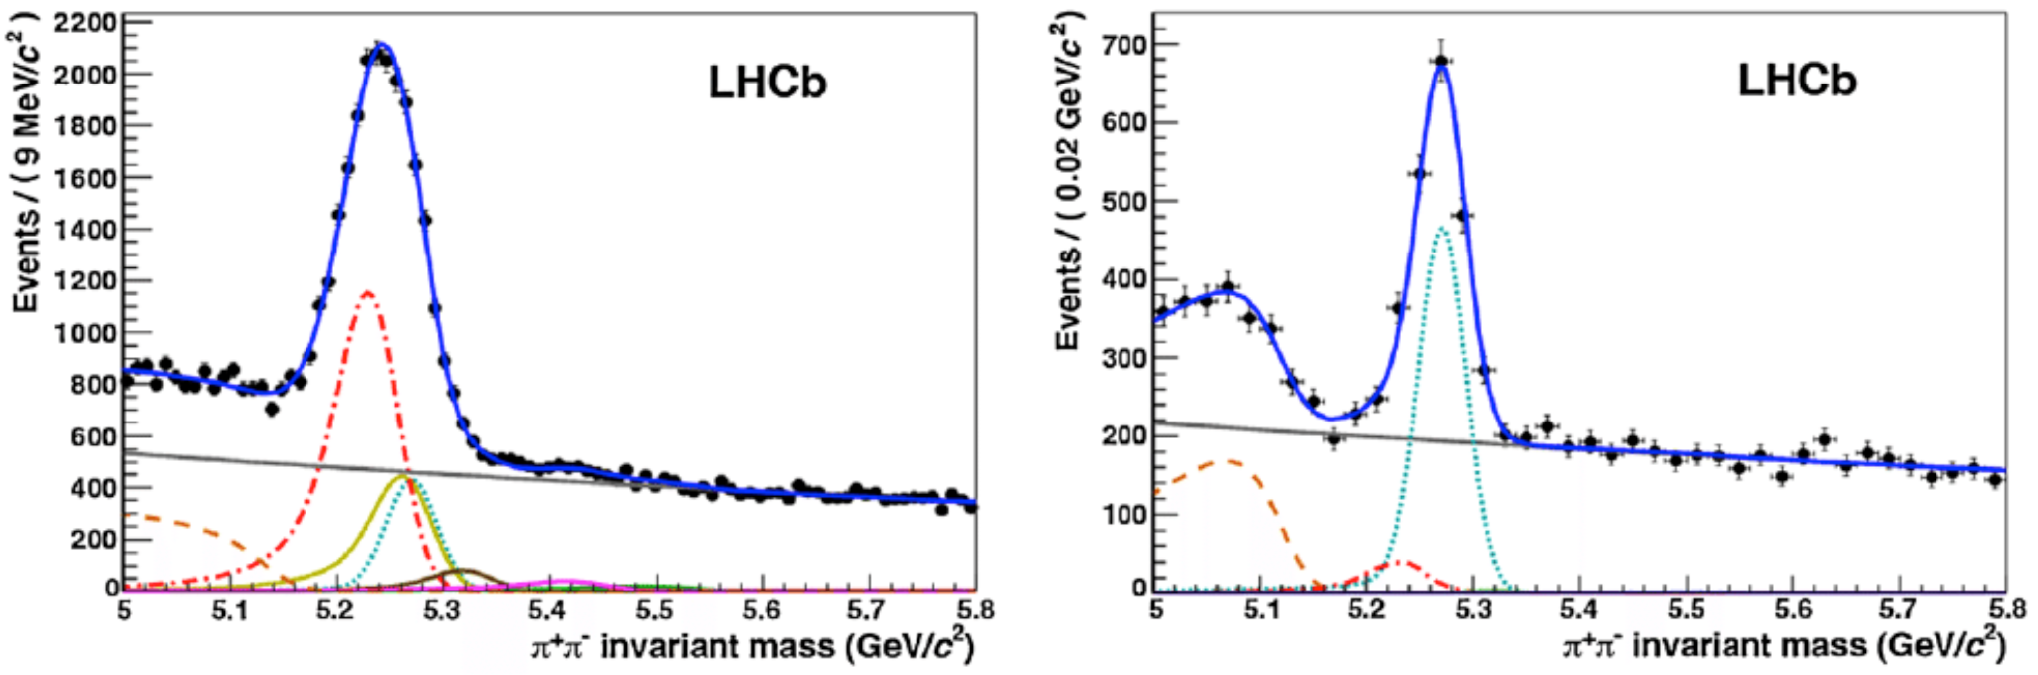

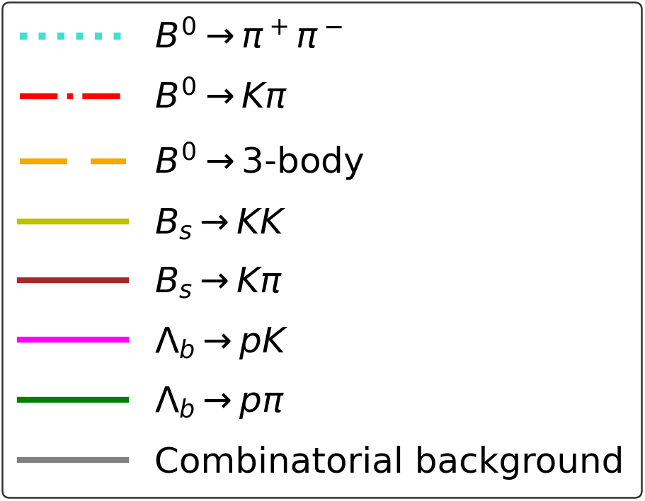
Particle IDentification - PID
The Ring Imaging CHerenkov detectors (RICHs) distinguishes processes based on their final state particles and works across a wide momentum range. - Borgato EPS 2025
Without RICH PID
With RICH PID
Decay of Interest
Decay of Interest
Eliminated by RICH PID
Trey Grijalva
Notes:
The ARICH enables us to tell different particles apart, allowing us to filter out leading-order modes we are not interested in so we can improve the precision of our rare decay studies. -- G. Cavallero RICH seminar
Wide momentum range = 2.6-100 GeV/C combining LHCb’s RICH1 & RICH2 (https://cds.cern.ch/record/2791320/files/ncc12175.pdf)
Figure caption:
“Invariant mass distribution for B →h+h−decays in the LHCb data before the use of the RICH information (left), and after applying RICH particle identiﬁcation (right).
The signal under studyis the decay B_0→π+π−, represented by the turquoise dotted line. The contributions from different b-hadron decay modes
(B0→Kπ red dashed-dotted line, B_0→3-body orange dashed-dashed line, B_s→KK solid olive drab line, B_s→Kπ solid brown line, Λ_b→pK solid magenta line, Λ_b→pπ solid green line),
are eliminated by positive identiﬁcation of pions, kaons and protons and only the signal and two background contributions remain visible in the plot on the right.
The grey solid line is the combinatorial background”

Slide 6
Cherenkov Radiation vs other energy losses
‘For a minimum ionizing particle, the rate of energy loss per unit path length (dE/dx) due to Cherenkov emission is about 0.1% of that due to ionization’ – J. V. Jelley 1955
So an 80 MeV π loses 4.5 MeV/cm due to ionization, but only 4.5 KeV/cm due to Cherenkov radiation
‘For an electron traversing 1 cm of water with a kinetic energy of 100 MeV, the ratio between the Bremsstrahlung signal and the Cherenkov signal in the visible range λ=400−500 nm is on the order of 10⁻⁵’ – J. V. Jelley 1955
Cherenkov light is quite weak, ≈370-490 γ/cm in water, so we require very sensitive detectors.
Trey Grijalva
Notes:
Cherenkov radiation is quite weak compared to other familiar forms of radiation produced by charged particles.
The energy lost to Cherenkov emission is about 0.1% of the ionization energy loss:
An 80 MeV pion in carbon with a density of 2.265 g/cm³ loses 4.5 MeV/cm due to ionization (Pgs 7 & 8 of https://alpha.physics.uoi.gr/foudas_public/APP/Lecture4-EnergyLoss.pdf)
So the energy lost by those pions due to cherenkov radiation would be 4.5 KeV/cm -- if the carbon was a Cherenkov radiator.
Bremsstrahlung signals are about 100,000 times stronger.
This means our detectors must be extremely sensitive!
Pdg-source pg 33 says 370, IceCube and many other sources say 490 photon/cm

Slide 7
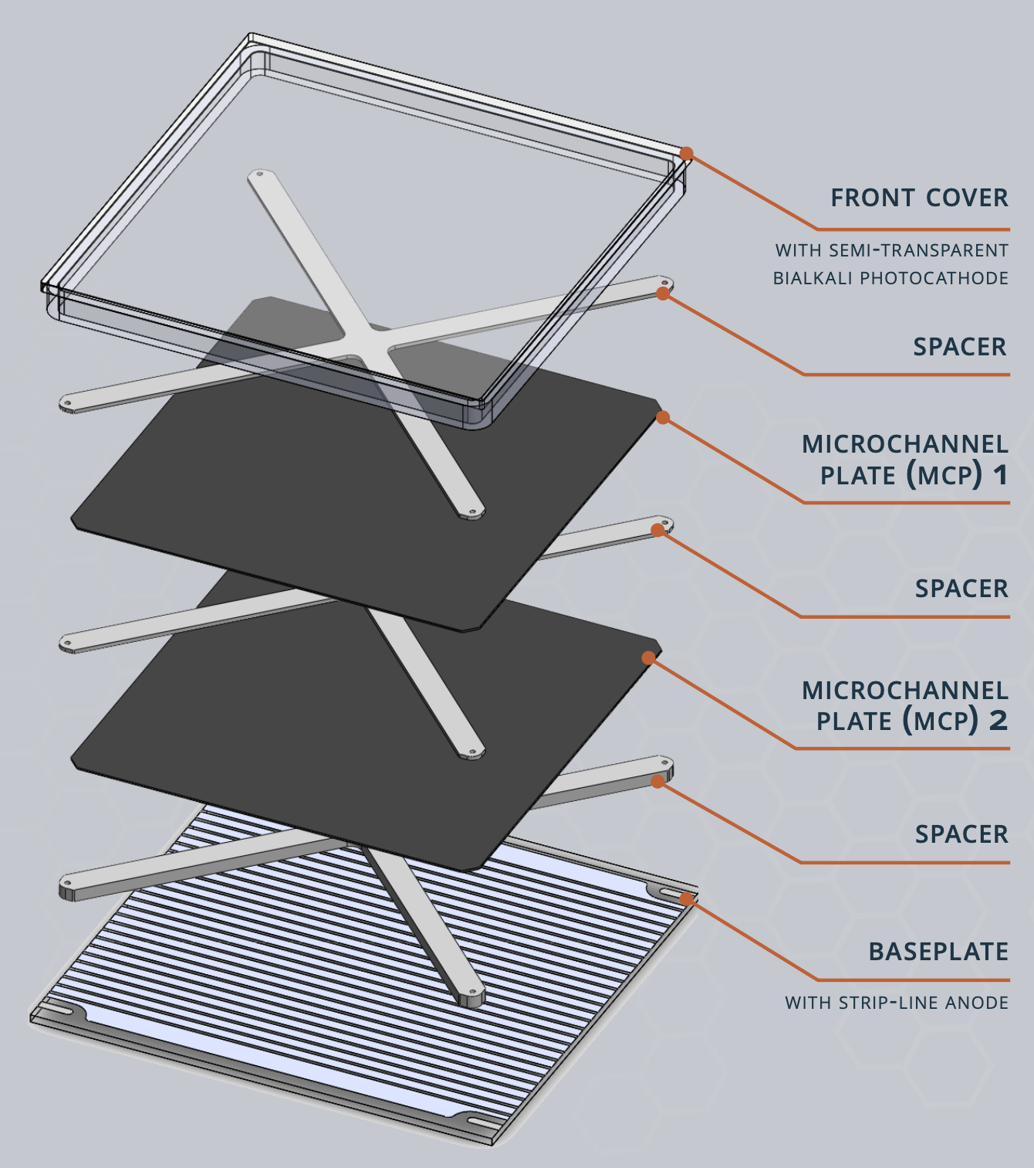
The LAPPD
Multiplication Factor “Gain” >10⁶
Quantum Efficiency ≥ 27%
Prompt timing of 30 ps
Dark Count Rate < 150 Hz/cm² ≈ MaPMTs
More magnetic field resistant than PMTs
‘Radiation Hard’ – no space-charge to sign-invert, as in semiconductor devices
≈1 cm
20 cm
20 cm
Trey Grijalva
Notes:
Belle-II is primarily considering the LAPPD as the next sensor to upgrade ARICH.
The multiplication factor, sometimes also called, “gain” is greater than 10^6
Quantum efficiency, which is the ratio of incident photons to the electrons that are produced, greater than 27%
It has prompt timing of 30 picoseconds
And dark count rate comparable to MAPMTS,
While being more magnetic field resistant than other PMT devices because of the small pore size of the MCPs.
It’s also more radiation hard than silicon-based sensors

Slide 8
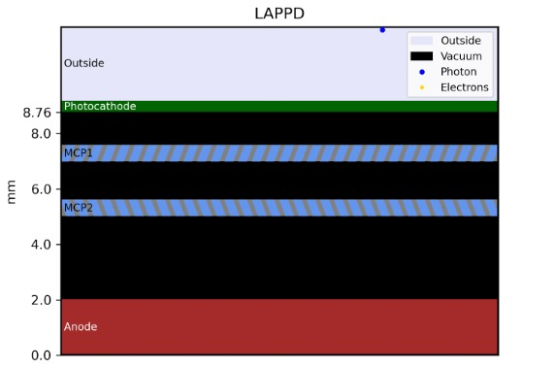

LAPPDs
A photon strikes the Photocathode which knocks a ‘photoelectron’ out
The photoelectron is accelerated through the vacuum to MCP #1
An electron incident on the wall of the channel is ‘multiplied’
Repeat 2 & 3 in MCP #2
An electron cloud moving towards the anode creates a signal
50-100 V
825-850 V
200 V
825-850 V
200-500 V
Trey Grijalva
Notes:
Here’s how they work:
You can see a photon is absorbed by the photocathode, which releases a photoelectron. In reality, I mentioned this “Quantum Efficiency” is about 27% (QE = #_e- / #_γ), so every incident photon doesn’t necessarily produce a photoelectron.
A photoelectron then falls into a channel in MCP 1 and is multiplied. Those electrons go on to MCP 2 for additional multiplication before heading towards the anode to create a signal.
However, as you can see, there is a possibility that the photoelectron bounces off of the 40% of the plate surface that isn’t a channel. More about that later from Connor.

Slide 9
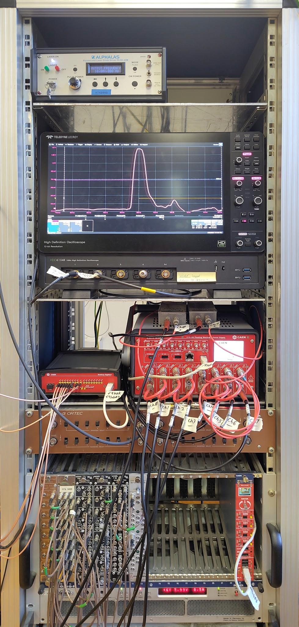
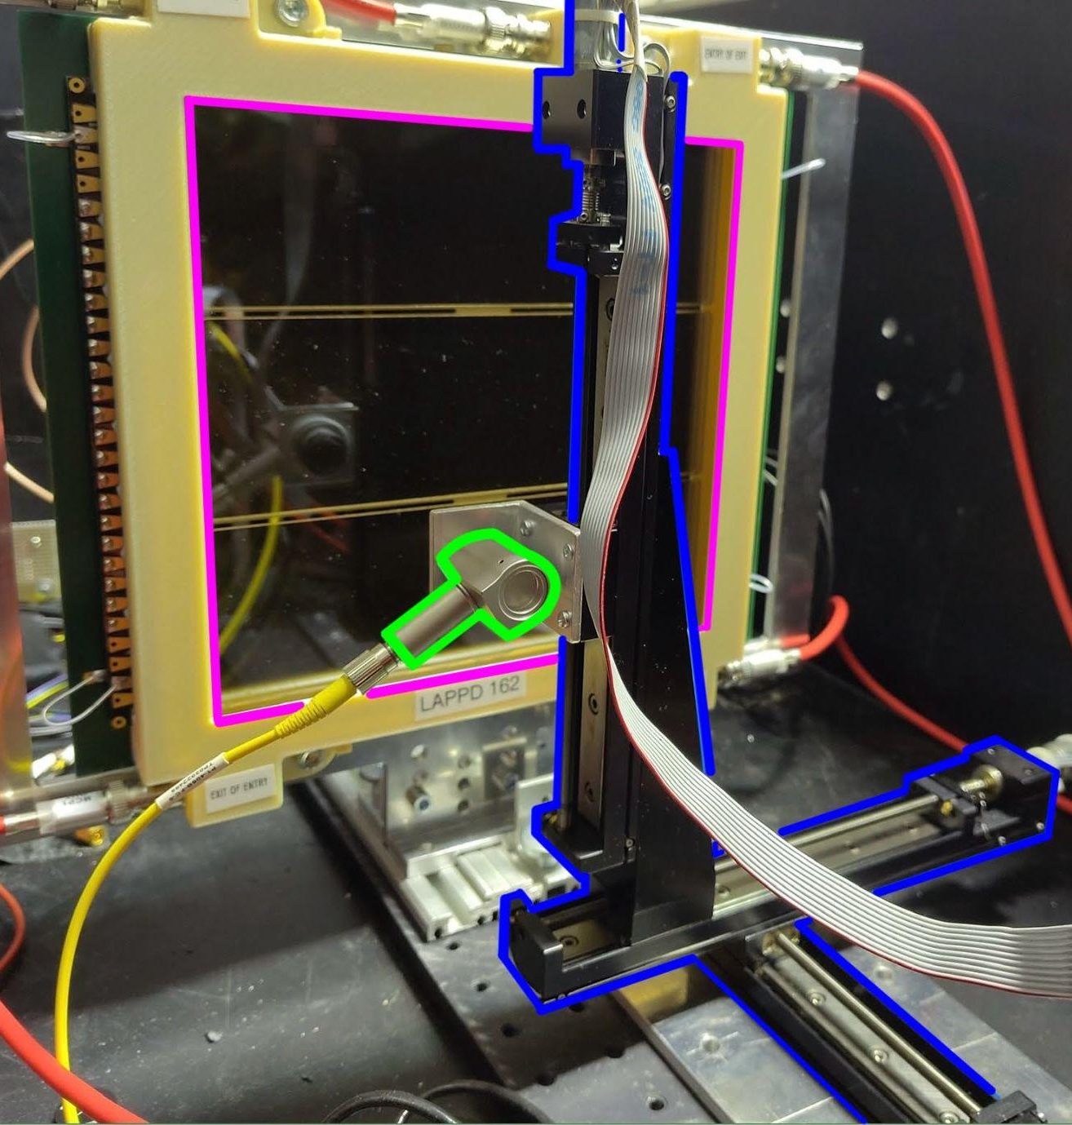
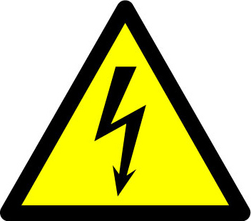

Experimental setup
LASER
LAPPD
Oscilloscope for reference
LASER focuser
Digitizer
High Voltage power supplies
LASER stages
Trey Grijalva
Notes:
On the left, you can see how we have a laser set up to precisely source photons.
With the stages, we can scan the laser over the surface to investigate within channels and around their edges to see the performance differences.
We also have the ability to collect data with several systems.
So far, data has mostly been collected as waveforms from the Oscilloscope,
But we have a “new” digitizer with the ability to simultaneously read-out 4x more channels as than the Oscilloscope.

Slide 10
✅ Done
✅ Update & document analysis code so it can be built and run on current HW & OSs
✅ Moved the setup to the lab to upgrade it
✅ Regrounded our lab
✅ Attended 2 summer schools that gave me organization inspiration and tools to improve our setup
✅ Implemented a Kanban board to plan, organize, and synchronize teamwork on our setups
✅ Planned a control software upgrade to Constellation
Trey Grijalva

Slide 11
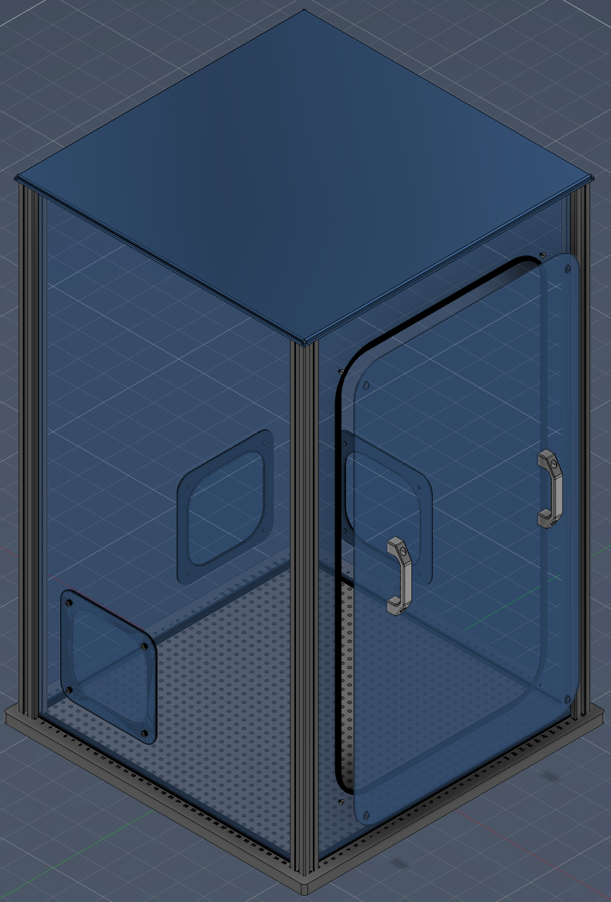
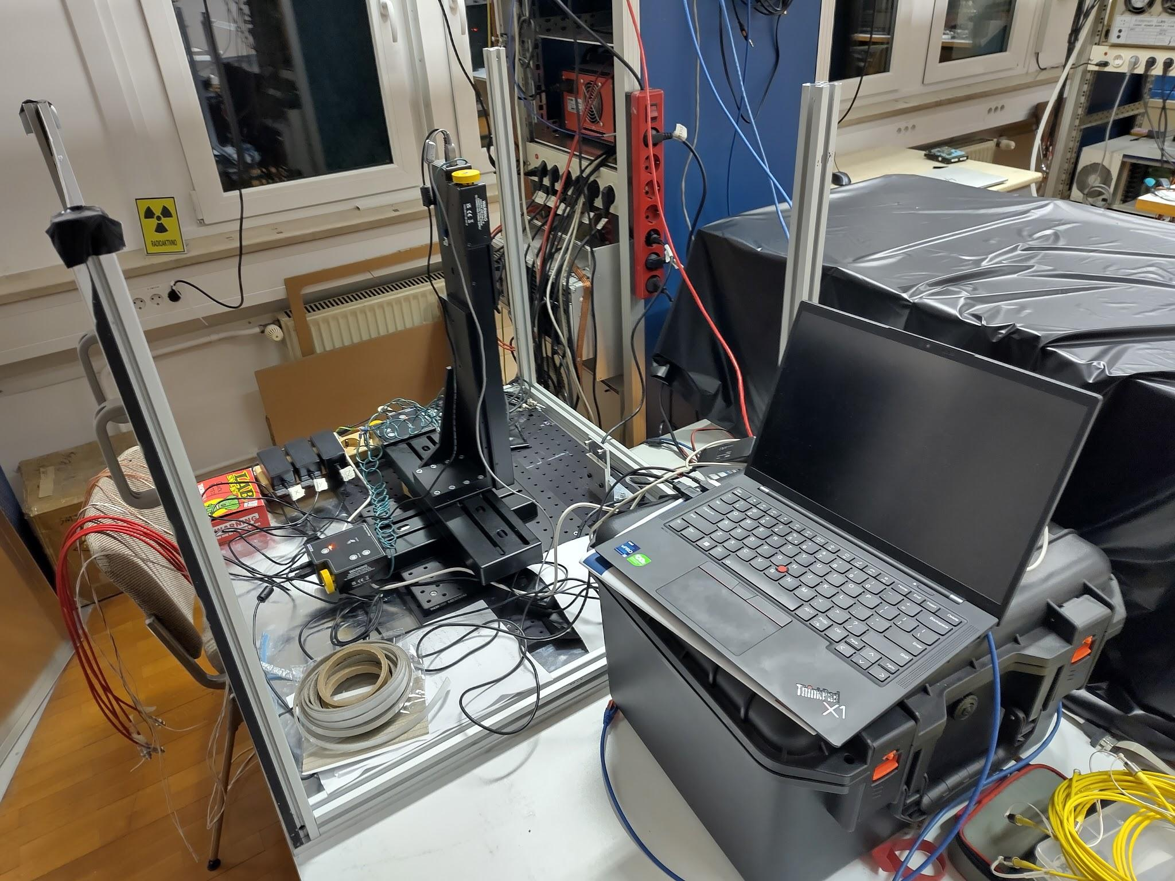
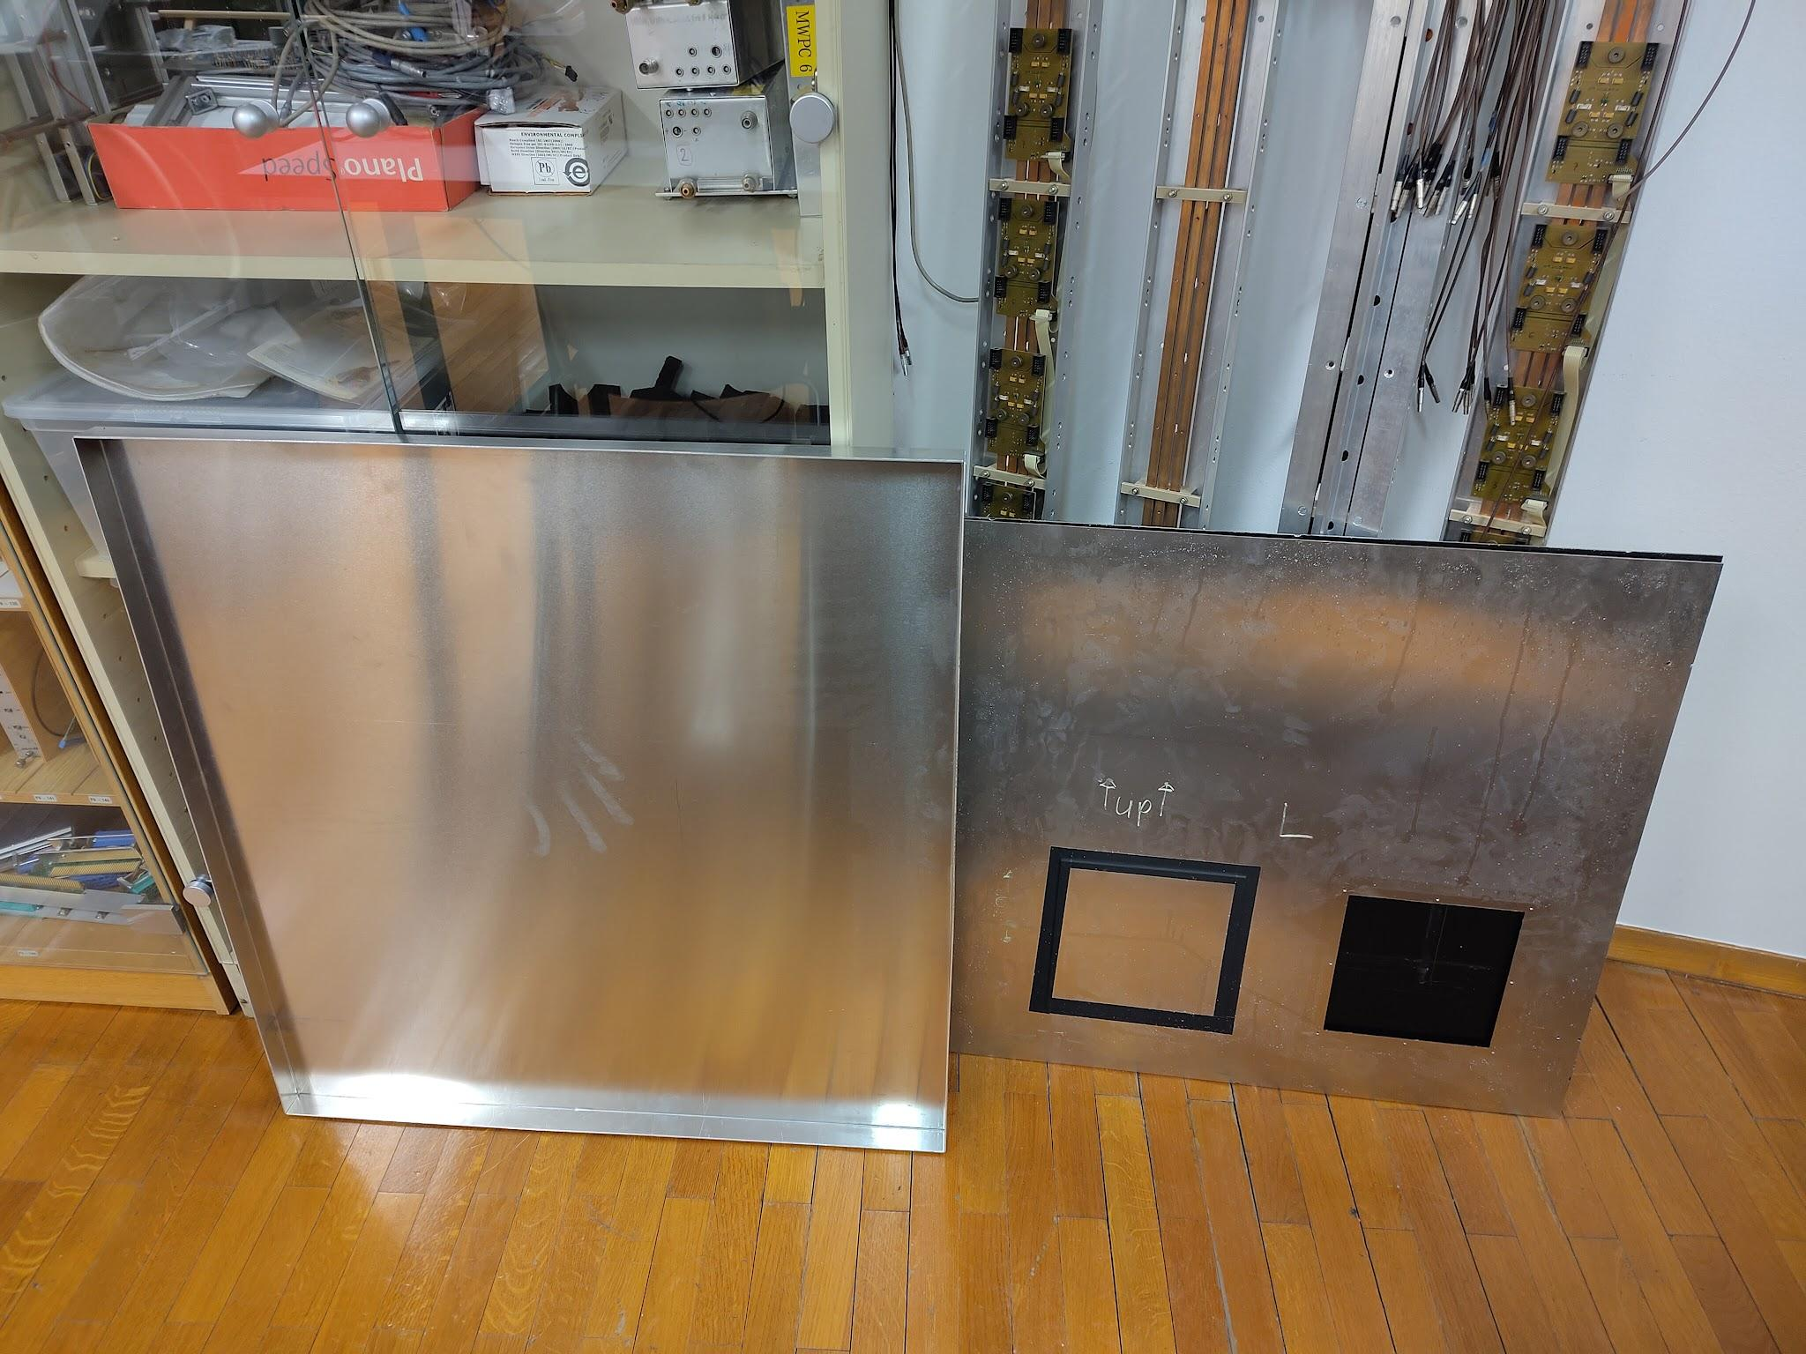
Work In Progress — light tight box
Trey Grijalva
Notes:
The second light-tight box is still disassembled as we wait for the EMI gasket foam to arrive so we can put in the walls...

Slide 12
Work In Progress — Constellation control software
Satellites
data
Why Constellation
Control
Modular
One satellite per instrument: swap hardware without touching the rest
Reproducible
Every run’s settings & conditions are logged alongside the data
Automated
Scripted scans run unattended through a common state machine
Shared
Reuse satellites from other labs; standard HDF5 output
Transferrable
Made by DESY for testbeam usage, we should be able to use it at other facilities
CAEN digitizer
H5DataWriter
HDF5 files
Scan scripts
automated
LeCroy scope
VME–CAMAC QDC
Existing analysis pipeline
Mission Control GUI
manual
CAEN HV
Thorlabs LTS stages
Observatory
logs & metrics, all satellites
MicroMo stages
exists (other labs) – to verify
new – to build
Status: planning done, implementation starting
Trey Grijalva
Notes:
I have finished planning and begun implementing Constellation control software for our two setups.
Constellation is a control and DAQ framework from DESY. The core idea is modularity: every instrument gets its own 'satellite', a small program that knows how to talk to that one device.
A controller — a scan script and/or the GUI — sends the same commands to all satellites, and they all follow the same state machine.
The digitizer, scope and HV supply already have satellites, we just need to verify they work for our hardware.
The stages and the VME–CAMAC electronics need new satellites, which I'll write.
The DAQ satellites write HDF5 files, and every satellite streams its logs and metrics to a central monitor, so every run's settings and conditions end up recorded alongside the data. That makes our scans reproducible and traceable.
Those HDF5 files will feed into our existing analysis pipeline — and what we plan to measure with all of this is what [post-doc] will tell you about next.
Status: planning is complete; implementation is starting.

Slide 13
Research plans
Investigate different response to 405 nm vs 670 nm light
Analyze performance of CAEN digitizer compared to Oscilloscope & CAMAC + VME setups
Check performance of various electrode sizes against our model
Beam-test our devices to see their performance in a high-rate & high-radiation environment
Trey Grijalva
Notes:
We are planning on
Investigating the detector’s response to 405 nm vs 670 nm light, expecting to learn about the development of the signal as the photoelectron is accelerated and multiplied
Analyze performance of CAEN digitizer compared to Oscilloscope and CAMAC & VME setups
Check performance of various electrode sizes against our model
Beam-test our devices to see their performance in a high-rate & high-radiation environment
These investigations will enable Belle-II make informed upgrade decisions.

Slide 14
Major sources
https://agenda.infn.it/event/44595/contributions/261119/attachments/133831/200116/richSeminar.pdf
https://indico.in2p3.fr/event/33627/contributions/155267/attachments/95347/146005/EPS2025_LHCbRICH_borgato.pdf
https://indico.cern.ch/event/1263731/contributions/5398563/attachments/2648336/4584678/RICH_UpgradeII_DRD4.pdf
https://www.desy.de/~garutti/LECTURES/ParticleDetectorSS12/L12_PID.pdf
https://indico.gsi.de/event/20387/contributions/90423/attachments/51827/78885/RICH2025_kspenko.pdf
J. D. Jackson, Classical Electrodynamics, 3rd ed. New York, NY, USA: Wiley, 1999
Images and logos are linked to their sources unless I made them myself. Video objects are not linkable, so the link to the full videos are in the speaker notes below.
Trey Grijalva

Slide 15

Fin
from me
Trey Grijalva
Notes:
Peter’s instruction slides explaining that this is intended for a general audience: https://www-f9.ijs.si/%7Ekrizan/sola/sempod/thesis-defense-intro.pdf

Slide 16
LAPPDs in magnetic fields
BACKUP
Gain falls ~exponentially with B, with mild angle dependence; gain & efficiency partly recoverable with higher bias (10 µm pores, up to ~1.5 T)
Pore size matters: 20 µm-pore LAPPDs fine up to ~0.9 T; above ~1 T gain drops but is recoverable with MCP voltage
Geometry matters: original LAPPD gaps (2 mm PC–MCP, 3.2 mm MCP–anode) not optimized for B-fields; smaller pores & shorter gaps help
Belle II precedent: an MCP-PMT at 1.5 T needed ~200 V more HV for the same gain & single-photon efficiency
Newest derivative: the EIC HRPPD has been tested up to 1.8 T
Trey Grijalva
Notes:
Short answer: MCP-based sensors lose gain in a B-field, but much less than dynode PMTs, and most of it can be recovered with higher bias. How much depends on pore size and the field angle.
[FILL IN: pore size of our tile — 10 µm or 20 µm — before quoting.]
Agarwala et al., Performance of an LAPPD in magnetic fields, NIM A 1072 (2025) 170122: https://www.sciencedirect.com/science/article/pii/S0168900224010489
Argonne g-2 magnet tests (CPAD 2022): https://indico.bnl.gov/event/17072/contributions/70453/
Xie et al., Rate capability and magnetic field tolerance…, NIM A 912 (2018) 85: https://arxiv.org/abs/1710.01713
Belle II TDR (MCP-PMT at 1.5 T, ~200 V more HV): https://arxiv.org/abs/1011.0352
HRPPD in Tesla-scale fields (up to 1.8 T): https://arxiv.org/abs/2608.07858
LAPPD/HRPPD for Cherenkov imaging incl. B-field, NIM A (2026): https://doi.org/10.1016/j.nima.2026.171486

Slide 17
Radiation tolerance & ageing
BACKUP
No silicon → no neutron bulk damage in the sensor. That damage is what raises APD leakage current in today’s HAPDs and dark counts in SiPMs
ARICH upgrade SiPM option needs cooling or annealing to keep neutron-induced dark counts under control
MCP-PMT weak spot = photocathode ageing: QE falls with integrated anode charge (ions & residual gas hitting the photocathode)
ALD-coated MCPs largely fixed this: Belle II TOP ALD tubes reach >13.6 C/cm² (requirement: 10 C/cm² at ≤20% QE loss)
LAPPD-specific lifetime data are sparse — an open question for ARICH-level photon rates
Trey Grijalva
Notes:
Short answer: there's no silicon in the sensor, so the neutron bulk damage that raises APD leakage current in the HAPDs, and dark counts in SiPMs, doesn't apply. The real lifetime limit for MCP-PMTs is photocathode ageing with integrated anode charge, and ALD coating has improved that dramatically — Belle II's own TOP tubes are the example.
Honest caveat: I haven't found a published LAPPD-specific lifetime number in C/cm²; ageing studies aren't our group's focus.
Belle II beam backgrounds (HAPD APD leakage current vs neutron fluence): https://arxiv.org/abs/2302.01566
SiPM DCR vs neutron fluence (Belle II TOP R&D), Sensors 25 (2025) 4018: https://doi.org/10.3390/s25134018
ARICH upgrade studies (SiPM cooling/annealing, LAPPD candidate), NIM A (2026): https://www.sciencedirect.com/science/article/pii/S0168900226001245
Belle II TOP detector (ALD MCP-PMT lifetime >13.6 C/cm²; spec 10 C/cm² at ≤20% loss): https://arxiv.org/abs/2504.19090
Novel photon detectors review (ALD MCP-PMTs: ~20 C/cm² Hamamatsu, 34 C/cm² Photonis): https://arxiv.org/abs/2401.06033

Slide 18
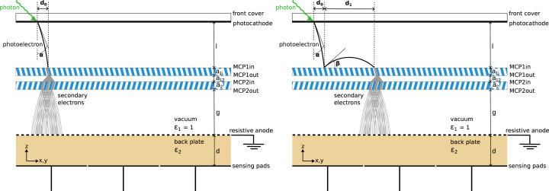
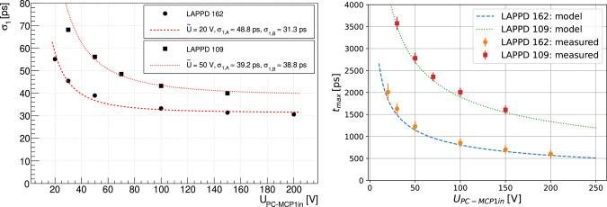
Paper
Electron bounce model
Model vs Data
Trey Grijalva
Notes:
Remember that bouncing electron from befroee. We modeled it and collected data from two different LAPPDs with slightly different gap sizes and voltages to verify that turning up the voltage applied across the gap from the back of the photocathode to top of the first MCP decreases the time the signal takes.
Here we can see that the model accounts for a bouncing electron’s displacement well.
Characterization of a large area MCP-PMT with capacitive read-out, arχiv: doi.org/10.48550/arXiv.2512.02990
Model detail slides:
https://agenda.infn.it/event/47073/contributions/276186/attachments/143395/217749/PD2025-Korpar.pdf

Slide 19





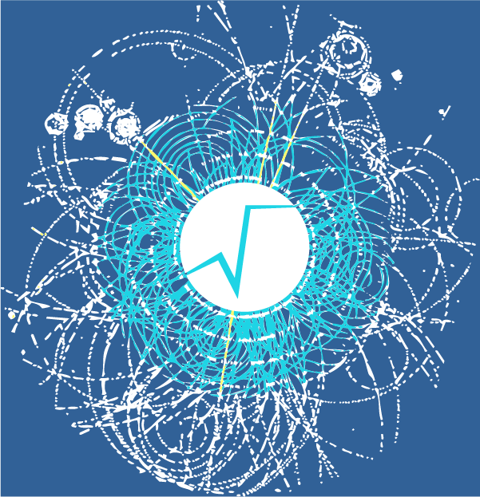




Analysis
BACKUP
0. rawDataToRootHists(.cxx) creates ROOT histograms and timing corrections ____from an “ini” scan parameter file + gZipped or waveform data
rootHistsToAnalysisReportPDF.cxx compiles the histograms into a PDF
copy2web.py uploads the report to F9’s intranet for backup and review
Trey Grijalva

Slide 20
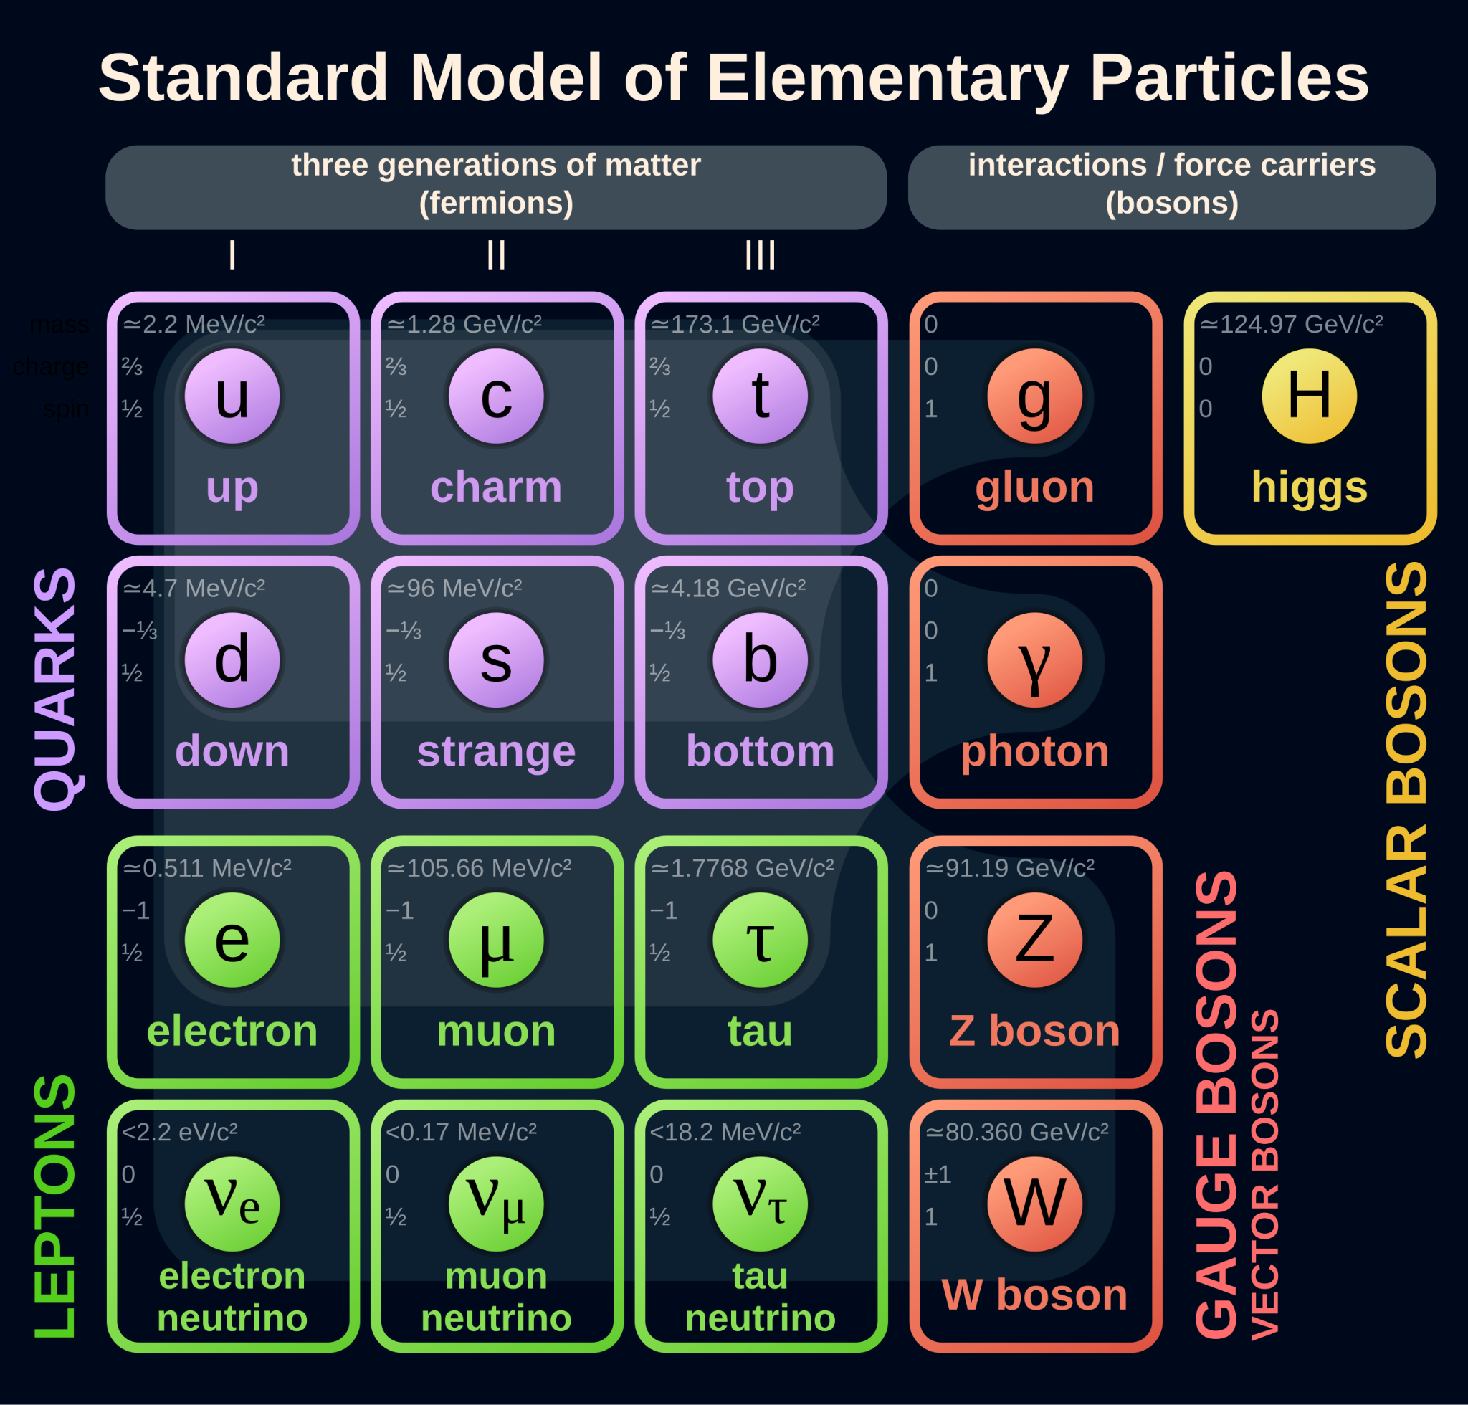
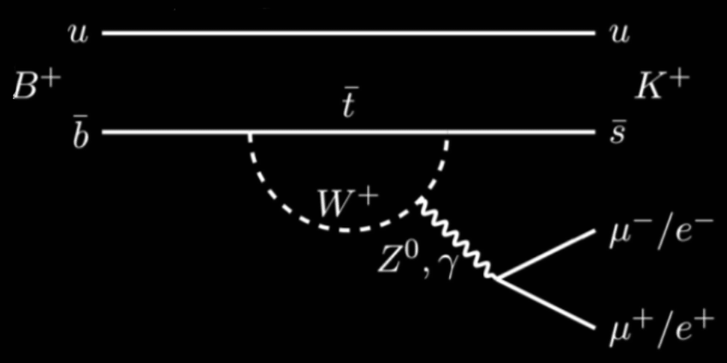
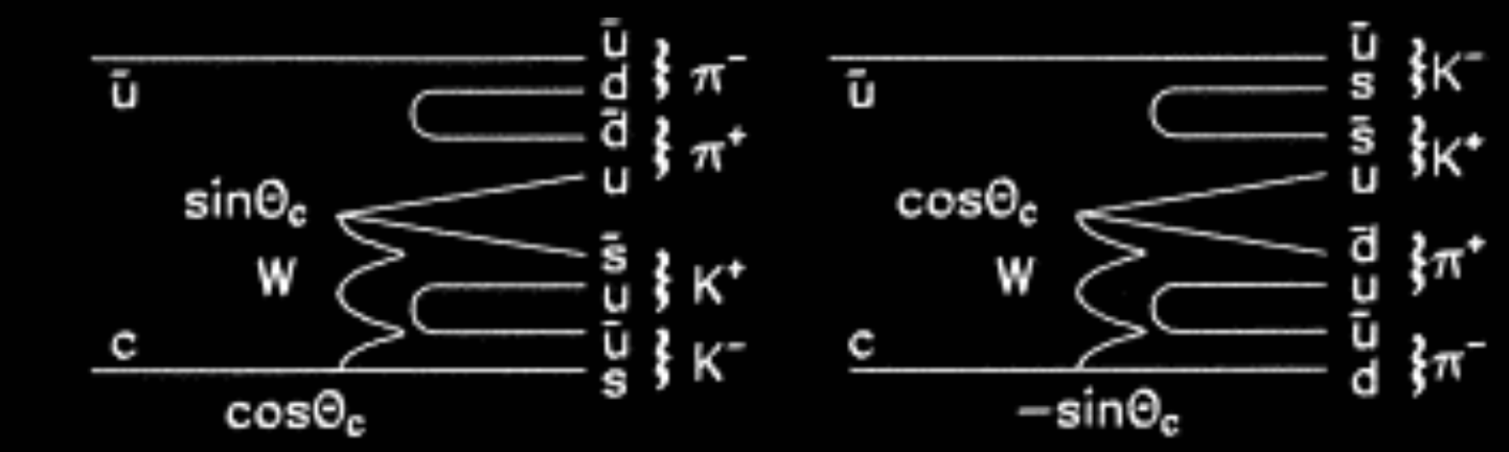
Rare processes
BACKUP
beauty
D⁰
D⁰
Trey Grijalva
Notes:
The top process has a branching fraction ~ 10⁻⁷ https://arxiv.org/pdf/1209.4284
The bottom processes hav a branching fraction ~ 10⁻³ https://pdgprod.lbl.gov/pdgprod/pdgLiveJson/Particle.action?init=0&node=S032&home=MXXX035

Slide 21
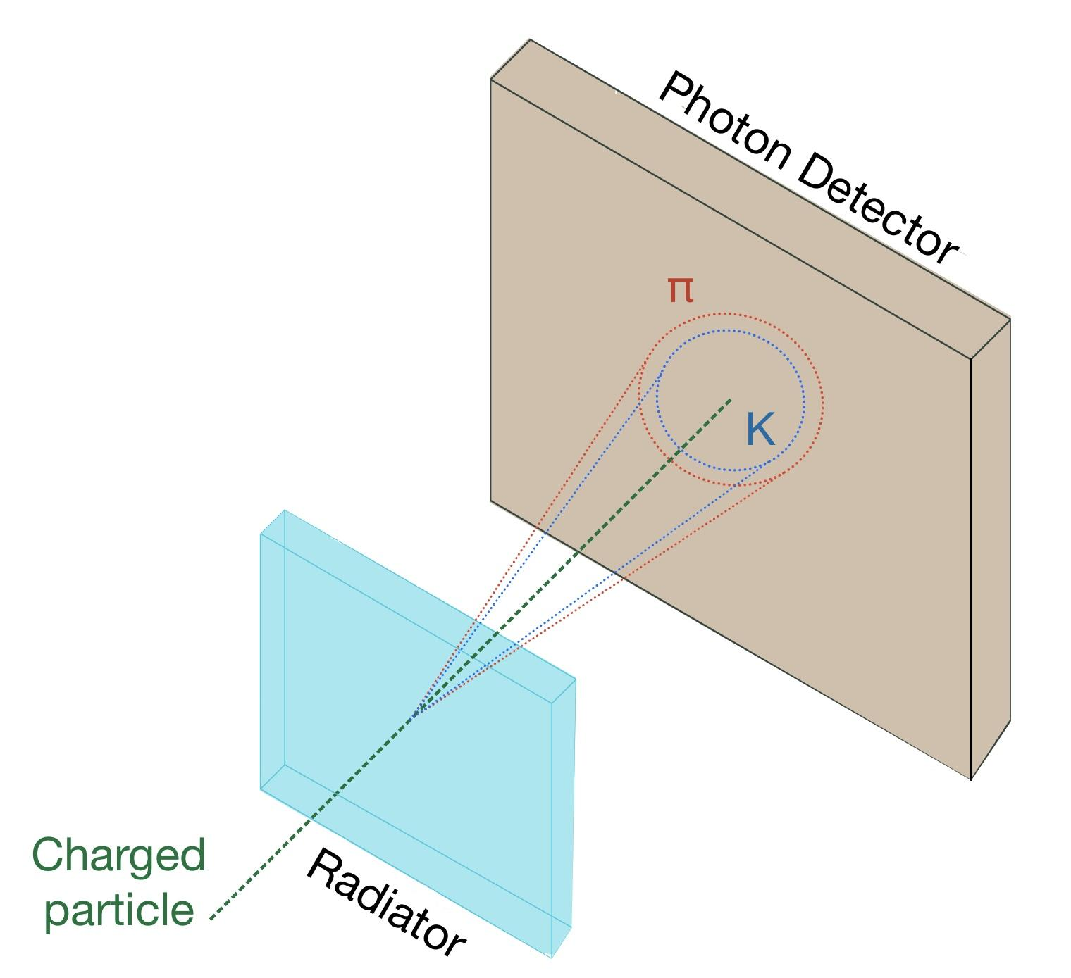
RICH Detectors
Ring Imaging CHerenkov detectors work when a charged particles passes through a radiator and produces a ring of photons
BACKUP
Trey Grijalva
Notes:
What is this RICH detector I have been talking about?
Ring Imaging Cherenkov “RICH” detectors work by taking a picture of the ring produced by a particle that passes through a Cherenkov radiator.
To determine which particle came through the detector, a log-likelihood fit is done on observed ring of photons to determine which particle probably passed through the radiator.

Slide 22
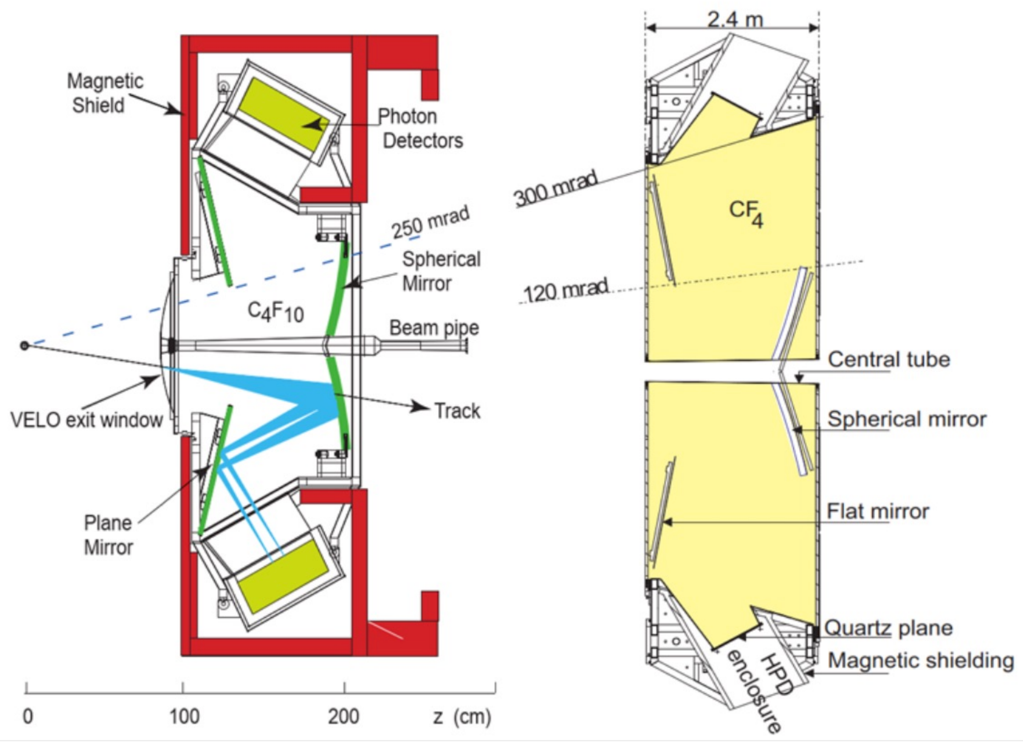
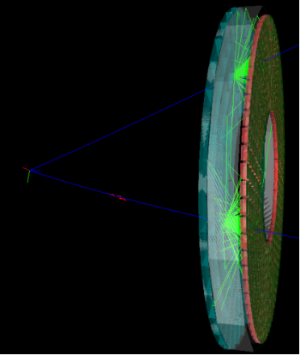
LHCb’s RICH Detectors Belle-II’s ARICH
Aerogel radiator
Cherenkov ring
Charged particle track
Single Sensor
Vertex
Charged particle track
Cherenkov ring
BACKUP
RICH 1
RICH 2
Trey Grijalva
Notes:
Back to the detectors themselves...
In reality, the design of the detectors is more complicated than the simplified drawing on slide 11.
Different detectors use different radiators for different situations, like packaging constraints or different momentum ranges. In LHCb has gaseous radiators and Belle II uses Aerogel.

Slide 23

Cherenkov Radiation
When a charged particle traverses a refractive medium faster than the phase velocity of light in the medium, the medium emits Cherenkov radiation. The emitted photons constructively interfere to form a coherent front.
BACKUP
Trey Grijalva
Notes:
A particle travelling through a material faster than the phase velocity of light in that material (c/n) will emit spherical wavefronts of EM radiation according to Huygen’s principal.
This energy polarizes the material and excites the atoms, most commonly the electrons of the atom. That excited electron can emit a photon to relax.
The emitted photons constructively interfere to form a coherent, polarized wavefront -- the cone pictured.

Slide 24


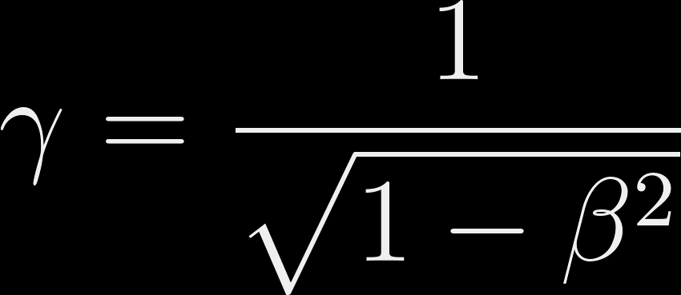


Using Cherenkov Radiation
BACKUP
Considering a Cherenkov photon emitted at the angle θ from a charged particle with rest mass m, relativistic velocity v & momentum p travelling through a medium with refractive index n,
Therefore, measuring the Cherenkov angle and momentum allows us to identify a particle by its mass
Trey Grijalva
Notes:
Considering a Cherenkov photon emitted at the angle θ from a charged particle with rest mass m, relativistic velocity v & momentum p travelling through a medium with refractive index n,
So, we detected the ring, and the index of refraction as well as the sensor’s distance from the radiator, therefore we can calculate the Cherenkov angle.
With that, and the momentum detected by the tracking detectors, we can calculate the mass of the particle to identify it.

Slide 25
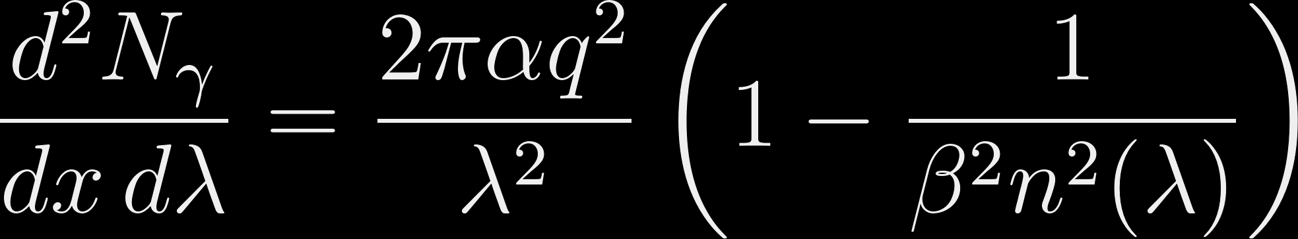
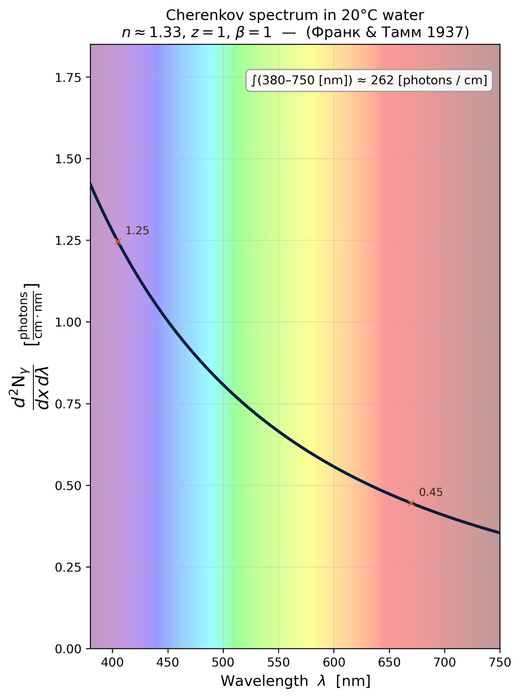
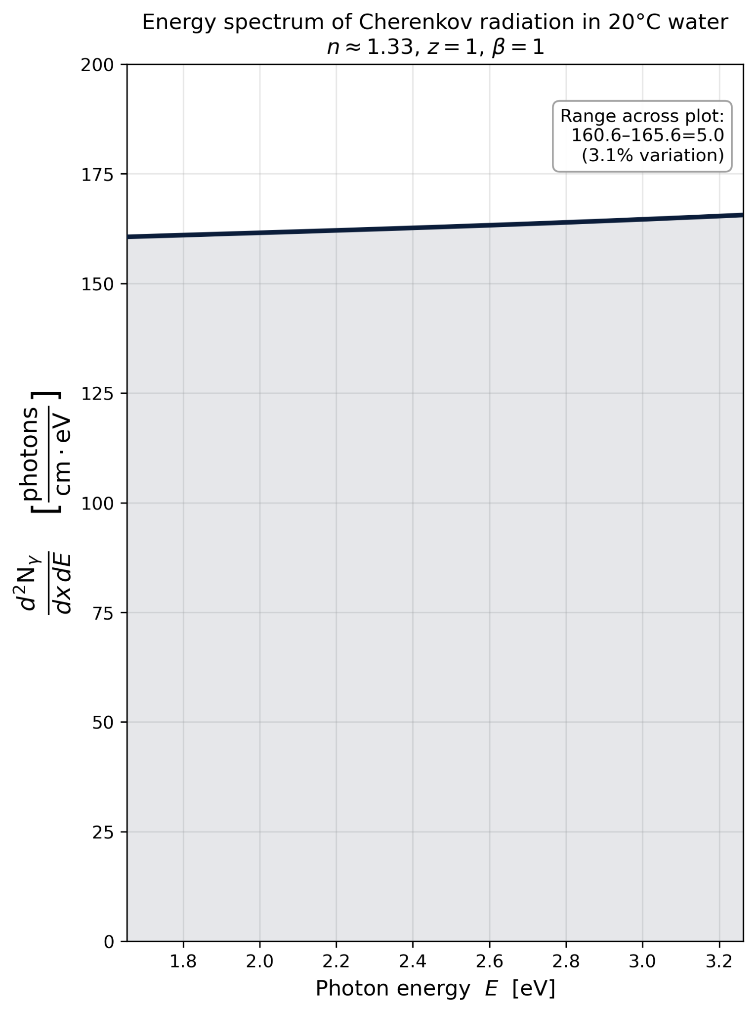
Cherenkov Radiation - Frank Tamm formula
Where
N_{γ} is the number of photons,
α is the fine structure constant, q is the charge.
BACKUP
Trey Grijalva
Notes:
Some people write the equation in terms of Energy,
Jackson shows write in terms of angular frequency to be consistent with his notation through the book.
I chose to write it in terms of wavelength because this shows why Cherenkov radiation appears blue when we see it around a reactor and this is what Frank & Tamm originally chose. (Although they wrote the derived version, not the version shown here after the integrals over x -> l and λ₂-λ₁)
The plot on the left show that the energy spectrum over the visual is pretty flat.
The plot on the right shows that most Cherenkov photons are of short wavelength, which is why reactors and strong sources appear to glow blue to our human eyes, which are tuned for the Sun’s spectrum which peaks at the edge of green at 555 nm (CIE ~ international commission on illumination)

Slide 26
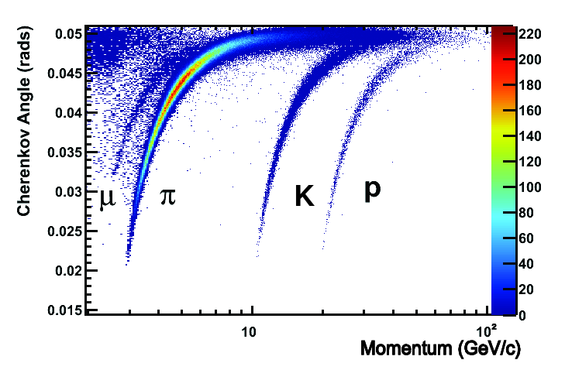
Particle Identification (PID)
Different particles with equal momentum produce rings with different opening angles
BACKUP
C₄F₁₀
Trey Grijalva
Notes:
Here you can see how the different particles with the same momentum have different Cherenkov ring opening angles.
I’ll explain that more in the coming slides, but what is important is that we can tell which particle is which by measuring this angle.
The top process has a branching fraction ~ 10⁻⁷ https://arxiv.org/pdf/1209.4284
The bottom processes hav a branching fraction ~ 10⁻³ https://pdgprod.lbl.gov/pdgprod/pdgLiveJson/Particle.action?init=0&node=S032&home=MXXX035

Slide 27
Particle Identification (PID)
BACKUP
Different particles with equal momentum produce different angles
D⁰
C₄F₁₀
D⁰
Trey Grijalva
Notes:
On the left are probably decays of the Charm and Beauty quarks.
On the right you can see how the different particles that have the same momentum have different Cherenkov angles.
I’ll explain that more in the coming slides, but what is important is that we can tell which particle is which by this measurement.
The top process has a branching fraction ~ 10⁻⁷ https://arxiv.org/pdf/1209.4284
The bottom processes hav a branching fraction ~ 10⁻³ https://pdgprod.lbl.gov/pdgprod/pdgLiveJson/Particle.action?init=0&node=S032&home=MXXX035

Slide 28

Micro Channel Plates (MCPs)
Inside each channel (blue) there is an emissive coating that releases more electrons when struck by an electron.
BACKUP
Trey Grijalva
Notes:
We have developed new technologies that promise better performance in the magnetic fields present in collider experiments, without compromising other performance. - https://doi.org/10.1016/j.nima.2023.168937
The new technology involves microchannel plates.
Instead of having discrete dynodes, they have a continuous channel with an emissive coating running through a plate.
An incident photon knocks a photoelectrona out of the photocathode which goes on to be “multiplied” as they bounce inside of the angled channel.

Slide 29

Shockley-Ramo theorem details
Shockley-Ramo
BACKUP
Trey Grijalva
Notes:
It’s important to emphasize that the signal we’re using to determine the timing performance isn’t the charge itself, it’s induced by the movement of the charge.

Slide 30
Shockley-Ramo theorem details
Shockley-Ramo
BACKUP
Trey Grijalva
Notes:
It’s important to emphasize that the signal we’re using to determine the timing performance isn’t the charge itself, it’s induced by the movement of the charge.

Slide 31
Shockley-Ramo theorem
Shockley-Ramo
BACKUP
Trey Grijalva
Notes:
It’s important to emphasize that the signal we’re using to determine the timing performance isn’t the electrons you see. The signal is induced by the movement of the charges.

Slide 32
Shockley-Ramo theorem
BACKUP
Trey Grijalva
Notes:
Having multiple anodes allows you determine where a particle went in space.
The nearby anodes can “see” the approaching charge, but only the anode the charge strikes actually collects the charge.

Slide 33
LHCb’s RICH Detectors Belle-II’s ARICH
BACKUP
Aerogel radiator
Cherenkov ring
Charged particle track
Sensor
Vertex
Charged particle track
Cherenkov ring
RICH 1
RICH 2
Trey Grijalva
Notes:
In reality, the design of the detectors is more complicated than the simplified drawing on slide 11.
Different detectors use different radiators for different situations, like packaging constraints or different momentum ranges.

Slide 34

LAPPDs
BACKUP
Trey Grijalva
Notes:
But we actually don’t have multiple anodes, we have one large, continuous anode that is capacitively coupled to a backplane for reading out the signal.
This capacitive coupling allows us to try different segmentation arrangements.

Slide 35
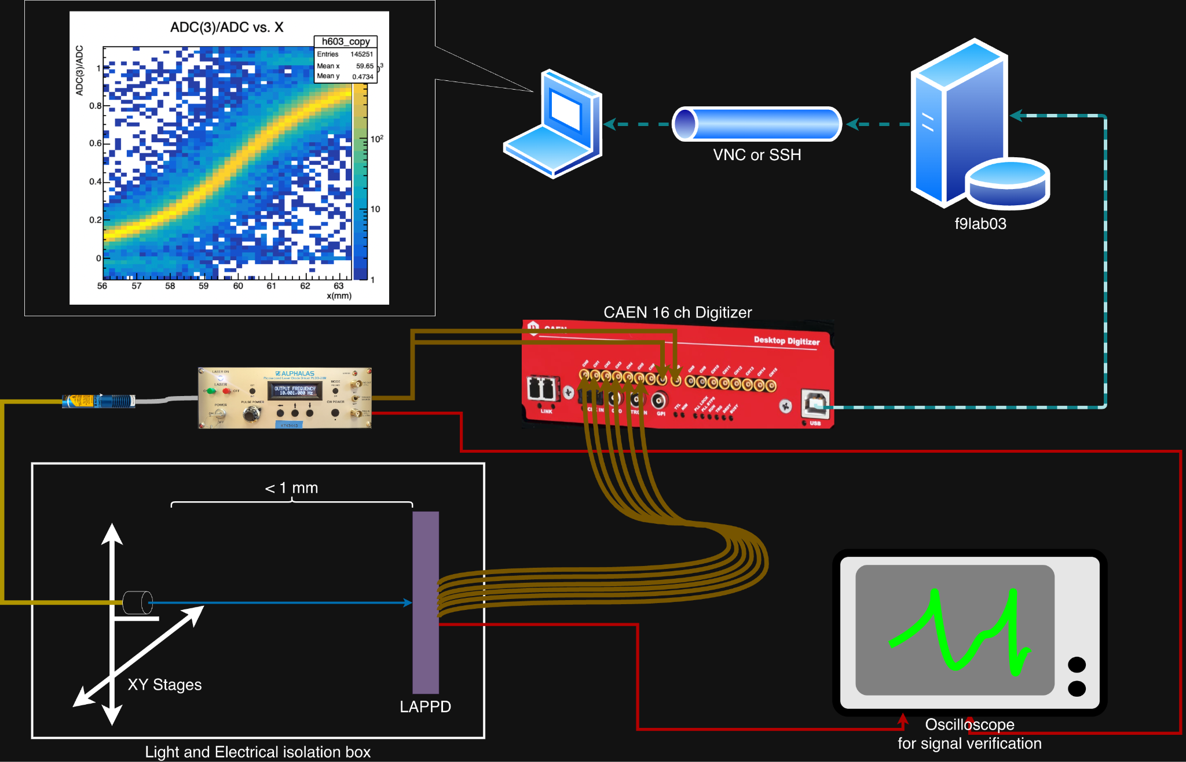
Experimental setup
BACKUP
Trey Grijalva
Notes:
This is a simplified diagram of the setup.
The laser is fired at the LAPPD, which produces a signal.
That signal is sent to the Oscilloscope so we can be sure everything is working, and to the CAEN digitizer to be collected as data on a PC.
The data on that PC is then analyzed to determine the performance of the detector.

Slide 36
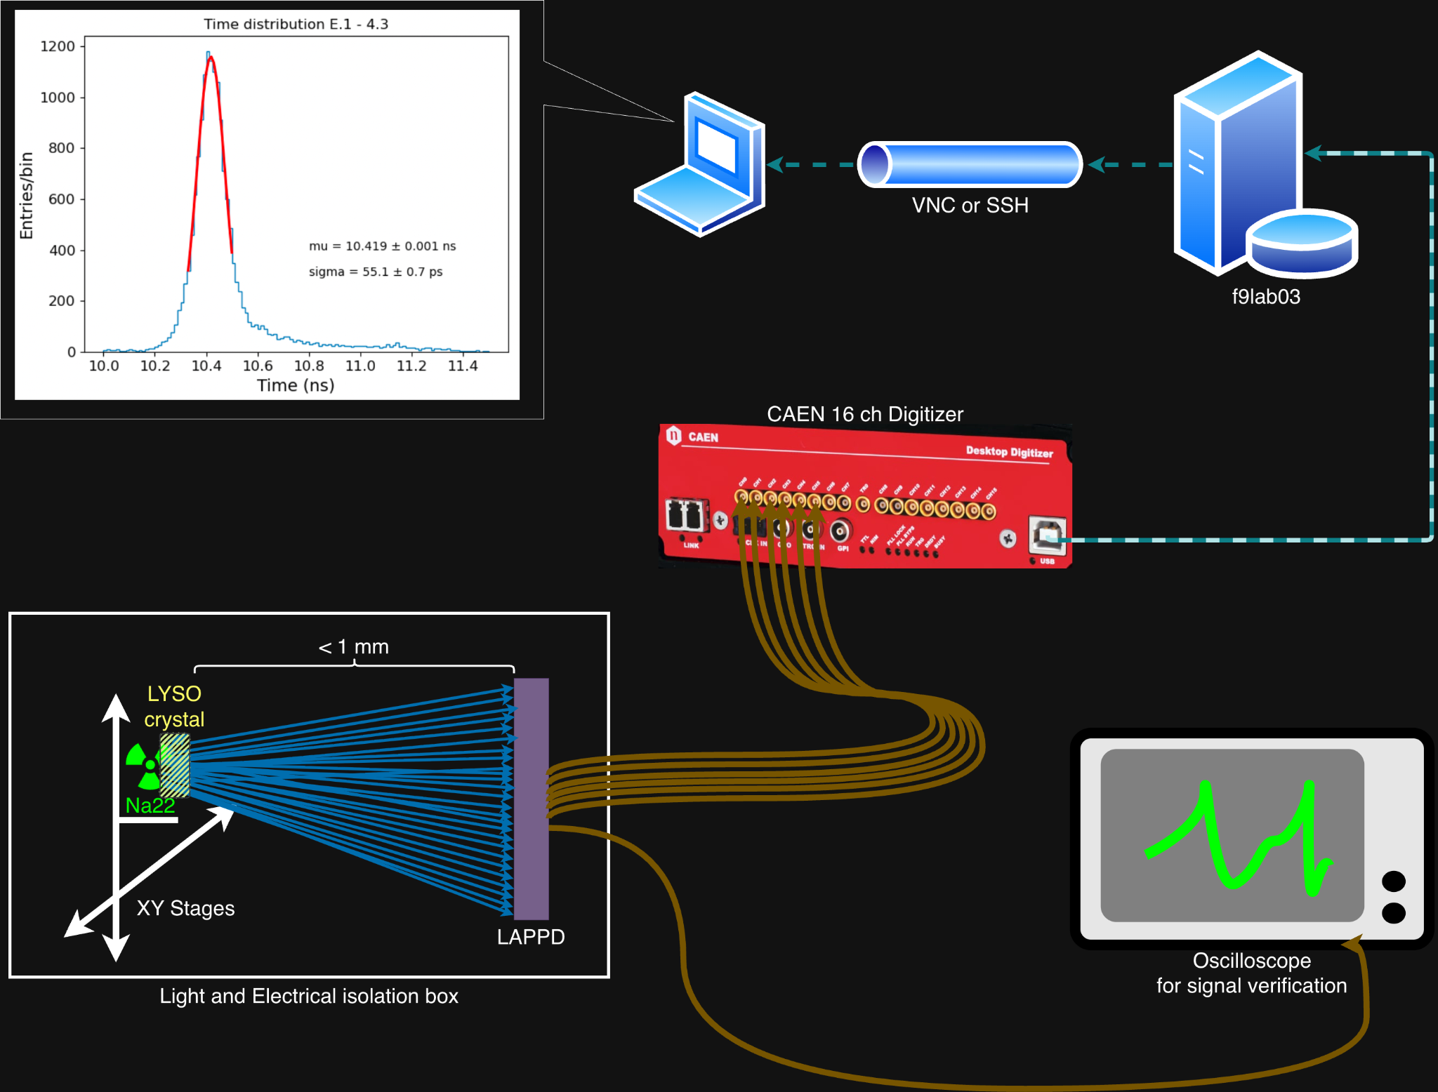
Characterization
Source setup and readout chain
BACKUP
Trey Grijalva

Slide 37
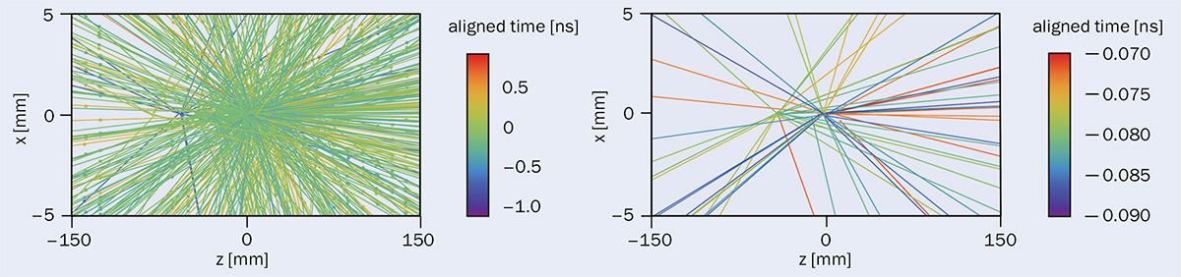
Motivation for R&D
BACKUP
Event pile-up over 2 ns
Event pile-up over 20ps
Future detectors require better time resolution (<50 ps) to separate tracks and ID particles
Trey Grijalva

Slide 38
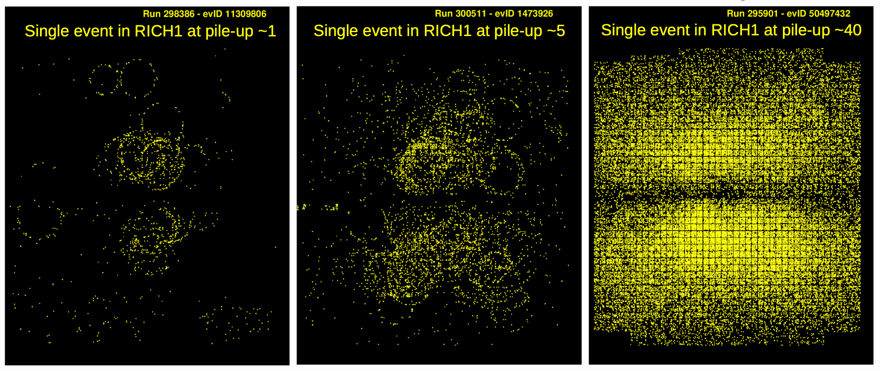
Motivation for R&D: RICH pile-up
BACKUP
Trey Grijalva
Notes:
Pile up [# of Interactions]

Slide 39
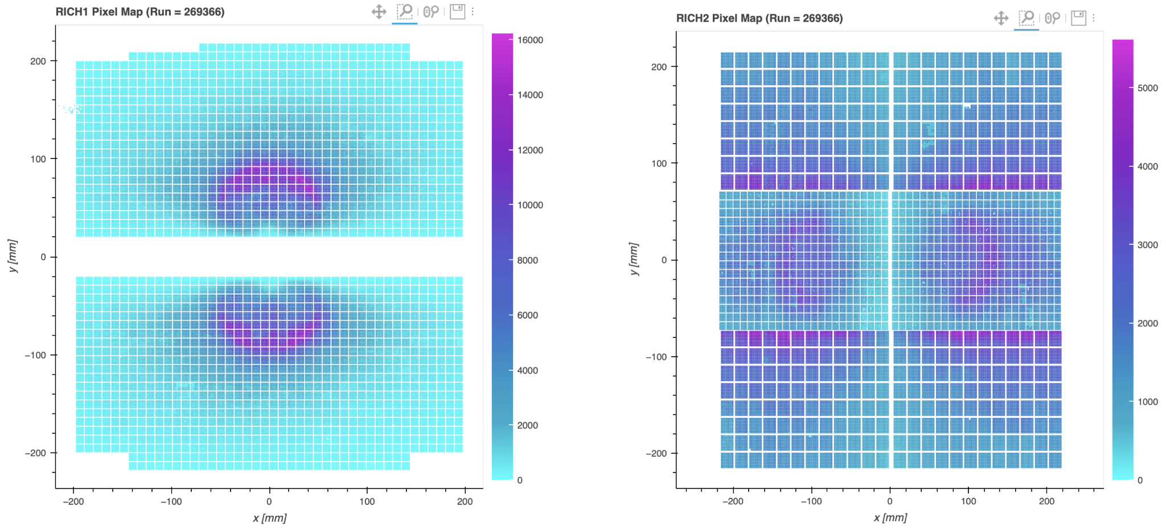
LAPPDs - segmentation flexibility requirement
BACKUP
Trey Grijalva
Notes:
Speaking of multiple anodes, let’s talk about segmentation.
The colors show occupation, with cyan being low occupation and magenta being high occupation.
As you can see on the left, the central region of RICH1 has several orders of magnitude higher occupancy than the outer regions.
On the right you can see that larger sensors further from the high-occupancy center also have relatively high occupancy.
Smaller sensor areas in high occupancy regions help avoid over-occupancy while larger sensors in lower occupancy regions help save overhead and cost.

Slide 40
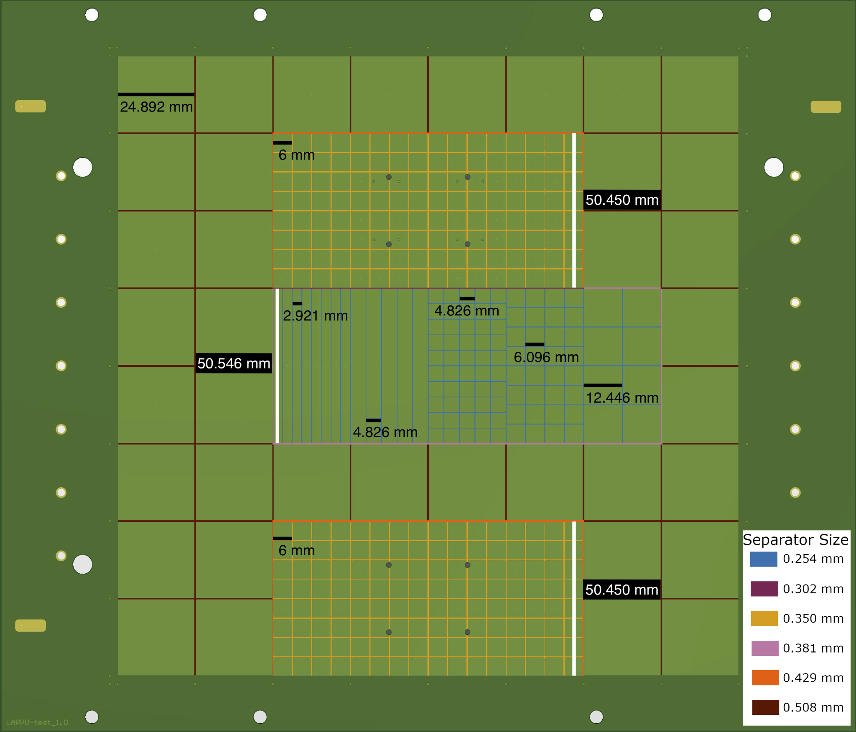
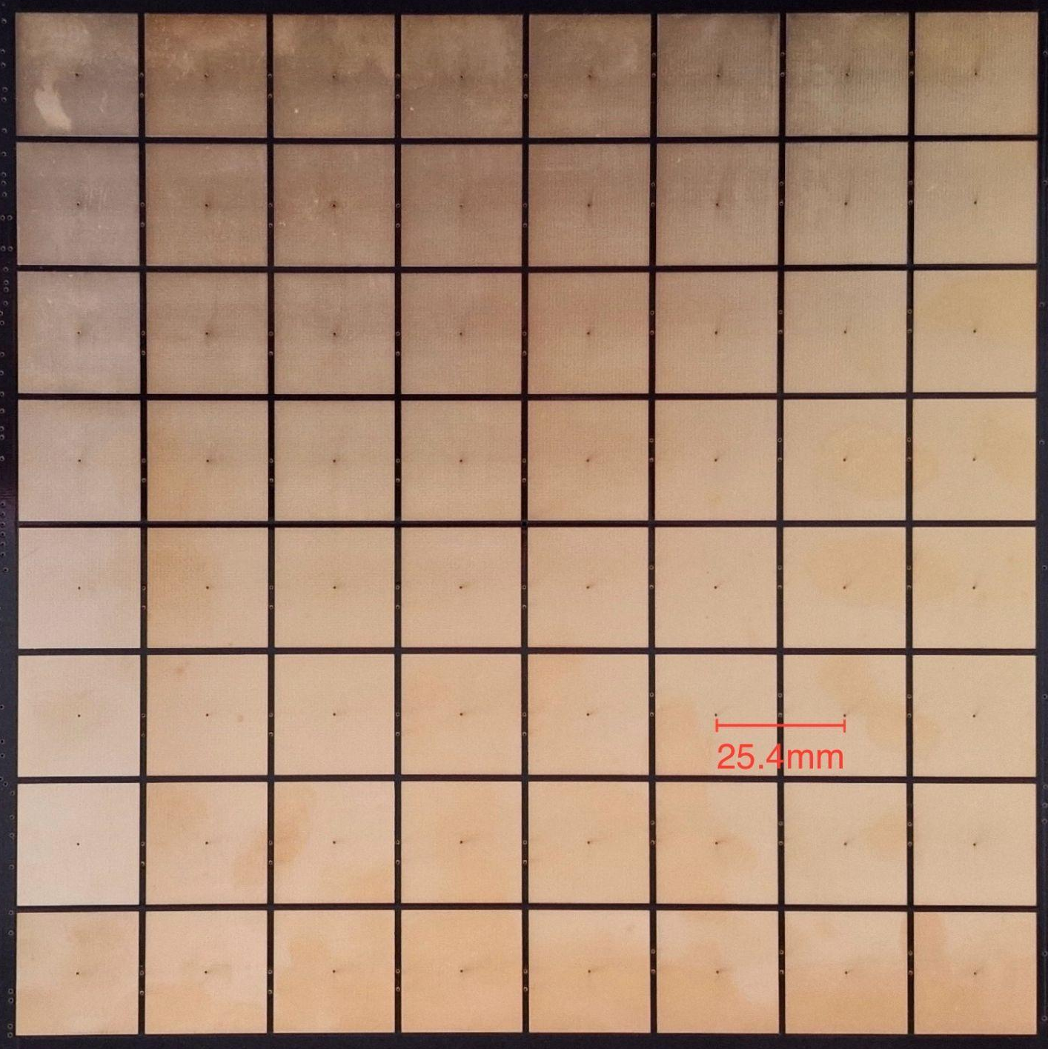
LAPPDs
Capacitive coupling allows flexible readout segmentation.
Trey Grijalva
Notes:
On the left is the original backplane with all the same electrode size at 25.4mm pitch.
On the right is the design we’re currently testing.
The newest LAPPDs have a capacitively coupled anode.
This means the anode is not directly connected to the electrode, which allows us to use different electrode sizes and configurations to see what performs the best.

Slide 41
Motivation for R&D: Upgrade 2
“The installation of the LHCb Upgrade II detector will occur during LS4. [(July ‘26 - Dec ‘29) ...] All PID subdetectors would be severely affected by the significant rise in particle flux and occupancy at the Upgrade II luminosity targets, some reaching 100% occupancy in the inner region near the beam line. [...] Improved granularity is shown to be insufficient to fully mitigate the effects of increased pile-up. Therefore, additional hit time information of order tens of picosecond resolution is required to suppress background” - LHCb Upgrade 2 TDR
BACKUP
Trey Grijalva

Slide 42
Detector R&D
Research and Development is defined as Applied research carries the findings of basic research to a point where they can be exploited to meet a specific need, while the development stage of research and development includes the steps necessary to bring a new or modified product or process into production. - Britannica
In practice, Detector R&D is the creation of tools & methods to test new detector technologies.
BACKUP
Trey Grijalva

Slide 43
DRD4
“The scope of the DRD4 international Collaboration, which is anchored at CERN, is to bundle and boost R&D activities in photodetector technology and particle identification techniques for future high-energy physics (HEP) experiments and facilities”
WG1: Photon Detectors
WP2: Vacuum-based Photon Detectors
Studies of large-area vacuum photo sensors, e.g., LAPPDs
BACKUP
Trey Grijalva
Notes:
One of the groups in their experimental programme is the DRD4 collaboration, which studies Photon Detectors and Particle Identification.

Slide 44
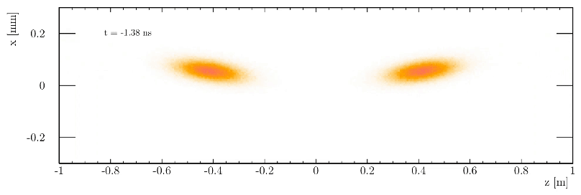
LHC
BACKUP
Trey Grijalva

Slide 45
Experimental setup
BACKUP
LAPPD
LASER focuser
LASER stages
Trey Grijalva

