Slide 1
HPC Vega za industrijo | HPC Vega for Industry
Speakers:
Darin Lah (IZUM)
dr. Dejvid Črešnar (IZUM)
Samo Miklavc (IZUM)
Teo Prica (IZUM)
Vid Vilec Letonja (IZUM)
dr. Žiga Zebec (IZUM)
Date: 15.10.2026​

Slide 2
Today‘s Schedule
09:00 AM
09:20 AM
Introduction to SLAIF and HPC Vega
09:20 AM
10:40 AM
Accessing and Optimizing HPC Vega Workflows
10:40 AM
11:00 AM
Coffee Break
11:00 AM
12:10 PM
Optimizing Your Workflow + Q & A
12:10 PM
12:30 PM
Coffee Break
Only for live participants
12:30 PM
14:00 PM
Live HPC Vega Showcase + Discussion

Slide 3
Introduction to SLAIF and HPC Vega
Speaker: dr. Dejvid Črešnar (IZUM)

Slide 4


Slovenian AI Factory (SLAIF) Project
Project duration: 1/9/2025 – 31/8/2028 (36 months)
Project consortium members:
Project objectives:
  Establish and operationalise SLAIF as a national AI and HPC ecosystem.
  Enable the development, experimentation, adoption, and innovation in AI.
  Target users from industry, SMEs, the public sector, and research.
  Focus on four strategic vertical domains: green transition, health and biotechnology, digital society, and AI for science.

Slide 5
SLAIF Services
Core AI Platform
User-Centric AI Services
Vertical Services for Sectorial Applications
AI Skills and Training
AI Workflows
Data preparation for training
Fine-tuning
Evaluation
Inference
LLM workflows
VLM workflows
Vision workflows
Audio Workflows
Classical ML
Data Storage Connectors
Workspace
Data movers
Dataspace connectors
Domain pipelines
Synthetic data
AI for Green Transition
Industrial visual inspection and defect detection
Energy grid optimisation
Weather forecasting
AI Talen Development
Curricula
Micro-credentials
Massive open online courses
AI for Health and Biotechnology
Biosignal and imaging diagnostics
Lab-test interpretation
SME and Industry Engagement
AI Industry Days
Matchmaking events
Polls and feedback
SME-tailored training
User Interface and User Experience
OpenShift cloud-like environment
Horizon dashboard
Kubernetes cluster
AI for Digital Society
Foundation models (reasoning engine) with agentic RAG
Anonymisation for regulated domains
Semantic Catalogue Hub
Registry of SLAIF services and artefacts – workflows, models, datasets, tools
Customising Training
Beginners, intermediate, advanced
Sector-specific modules
AI for Science
Scientific modelling
Symbolic regression

Slide 6


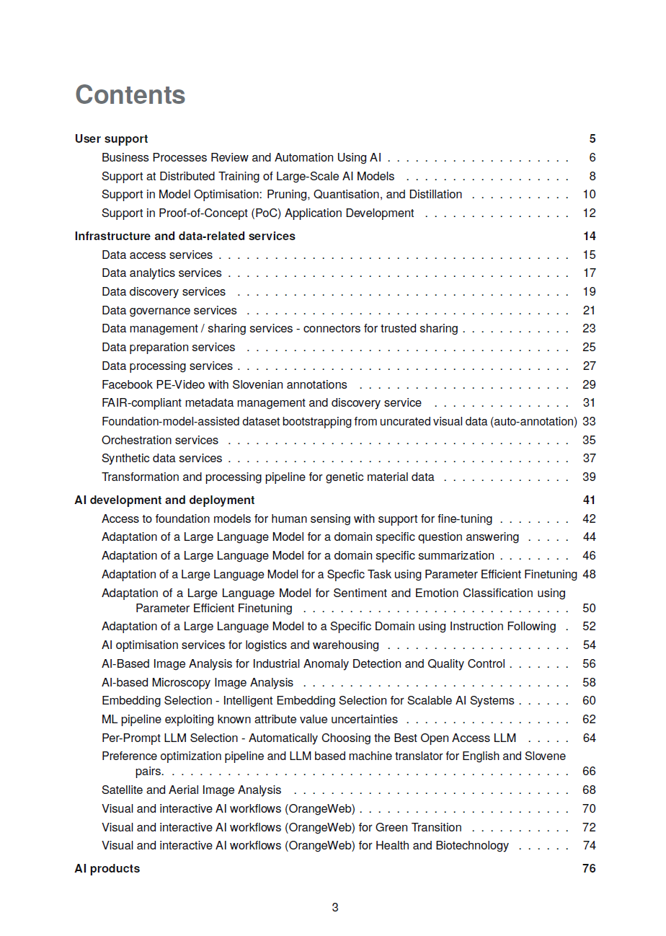
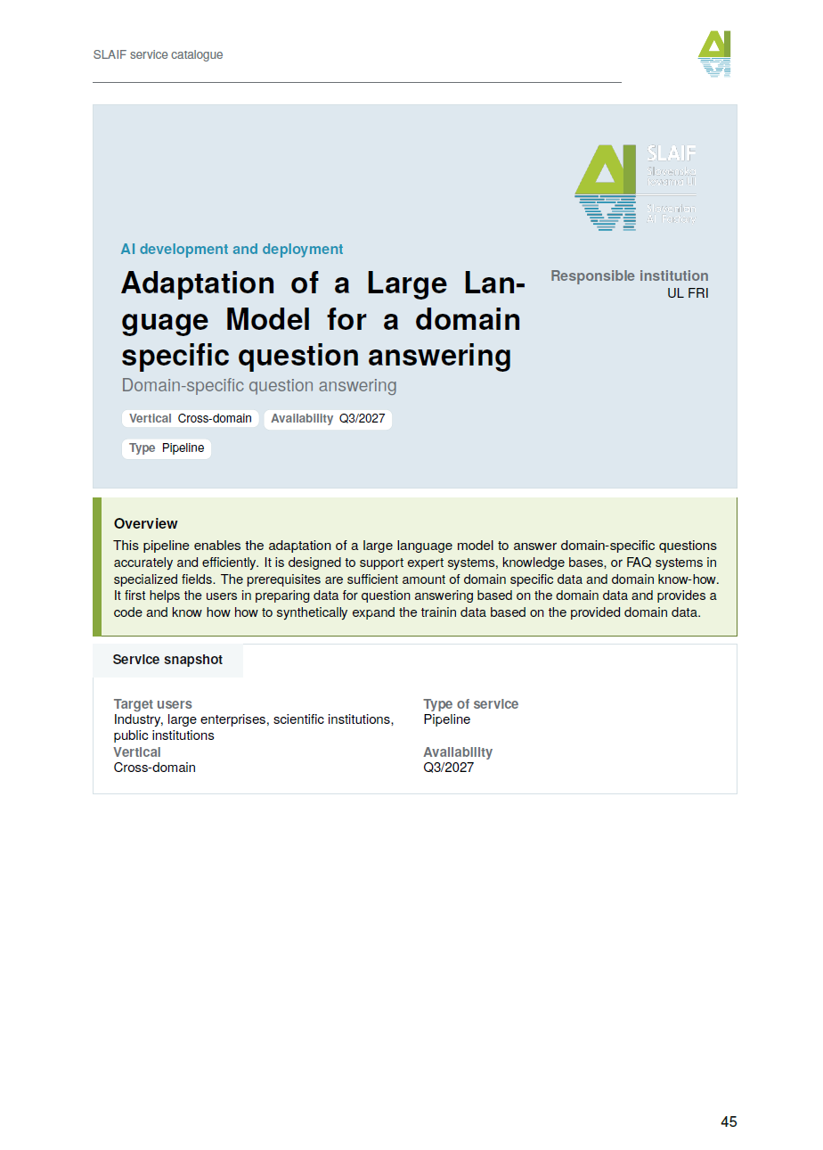
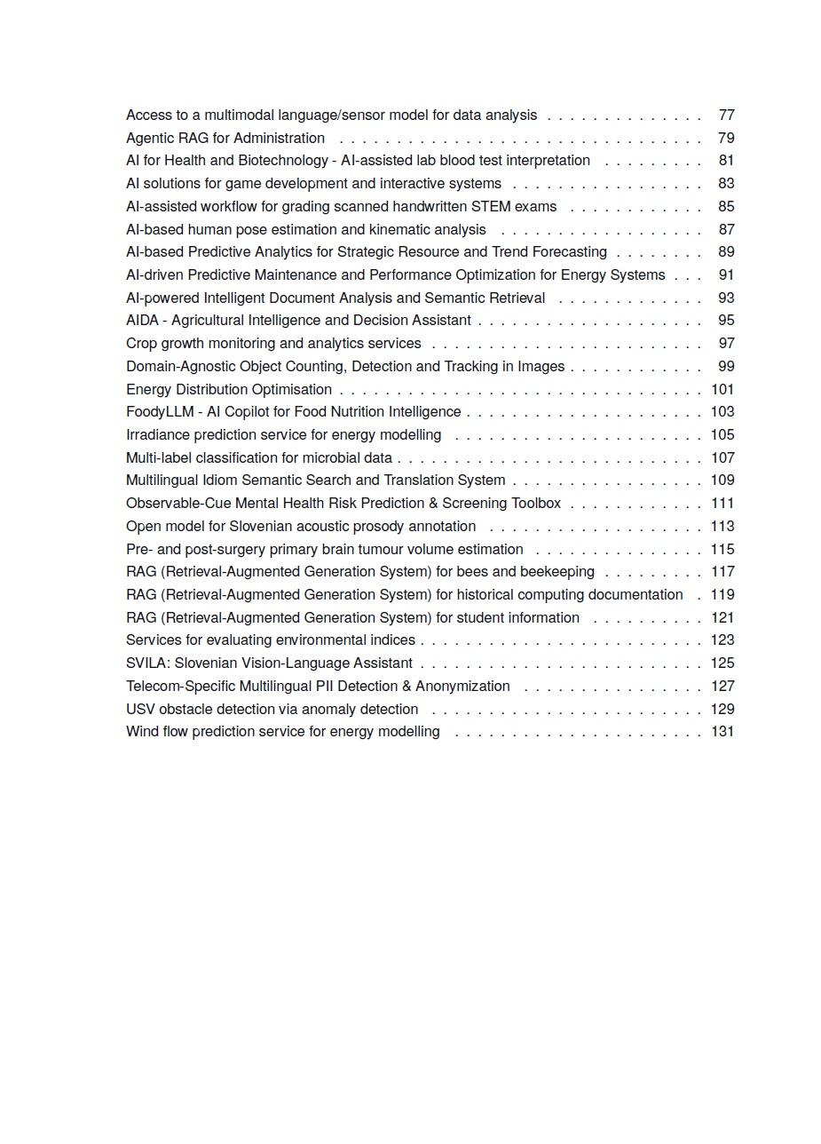
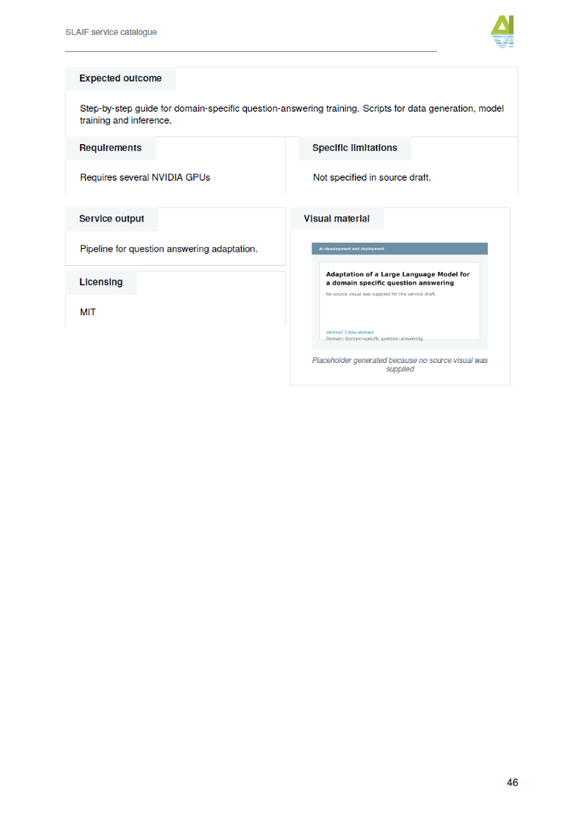
SLAIF Service Catalogue
Available on the SLAIF website:
https://www.slaif.si/

Slide 7


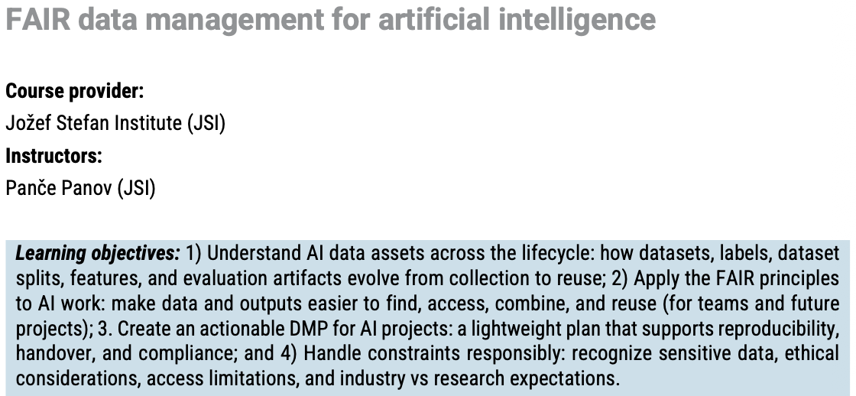
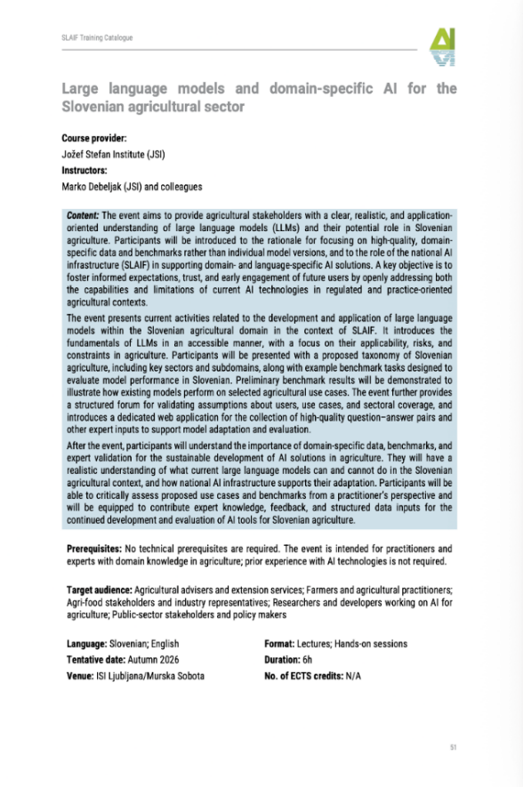
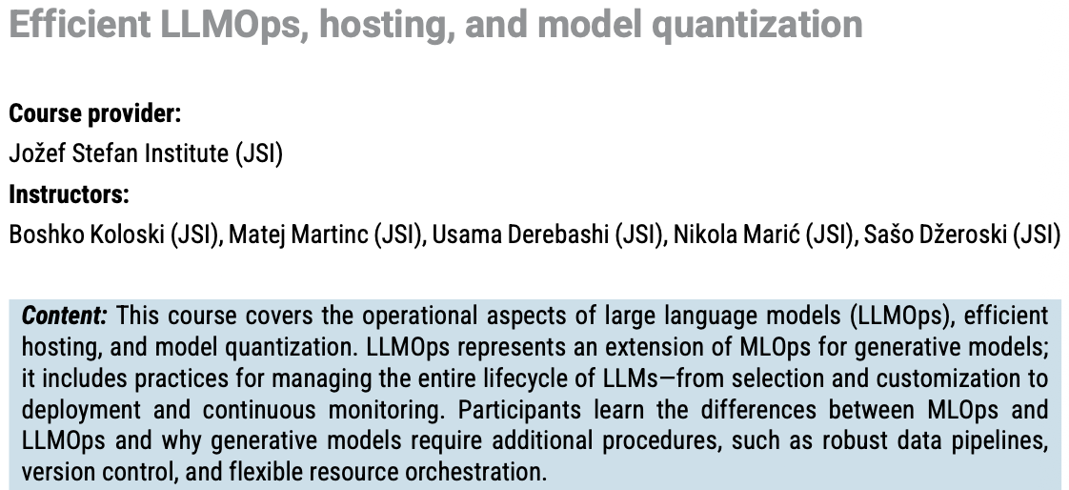
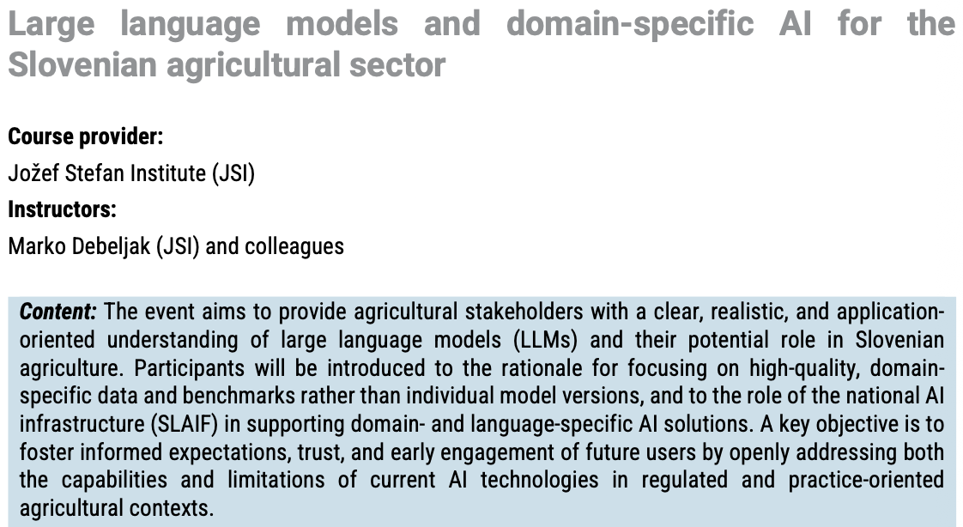
SLAIF Service Catalogue
Available on the SLAIF website:
https://www.slaif.si/

Slide 8
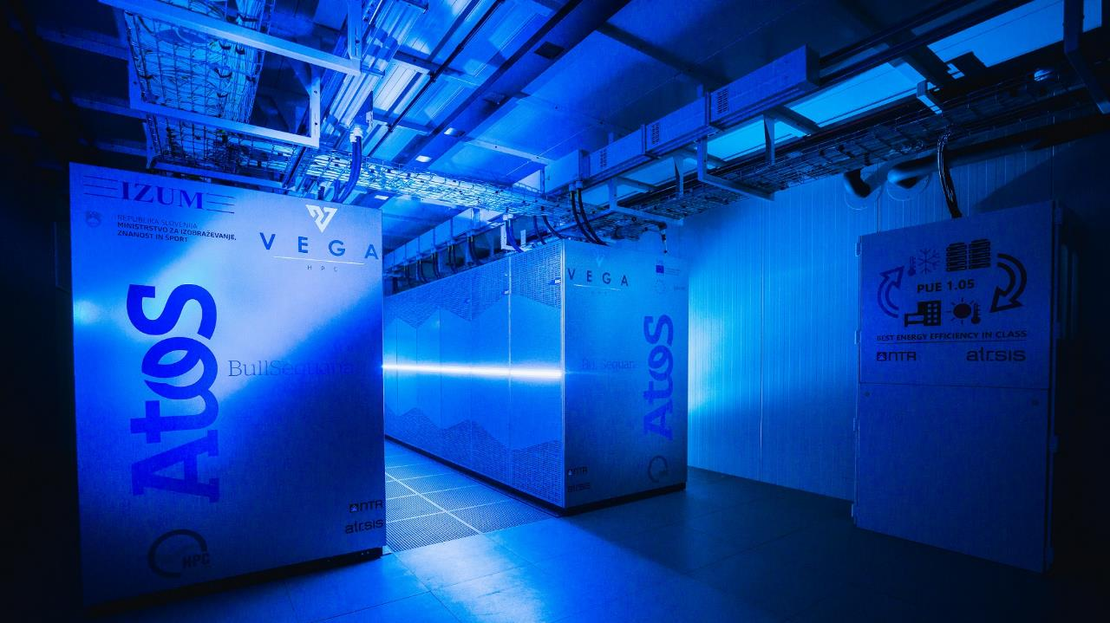
High-Performance Computer Vega (HPC Vega)
Named after Baron Jurij Vega – mathematician, physicist, and artillery officer.
Commissioned as the primary supercomputer system of the Slovenian national research infrastructure upgrade project HPC RIVR.
First operational HPC system of the EuroHPC JU family.
Operational since April 2021.

Slide 9
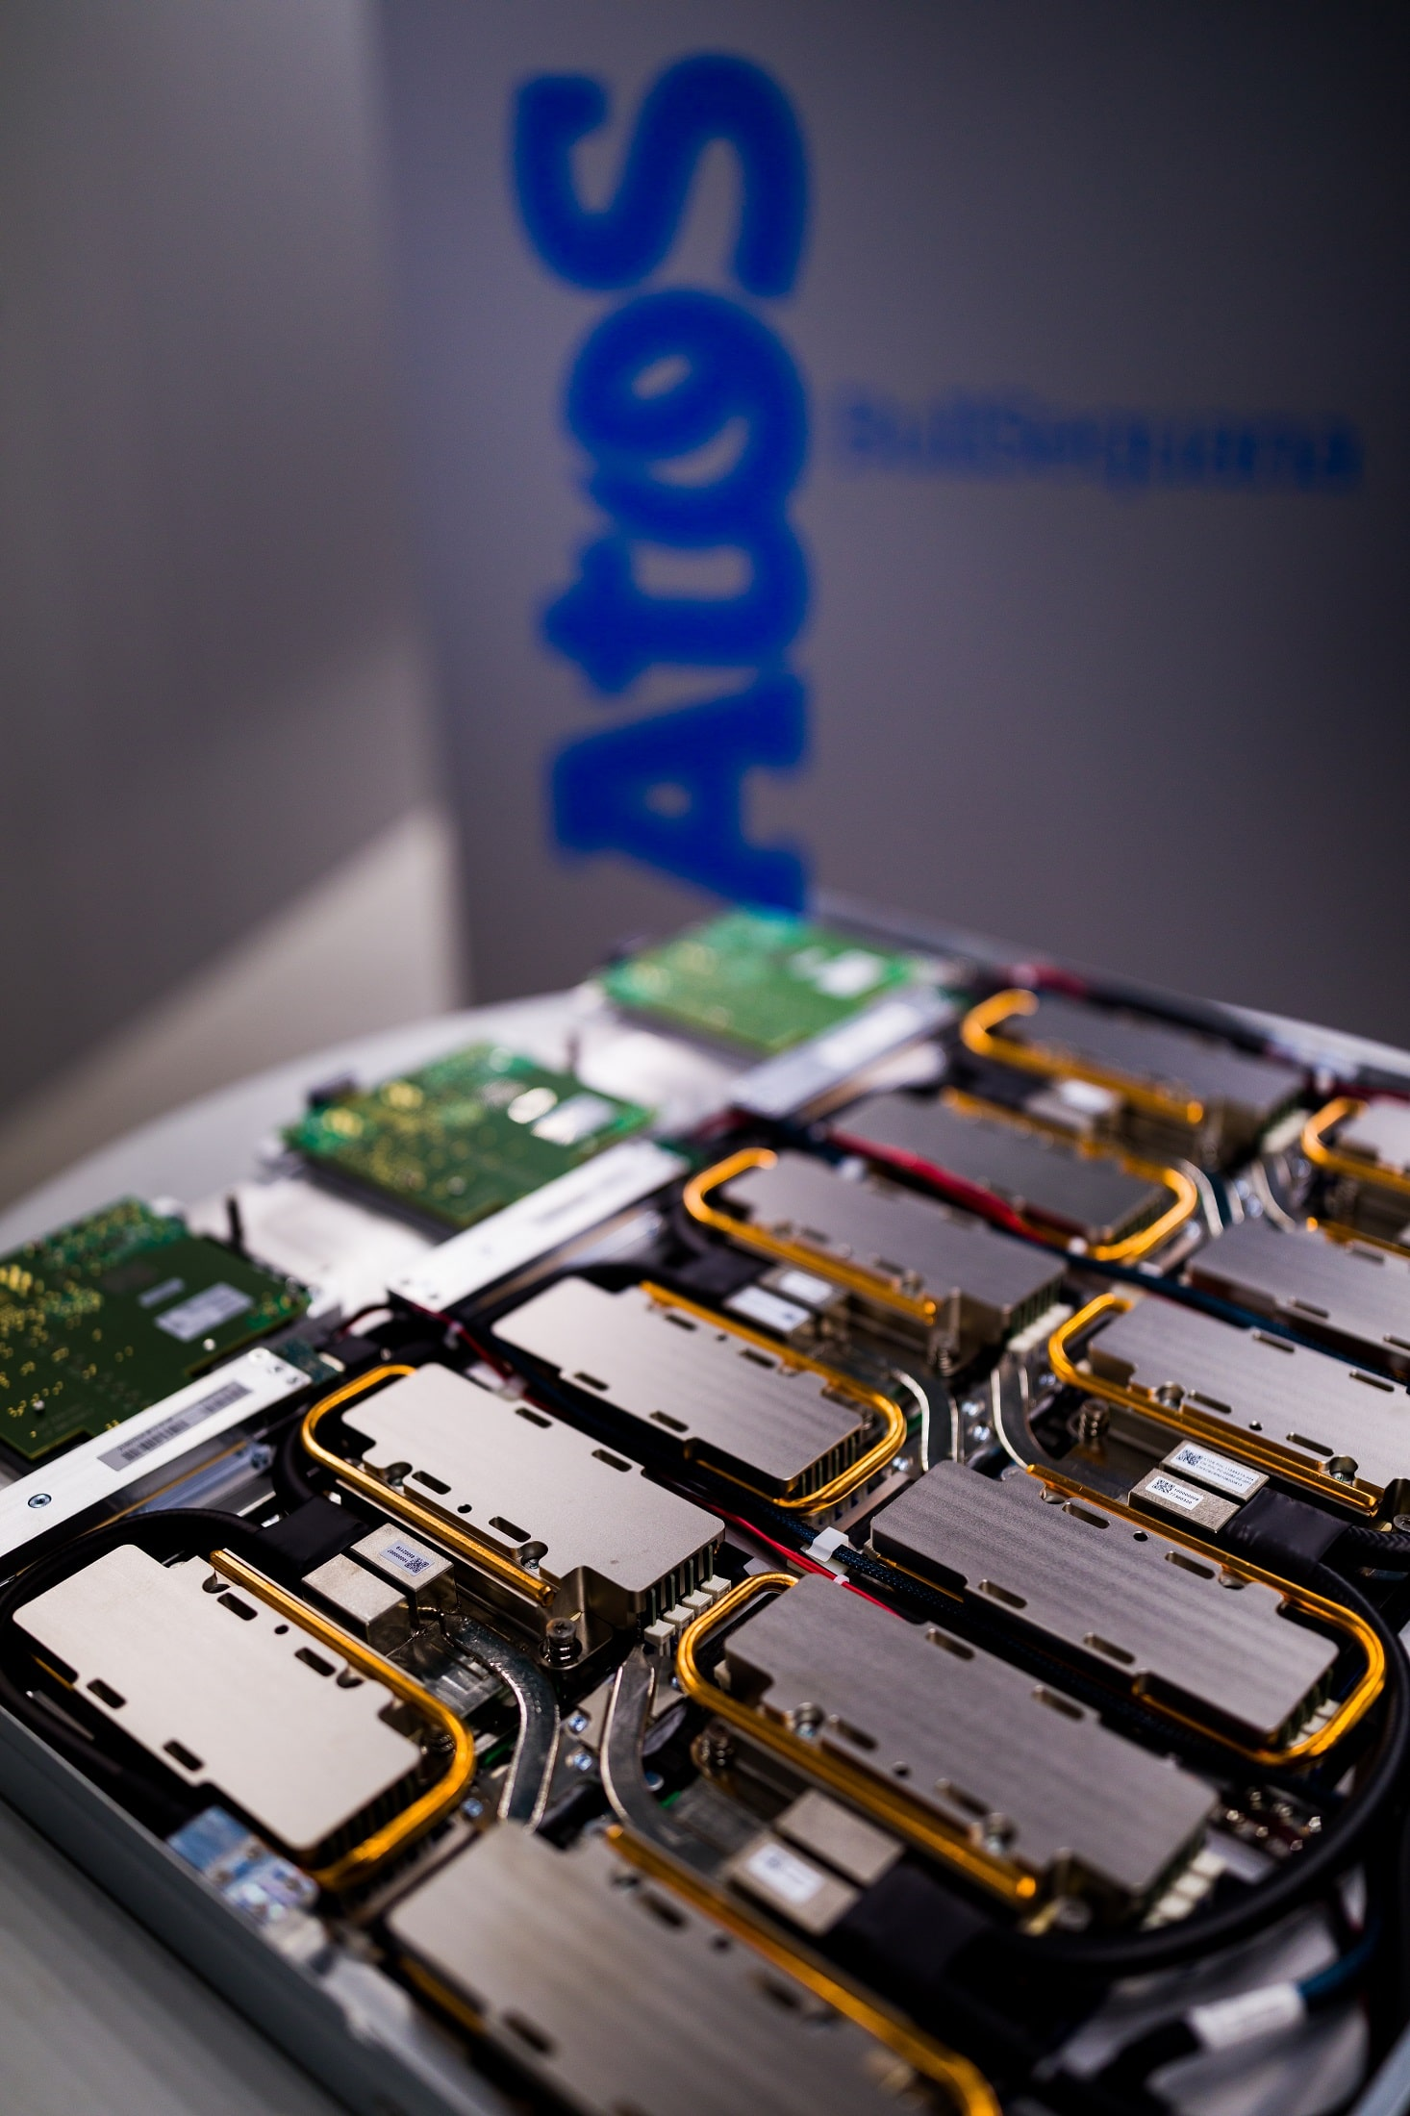
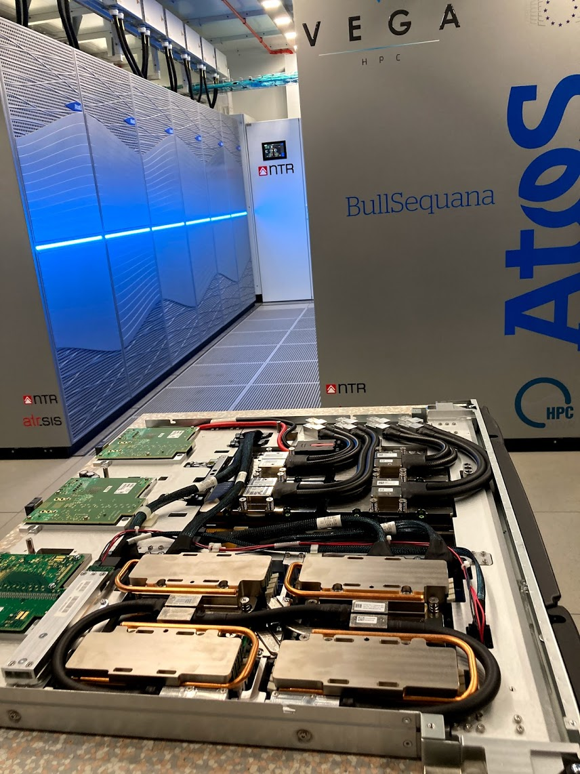
High-Performance Computer Vega (HPC Vega)
960 CPU nodes (1920 AMD Epyc 7H12 CPUs – 122000 cores):
  768 standard compute nodes (256GB of RAM);
  192 large memory compute nodes (1TB of RAM).
60 GPU nodes (240 NVIDIA A100 GPUs).
18PB large capacity storage system Ceph (>200GB/s).
1PB high-performance storage system Lustre (>400GB/s).
More details at: https://izum.si/en/vega-en/

Slide 10

High-Performance Computer Vega2?
Phased implementation strategy:
Stage 1 – Initial Deployment and Foundational Integration (Pre-Expansion)
Establish immediate operational capabilities using a hybrid integration model (connecting local cloud to HPC resources).
Stage 2 – Infrastructure Expansion (Post-Procurement)
Significant expansion of local resources through planned procurement.
Stage 3 – AI-HPC Phase II Expansion (2028 Deployment)
Balance immediate research needs with a scalable pathway for long-term infrastructure growth.
Arnes data centre Maribor

Slide 11
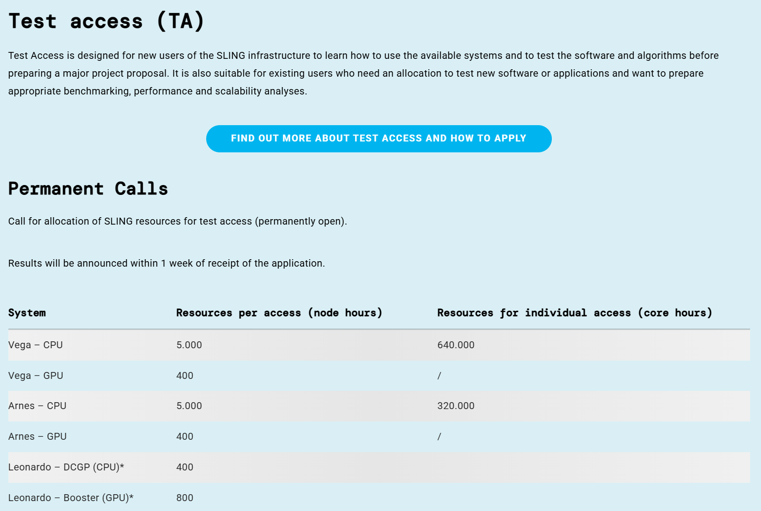

How to get Access?
Non-commerical Route
Free of charge, limited amount of resources
Slovenia National Supercomputing Network (SLING)
  Test Access (permanently open)

Slide 12
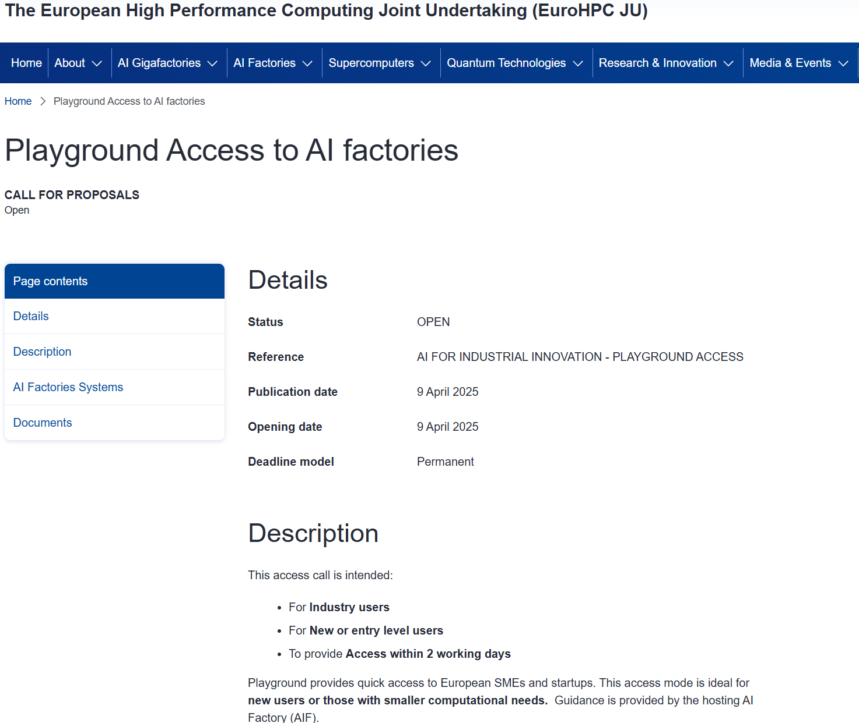
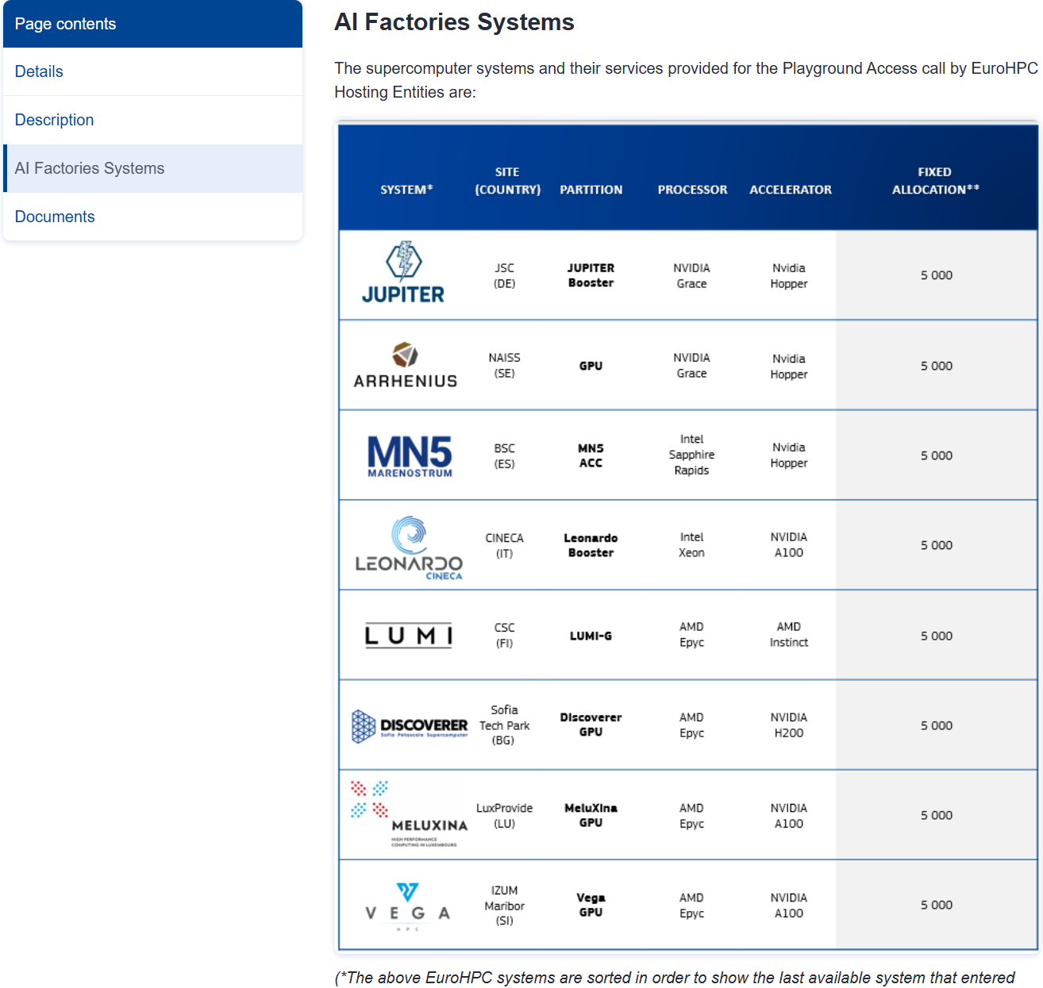
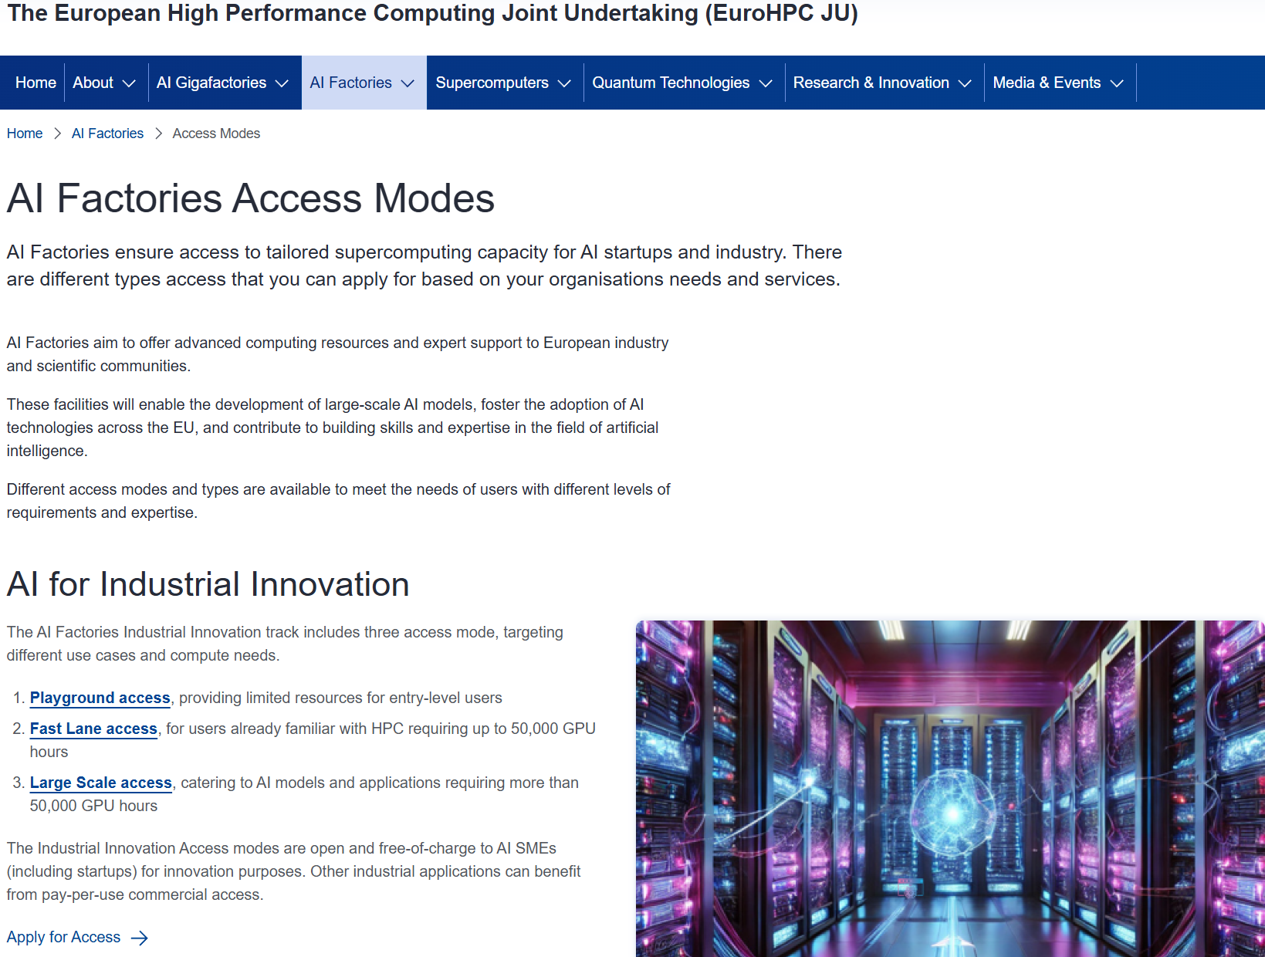
How to get Access?
Non-commerical Route
Limited amount of resources
Slovenia National Supercomputing Network (SLING)
  Test Access (permanently open)
European HPC Joint Undertaking (EuroHPC JU)
  AI Factories
    Playground Access (permanently open)

Slide 13
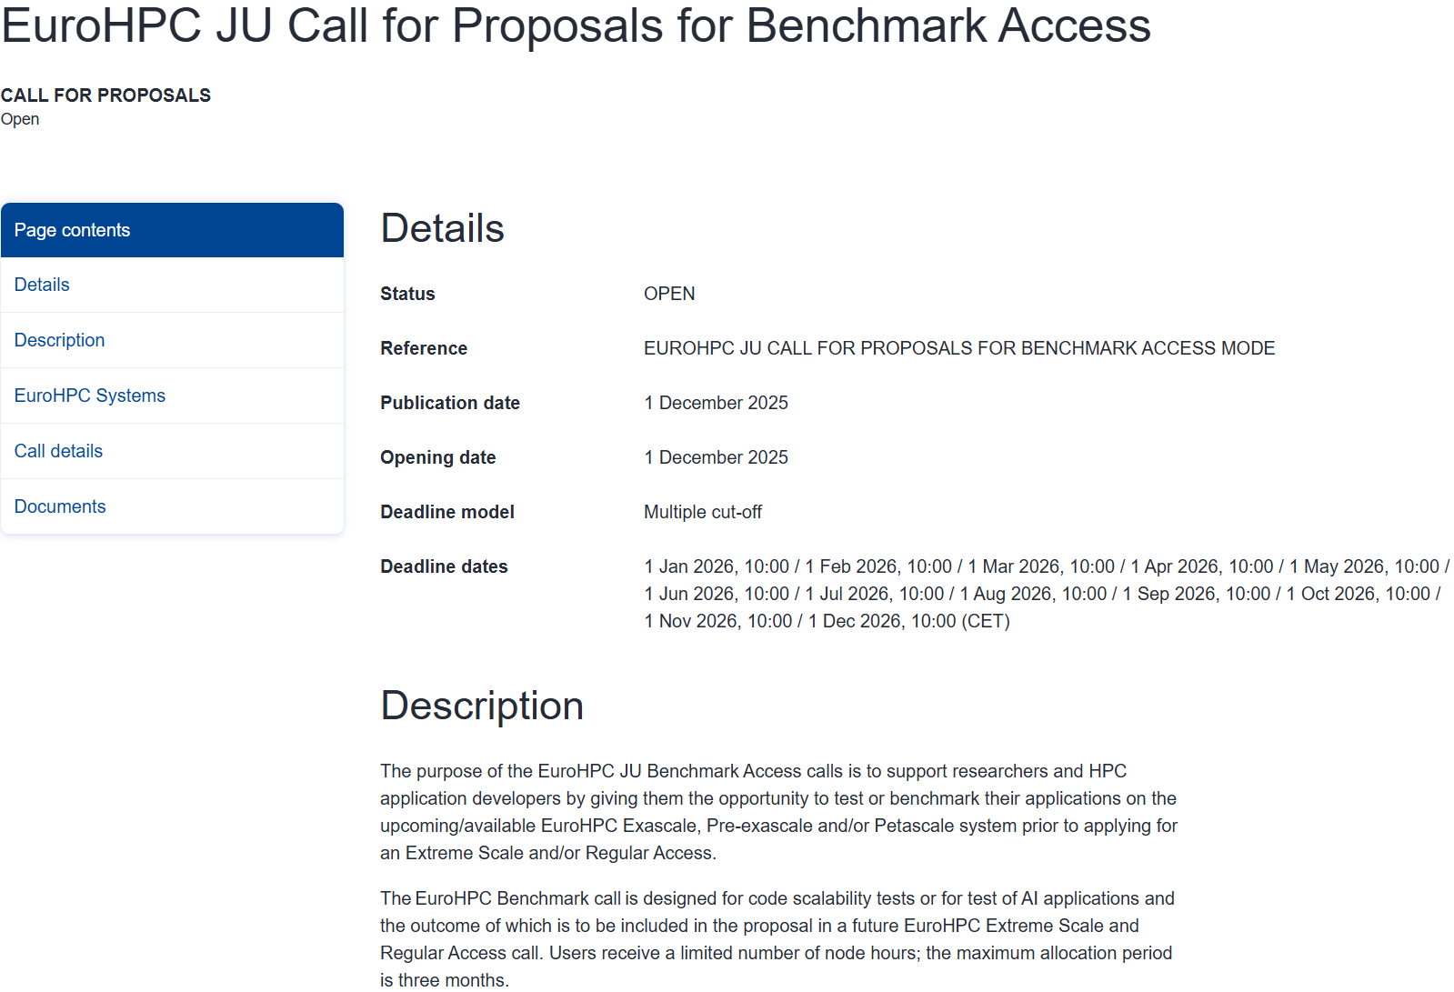

How to get Access?
Non-commerical Route
Limited amount of resources
Slovenia National Supercomputing Network (SLING)
  Test Access (permanently open)
European HPC Joint Undertaking (EuroHPC JU)
  AI Factories
    Playground Access (permanently open)
  Supercomputers
    Benchmark Access (application deadlines)
    Development Access (application deadlines)

Slide 14

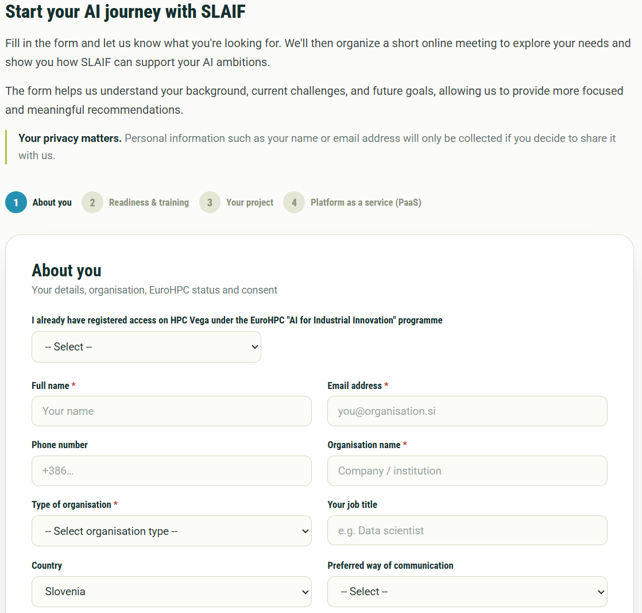
How to get Access?
Non-commerical Route
Limited amount of resources
Slovenia National Supercomputing Network (SLING)
  Test Access (permanently open)
European HPC Joint Undertaking (EuroHPC JU)
  AI Factories
    Playground Access (permanently open)
  Supercomputers
    Benchmark Access (application deadlines)
    Development Access (application deadlines)
Slovenia AI Factory (SLAIF)

Slide 15
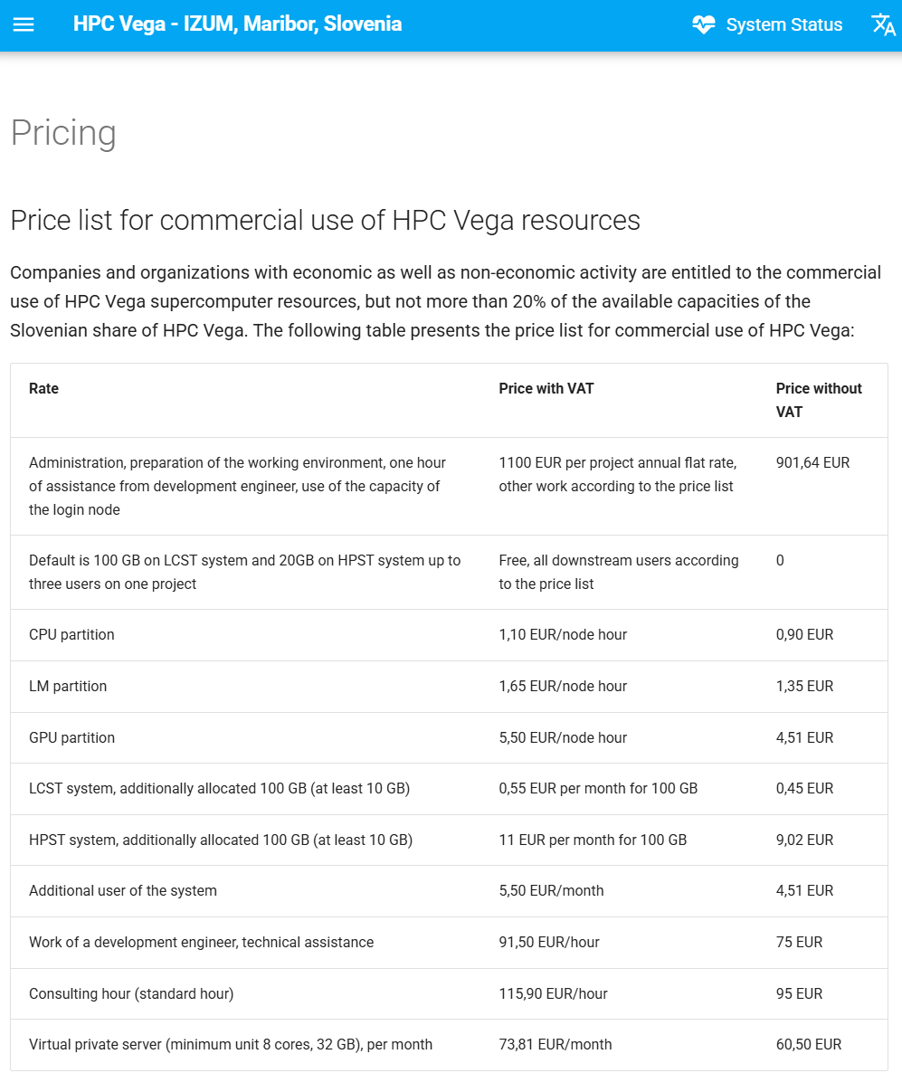
How to get Access?
Non-commerical Route
Commercial Route
Limited amount of resources
Slovenia National Supercomputing Network (SLING)
  Test Access (permanently open)
European HPC Joint Undertaking (EuroHPC JU)
  AI Factories
    Playground Access (permanently open)
  Supercomputers
    Benchmark Access (application deadlines)
    Development Access (application deadlines)
Slovenia AI Factory (SLAIF)
What you pay for is what you get
HPC Vega at IZUM
  Price List

Slide 16
Important Links
SLAIF Home Page: https://www.slaif.si/
SLING National Open Access: https://www.sling.si/en/calls-for-open-access-and-use-of-resources/
EuroHPC JU AI Factories Access Modes: https://www.eurohpc-ju.europa.eu/ai-factories/ai-factories-access-modes_en
EuroHPC JU Playground Access: https://www.eurohpc-ju.europa.eu/playground-access-ai-factories_en
EuroHPC JU Supercomputer Access Calls: https://www.eurohpc-ju.europa.eu/supercomputers/supercomputers-access-calls_en
EuroHPC JU Benchmark Access: https://www.eurohpc-ju.europa.eu/eurohpc-ju-call-proposals-benchmark-access_en
EuroHPC JU Development Access: https://www.eurohpc-ju.europa.eu/eurohpc-ju-call-proposals-development-access_en
HPC Vega Pricing List: https://vegadocs.vega.izum.si/price-list/

Slide 17





Thank you for your attention!
SLAIF: Slovenska tovarna umetne inteligence je prejela financiranje Skupnega podjetja za evropsko visokozmogljivo računalništvo v okviru sporazuma o nepovratnih sredstvih št. 101254461. Projekt financirata Ministrstvo za visoko šolstvo, znanost in inovacije Republike Slovenije ter program Horizon Europe Evropske unije.
SLAIF: Slovenian AI Factory has received funding by the European High Performance Computing Joint Undertaking under the grant agreement no. 101254461. The project is funded by the Ministry of Higher Education, Science and Innovation of Republic of Slovenia and by Horizon Europe Programme of the European Union.
© 2026 by SLAIF, licensed under CC BY-SA 4.0

Slide 18
Getting Started on Vega
Speakers: Darin Lah (IZUM)

Slide 19
Generate an SSH Key Pair
Open a terminal on your local machine.
Generate an ed25519 key pair.
Choose a save location.
Set a passphrase for extra security.
An SSH key pair replaces passwords with a private/public key pair - faster & safer
Private key - id_ed25519
Public key - id_ed25519.pub
Stays on your local machine, never shared. Proves your identity.
Uploaded to Vega. Safe to share.
$ ssh-keygen -t ed25519 -C "name@example.com"
Enter file in which to save the key
(/home/you/.ssh/id_ed25519): [Enter]
Enter passphrase (empty for no passphrase): ****
$ cat ~/.ssh/id_ed25519.pub
Notes:
The first thing you will need to do in order to get access to Vega is generate an ssh key pair. An ssh key pair replaces passwords with a private and public key pair, so it allows for a faster and safer login. So first off, you open a terminal on your machine, and generate a key pair with this command (SCREEN). You choose a save location and set up a passphrase for extra security. Once you do that, you just give us access to your public key, and we can grant you access to Vega.

Slide 20
SSH Config for faster logins
Create or edit ~/.ssh/config on your local machine to turn a long command into a one-word login.
Now you can simply run:
# ~/.ssh/config
Host vega
HostName login.vega.izum.si
User your_username
IdentityFile ~/.ssh/id_ed25519
ServerAliveInterval 60
$ ssh vega
If you‘re using VSCode, you can also install a “Remote - SSH” Extension which also reads this file - “vega” will then appear automatically as a connection target.

Slide 21
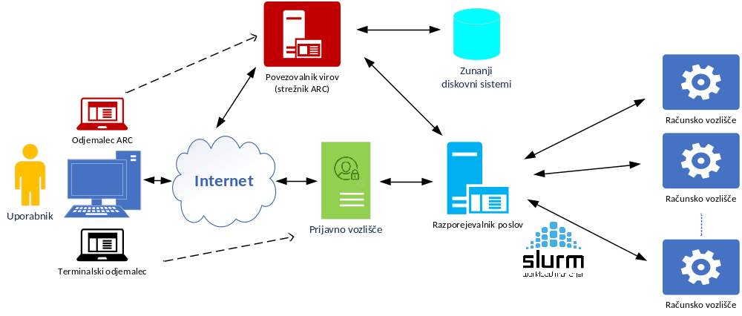
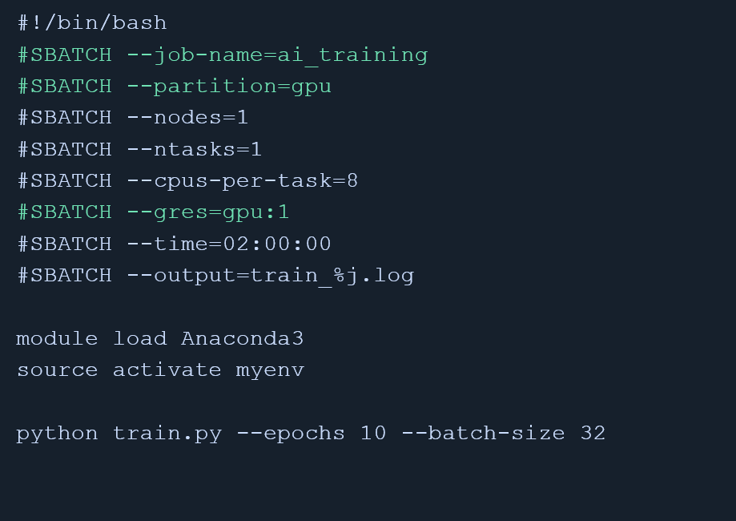
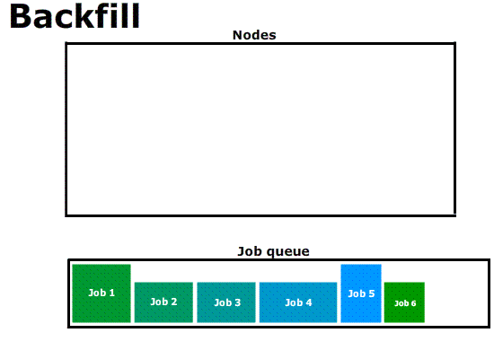

How Vega Schedules Jobs: SLURM
ACR server
External disk systems
Compute node
ACR client
Compute node
User
Workload manager
Login node
Time
Terminal client (or GUI)
Open on demand
Compute node
Number of cores (nodes)
Vega uses a workload manager called SLURM to share compute fairly
You describe what you need
SLURM finds the resources and runs your job when they‘re free
Job queue

Slide 22

Basic Linux Commands for Navigation
pwd
Print current working directory
ls -la
List all files, including hidden, with details
cd <dir>
Change directory (cd .. goes up one level)
mkdir <name>
Create a new directory
cp / mv <a> <b>
Copy / move a file or directory
rm -r <dir>
Remove a directory and its contents
nano / vim <file>
Edit a file in the terminal
man <command>
Show the manual page for a command
https://vegadocs.vega.izum.si/introduction/
Source:
https://dribbble.com/shots/5667639-File-Transfer-Animation

Slide 23
Submitting jobs
A batch job is a shell script with #SBATCH directives at the top, describing the resources you need.
--job-name
Name shown in the queue
--partition
Which pool of nodes to use
$ sbatch train_job.sh
Submitted batch job 184213
--nodes / --ntasks
How many nodes / tasks
--cpus-per-task
CPU cores per task
--gres=gpu:N
Number of GPUs requested
SLURM queues the job and starts it as soon as matching resources are free — no need to babysit the terminal.
--time
Max wall-clock time (HH:MM:SS)
--output
Where to write job output
https://vegadocs.vega.izum.si/introduction/

Slide 24
Example: AI Training Job
What this does
Requests 1 node, 8 CPU cores, and 1 GPU for up to 2 hours
Loads the Anaconda module, then activates a conda environment with your AI/ML packages
Runs train.py, logging everything to train_<jobid>.log.
Save as train_job.sh, then submit with sbatch train_job.sh.
#!/bin/bash
#SBATCH --job-name=ai_training
#SBATCH --partition=gpu
#SBATCH --nodes=1
#SBATCH --ntasks=1
#SBATCH --cpus-per-task=8
#SBATCH --gres=gpu:1
#SBATCH --time=02:00:00
#SBATCH --output=train_%j.log
module load Anaconda3
source activate myenv
python train.py --epochs 10 --batch-size 32
Command to run example:
# 1. Connect and go to your project folder
$ ssh vega
$ cd ~/projects/ai-demo
# 2. Submit the job
$ sbatch train_job.sh
Submitted batch job 184213
# 3. Watch the log as it runs
$ tail -f train_184213.log
15/10/2026

Slide 25
Job Submission & Management
sbatch script.sh
Submit a batch job
squeue -u $USER
List your queued / running jobs
scancel <jobid>
Cancel a job
$ seff 184213
Job Wall-clock time: 01:42:03
CPU Utilized: 12:45:10 (93.5%)
Memory Utilized: 6.20 GB (77.5%)
scontrol show job <jobid>
Full detail on a specific job
sinfo
See partitions and node availability
sacct -j <jobid>
Accounting info after completion
seff <jobid>
Efficiency report
https://vegadocs.vega.izum.si/introduction/
15/10/2026

Slide 26
Introduction to distributed ML
Speakers: Vid Vilec Letonja (IZUM)

Slide 27

What you will learn
When to utilize distributed ML workflows
The types of Pytorch parallelisms
How to train ML models with Pytorch
How to adapt training workflows for distributed data parallel (DDP)
How to submit Pytorch jobs on Slurm

Slide 28
Distributed training, when?
Model fits on a single gpu, but too much data (DDP)
Model fits on a single, but training slow (DDP)
Model doesn’t fit on a single gpu (FSDP2)
Nothing fits on a single gpu (TP or PP)

Slide 29
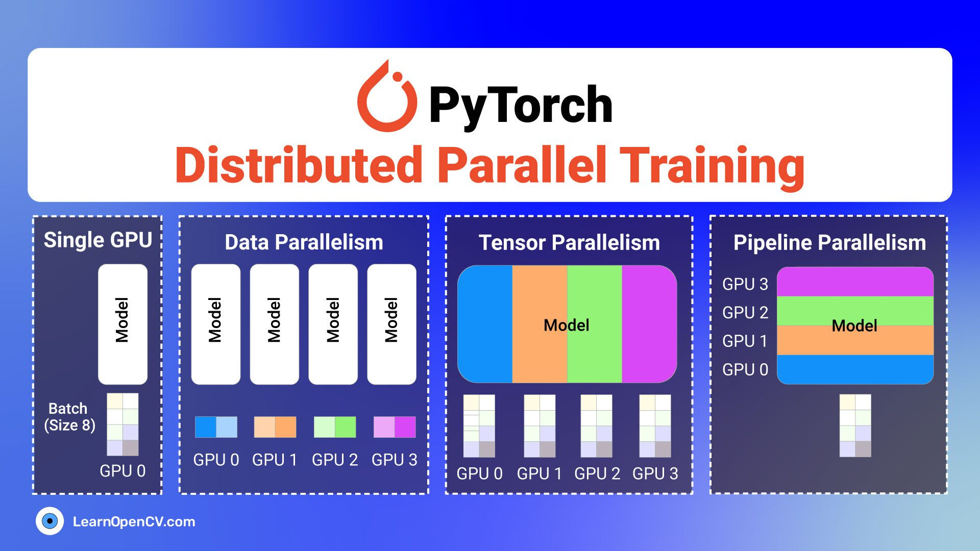
Types of distributed training

Slide 30
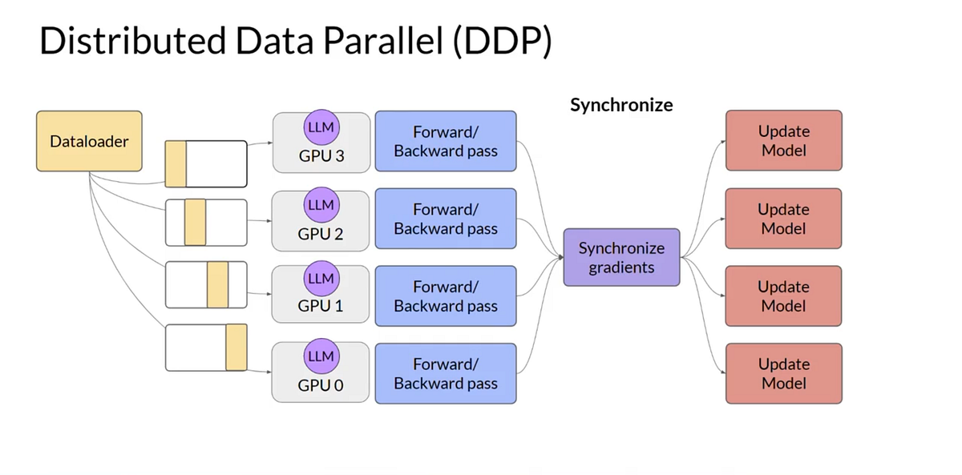
What we will use

Slide 31
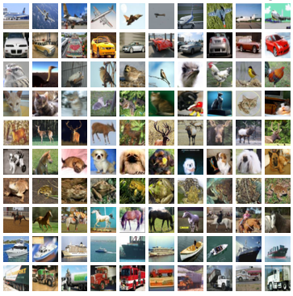
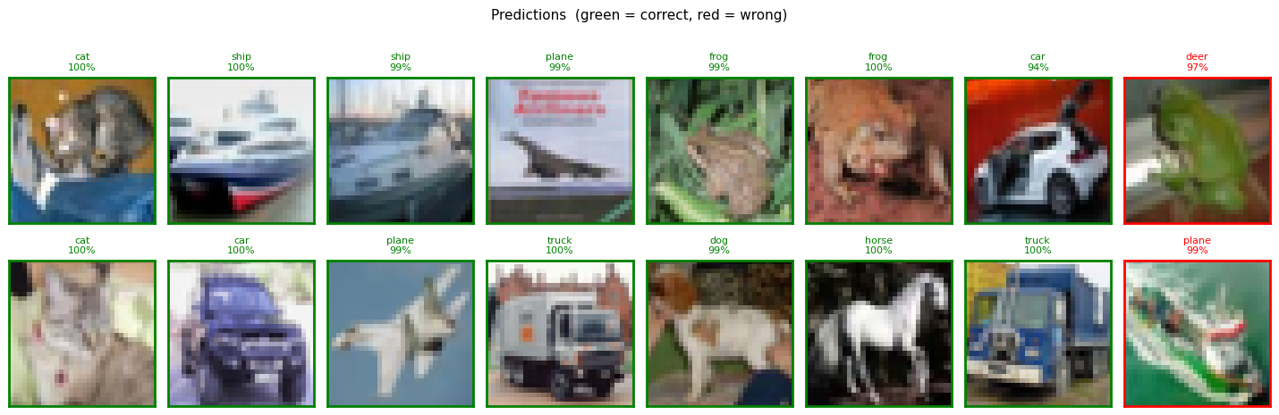
What we will train
A simple Convolutional/ResNet image classifier
Using Cifar 10 Dataset

Slide 32
Hands on workshop
~ 30 minutes

Slide 33
Optimizing HPC Vega Workflows
Speaker: Samo Miklavc (IZUM)

Slide 34
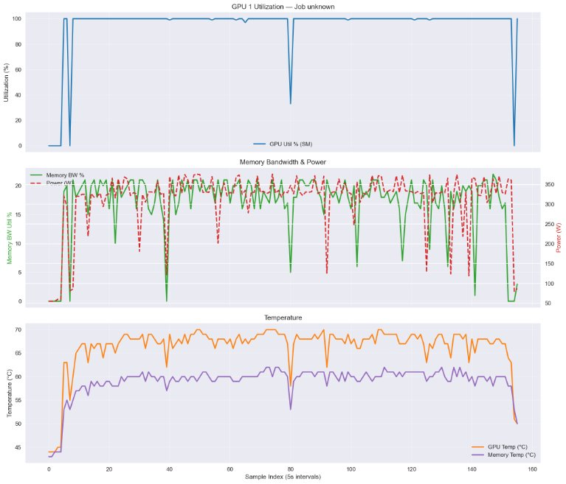
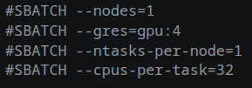


Slurm Job Configuration (Single vs. Multi-Node)
Defining the Slurm Environment (sbatch scripts)
Monitoring tools --> multi GPU and multi node setups
Cpus-per-tasks --> count of CPU cores which work on 1 task
Ntasks-per-node --> used by running MPI jobs
Mem --> specifies amount of RAM available to job
Don't allocate too much wall time for quick jobs
Single node setup
Multi node setup
GPU monitoring results
15/10/2026

Slide 35
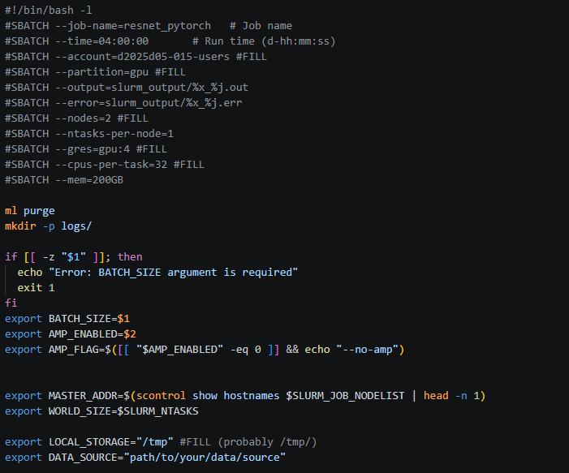
Example of actual sbatch script used for ResNet training (image recognition)
Sbatch directives on top
Using official pytorch container with Apptainer
Env variables config with support for multi GPU and multi node training
15/10/2026
HPC Vega for Industry
35

Slide 36
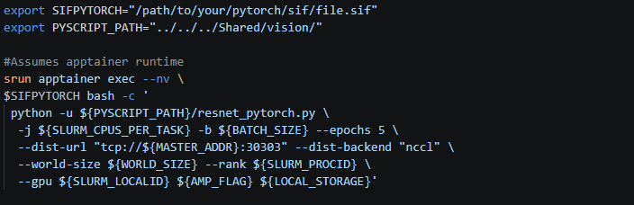
ResNet sbatch script continued
Pytorch container configuration with required env. variables and flags needed for ResNet training
This script can be easly adopted to fine-tuning and inference
15/10/2026
HPC Vega for Industry
36

Slide 37
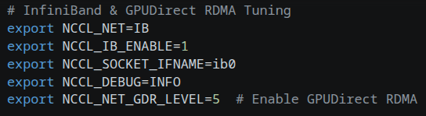
Network & NCCL Optimization
Vega relies on high-speed InfiniBand (IB) for multi-node communication.
Explicitly configuring NCCL (NVIDIA Collective Communication Library) prevents fallback to slower TCP (Transmission Control Protocol) sockets.
Huge performance increases can be gained by using IB over TCP
Example config used to set up IB communications. Paste this in sbatch scripts
15/10/2026
HPC Vega for Industry
37

Slide 38
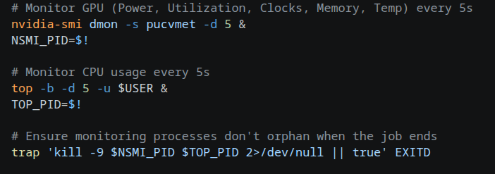
In-Job Resource Monitoring
Monitoring GPU and CPU Utilization
Capture telemetry during the job to identify bottlenecks (e.g., CPU starvation or GPU underutilization).
Following commands can be used for monitoring CPU and GPU telemetry, use this in sbatch scripts
15/10/2026
HPC Vega for Industry
38

Slide 39

Post-Job Efficiency Analysis
After the job completes, use Slurm's accounting tools to verify resource utilization and optimize future #SBATCH requests.
Check Resource Statistics (sstat):
Check Overall Efficiency (seff):
Best Practice: If seff shows low CPU/Memory efficiency, adjust --cpus-per-task or memory limits to free up Vega resources for other users.
15/10/2026
HPC Vega for Industry
39

Slide 40
Coffee Break
10:40 – 11:00
15/10/2026

Slide 41
HPC Vega Use Cases
Speaker: Samo Miklavc (IZUM)

Slide 42
Use Case 1 – High-Velocity Stream Processing
The Workload: Simultaneously parsing, validating, and storing millions of high-frequency telemetry and sensor data points per second.
The HPC Vega Solution: Parallelized data ingestion pipelines that eliminate I/O bottlenecks and distribute the load across compute nodes.
The Impact:
  Sub-second latency
  Instant anomaly detection
  Seamless state awareness across distributed assets.
15/10/2026
HPC Vega for Industry
42

Slide 43
Use Case 2 – Accelerating Combinatorial Optimization
The Workload: Dynamically calculating optimal resource allocation, routing, or scheduling across hundreds of moving or interdependent variables.
The HPC Vega Solution: GPU-accelerated mathematical solvers designed to crush complex combinatorial problems in a fraction of the time.
The Impact:
  Quick times to solutions,
  Real-time decision-making.
15/10/2026
HPC Vega for Industry
43

Slide 44
Use Case 3 – Scalable Predictive Analytics & AI
The Workload: Training ML models on vast, historical, multi-dimensional datasets to identify subtle patterns.
The HPC Vega Solution: Scalable, high-memory GPU clusters that drastically reduce the time to train, tune, and validate complex deep learning models.
The Impact:
  Faster model training, tuning
  Larger datasets can be used for trainings
  Optimized resource utilization (support)
  Better pattern detection
15/10/2026
HPC Vega for Industry
44

Slide 45
Use Case 4 – High-Fidelity Simulation & Digital Representation
The Workload: Running parallel, compute-heavy simulations to model complex physical or logistical systems.
The HPC Vega Solution: Dedicated, high-performance compute environments capable of running thousands of iterative "what-if" scenarios concurrently.
The Impact:
  Rapid validation of strategies
  Process optimizations, or system changes in a virtual environment before deploying them to production.
15/10/2026
HPC Vega for Industry
45

Slide 46

The HPC Vega Infrastructure Advantage
Elastic Scalability: Seamlessly absorb unpredictable computational spikes without degrading end-user experience or system stability.
Data Sovereignty & Security: Localized, enterprise-grade infrastructure ensuring data remains protected, compliant, and under your direct control.
Cloud-Native Foundation: Powered by OpenStack and Kubernetes (k8s) for seamless container orchestration, effortless scaling, and modern DevOps integration.
15/10/2026
HPC Vega for Industry
46

Slide 47
AI meets HPC
Speaker: Teo Prica (IZUM)

Slide 48
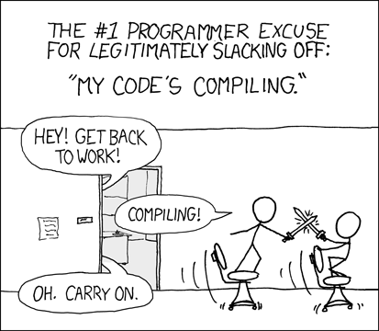
Software in HPC
Scientific software presents challenges,
lacking of comments and examples,
insufficient documentation,
written by scientists forced to code,
lack of support,
non-standard installation,
non-optimized,
and beyond.
15/10/2026

Slide 49
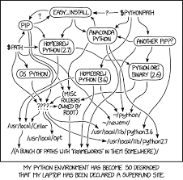
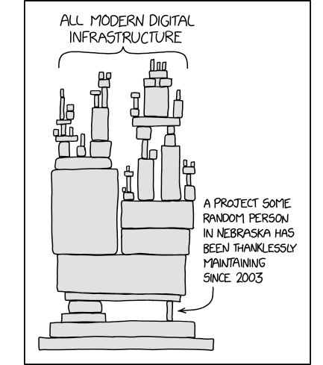


Dependency Hell
Is a common problem due to complex, conflicting, or overlapping dependencies in the software stack.
15/10/2026

Slide 50

Containerization in HPC
Containers in HPC offer flexible and alternative software deployment.
Avoid local installation on system.
Container shares the physical hardware and OS.
Comparable performance to bare-metal
  Container != virtual machine (VM)
Embraced technology, slow adaptation.
Convenient option for industrial users.
Integrated into cloud-based. HPC, AI/ML worklooads, and scientific computing frameworks.
15/10/2026

Slide 51

AI meets HPC
Analyzed end-user needs
Convergence HPC and AI
Evaluation of different platforms and solutions
  OpenStack
  OpenShift Container Platform
  OKD
  RKE2
  Slinky (higher utilization of compute nodes)
15/10/2026

Slide 52
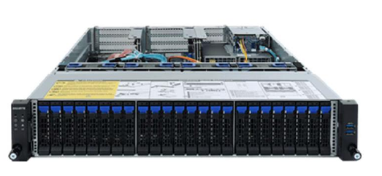
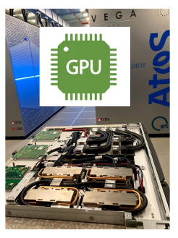
HPC Vega - available architecture
Bare metal virtualization nodes & compute nodes
  5x Atos BullSequana X430-A5
  2 x AMD EPYC 7502 (32c, 2.5GHZ, 180W)
  512GB RAM DDR4 3200MT/s
  2 x 7.6TB U.2 SSD
  1 x 100GbE DP ConnectX5
  1 x 100Gb IB HDR ConnectX-6 SP
Compute node with graphical accelerators (GPUs) x N (on-demand)
  4 x NVIDIA A 100
  2 x AMD Rome 7H12
  512 GB RAM, 2 x HDR DP, 1 x 1.92TB M.2 SSD
15/10/2026

Slide 53
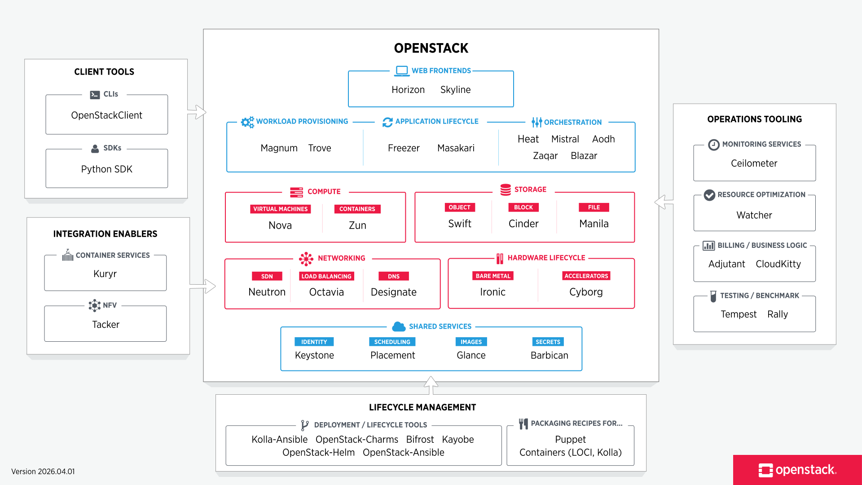
OpenStack: Modular Framework
Deployment depending on
end user needs.
15/10/2026

Slide 54
OpenStack: Deployment
3 x Service partition (HA mode)
2 x Nova compute with CPU (only)
2 x GPUs nodes with A100 (Add upon demand)
Deployment with automated Kolla-Ansible.
15/10/2026

Slide 55
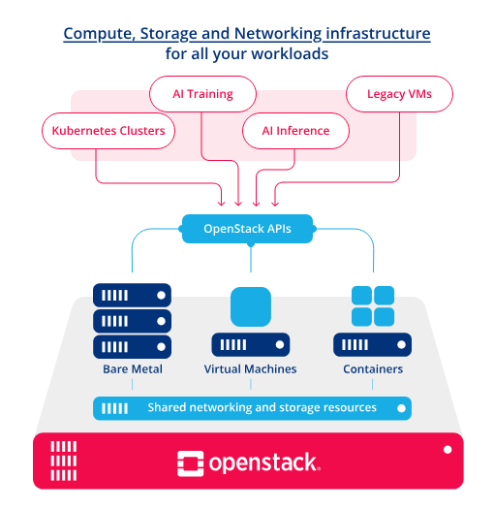
OpenStack Deployed Components
Network: Neutron (provides network, subnets, routing, IPs)
Services: Keystone (users, projects, RBAC), Placement
Images: Glance (RBD images)
Accelerators: Cyborg (GPUs)
Compute: Nova (manages compute instances), Zun (containers)
Kubernetes: Magnum (provides support for K8s orchestration)
Storage: Cinder, Swift
Front end: Horizon (web-based dashboard)
Back end: OpenStack Client (CLI)
Monitoring: Prometheus & Grafana
      (metrics, data visualization)
15/10/2026

Slide 56
User-oriented Infrastructure Platform
Sefl-Service & Flexibility
  User gets a flexible playground infrastructure access (on demand).
  Faster adaptation in comparison with traditional HPC environment.
  VM images and common software (could be pre-available).
  Kubernetes clusters are provisioned via Magnum.
Multi-tenancy & Security
  Multi-tenancy with tenant isolation.
  Role-based access control (RBAC) and project level quotas.
  Authentication: TOTP, EC2 credentials, certificates, SSH.
  Network and storage isolation.
  Encryption (under evaluation).
Operations
  Monitoring, logging, etc.
  Backup and recovery.
  Self-service VM/container lifecycle.
  Quota management.
15/10/2026

Slide 57
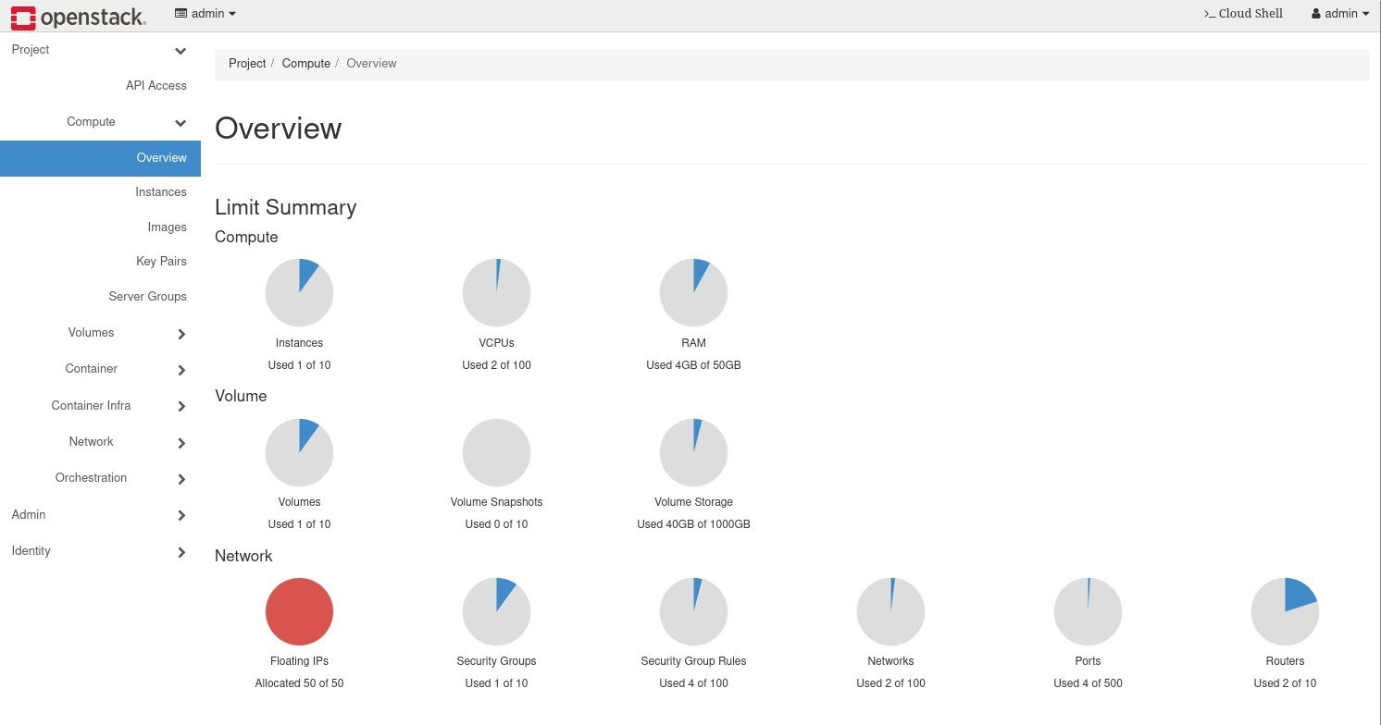
15/10/2026

Slide 58
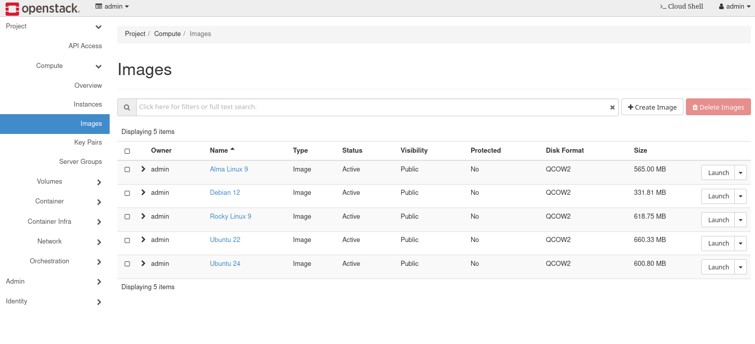
15/10/2026

Slide 59
OpenShift Container Platform: Deployment
On Vega we acquired 30 OpenShift Container Platform licenses (academic)
3 x Master (HA mode)
2 x Nova compute with CPU (only)
GPUs nodes with A100 (Added upon demand)
15/10/2026

Slide 60
OpenShift Container Platform: Deployment on HPC Vega
User provisioned installation automated with OpenShift ignition (master, workers), based on RHCOS.
Internal container registry mirror
Installed operators:
  cert-manager,
  node discovery,
  GPU operator,
  SR-IOV operator,
  Ceph (in preparation phase).
No official support for Slurm slinky-bridge (so far).
Targeted use cases: SMEs which are used to OpenShift
Academic licenses for Proof Of Concept (Vega)
  "bring your own licenses"
15/10/2026

Slide 61
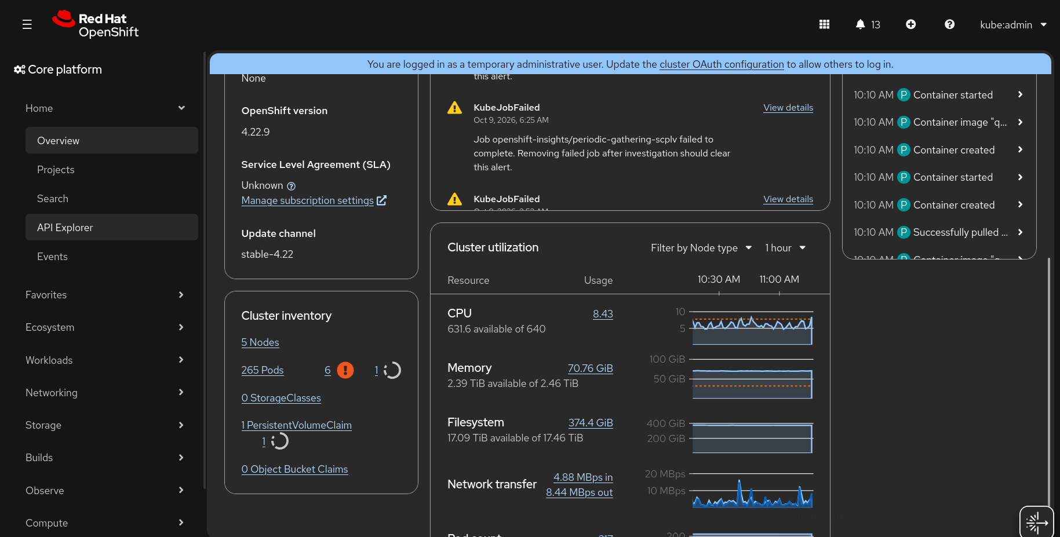
OpenShift Container Platform: Overview
15/10/2026

Slide 62
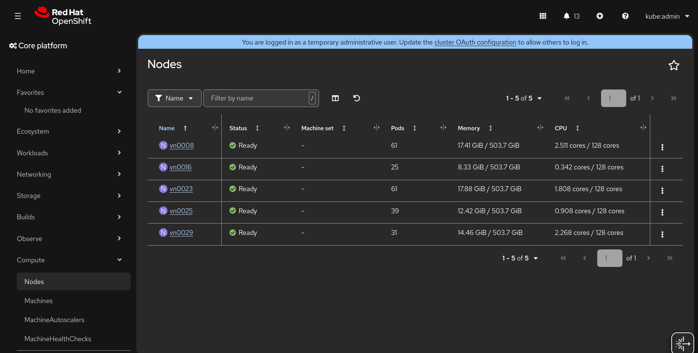
OpenShift Container Platform: Nodes
15/10/2026

Slide 63
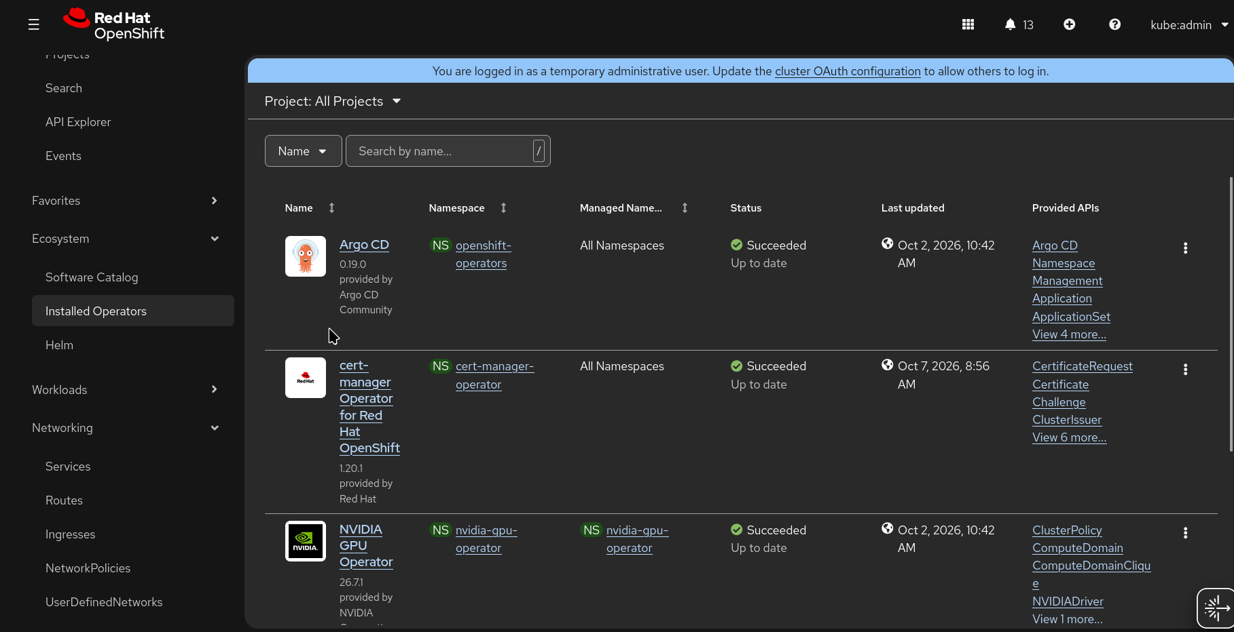
OpenShift Container Platform: Operators
15/10/2026

Slide 64
Kubernetes (RKE2): Deployment on HPC Vega
Virtual environment (hosted on PVE)
3 x Master (HA mode)
2 x Workers CPU (only)
Deployment with RKE2 scripts.
Helm, cert-manager, etc.
Offloading to HPC Vega infrastructure slinky-bridge
in evaluation phase
Reconfiguration and adjustments on production HPC Vega (slurm upgrade, enabling rest, new partition, etc.)
15/10/2026

Slide 65
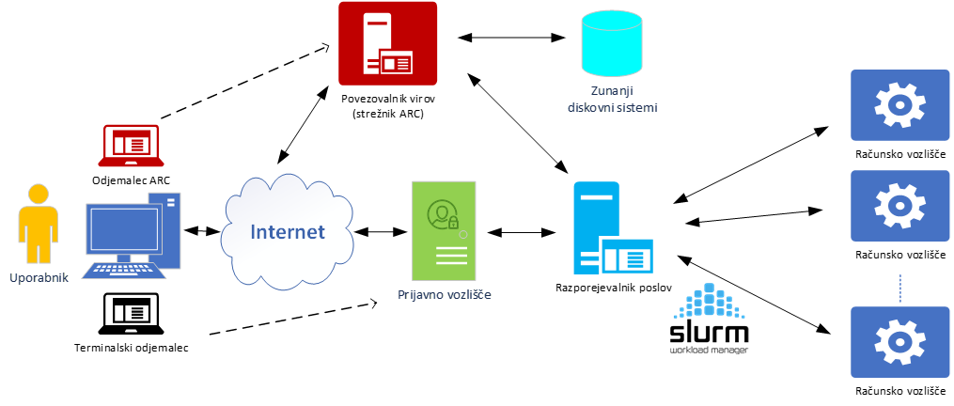
HPC Vega
Terminal client (or GUI)
Slinky-bridge
Cloud Infrastructure
CephFS
15/10/2026

Slide 66
Conclusion
OpenStack/OpenShift environment deployed on HPC Vega.
A secure, isolated, self-service cloud environment that gives users compute capabilities with greater flexibility and faster experimentation.
On-boarding and looking for early adopters:
  Support for smaller use-case,
  possible issues still appears.
15/10/2026

Slide 67
Get Access to Vega
Speaker: Darin Lah (IZUM)

Slide 68




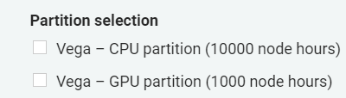

SLING Test vs. Development Projects
Access for 3 months
Access for 12 months
Describe the needs for development and programming tools
Project duration and planned project steps
Previous experience
15/10/2026

Slide 69


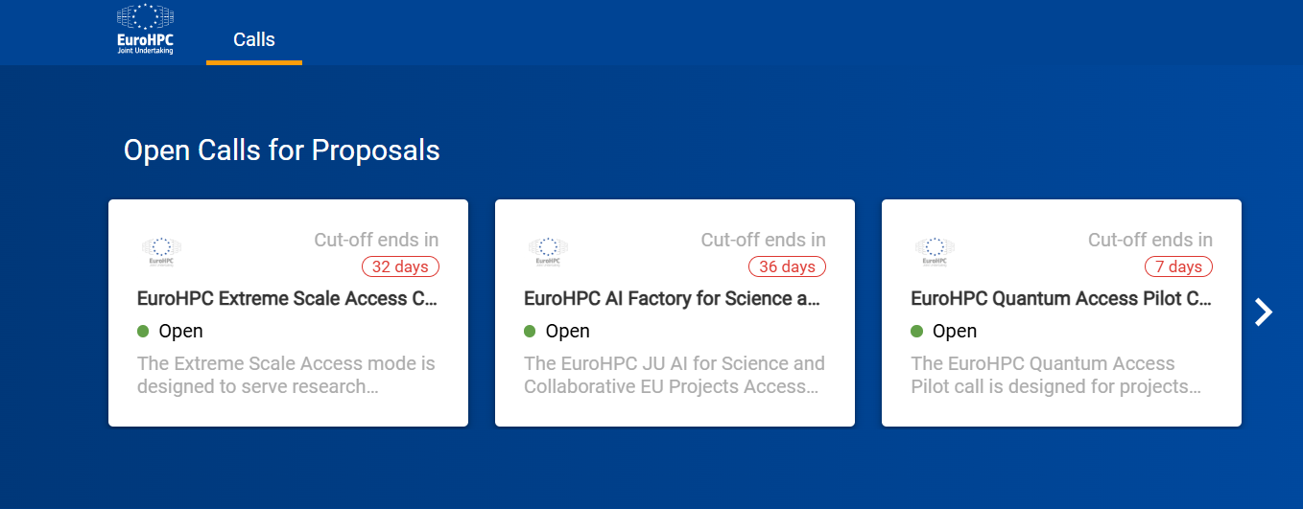
EuroHPC JU Access
AI Factory Playground call - 5000 GPU hours
AI Factory for Science and Collaborative EU Projects - not available on HPC Vega, GPU hours amount is dependend on partition
AI Factory Fast Lane call - not available on HPC Vega, GPU hours amount is dependend on partition, quick acceptance times
AI Factory Large Scale call - not available on HPC Vega, GPU hours amount is dependend on partition, up to 3000000 GPU hours per year
15/10/2026

Slide 70


SLAIF Access & Events
15/10/2026

Slide 71












Other Workshops, Webinars & Trainings
SLING events
ENCSS events
AI:AT training
EPICURE events
CINECA training
Minerva AI training
15/10/2026

Slide 72








Other Workshops, Webinars & Trainings
LUMI events
JSC training
ETP4HPC events
BSC training
15/10/2026

Slide 73
Thank you for your attention!
SLAIF: Slovenska tovarna umetne inteligence je prejela financiranje Skupnega podjetja za evropsko visokozmogljivo računalništvo v okviru sporazuma o nepovratnih sredstvih št. 101254461. Projekt financirata Ministrstvo za visoko šolstvo, znanost in inovacije Republike Slovenije ter program Horizon Europe Evropske unije.
SLAIF: Slovenian AI Factory has received funding by the European High Performance Computing Joint Undertaking under the grant agreement no. 101254461. The project is funded by the Ministry of Higher Education, Science and Innovation of Republic of Slovenia and by Horizon Europe Programme of the European Union.
© 2026 by SLAIF, licensed under CC BY-SA 4.0

