Slide 1
Od znanja do uporabe: izobraževanja SLAIF za zaposlene
Vida Groznik in Slavko Žitnik
SLAIF WP6 gradi slovenski cevovod talentov za umetno inteligenco in visokozmogljivo računalništvo – od doktorskih študentov do odločevalcev v malih in srednje velikih podjetjih ter zaposlenih v javnem sektorju – ki bodo superračunalnik SLAIF in njegov portfelj storitev izkoristili za napredek na vseh področjih dela.

Slide 2
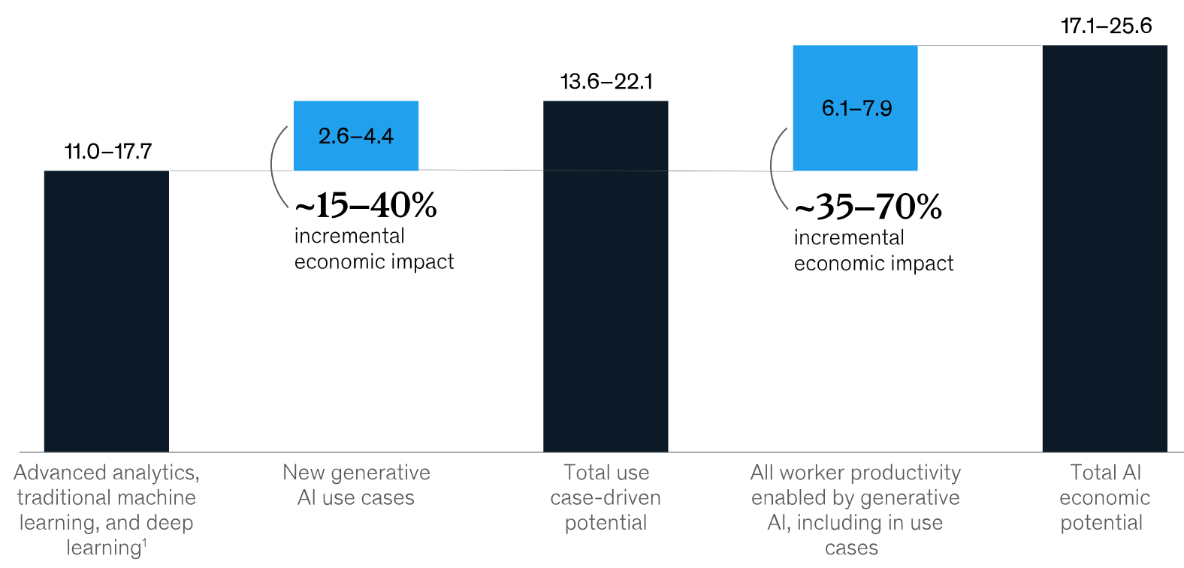
Širši vidik o UI
Evropsko digitalno desetletje 2030
  80% prebivalcev EU z osnovnimi digitalnimi veščinami
  20 mln. IKT strokovnjakov
Slovenija (DESI 2026)
  46,5% prebivalcev z osnovnimi digitalnimi veščinami (EU 60,4%)
  4,5% IKT strokovnjakov (EU 5,0%)
Globalen poslovni potencial (McKinsey)
  povečanje produktivnosti
  za 2,6 - 4,4 mrd. USD
Notes:
Slovenija:
99,8% SME, zaposlujejo 70% ljudi => generirajo 65% dohodkov
EU:
25,8 mln. SME, zaposlujejo >88 mln. ljudi

Slide 3
SLAIF WP6
Koordinator: Univerza v Ljubljani · Aktivno sodeluje vseh 10 konzorcijskih partnerjev
4
10
5
Naloge
Partnerjev
Regionalnih centrov
Talenti · Prilagajanje vsebin ·
Sodelovanje z MSP · Uvajanje
Univerze · raziskovalni instituti ·
GZS · Tehnološki park LJ
Ljubljana · Maribor · Novo mesto ·
Koper · Nova Gorica
Misija
Izobraziti talente za UI in HPC s prilagojenimi programi usposabljanja, ki obravnavajo potrebe različnih uporabnikov – študentov, strokovnjakov, malih in srednje velikih podjetij in javnega sektorja – spodbujati vključevanje vseh deležnikov prek dostopnih učnih poti in vzpostaviti uvajalne aktivnosti, ki podpirajo nove uporabnike pri vključevanju umetne inteligence v njihove delovne procese.

Slide 4
Prvo leto v številkah
98 and updating ...
24+
600+
training activities in one registry
training activities delivered
recorded participants
Consolidated from 96 proposals submitted by all 10 partners
Webinars, hands-on workshops, SME sessions, university and doctoral courses
Plus ~400 school and university students reached through outreach
2 + 2
5
2
micro-credentials
SLAIF Hubs / Training Centres
Industry Open Days
Approved: UNG, UM · In accreditation: UM (biomedical), UL FRI (LLM fine-tuning)
Novo mesto, Ljubljana (UL FRI, TPLJ), Maribor (allocated), Koper (initiated)
JSI, 17 Nov 2025 · UM, 10 Apr 2026 with almost 100 participants
Notes:
All figures from D6.1. 600+ is recorded attendance for activities with figures available; the ~400 students are outreach (299 HPC Open Doors Day, 100 HackathON). Training centres: Novo mesto (FIS), Ljubljana (UL FRI), TPLJ AI Hub / Demo Training Centre, Koper (UP, initiated), Maribor (UM, space allocated).

Slide 5

Bogat portfelj izobraževanj
Različni tipi izobraževanj
Planiranih
98
Predavanja & delavnice
63
Kratke (2h), Srednje (4h), Daljše (8h), Posvet
Spletni seminarji za širši domet
20
izobraževalnih aktivnosti
razporejenih skozi celotno trajanje projekta
Mikro-certifikati (v skladu z EQF)
15
Izvaja vseh 10 partnerjev v projektu.
Decentralizirana izvedba po različnih krajih v Sloveniji.
52 izobraževanj združuje predavanja s praktičnimi vajami
38 v Slovenščini · 21 v Angleščini · 39 "dvojezična“ izvedba

Slide 6
Tematska pokritost celotnega nabora tehnologij UI/HPC
Uravnotežen portfelj — od osnov do najnaprednejših tem, s poudarkom na MSP
Podatkovna znanost & temelji ML
19
Infrastruktura HPC & delotoki
18
VJM & obdelava naravnega jezika
16
Uvajanje UI v MSP in industrijo
12
UI v zdravstvu in biomedicini
11
Etika UI in skladnost z Aktom o UI
6
Opazovanje Zemlje & kmetijstvo
3
Računalniški vid
2
Kibernetska varnost
1
Skoraj tretjina kataloga (33 od 88) je namenjena MSP, uvajanju UI v industriji in skladnosti z Aktom EU o umetni inteligenci — s čimer neposredno naslavlja industrijsko usmerjeno poslanstvo Tovarne UI.

Slide 7
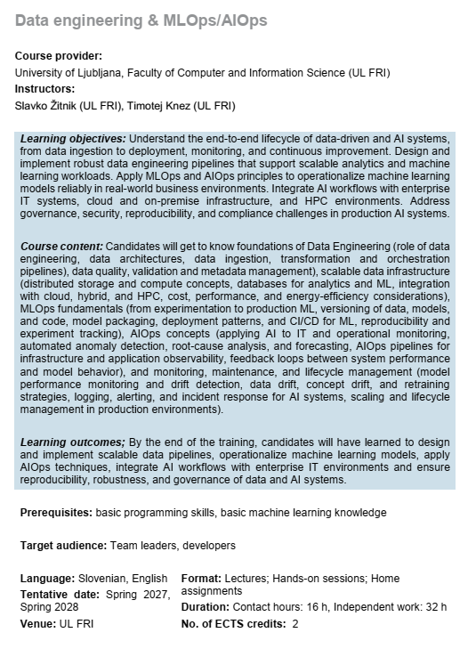
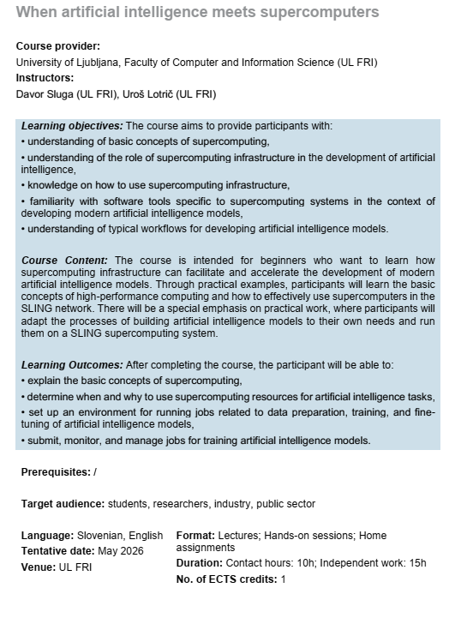
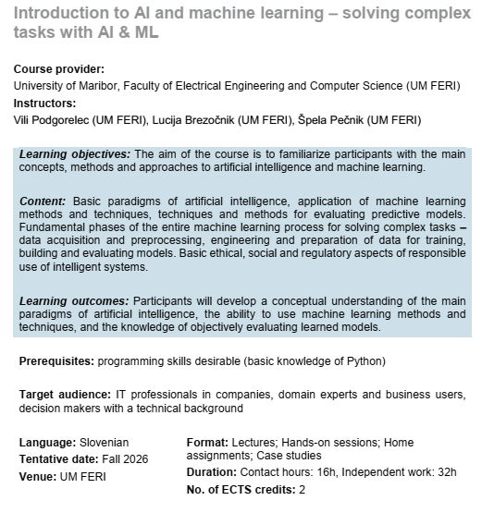
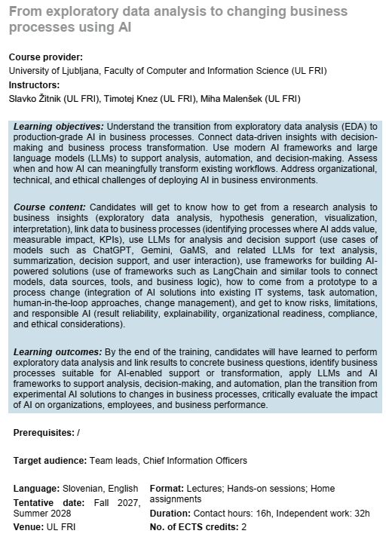
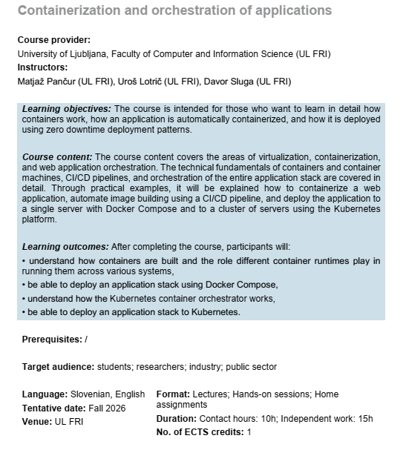
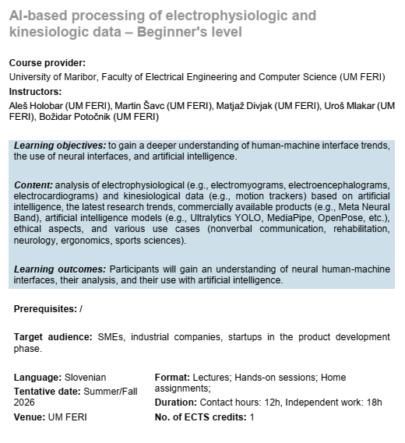
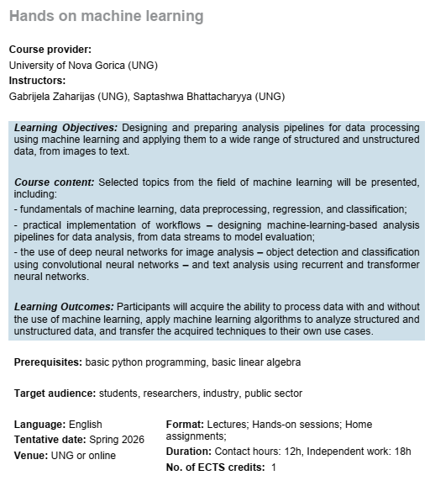
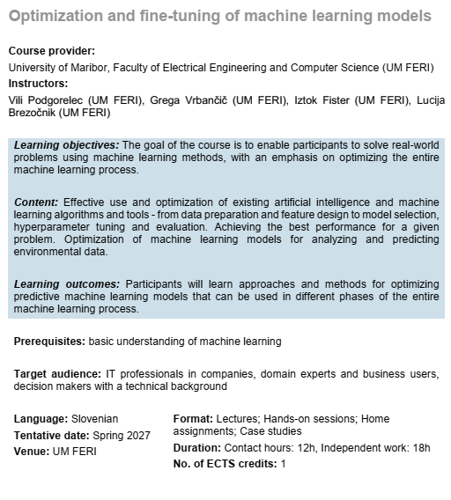
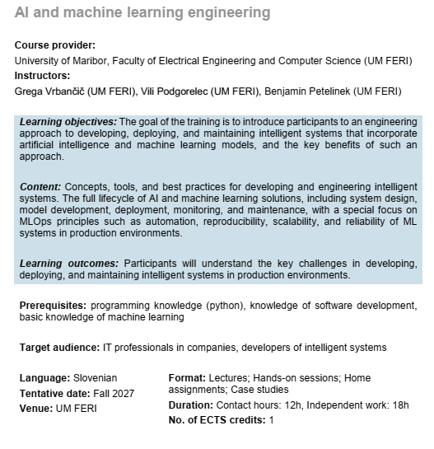
Mikrodokazila

Slide 8
From exploratory data analysis to changing business processes using AI
Training example
Course provider: University of Ljubljana, Faculty of Computer and Information Science (UL FRI) Instructors: Slavko Žitnik, Timotej Knez, Miha Malenšek
Learning Objectives
Course Content
Learning Outcomes
Understand the transition from exploratory data analysis (EDA) to production-grade AI in business processes. Connect data-driven insights with decision-making and business process transformation. Use modern AI frameworks and large language models (LLMs) to support analysis, automation, and decision-making. Assess when and how AI can meaningfully transform existing workflows. Address organizational, technical, and ethical challenges of deploying AI in business environments.
Candidates will get to know how to get from a research analysis to business insights (exploratory data analysis, hypothesis generation, visualization, interpretation), link data to business processes (identifying processes where AI adds value, measurable impact, KPIs), use LLMs for analysis and decision support (such as ChatGPT, Gemini, GaMS, and related LLMs for text analysis, summarization, decision support, and user interaction), use frameworks for building AI-powered solutions (such as LangChain and similar tools to connect models, data sources, tools, and business logic), how to come from a prototype to a process change (integration of AI solutions into existing IT systems, task automation, human-in-the-loop approaches, change management), and get to know risks, limitations, and responsible AI.
By the end of the training, candidates will have learned to perform exploratory data analysis and link results to concrete business questions, identify business processes suitable for AI-enabled support or transformation, apply LLMs and AI frameworks to support analysis, decision-making, and automation, plan the transition from experimental AI solutions to changes in business processes, critically evaluate the impact of AI on organizations, employees, and business performance.
Prerequisites: /
Target audience
Team leads, chief information officers
Language
Slovenian, English
Format
Lectures; Hands-on sessions; Home assignments
Tentative date
Fall 2027, Summer 2028
Duration
Contact hours: 16h, Independent work: 32h
ECTS credits
2

Slide 9




Učni centri SLAIF – „one-stop shop“
Individualizirana podpora
Lokacije: UL, UM, FIŠ, TPLJ, UP
Tehnična podpora uporabnikom in razvijalcem UI
Možnost preizkušanja infrastrukture HPC
sodelovanje z raziskovalci
prvi stik s SLAIF: https://slaif.si/get-access

Slide 10
Infrastruktura za izobraževanja
Izobraževalna platforma
Sistem za prijave na dogodke Indico
edu.slaif.si
indico.slaif.si
Centralni repozitorij: zapiski predavanj, izvorna koda, zvezki Jupyter, dodatni materiali
Seznam vseh izobraževanj in dogodkov v okviru SLAIF z opisom vsebine dogodkov
Interaktivno poučevanje: integrirani kvizi, naloge, oddaja domačih nalog, ocenjevanje na daljavo
Enostavna prijava na dogodke in obveščanje
Redno dodajanje novih izobraževalnih dogodkov
Standardizirana struktura za vsebine
Prosto dostopna (ni potrebe po prijavi v sistem)

Slide 11
Short-term plan
Selection of confirmed training activities
Sep 2026
Oct 2026
Nov 2026
Dec 2026
Spring 2027
Jun–Aug 2027
M13
M14
M15
M16
M19–M21
M22–M24
UL FE agentic workshops (15 & 21 Sep)
UL FRI: AI meets Supercomputing; Containerisation
UM biomedical micro-credential accreditation
UP Industry Day
(WE ARE HERE)
IZUM onboarding event for SMEs (Vega)
UNG course promotion via regional chamber
UNG first accredited micro-credential
UP: AI for manufacturing SMEs (11 Nov), Responsible AI (25 Nov)
UL FRI Fine-tuning LLMs (20 Nov)
UP High-Performance Data Analytics (10 Dec)
UL FRI Data Analyst
FIS HPC in Practice III (Q4)
Repeats: UL FRI workshops, LLM half-day
UP: GPU/HPC workflows, LLM indexing
Doctoral courses 2026/27 (UL FRI, UM)
UL FRI Fine-tuning LLMs, 2nd edition
● Training ● Other key activities
Notes:
Training activities in normal text; other key activities (events, accreditation, awards, reports) in grey italics. M18 = February 2027, the reporting cut-off. The UNG cohort and UL FRI fine-tuning course are the first chances to produce certified specialists (KPI 16).

Slide 12
Five things every SLAIF colleague can tell the community
Use these when someone asks “What does SLAIF offer for skills and training?”
1
One catalogue, one place to register
98 training activities; registration at indico.slaif.si, course materials at edu.slaif.si.
2
Learning pathways
8 pathways, 3 difficulty levels and 4 progression stages; every activity is mapped (check slaif.si website).
3
Formally recognised skills
EQF-aligned micro-credentials: UNG “Hands-on Machine Learning” (2 ECTS) and UM “Introduction to AI and ML” approved; more in accreditation.
4
A physical place to start
SLAIF Training Centres with a single e-mail entry point: DGX Spark co-working at UL FRI, a 10-laptop training room at FIS, AI HUB at TPLJ.
5
Proven industry demand
TPLJ “Agentic AI in Enterprises” grew from 22 to 78 participants (72 from SMEs); UL FE agentic-programming workshop repeated within two weeks, ~70% from industry.
Notes:
These are the messages for everyone in SLAIF to advertise. Links: indico.slaif.si for registration, edu.slaif.si for materials.

Slide 13




Srečajmo se ...
SLAIF: Slovenska tovarna umetne inteligence je prejela financiranje Skupnega podjetja za evropsko visokozmogljivo računalništvo v okviru sporazuma o nepovratnih sredstvih št. 101254461. Projekt financirata Ministrstvo za visoko šolstvo, znanost in inovacije Republike Slovenije ter program Horizon Europe Evropske unije.
SLAIF: Slovenian AI Factory has received funding by the European High Performance Computing Joint Undertaking under the grant agreement no. 101254461. The project is funded by the Ministry of Higher Education, Science and Innovation of Republic of Slovenia and by Horizon Europe Programme of the European Union.
© 2026 by SLAIF, licensed under CC BY-SA 4.0

