Slide 1


SLAIF industry days
Date: 13.10.2026
Žiga Zebec, SLAIF Coordinator (IZUM)

Slide 2
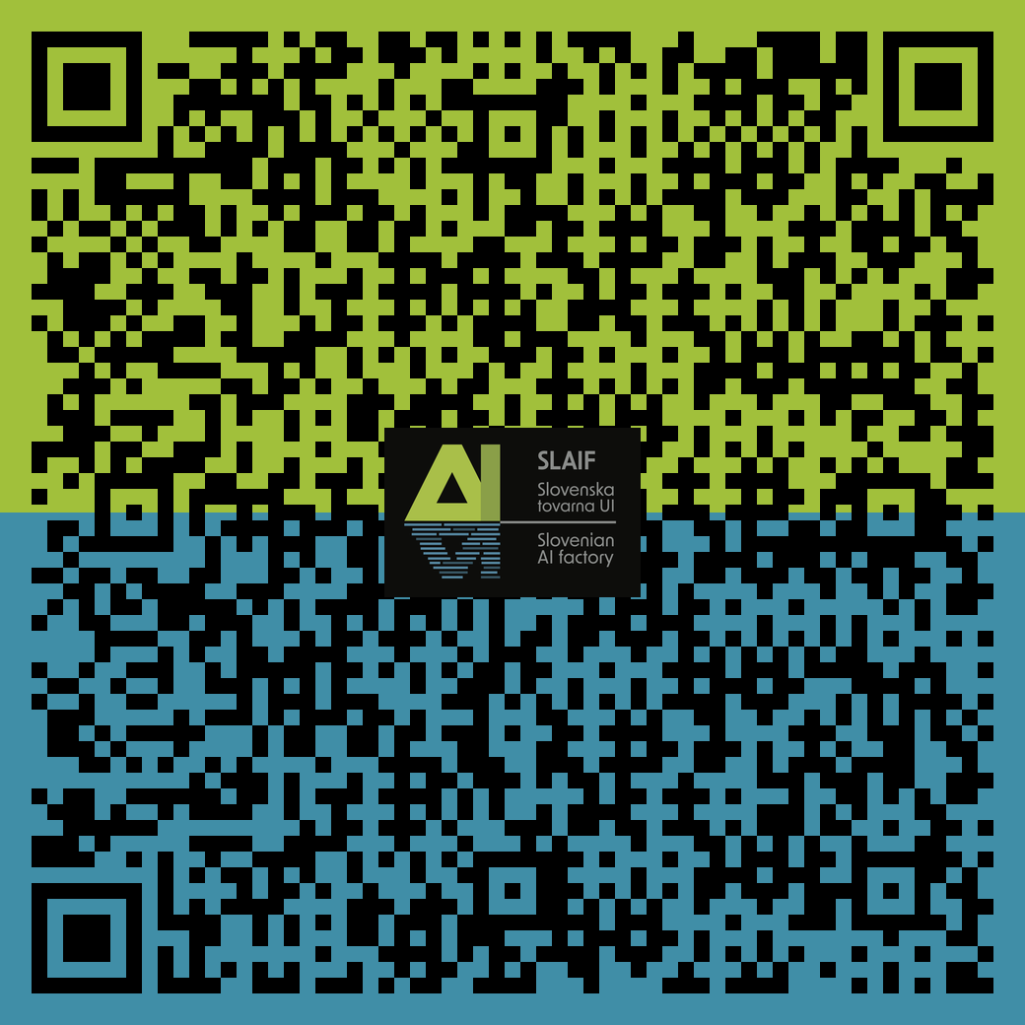
What SLAIF offers today ?
Computational resources supported by HPC Vega
HPC / Cloud like environment (OpenStack – Kubernetes)
Supported by services and trainings
All the data stays in Slovenia (EU)
www.slaif.si

Slide 3
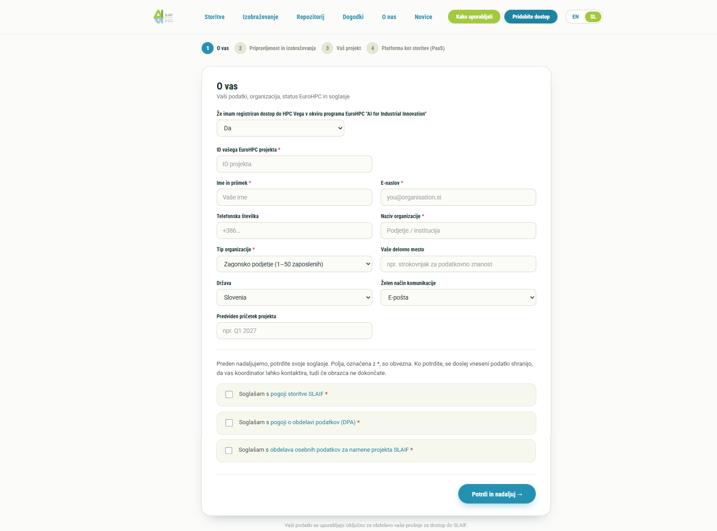
www.slaif.si
12/10/2026 · WP1

Slide 4
European AIF ecosystem
Training & inference for European foundational models => JAIF (Jülich) & IT4AI (Leonardo)
Consultancy on Intellectual property (IP) and Trade-Mark™ protection => AI:AT
Close collaboration with IT4AI, AI:AT, BRAIN++, BSC, ..
Joint European initiatives & funding opportunities
www.slaif.si

Slide 5
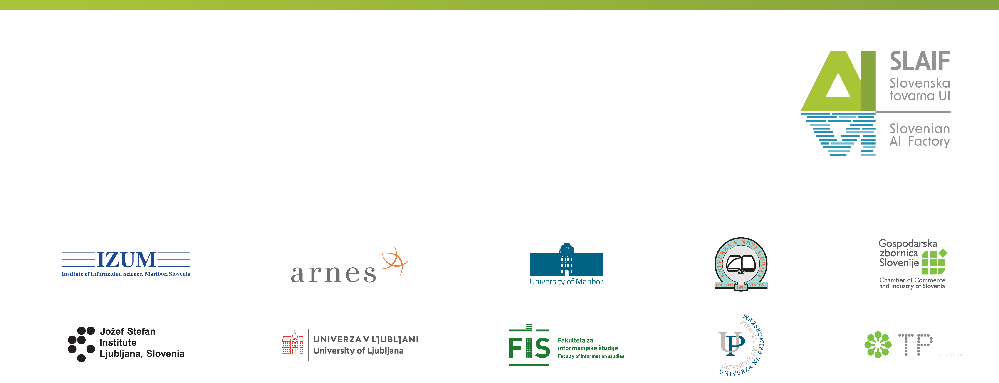






Thank you for your attention!
SLAIF: Slovenska tovarna umetne inteligence je prejela financiranje Skupnega podjetja za evropsko visokozmogljivo računalništvo v okviru sporazuma o nepovratnih sredstvih št. 101254461. Projekt financirata Ministrstvo za visoko šolstvo, znanost in inovacije Republike Slovenije ter program Horizon Europe Evropske unije.
SLAIF: Slovenian AI Factory has received funding by the European High Performance Computing Joint Undertaking under the grant agreement no. 101254461. The project is funded by the Ministry of Higher Education, Science and Innovation of Republic of Slovenia and by Horizon Europe Programme of the European Union.
© 2026 by SLAIF, licensed under CC BY-SA 4.0

