Slide 1
CPR REFRESHER – F9
Bojan Hiti & ChatGPT
21 October 2026
F9 Seminar Room
Sources:
http://www.osha.mddsz.gov.si/prva-pomoc/
https://osnove1pomoci.wordpress.com/defibrilator/

Slide 2
Cardiac Arrest
Out-of-hospital cardiac arrest is a time-critical medical emergency
3–5 daily occurrences in Slovenia
Survival rate is less than 15 %
Immediate CPR by a bystander can substantially improve the chance of survival (2 – 4×)
Brain injury can begin within minutes when blood flow stops, so do not wait for emergency medical services to arrive
Call 112, start CPR, and use an AED as soon as possible

Slide 3
Recognize & Respond
CHECK — Is the scene safe? Is the person responsive?
CALL — If unresponsive, call 112 (speakerphone) and ask someone to bring an AED
CHECK — Open the airway. If breathing is absent or abnormal (including gasping), start CPR
START — Push hard and fast in the center of the chest. Use the dispatcher’s instructions

Slide 4
CPR
CPR BASICS
30 chest compressions : 2 rescue breaths (if trained and willing)
Rate: 100–120 compressions/min
Depth: 5–6 cm in an adult; allow full recoil
Minimize pauses between breaths: give each breath just enough to make the chest rise
If unable/unwilling to give breaths, give continuous chest compressions and follow 112 dispatcher instructions
Children & drowned persons: breathing/airway problems are the primary issue
Start with 5 breaths, then continue with standard CPR

Slide 5
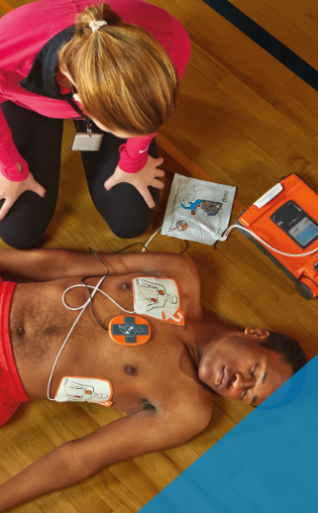
AED (automated external defibrillator)
AED attempts to restore the heart’s rhythm with an electric shock
CPR is still required (AED is not a replacement for CPR)
Gives audible instructions
Act as soon as it arrives
Expose and dry the chest; attach pads as shown on the pads
Keep everyone clear during rhythm analysis and shock delivery
If a shock is advised: shout “CLEAR”, check nobody is touching the person, deliver the shock, then resume CPR immediately
If no shock is advised: resume CPR immediately

Slide 6
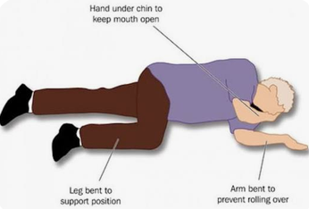
Unexpected situations: what to do?
Keep interruptions as short as possible. If unsure, follow the 112 call-taker and AED prompts.
Vomiting (common)
Pause CPR briefly. Turn the person onto their side, clear visible vomit from the mouth, then turn them onto their back and resume CPR promptly. Do not do a blind finger sweep.
Some AED have an accessory kit with a protective mask
Gasping / Snorting
Gasping is not normal breathing. If unresponsive with abnormal breathing, continue CPR and use the AED.
Movement or possible recovery
Brief gasps or small movements do not necessarily mean recovery. If the person becomes responsive and is breathing normally, stop compressions, check breathing, keep the airway open and monitor closely.
After recovery:
if breathing normally but still unresponsive, place in the recovery position when appropriate and monitor continuously. Be ready to restart CPR if breathing becomes abnormal.

Slide 7
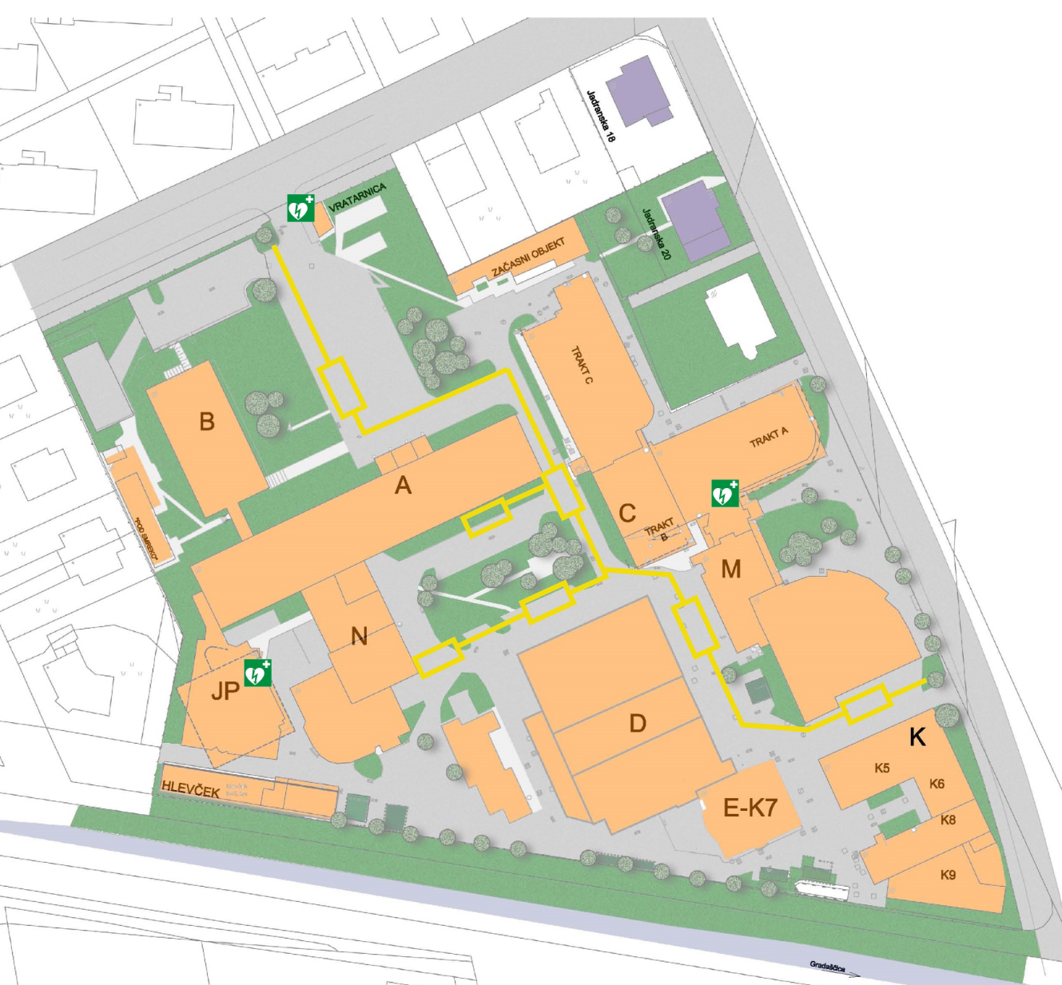
At JSI
3 AED are available
The standard entry for emergency services is the main gate (Jamova)
  Recommended to send a person there to guide the team to the patient to avoid on-site delays
Notify the guards (at AED) – where is the emergency
Do we have a list of emergency contacts of F9 employees?
  For example to provide medical history to the medical team

