Slide 1
Layout Task Force Timeline and achievements so far
June Workshop:
  4P + 5.1S → 5P + 4S
Pixel/Strip Layers:
  In June we have decided to have 5P+4S. Arguments illustrated by Pixel, Strip, Physics to prefer this solution to the LoI.
September ITK Week
  Fixed Pixel/Strip volumes
September/October
  Agree on settings for STEP1 Layouts
November Workshop
  Discussion of the layouts and first results
  Discuss the eta coverage
Spring 2016
  Wrap-up of the results and final report.

Slide 2
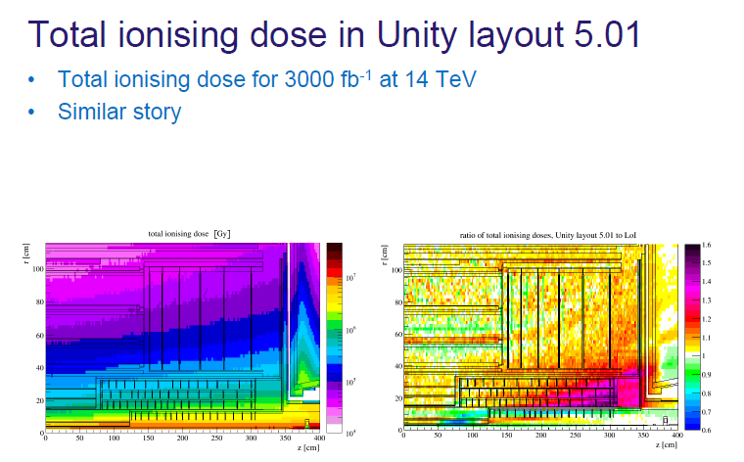
Paul/Ian Fluence Studies

Slide 3
Getting to the TDRs :
ITk-IDR was November 2014 - First TDR scheduled Q4 2016.
Need to check to see if we are on track and, if necessary, make course correction.
The Lankford Review:
  At CERN on Monday 23rd November : https://indico.cern.ch/event/454080/
  The mandate for the review team is on the web-page
  Not a technical review but a progress review
  Reviewers : A. Lankford (chair), L. Pontecorvo^{ђ}, A. Cattai ^{ђ}, P. Farthout ^{ђ} , C. Rembser, K. Einsweiler and S. McMahon.
  The team should be mindful of progress since the IDR (^{ђ} members of IDR review team)
  Light touch “3 hrs strips 1.5hrs pixels” including plans for delivery of the TDR
  Also look at Common Mechanics and Common Electronics

Slide 4
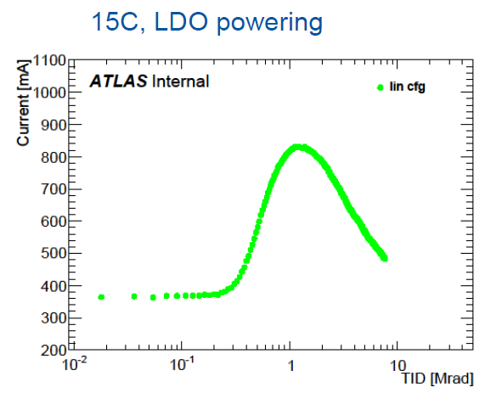
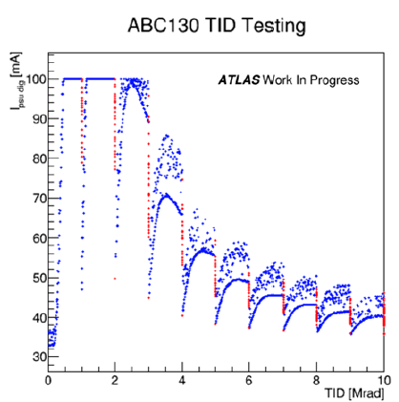
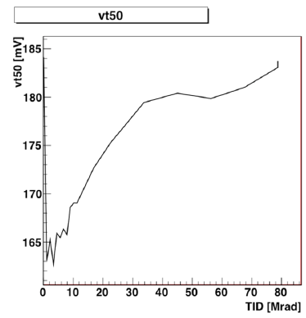
Tuesday Evening : Irradiation Studies for IBL/ITk ASICs
https://indico.cern.ch/event/461386/
Presentations from
  ID : Pixels : FEI4
  ITk –Strips : ABC130
  GBTX
  ID : Pixels
  Shift of ToT Tuning (downward trend with TID), increase of LV leakage current
  Effect on NMOS transistors: see slides 11 & 12
  ITk –Strips : ABC130
  Tests at high-rate (62kRad/h), ambient temperature, presented during ITk week in Sept.
  Consistent with single transistor measurements on single transistors by F. Faccioin 2005 (http://cds.cern.ch/record/1024467/files/cer-002683553.pdf) 2005
  An aside (that has also come up this week)
  The phenomenon was seen, in high rate tests, in 2002 by the SCT with DMILL technology
  The effect is known to be a function of ionizing rate and temperature
  When the SCT did the calculation of operational effects, considered acceptable
  However, based on tests several batches were rejected as prone to excessive currents.
    Batch dependent effects.
FEI4
ABC130
ABC130

Slide 5
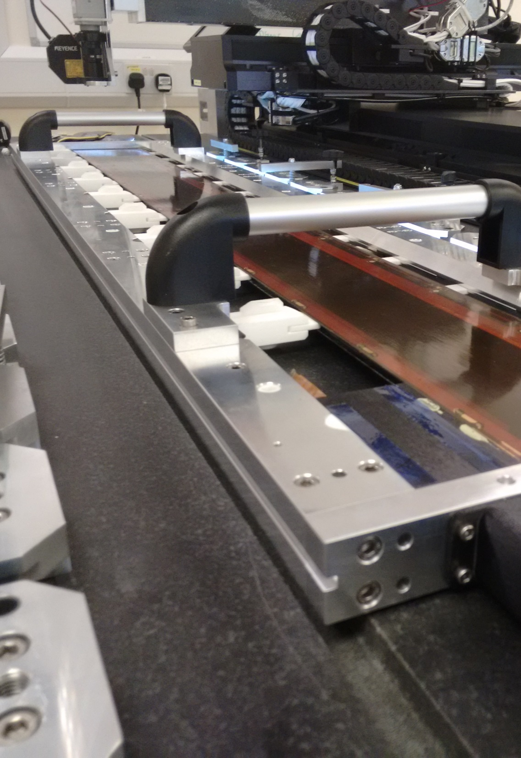
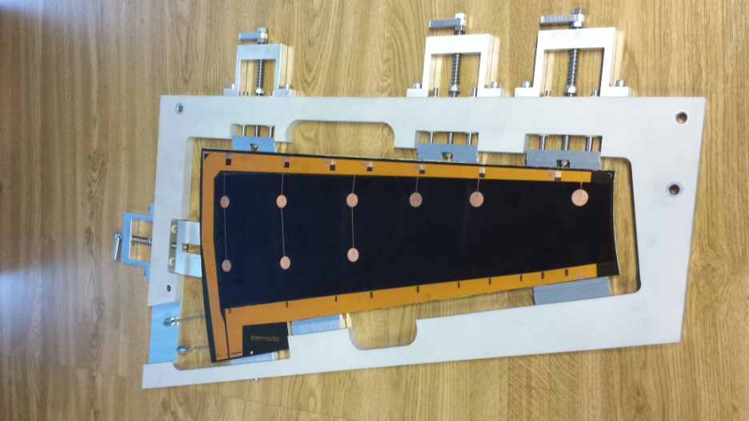
ITK Strip Highlights - 3
Large scale protypes:
  Full scale thermo-mechanical stave
  Petal on the way. This will help to understand overall system aspects as well as handling
  Thermo-mechanical results will be compared with FEA calculations
Module
placement for barrel staves
Petal prototype in frame

Slide 6
CMOS sensors
Demonstrator program proceeding (with some delay): one chip already submitted (AMS 35) few about to be submitted (LF, AMS 18, XFAB).
Several lines of investigation going on in parallel:
  Passive sensors, capacitive coupled active sensors, monolithic devices, large pitch/large area modules.
New, encouraging results from the test beam.
Lot of potentiality, no showstoppers but not much time left to produce solid evidence that this technology can be used over the large scale of an ITk-pixel detector.
“In-time” Charge collection

Slide 7
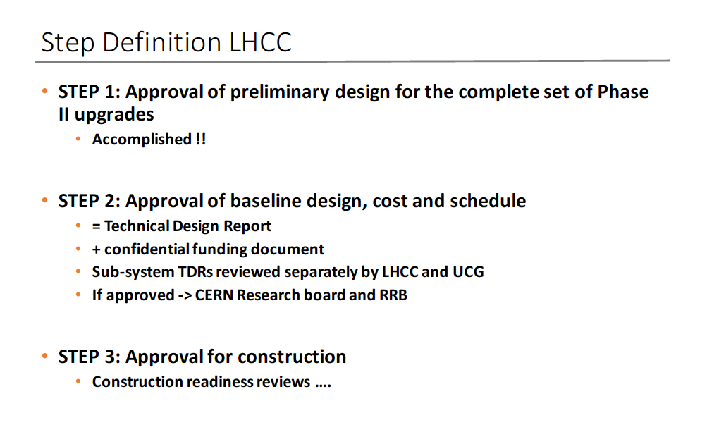

Slide 8
Lankford review
https://indico.cern.ch/event/454080/
Strip Talk
https://indico.cern.ch/event/454080/session/1/attachments/1192500/1731235/LankfordReviewStrips.pdf
Local Support and electronics
https://indico.cern.ch/event/460716/
Reliability testing of bus tapes 10'
Graham Beck (University of London (GB)
https://indico.cern.ch/event/460716/contribution/0/attachments/1188940/1725152/Bus_Tape_Reliability_Tests.pptx

Slide 9
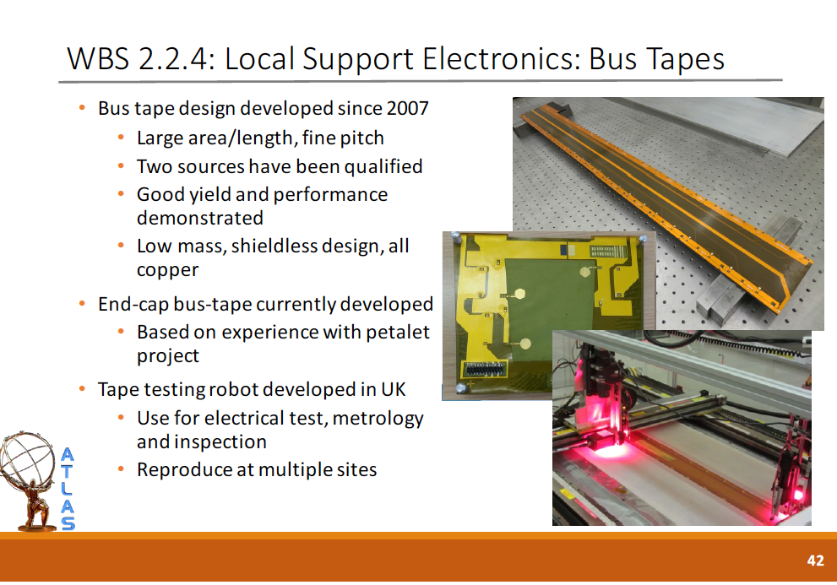

Slide 10
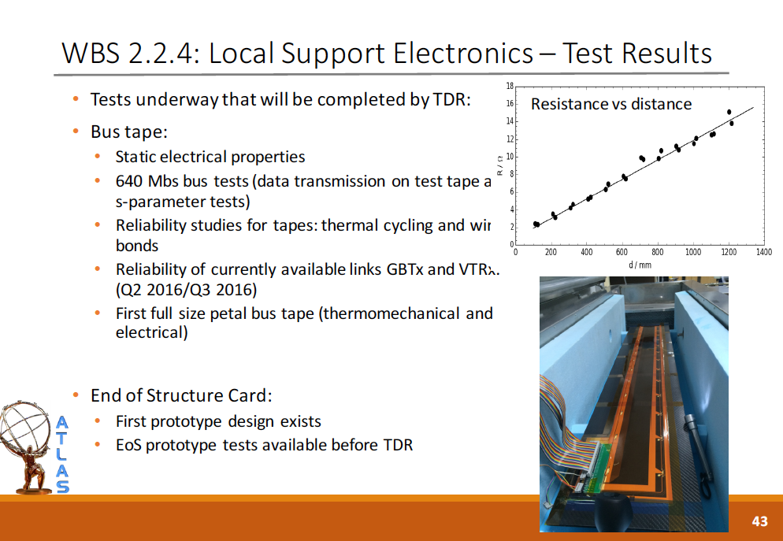

Slide 11
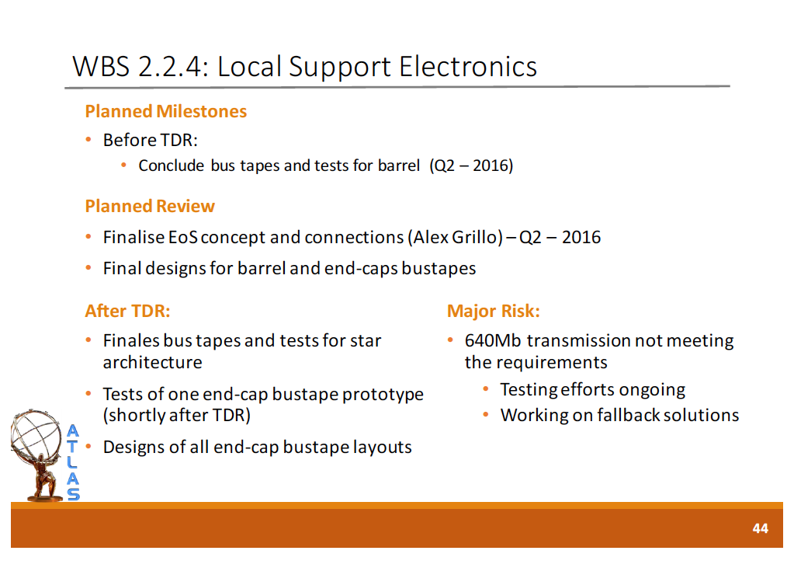

Slide 12
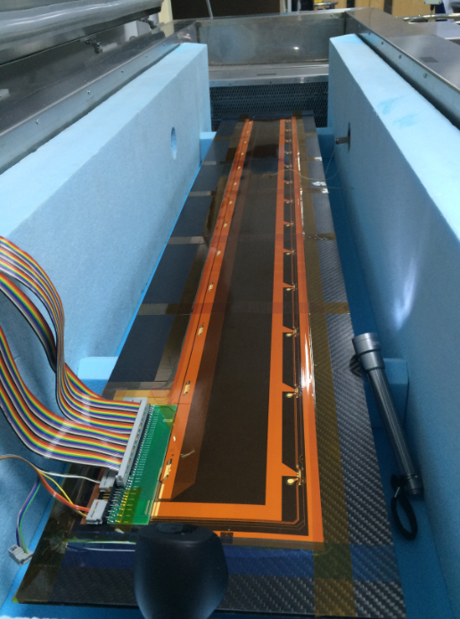
CFRP plank + facing
inside coffin.
Heaters, N₂ inlet, Centrifugal fan ,
T sensors (=> controller)
Vent
RH/T monitor (Rotronic ).
Thermocouples: plank, tape, air.
← to
Agilent 34970A Switch Unit
/ R measurement
camera

Slide 13
Pull Test Results
Measured pull tests on samples with and without plasma cleaning.
All tests good, i.e. break at heel.
Much better than recommended QC by wire bonding group: Mean – 5 sigma > 2.5 gm
No significant difference with plasma cleaning (differences less than 2 sigma).
 | With | Without Plasma clean
Number of pulls | 37 | 44
Mean (g) | 10.02 | 10.35
RMS (g) | 0.88 | 1.03
Mean-5 sigma (g) | 5.64 | 5.20

Slide 14
To do in Ljubljana:
Transmission properties on test tapes with dummy sensors and custom drivers
Thermal cycling tests
Bonding tests
Electrical test
Plasma cleaning?
Commitment
https://indico.cern.ch/event/461795/

Slide 15
